Slide 1
Paul Update
9/18/2023

Slide 2
Overview

Slide 3

Data
I looked at the encoding data for SchemeRep
  Single trial betas linked to object presentation
Didn’t yet incorporate memory data
I learned about how to run Word2Vec + DNNs because Lifu didn’t yet try applying these to the scene images
  However, I didn’t do the word2vec properly, so I don’t provide results on that
Analysis done with the Brainnetome (BN) atlas
  Consistent with Lifu and Shenyang

Slide 4


Slide 5
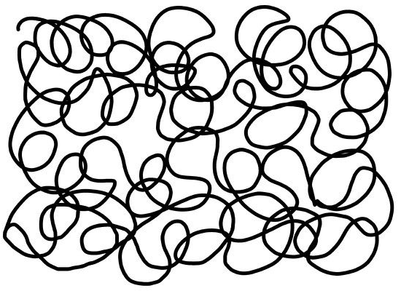
Stimulus representations
Cognitive meaning of the difference vector:
  Priming:
    Scenes prime some representations, which will show weaker/stronger responses if activated again by the object
  Relational memory:
    Broadly: The informational content of items influences how an association is encoded
    Specifically: Associative memories do not just blindly connect item representations. Rather, associations should be seen as representations that encode the relationship between the items
  Prediction error:
    Scenes establish an expectation (a “prediction”) that may be violated
    Predictive coding theory argues that all information is processed as prediction errors
  Unclear meaning yet informative
    There is no clear psychological meaning of a “difference vector”. Nonetheless, because the measure combines object and scene information, findings must reflect some type of interaction between representations
-
=
absolute
difference

Slide 6
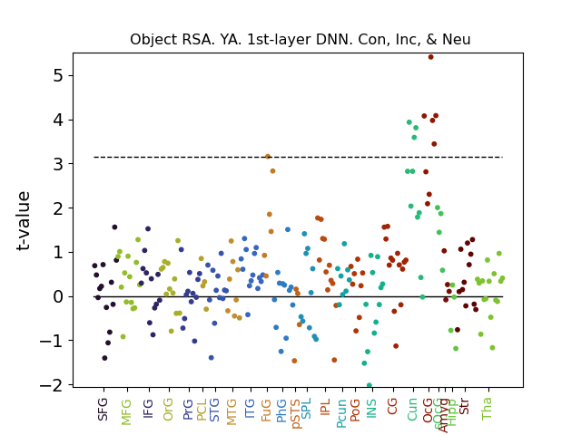
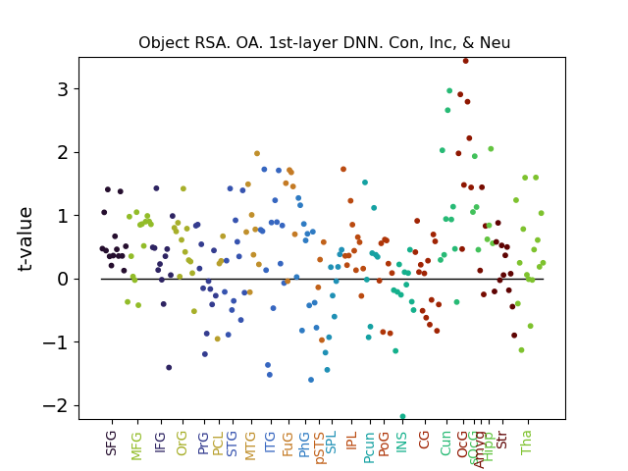
Object RSA
Clear occipital patterns for YA
As expected, OA show less although this is still more than I figured would arise
Appears if looking at hits or misses but more so hits
Dashed line = FDR
correction cutoff for 246 ROIs (overly conservative because it doesn’t account for the ROIs not being independent)

Slide 7
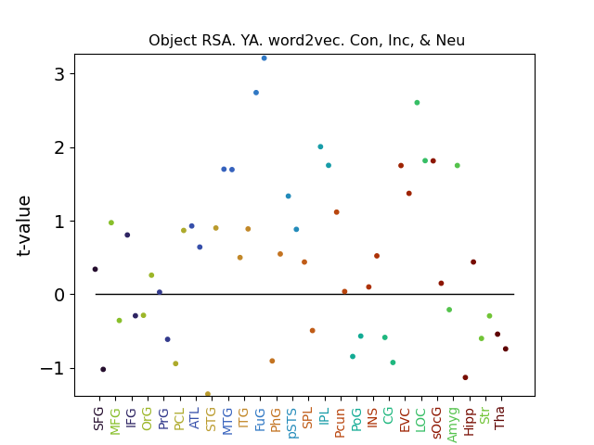
Object RSA with word2vec

Slide 8
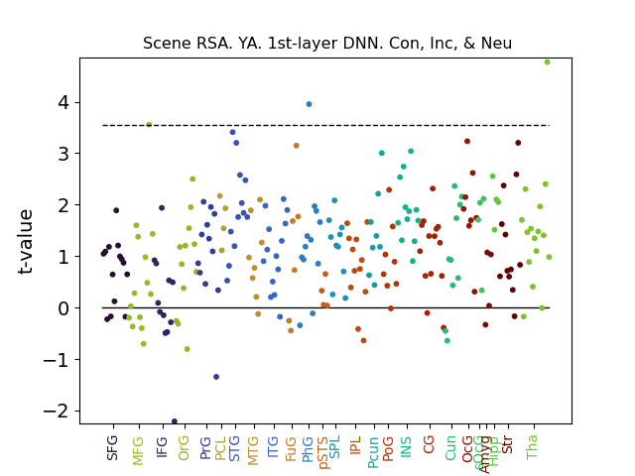
Scene RSA
Decoding scene from the parahippocampal gyrus may be interesting
  YA only, no OA patterns
Future direction:
  Look into the exact anatomy of the PHG ROI to see whether it corresponds to the PPA
  Use larger ROIs to test the robustness of this pattern
  Use single trial betas from scene presentation

Slide 9
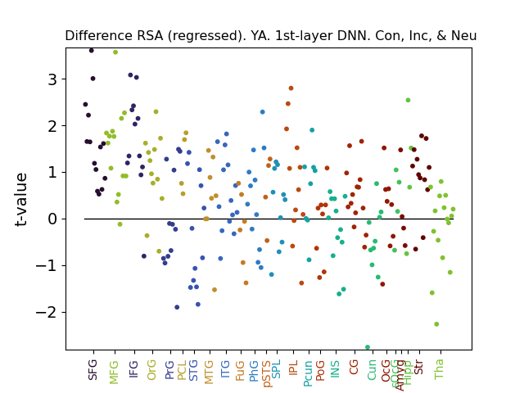
Difference RSA
Interestingly, a clear difference effect is seen in the PFC
  SFG, MFG, IFG
  Absolute difference
Striking that for virtually all
~40 ROIs tested, the 2nd order correlation was above zero
  Similar results regardless of whether object decoding effects is regressed out
  Specifically linked to memory encoding (results not shown)
  OA do not show this effect. We would expect the opposite if they are using semantic knowledge (schema) to process the object
Future:
  Use larger ROIs to test robustness
  Investigate Object-Scene-Difference connectivity?
Notes:
Confirmed by an additional analysis that organized the ROIs by region (e.g., the 14 SFG ROIs are under the region “SFG”), and performed RSA with respect to the mean activity within a given region (i.e., treating a whole region as a single voxel). Replicates the difference PFC results.

Slide 10
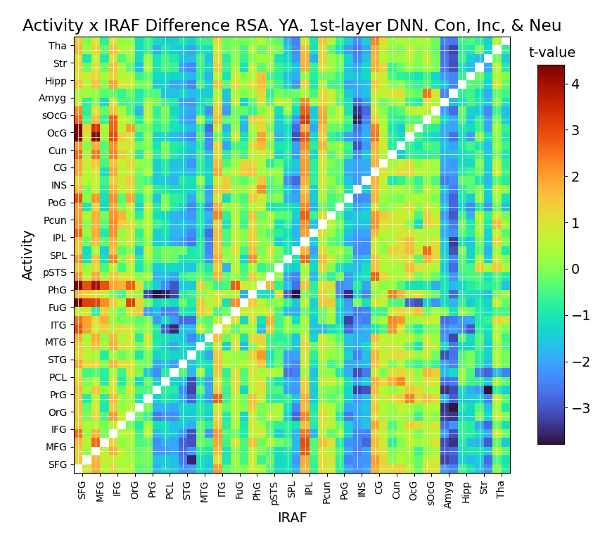
Difference RSA x connectivity
Similar to beta series correlations
  Use difference-vector IRAF for one region
PFC IRAF linked to stronger occipital connectivity and PhG/FuG connectivity
This effect only arises for objects that yield subsequent hit

Slide 11
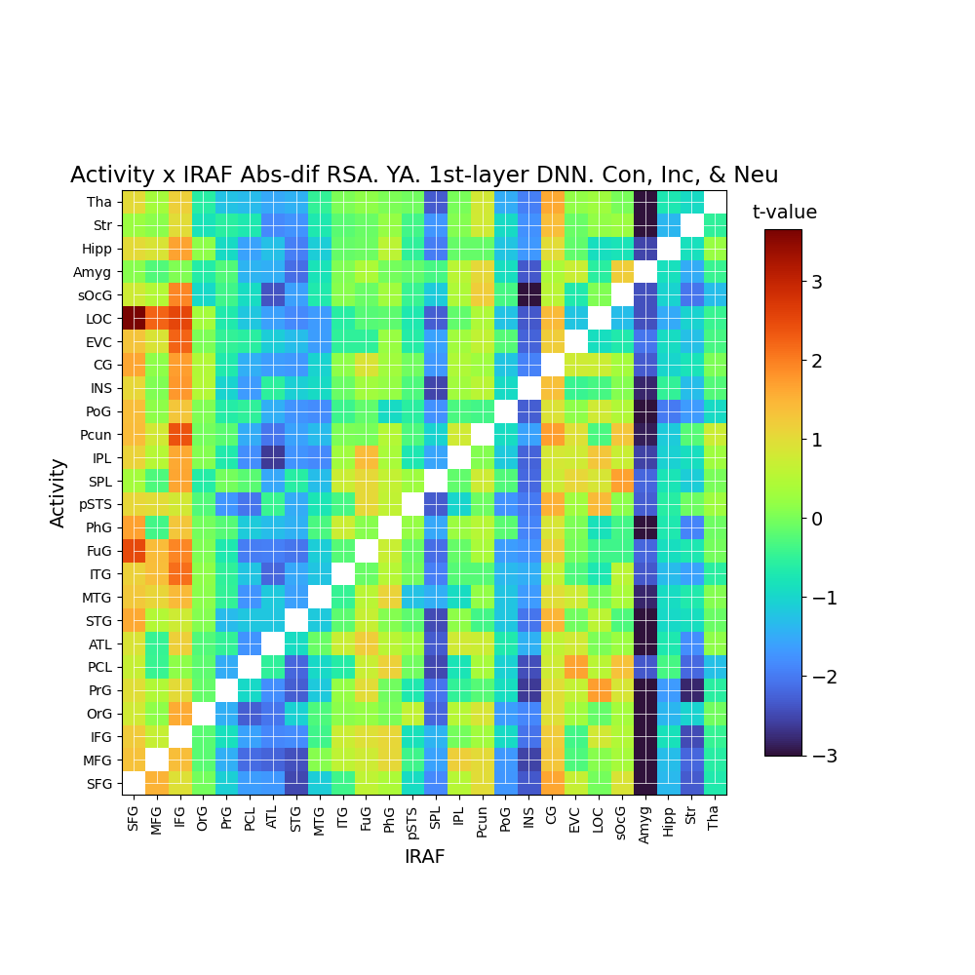
The amygdala also shows an interesting pattern
  Stronger representation in the amgydala is linked to decreased connectivity with everything else
  Beyond the present focus?

Slide 12
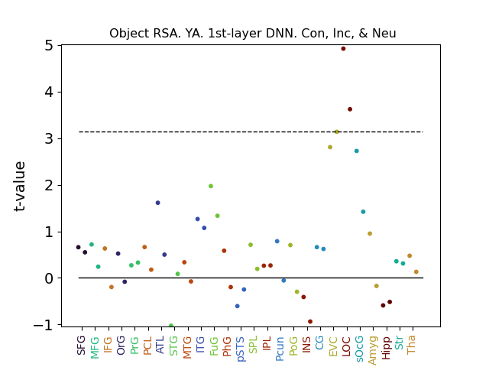
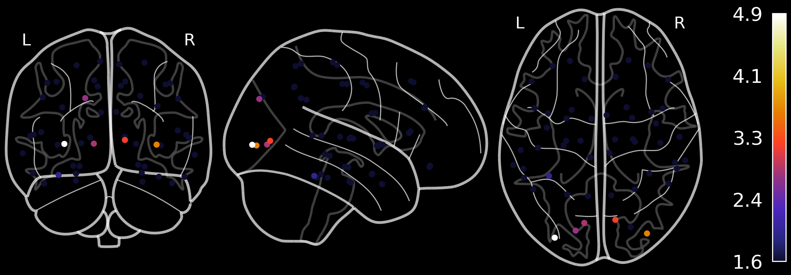

Slide 13
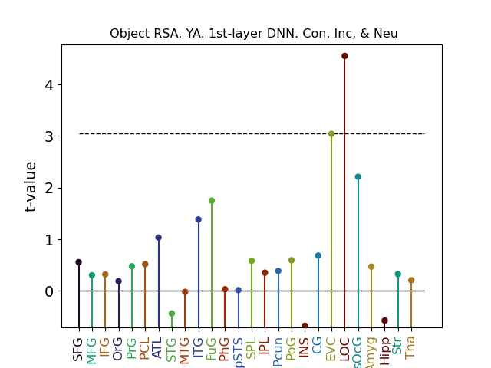
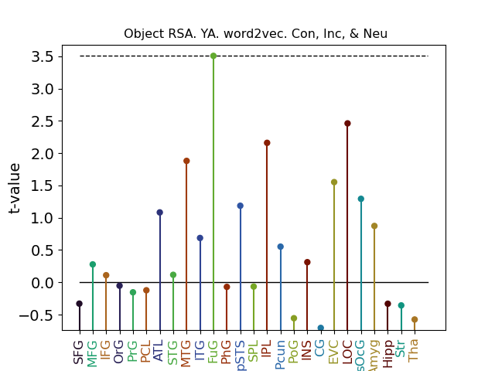
Decoding object representation
Perceptual decoding
Semantic decoding

Slide 14
Clean

Slide 15
Link condition to RDM…

Slide 16
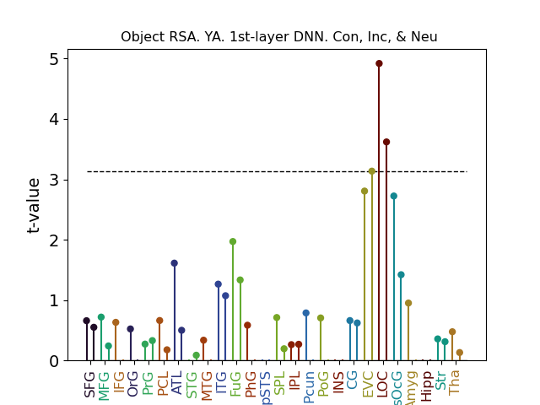
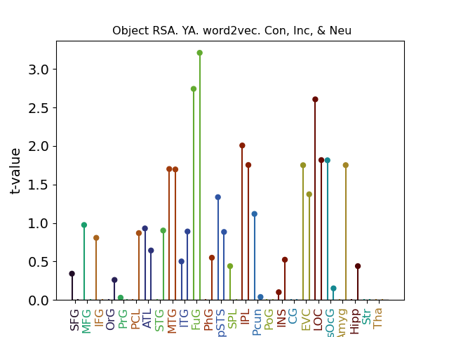
Result 1A/1B: Object representation
Perceptual object decoding
Semantic object decoding
Reproducing patterns from Lifu’s thesis

Slide 17
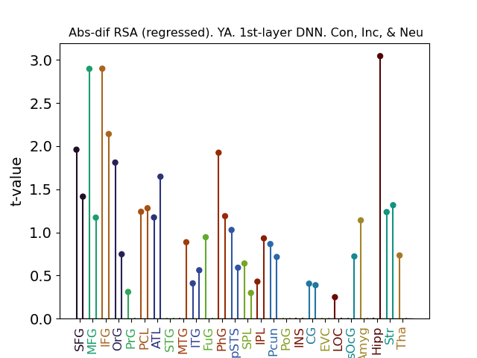
Result 2A/2B/2C: Schema-object integration
Confirmed by an additional “macro-level” analysis focusing on the LPFC overall
  26 ROIs
  Activation averaged across ROI
  fMRI vector calculated using ROI-activation in place of voxel-activation
  Submitted to RDM
  Yields significant RSA effect
  (t = 2.1, p = .02)
Trend suggests that high LPFC IRAF linked to subsequent memory hit
LPFC
Hipp.
Notes:
Downside: Doesn’t pan out for word2vec analysis. lPFC doesn’t pan out for connectivity. Also, doesn’t work if only looking at a single congruent/incongruent/neutral condition
HC result a bit less robust

Slide 18
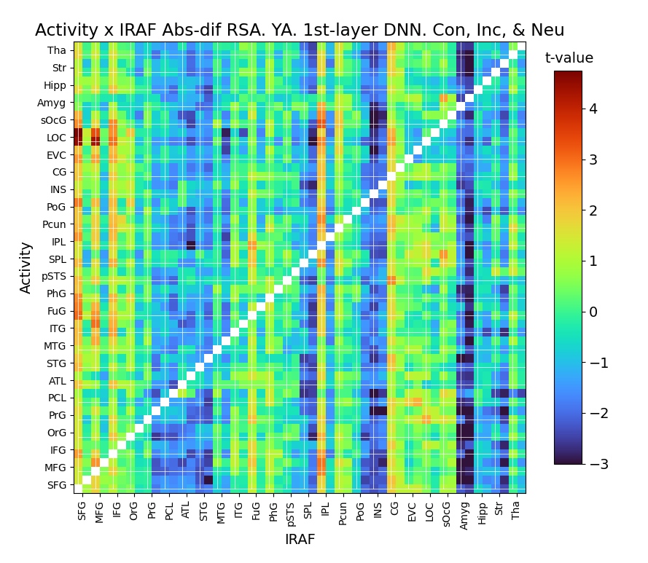
Result 3: Difference RSA x connectivity
Similar to beta series correlations
  Use difference-vector IRAF for one region
PFC IRAF linked to stronger occipital connectivity and PhG/FuG connectivity
This effect only arises for objects that yield subsequent hit

Slide 19
Speculative

Slide 20
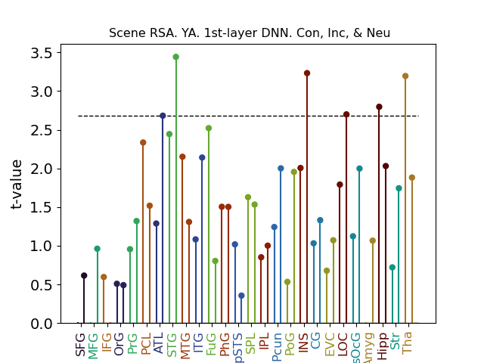
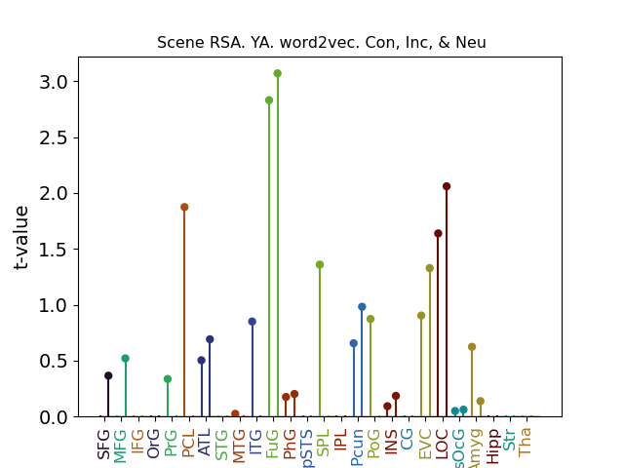
Scene representation
Perceptual scene decoding
Semantic scene decoding
Need scene single-trial betas. For object, difficult to distinguish from object decoding

Slide 21
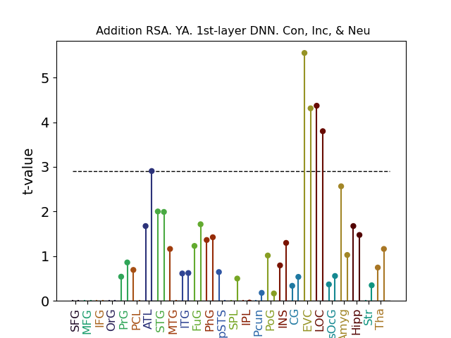
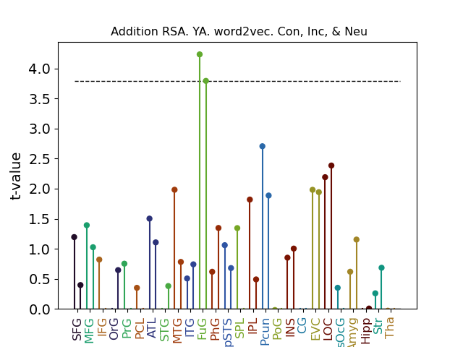
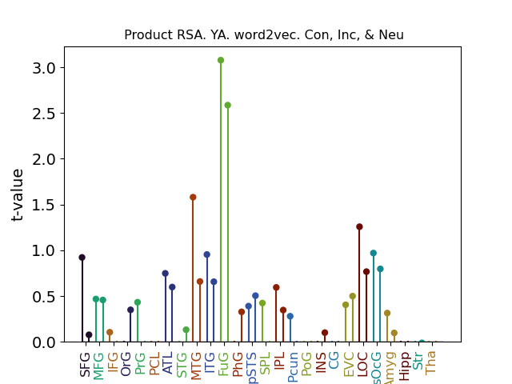
Addition & Product RSA
Perceptual addition
decoding
Semantic addition
decoding
Semantic product
decoding
Similar patterns when taking the absolute value of the addition or product vector. Note the null PFC results
Notes:
No meaningful perceptual product results

Slide 22
TODO
Look at scene presentation single-trial betas

Slide 23
RSA Connectivity

Slide 24
Overview: How do multiple brain regions work together to represent stimuli?
Linking regions based on their sensitivity to particular types of representations (IRAF)
  Trial-by-trial correlations between regions
  Similar to beta series correlations but with IRAF values
Does one region’s activity upregulate representational sensitivity in another region?
  Trial-by-trial correlation between activity in one region x IRAF in another region
  Consistent with the boosting/linking point in the grant
Representation of stimuli as connectivity
  Are stimuli represented as interactions between multiple voxels or regions?
  Investigate connectivity between pairs of regions or among multiple regions in a network
These types of results may speak to compensation if these connectivity patterns are more prominent among OAs

Slide 25
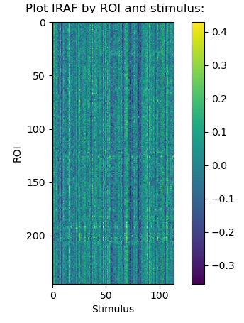
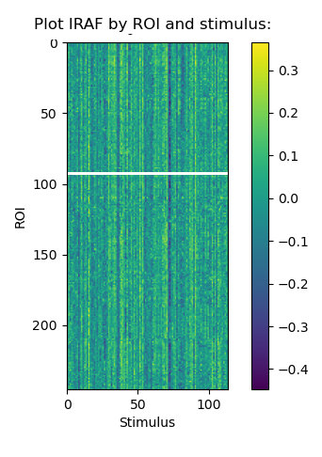
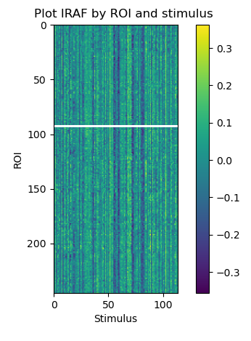
IRAF x IRAF connectivity
Plain IRAF x IRAF doesn’t really work
In part because IRAF patterns for a given stimulus are similar across all ROIs, which makes some connectivity measurements artificial
  Virtually every region shows positive IRAF connectivity with every other region
Three participant IRAF values are plotted here over time for every ROI
There are other issues with correlating IRAF between different regions that are harder to describe. Essentially, correlations between IRAFs will arise even if the stimulus vector is randomized.
I played around with normalizing with respect to stimulus

Slide 26
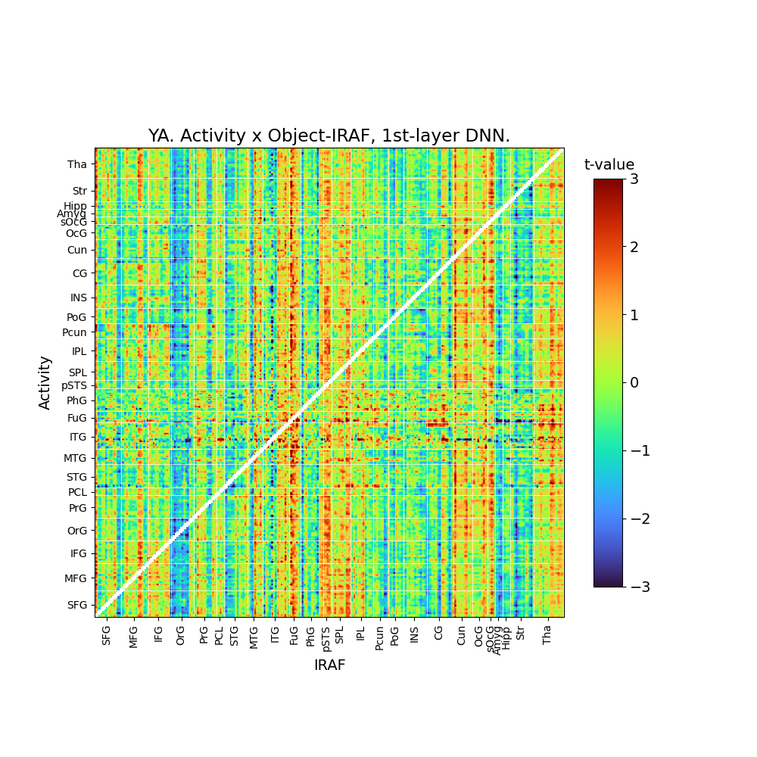
One area modulating IRAF in another region
Related to the linking and boosting points made in the grant/papers
Correlate:
  Region A: Mean connectivity across all voxels for a given trial
  Region B: IRAF
Correlation matrix plotted
  Not symmetrical, so it looks different from most connectivity matrices
Hard to say whether this is meaningful, but it is encouraging to see patterns linked to occipital IRAF

Slide 27
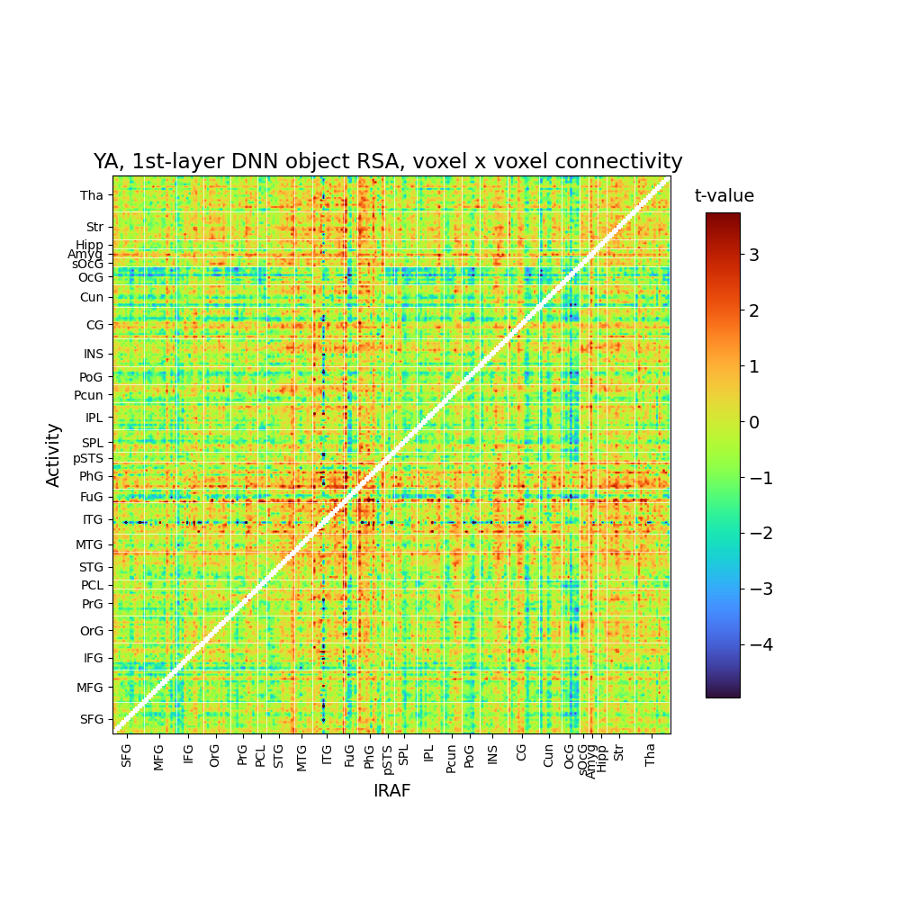
RSA single-trial connectivity
Single trial connectivity can be represented as the product of voxel activations
  E.g., Connectivity between voxel 0 from region a with voxel 0 from region b
  If region a has 100 voxels and region b has 50 voxels, there are 5000 combinations
  Can correlate these product vectors between trials to calculate fMRI RDM
Didn’t really pan out to anything meaningful

Slide 28
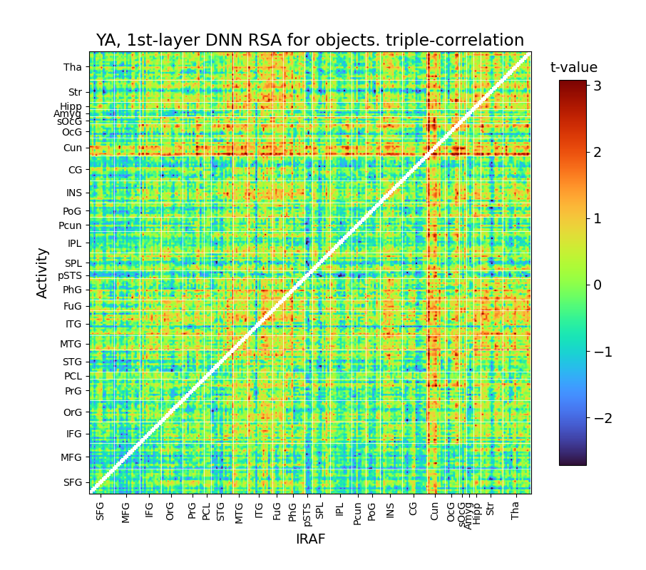
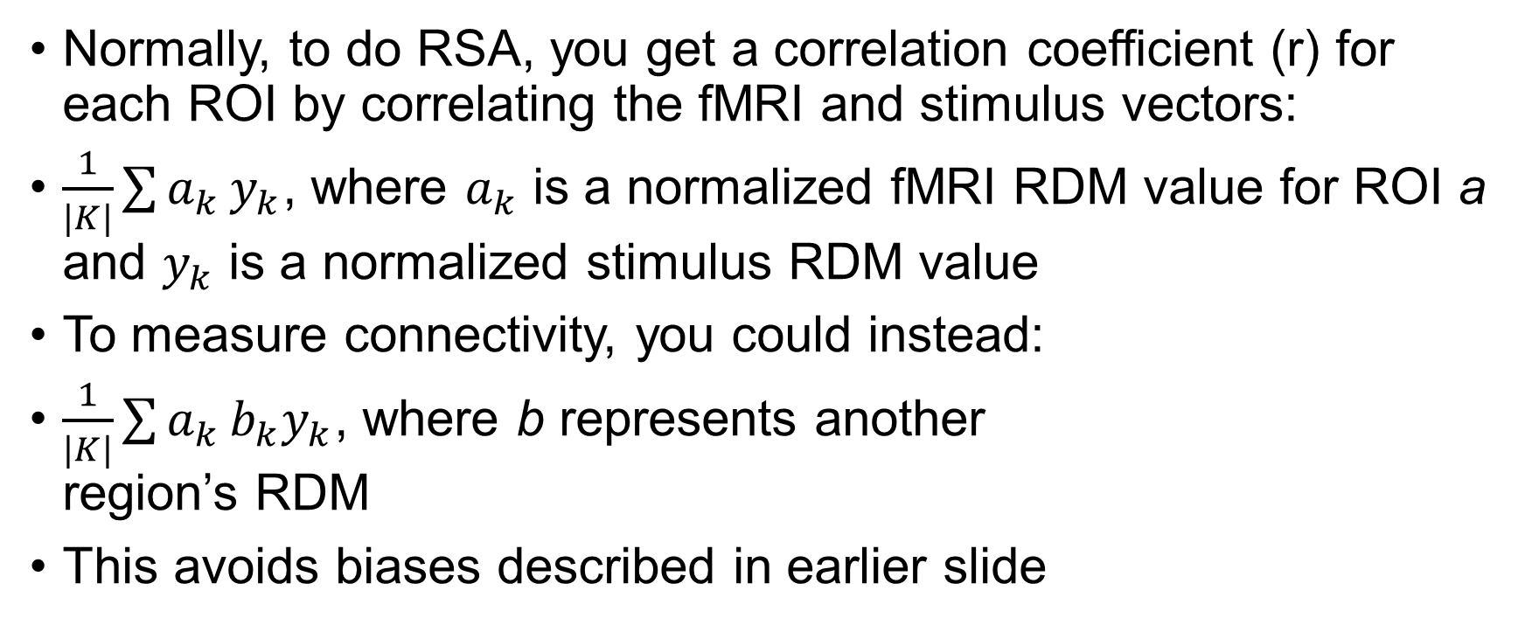
RSA connectivity as triple correlation
Normally, to do RSA, you get a correlation coefficient (r) for each ROI by correlating the fMRI and stimulus vectors:
$\frac{1}{|K|}\sum{a_{k}}y_{k}$, where $a_{k}$ is a normalized fMRI RDM value for ROI a and $y_{k}$ is a normalized stimulus RDM value
To measure connectivity, you could instead:
$\frac{1}{|K|}\sum{a_{k}}b_{k}y_{k}$, where b represents another
region’s RDM
This avoids biases described in earlier slide

Slide 29
RSA network
Next steps, examine multiple regions
May employee some of the modularity methods used in Lifu’s thesis

Slide 30
Leftover slides

Slide 31
Brief exploration
What if…
  Instead of representing an fMRI vector as all the voxel activations within a given ROI, you instead calculated the ROI vector as the product of all voxel weights (a measure of connectivity)?
What happens?
  You get null results
  Even things like RSA of object in the occipital lobe is fail

Slide 32
Investigating difference vector
Difference vector: (x0 – x1)
If (x0 – x1) yields an RSA effect, it may hard to distinguish from whether it is:
  Indeed a difference effect
  Driven by x0
  Driven by –x1
Analogous to how for regressions, people advice against using terms like (x0 – x1) but instead to just put x0 and x1 separately
This would be particularly problematic if the difference vector effect is in the same spot as the object effect

