Slide 1
Paul Update
9/18/2023

Slide 2
Background
Predictive coding theory argues that all information is processed in terms of prediction errors
  Prediction error is a computational mechanism used across the brain
    Goes well beyond early theories that reward prediction error underlies behavioral learning and ventral striatum processing
  Perceptual prediction error
    Perception depends on the perceived likelihood of encountering a stimulus
  Cognitive prediction error
    Information is processed in terms of prior beliefs and updating
Predictive coding has been studied with univariate analyses
  Perceptual prediction error correlated with activity in both cortical and subcortical regions
Notes:
Prediction error is not just an “outcome” of processing information but rather is a computational mechanism that influences
Example of perceptional prediction error: car honking feels louder in a classroom than on a busy street
Meta analysis: Corlett, P. R., Mollick, J. A., & Kober, H. (2022). Meta-analysis of human prediction error for incentives, perception, cognition, and action. Neuropsychopharmacology, 47(7), 1339-1349.
Perception results: Iglesias, S., Mathys, C., Brodersen, K. H., Kasper, L., Piccirelli, M., den Ouden, H. E., & Stephan, K. E. (2013). Hierarchical prediction errors in midbrain and basal forebrain during sensory learning. Neuron, 80(2), 519-530.
* dlPFC result (IFG and MFG)

Slide 3
Primary Question
Are stimuli represented as prediction errors?
  No study has genuinely investigated this question
    “Genuinely” = beyond univariate tests
  Yet, this idea is a central element of predictive coding theory
  This question gets at a critical point of contention
    Opponents of the theory accept that prediction error plays some role in the brain (e.g., in the striatum) but push back against these bolder higher-order claims
Multivariate analyses of representations are strong tests of predictive coding theory
  Other neural theories, supported by univariate results, broke down when tested via multivariate methods

Slide 4
Present Study and Hypotheses
Identify areas that make predictions
  Based on schema (scene) presentation, which regions represent the schema?
Among the regions representing the scene, does any area represent the object as a prediction error relative to the scene?
Is prediction error used as a computational mechanism?
  Specifically, is object information encoded as a prediction error?
    Does stronger prediction-error representation predict subsequent memory?
    Are there signatures of prediction error during retrieval, even when the original scheme is no longer shown?

Slide 5
Methods

Slide 6

Data
I looked at the encoding data for SchemeRep
  Object presentation screen
  Scene presentation screen
3 s
3 s
jitter
4 s
Notes:
I learned about how to run Word2Vec + DNNs because Lifu didn’t yet try applying these to the scene images
However, I didn’t do the word2vec properly, so I don’t provide results on that

Slide 7

3-session fMRI study (SchemRep)
Baseline: rated image-label typicality for objects
Encoding: 3 pre-defined conditions for scene-object schema congruency, subjective ratings 1-4
Retrieval: conceptual old/new followed by visual old/similar/new

Slide 8

Brainnetome atlas
Used by Lifu and Shenyang
246 ROIs
  Cortical and subcortical
Notes:
Notably organized into:
EVC
LOC
FuG
ATL
Hippocampus
IFG
MFG
SFG

Slide 9
Analysis overview
Perform RSA
  fMRI RDM based on:
    Scene-presentation screen single-trial betas
    Object-presentation screen single-trial betas
  Stimulus RDM based on:
    Object stimulus vector
    Scene stimulus vector
    Object-scene difference stimulus vector

Slide 10

Stimulus representations
Single trial
Scenes establish a “prediction”
Object presentation is the prediction error
-
=
absolute
difference
1
2
3
4
5
1
2
3
4
5
1
2
3
4
5
Trial 1
Trial 1
Trial 1
Trial 2
Trial 2
Trial 2
Trial 3
Trial 3
Trial 3
Trial 4
Trial 4
Trial 4
Trial 5
Trial 5
Trial 5
Object RDM
Scene RDM
Abs-Dif RDM

Slide 11
Stimulus representations
Single trial
Psychological meaning of the difference vector:
  Priming:
    Scenes prime some representations, which will show weaker/stronger responses if activated again by the object
    Link to repetition suppression
  Prediction error:
    Scenes establish a “prediction” that may be violated
    Predictive coding theory argues that all information is processed as prediction errors
    Hard to distinguish from priming view
  Relational memory:
    Broadly: The informational content of items influences how an association is encoded
    Specifically: Associative memories do not just blindly connect item representations. Rather, associations should be seen as representations that encode the relationship between the items
Speculative:
  Unclear meaning yet informative
    There is no clear psychological meaning of a “difference vector”
    Nonetheless, because this measure combines object and scene information, the findings must reflect some type of interaction between representations
  Analogical reasoning
    In the analysis, representational similarity entails parallels between trial 1’s scene-object relationship and trial 2’s scene-object relationship (i.e., an analogy)
    Because the analysis is looking for analogies, this implies that this is related to how humans process analogies?
Possible competing hypotheses?
-
=
absolute
difference
1
2
3
4
5
1
2
3
4
5
1
2
3
4
5
Trial 1
Trial 1
Trial 1
Trial 2
Trial 2
Trial 2
Trial 3
Trial 3
Trial 3
Trial 4
Trial 4
Trial 4
Trial 5
Trial 5
Trial 5
Object RDM
Scene RDM
Abs-Dif RDM

Slide 12


Scene and object vectors

Slide 13

Abs-dif vector
Pink object
Object Scene
Brown scene
Green scene

Slide 14



Stimulus RSM/RDMs
Perceptual representations (1st layer of DNN)
The difference vector RSM doesn’t look particularly weird
Although not visualized here, the congruent/incongruent/neutral conditions don’t have much bearing on the vectors or RSMs

Slide 15
Results

Slide 16


Result 1A: Schema representation
Perceptual scene decoding
Semantic scene decoding
PFC
Establishes the prediction
Notes:
Post hoc tests on bilateral SFG, for the eight dmPFC ROIs, t = 4.14. For the six dlPFC ROIs, t = 2.94. SFG bilateral altogether is 4.17.
mPFC overall (including some orbital and CG, yields 3.85. Excluding CG, we get 3.6.

Slide 17


Result 1C/1D: Object representation
Perceptual object decoding
Semantic object decoding
Weak/Null PFC
Reproducing patterns from Lifu’s thesis

Slide 18
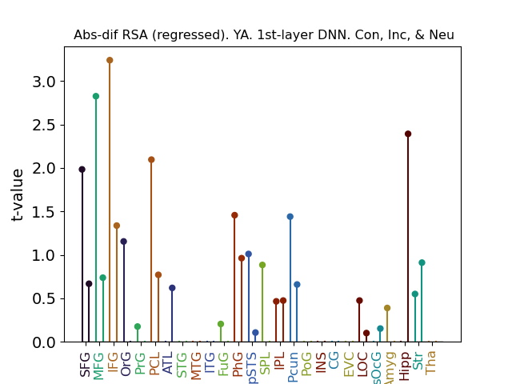
Result 2A/2B: Schema-object prediction error
Null scene RSA
Confirmed by an additional “macro-level” analysis focusing on the LPFC overall
  Activation averaged by ROI
    26 ROIs = 26-length vector
    Submitted to RDM
  Significant RSA effect
  (t = 2.1, p = .02)
“Micro”
(standard)
“Macro”
LPFC
Hipp.
Notes:
Downside: Doesn’t pan out for word2vec analysis. lPFC doesn’t pan out for connectivity. Also, doesn’t work if only looking at a single congruent/incongruent/neutral condition
HC result a bit less robust

Slide 19
Result 2C: Connectivity: Activity x IRAF
Related to the linking and boosting points made in the grant/papers
Correlate:
  Region A: Mean connectivity across all voxels for a given trial
  Region B: IRAF
  Note: A x B ≠ B x A
  Test if significantly above zero

Slide 20
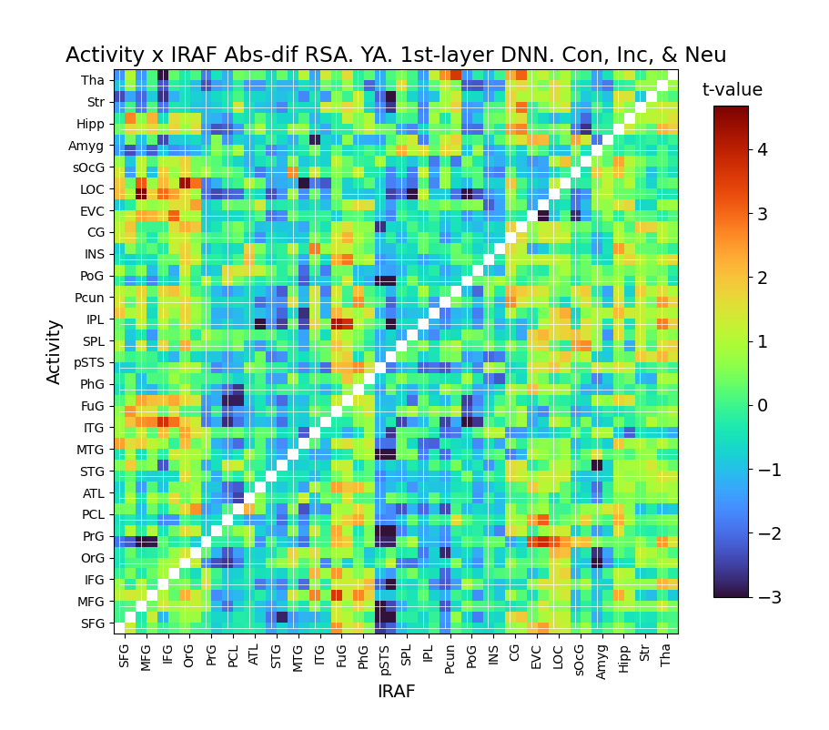
Result 2C: Difference RSA x connectivity
MFG IRAF linked to stronger LOC connectivity
  General pattern of LPFC-Occipital
  Possible link to fusiform gyrus and posterior inferior temporal lobe as well
Linked to subsequent memory
Notes:
The amygdala also shows an interesting pattern
Stronger representation in the amgydala is linked to decreased connectivity with everything else
Beyond the present focus?

Slide 21
Result 2A/2B/2C: Schema-object integration
Confirmed by an additional “macro-level” analysis focusing on the LPFC overall
  26 ROIs
  Activation averaged across ROI
  fMRI vector calculated using ROI-activation in place of voxel-activation
  Submitted to RDM
  Yields significant RSA effect
  (t = 2.1, p = .02)
Trend suggests that high LPFC IRAF linked to subsequent memory hit
  Analysis on shown in graph significant if looking at hits but not if looking at misses
  However, the t-test comparing IRAFs for hit vs. miss doesn’t cross the significance threshold
  Link to memory not seen for hipp.
Unexpectedly, OA do not show this effect
LPFC
Hipp.
Notes:
Downside: Doesn’t pan out for word2vec analysis. lPFC doesn’t pan out for connectivity. Also, doesn’t work if only looking at a single congruent/incongruent/neutral condition
HC result a bit less robust

Slide 22
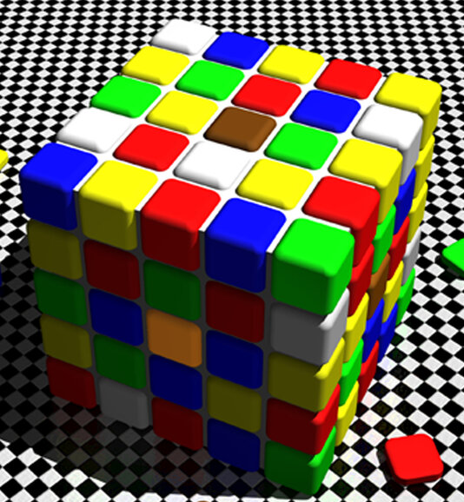
Interpretation
LPFC findings consistent with the prediction error idea
  LPFC processes the scene
  The LPFC processes the object relative to the scene
Notes:
Also possible to explain in terms of priming:
Scene primes neural populations, which influences those populations’ responses to the object

Slide 23
Interpretation
LPFC result:
  Findings consistent with the prediction error idea
    LPFC processes the scene
    The LPFC processes the object relative to the scene
  However, it is hard to analytically distinguish this interpretation from the priming idea:
    Scene primes neural populations, which influences those populations’ responses to the object
    Could the fact that this analysis panned out for the perceptual but not semantic RSA support one of the two views?
Hippocampus result
  The hippocampus does not bind information arbitrarily
  Rather, the hippocampus’s response depends on what items it is binding
  The binding should be seen as a relationship, whose meaning is based on analogies to other bound pieces of information
    e.g., when people associate a red stimulus and a green stimulus, they infer the relationship between the two stimuli by bootstrapping previously formed relationships between red and green stimuli
    Green stoplight = go, red stoplight = stop
    Green text = reward, red text = punishment

Slide 24
Result 3A
LPFC abs-dif IRAF predicts subsequent memory

Slide 25


Result 3B
Conceptual task: Scene RSA
Visual task: Scene RSA

