Slide 1
EE5630 DSP Classroom Meeting
May 4-5, 2020
Yi-Wen Liu, Associate Professor
Dept. Electrical Engineering
National Tsing Hua University

Slide 2
Overview of this unprecedented semester
11 Video lectures from MIT
14 extra videos from YWL
7 HWs
3 streaming sessions
Below are the textbook sections you should already be familiar.
2.7-2.9 Discrete-time Fourier transform
4.2-4.4; 4.6 All about sampling
5.1-5.6: Linear time-invariant system analysis
5.7 (This week!)
7.1-7.6 IIR and FIR Filter design

Slide 3
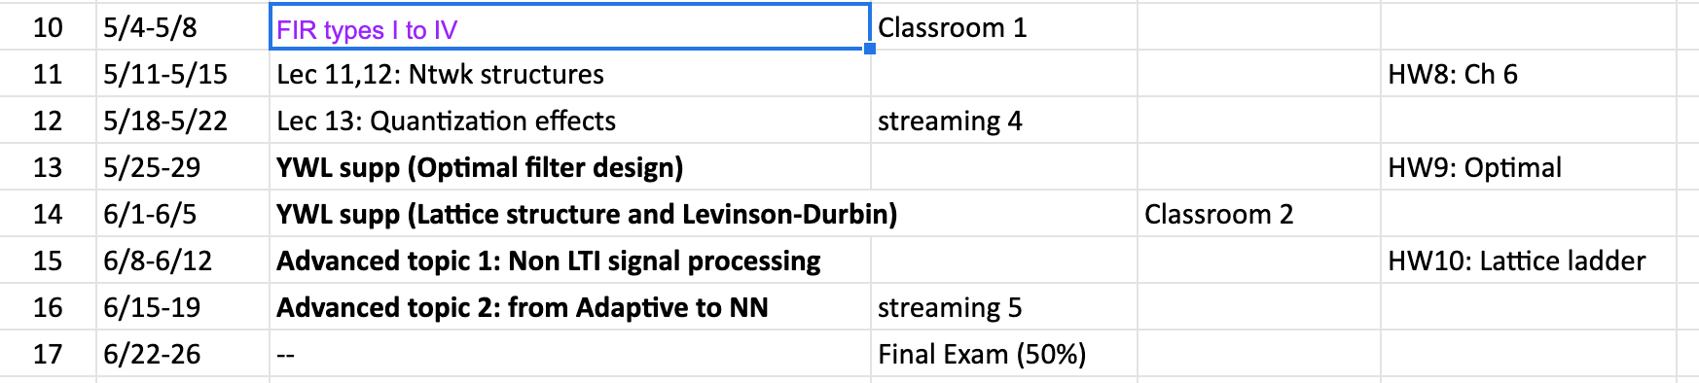
Upcoming schedules

Slide 4
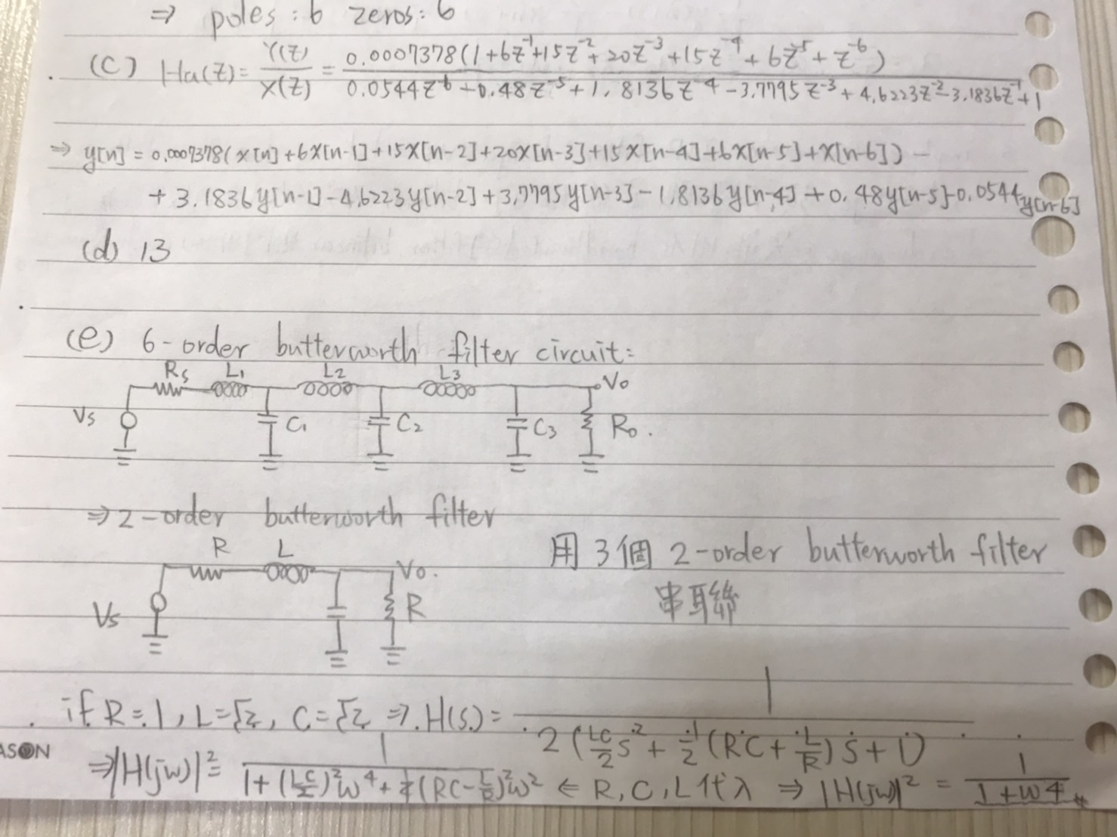
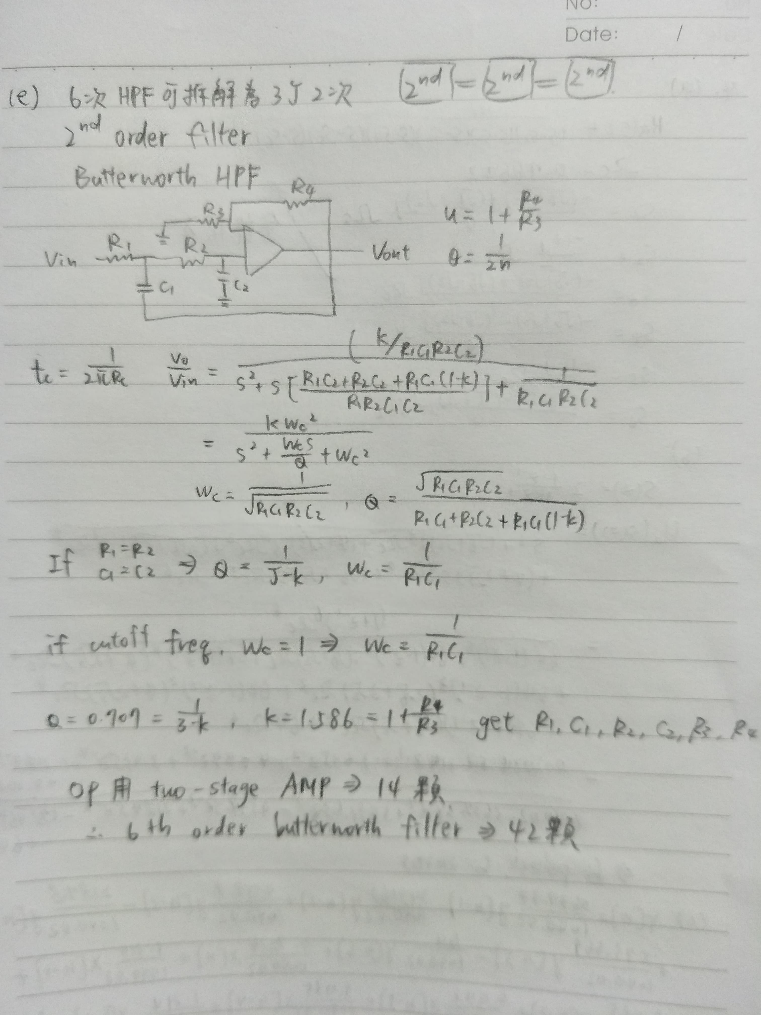
Some comments regarding HW6
My philosophy is to use HWs for harder and trickier questions, while keeping the exams simpler (not necessarily easier).

Slide 5
Let’s begin the mock exam!
To warm up, the first few questions are about the discrete-time Fourier transform.

Slide 6
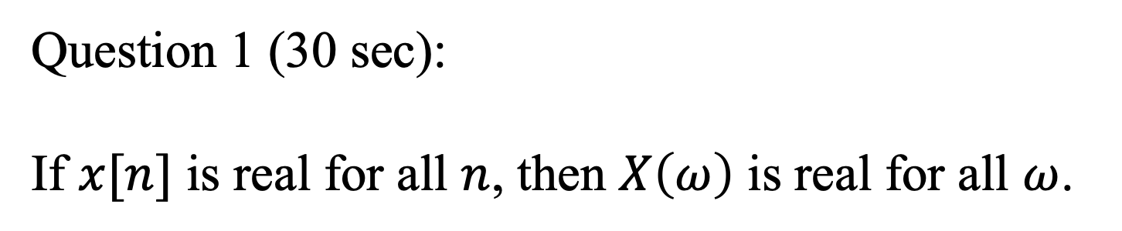
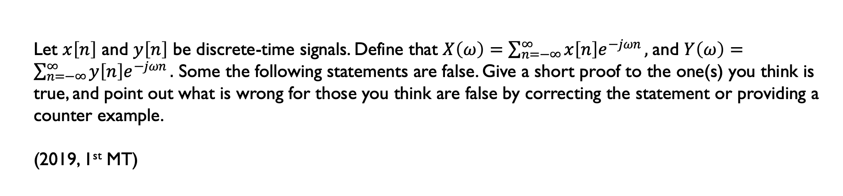
Let $x\left[n\right]$ and $y\left[n\right]$ be discrete-time signals. Define that $X\left(ω\right)=\sum_{n=−∞}^{∞}{x\left[n\right]e^{−jωn}},$and $Y\left(ω\right)=\sum_{n=−∞}^{∞}{y\left[n\right]e^{−jωn}}.$ Some the following statements are false. Give a short proof to the one(s) you think is true, and point out what is wrong for those you think are false by correcting the statement or providing a counter example.
(2019, 1st MT)
Question 1 (30 sec):
If $x[n]$ is real for all $n$, then $X\left(ω\right)$ is real for all $ω$.

Slide 7
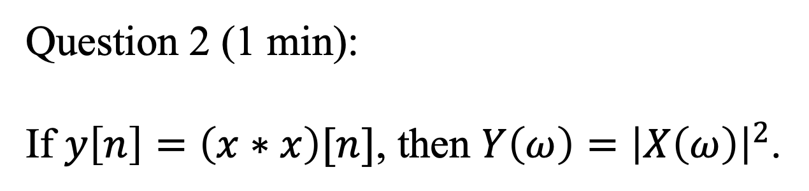
Let $x\left[n\right]$ and $y\left[n\right]$ be discrete-time signals. Define that $X\left(ω\right)=\sum_{n=−∞}^{∞}{x\left[n\right]e^{−jωn}},$and $Y\left(ω\right)=\sum_{n=−∞}^{∞}{y\left[n\right]e^{−jωn}}.$ Some the following statements are false. Give a short proof to the one(s) you think is true, and point out what is wrong for those you think are false by correcting the statement or providing a counter example.
(2019, 1st MT)
Question 2 (1 min):
If $y\left[n\right]=\left(x∗x\right)[n]$, then $Y\left(ω\right)={\left|X\left(ω\right)\right|}^{2}$.

Slide 8
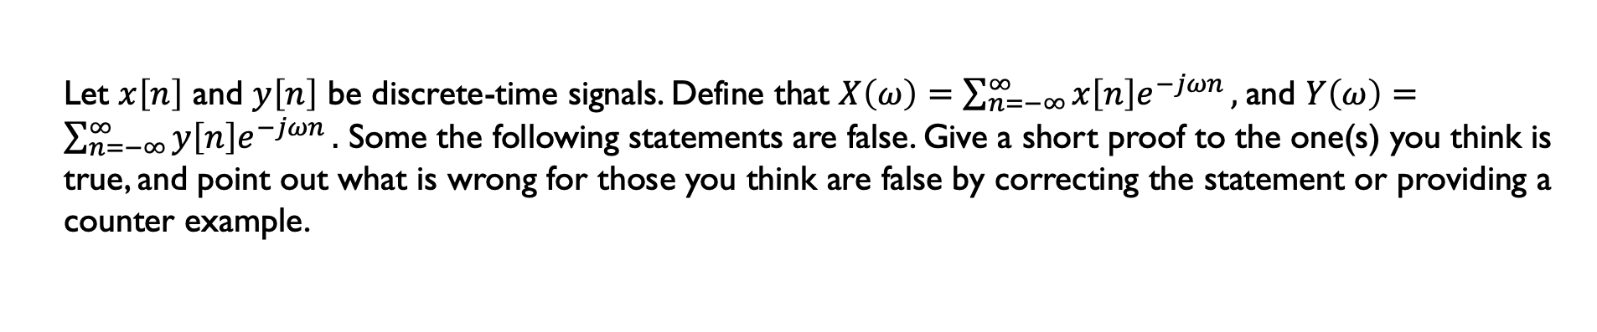
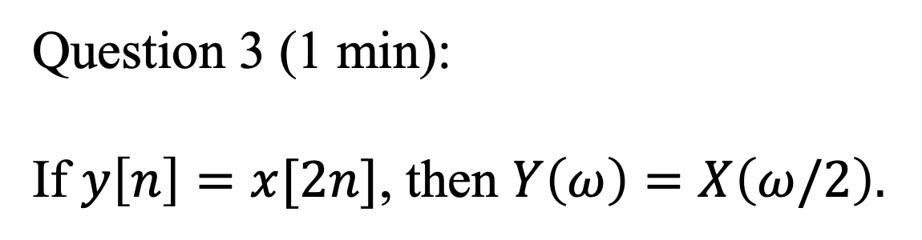
Let $x\left[n\right]$ and $y\left[n\right]$ be discrete-time signals. Define that $X\left(ω\right)=\sum_{n=−∞}^{∞}{x\left[n\right]e^{−jωn}},$and $Y\left(ω\right)=\sum_{n=−∞}^{∞}{y\left[n\right]e^{−jωn}}.$ Some the following statements are false. Give a short proof to the one(s) you think is true, and point out what is wrong for those you think are false by correcting the statement or providing a counter example.
Question 3 (1 min):
If $y\left[n\right]=x[2n]$, then $Y\left(ω\right)=X\left(ω/2\right).$

Slide 9
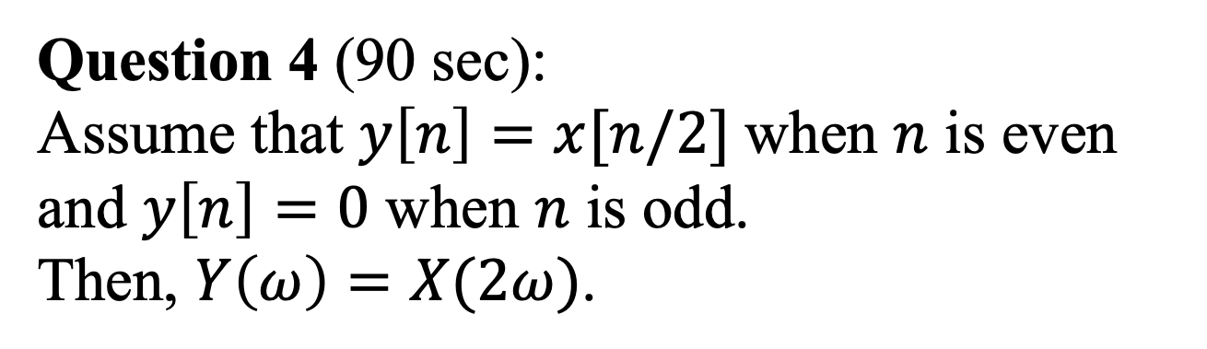
Let $x\left[n\right]$ and $y\left[n\right]$ be discrete-time signals. Define that $X\left(ω\right)=\sum_{n=−∞}^{∞}{x\left[n\right]e^{−jωn}},$and $Y\left(ω\right)=\sum_{n=−∞}^{∞}{y\left[n\right]e^{−jωn}}.$ Some the following statements are false. Give a short proof to the one(s) you think is true, and point out what is wrong for those you think are false by correcting the statement or providing a counter example.
(2019, 1st MT)
Question 4 (90 sec):
Assume that $y\left[n\right]=x[n/2]$when $n$ is even and $y\left[n\right]=0$ when $n$ is odd. Then, $Y\left(ω\right)=X(2ω)$.

Slide 10
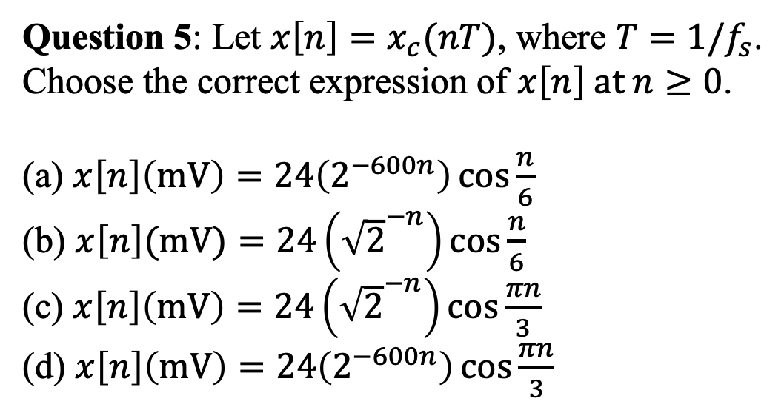
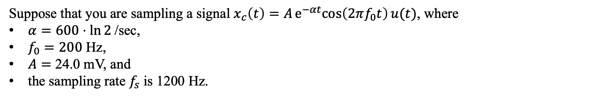
Suppose that you are sampling a signal $x_{c}\left(t\right)=Ae^{−αt}cos\left(2πf_{0}t\right)u(t)$, where
$α=600⋅ln{2}$/sec,
$f_{0}=200$ Hz,
$A=$ 24.0 mV, and
the sampling rate $f_{s}$ is 1200 Hz.
Question 5: Let $x\left[n\right]=x_{c}(nT)$, where $T=1/f_{s}$.
Choose the correct expression of $x\left[n\right] at n≥0$.
(a) $x\left[n\right]\left(mV\right)=24\left(2^{−600n}\right)\cos{\frac{n}{6}}$
(b) $x\left[n\right](mV)=24\left({\sqrt{2}}^{−n}\right)\cos{\frac{n}{6}}$
(c) $x\left[n\right]\left(mV\right)=24\left({\sqrt{2}}^{−n}\right)\cos{\frac{πn}{3}}$
(d) $x\left[n\right]\left(mV\right)=24\left(2^{−600n}\right)\cos{\frac{πn}{3}}$

Slide 11
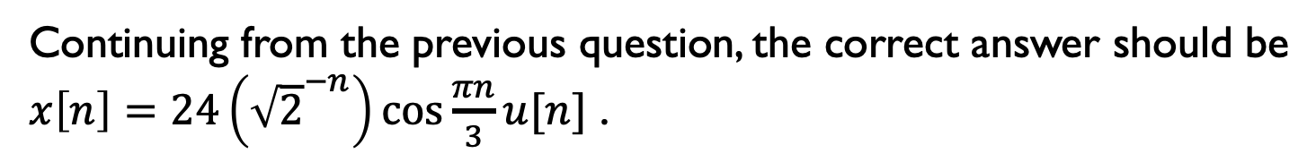
Continuing from the previous question, the correct answer should be
$x\left[n\right]=24\left({\sqrt{2}}^{−n}\right)\cos{\frac{πn}{3}}u[n]$ .
Question 6: Suppose that h[n] = x[n] is the impulse response of a LTI system, denote as H.
H is causal and stable.
H is non-causal but stable.
H is causal but not stable.
We cannot be sure.

Slide 12
The next few questions are getting harder.

Slide 13
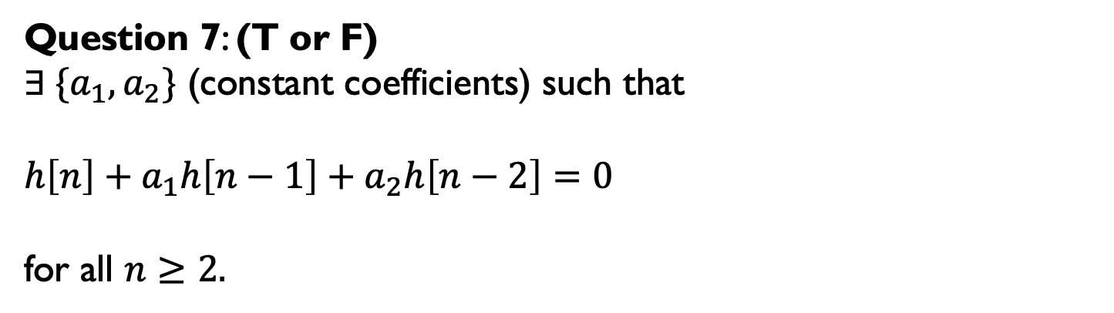
Let $h\left[n\right]=24\left({\sqrt{2}}^{−n}\right)\cos{\frac{πn}{3}}u[n]$ be the impulse response of H(z).
Question 7: (T or F)
$∃ {\{a}_{1},a_{2}\}$ (constant coefficients) such that
${h\left[n\right]+a}_{1}h\left[n−1\right]+a_{2}h\left[n−2\right]=0$
for all $n≥2.$

Slide 14
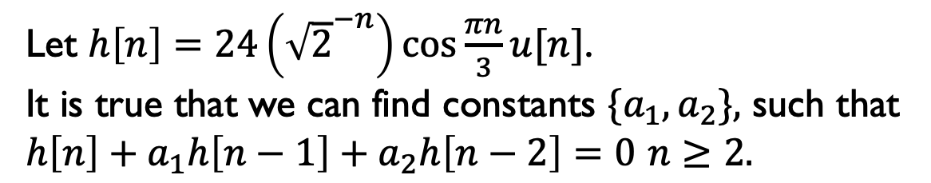
Let $h\left[n\right]=24\left({\sqrt{2}}^{−n}\right)\cos{\frac{πn}{3}}u[n]$. It is true that we can find constants ${\{a}_{1},a_{2}\},$ such that
${h\left[n\right]+a}_{1}h\left[n−1\right]+a_{2}h\left[n−2\right]=0$ $n≥2.$
Question 8:
Is H(z) a minimum-phase filter?

Slide 15
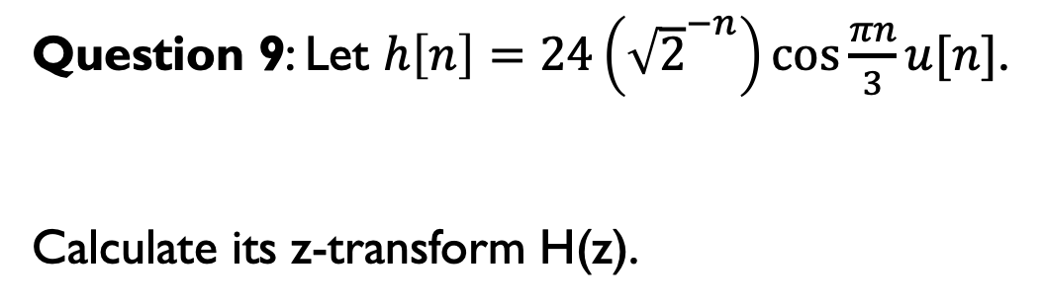
Question 9: Let $h\left[n\right]=24\left({\sqrt{2}}^{−n}\right)\cos{\frac{πn}{3}}u[n]$.
Calculate its z-transform H(z).
(Any volunteer?)

Slide 16
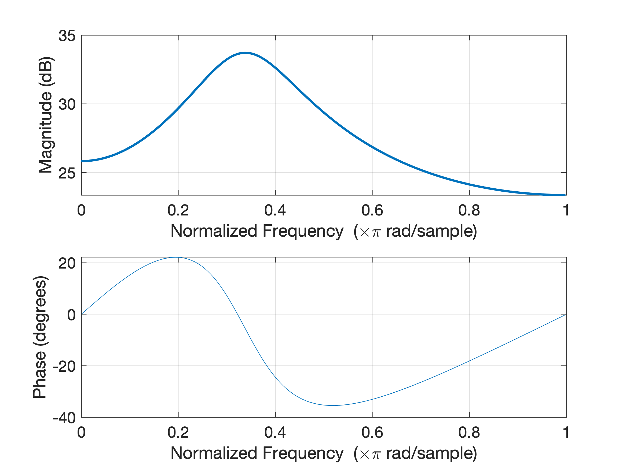
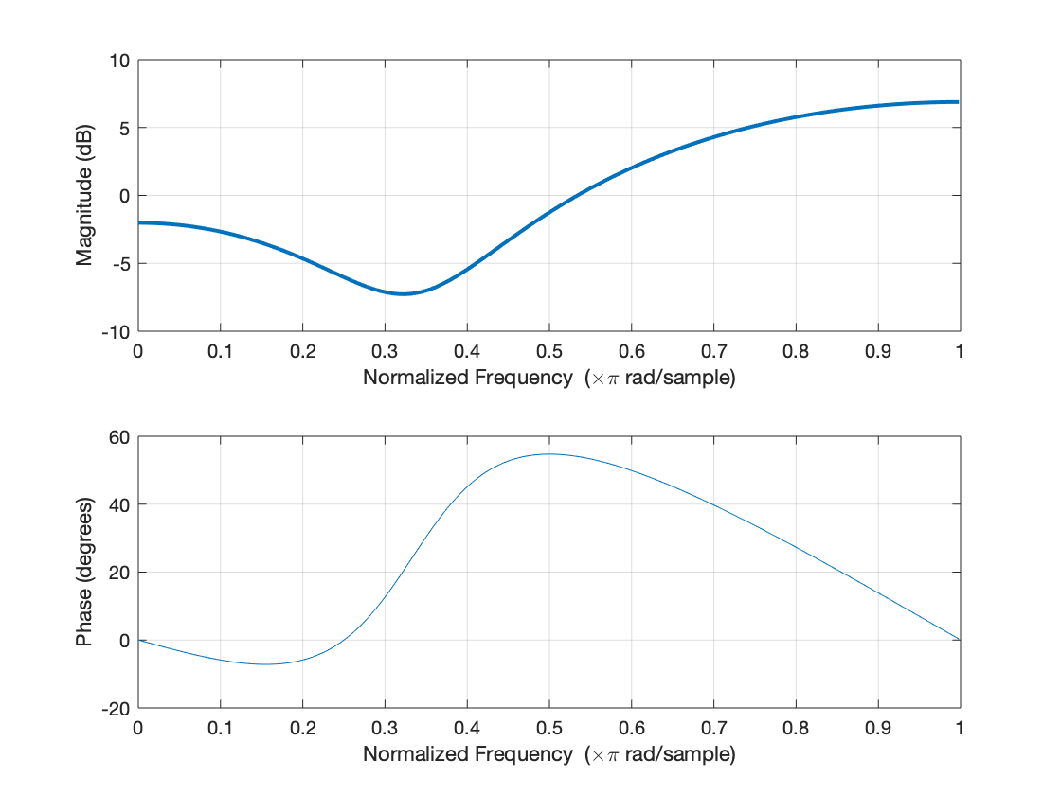

Question 10: Let $h\left[n\right]=24\left({\sqrt{2}}^{−n}\right)\cos{\frac{πn}{3}}u[n]$.
Which one of the below shows its magnitude and phase spectrum?
(a)
(b)

Slide 17
Imtermission

Slide 18
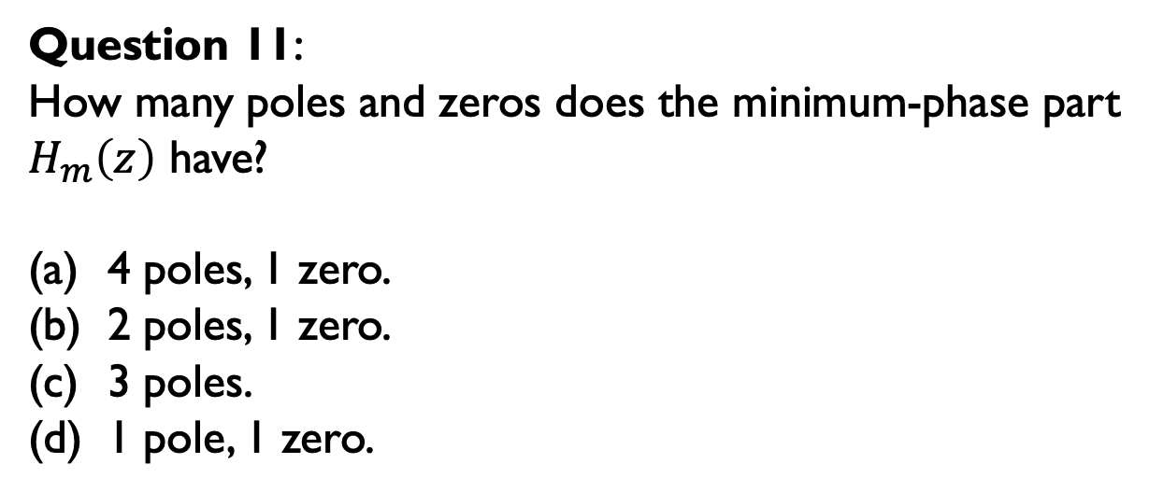
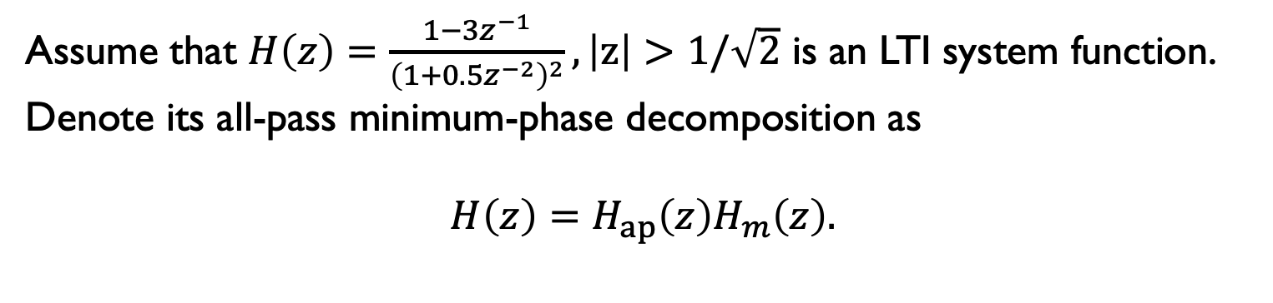
Assume that $H\left(z\right)=\frac{1−3z^{−1}}{{\left(1+0.5z^{−2}\right)}^{2}}, \left|z\right|>1/\sqrt{2}$ is an LTI system function.
Denote its all-pass minimum-phase decomposition as
$$H\left(z\right)=H_{ap}\left(z\right)H_{m}\left(z\right).$$
Question 11:
How many poles and zeros does the minimum-phase part
$H_{m}\left(z\right)$ have?
4 poles, 1 zero.
2 poles, 1 zero.
3 poles.
1 pole, 1 zero.

Slide 19
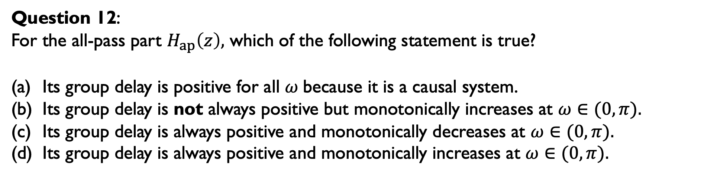
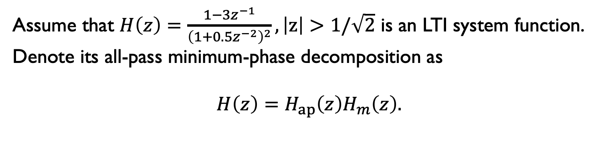
Assume that $H\left(z\right)=\frac{1−3z^{−1}}{{\left(1+0.5z^{−2}\right)}^{2}}, \left|z\right|>1/\sqrt{2}$ is an LTI system function.
Denote its all-pass minimum-phase decomposition as
$$H\left(z\right)=H_{ap}\left(z\right)H_{m}\left(z\right).$$
Question 12:
For the all-pass part $H_{ap}\left(z\right),$ which of the following statement is true?
Its group delay is positive for all $ω$because it is a causal system.
Its group delay is not always positive but monotonically increases at $ω∈(0,π).$
Its group delay is always positive and monotonically decreases at $ω∈(0,π).$
Its group delay is always positive and monotonically increases at $ω∈(0,π).$

Slide 20
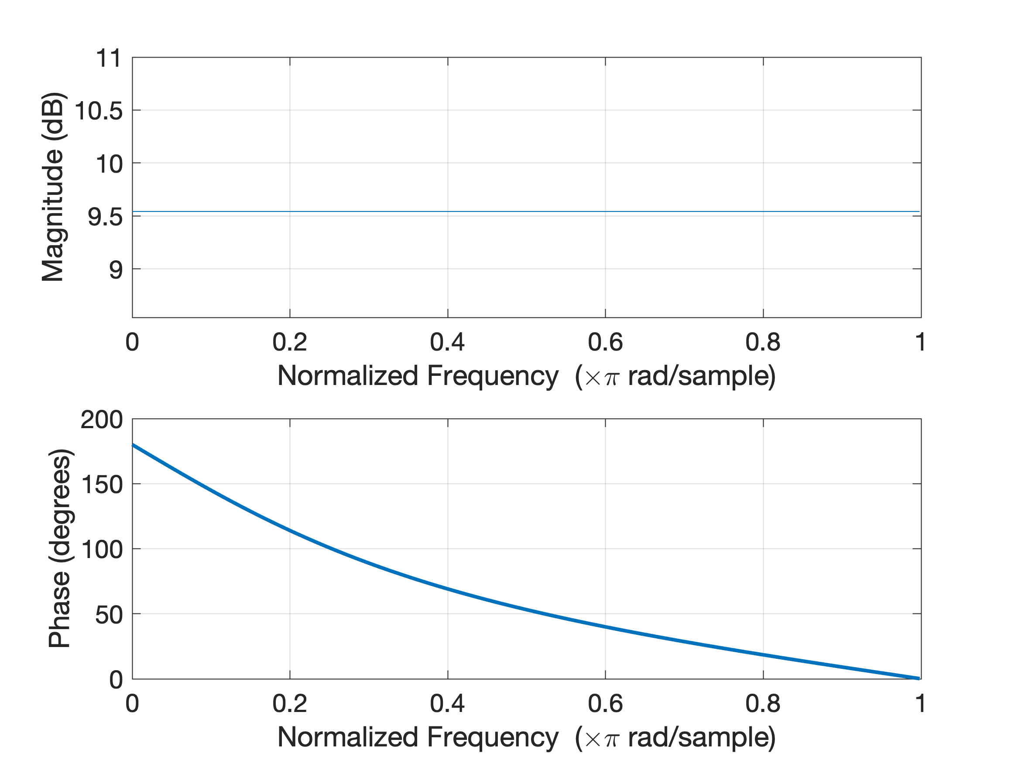

Slide 21
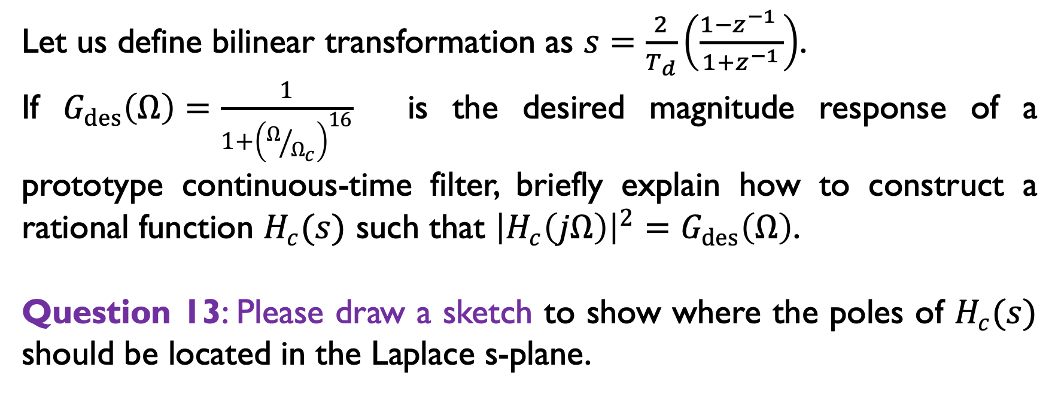
Let us define bilinear transformation as $s=\frac{2}{T_{d}}\left(\frac{1−z^{−1} }{1+z^{−1}}\right)$.
If $G_{des}\left(Ω\right)=\frac{1}{1+{\left(Ω/{Ω_{c}}\right)}^{16}}$ is the desired magnitude response of a prototype continuous-time filter, briefly explain how to construct a rational function $H_{c}(s)$ such that ${\left|H_{c}\left(jΩ\right)\right|}^{2}=G_{des}\left(Ω\right)$.
Question 13: Please draw a sketch to show where the poles of $H_{c}(s)$ should be located in the Laplace s-plane.

Slide 22
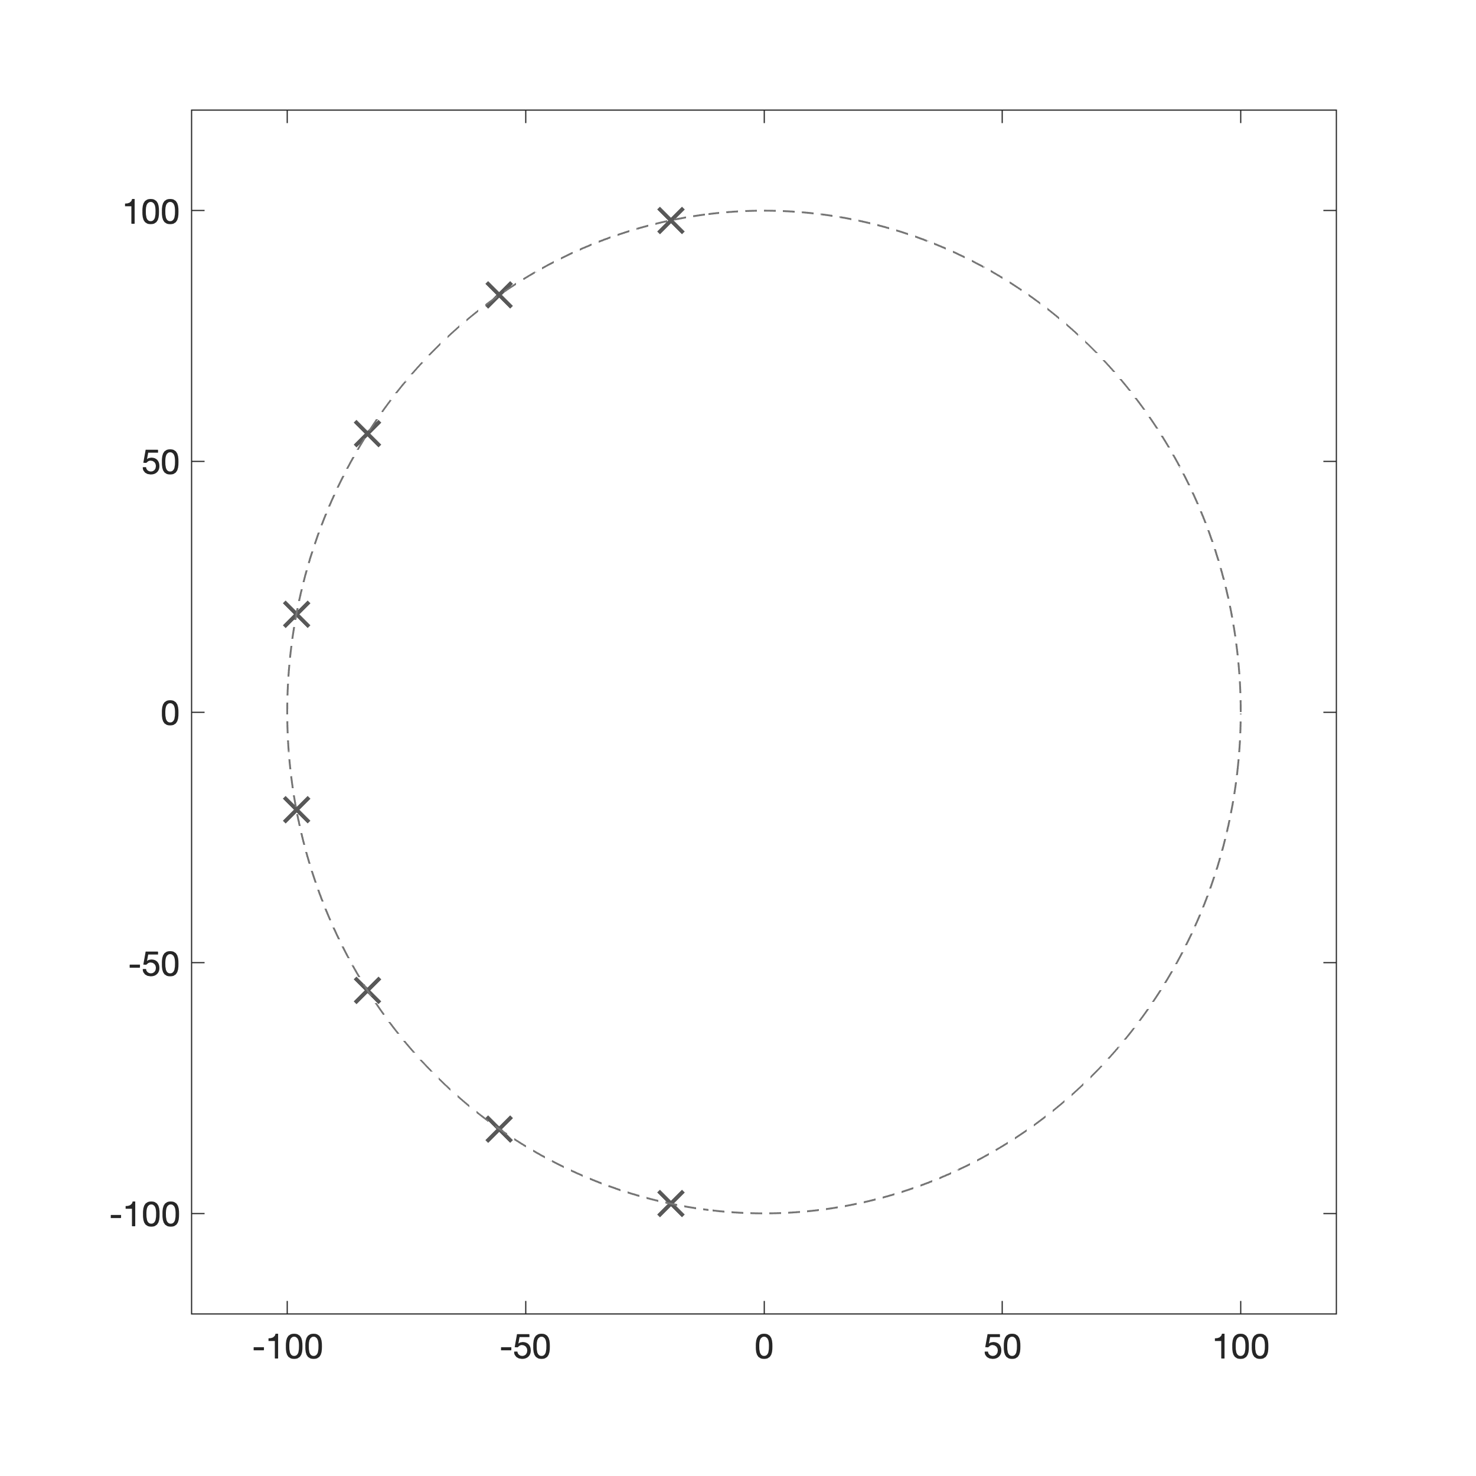
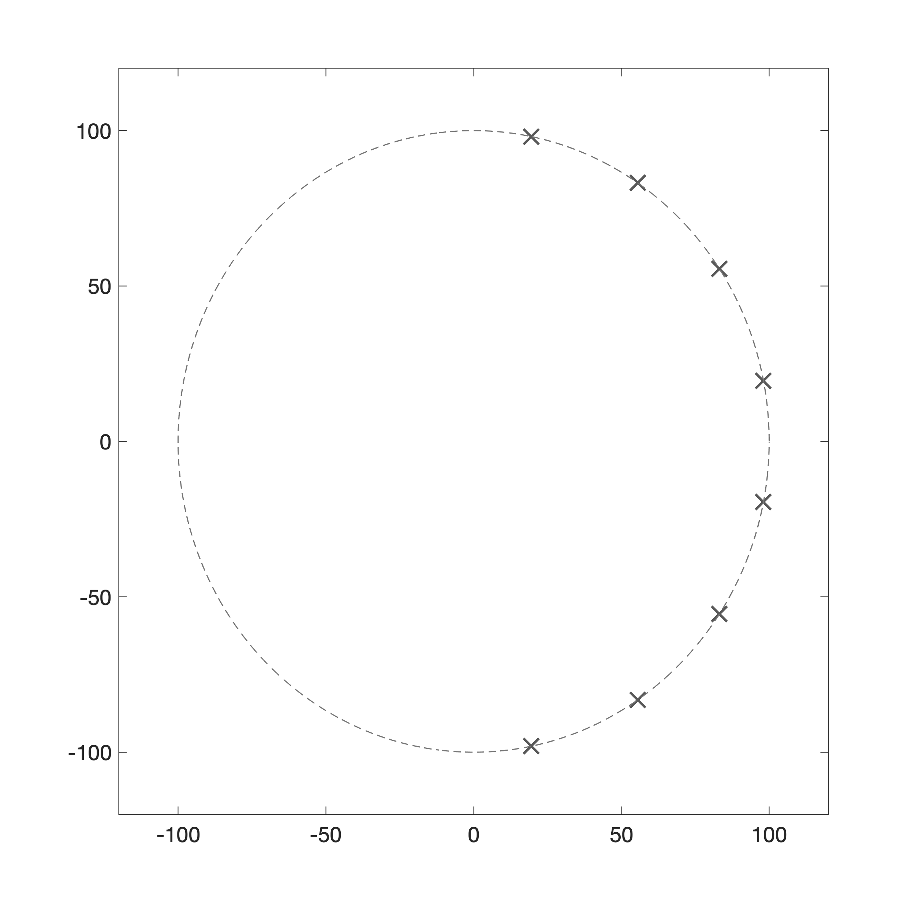
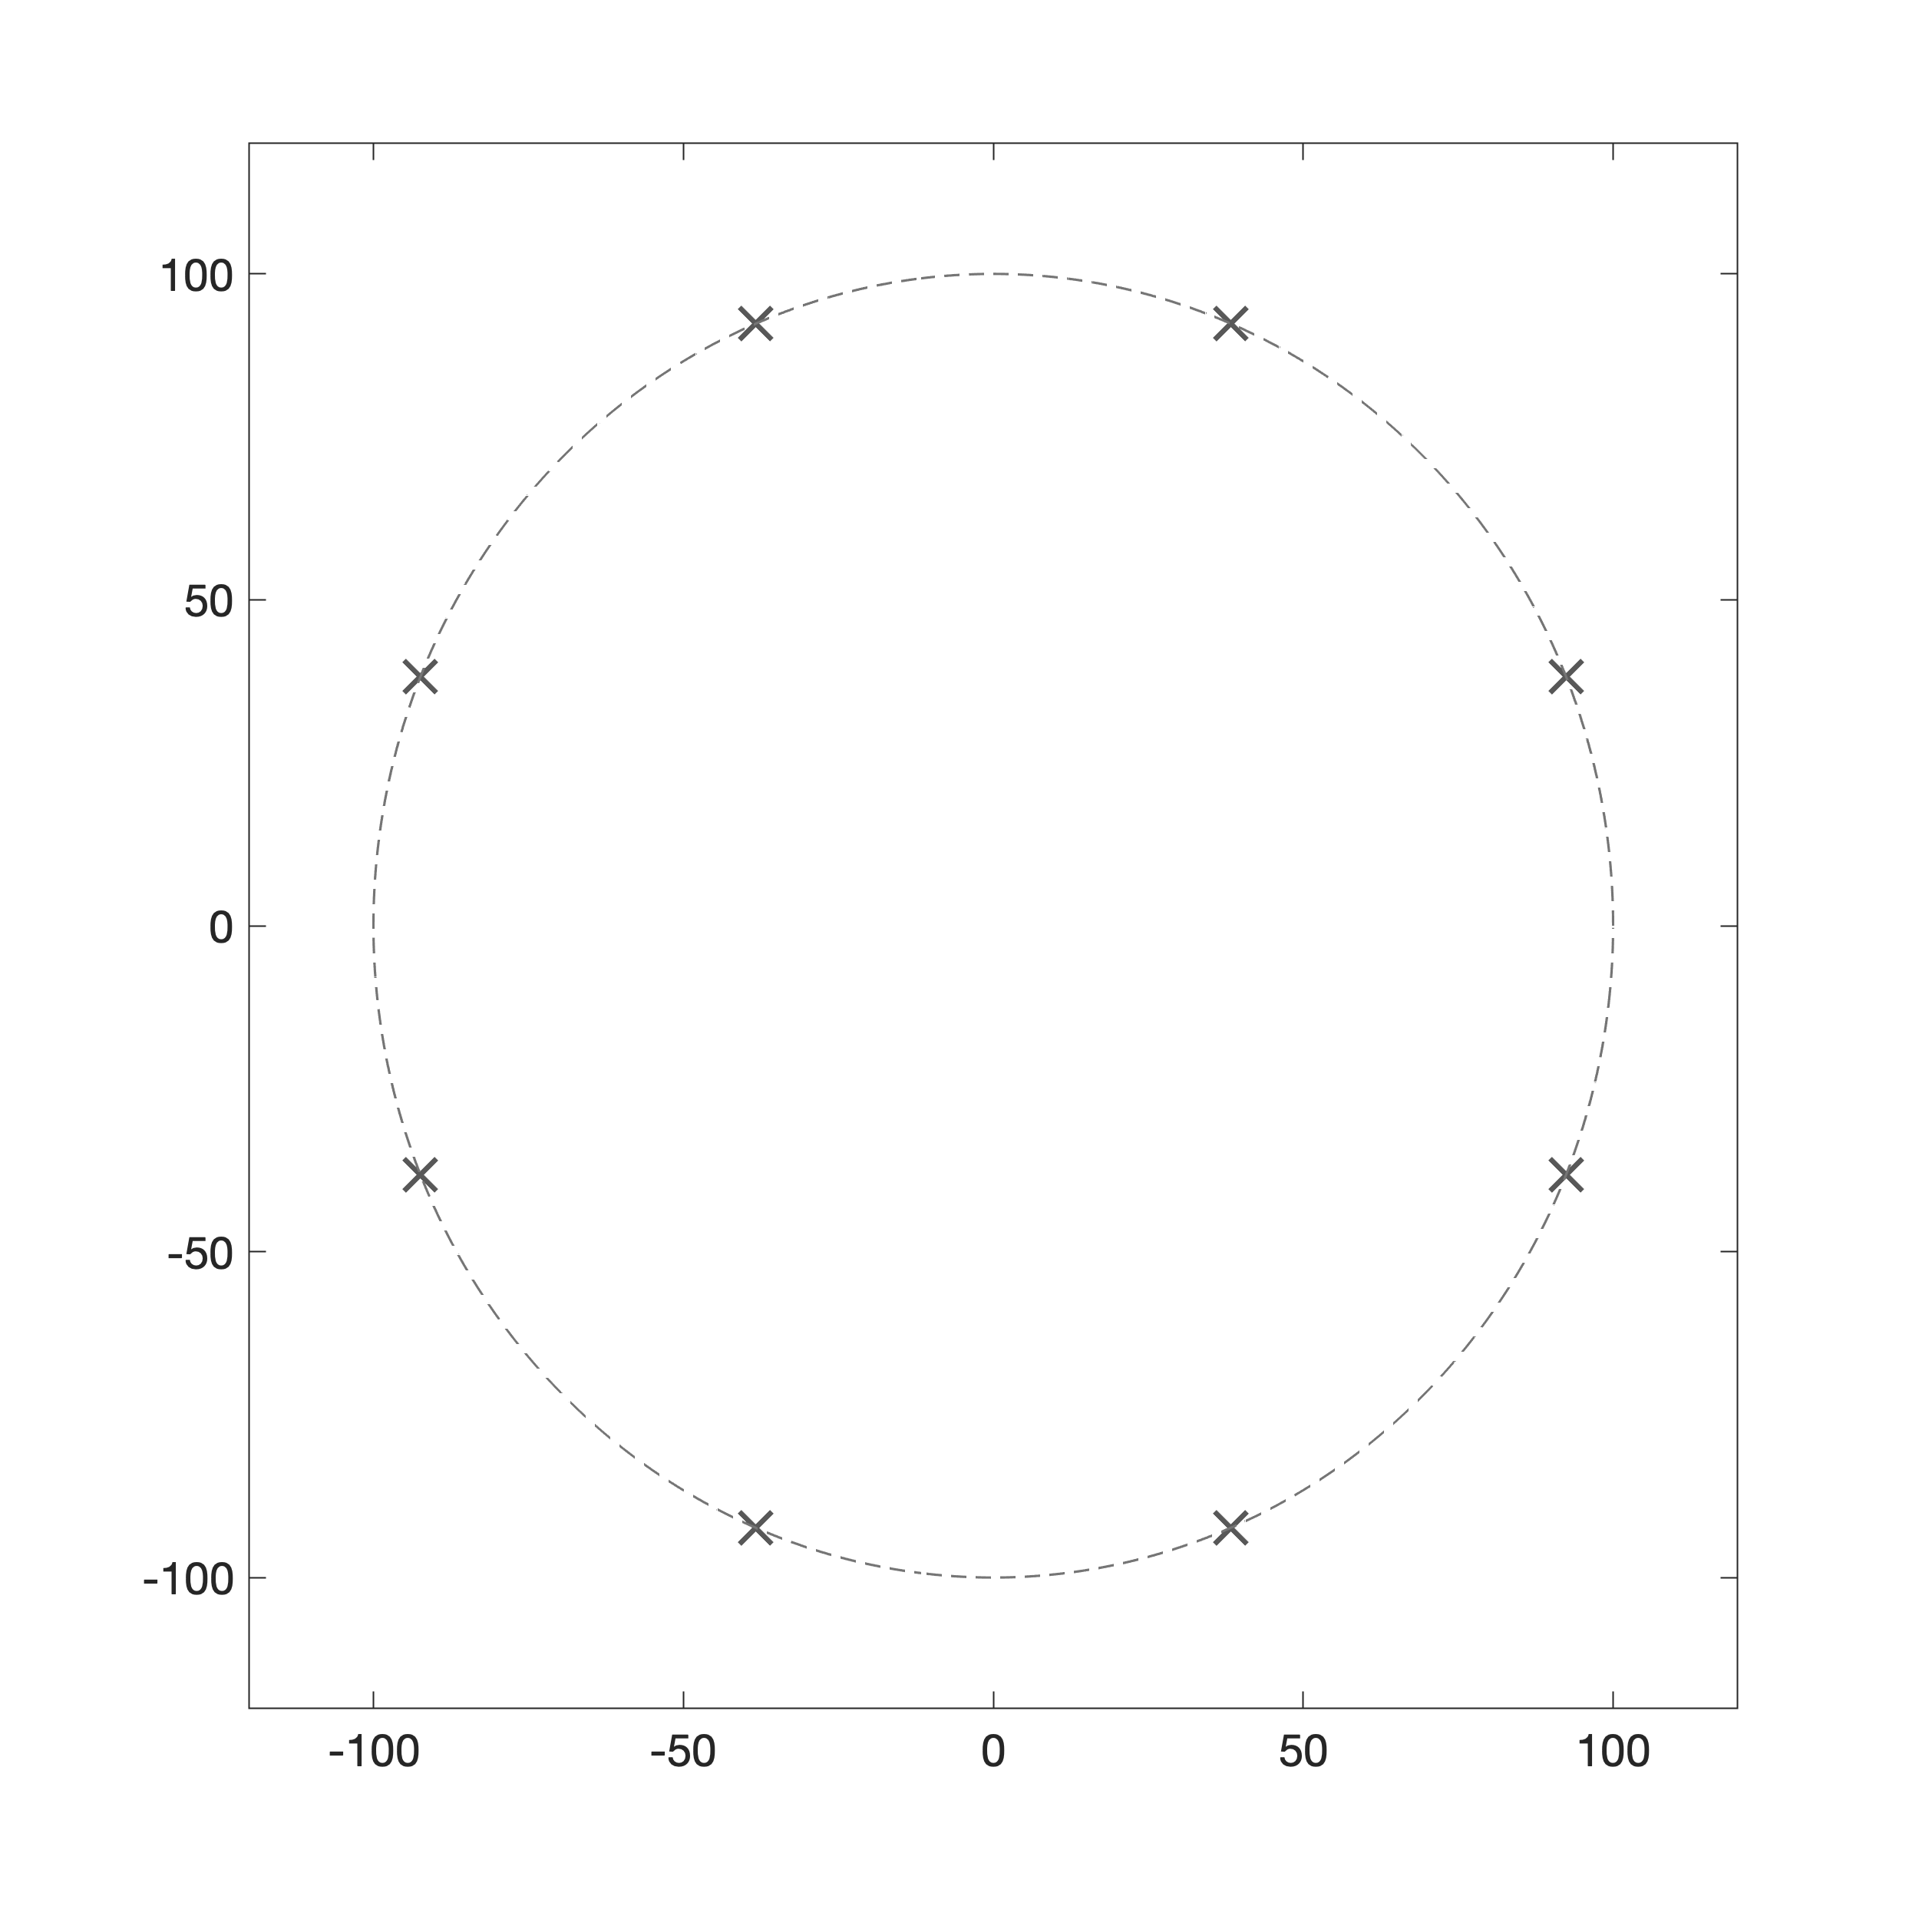

Question 13 (continued). Suppose that $Ω_{c}=100$rad/s. Which one of the plots below shows the locations of the poles of $H_{c}(s)$ most accurately?
(a)
(b)
(c)

Slide 23
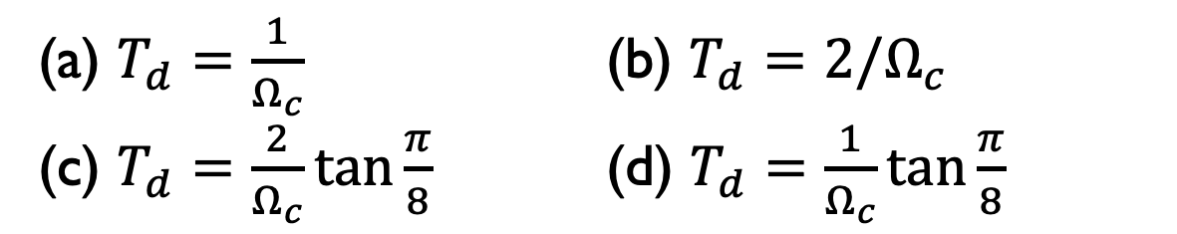
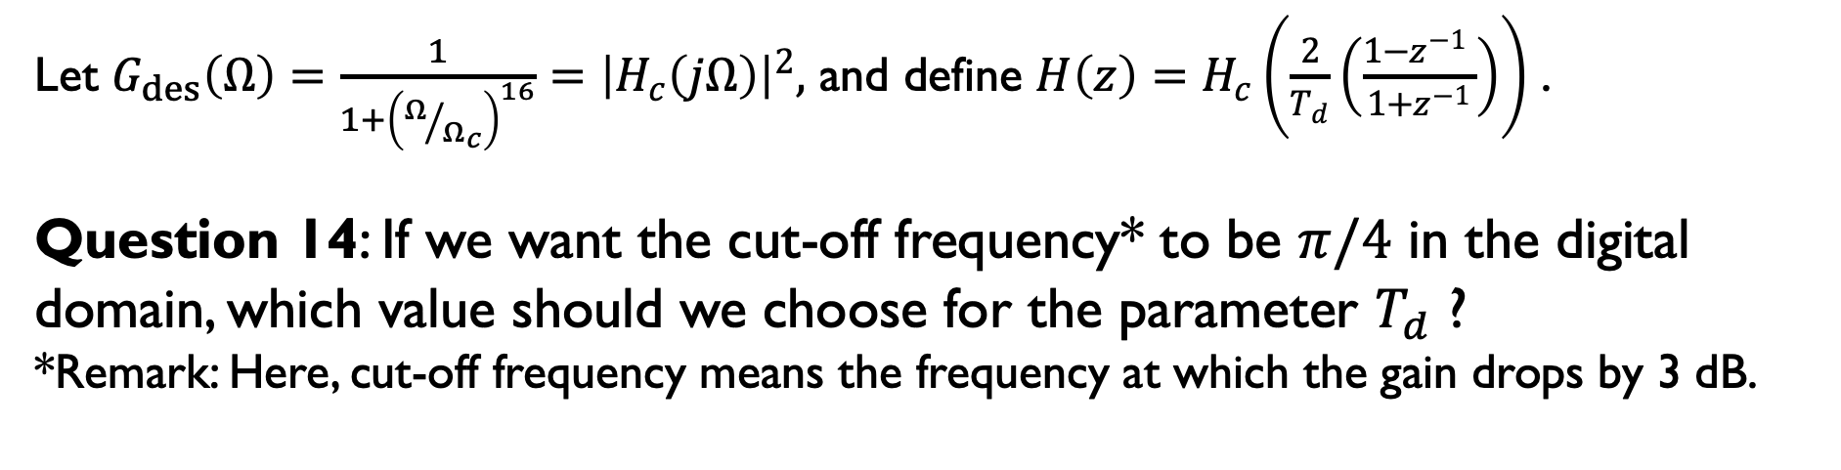
Let $G_{des}\left(Ω\right)=\frac{1}{1+{\left(Ω/{Ω_{c}}\right)}^{16}}={\left|H_{c}\left(jΩ\right)\right|}^{2},$ and define $H\left(z\right)=H_{c}\left(\frac{2}{T_{d}}\left(\frac{1−z^{−1} }{1+z^{−1}}\right)\right)$ .
Question 14: If we want the cut-off frequency* to be $π/4$ in the digital domain, which value should we choose for the parameter $T_{d}$ ?
*Remark: Here, cut-off frequency means the frequency at which the gain drops by 3 dB.
(a) $T_{d}=\frac{1}{Ω_{c}}$ (b) $T_{d}=2/Ω_{c}$
(c) $T_{d}=\frac{2}{Ω_{c}}\tan{\frac{π}{8}}$ (d) $T_{d}=\frac{1}{Ω_{c}}\tan{\frac{π}{8}}$

Slide 24
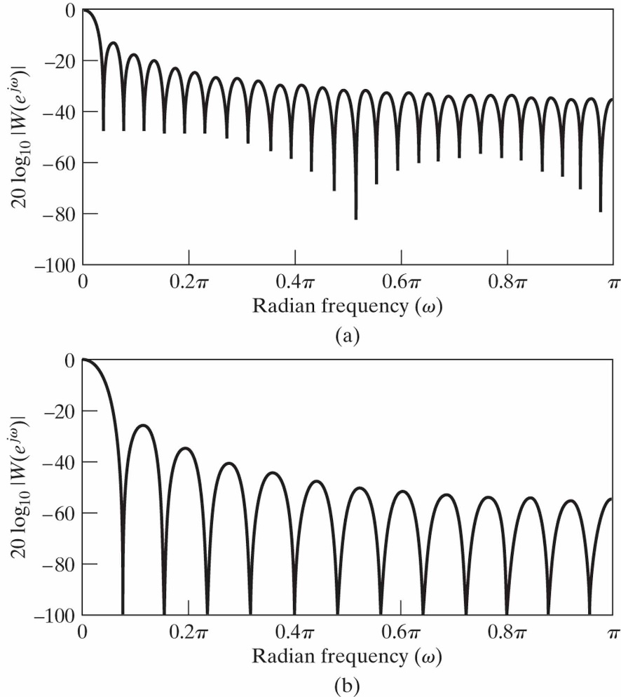
Question 15: On the left, we have the magnitude spectrum of a rectangular window and a Barlett (triangular) window, respectively.
How many non-zero samples does the rectangular window have?
25
49
26
51

