Slide 1
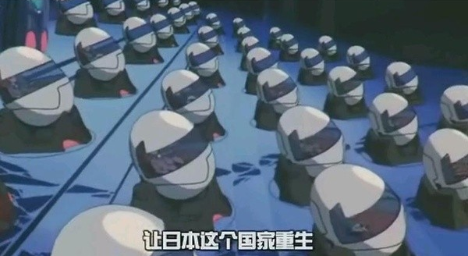
Noah's Capsule CHK001
Group 1
110064532郭孟軒
109061613黃柏凱
110061616許祐杰
111066529陳峒羽
110061901許鏡瑋

Slide 2
Outline
Motivation and application
Technology
Task Partition
Schedule

Slide 3
Part 1
Motivation and Application

Slide 4
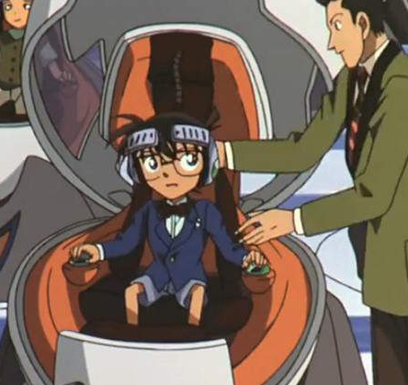
Motivation and Application
High house Prices in City
Hight pressure in Modern Life
Self-quarantine at your home
Need a place for your own ?

Slide 5
Motivation and Application
Pleasant Modern Age
IoT Environment, Interactive Technology
immersive experience
Working experience
Gaming experience
film viewing experience
Smart home
home automation
Easily control
a truely home experience
Self-health Monitoring
Avoid sitting too long
drinking water period
Heart rate …etc.

Slide 6
Part 2
Technology

Slide 7
Technology - IOT Control system + Entertainment devices
Storage Device
8 TB V NAND SSD
Display
QLED Curved Monitors *2 (Main)
QLED Curved Monitors *2 (Side)
QLED Curved Monitors cover all around
CPU: Intel 13rd Core
RAM: DDR5 up to 32GB
GPU: NVIDIA GeForce RTX 4090
WIFI : WIFI 6
Blue tooth: Blue tooth 5.3
VR: Valve Index
Sensing
Camera
Temperature sensors
Humidity sensors
Light sensors
Air quality monitoring sensor
Notes:
Technology https://shop.kmb.com.tw/index.php?route=product/product&product_id=851&language=zh-TW&currency=TWD&gclid=CjwKCAjw5P2aBhAlEiwAAdY7dMgymCIa1_CM857xjDmZcp1zjtp40Dese9YmaYQDdVpKlQKVedVOqBoCEiEQAvD_BwE https://www.youtube.com/watch?v=F99YrfCzJ7o&ab_channel=Joeman

Slide 8
Part 3
Task Partition

Slide 9
Task Partition
Technology analysis
Smart cockpit : 許鏡瑋，黃柏凱
Entertainment devices : 陳峒羽，郭孟軒
Smart home Control system :許祐杰，許鏡瑋，黃柏凱，陳峒羽，郭孟軒
Report
許鏡瑋，郭孟軒，黃柏凱，陳峒羽

Slide 10
Part 4
Schedule

Slide 11
Schedule
20%
30%
50%
75%
100%
2022/11/14
System Analysis
2022/11/21
Tehcnology Analysis
2022/11/28
System
Architecture
Diagram
2022/12/5
Final Presentation
2022/11/7
Proposal

Slide 12
Thank you

Slide 18
Motivation and Application
Self-health Monitoring
Control your smart home with control system.
The future of health On full display.
Blood oxygen, heart rate …etc.
Drink water period.
Manage your task, and give you remind.
Also manage your pressure.
Notes:
https://www.apple.com/apple-watch-series-7/index.html

Slide 19
Motivation and Application
Smart home
A home that takes care of your task
Lights up your way
Knows how to help
Automatically control the lights and ERV
Gives you the best experience than your home.
Notes:
https://www.ingrem.com/G1-2022 https://zh.m.wikipedia.org/zh-tw/%E5%85%A8%E7%86%B1%E4%BA%A4%E6%8F%9B%E6%A9%9F

Slide 20
Motivation and Application
immersive experience - gaming experience
Playing with 144 Hz QLED Curved Monitors
Ultra-large, ultra-wide curved screen
HDR changes the game
Built for speed
with other monitor keep in touch with your friend.
Gaming workstation
Science zero gravity, release your pressure
Touch screen control, control your own station.
Notes:
https://www.ingrem.com/G1-2022

Slide 21
Motivation and Application
immersive experience - working experience
working at any place you want .
In the ocean working with fish
on the beach working with Ocean Waves Sea Sounds
In the coffee shop working with Jazz
near the onsen …etc
working with Huge monitor .
improving your efficiency

Slide 22
Technology - Smart cockpit
Sensing
Temperature sensors
Humidity sensors
Pressure sensors x16
WIFI and Bluetooth
WiFi 6 802.11ax
Dual- modeBluetooth 5.0
Single board microcontroller
CPU: Quad-core ARM Cortex-A55
RAM: LPDDR4 up to 8GB
high-performance NPU
High Performance Edge Computing Single Board Computer
Notes:
https://www.mixtile.com/edge-2/?gclid=CjwKCAjwh4ObBhAzEiwAHzZYU_u1IRRLD0wddX_4xcIKFUtVaLKUMpPnQXPDCN7ZIcrry-hLXqysXxoCbqcQAvD_BwE https://www.mixtile.com/edge-2/?gclid=CjwKCAjwh4ObBhAzEiwAHzZYU_u1IRRLD0wddX_4xcIKFUtVaLKUMpPnQXPDCN7ZIcrry-hLXqysXxoCbqcQAvD_BwE

