Slide 1
Drone-aided Police’s Control System Group 3
工科所 109011566 楊智勝
資工所 111062656 許芷毓
交大電信所 0007-310513008 楊士緯
電機系 108061181 郭義安
光電所 110066534 陳俊翰

Slide 2
Outline
Motivation and Application
Technology
Task Partition
Schedule

Slide 3
Motivation and Application

Slide 4
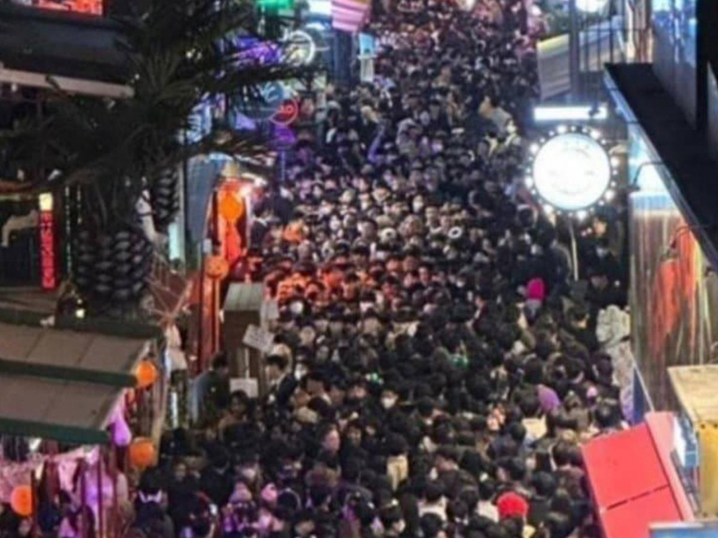
Motivation and Application
Itaewon crowd crush (梨泰院)
It’s difficult for the police to rescue.
At the scenario of too many people
We propose a UAV-based evacuate system
For a emergency situation, the system can deployment the UAVs rapidly and broadcast the alert information
For a traffic jam, it can control the congestion problem without police
It can also improve the mobile signal (LTE, 5G NR) coverage with the portable small cell station

Slide 5
Motivation and Application
Drone
Sound alert
The police can broadcast to the crowd
Image alert
Real time image upload to the server
Project icon on the wall or building
Communication
5G, Wi-Fi (Enhance signal coverage by multiple drones)

Slide 6
Technology

Slide 7
Technology
Sensor
ultrasound sensor:Valentine V1 Gen2 Radar Detector
temperature sensor:TMP117
Accelerometer & Speed Sensor:H3LIS331DL
moisture sensor:HDC3021-Q1
Motion & Position Sensor:ADXL314
Gyroscopes:IAM-20380
Camera
Moment Drone Series Mavic 2 Pro Anamorphic Lens
Monitor and Projector
Mini projector : Nebula Capsule Small Portable Movie Projector

Slide 8
Technology
Speaker
Global Drone Speaker
Base Station
LiteOn 5G small-cell : FlexiFi RDU
Wi-Fi AP:Netgear, Cisco, etc.
Storage Device
Cloud Storage
Network Protocol
IEEE 802.15.1(Bluetooth)
IEEE 802.11(Wi-fi)
5G (sub-6G or 28 GHz)

Slide 9
Task Partition

Slide 10
Task Partition
Technology analysis
Sensor: 楊智勝
Camera:許芷毓
Monitor & Speaker:楊士緯
Router & Network Protocol:郭義安
Storage Device:陳俊翰
Report
All

Slide 11
Schedule

Slide 12
Schedule
2022/11/7
Proposal
2022/11/14
System Analysis
2022/11/28
Technology Analysis
2022/12/05
System architecture diagram
2022/12/12
Discussion

