Slide 1
Health Monitoring
IoT System for Vehicle
Group 4
111061580張睿紘 110061635 王瑞賢
111064559 徐詠祺 111065535 楊文彣
111064539 張文彥

Slide 2
Outline
Motivation
Technology
Task Partition
Schedule

Slide 3
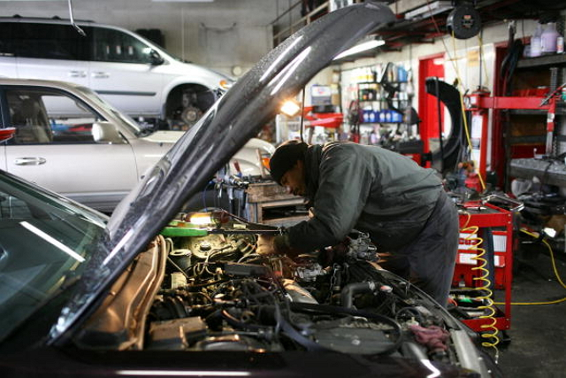
Motivation
The lack of awareness of vehicle maintenance
Higher risk of nasty accident
Spend more time and money to repair
To introduce needed products or repairing suggestions to customers
Significant data for car
insurance company

Slide 4
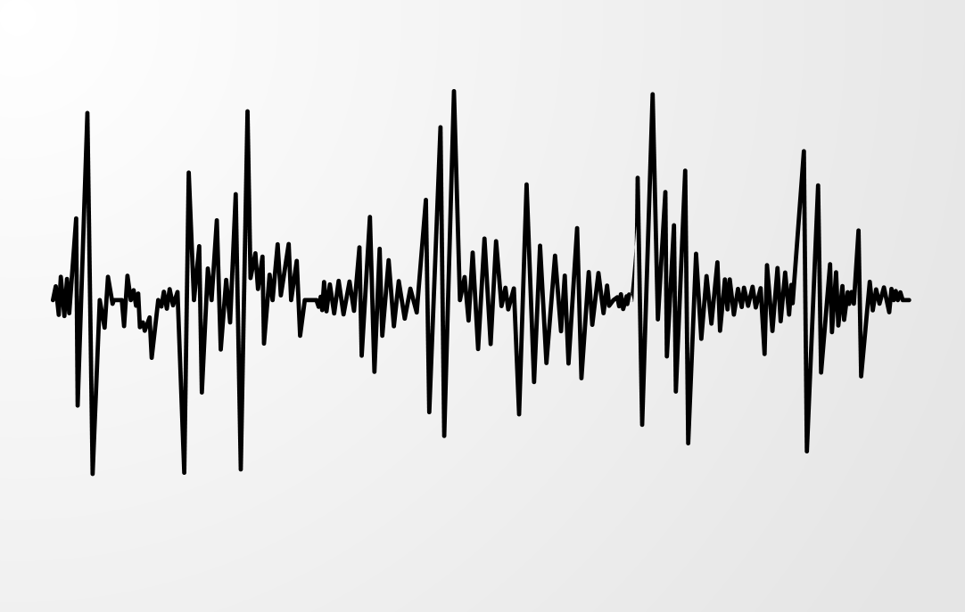
Motivation
Detects early-stage failures:
Reduce the risk of breakdown
Improve machine performance
Extend machine use life
Scoring machine health and your driving habbits
Predicts failures:
Predicting machine failure from
sensors detection and your
driving style

Slide 5
Technology
Sensors:
Virbration
Temperature
Pressure
Tx & Rx:
Low latency Tx & Rx
many I/O ports
Power management
DVFS
Storage Device:
Cloud Storage
Network
LTE / Wi-Fi backhaul

Slide 6
Task Partition
Sensors:徐詠祺
Tx & Rx:張睿紘
Power management:張文彥
IoT system:楊文彣
Application:王瑞賢

Slide 7
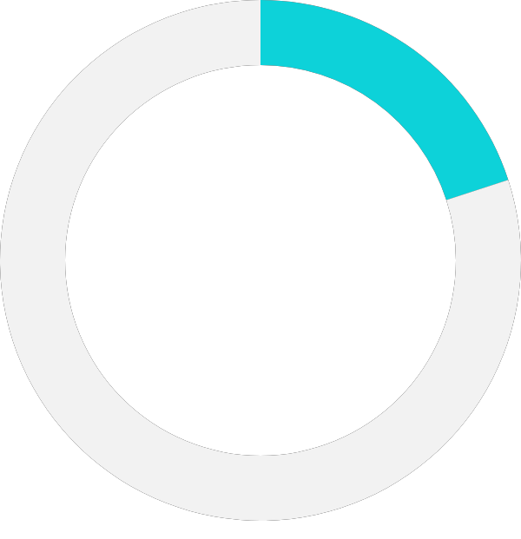
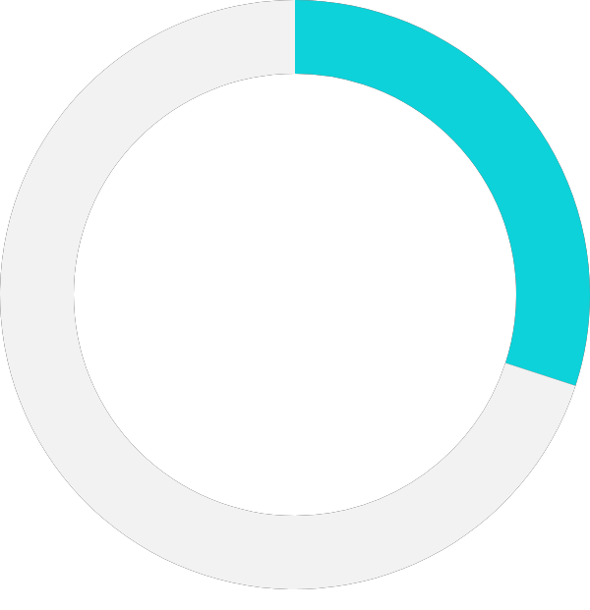
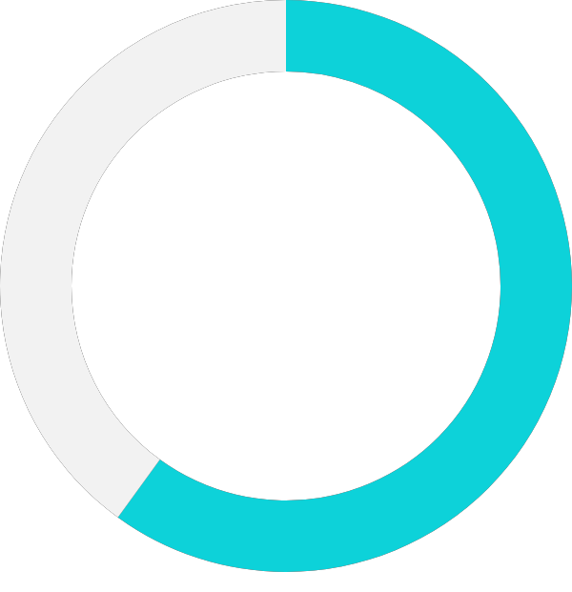


Schedule
20%
30%
60%
Proposal
11/6
System Analysis
11/17
Technology Analysis
12/11
80%
100%
System architecture diagram
Presentation
1/16
12/18

Slide 8
Thank you!

