Slide 1
Smart laundry room
Group 5
111062572 施冠彰
111062644 黃廉傑
111062510 張又仁
111062575 許詠晴

Slide 2
Outline
Motivation and Application
Technology
Task partition
Schedule

Slide 3
Motivation and Application
常常忘記洗衣服曬衣服烘衣服收衣服
用不正確的方法清洗或烘衣服會造成衣服的損傷
常常浪費時間在確認衣服是否乾了
智慧洗衣籃
智慧洗衣機
智慧烘衣
智慧衣架
Ps 可分多頁加點圖片

Slide 4
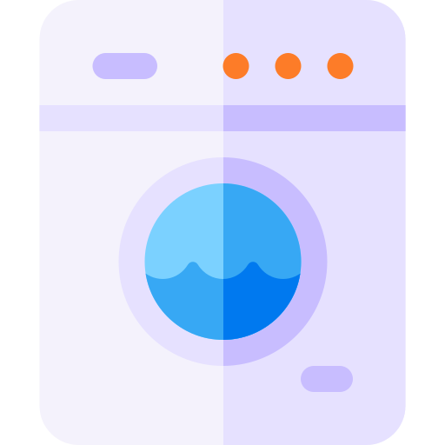




Motivation and Application
How much time do you spend on do the Laundry?
Ideal Laundry Time
0Hr 0Min
0Hr 50Min
13Hr 50Min
14Hr 0Min
Take the blanket
To the washing machine
Complete washing
Dry clothes
Complete dry clothes
Folding clothes
Complete
Do laundry

Slide 5


Motivation and Application
How much time do you spend on do the Laundry?
Actual Laundry Time
……
0Hr 0Min
0Hr 10Min
1Hr 10Min
2Hr 0Min
5Hr 0Min
5Hr 10Min
Take clothes to
Washing machine
No available machine, waiting
Found available machine, start laundry
Hang the clothes, wait for dry.
It's raining!
Change to use clothes dryer
No dryer available now.
Waiting…

Slide 6


Motivation and Application
We Spent too much time to do the laundry
Wait for available watching machine → 25Min ~ 50Min
Bad weather cause the clothes hard to dry, even redo the laundry → 12Hr ~ 24Hr
Wait for available clothes dryer → 30Min ~ 2Hr
No complete notification, task done but not yet to get your clothes → 1Hr ~ 24Hr
Average waste time: 8 Hr per once (Worst Case)
Do laundry twice per week → 64 Hr/month, 768 Hr/year
Take the lecture with 3 academic credit in 1 semester
→ 60 Hr, you can take additional 12 lectures in one year
Take 20 Hr you can learn one skill
→ You can learn additional 38.4 skills in one year

Slide 7

Motivation and Application
Wrong Washing & Drying Cause Clothing Damage
Different clothes material need different washing process
Different clothes material need different Drying time, temperature
Most People do not know it. Cause Clothing Damage

Slide 8
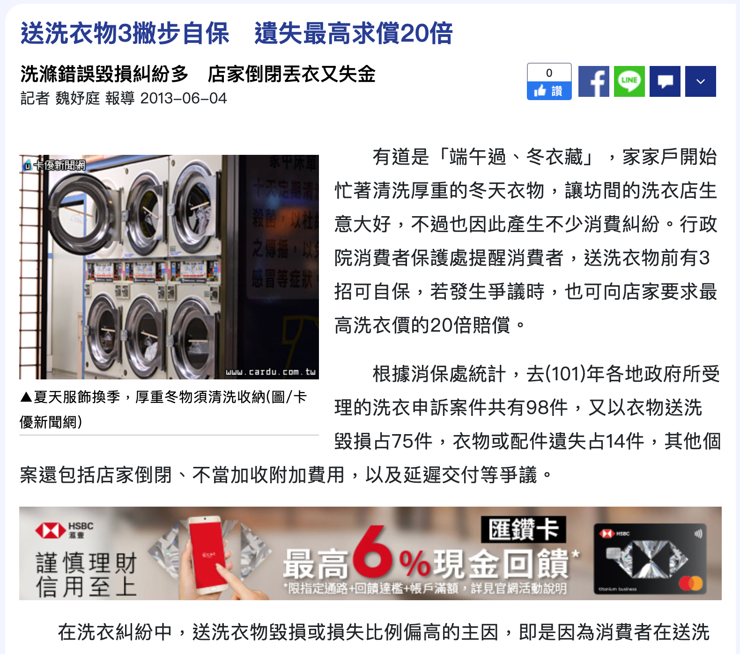
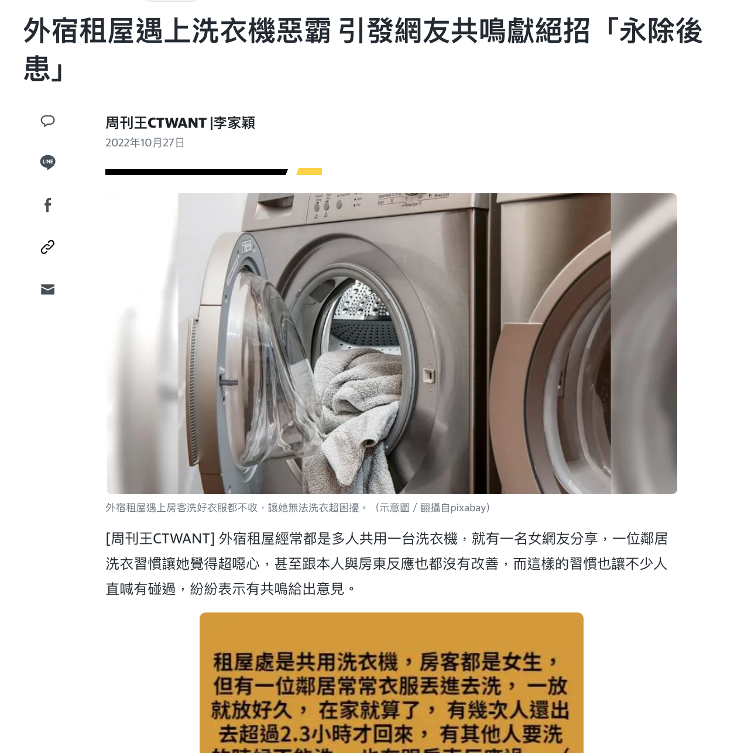
Motivation and Application

Slide 9





Motivation and Application
Laundry Cloud Admin
Laundry Cloud APP
Laundry Cloud
Smart Washer
Smart Dryer
Smart basket
Smart hanger

Slide 10
Technology
Sensing Device
Temperature Sensor
Humidity Sensor
Sunlight Sensor
Clothes Wetness Detection: RFID
Camera
Storage Device
Cloud Storage
Network Protocol
IEEE 802.15.1(Bluetooth)
IEEE 802.11(Wi-fi)
App
Android/ios

Slide 11
Task Partition
Technology analysis
Sensing Device:
Storage Device, Network
App
Report
ALL

Slide 12
Schedule
2022/11/7: Proposal
2022/11/28:System Analysis
2022/12/05:Technology Analysis
2022/12/12:System Architecture
2023/01/09:Presentation

