Slide 1
3D Sensing for vehicle technologies
通訊所
110064533
陳劭珩

Slide 2
Outline
Introduction
Technology
Applications
Conclusion
References

Slide 3
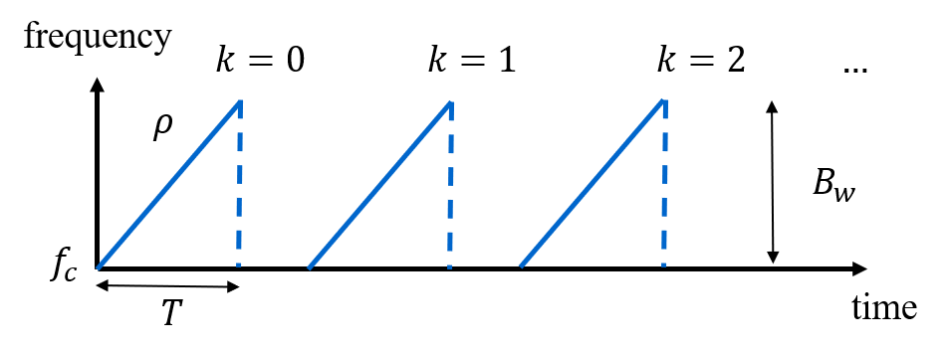
Introduction
Why radar?
It’s under-researched
There is no dominant product or company in the market yet
It has some irreplaceable advantages
Long detection range (up to 300 m)
All-weather operation
Low power consumption
Most importantly, low cost
What radar? Specifically?
FMCW radar means an antenna system that transmits and receives EM waves with certain modulation to achieve certain task
Frequency-Modulated Continuous-Wave, FMCW

Slide 4
Technology
FMCW radar fundamentals
Off-the-shelf automotive radars operate with a sequence of linear FMCW signals to simultaneously measure range, angle, and velocity
The automotive radar is allowed to use 2 frequency bands in mmwaves
24 GHz (24~24.25 GHz)
77 GHz (77~79 GHz)
There is a trend towards 77 GHz for several reasons:
Larger bandwidth
76–77 GHz for long-range
77–81 GHz for short-range
Higher Doppler resolution
Smaller antennas with sub-wavelength sized
Different radar devices vary in their sensing capabilities
Different radar device normally means different modulation patterns

Slide 5
Technology
Fun facts about frequency bands
Licensed-band in 5G Spec
FR1 410 MHz – 7.125 GHz
FR2-1 24.25 GHz – 52.6 GHz
FR2-2 52.6 GHz – 71 GHz
Up to 100 GHz belongs to 5G, but above 71 GHz are not licensed
Up to 6 GHz belongs to 4G
Aside from licensed-bands, there are also private 5G (Local 5G) bands,
the specific regulations different from country to country
e.g. 4.6 GHz – 4.9 GHz is a private 5G band in Japan
How expensive are the frequency bands in 5G in Taiwan?
A 15 year authorization cost $150 billion NTD
1 MHz bandwidth worth $200 ~ 500 million NTD

Slide 6
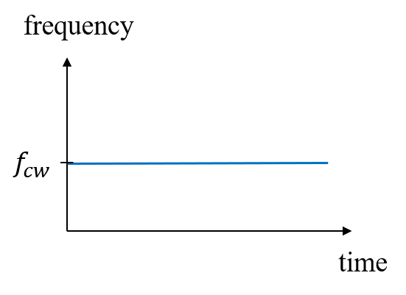
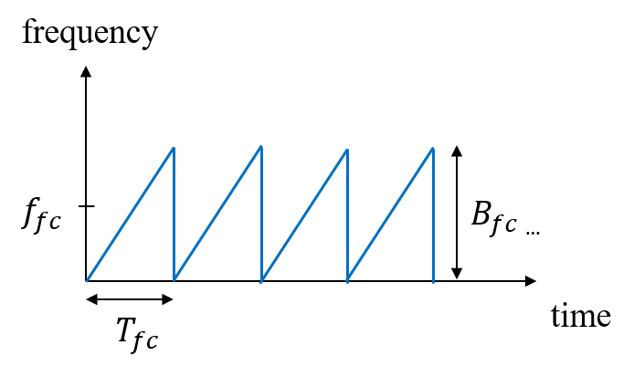
Technology
Modulation patterns
Unmodulated CW
This modulation pattern is used for some mmwave communication signals
Fast chirp FMCW (Sawtooth modulation)
This modulation pattern is used in a relatively large range (maximum distance) combined with a negligible influence of Doppler frequency (for example, a maritime navigation radar).
Account for 90% of the modulation we probably going to seen in out daily lives

Slide 7
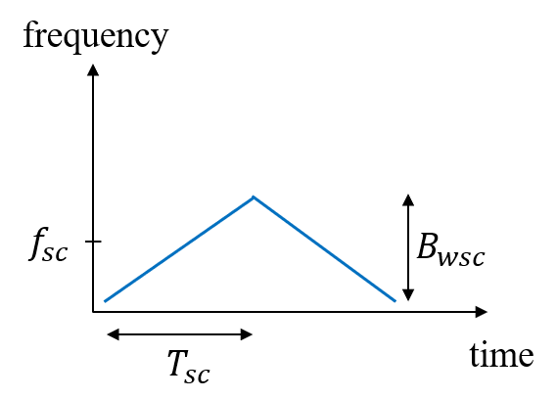
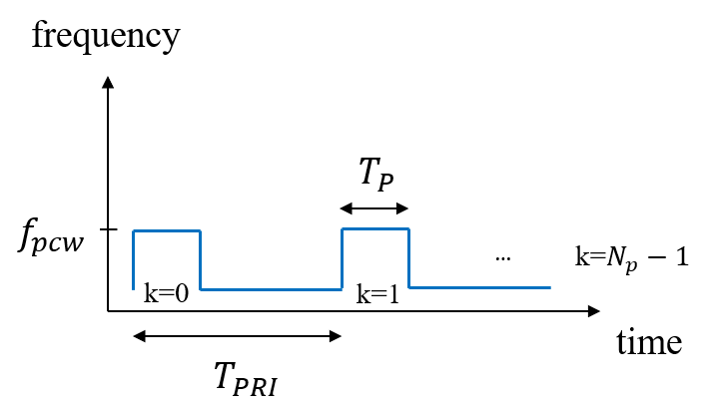
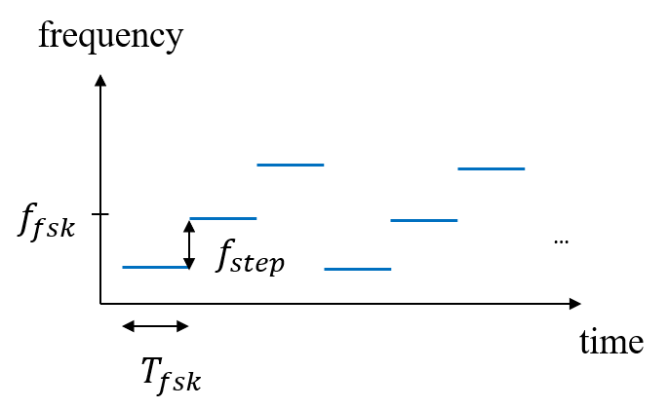
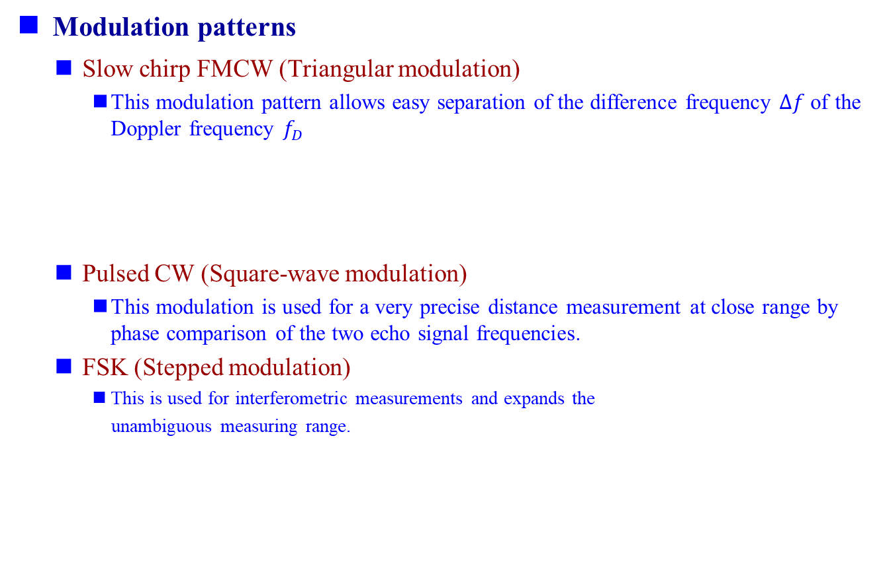
Technology
Modulation patterns
Slow chirp FMCW (Triangular modulation)
This modulation pattern allows easy separation of the difference frequency $∆f$ of the Doppler frequency $f_{D}$
Pulsed CW (Square-wave modulation)
This modulation is used for a very precise distance measurement at close range by phase comparison of the two echo signal frequencies.
FSK (Stepped modulation)
This is used for interferometric measurements and expands the
unambiguous measuring range.

Slide 8
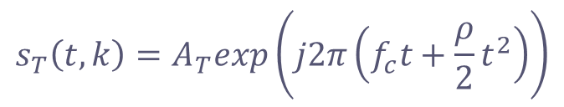
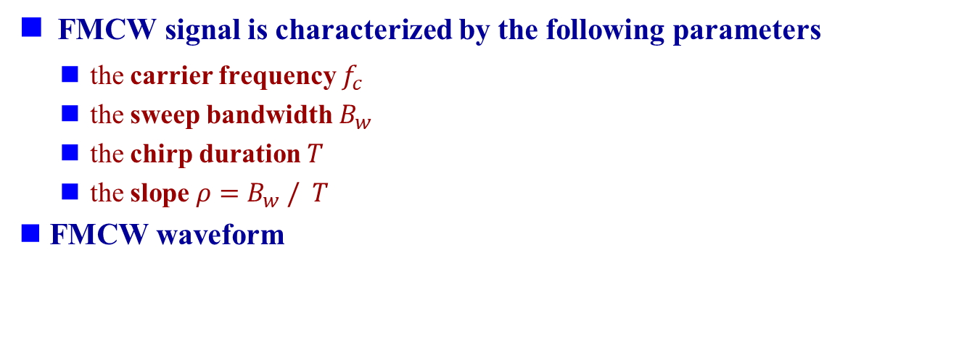

Technology
FMCW signal is characterized by the following parameters
the carrier frequency $f_{c}$
the sweep bandwidth $B_{w}$
the chirp duration $T$
the slope $ρ=B_{w} / T$
FMCW waveform
$$s_{T}\left(t,k\right)=A_{T}exp\left(j2π\left(f_{c}t+\frac{ρ}{2}t^{2}\right)\right)$$
$$k=0,1,…K−1, 0≤t<T$$

Slide 9
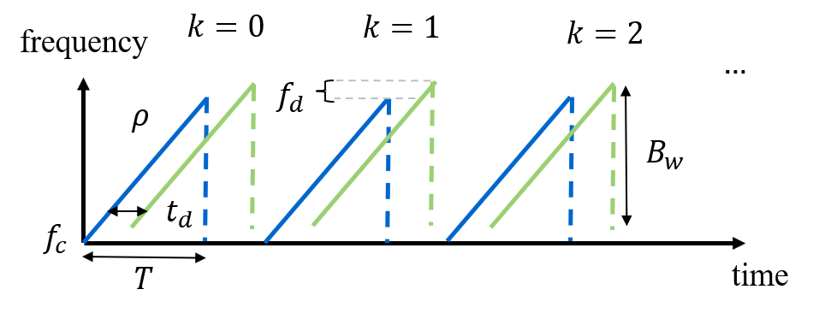
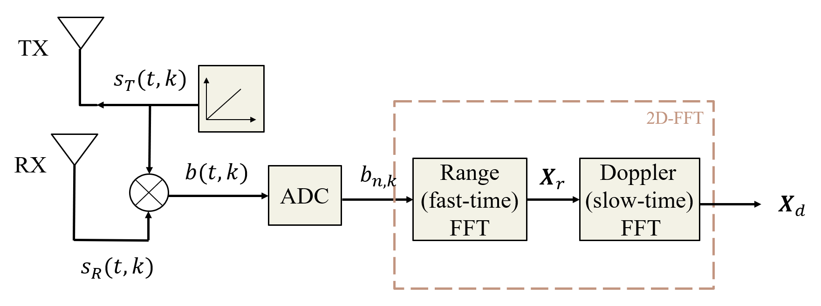
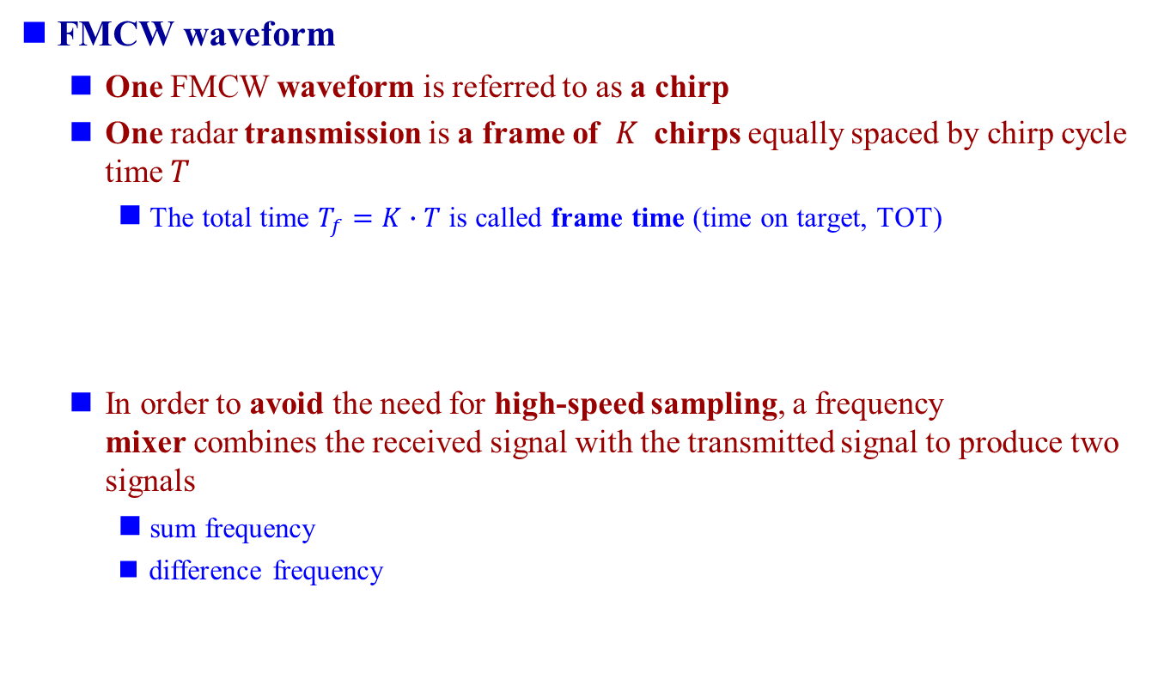
Technology
FMCW waveform
One FMCW waveform is referred to as a chirp
One radar transmission is a frame of $K$ chirps equally spaced by chirp cycle time $T$
The total time $T_{f}=K∙T$ is called frame time (time on target, TOT)
In order to avoid the need for high-speed sampling, a frequency mixer combines the received signal with the transmitted signal to produce two signals
sum frequency
difference frequency

Slide 10
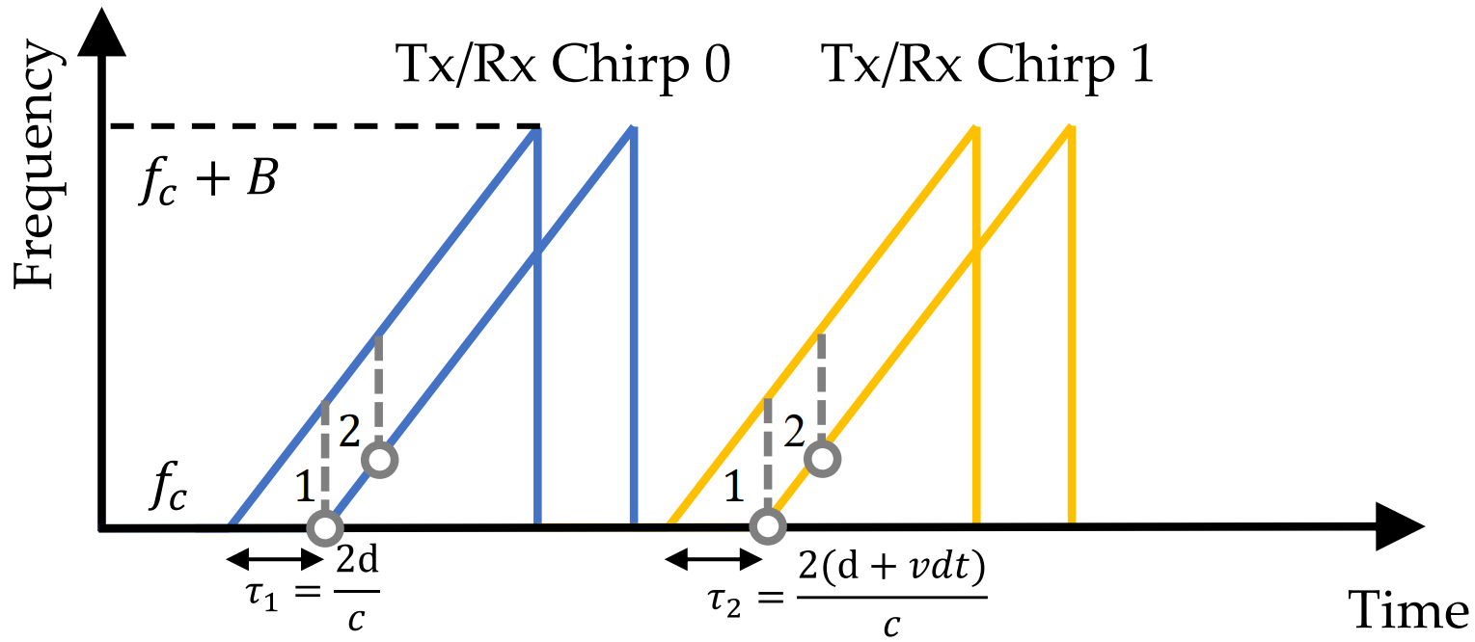
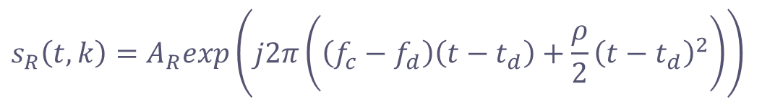

Technology
FMCW waveform
Then, a low-pass filter is used to filter out the sum frequency component and obtain the IF signal (Intermediate Frequency, IF)
In this way, FMCW radar can achieve GHz with only MHz sampling
Resulting complex exponential IF signal
Next, the IF signal is sampled N times by an ADC converter, resulting in a discrete-time complex signal
$$s_{R}\left(t,k\right)=A_{R}exp\left(j2π\left(\left(f_{c}−f_{d}\right)\left(t−t_{d}\right)+\frac{ρ}{2}{\left(t−t_{d}\right)}^{2}\right)\right)$$
$$k=0,1,…K−1, t_{d}≤t<T+t_{d}$$

Slide 11
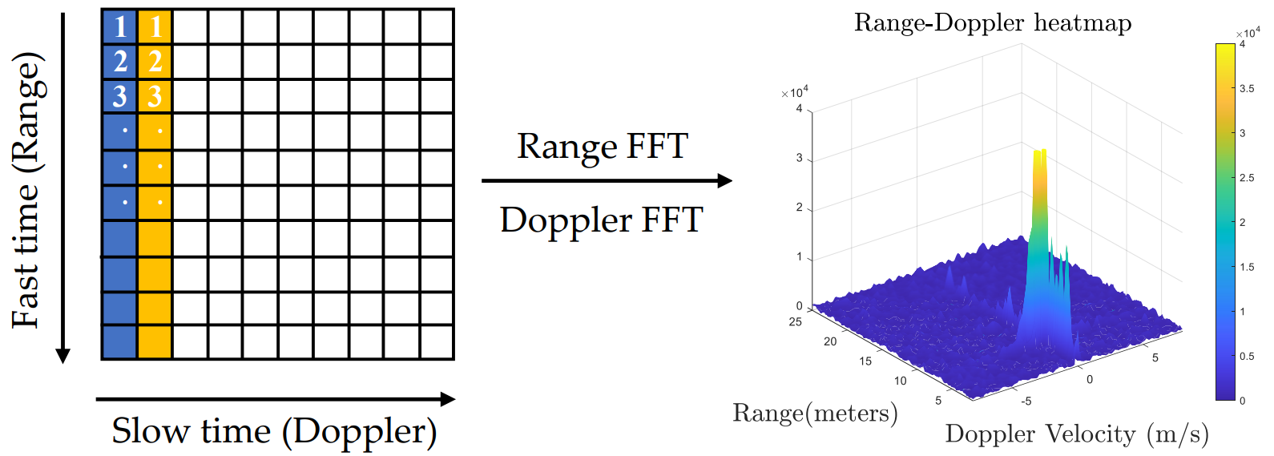
Technology
FMCW signal processing
Multiple frames of chirp signals are assembled into a 2D matrix
The dimension of the sampling points within a chirp is referred to as fast time
The dimension of the chirp index within one frame is referred to as slow time
Next, a range FFT is applied in the fast-time dimension to resolve the frequency change, followed by a Doppler FFT in the slow-time dimension to resolve the phase change.
As a result, we obtain a 2D complex-valued data matrix called the Range–Doppler map, RD map

Slide 12
Technology
FMCW radar detection pipeline
First, RD maps are integrated coherently along the virtual receiver dimension to increase the SNR
e.g. say, we have a simple MIMO radar system with 4 Tx and 4 Rx antenna, which means we can synthesize a virtual array with 4 x 4 = 16 channels
Then, a CFAR detector is applied to detect peaks or estimate the noise level in the RD map
Finally, the DOA estimation method is applied for angle estimation
for conventional radars, only azimuth angle is resolved
for next-generation radars, both azimuth and elevation angles can be resolved
The output of the radar is a point cloud with measurements of range, Doppler, and angle

Slide 13
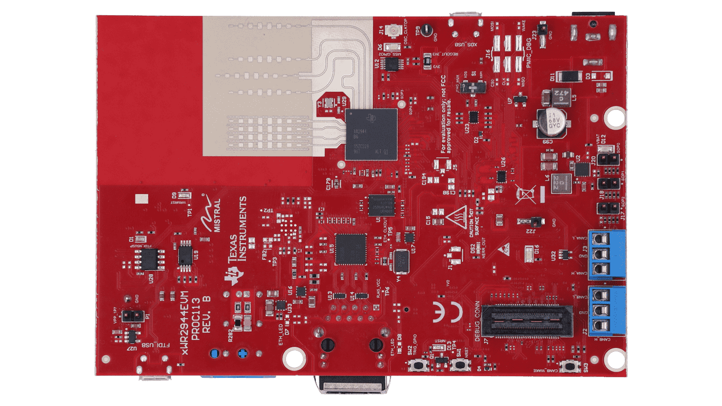
TI AWR2944EVM
Features
76 to 81 GHz mmwave radar sensor
Onboard four-transmit four-receive (4Tx / 4Rx) antenna
On-chip C66x DSP core and Arm Cortex-R5F controller
On-chip hardware accelerator for FFT
AWR2944 Evaluation Module (EVM) ($549 USD)
Notes:
CAN-FD Protocol, Controller Area Network Flexible Data-Rate
I2C Bus, Inter-Integrated Circuit Bus

Slide 14
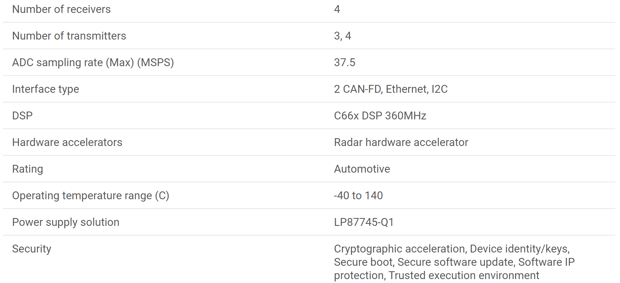
TI AWR2944 Spec
Parameters
Notes:
CAN-FD Protocol, Controller Area Network Flexible Data-Rate
I2C Bus, Inter-Integrated Circuit Bus

Slide 15
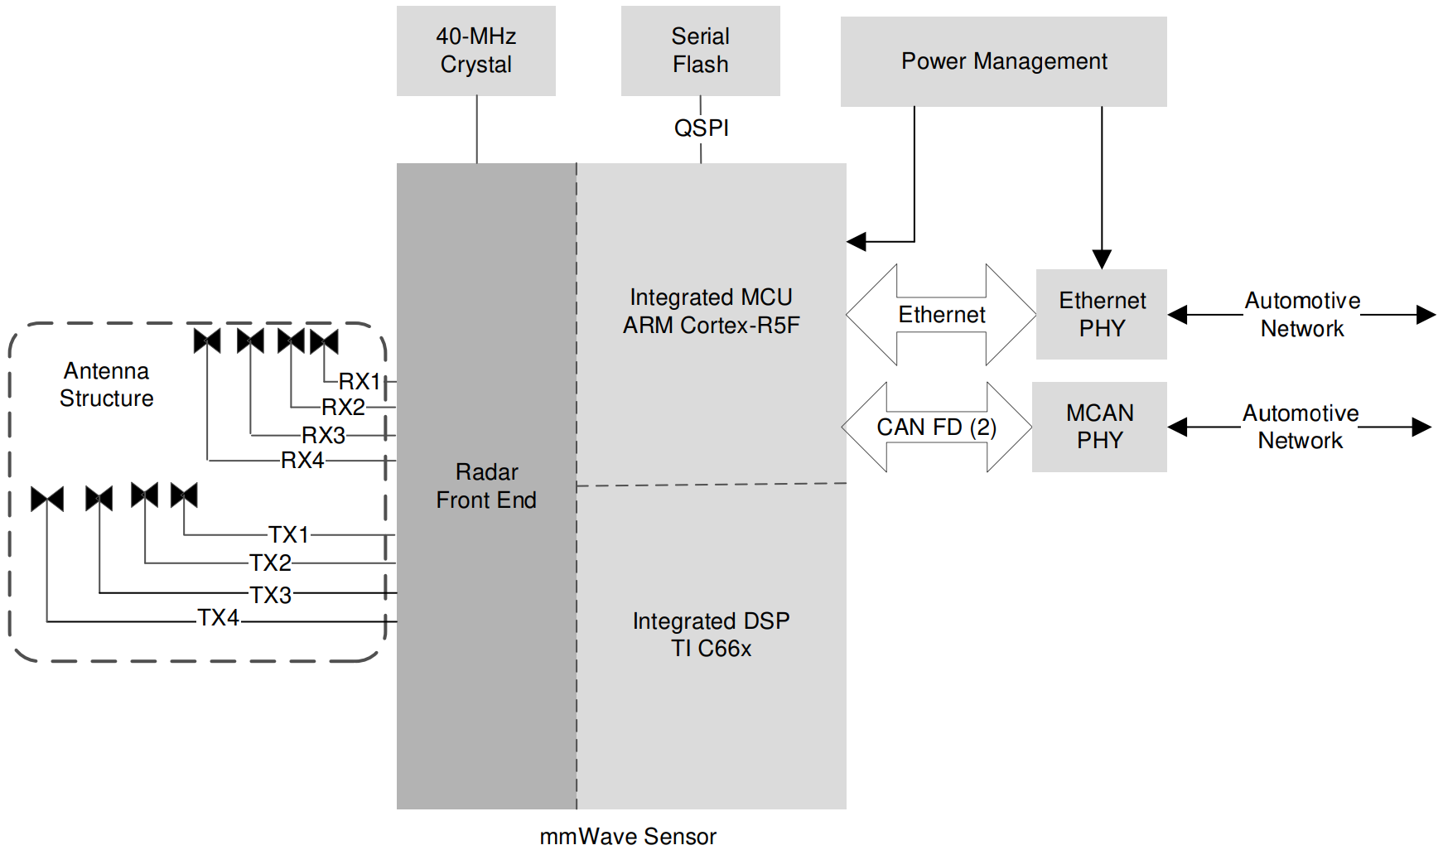
TI AWR2944 Spec
Functional Block Diagram
Notes:
CAN-FD Protocol, Controller Area Network Flexible Data-Rate
I2C Bus, Inter-Integrated Circuit Bus

Slide 16
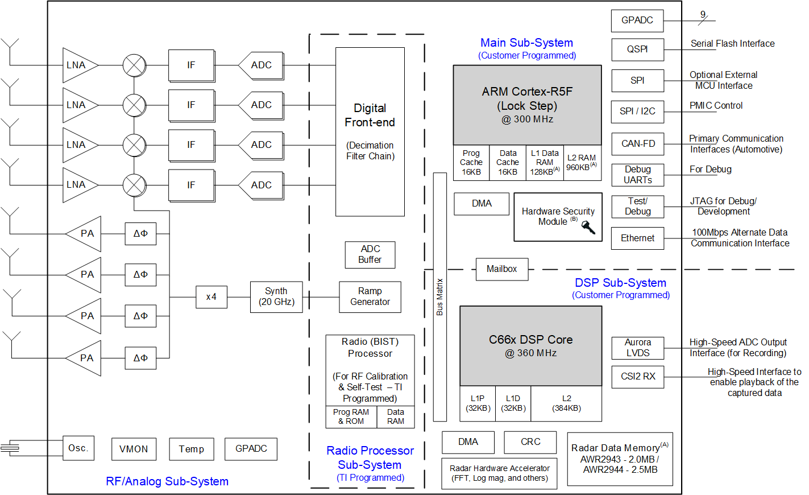
TI AWR 2944 Spec
Functional Block Diagram
Notes:
CAN-FD Protocol, Controller Area Network Flexible Data-Rate
I2C Bus, Inter-Integrated Circuit Bus

Slide 17
Applications
Active safety functions
Automatic Emergency Braking (AEB)
Forward Collision Warning (FCW)
Autonomous driving
Provide range and velocity estimation for the decision fusion algorithm
Non-contact vital sign detection
Breath rate
Heart rate
Use cases
Burn patients
Patients that have been isolated due to infectious disease

Slide 18
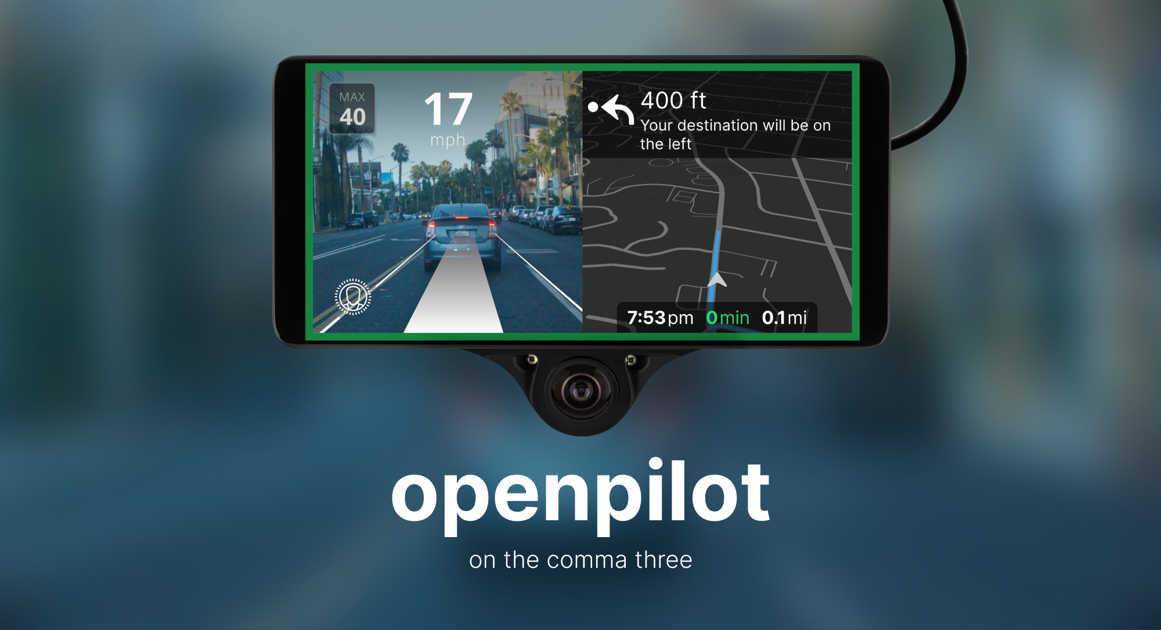
Opponents
Vision – Comma ai Driver Assistance System ($2499 USD)
Camera
Three 1080p cameras w/ 120 dB of dynamic range: dual-cam 360° vision
One narrow cam to see far-away objects
Processor
Qualcomm Snapdragon 845
Storage
32 GB built-in storage
1TB Samsung 980 NVMe SSD
Connectivity
LTE
Wi-Fi
High-Precision GPS
Night-vision
IR LEDs for interior night-vision monitoring

Slide 19
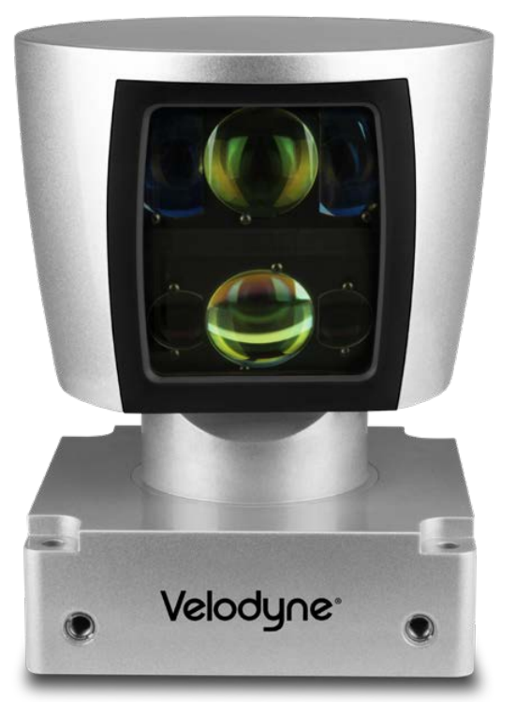
Opponents
LiDAR – Velodyne HDL-64E LiDAR Sensor ($80000 USD)
Sensor
Time of Flight Distance Measurement with Intensity
64 channels
Measurement Range: Up to 120 m
Single or Dual Returns
Field of View (Vertical): +2.0° to -24.9° (26.9°)
Angular Resolution (Vertical): 0.4°
Field of View (Horizontal): 360°
Angular Resolution (Horizontal/Azimuth): 0.08° – 0.35°
Rotation Rate: 5 Hz – 20 Hz
Laser
Laser Product Classification: Class 1 Eye-safe
Wavelength: 903 nm
Dynamic Laser Power Selection for Larger Dynamic Range

Slide 20
Conclusion
SWOT
Strengths
Long detection range
All-weather operation
Low power consumption
Low cost
Weaknesses
Low angular resolution
Hard to detect stationary object
Opportunities
Autonomous driving
Vital sign detection
Threats
Vision
LiDAR

Slide 21
References
Zhou, Yi, et al. "Towards Deep Radar Perception for Autonomous Driving: Datasets, Methods, and Challenges." Sensors 22.11 (2022): 4208. (https://www.mdpi.com/1424-8220/22/11/4208)
AWR2944EVM (https://www.ti.com/tool/AWR2944EVM)
AWR2944 Spec (https://www.ti.com/product/AWR2944)
Comma ai (https://comma.ai/shop/comma-three)
Velodyne 64-line LiDAR (https://www.neuvition.com/media/blog/lidar-price.html)

