Slide 1
Magic Glasses
Group 4
109065705 周新敏
110064506 陳品諼
110064526 邱郁閔
110062571 蘇郁淇
http://www.free-powerpoint-templates-design.com

Slide 2
Content
01
Motivation and Application
02
Technology
03
Task Partition
04
Schedule

Slide 3
Part 1
Motivation and Application

Slide 4
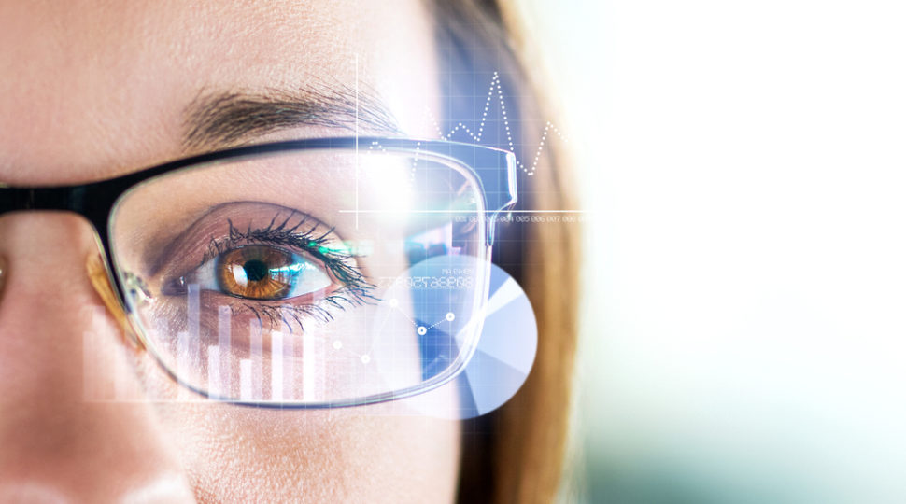
Motivation and Application
Language Translation
International exchange
frequently makes language
translation important and critical
Gesture recognition
Rely on glasses heavily
Listen
speak
text
Gesture

Slide 5
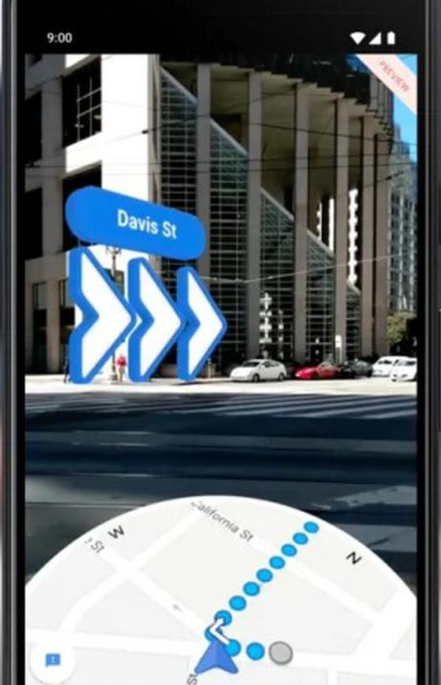
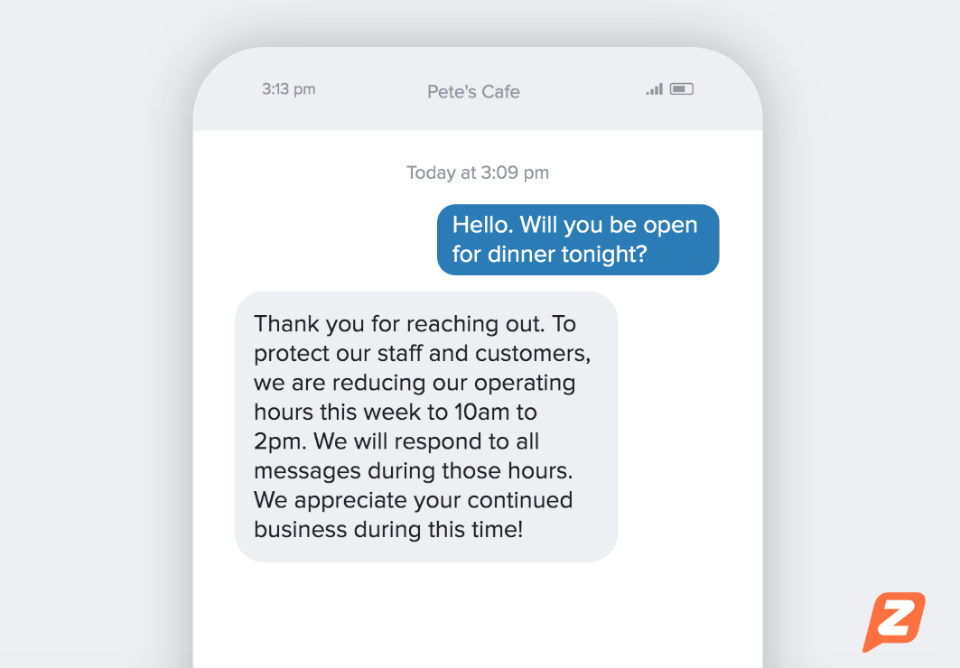
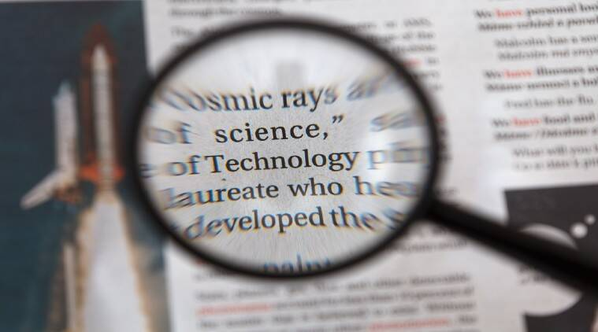
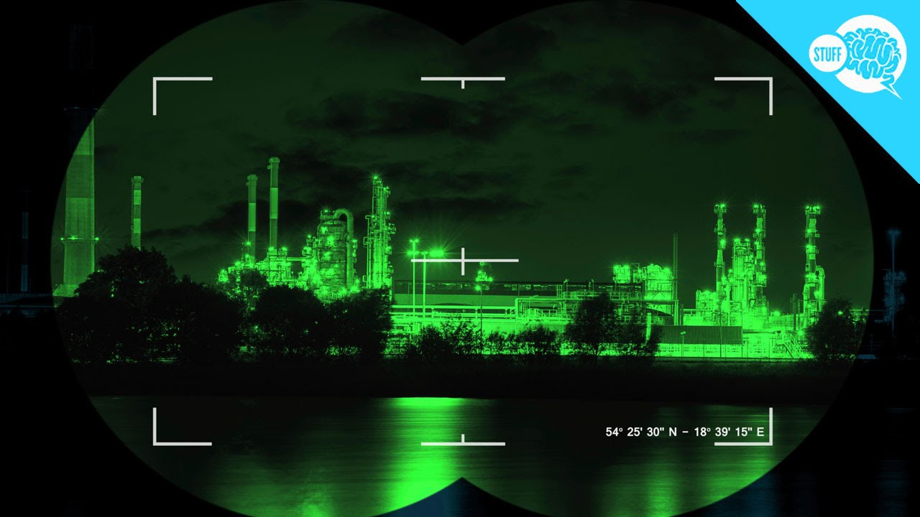

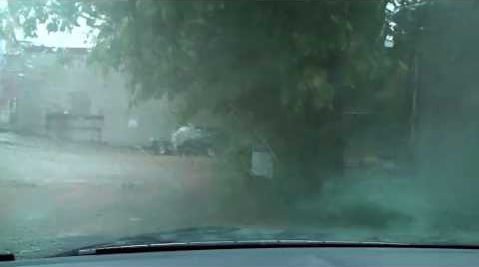
Motivation and Application
Daily Life problems
Google map
Respond message
Zoom in/ Zoom out
Night vision
Defogging
Anti UV

Slide 6
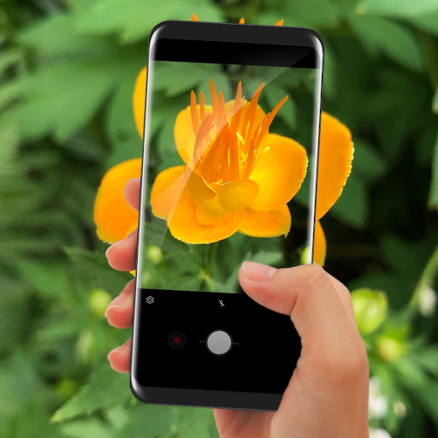
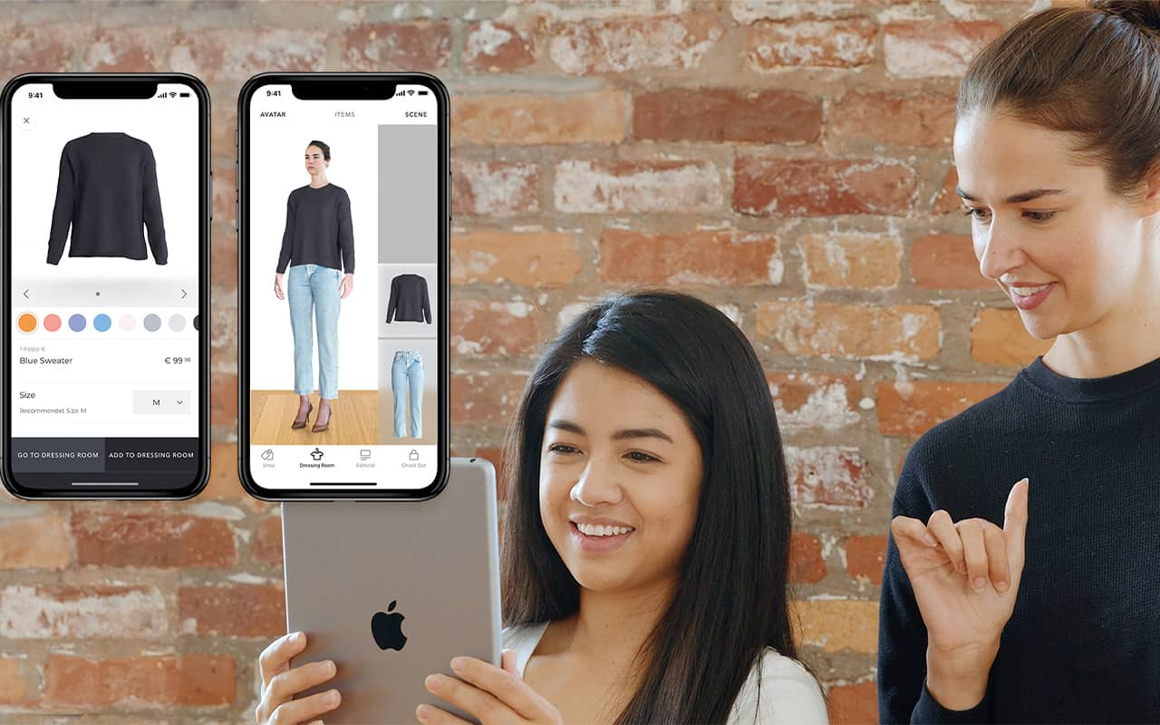
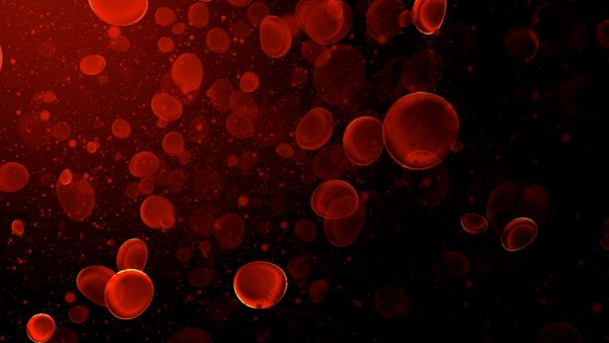
Motivation and Application
Cool function
Measure oxygen saturation
Try clothing on
Plant/ bird recognition

Slide 7
Part 2
Technology

Slide 8
Technology
Sensing Device
Temperature Sensor(LM35)
PPG Sensor
Photo Transistor (Light Sensor)
Micro Electro Mechanical Systems(MEMS) sensor
Ultrasonic Sensor
Storage Device
Cloud Storage
Display
LCoS AR Display
Network Protocol
IEEE 802.15.1(Bluetooth)
IEEE 802.11(Wi-fi)

Slide 9
Part 3
Task Partition

Slide 10
Task Partition
Technology analysis
Sensing Device: 陳品諼、邱郁閔
Storage Device, Display: 周新敏
Network Protocol: 蘇郁淇
Report
周新敏、陳品諼、邱郁閔、蘇郁淇

Slide 11
Part 4
Schedule

Slide 12
Schedule
20%
30%
50%
75%
100%
2021/11/8
2021/11/15
2021/11/29
2021/12/06
2021/12/20
Proposal
System Analysis
Technology Analysis
System architecture diagram
Presentation

Slide 13
THANK YOU

