Slide 1
Longest And Shortest Path
電子設計自動化Lab 1
中原大學 電子系
黃世旭 教授

Slide 2
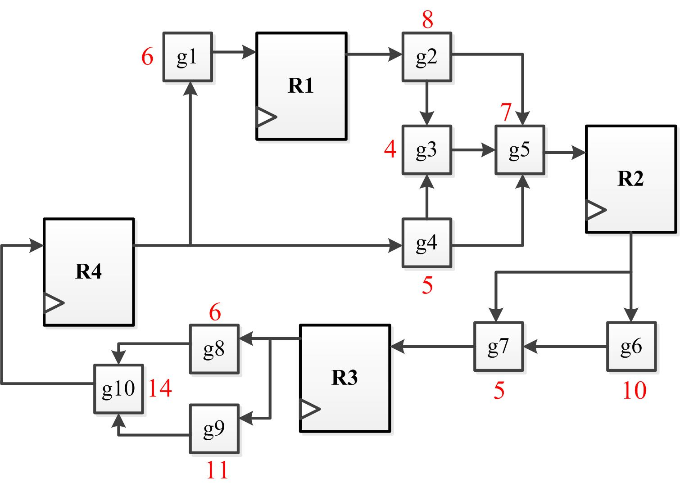
Lab1
Write a C or C++ program to find the longest path and the shortest path between every pair of registers.
Input file : a circuit file ( .txt ) .
Output file : result file ( _out.txt ). Include the longest and shortest delay.

Slide 3
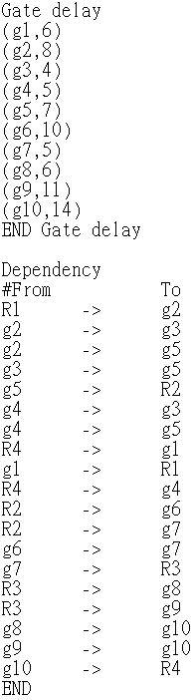
Input Format
Gate delay of each cell.
R1 g2
DATA
from to
Data Transfer Dependency
Note : “R” is register, “g” is gate

Slide 4
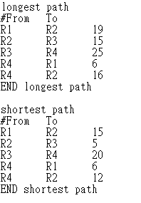
Output Format
File name: case?_out.txt
Longest path delay
shortest path delay

Slide 5
Lab1 Report
1.Report (pdf file or word file)
Problem description.
Your data structure.
How to execute your C or C++ program.
The answer to these release problems.
2.Your .cpp file.
3.Your execution file.

Slide 6
分數計算
Shortest path – 90%
Longest and shortest path – 100%
未完成程式者依完成度給分

