Slide 1
Creating Story Graphs
Paul Nichols
November 2012

Slide 2
Problem
Large and growing data set of:
News articles (RSS)
Goal:
Find best linkages between instances over time
Graph visualization of linkages in data sets to tell a story

Slide 3
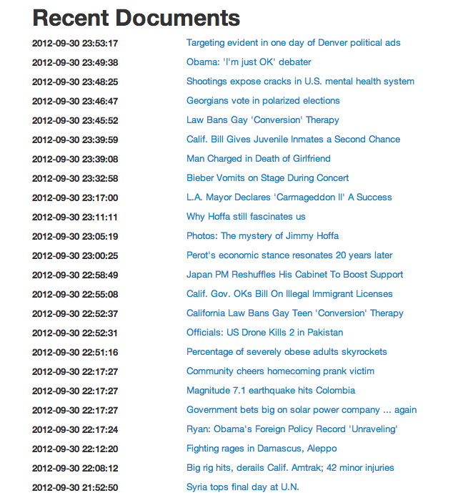
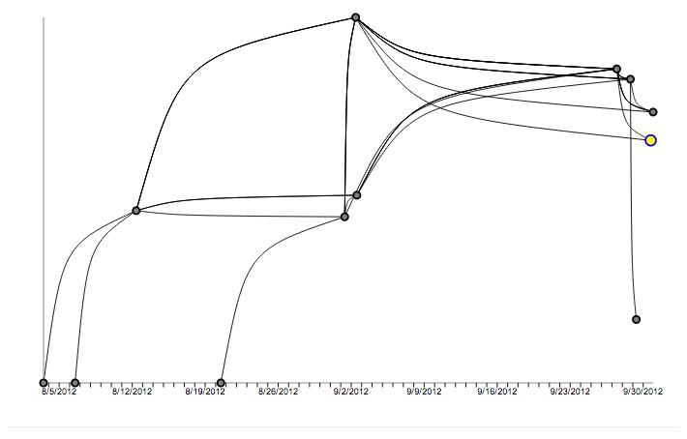
Problem

Slide 4
Problem
Given: vertices V = {(timestamp, “features”), ... }
Construct graph G = (V, E)
Core problem is creating edge set E between u, v in V
Edges are weighted by “similarity”
Graph should not be complete: |E| << |V|²
Edges implicitly directed (by time)

Slide 5
Problem
Possible Queries on G:
Identify points of confluence (merging)
Identify points of diversion (splitting)
Identify when a story begins
Identify when a story ends
Summarize the lifetime of a story

Slide 6
Smart RSS Reader
Apply techniques on articles from RSS feeds
Documents (Vertices) in Bag of Words form
Build up data set over time with daily process
60 days worth of data from 08-01-2012 to 09-31-2012
Datasets: News, Business, Sports

Slide 7
Daily Process
Download RSS
Extract Text/Features
Edge Creation
Import

Slide 8
Daily Process
Download RSS Feed
Leverage undocumented Google Reader API
Extract features
Leverage Lynx, perl
Create edges between documents within window W of 30 days
Import documents, content and edges into database
MySQL, memcache

Slide 9



Naive Edge Creation
Idea:
Cosign similarity using bag of words representation
Can improve quality by using TF-IDF term weighting
Apply similarity threshold to prune E
Notes:
cos: 1 exactly the same, -1 exactly opposite, 0 indicates independence. No negative weights so value ranges from [0,1].
Alternative euclidean distance. Different interpretation

Slide 10
Naive Edge Creation
Advantages:
Fast(er): O (W |D|² L) to pre-compute similarity
|D| = Documents / day
L = Document length
W = Window of days
Simple: Not probabilistic, dot products
Disadvantages:
Thematically limited
Edge “quality”, interpretability
Notes:
Themes could be “obama, debates, economy”

Slide 11
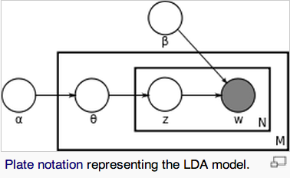
Topic Modeling (LDA)
Generative technique to estimate “topic” probability distributions in documents
Thematically richer representation of documents
Input: N documents, K topics:
Output: 2 Distributions
Document – Topic θ_{n}
Topic – Word Φ_{k}
Using Mallet library
Notes:
Generative model = randomness drawn from prior distributions. In this case, alpha, beta multinomial distribution. Mallet provides parallel topic model

Slide 12
Topic Edge Creation
Advantages:
Bag of Words ➔ Mixture of Topics
Topic encapsulates theme
Multiple edges between documents allowed
Highest probability = best edges
New Process:
Perform daily topic modeling for K topics
Save distributions
Pre-compute E between every <doc, topic> pair
Notes:
TODO: assumption about topic similarity, assume document independence,

Slide 13
Topic Edge Creation
Before: e = f(D, D’)
After: e = f(D, T, D’, T’)
Compute edge weight by document-topic weights
e = P (T | D) P (T’ | D) [ X ]
Need X to “join” <D,T> and <D’,T’> by similarity
X = f(D, T, D’, T’)
High when D ≈ D’ or T ≈ T’, or both?
X in [0,1]
Notes:
TODO: X is some function f(D,T,D’,T”) such f in [0,1] and is high when either d,d’ or t,t’ are similar

Slide 14
Topic vs. Document Sim.
1) Topic Similarity | 2) Topic Similarity by Document terms
3) Document Similarity | 4) Document Similarity by Topic terms
Notes:
Before: Doc to Doc similarity. After:

Slide 15
Topic vs. Document Sim.
Topic Similarity
High level, more abstract/implicit document quality
Loose fit
Document Similarity
Low level, concrete/explicit document quality
Tight fit
Ideal scheme blends both
Weight document terms by topic model
Notes:
Topic Similarity – documents can be similar topic wise even when terms not in topics. Document Similarity – can only be similar by what appears in document

Slide 16
1) T-Sim
Idea:
Use topic distribution to summarize documents
Cosign similarity between topic-word distribution
Edge Strength between <D, T> and <D’, T’>:
P(T|D) P(T’|D’) (T • T’) / (|T| |T’|)
Topic similarity independent of D, D’
Can pre-compute – O(W |T|² L)

Slide 17
2) T-Sim by D
Idea:
Rely on subset of topic distributions T, T’
Subset by terms in D U D’
Edge Strength between <D, T> and <D’, T’>:
P(T | D) P(T’ | D) Π_{w in D U} _{D’} P(w | T) P (w | T’)
Requires smoothing probability for words not in T, T’
Notes:
Prod P(w|T)P(w|T’) = P(T and T’). Assuming T, T’ independent. Possibly not true

Slide 18
3) D-Sim
Idea:
Use document similarity (cosign on BoW)
Edge Strength between <D, T> and <D’, T’>:
P(T | D) P(T’ | D’) D • D’ / ( |D| |D’| )
Document similarity independent of T, T’
Can pre-compute – O(W |D|² L)

Slide 19
4) D-Sim by T
Idea:
Weight document similarity by topic distributions
Edge Strength between <D, T> and <D’, T’>:
P(T | D) P(T’ | D’) DT • D’T’ / ( |DT| |D’T’| )
Optional smoothing probability for words not in T, T’
Notes:
pointwise multiplication

Slide 20
Topic Edge Variants
All variants use document-topic weights:
P(T | D) P(T’ | D’) [ X ]
All variants at least O(W |D|² |T|²)
Added cost for Topic Similarity
Added cost for Document Similarity
Trade offs made in [ X ]
Pre-computation can remove O(L) factor
Random access required
Notes:
TODO: assumption that topics are independent day-day, not necessarily true

Slide 21
Complexity
O(W |D|² L) is bad, O(W |D|² |T|² L) is terrible
D ≈ 5000, T = 100, W = 30
Topic similarity
L_{T} = Avg. Topic vocab ≈ 320 Terms
S = Dot product, O(L_{T})
Document similarity O(L_{D})
L_{D} = Avg. Doc length ≈ 500
S = Dot product, O(L_{D})

Slide 22
Complexity Reduction?
Look at the behavior of topic distributions...

Slide 23
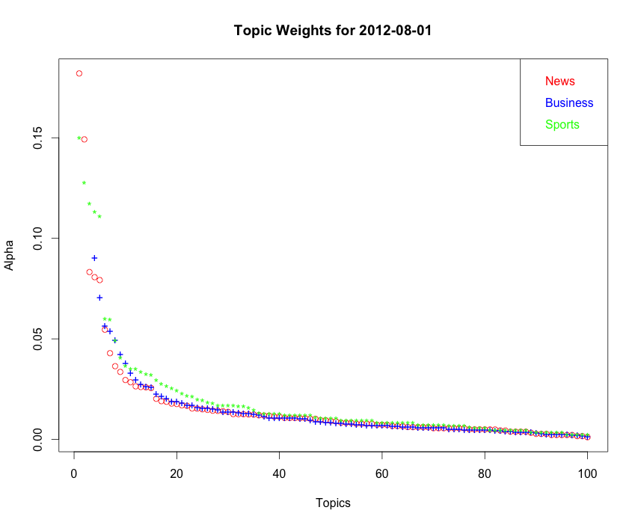
Notes:
TODO: take away is most topic weights don’t contribute much

Slide 24
Complexity Heuristics
Most topics contribute very little
Spurious topics when K too large, should be excluded
Reduce search space with thresholds
All methods can use document-topic threshold
Topic similarity threshold – limit by T, T’
Document similarity threshold – limit by D, D’
10% of N² still O(N²)
Thresholds hard without pre-computation
Weighted document similarity unique to D, T

Slide 25
Complexity Heuristics
Problem:
Edge score unique to D, T, D’, T’
Nothing to factor out, pre-compute
Idea:
Document-topic thresholds still apply
Topic similarity, Document similarity still important
Compute document similarity, reduce O(|D|²) to O(|D|)
Compute topic similarity on D, reduce O(|D||T|²) to O(|D||T|)
Compute edges(DT, D’T’), O(|D|² +|T|² + |D||T|L) = O(|D|²)

Slide 26
Creating Sub-graphs
Start from document S
Choose Neighbors
B highest weighted edges
Edges above threshold
Best edges have large weight (probability, similarity)
Expand to desired depth
Optional:
Assist sub-graph creation by query by term(s)

Slide 27
Evaluation
Problem:
Many options for edge creation – how to compare
Unsupervised method – no right answer
Principles of good sub-graphs:
Maximize documents returned
Minimize topics present
Minimize divergence/growth of sub-graph vocabulary

Slide 28
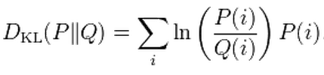
Evaluation
Divergence
KL divergence:
p = term distribution of start document
q = term distribution of neighbors
Within Cluster Sum of Squares
Treat start document as centroid

Slide 29
Evaluation
Upper Bound of Quality:
random, chronological edge creation > Method
Comparison of Quality:
Method 1 > Method 2 > ... > Method N
Use principles to quantify
Does not mean Method < Good Enough
Lower Bound of Quality:
Hard to quantity for unsupervised method

Slide 30
Evaluation
Examine random sample of 2 weeks
Question: are methods that different?
Intersection of top 10 neighbors between methods
Test of Recall
Question: are methods accurate?
KL/WCSS statistics on content of top 10 neighbors
Test of Precision

Slide 31
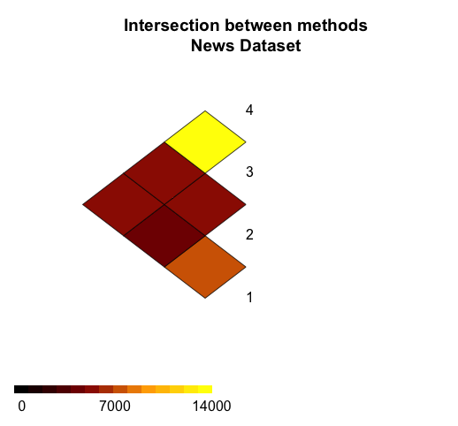
Evaluation: Intersection
Notes:
TODO: graph is over 2 weeks starting 2012-08-25. 1,2 are similar, as are 3,4. Believable.

Slide 32
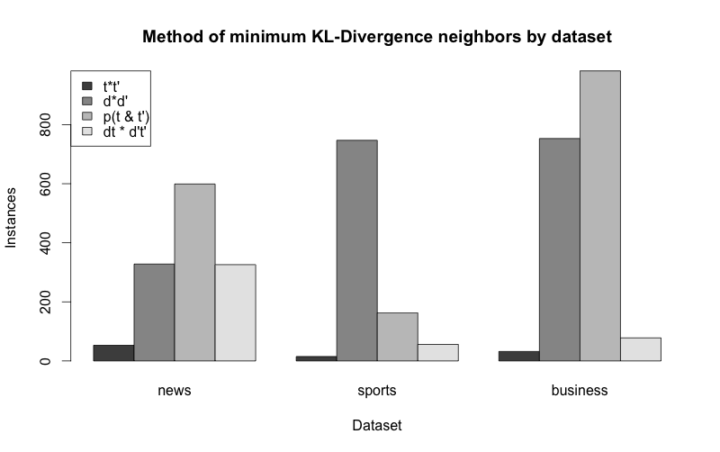
Evaluation: KL-D
Notes:
TODO: legend might not be clear items map to methods 1-4

Slide 33
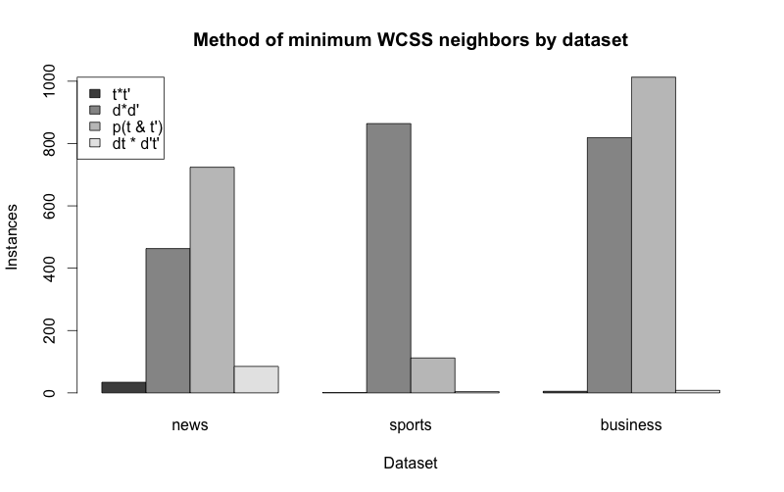
Evaluation: WCSS

Slide 34
Evaluation: Take away
Intersection of neighbors by method
Shows methods not too different
Same documents returned
KL/WCSS on neighbor content
Provides consistency check, not proof,
Criteria somewhat redundant
Shows T-Sim neighbors not very similar
D-Sim optimizes similar statistic, cheating
T-Sim by D best compromise

Slide 35
Next Steps
Further improve topic modeling quality
Boosting documents by Title
NLP
Incorporate POS, Entity extraction
Performance
Graph queries slow – consider graph DB
Storing documents slow – consider NoSQL
Implementation Language
Visualization

Slide 36
Demo

Slide 37
Questions

