Slide 1
A Teacher’s Guide
PowerPoint

Slide 2
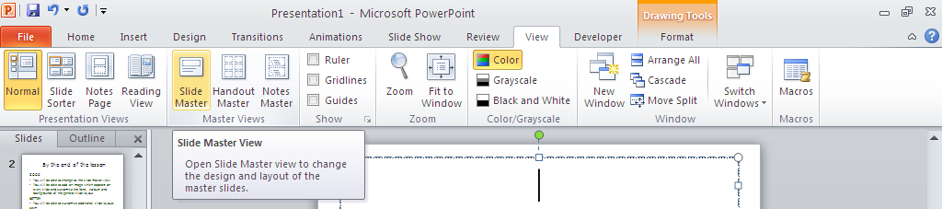
Step 1
Click on the View tab
Click on Slide Master

Slide 3
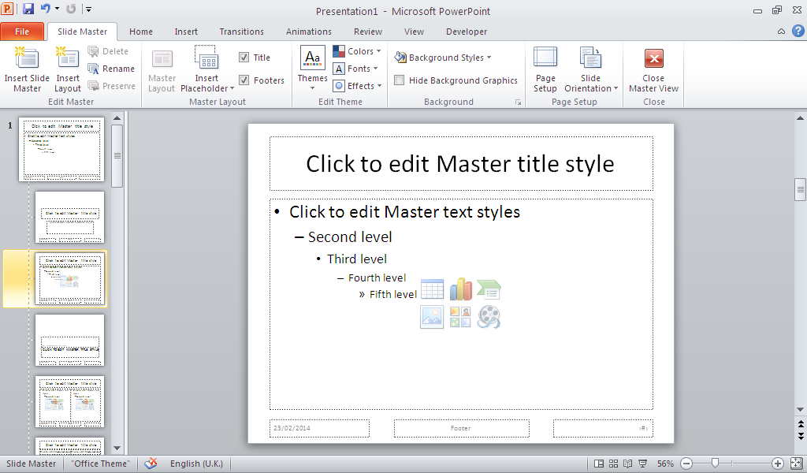
Step 2
Choose a background here
Do not change the words here or they will show on EVERY slide.
You can change the shape fill and fonts though
Select font and colour themes here
Choose the top template to modify ALL slides
You can modify other layouts ONLY here
Notes:
It is important to remember not to change the words or delete the boxes from any of these slides
You should also make most of your changes on the top slide as this will change ALL of the slides in the presentation.

Slide 4
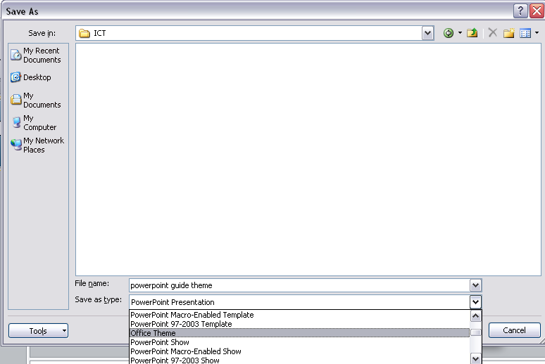
Step 3
Click Save as type
Select Office Theme

