Slide 1
Computer Programming
lesson 03
Notes:
Gray 80 69 69 69, Calibri 24
Dark Red RGB 153 0 0, Calibri 54

Slide 2
Objective and Outcome
Teaching Objective
We are going to look at how to construct a non linear program which will respond differently to user input
Learning Outcome
All of you will have experienced writing programs to solve different problems
Most of you will be able to select the appropriate data type which will allow for accurate processing
Some of you will be understand the importance of accurate syntax and how it will affect the outcome of the program
Notes:
Adapted from ComputingCurriculum (Computing at School Working Group)

Slide 3
Lesson Keywords
Words to remember
Variables
Data types
Functions
Instructions or Algorithms

Slide 4
Different Data Types
Some of the Data types available in Python
Data type | Data | Example assigned to a variable
Number | 1,2,3….. | age = 12
String | “hello”..”dog” | name = “Garry”
Floats | 3.012 | average = 7.235
Boolean | Yes or No | flag = True, flag = False

Slide 5
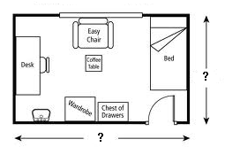
Exercise 1 (10 mins)
The size of the room
Write a program that will calculate the area of a room

Slide 6
Exercise 1 (10 mins)
The steps you need (Instructions or Algorithm)
DECLARE three VARIABLES width, length, ans
USER to INPUT length
USER to INPUT width
ans = width * length
PRINT ans

Slide 7
Exercise 2 (10 mins)
Write a program that works out the area of a triangle
The area for a triangle is:
Area = ½ * base * height
Steps you need (Instructions or Algorithm)
DECLARE three VARIABLES base, height, area
USER to INPUT height
USER to INPUT base
area = (height * base)* 1 / 2
PRINT area

Slide 8
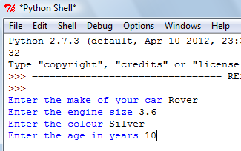
Exercise 3 (10 mins)
Write a program that allows the user to input:
their car name, colour, engine size and year
Steps (Algorithm)
INPUT make (this will be string)
INPUT colour (this will be string)
INPUT engine_size (decimal)
INPUT years_old (number)
JOIN message and PRINT to screen
You can use + str(engine_size) + to join the message

Slide 9
Plenary
In today’s lesson we have learnt
How to program with different data types
We have assigned different data types to variables
We have concatenated a string and number data type into a sentence
We have got the user to enter data (using the input() Function)
We have also used the raw_input() for a string data type
And entered a floating data type using float(input()

