Slide 1


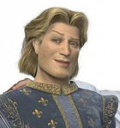
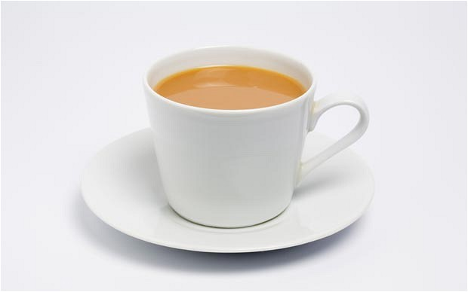

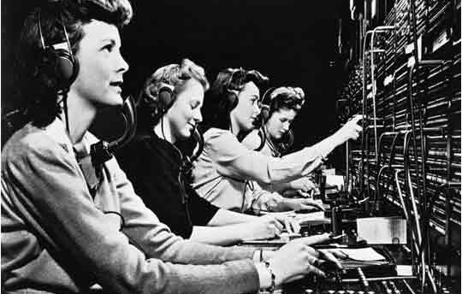
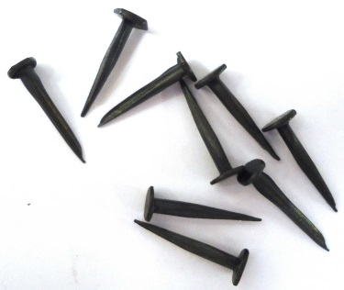
PYTHON DINGBATS
See if you can guess the PYTHON keywords from the pictures below
CE
EA
PRINT
HELLO WORLD
S
SYN
OPERATOR
SYNTAX ERROR

