Slide 1
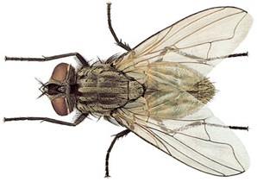
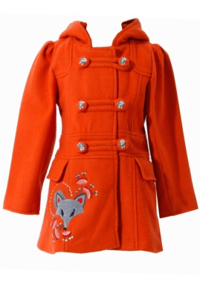






PYTHON DINGBATS
See if you can guess the PYTHON keywords from the pictures below
Y
C
IST
+A
FLOAT
DATA TYPE
K
C
MAN
BOOLEAN
INTEGER

