Slide 1
Kodu Games Programming

Slide 2
Objective and Outcome
Teaching Objective
The focus of today’s lesson is to use some of the tools to change the world that we have created
Learning Outcome
All – of you will create a World and then change its appearance
Most – of you will be able to create a Kodu that can fire at obstacles
Some – of you will be able create a cannon that fires continuously at the Kodu

Slide 3
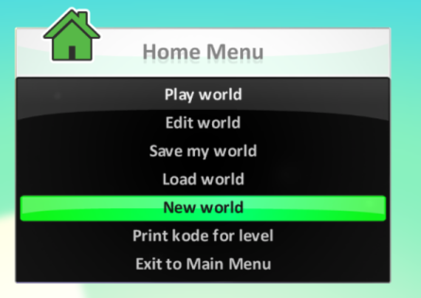
My Worlds
Select a New World

Slide 4
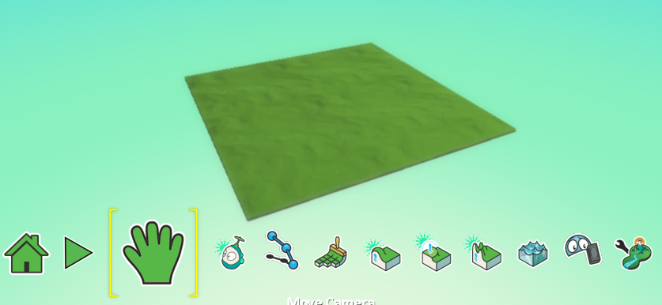
My Worlds
We can add to our world to make it more exciting

Slide 5
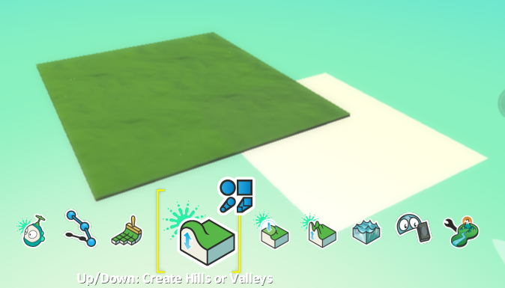
Adding Hills
When you click on the Hills option a huge white square appears in the world. This will be the size of the hill

Slide 6
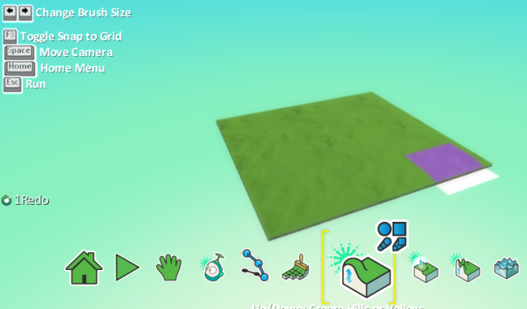
Adjust the size of the hill
Use the arrow keys to make the hill smaller or larger

Slide 7
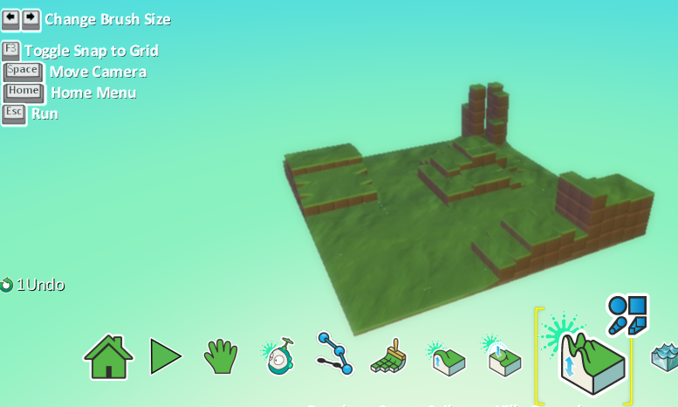
Create a landscape

Slide 8
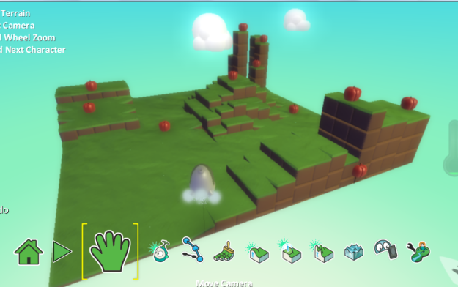
Add Objects
Use the Add Objects option to add clouds and apples

Slide 9
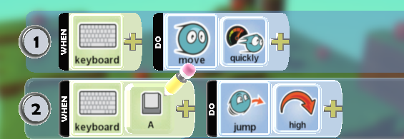
Moving your Kodu
If you put the apples up high on the hills the Kodu must be able to access them
Code the Kodu so that when the A key is pushed it bounces

Slide 10
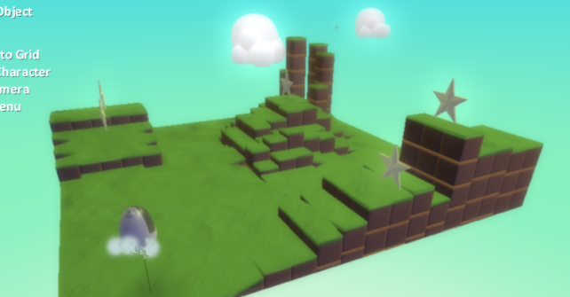
Test the movement
Test your Kodu, make sure it can reach the highest apples
If your apples keep falling off change them for stars

Slide 11
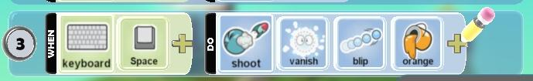
Shooting
Let’s now make the Kodu shoot the stars
Right click on the Kodu and add the following
When space bar pushed, shoot, make the object disappear, use orange blip bullets

Slide 12
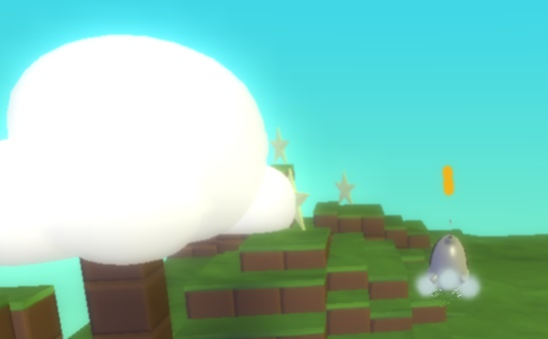
Testing
When you push the space bar bullets should appear, the stars should disappear when you shout them

Slide 13
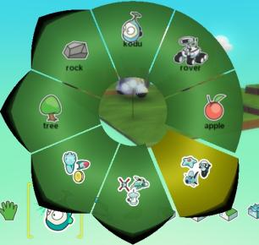
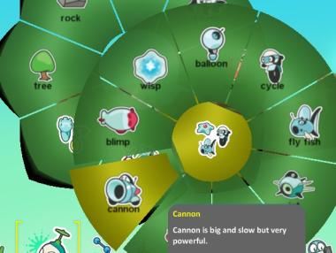
Adding a cannon
It would be good if we could add an enemy cannon which would make the game harder
Click on the Object option and ADD an OBJECT

Slide 14
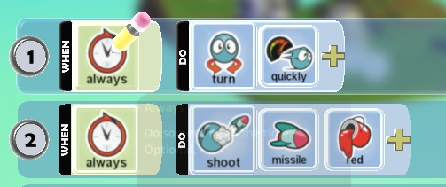
Program Cannon
Now you have a cannon in the World program it to turn continuously and fire rockets
1 Always turn quickly
2 always shoot red missiles

Slide 15
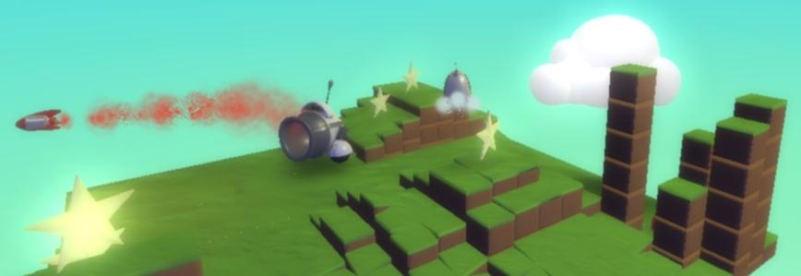
Test the program

Slide 16
Extension
Like in the first program add a score for each star that is hit
Add trees and rocks
Give the Kodu three lives before the game finishes

Slide 17
Plenary
In today’s lesson we have looked at ways in which we can change the world that we have created
We have added hills and clouds
We have created a Kodu that can fire bullets
We have created an enemy cannon which fires continuously

