Slide 1
Kodu Games Programming

Slide 2
Objective and Outcome
Teaching Objective
The focus of today’s lesson is create a two player game that uses the keyboard
Learning Outcome
All – of you will create a two player world where players can move independently
Most – of you will create players that shoot missiles at the other player
Some – of you will be able to keep score and create a winner screen which appears after a winning score is reached

Slide 3
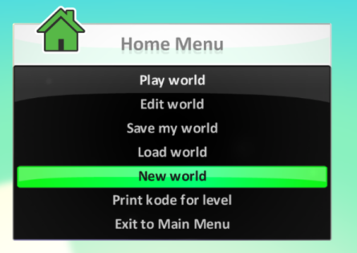
My Worlds
Select a New World

Slide 4
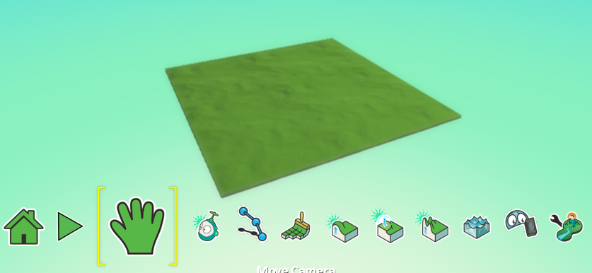
My Worlds
We can add to our world to make it more exciting

Slide 5
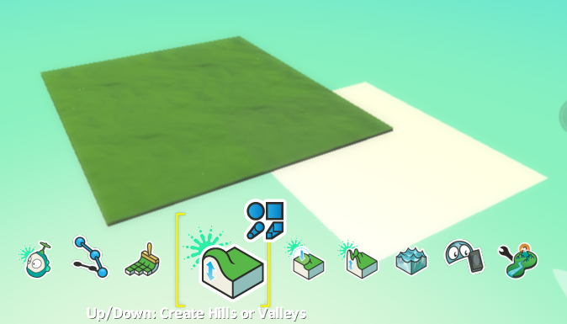
Adding Hills
When you click on the Hills option a huge white square appears in the world. This will be the size of the hill

Slide 6
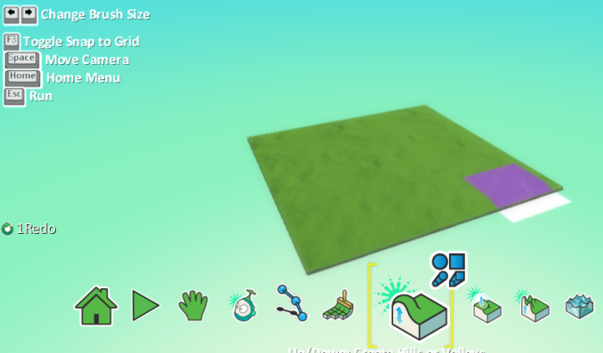
Adjust the size of the hill
Use the arrow keys to make the hill smaller or larger

Slide 7
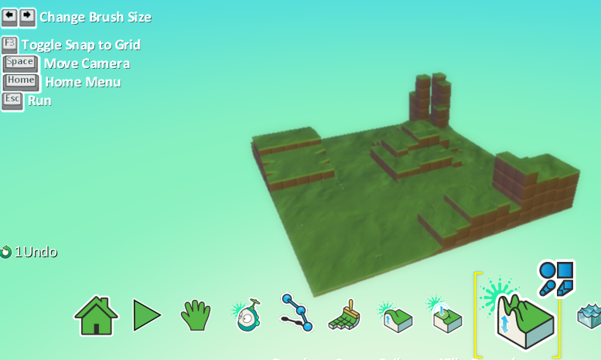
Create a landscape

Slide 8
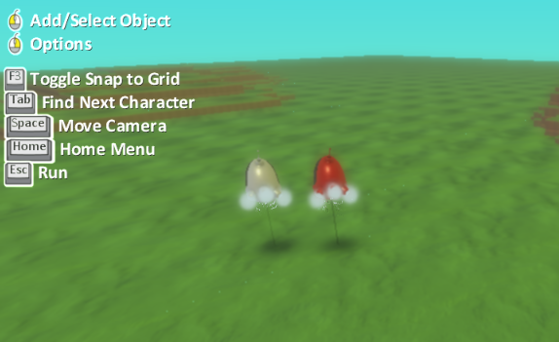
Add Characters
Add two Kodus use the colour schemes to make them different

Slide 9
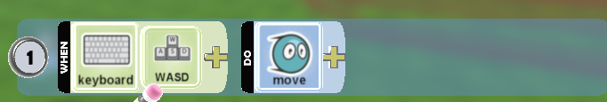
Moving Player 1
To have two players we must choose a key combination for both.
For Player 1 choose the combination below
WASD

Slide 10

Moving Player 2
Select your second player and then assign the arrow key combination to it
Player 2
Arrows

Slide 11
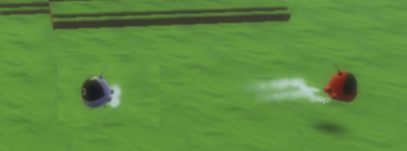
Test the movement
Now test your characters, they should move independently when you move the appropriate keys

Slide 12

Shooting Player 1
We need now to make Player 1 shoot
When Q key pressed, shoot purple missiles and stun the opponent

Slide 13

Shooting Player 2
We need now to make Player 2 shoot
When P key pressed, shoot green missiles and stun the opponent

Slide 14
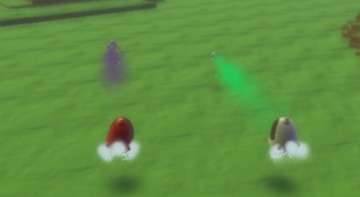
Testing shooting
Both players should be able to shoot at the same time

Slide 15
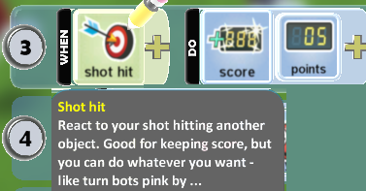
Adding scoring Player 1 and 2
Add the following condition to player 1 and player 2
When SHOT HIT Do SCORE 5 points

Slide 16
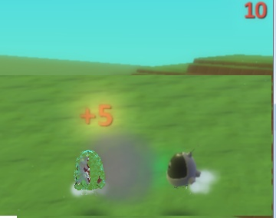
Checking Score
Check that each time you hit the other player the score increments by 5. Check for players 1 and 2

Slide 17
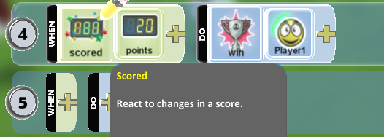
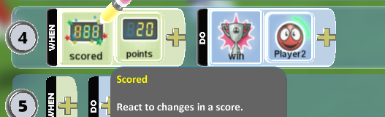
Add a winning screen Player 1 and 2
Add a condition to finish the game. Both players will need this code

Slide 18
Extension
Test the game to see if it works properly
Add other objects to the game which if you hit give you points
Deduct points when you are hit by the other player

