Slide 1
Computer Programming
lesson 1
Notes:
Gray 80 69 69 69, Calibri 24
Dark Red RGB 153 0 0, Calibri 54

Slide 2
Objective and Outcome
Teaching Objective
We are going to look at how to construct a computer program. We will look at the role of variables, operators and comments
We will use a programming language called Python
Learning Outcome
All of you will have experienced writing a simple computer program
Most of you will understand how to input into a program
Most of you will understand what a function is
Some of you will be able to develop a simple program on your own
Notes:
Adapted from ComputingCurriculum (Computing at School Working Group)

Slide 3
Lesson Keywords
Words to remember
Python
Operator
Variable
Assignment
Function

Slide 4
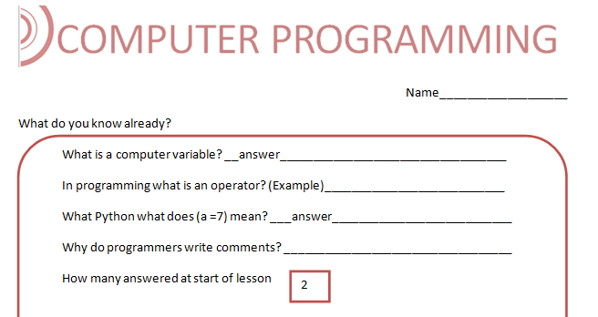
What do you know? (5 mins)

Slide 5
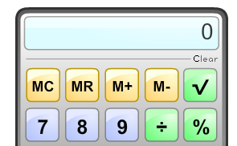
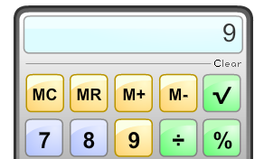
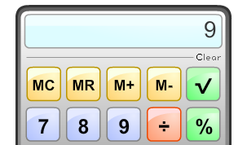
How a calculator works
We input our first number – 9
We then select the operator (the divide sign)
Notes:
Gray 80%

Slide 6
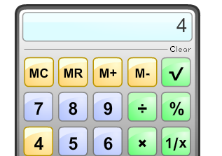
How a calculator works
When we input our second number 4, nine disappears along with the operator divide. They are placed into memory
9 /
Internal Memory
Notes:
Gray 80%

Slide 7
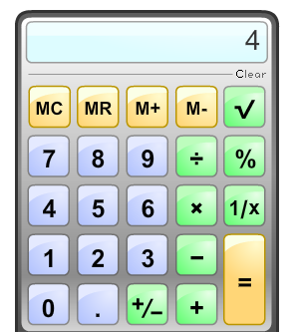
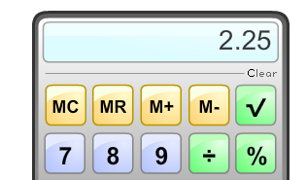
How a calculator works
The equals sign will return both the 9 and the operator in order to work out the answer and return it to screen
Internal Memory
9 /
Notes:
Gray 80%

Slide 8
How a calculator works
The calculator uses some important concepts which we will use when we create our program
It has input (the numbers 9 and 4) – these are called variables
Variables are held in temporary storage
The calculator used an operator (/) divide.
The calculator used an assignment operator ( =).
In Python programming this does not mean equals
Equals is written (==)
a ==7, this means a equals 7
a = 7, this means assign the value 7 to a, it may change later
Notes:
Gray 80%

Slide 9
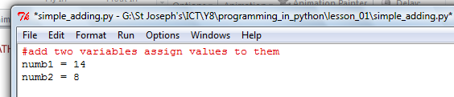


Our calculator program
Our calculator program will add up two numbers and then return the answer to the screen
Notes:
Gray 80%

Slide 10
Our calculator program
The program explained
#red writing is useful comments
numb1 and num2 variables which will be located memory
The variable ans is assigned the sum
ans = 14 + 8
ans will be printed as 22
22
Notes:
Gray 80%

Slide 11
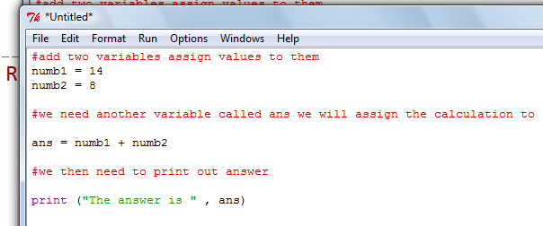
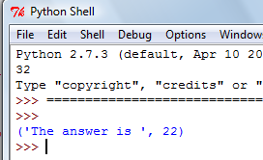
Computer Programming
Running our Python program
The star is telling us we have not saved the program
Save it as adding.py. Push F5 on the keyboard to run
Notes:
Gray 80%

Slide 12
Checkpoint
Computer Programming
What Language are we using?
Describe a variable?
What does this = mean?
sound
Python
A temporary value in memory
x = x + 1
Assign to
Notes:
Gray 80%

Slide 13
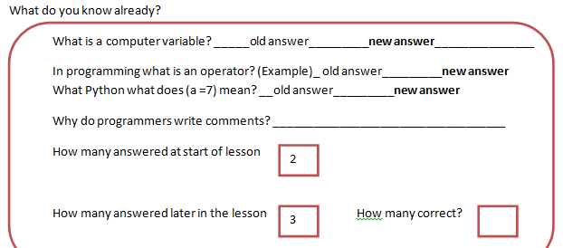
Revisit Exercise 1 (5 mins)
Can you now revisit exercise 1 and try to answer the questions again, put your new answer next to your old
Notes:
Gray 80%

Slide 14
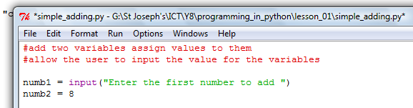
Exercise 2 - A static program
Our program is static in that it only adds up two numbers
Let’s change it so we can add up any numbers like a calculator
Green letters are known as a string
input is a built in Function stored in the code Library
Notes:
48

Slide 15
Recording your python programs
Create a new folder in your current ict folder called “python”
Create a Word document your_name_python.docx
E.g. Fred_smith_python.docx
From now on for each working (or non working – as far as you got)
Require a sub heading – the exercise number is adequate
Require 2 screen shots (use crop to leave only the following)
One of the actual python program source
One of the program after it completes running
Just keep adding to the end of the document for each program you get working/or not
Notes:
48

Slide 16
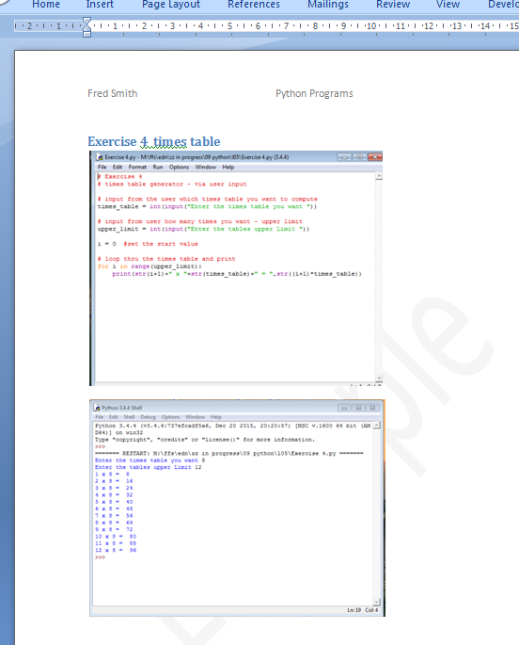
Example of Recording your python programs
Notes:
48

Slide 17
Exercise 3 - BIDMAS
Brackets of Indices, division, multiplication, addition, subtraction
The order we do are calculations in is important
Worked example:
Calculate: 3 x (7 - 3)
Solution
In this question, we have a bracket, a subtraction and a multiplication.
BIDMAS tells us that brackets come first, so we calculate:
3 x (7 - 3) = 3 x 4
= 12

Slide 18
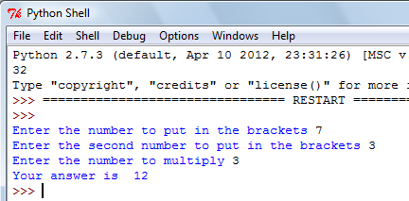
Exercise 3 - BIDMAS
Can you change the program so it can work out this sum?

Slide 19

Checkpoint
Computer programming
Name a function we had used?
What are letters known as in programming?
x = input(Enter name)
Where is the error here?
Print() or input()
A string
No speech marks
Notes:
48

Slide 20
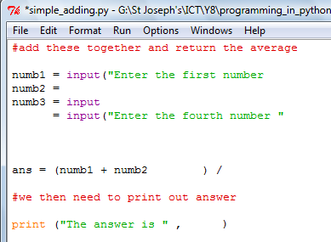
Extension
Can you work out the missing syntax?
This program should add up four numbers and then return the average

Slide 21
Plenary
In today’s lesson we have learnt
How to program a simple calculator
What a variable is (temporary memory allocation)
What a function is (print() and input()
We have written a string (a string is letters)
We have got the user to enter data (using the input() Function)

