Slide 1
Computer Programming
lesson 02
Notes:
Gray 80 69 69 69, Calibri 24
Dark Red RGB 153 0 0, Calibri 54

Slide 2
Objective and Outcome
Teaching Objective
We are going to look at how to construct a computer program using different data types
Learning Outcome
All of you will have experienced writing a simple computer program using different data types
Most of you will be able to concatenate strings and variables
Some of you will be able to be make choices about what data types to use and how best to join them
Notes:
Adapted from ComputingCurriculum (Computing at School Working Group)

Slide 3
Lesson Keywords
Words to remember
Variables
Data types
String
Number
Floating Number
Concatenate

Slide 4

Assigning variables
How to assign a variable
Declaring a variable at the start of the program ensures that there is memory space available
The operand to the left of the = operator is the name of the variable, and the operand to the right of the = operator is the value stored in the variable. For example:
Variable value to store in the variable

Slide 5
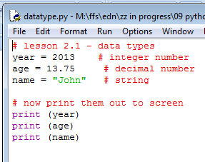
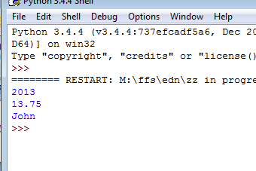
Data types
Python has lots of different data types that we can use
String for text name = “John”
Number for whole numbers counter = 100
Floating number for decimals miles = 1000.0
Notes:
Gray 80%

Slide 6
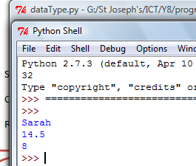
Exercise 1 (5 minutes)
Using this example, write a program that displays:
Your name
Your age as a decimal so 12.25 would be 12 and a ¼
What year you are in
Notes:
Gray 80%

Slide 7
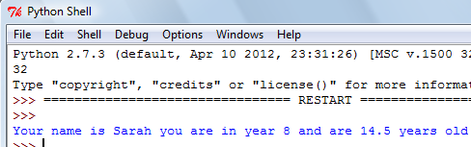
Concatenate a string
The program we just wrote used three different variables, it printed them all out on separate lines
We could join them together in one sentences
Notes:
Gray 80%

Slide 8
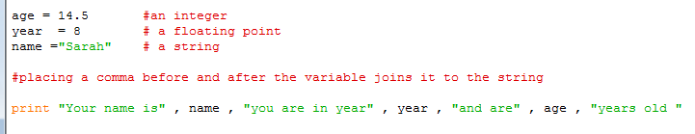
Concatenate a string
Strings can be joined to other variables using a (, ) comma
Now try exercise two
OR use a FUNCTION to convert the variable to a string
Notes:
Gray 80%

Slide 9
Checkpoint
Computer Programming
Name three different data types?
What is a function?
What character do we use to concatenate a string?
sound
String, number, floating
Premade code which we can use
A comma
Notes:
Gray 80%

Slide 10
Exercise 3 – Adding input
The input() Function (and int() , float() )
The input() Function will allow us to enter a string data type
Example month = input(“Enter the month “)
Whole numbers need a combination of input() and int()
Example score = int(input(“Enter the score”))
Floating numbers need a combination of input() and float()
Example = percentage = float(input(“Enter decimal “))

Slide 11
Exercise 3 – Adding input
Using the Functions below, ask the user to enter their name, age and year group
Example month = input(“Enter the month “)
Whole numbers can be entered using just input() and int()
Example score = int(input(“Enter the score”))
Floating numbers need a combination
Example percentage = float(input(“Enter decimal “))

Slide 12
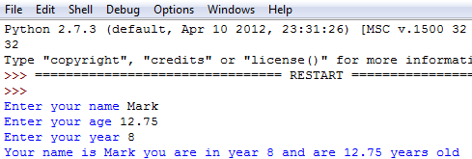
Exercise 3 – The program
Can you change the program so it works like this?

Slide 13
Plenary
In today’s lesson we have learnt
How to program with different data types
We have assigned different data types to variables
We have concatenated a string and number data type into a sentence
We have got the user to enter data (using the input() Function)
We have also used the raw_input() for a string data type
And entered a floating data type using float(input()

