Slide 1
PYTHON LOOPING
Programming Loops with Python
Lesson 5
Notes:
Gray 80 69 69 69, Calibri 24
Dark Red RGB 153 0 0, Calibri 54

Slide 2
Objective and Outcome
Teaching Objective
We will look at the structure and purpose of a For..Loop
Learning Outcome
All of you will be able to recognise the syntax for a For..Loop and then construct one
Most of you will understand how to set both the upper and lower boundaries of a For..Loop. You will be able to concatenate a string with loop variables
Some of you will be able to implement a loop in a times table program

Slide 3
The For...Loop
The For Loop is very useful when you want to complete a repetitive task
Sending out 1000 emails would be easier with a For..Loop
The syntax
FOR i in range (upper limit)
PRINT (Message)

Slide 4
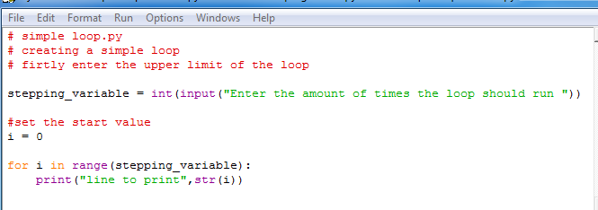
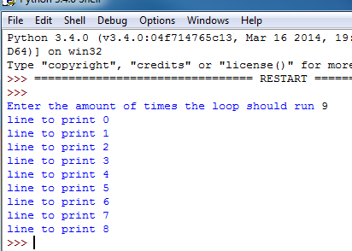
Write a for loop...

Slide 5
The syntax...
The user inputs the upper value of the loop
i = 0, this is the start
for……in range are the keywords for the loop

Slide 6
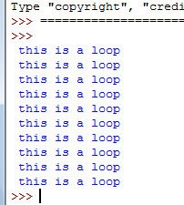
Exercise 1 – 10 mins
A simple loop
Write a loop that repeats 10 times
Algorithm
upper_range = 10
for i in range (upper_range)
PRINT (“This is a loop”)

Slide 7
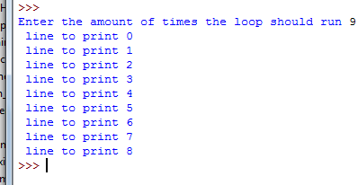
Exercise 2 – 10 mins
A simple loop where the user inputs the upper limit
Algorithm
INPUT uppervalue
For i in range (uppervalue)
PRINT (“message”, i)

Slide 8
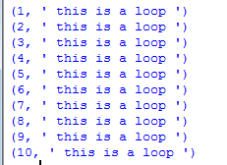
Exercise 3 – 10 mins
A simple loop that starts at 0
Loops start at zero, to start it at 1 you
Need to add 1 to i
Algorithm
upper_range = 10
for i in range (upper_range)
PRINT (i + 1, “This is a loop”)

Slide 9
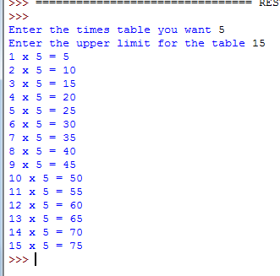
Exercise 4 – 10 mins
A simple loop that works out the times table
Algorithm
INPUT timestable
INPUT upperlimit
FOR i in Range (upperlimit)
PRINT (( i + 1) x timestable = (i +1)*timestable)

Slide 10
Plenary
In today’s lesson we have written a simple loop structure
We have set both the upper and lower bounds of a loop
We have made the loop repeat a printing command
We have used a loop to create a times table program

