Slide 1


Spot the bug!

Slide 2
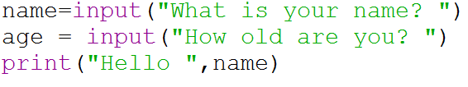

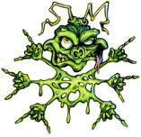
Variable name spelt incorrectly

Slide 3
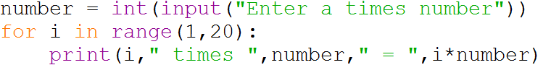
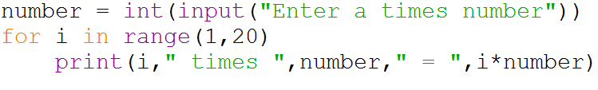
Missing colon
Syntax Error
Notes:
Question: What does the : do?

Slide 4
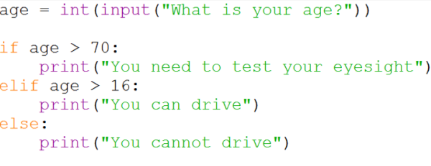
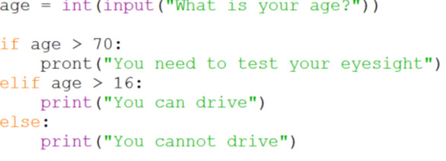
Keyword spelt
Incorrectly
Syntax Error
Notes:
Question: What other keywords are there in Python?

Slide 5
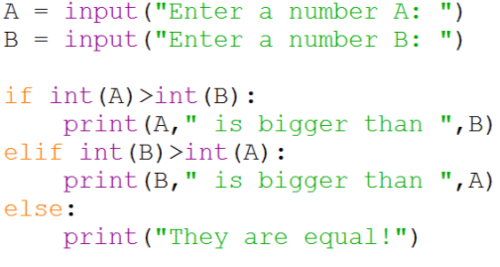
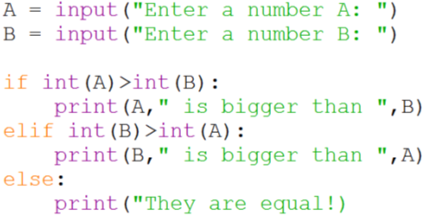
Missing “”
String termination
Syntax Error
Notes:
Question: Is python bothered about what you put inside speech-marks?

Slide 6
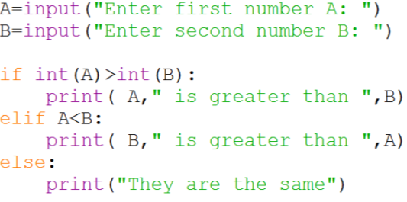
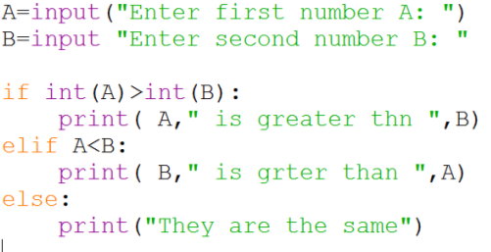
Missing brackets
Syntax Error

Slide 7
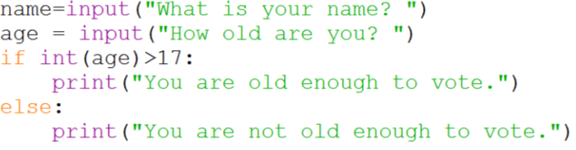
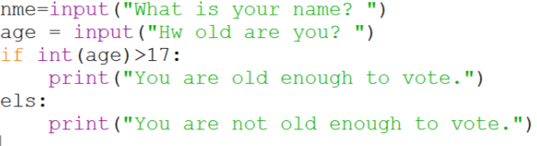
Keyword spelt
Incorrectly
Syntax Error

Slide 8
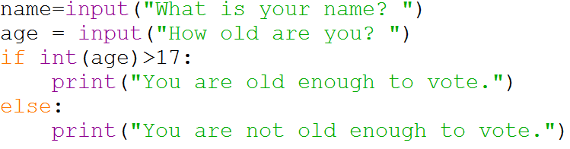
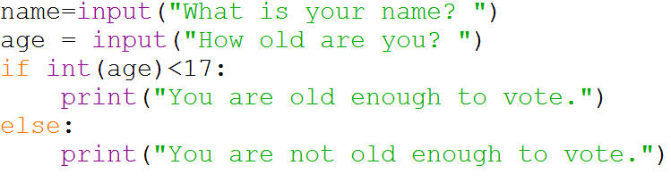
Logic Error
Why?

Slide 9

Syntax Error: Something that stops the Python
interpreter from understanding
the code (it cannot run)
Logic Error: Something that stops the program
doing what it is meant to do, or
causes a run time error (such as
“division by zero”)

