Slide 1
ECDL: PowerPoint
Lesson 4: Tables

Slide 2

By the end of the lesson
- Create a Table in a PowerPoint Slide
- Select the different parts of this table
- Add , modify and delete rows and columns of this table
- Enter data into this table

Slide 3

Starter
Watch the YouTube video from the web page for this lesson
Read the Web based lesson at http://www.gcflearnfree.org/office2013/powerpoint2013/23

Slide 4
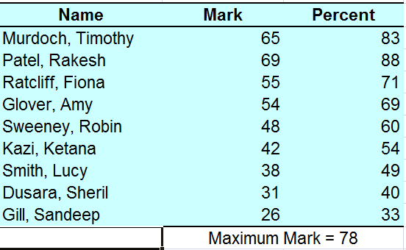

Part 1
Create a new presentation
On a blank slide insert a new table
Enter the Data Below

Slide 5
Part 2
Delete one Row of data
Insert a new row of data (make up your own names and data)
Modify the column width and height so that the contents fits “snugly”
Change the first row font size and make BOLD so that it stands out as a suitable Heading
Merge the two cells (and Centre) the text for “maximum marks=78”
Change the appearance of the table from the Design>table appearance ribbon

Slide 6

Plenary
Open your PowerPoint Guide for Teachers
Add new slides for :
How to insert a Table of data
How to add and remove rows and columns
How to change the cell width/height and merge two cells together
How to change the appearance of the table from the “table Style” ribbon

