Slide 1
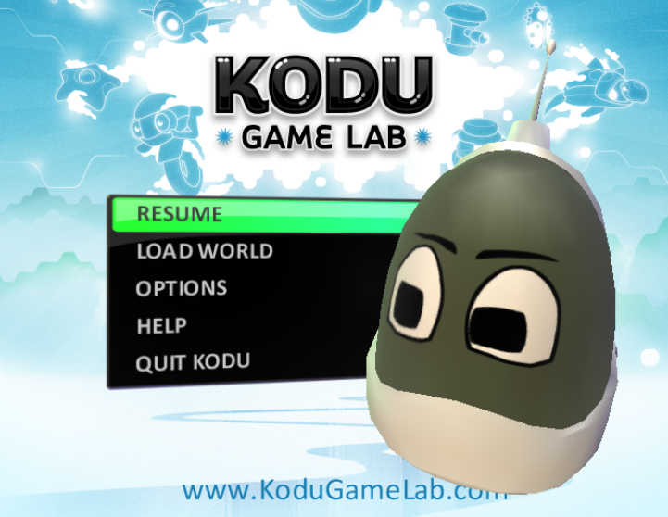
Kodu Game
[Enter Game Name]

Slide 2
Aim and Audience
What is the aim of the game?
Who is the target audience?

Slide 3
Test strategies
How will you test the game?

Slide 4
Evidence of World created
Show the world you created and point out the changes in terrain

Slide 5
Objects Added
Show objects and what they do

Slide 6
Objects Interacting
Show interaction, shooting, bumping into, eating etc

Slide 7
Pathways
Have you got an object on a pathway

Slide 8
Creatables
Show your creatable working

Slide 9
Two players
What keys move them?

Slide 10
Feedback
Feedback given
Improvements made

