Slide 1
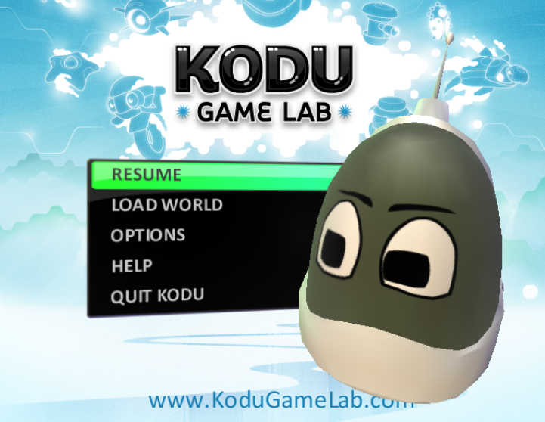
Kodu Game
[Enter Game Name]

Slide 2
Level 3
Students will plan a game. Students will comment on the success of the game
Students will create a world with objects in it. Students will alter the terrain of the world. The game will have a moving object, controlled by the keyboard.

Slide 3
Level 4
Students will plan a game for a specific target audience. Students will show evidence of how they have refined their game to meet their client’s needs (evidence of feedback). They will evaluate the success of their solution
Students will create a world with objects in it. Students will alter the terrain of the world to suit the purpose of the game. The game will have a moving object that responds to other objects and demonstrates output

Slide 4
Level 5
Plan and develop a structured game which uses a combination of features to enhance the user’s experience. Use criteria to evaluate the quality of solutions, identifying improvements and refining their work.
Students will create a more complex world with objects from an empty world. They would alter the terrain to include water, hills, walls and landscapes. The game would accommodate two players and would demonstrate interaction such as shooting and scoring

Slide 5
Level 6 - 7
Plan and develop a structured game which uses a combination of features to enhance the user’s experience. Use criteria to evaluate the quality of solutions, identifying improvements and refining their work. The game will show logic and will include other levels of difficulty
They would create a more complex tailor – made world suitable for the defined target audience. The game will involve more than one player with interaction such as scoring and losing points. The game might include more complex techniques such as pathways and creatables, camera movement and object behaviours

Slide 6
Aim and Audience
What is the aim of the game?
Who is the target audience?

Slide 7
Test strategies
How will you test the game?

Slide 8
Evidence of World created
Show the world you created and point out the changes in terrain

Slide 9
Objects Added
Show objects and what they do

Slide 10
Objects Interacting
Show interaction, shooting, bumping into, eating etc

Slide 11
Pathways
Have you got an object on a pathway

Slide 12
Creatables
Show your creatable working

Slide 13
Two players
What keys move them?

Slide 14
Feedback
Feedback given
Improvements made

