Slide 1
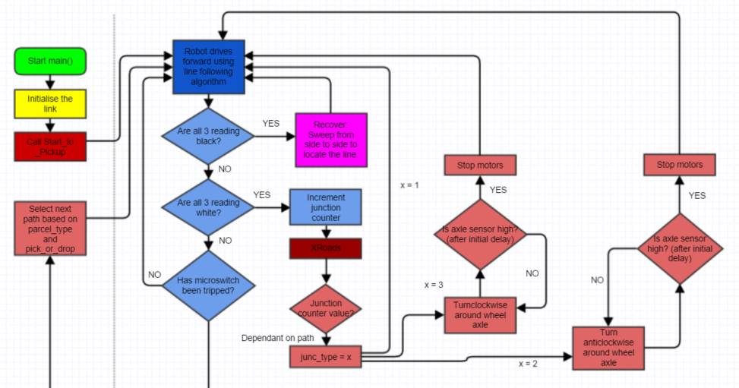

Slide 2
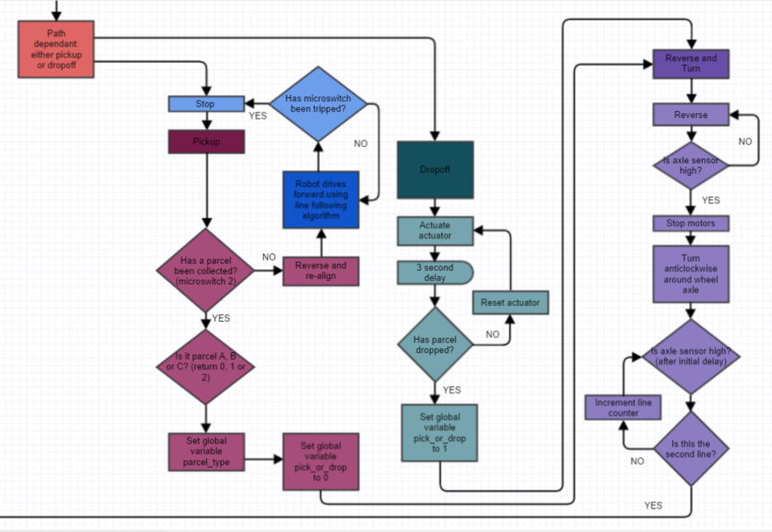

Slide 3
Problems encountered during implementation
Time proportional aspect of the line following algorithm created jerky oscillations, so was taken out.
Sensors moved closer together to increase line following precision for pick up and delivery, proportional gain reduced to accommodate this.
Very small delay added to Xroads program to let rear axle line up with junction.
Robot speed was too slow, so motors were changed for a higher gearing.
Xroads ‘straight on’ introduced a deviation from the line.

Slide 4
Alterations to Design
Reverse and Turn modified to be applicable to all paths, using a switch statement as in Xroads.
Line following changed from a ‘void’ function to an ‘int’ to differentiate between the microswitch tripping or hitting a junction.
Line following also changed to have speed as an input, so it could be used by different functions requiring different speeds.
Reduced the ‘straight on’ delay to a minimum to reduce the error from moving without line following.

