Slide 1
On Orderings in Security Models
GuttmanFest 2022
Paul Rowe
August 12, 2022

Slide 2
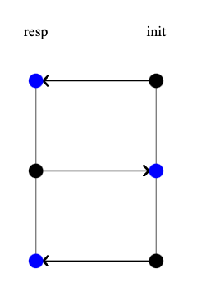
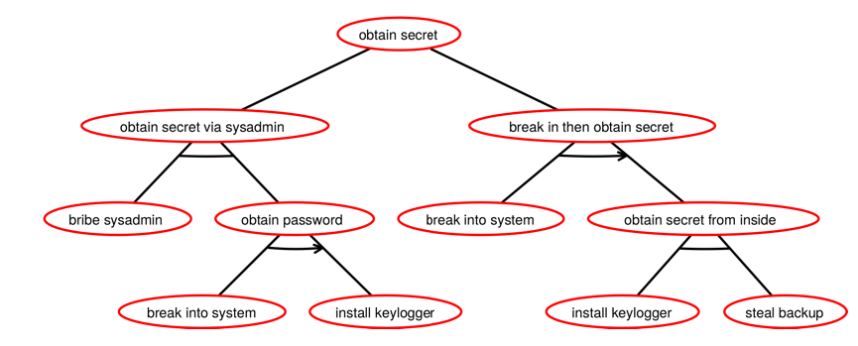
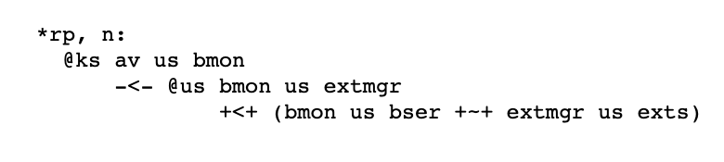
Orderings for Three Distinct Topics
Sequential
Attack Trees
Copland
Phrases
Cryptographic
Protocols
We present a uniform framework for defining orders
across these (and potentially other) domains
Notes:
Strength measures are non-total orders
Homomorphisms among objects serve to define orders
We show how to adapt a technique for ordering sequential attack trees to a general-purpose reusable approach that treats semantics as a black box

Slide 3
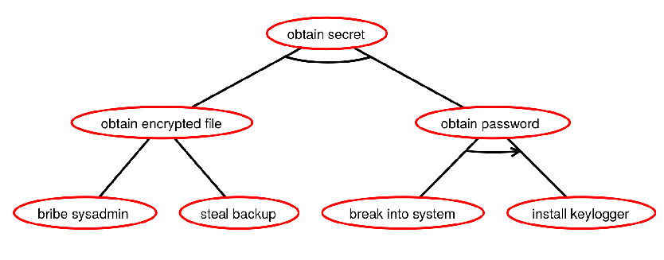
Sequential Attack Trees: Two Notations
Taken from Horne et al. [1]
(bribe sysadmin $∇$ steal backup) $∆$ (break into system $⊳$ install keylogger)

Slide 4
Attack Trees: Semantics (Informally)
Partial orders of events: “Break into system then install key logger. Also, either
bribe the sysadmin for an encrypted file or steal a backup copy”
Break into
system
Install keylogger
Break into
system
Install keylogger
Bribe
sysadmin
Steal
backup

Slide 5


Composition Operators on Posets
Sequential Composition
Disjoint Union
G
G$⊎$ H
G $∗$ H
H

Slide 6




Composition Operators on Sets of Posets
$$𝒮=\{ G_{1}, G_{2},G_{3}\}$$
$$𝒯=\{ H_{1}, H_{2}\}$$
Distributive Product
$$𝒮⋈𝒯=\{G_{1}⊎H_{1}, G_{2}⊎H_{1}, G_{3}⊎H_{1},$$
$G_{1}⊎H_{2}, G_{2}⊎H_{2}, G_{3}⊎H_{2}\}$
Pointwise Sequential Composition
$$𝒮⇝𝒯=\{G_{1}∗H_{1}, G_{2}∗H_{1}, G_{3}∗H_{1},$$
$G_{1}∗H_{2}, G_{2}∗H_{2}, G_{3}∗H_{2}\}$

Slide 7




















Base Semantics for Attack Trees
Adapted from Jhawar et al. [2]
$${⟦\left(A_{1}∇ A_{2}\right) ∆ \left(A_{3}⊳A_{4}\right)⟧}_{ℬ}$$
{
$$a_{1}$$
$$a_{2}$$
}
{
$$a_{3}$$
$$a_{4}$$
,
$$⋈$$
}
$${⟦A_{1} ∇ A_{2}⟧}_{ℬ}⋈ {⟦A_{3}⊳A_{4}⟧}_{ℬ}$$
$$({⟦A_{1}⟧}_{ℬ}∪{⟦A_{2}⟧}_{ℬ})⋈({⟦A_{3}⟧}_{ℬ}⇝{⟦A_{4}⟧}_{ℬ})$$
{
$$a_{1}$$
$$a_{3}$$
$$a_{4}$$
$$a_{2}$$
$$a_{3}$$
$$a_{4}$$
,
}
$$a_{1}$$
$$a_{2}$$
{
}
{
}
$$a_{3}$$
$$a_{4}$$
$$∪$$
$$⋈$$
{
}
{
}
$$⇝$$

Slide 8



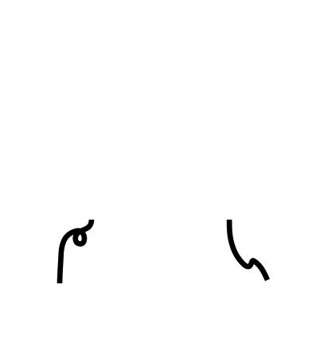



Layered Attestation
$$n_{0}$$
$${⟦n_{0}, ev⟧}_{sk(a)}$$
Bank: $ev$ is evidence of no “man in the browser”
Office: $ev$ is evidence of conformance to corporate configuration

Slide 9

Copland Syntax
Atomic actions
KIM P $\overline{a}$ Measure the kernel of P
USM $\overline{a}$ Measure this user space
… Other measurements
SIG Sign evidence with my key
Remote request
@_{P} T Perform T at P
Combining actions
$t_{1}→t_{2}$ Sequential composition with data passing
$t_{1}≺t_{2}$ Sequential composition without data passing
$t_{1}∼t_{2}$ Parallel composition
Language is parametric w.r.t. atomic actions

Slide 10









Copland Event Semantics
REQ(0, 2, $ξ$)
$$π$$
@₂( ( KIM 1 $∼$ @₁( USM $→$ SIG ) ) $→$ SIG )
SPLIT(2, $ξ$, $ξ$, $ξ$)
KIM(2, 1, $ξ$, $K_{2}^{1}(ξ)$)
REQ(2, 1, $ξ$)
Event semantics also defined using
poset composition operators. Very similar
to Attack Tree semantics!
Semantics tracks both control flow (event
ordering) and data flow.
USM(1, $ξ$, $U_{1}(ξ)$)
2
1
SIG(1, $U_{1}(ξ)$, ${⟦U_{1}(ξ)⟧}_{1}$)
RPY(2, 1, ${⟦U_{1}(ξ)⟧}_{1}$)
JOIN(2, $K_{2}^{1}(ξ)$, ${⟦U_{1}(ξ)⟧}_{1}$, $K_{2}^{1}\left(ξ\right)∥{⟦U_{1}(ξ)⟧}_{1}$)
SIG(2, $K_{2}^{1}\left(ξ\right)∥{⟦U_{1}(ξ)⟧}_{1}$,${⟦K_{2}^{1}\left(ξ\right)∥{⟦U_{1}(ξ)⟧}_{1}⟧}_{2}$)
RPY(0, 2, ${⟦K_{2}^{1}\left(ξ\right)∥{⟦U_{1}(ξ)⟧}_{1}⟧}_{2}$)

Slide 11



Specialization Idea
Down-set Semantics
Up-set Semantics
Specialization Orders

Slide 12

Specialization Idea
We want to order attack trees by some measure of difficulty or cost
Idea: $t_{1}$ specializes $t_{2}$ iff $t_{1}$ requires more actions under more constraints than $t_{2}$
Key observations:
Actions and constraints are encoded in graph structure
Homomorphisms preserve actions and constraints
Introduce upward or downward closure under homomorphisms

Slide 13
Specialization Semantics for Attack Trees
Down-set Semantics
Up-set Semantics
Specialization Orders

Slide 14

Removing Dependence on Details of Semantics
Can we avoid “interspersing” up/down closures with semantics? Yes!
Theorem:
and
This allows us to treat the semantics as a black box,
suggesting similar constructions based on different semantics.
Computing the order may still be difficult.
It requires deciding set inclusion between possibly infinite sets.

Slide 15





Covers and Supports: Down-set and Up-set Orders
$T$ covers $S$
iff
every element of $S$, has a homomorphism into some element of $T$.
$S$ supports $T$
iff
for every element of $T$, there is a homomorphism from some element of $S$.
Down-set semantics
Up-set semantics
Theorem:

Slide 16
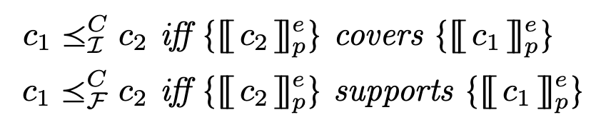
From Theorem to Definition
Theorem for attack trees
Definition for Copland phrases

Slide 17
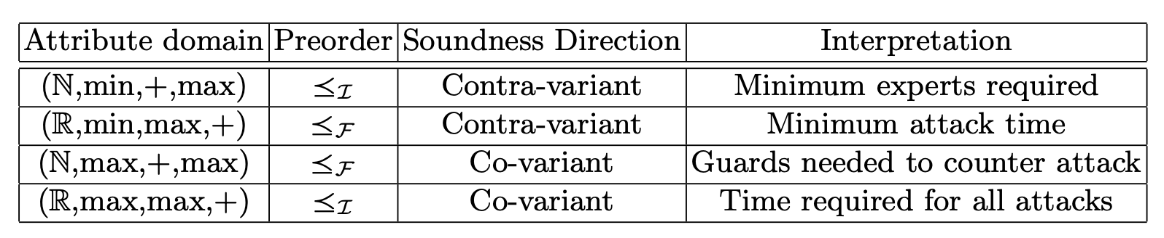
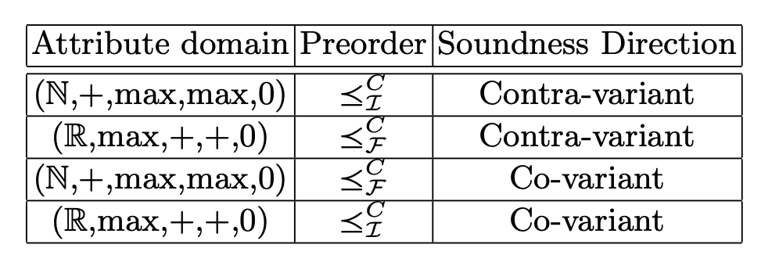
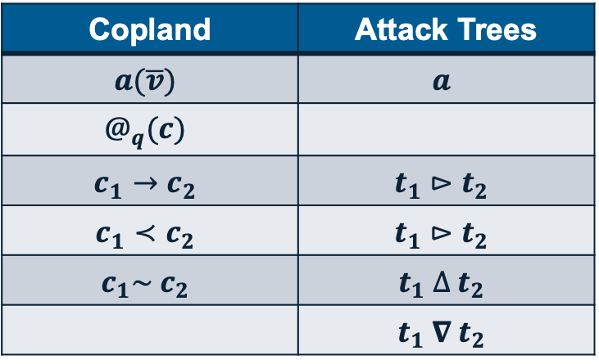
Semantic Similarity Translates Results for Free
Attack Tree Soundness Results From Horne et al. [1]
Copland / Attack Tree Correspondence
Copland | Attack Trees
$$a(\overline{v})$$ | $$a$$
$$@_{q}(c)$$
$$c_{1}→c_{2}$$ | $$t_{1}⊳t_{2}$$
$$c_{1}≺c_{2}$$ | $$t_{1}⊳t_{2}$$
$$c_{1}\sim c_{2}$$ | $$t_{1} ∆ t_{2}$$
 | $$t_{1} ∇ t_{2}$$
“Free” Copland Soundness Results

Slide 18

Copland Adversarial Semantics
Copland event semantics does not account for adversary
We developed trust analysis tool to enumerate adversarial executions subject to some initial assumptions $H$
Uses a chase-based model finder
Produces sets of event posets containing regular and adversary actions
Strength ordering idea:
View results of analysis as Copland adversarial semantics $𝒜_{H}(c)$
Define down-set and up-set orderings
Determine which one represents natural strength order

Slide 19
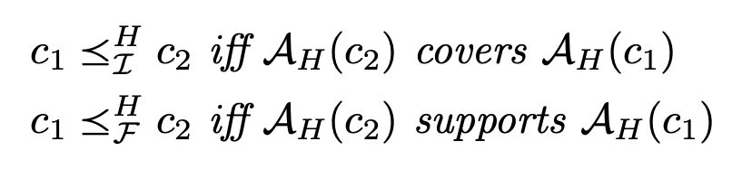


Do the Adversarial Orders Measure Trustworthiness?
Adversarial semantics orders
Previous work implicitly defines a ”natural” trust order on Copland $≼_{RD}^{H}$.
How do $≼_{ℐ}^{H}$ and $≼_{ℱ}^{H}$ compare to $≼_{RD}^{H}$?
Theorem:

Slide 20

Some Lingering Questions
What does $≼_{ℱ}^{H}$ capture in terms of trustworthiness?
Is there a “natural” description of its logical content?
Why does $≼_{ℐ}^{H}$ seem to be irrelevant for trustworthiness?
Is there a description of its logical content that would explain that?
Does it maybe have an unrecognized value?

Slide 21
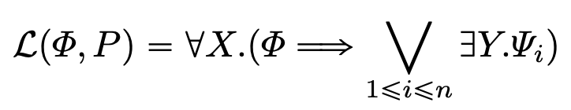

Ordering Cryptographic Protocols
CPSA characterizes the strongest goal a protocol achieves relative to stated assumptions $Φ$
This can be expressed in logical form:
We can define an order $≼_{Φ}$ using the logical strength of $ℒ(Φ,P)$:
$P_{1}≼_{Φ}P_{2}$ iff $ℒ\left(Φ,P_{2}\right)⇒ℒ(Φ,P_{1})$
Can we define corresponding orders with our new approach?

Slide 22

Towards Supports & Covers Protocol Orders
The logic conveniently “washes away” incidental details in the skeletons
When considering homomorphisms we must contend with those details
The details may get in the way of certain homomorphisms existing
It’s a barrier to defining down-set or up-set orders corresponding to $≼_{Φ}$
Joshua’s theory of protocol transformation is key insight
$𝒯:P_{1}→P_{2}$ applies to protocols and their skeletons
$σ_{P}\left(Φ\right)=𝔸$ fills in details in skeleton washed away by $Φ$

Slide 23
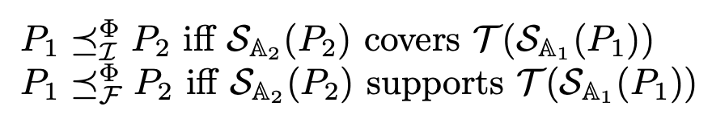
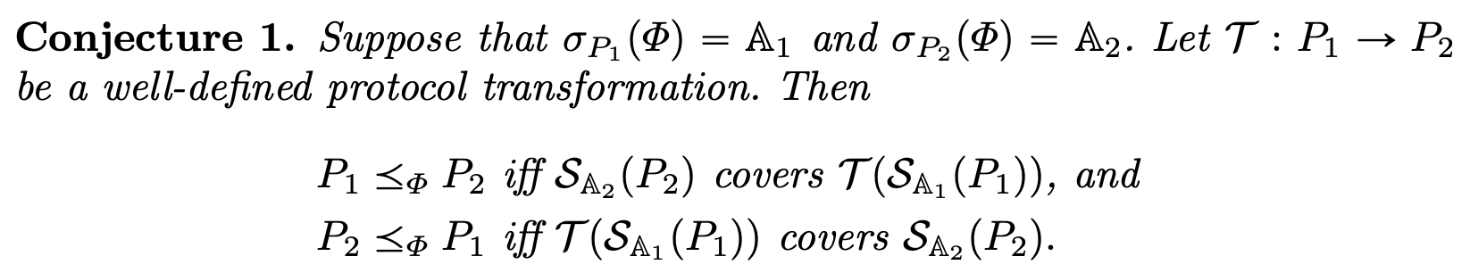

Protocol Down-set and Up-set Orders
Protocol orders
where $σ_{P1}\left(Φ\right)= 𝔸_{1}$ and $σ_{P2}\left(Φ\right)= 𝔸_{2}$

Slide 24
Some More Lingering Questions
Why is Copland trust semantics related to the up-set order, but protocols are related to the down-set order?
What does the up-set protocol order correspond to?
Are there other security orderings in the literature that are naturally down-set or up-set orderings?

Slide 25
Conclusion
Attack tree specialization orders
Copland event semantics orders
Copland adversarial semantics orders
Cryptographic protocol orders

Slide 26
References
[1] Horne, R., Mauw, S., Tiu, A.: Semantics for specialising attack trees based on linear logic. Fundam. Informaticae 153(1-2), 57–86 (2017). https://doi.org/10.3233/FI2017-1531
[2] Jhawar, R., Kordy, B., Mauw, S., Radomirovi´c, S., Trujillo-Rasua, R.: Attack trees with sequential conjunction. In: Federrath, H., Gollmann, D. (eds.) ICT Systems Security and Privacy Protection. pp. 339–353. Springer International Publishing, Cham (2015). https://doi.org/10.1007/978-3-319-18467-8 23

