Slide 1
Decision Tree
10-Nov-22

Slide 2





Background
SGTC: AI/ML based technology development for demand forecasting, technology promotion, open innovation
SIMTech: AI/ML technology in supply chain risk, inventory, pricing management
NTU: Energy aware job scheduling, cost reduction for green data centers
Tata Motors: Quality management- customer complaint reduction, product/process audit, change management
Bachelors
Tata Motors Ltd.
NTU Singapore
SIMTech, A*STAR
SIMTech, A*STAR
2008
2012
2016
2019

Slide 3
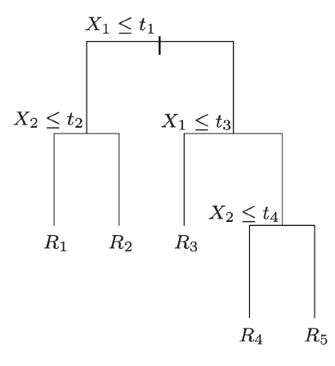
Decision Tree
Decision trees are a non-linear machine learning model that
Assign each point to a leaf (region of feature space)
According to a sequence of decisions based on features.
We can assign each region:
a number (regression)
or
Category (classification) to make a prediction.
https://people.orie.cornell.edu/mru8/orie4741/

Slide 4
Summary and way forward
Important nonlinear model
Constructed based on partitioning the feature space in rectangles
Every point falls in only one region, all prediction in same region is same
Server as foundation for ensemble method that is proven to be effective in many different contexts
Interpretable, user have additional insights

