Slide 1

Energy Efficient Scheduling in Data Centers
Debdeep Paul*, Wen-De Zhong*,
Sanjay K. Bose**
* School of Electrical and Electronic Engineering, NTU Singapore
** Dept. of EEE, IITG, India

Slide 2
Outline
Motivation and background
Model
Two scheduling procedures
Results
Conclusions

Slide 3
Motivation
Data centers are energy hogs
Energy consumed by data centers 2-3% of the total energy consumed in the US
And it is growing 12~15% a year, US electricity growth 1%

Slide 4
Background
Energy efficiency in data centers, enormous improvements in last few decades
Building energy management: cooling, lighting
Dynamic right sizing: to turn off extra servers
Geographical load balancing: follow the renewables
Recent focus on sustainability- e.g., renewable integration
Data centers are a promising option
Unharnessed opportunities
have significant flexibility (building energy management, workload management- leveraging Slack e.g.,)
highly automated

Slide 5
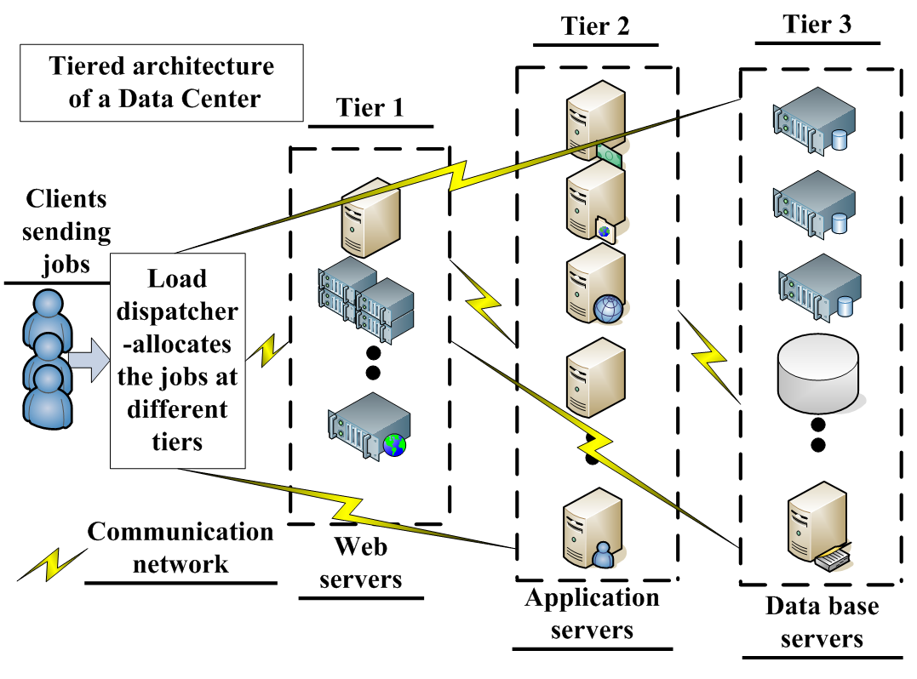
Model: key ideas
Capture the tiered
architecture of the data center
Deferrable and non deferrable jobs (Scientific simulations.., Real time..)
Energy aware scheduling (Demand Response)
Different attributes through costs
Two optimization procedure:
Electricity expense
Server switching- from OFF to ON and vice versa
Max servers

Slide 6
Scheduling procedure-I: CapexOpexMin Key ideas
←Power consumed
←Power cost; co-located renewables
← Switching cost
← Peak server provisioning cost
Constraints:
All jobs are serviced
QoS guarantee
Mapping from job request to # of servers to be provisioned
Total jobs= Deferrable + non deferrable jobs
← Safety margin

Slide 7
Scheduling procedure-I: CapexOpexMin
Convex problem– computationally tractable
Ensuring:
Individual deferrable jobs:
Upper and lower bound on # of servers
Sum across all active jobs to obtain upper and lower bound on total # servers
Deferrable jobs are serviced before deadline
Total # of servers in each tier does not exceed # of servers present at that tier

Slide 8
Scheduling procedure-II: OpexMin
s.t. same conditions as CapexOpexMin
Implement the algorithms in CVX, Matlab 7.11.0
CapexOpexMin- 3 sec and OpexMin- 2 sec to converge
Objective is to have effect of all the attributes in the overall objective function

Slide 9
Simulation setup
Electricity price traces obtained from wholesale electricity market in Singapore
Real renewable energy trace
Job traces obtained from a commercial server cluster owned by Facebook
Assumed a data center with total 120K servers
Compared the proposed algorithms with the corresponding oracle counterpart with perfect future forecast

Slide 10
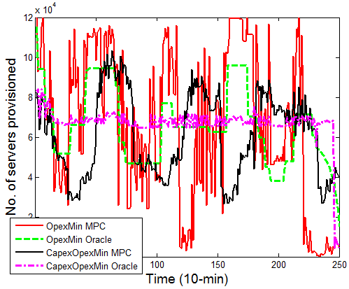
Simulation results (1/4)
~ 14% peak reduction
Notes:
Mention cumulative Electricity expenses

Slide 11
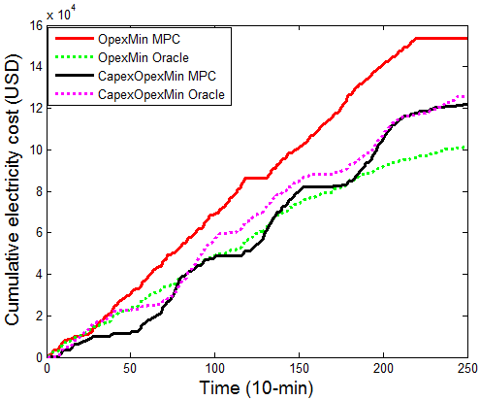
Simulation results (2/4)
~ 21% reduction in electricity expense
Notes:
Mention cumulative Electricity expenses

Slide 12
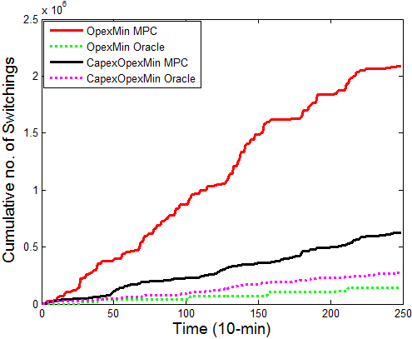
Simulation results (3/4)
~ 70% reduction in # of switchings
Notes:
Mention cumulative Electricity expenses

Slide 13
Simulation results (4/4)
13.8% peak reduction, translates into $170~$340M
 | CEC | CRC | CNS
CapexOpexMin over OpexMin | 21% | -12% | 70%
OpexMin Oracle over MPC | 34% | 2.17% | 93.3%
CapexOpexMin Oracle over MPC | -3% | 12.7% | 56.3%
Very sensitive to uncertainty

Slide 14
Conclusions
The proposed method achieves substantial server provisioning (capital) cost reduction
Capturing switching cost through variance imposes a better control, especially if frequent server switching is a concern
Capturing switching cost through variance reduces sensitivity with respect to optimization horizon, especially in terms of switching

Slide 15
Previous works
[1] B. Urgaonkar, G. Pacifici, P. Shenoy, M. Spreitzer, and A. Tantawi, "An analytical model for multi-tier internet services and its applications," ACM SIGMETRICS 2005.
[2] A. Subramanian, M. J. Garcia, D. S. Callaway, K. Poolla, and P. Varaiya, "Real-time scheduling of distributed resources," IEEE Trans.Smart Grid, 2013.
[3] A. Krioukov, C. Goebel, S. Alspaugh, Y. Chen, D. E. Culler, and R. H. Katz, "Integrating renewable energy using data analytics systems: challenges and opportunities," IEEE Data Eng. Bull., 2011.

Slide 16
Thank you so much!
Further queries:
debdeep1@e.ntu.edu.sg

