Slide 1
Explainable Markov Chain Based Pattern Forecasting
Debdeep Paul*, Chandra Wijaya*, Sahim Yamaura*, Koji Miura**, Yosuke Tajika**
Panasonic Industrial Devices Pte. Ltd., Singapore*, Panasonic Industry Co., Ltd, Japan**

Slide 2
Overview
Motivation
Problem setting
System architecture
Model
Experiments
Results
Conclusion and future extension

Slide 3
Motivation
This paper deals with the pattern forecasting of demand timeseries for B2B industrial products, which is less explored and often remain esoteric to the practitioners
demand for different types of B2B products is highly volatile, nonstationary- comes from a wide class of statistical distributions.
The supply chain managers require the pattern forecast that is used in upstream decision support systems
black-box machine learning (ML) needs explainability for the business users to establish connection with their domain expertise and thereby build trust in the advanced ML technologies

Slide 4
Contributions
firstly, we propose a method for encoding a continuous variable to a discrete number of states and model the transitions through a data driven feature dependent Markov chain (FDMC).
secondly, we propose a strategy for quantitative modeling of the pattern of interest through a score as a function of the respective entries in the transition probability matrix (TPM).
Thereafter based on that score we quantify the likelihood of emergence of the pattern of interest and explain it

Slide 5
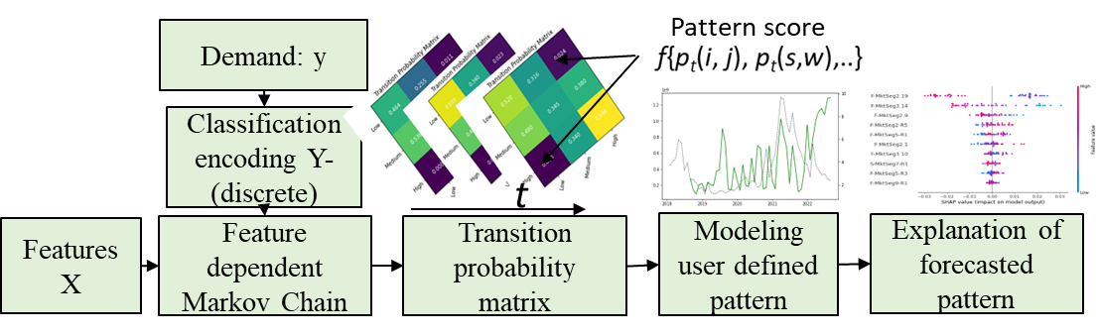
System architecture
firstly, we propose a method for encoding a continuous variable to a discrete number of states and model the transitions through a data driven feature dependent Markov chain (FDMC).

Slide 6
Feature based Markov Chain
a DTMC is a stochastic process
DTMC is a matrix, Pt, for timeslot t, whose
represents the probability of going to state j on the next transition given the current state is
We adopt the method proposed in

Slide 7
Explainability
This paper provides two metrices to evaluate the quality of the explainability namely, i) relevance, and, ii) informativeness.
Relevance is defined as the extent to which the explanation is consistent with the inherent physical process and is evaluated based on user feedback/annotations.
Informativeness is defined as the amount of information contained in the explanation.

Slide 8
Explainability
This paper provides two metrices to evaluate the quality of the explainability namely, i) relevance, and, ii) informativeness.
Relevance is defined as the extent to which the explanation is consistent with the inherent physical process and is evaluated based on user feedback/annotations.
Informativeness is defined as the amount of information contained in the explanation.
We measure this by the sharpness of feature attributes such as the variance in the importance score. Higher the variance higher is the information content

Slide 9
Explainability
Our input data is high dimensional where the number of columns is much higher than number of rows, therefore the value of the appropriateness in choosing the feature selection method is significantly high. We leverage a recently developed lasso type feature selection method that enforces feature sparsity, controllability, namely LassoNet
compared the performance with a conventional method based on decision tree; referred to as DT-FS in terms of accuracy and explainability

Slide 10
Experiments
. In our dataset we have 56 months demand and 96 related indices used as features, referred to as X1 to X96. The first 50 months are used as training set and remaining 6 are used as testing set in which the performance of the model is evaluated. A three state FDMC is leveraged where the TPM for timeslot t is a 3×3 matrix. First 9 months is used to train the FDMC. In this experiment we model the nature or intensity of the change that we call as, i) steady state, ii) moderate fluctuation, and, iii) drastic fluctuation

Slide 11
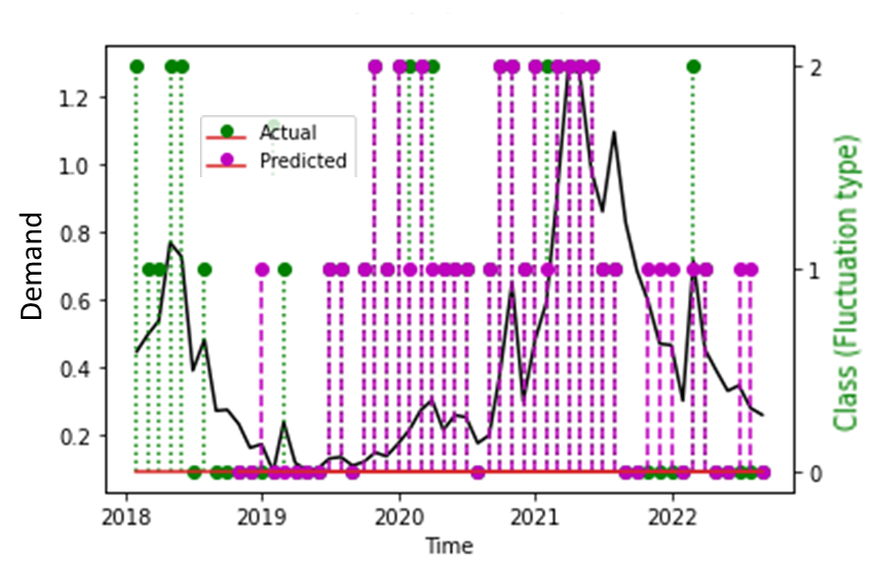
Experiments
. In our dataset we have 56 months demand and 96 related indices used as features, referred to as X1 to X96. The first 50 months are used as training set and remaining 6 are used as testing set in which the performance of the model is evaluated.

Slide 12
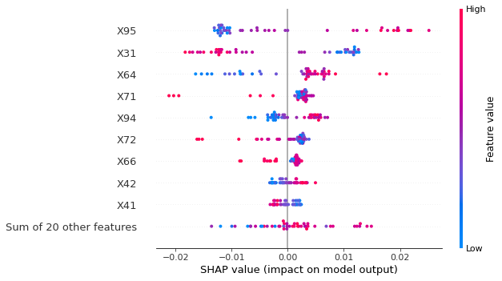
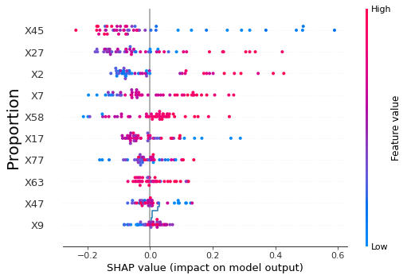
Experiments
. In our dataset we have 56 months demand and 96 related indices used as features, referred to as X1 to X96. The first 50 months are used as training set and remaining 6 are used as testing set in which the performance of the model is evaluated.

Slide 13
Experiments
Feature selection | SHAP-Variance | Accuracy | F1-Score
DT-FS | 8.36×10⁻⁶ | 0.5 | 0.43
LN-FS | 0.38 | 0.67 | 0.51
. In our dataset we have 56 months demand and 96 related indices used as features, referred to as X1 to X96. The first 50 months are used as training set and remaining 6 are used as testing set in which the performance of the model is evaluated.

Slide 14
Conclusions, future directions
this paper we focused on pattern modeling and forecasting for demand timeseries of B2B products by encoding the continuous variable (demand) to discrete number of states and modeling through a data driven feature dependent Markov chain. From the entries of the transition probability metrices (one for each timeslot), the score corresponding to a specific pattern of interest is appropriately quantified. Thereafter we developed methods for explaining the forecasting of specific user defined patterns through a popular method for post hoc explainability. We performed a case study with real world dataset and compared two feature selection methods for fitting the feature dependent Markov chain

Slide 15
References
[1] M. C. Cohen, P.-E. Gras, A. Pentecoste, and R. Zhang, Demand prediction in retail: A practical guide to leverage data and predictive analytics. Springer, 2022.
[2] F. Doshi-Velez and B. Kim, "Towards a rigorous science of interpretable machine learning," arXiv preprint arXiv:.08608, 2017.
[3] S. Barratt and S. Boyd, "Fitting feature-dependent Markov chains," Journal of Global Optimization, pp. 1-18, 2022.
[4] S. M. Lundberg and S.-I. Lee, "A unified approach to interpreting model predictions," Advances in neural information processing systems, vol. 30, 2017.
[5] I. Lemhadri, F. Ruan, L. Abraham, and R. Tibshirani, "Lassonet: A neural network with feature sparsity," The Journal of Machine Learning Research, vol. 22, no. 1, pp. 5633-5661, 2021.

