Slide 1
Decision Tree
10-Nov-22

Slide 2
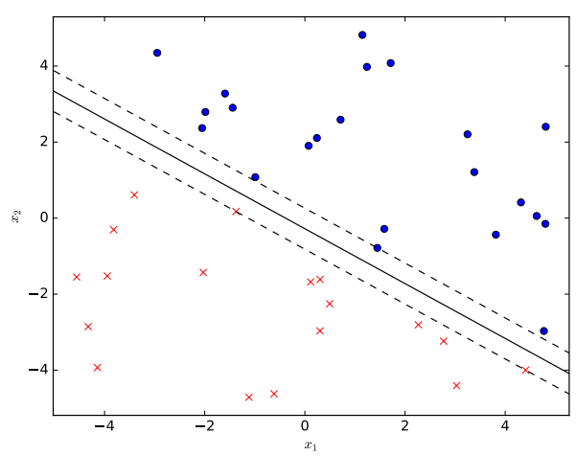
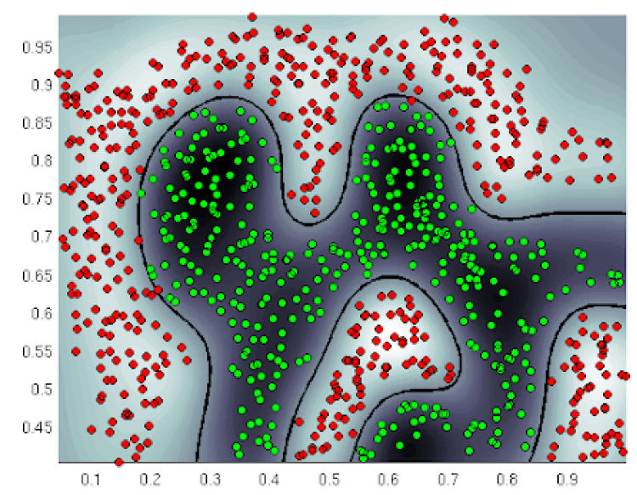
Decision Tree
By the end of this sample lesson, student will be able to:
Explain how a decision tree functions, and
How to construct a decision tree
Hands on practice to implement two main components of a decision tree

Slide 3
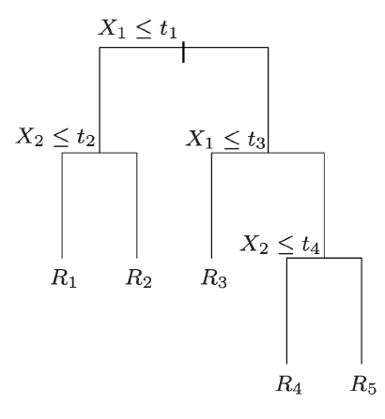
Decision Tree
Decision trees are a non-linear machine learning model that
Assign each point to a leaf (region of feature space)
According to a sequence of decisions based on features.
We can assign each region:
a number (regression)
or
Category (classification) to make a prediction.
https://people.orie.cornell.edu/mru8/orie4741/

Slide 4
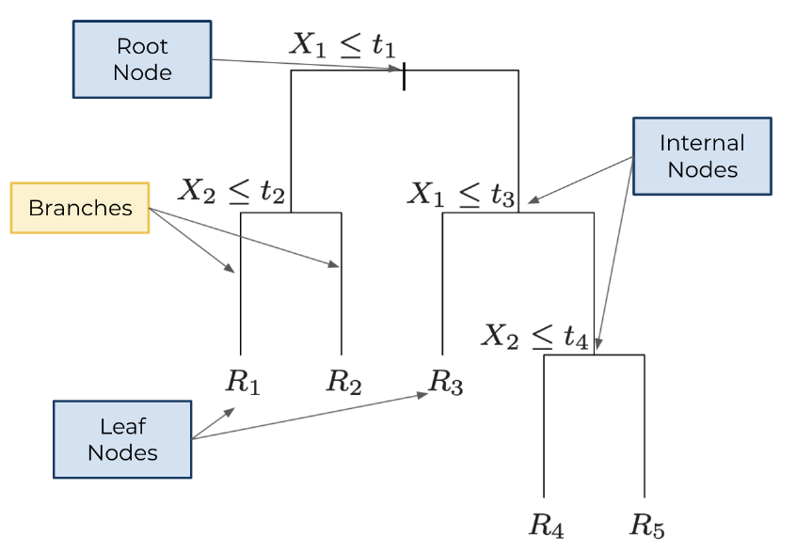
Terminology
Decision trees are a non-linear machine learning model that

Slide 5
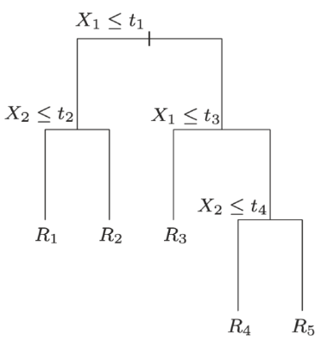
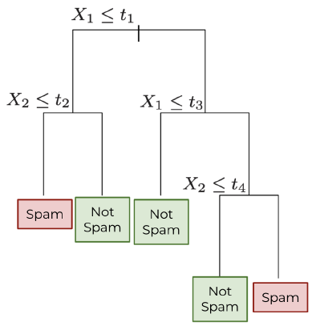
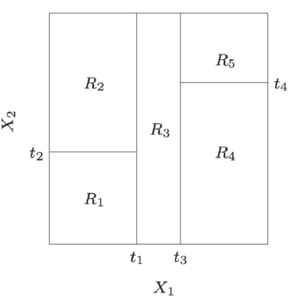
Feature Space Partitioning
Each split in the decision trees considers a single feature, so every leaf is a rectangle.
The leaves partition the feature space.

Slide 6
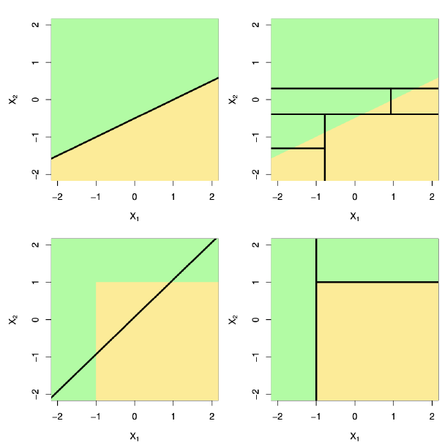
Trees vs linear classifiers
Linear models are easy, but the world is is full of non-linear data
Best model depends on the data

Slide 7
Formalizing decision trees
Partition the feature space into M regions R₁, R₂, R_{M}.
For each region R_{m}, assign a response
Our prediction is:
1 when
Where
0, otherwise

Slide 8
The best split
Consider all possible features to split on
And thresholds to split at
And choose the best split
What should best mean?
A. Make each leaf node as homogeneous as possible
B. Make each leaf node as similar to other nodes as possible
Definition:
A node is pure if every point in the node has the same label

Slide 9
How to measure purity
Consider a classification task with dataset
{(X₁, y₁), , , ,(X_{n}, y_{n})}. Define
the number of points in region m:
fraction of points in region m with label 1:
We can measure impurity via
Misclassification error
Gini index
Cross entropy

Slide 10
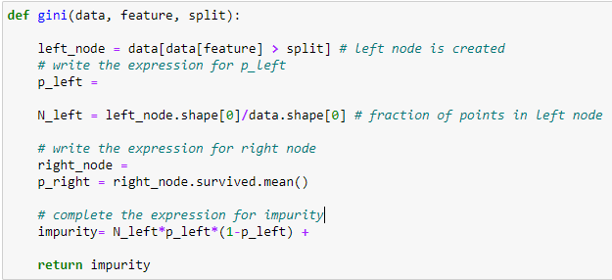
Implementation of Gini function

Slide 11
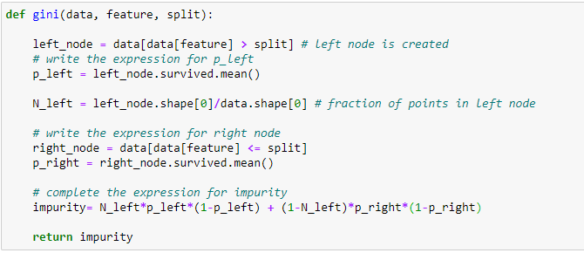
Implementation of Gini function

Slide 12
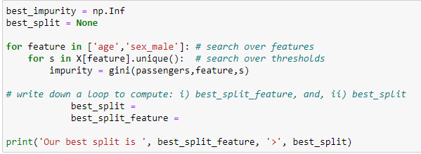
Implementation of Gini function

Slide 13
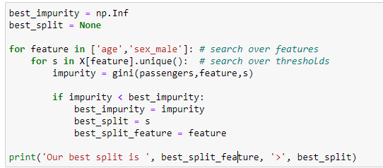
Implementation of Gini function

Slide 14
Classification Trees
In classification, each c_{m} corresponds to a label.
We seek the partition that minimizes classification error
Root node:
60% A, 40% B
X₁≥3
X₁<3
Node 1:
60% A, 40% B
Node 2:
60% A, 40% B
X₂>1
X₂≤1
X₂≥4
X₂<4
Root node:
60% A, 40% B
Root node:
60% A, 40% B
Root node:
60% A, 40% B
Root node:
60% A, 40% B
X₂≤1

