Slide 1
Explainable Markov Chain Based Pattern Forecasting
Debdeep Paul*, Chandra Wijaya*, Sahim Yamaura*, Koji Miura**, Yosuke Tajika**
Panasonic Industrial Devices Pte. Ltd., Singapore*, Panasonic Industry Co., Ltd, Japan**

Slide 2
Overview
Motivation
Problem setting
System architecture
Model
Experiments
Results
Conclusion and future extension

Slide 3
Motivation
Deals with the pattern forecasting of demand timeseries for B2B industrial products- less explored [1]
Demand for different types of B2B products is highly volatile, nonstationary- wide class of statistical distributions
Managers require the pattern forecast that is used in upstream decision support systems
Black-box ML needs explainability for the business users to establish connection with their domain expertise and thereby build trust in the advanced ML technologies

Slide 4
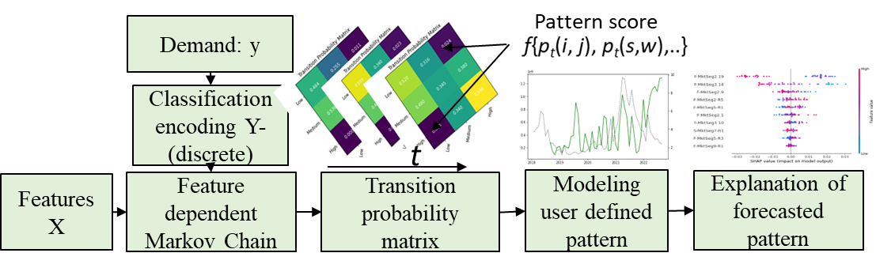
Contributions
Firstly, we propose a method for encoding a continuous variable to a discrete number of states and model the transitions through a data driven feature dependent Markov chain (FDMC) [2]
Secondly, we propose a strategy for quantitative modeling of the pattern of interest through a score as a function of the respective entries in the transition probability matrix (TPM).
Thereafter based on that score we quantify the likelihood of emergence of the pattern of interest and explain it
System architecture

Slide 5
Feature based Markov Chain
DTMC is a stochastic process
is the state at time step t and such that, and
Where is independent of the timestep and of past history.
The transition probability matrix (TPM) associated with any DTMC is a matrix, P_{t}, for timeslot t, whose (i, j)^{th} entry represents the probability of going to state j on the next transition given the current state is i
We adopt method [3] to compute the TPM through a set of features that may be considered as a data driven approach with a specified feature matrix for

Slide 6
Explainability
This paper provides two metrices to evaluate the quality of the explainability namely, i) relevance, and, ii) informativeness.
Relevance is defined as the extent to which the explanation is consistent with the inherent physical process and is evaluated based on user feedback/annotations.
Informativeness is defined as the amount of information contained in the explanation.
We measure this by the sharpness of feature attributes such as the variance in the importance score. Higher the variance higher is the information content

Slide 7
Explainability
Our input data is high dimensional where the number of columns is much higher than number of rows, therefore the value of the appropriateness in choosing the feature selection method is significantly high. We leverage a recently developed lasso type feature selection method that enforces feature sparsity, controllability, namely LassoNet
compared the performance with a conventional method based on decision tree; referred to as DT-FS in terms of accuracy and explainability

Slide 8
Experiments
In our dataset we have 56 months demand and 96 related indices used as features, referred to as X₁ to X₉₆. The first 50 months are used as training set and remaining 6 are used as testing set in which the performance of the model is evaluated.
A three state FDMC is leveraged where the TPM for timeslot t is
P_{t}
In this experiment we model the nature or intensity of the change that we call as, i) steady state, ii) moderate fluctuation, and, iii) drastic fluctuation, respectively.
g(P_{t})=

Slide 9
Experiments
function of diagonal entries
function of probabilities corresponding to transitions between adjacent states
function of probabilities corresponding to transitions between non-adjacent states
where the constants is used to rationalize the scores
scores corresponding to different states are computed by normalizing with respect to the total score and is obtained by
scores corresponding to steady state, moderate fluctuation, and drastic fluctuation, respectively

Slide 10
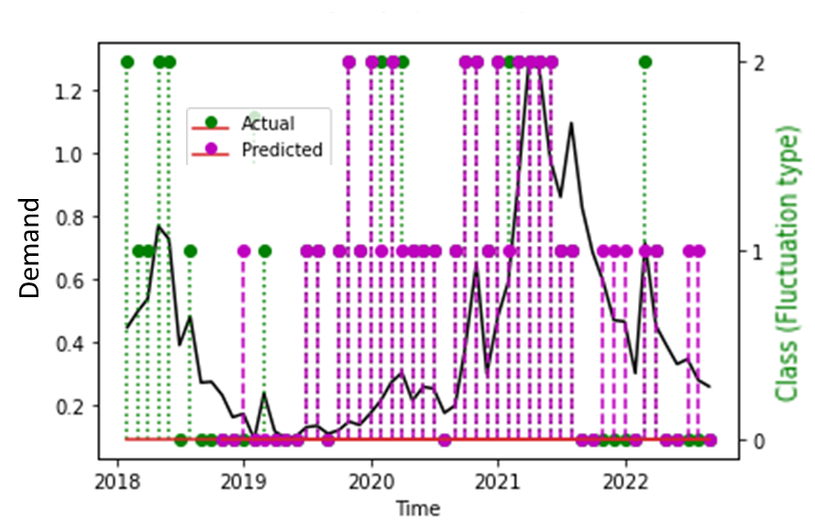
Feature Selection
The number of features selected through DT-FS is 29 and that through LN-FS is 10, quite inline with tendency towards sparsity of LassoNet.
Enables the model to filter out the irrelevant, noisy features and improves the accuracy.
Pattern prediction with LN-FS

Slide 11
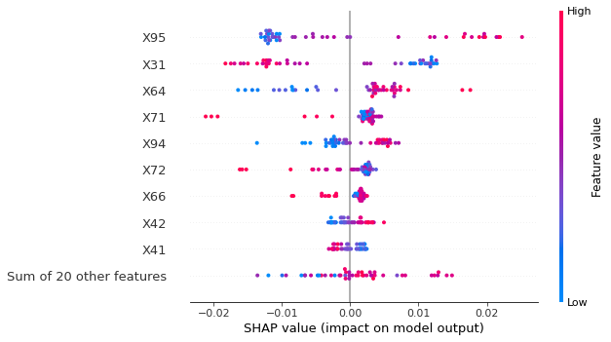
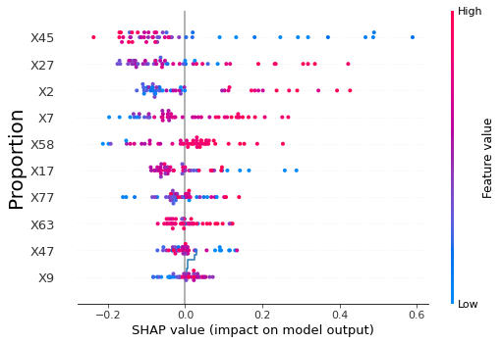
SHAP values of features:
(a) DT-FS (b) LN-FS
Feature selection | SHAP-Variance | Accuracy | F1-Score
DT-FS | 8.36×10⁻⁶ | 0.5 | 0.43
LN-FS | 0.38 | 0.67 | 0.51
Summary

Slide 12
Conclusions, future directions
We focused on pattern modeling and forecasting for demand timeseries of B2B products by encoding the continuous variable (demand) to discrete number of states and modeling through a data driven feature dependent Markov chain.
From the entries of the transition probability metrices (one for each timeslot), the score corresponding to a specific pattern of interest is appropriately quantified.
Thereafter we developed methods for explaining the forecasting of specific user defined patterns through a popular method for post hoc explainability.
We performed a case study with real world dataset and compared two feature selection methods for fitting the feature dependent Markov chain

Slide 13
References
[1] M. C. Cohen, P.-E. Gras, A. Pentecoste, and R. Zhang, Demand prediction in retail: A practical guide to leverage data and predictive analytics. Springer, 2022.
[2] F. Doshi-Velez and B. Kim, "Towards a rigorous science of interpretable machine learning," arXiv preprint arXiv:.08608, 2017.
[3] S. Barratt and S. Boyd, "Fitting feature-dependent Markov chains," Journal of Global Optimization, pp. 1-18, 2022.
[4] S. M. Lundberg and S.-I. Lee, "A unified approach to interpreting model predictions," Advances in neural information processing systems, vol. 30, 2017.
[5] I. Lemhadri, F. Ruan, L. Abraham, and R. Tibshirani, "Lassonet: A neural network with feature sparsity," The Journal of Machine Learning Research, vol. 22, no. 1, pp. 5633-5661, 2021.

