Slide 1
Midterm Demand Forecasting AI - Weekly Progress
Access Restricted
- Smart Marketing Project
24-Sep-2024
Singapore Technology Centre
Panasonic Industrial Devices Singapore

Slide 2
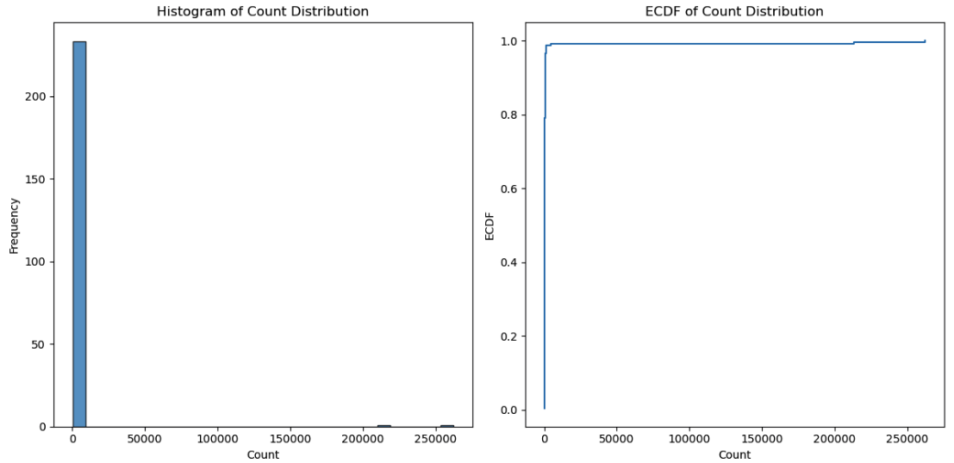
GenAI: BerTopic + HDBSCAN
Fairly balanced distribution of # CE spans

Slide 3
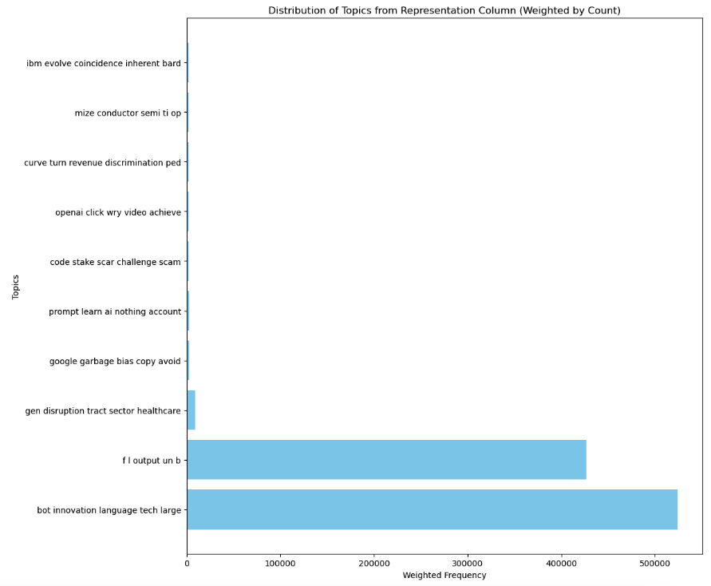
GenAI: BerTopic + HDBSCAN
Very skewed distribution of topics
One cluster happens to be in -1 implying that is an outlier
Topic is not meaningful
The most significant topic is not informative
Sort of intuitive- but for quantification and formalization requires appropriate metrics

Slide 4
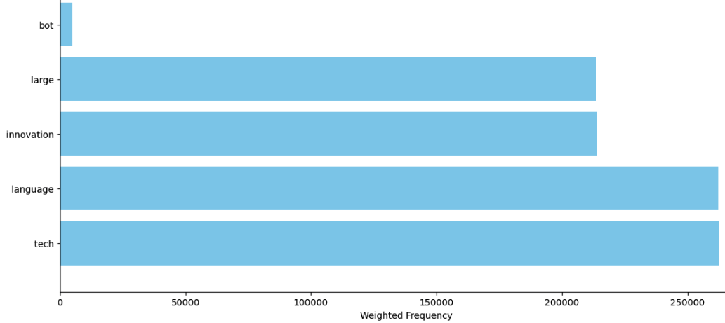
GenAI: BerTopic + HDBSCAN
Distribution of words
Privacy is critical

Slide 5
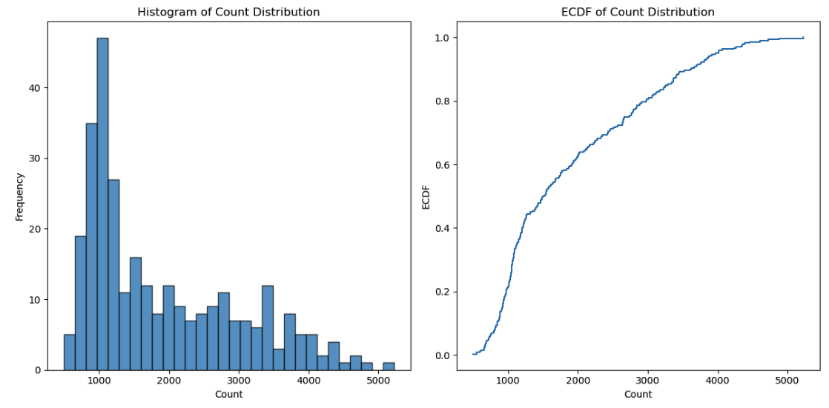
GenAI: BerTopic + k-means
Fairly balanced distribution of # CE spans

Slide 6
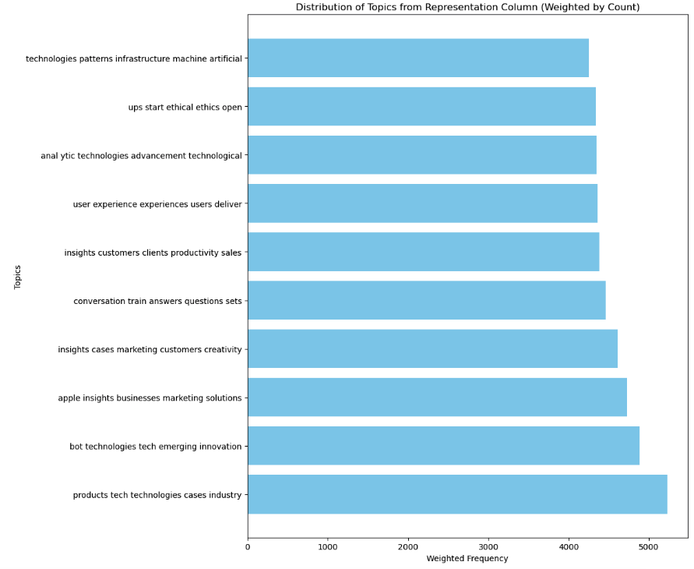
GenAI: BerTopic + k-means
Impactful topics are uniformly distributed
Much better than the previous case
Informative (later)
More meaningful
Fairly balanced distribution of # CE spans

Slide 7
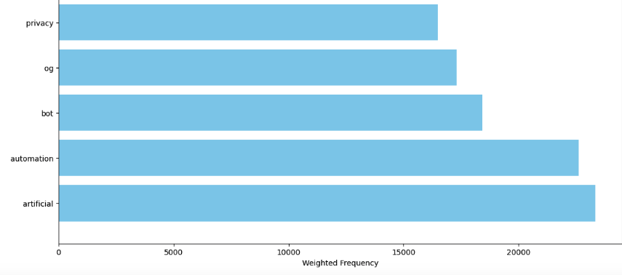
GenAI: BerTopic + k-means
Distribution of words
Privacy is critical
Fairly balanced distribution of # CE spans

Slide 8
Comparison
 | BERTopic with k-means | BERTopic with HDBSCAN
Entropy | 8.01 | 2.742
Skewness | 0.856 | 10.87
Std dev | 1.08 ×10³ | 2.192×10⁴
Kurtosis | -0.34 | 117.34
Uncertainty
Negative kurtosis refers to the shape of a probability distribution curve that is less peaked (or flatter) than the normal distribution.

Slide 9
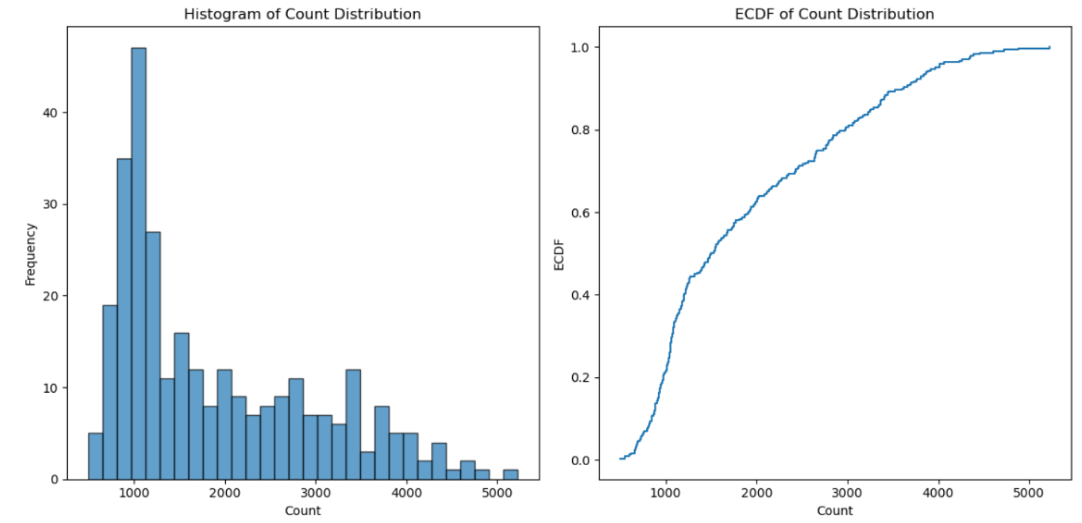
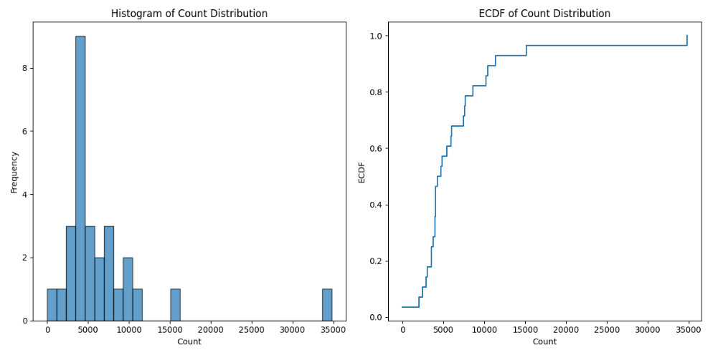
Quantitative metrices to complement the Golden standard
High level objective- where the market is going towards
How many topics are there- relative contributions
How topics are distributed- Some topics most of the share, few has less share
Quantitative measurement of the tail properties of the intensity of importance of different topics
Shows the effectiveness of the chosen keywords
Cross scenario comparison:
Cloud: AWS, azure, GCP
Infrastructure: server, data center, GPU (+/- Panasonic)
Gen AI
Industry

Slide 10
Tail properties
The tail of a distribution refers to the extreme ends of the distribution, where events or values occur with low probability but can have a significant impact. The characteristics of the tail are crucial for understanding the behavior of extreme values
Tail Weight (or Thickness)
The thickness or weight of the tail describes how quickly the probabilities decay as you move further into the tail (towards more extreme values). There are two common classifications:
Heavy-tailed distributions: These have tails that decay more slowly, meaning extreme values are more likely to occur compared to light-tailed distributions. Examples include the Cauchy and Pareto distributions.
Light-tailed distributions: These have tails that decay quickly, meaning extreme values are rare. Examples include the normal distribution and exponential distribution.

Slide 11
Skewness
Skewness measures the asymmetry of the probability distribution. It indicates whether the tail on one side (left or right) is longer or more pronounced than the other.
Positive skew (right skew): The right tail is longer or heavier, indicating that extreme high values are more likely

Slide 12
Kurtosis
Kurtosis quantifies the "tailedness" or the presence of outliers in the distribution. Specifically, it measures how much probability mass is in the tails compared to a normal distribution:
Leptokurtic: Distributions with heavy tails and a sharper peak than the normal distribution, indicating a higher likelihood of extreme values (e.g., Cauchy, t-distribution with small degrees of freedom).
Platykurtic: Distributions with lighter tails and a flatter peak, meaning fewer extreme values (e.g., uniform distribution).
Mesokurtic: Distributions with kurtosis similar to the normal distribution.

Slide 13
Survival function
The survival function (also known as the complementary cumulative distribution function) gives the probability that a random variable XXX exceeds a certain value xxx:
S(x)=1−F(x)=P(X>x)S(x)
= 1 - F(x) = P(X > x)S(x)=1−F(x)=P(X>x)
For tail analysis, this function is useful because it directly shows the likelihood of extreme values. Distributions with heavy tails tend to have slower decaying survival functions.

Slide 14
Quantiles
Quantiles are often used to examine the tail behavior. The higher quantiles, like the 95th, 99th, or 99.9th percentiles, indicate where the extreme values start.
Upper quantile: This gives insight into the right tail (extreme high values).
Lower quantile: This gives insight into the left tail (extreme low values)

Slide 15
Value at Risk
Value at Risk is a common risk measure used in finance to assess the tail behavior. It defines the worst loss expected over a given time period at a certain confidence level. For example, the 5% VaR corresponds to the loss at the 95th percentile.
VaR focuses on the extreme quantiles and is used to understand the risk in the tail of the distribution.

Slide 16
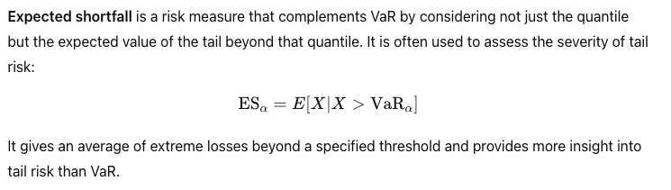
Expected shortfall

Slide 17
Tail Dependence
In multivariate distributions, tail dependence measures how the extreme values in one variable relate to extreme values in another variable. This is particularly useful in financial risk analysis and modeling the co-movement of extreme events.
Upper tail dependence: Measures the degree of dependence in the upper tails of two distributions.
Lower tail dependence: Measures the degree of dependence in the lower tails of two distributions.

Slide 18
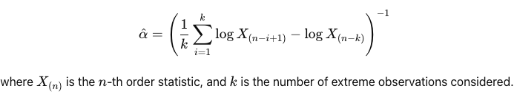
Hill Estimator
The Hill estimator is used to estimate the tail index of heavy-tailed distributions. It provides a way to assess how heavy the tail is by examining the extreme values of a dataset:

Slide 19
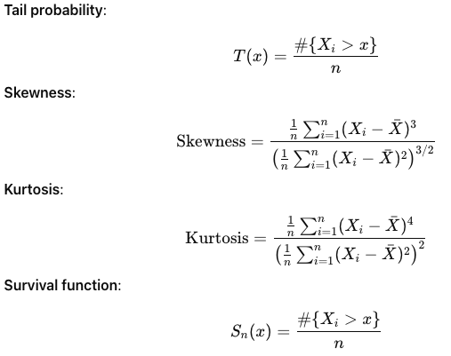
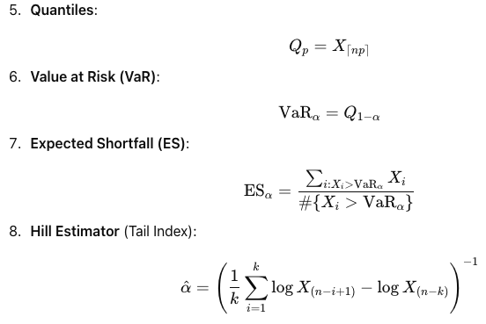
Empirical setting

Slide 20
Proposal for a Paper
Contribution | TENCON | Proposed
Information theory- to quantify overall info content- informativeness | Included | Included
Skewness: in terms of influencing topics | Not included | Included
Tail properties | Not included | Included
Subgraph analysis | Brief | Comprehensive
Use cases | Cyber security | Cybersecurity Industrial electronic GenAI
Performed data cleaning with improvements in the pipeline- word level tokenization
Insights on GenAI topics- the sharpness/granularity of information- choice of keywords is important to create an informative graph

Slide 21
Summary
To characterize the tail of a distribution, you should consider:
Tail weight (heavy or light-tailed behavior)
Skewness (asymmetry)
Kurtosis (tailedness or extreme values)
Survival function (decay of probabilities in the tail)
Quantiles (extreme percentiles)
VaR and ES for practical tail assessment: This case intensity of dominating topics/factors
Extreme value metrics like the Tail Index, Hill estimator, and EVT methods for analyzing the tail more rigorously.
Each of these properties provides insight into how likely extreme events are and the potential impact they can have, which is crucial in areas dealing with risks or outliers.

Slide 22
Thanks

Slide 23
Industry: BERTopic with HBDSCAN
Distribution of # of CE spans contained in a node
have a higher likelihood of producing extreme values compared to distributions like the normal distribution
the probability of observing a value far from the mean is high

Slide 24
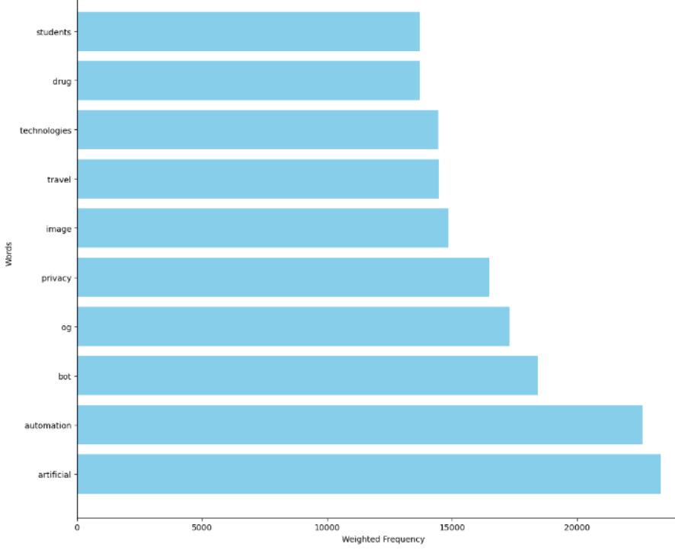
Top 10 words
Distribution of words
Privacy is critical
Notes:
Num vs tsf forecast

Slide 25

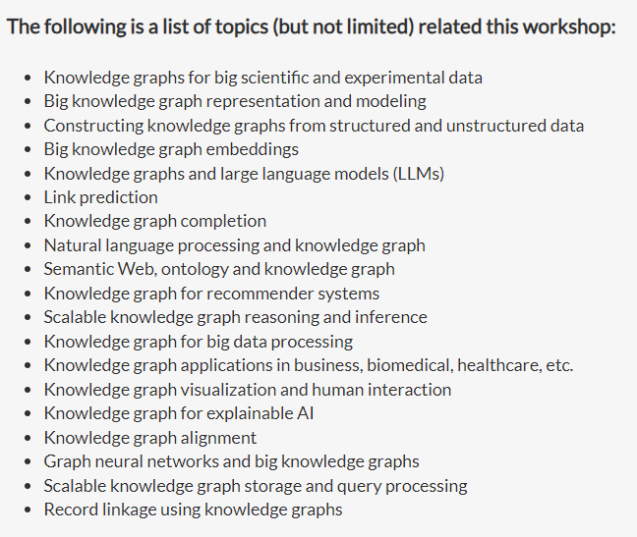
Paper proposal
Notes:
Num vs tsf forecast

Slide 26
Paper proposal
Notes:
Num vs tsf forecast

Slide 27
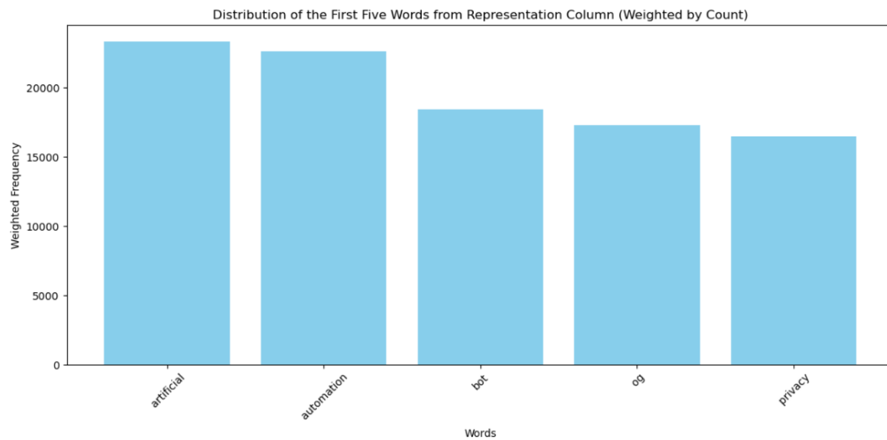
Word distribution
Distribution of words

Slide 28


Paper proposal
Notes:
Num vs tsf forecast

Slide 29
Novelties of the proposed paper
Performance evaluation metrices of the CKG:
Entropy
Skewness
Variance
Kurtosis
Uncertainty
Comparison across various components of the pipeline:
4 use cases
Industry devices
GenAI
Cybersecurity
 | Clustering | Topic model
Custom | K-means | TF-idf
Bertopic | Hdbscan | Bertopic
Bertopic | K-means | Bertopic

Slide 30
Metrices to compared different graphs
Kurtosis measures the "tailedness" or the peakedness of the
distribution of information content,
presence of outliers and
the overall shape of the distribution
If the kurtosis is high,
the distribution has heavier tails and a sharper peak compared to a normal distribution
there are more nodes with extreme information content values (either very high or very low) than would be expected in a normal distribution.
High -ve:
the distribution has a longer or fatter tail on the left side.
a few nodes with very low information content, while most nodes have higher information content
a tree where a few nodes are not very informative, but most nodes are.
A kurtosis close to zero
distribution is similar to a normal distribution in terms of tail behavior and peak
information content is spread out in a way that's expected under normal circumstances, without too many outliers.
High +ve:
distribution has a longer or fatter tail on the right side
a few nodes with very high information content, while most nodes have lower information content
Skewness
measures the asymmetry of the distribution of information content in the nodes
Near zero:
distribution is fairly symmetrical, meaning the information content is more evenly distributed among the nodes
High –ve:
lighter tails and a flatter peak compared to a normal distribution.
the information content is more evenly spread out, with fewer extreme values.
Notes:
Num vs tsf forecast

Slide 31
Weighted Freq of Words
High Positive Skewness and High Kurtosis: few nodes are highly informative (outliers) while most nodes have lower information content.
High Negative Skewness and High Kurtosis: most nodes are highly informative, but a few nodes have very low information content (outliers).
Low Skewness and High Kurtosis: balanced graph with some extreme values in both directions.
Low Skewness and Low Kurtosis: very balanced graph where information content is evenly distributed with no extreme values.
Notes:
Num vs tsf forecast

Slide 32
Comparison
 | BERTopic with HDBSCAN | BERTopic with K-means
Entropy | This indicates moderate uncertainty in the distribution | distribution of information is more uncertain and less predictable than HDBSCAN
Skewness | long tail on the right side, meaning there are a few nodes with much higher values compared to the rest | Both distributions are positively skewed, but K-means is much more skewed, indicating that there are more nodes with very high values.
Variance | high spread around the mean, suggesting significant variability in the data | a slightly higher variance, meaning the data points are more spread out
Spread around Mean | data points are more dispersed from the mean | indicating slightly lower variability in information content among the nodes
Uncertainty | less unpredictability compared to the K-means distribution | higher uncertainty due to higher entropy, making it more unpredictable
Kurtosis | indicates a distribution with heavy tails and a sharp peak, suggesting more extreme values or outliers. | more pronounced outliers and a sharper peak in the distribution
Notes:
Num vs tsf forecast

Slide 33
Summary
Notes:
Num vs tsf forecast

Slide 34
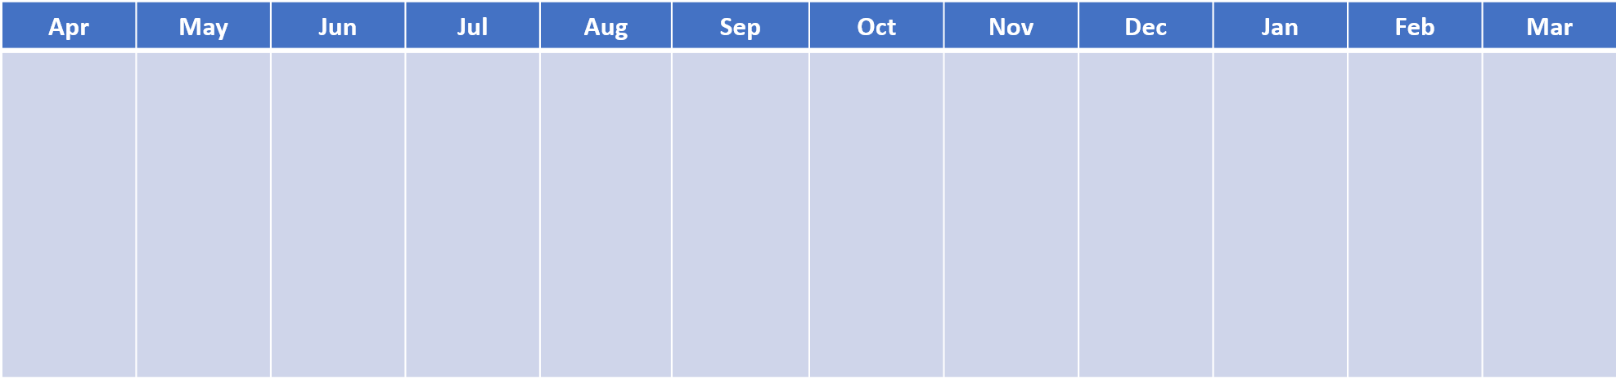
Causal relationships
Timeline
Category | Success Criteria FY24 | Customer Value | Content | Core Tech needed
Enhanced Causal Knowledge Graph | Mid-Year Milestone: Enhance explainability through advanced KG End-Year Milestone: Causal factor index generation to improve forecast accuracy for Industry relay, IDBD AC | Improve forecast accuracy Improve explainability Understand cause-effect pairs with temporal evolution of trends- provide explainability and what-if analysis to forecast​ | Knowledge Graph Analysis​ Identify key players, pattens, ​ Enhancement of representation capacity and information content of the graph​ ​ Causal factor index generation​ Extract temporal features​ Monitor changing causal factors in potentially unstable market​ | Graph analysis (classical to SOTA) Temporal Extraction Causal analysis
Knowledge Graph Analysis
Causal factor identification (index creation)
Data Analysis
Clustering Enhancement
Graph Generation & Analysis
Temporal Extraction & Analysis
Index Generation
Evaluation
Clustering analysis
Knowledge Graph and sub graphs
Integrate causal & temporal analysis
Causal index generation
Customization for generic forecast- Industry relay, IDBD AC
Customization for trend- DSBD

