Slide 1
Study Unit 4 Understanding Inheritance
16-Sep-25

Slide 2

Learning Outcomes
By the end of this Study Unit, you should be able to:
appraise the object-oriented principle of inheritance
appraise the benefits of inheritance
implement a derived class
appraise the restrictions imposed with inheritance
apply the criteria in choosing a class specifier
implement a C++ program that overrides an inherited access
differentiate the C++ functions that override and overload parent class functions within a child class
implement a base class constructor within a derived class
apply multiple inheritance in C++ programs
appraise the special problems posed by multiple inheritance apply the use of virtual inheritance in C++ programs
apply the use of virtual inheritance in C++ programs

Slide 3
Overview
This unit provides an outline of the content of Chapter 10 of the textbook Object-Oriented Programming Using C++ by Joyce Farrell.
Inheritance is based on the principle that knowledge of a general category can be applied to more specific objects. Specifically, inheritance in C++ means we can create classes that derive their attributes from an existing class.
In this unit, we will learn about the various types of inheritance and their advantages and disadvantages.

Slide 4
Understanding Inheritance
If we need to write a program using a new class named, FirstYearStudent, the job is easier if FirstYearStudent is inherited from a class named Student. The FirstYearStudent class may require some additional data members and functions that other Student objects do not need.
The FirstYearStudent class inherits from the Student class, or is derived from it. The Student class is called a parent class, base class, superclass, or ancestor. The FirstYearStudent class is called a child class, derived class, or descendant.
A useful feature of C++ inheritance is that the descendant class can override a function from the parent. When overriding a function, we are substituting one version of the function for another. When a function in a derived class has the same function signature as a function in the base class, the function in the derived class will override the function in this base class.

Slide 5
Understanding the Advantages Provided by Inheritance
Inheritance is considered a basic building block of an object-oriented programming. One major features of an object-oriented programming is the ability to create classes from those that already exist.
Programs in which we derive new classes from existing classes offer advantages due to reusability. Reusability saves time because much of the code needed for our class are already written. Reusability improves the reliability of our program because the existing code has already been tested.
When we understand how the base class works, we can focus on the complexity added as a result of the extension of the class. In a derived class, we can extend and revise a base class without corrupting the existing base class.

Slide 6
Understanding the Advantages Provided by Inheritance
The reliability of a base class increases as more and more classes are derived from it. It is important for programmers to take the time to develop reliable base classes so that future programming will go much smoothly.

Slide 7
Creating a Derive Class
To create a derived class, we must include the following elements in the order listed:
keyword class
derived class name
colon (:)
class access specifier (public, private or protected)
base class name
opening brace
class definition statements
closing brace
semicolon (;)

Slide 8
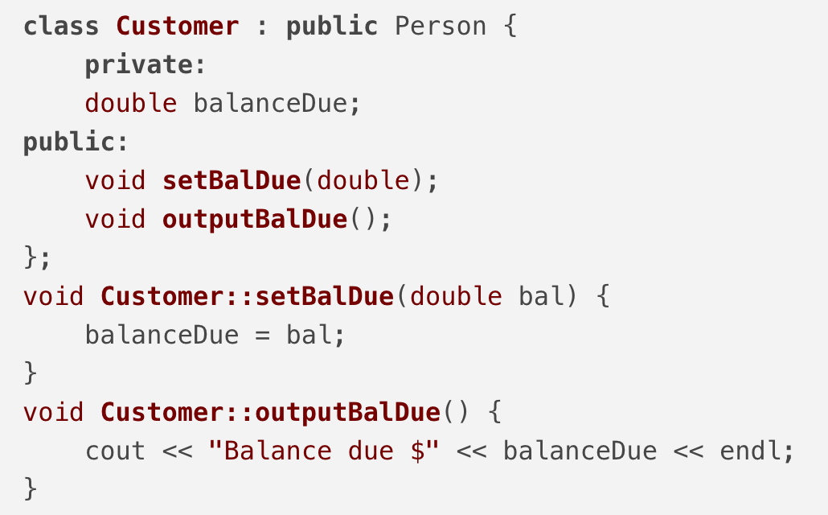
Customer class is drived from the Person class
Listing4-1 shows how the Customer class is drived from the Person class. In the main function, we can see that a Customer object can use functions from both the base class and the derived class. The Customer class inherits the setFields() function and outputData() function from the Person class.

Slide 9
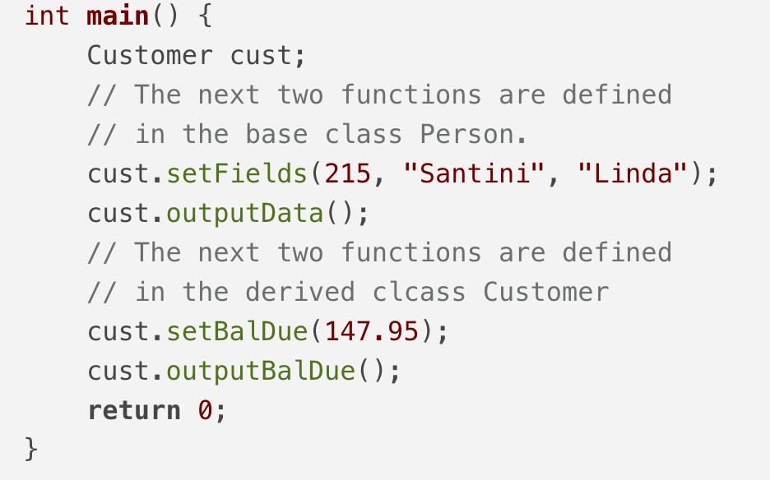
Customer class is drived from the Person class
Listing4-1 shows how the Customer class is drived from the Person class. In the main function, we can see that a Customer object can use functions from both the base class and the derived class. The Customer class inherits the setFields() function and outputData() function from the Person class.

Slide 10
Understanding Inheritance Restrictions
When a base class serves as a base class to other classes, all its members are included when we create an object from a derived class. However, members of a base class that are private are not directly accessible from within the derived class functions.
The protected access specifier allows members to be used by class member functions and by derived class, but not by other parts of the program. The access specifiers follow these rules:
private data and functions can be accessed only within a class
protected data and functions can be accessed only by functions in the same class, or by functions in derived classes
public data and functions can be access anywhere the class is in scope

Slide 11
Understanding Inheritance Restrictions
Besides being unable to directly access private members of a base class, several base class members are never inherited:
constructors
destructors
friend functions
overloaded new operators
overloaded = operator
If a derived class requires any of the preceding items, the item must be explicitly defined within the derived class definition.

Slide 12
Choosing the Class Access Specifier
If a derived class uses a public access specifier for inheritance, then the following statements are true:
Base class members that are public remain public in the derived class.
Base class members that are protected remain protected in the derived class.
Base class that are private are inaccessible in the derived class.
If a derived class uses a protected access specifier for inheritance, then the following statements are true:
Base class members that are public become public in the derived class.
Base class members that are protected remain protected in the derived class.
Base class that are private are inaccessible in the derived class.

Slide 13
Choosing the Class Access Specifier
If a derived class uses a private access specifier for inheritance, then the following statements are true:
Base class members that are public become private in the derived class.
Base class members that are protected become private in the derived class.
Base class that are private are inaccessible in the derived class.
A class’s private data can be accessed only by a class’s member functions (or friend functions), and not by any function in the derived class. The inheritance access specifier in derived classes is often public, so that the derived class can refer to all the non-private data and functions of the base class.
When a class is derived from another derived class, the newly derived class never has any more liberal access to a base class member than does its immediate predecessor.

Slide 14
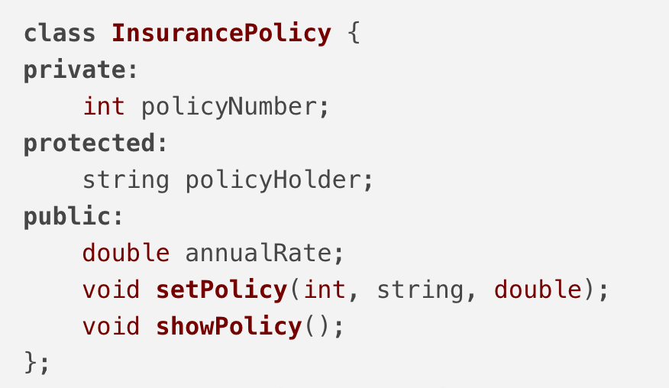
Overriding Inherited Access
We can override the class access specifier for any specific class member. We can only override the class access specifier when it does not suit our needs for some members of the class.
Listing4-2 shows that the AutomobileInsuracePolicy class derives the InsurancePolicy class with a protected access specifier i.e. all the non-private members in the base class become protected in the derived class. AutomobileInsurancePolicy is able to override the access specifier for showPolicy() so that it can be public within the AutomobileInsurancePolicy class.

Slide 15
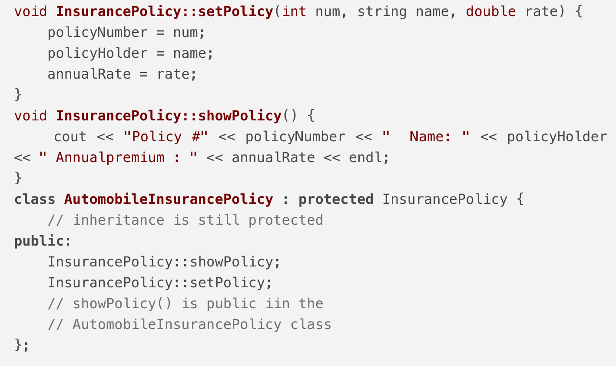
Overriding Inherited Access
Listing4-2 AutomobileInsurancePolicy class with showPolicy() function overriding its class access specifier

Slide 16
Overriding and Overloading Parent Class Functions
Any derived class function with the same name and argument list as the base class function overrides the base class function. Any derived class function with the same name as the base class function, yet with an argument list that differs from the base class function, overloads the base class function.
Listing4-3 shows the Person class (base class) and the Employee class (derived class). The setFields() function in Employee class overloads the setFields() function in Person class. Both functions have the same name but different number of arguments.
The outputData() function in Employee class overrides the outputData() function in Person class. Both functions have the same name and same (no) arguments.

Slide 17
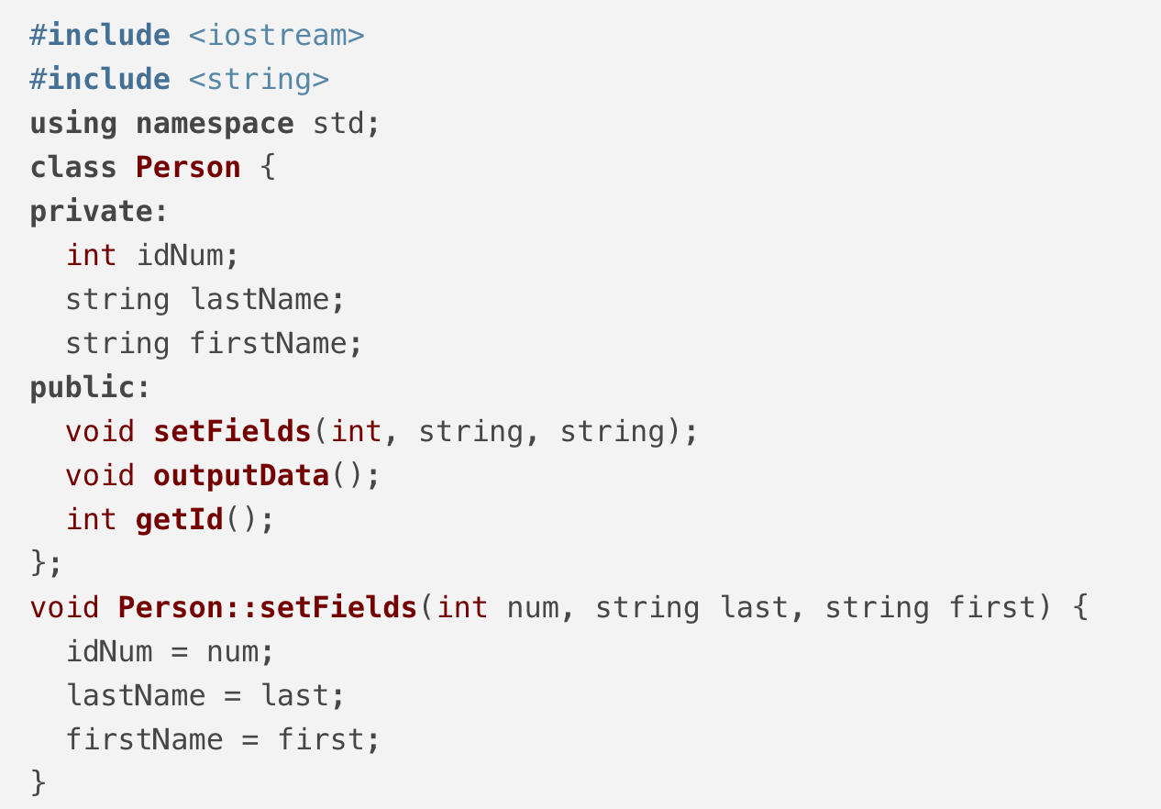
Overriding and Overloading Parent Class Functions

Slide 18
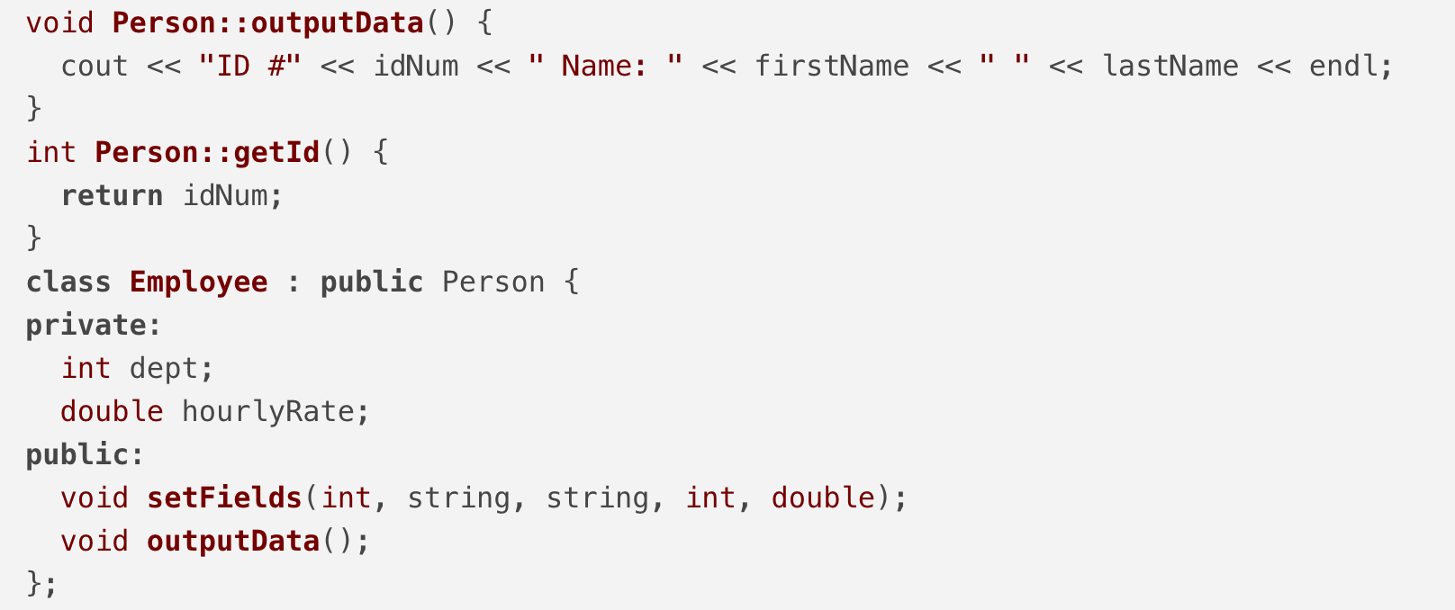
Overriding and Overloading Parent Class Functions

Slide 19
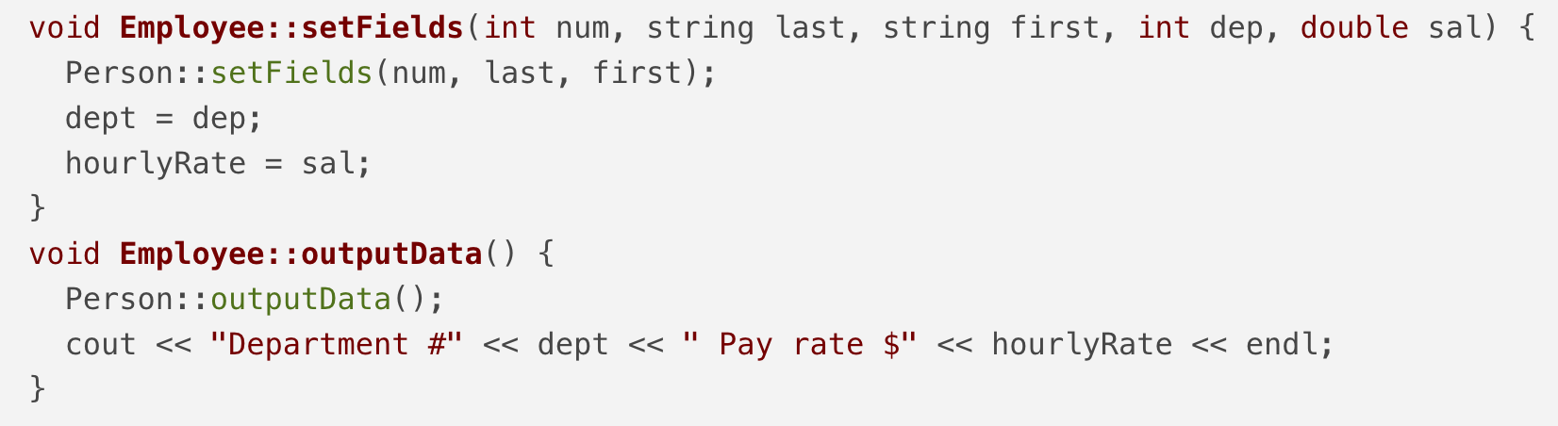
Overriding and Overloading Parent Class Functions

Slide 20
Providing for Base Class Construction
When we instantiate an object, we automatically call its constructor function. When we instantiate a class object that has been derived from another class, a constructor for the base class is called first, followed by the derived class constructor.
If the base class contains only constructors that requires arguments, then we must provide constructor for every derived class. Listing4-4 shows the PetStoreItem with a constructor that takes in two arguments: a int (for the stock number) and a double (for the price). Its derived class, PetStoreAnimal, has to provide a constructor to initialise the data member in both the base class and the derived class.

Slide 21
Providing for Base Class Construction

Slide 22
Providing for Base Class Construction

Slide 23
Using Multiple Inheritance
When a child class derives from a single parent, we are using single inheritance. A child class can derive from more than one base class, this type of inheritance is called multiple inheritance.
Listing4-5 shows how the RV class derives from Vehicle and Dwelling. The RV class inherits from both Vehicle and Dwelling, so both classes are listed after the colon in the class header, separated by commas.

Slide 24
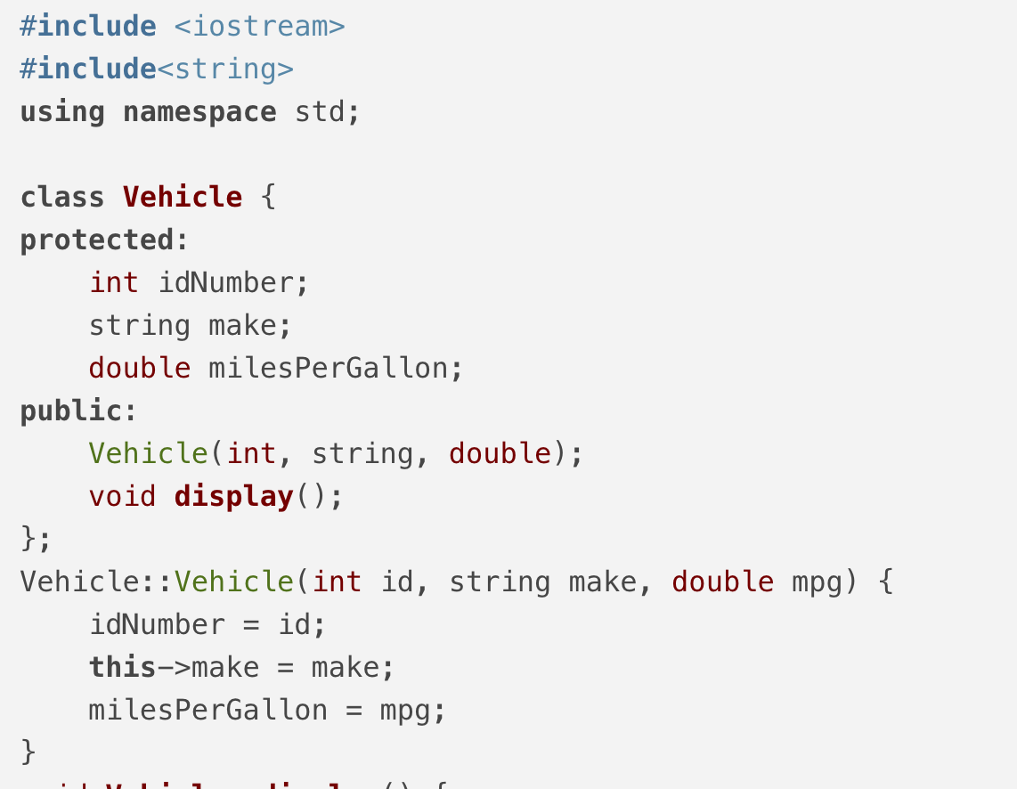
Using Multiple Inheritance

Slide 25
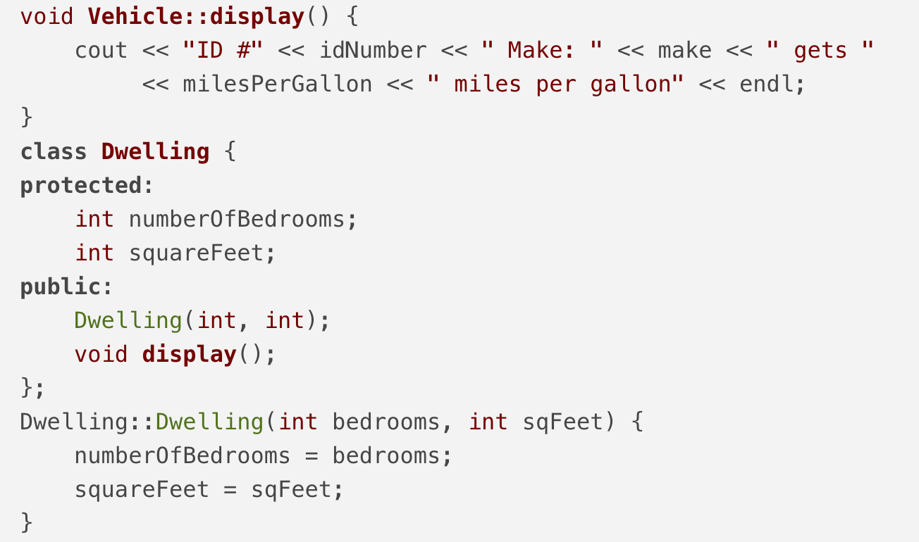
Using Multiple Inheritance

Slide 26
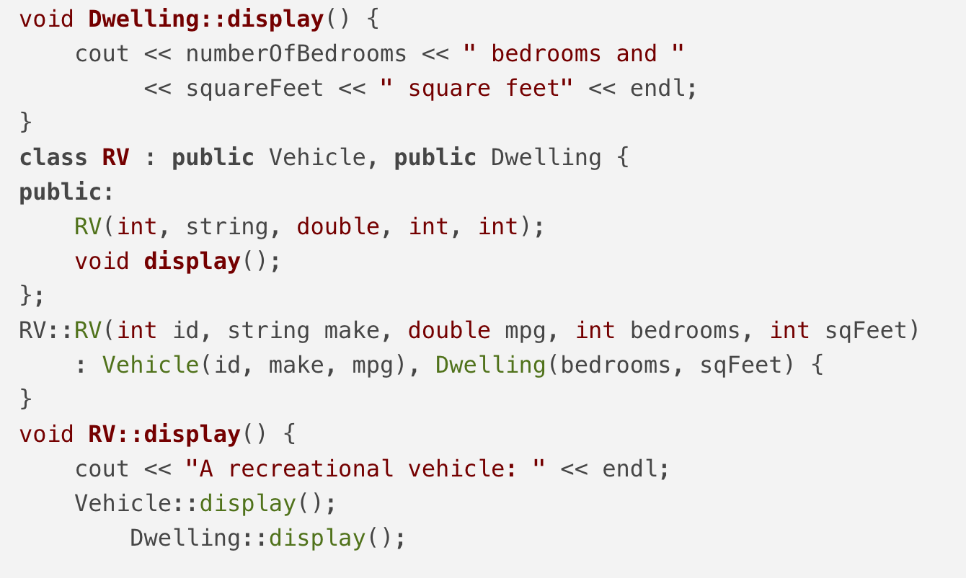
Using Multiple Inheritance

Slide 27
Disadvantages of Using Multiple Inheritance
One problem with multiple inheritance is that if two base classes contain members with the same name, we must use a resolution operator when working with those members. A derived class with more than one base class must provide for the constructors of all base classes, and the syntax can become quite long.
The definition of a class that inherits from a single base class is almost easier to understand and less prone to errors than the definition of a class that inherits from two or more base classes. Multiple inheritance is never required to solve a programming problem; the same result can always be achieved through single inheritance.

Slide 28
Using Virtual Classes
Consider the relationship that occurs when StudentEmployee inherits from both Employee and Student, and both Employee and Student inherit from Person.
The StudentEmployee class ends up being a descendant of Person twice. StudentEmployee would end up with two copies of each member of Person. To avoid such duplicate inheritance, you must use the keyword virtual when you define each of the derived classes.
The word virtual indicates that the base class is used for only once. The headers of the classes become:
class Student : virtual public Person
class Employee : virtual public Person

Slide 29
Using Virtual Classes
Alternatively, we could define StudentEmployee using the keyword virtual in the class definition as follows:

