Slide 1
Study Unit 3 Understanding Inheritance
02-Sep-25

Slide 2

Learning Outcomes
By the end of this Study Unit, you should be able to:
appraise the concept and purpose of a friend in C++ programs
implement a C++ program that declares a friend function
examine the benefits of polymorphism and overloading
implement a C++ program that uses a friend function to access data from two classes implement the general rules that apply to operator overloading
implement a C++ program that overloads an arithmetic operator I
implement a C++ program that overloads operators to work with an object and a primitive type apply the technique to chain multiple mathematical operations in an expression
implement a C++ program that overloads operators to work with an object and a primitive type

Slide 3
Learning Outcomes
apply the technique to chain multiple mathematical operations in an expression
implement a C++ program that
overloads the insertion operator (<<) for output
overloads the extraction operator (>>) for input
overloads the prefix and postfix ++ and – operators
overloads the == operator
overloads the = operator
overloads the subscript and parentheses operators

Slide 4
Definition
This unit provides an outline of the contents from Chapter 9 of the textbook Object-Oriented Programming Using C++ by Joyce Farrell.
We will apply an object-oriented technique that allows some external functions to access private data, so that we can add “natural” language features to our objects.
This unit also expand our mastery over object-oriented programming in C++ by introducing friend functions and operator overloading. These features allow us to create classes that can be used in an intuitive manner

Slide 5
What are Friends?
Encapsulation and data hiding are two primary features of object-oriented programs. We use data hiding when we create private class members; they remain inaccessible to functions that do not belong to the same class.
Sometimes, it is, however, convenient to allow an external, non-member function to have access to a private data member. A friend function is a function that can access non-public members of a class, even though the function itself is not a member of the same class.
When we create a function, we cannot simply call it a friend function and declare it to be the friend of a given class. Rather, when we create a class, we must declare the names of the functions we allow to be friends with our class.
Do not write friend functions simply to overcome data encapsulation – this approach violates the spirit of object-oriented programming. Later, we will earn about overloading operators, in which friendship sometimes plays a useful part.
Notes:
Encapsulation in object-oriented programming (OOP) is the principle of bundling data (variables) and the methods (functions) that operate on that data into a single unit (a class), while also controlling access to that data.
Key Ideas:
Data Hiding: Class members are marked private, protected, or public to restrict direct access.
Controlled Access: Access to private data is provided through public methods (getters and setters).
Modularity: Objects manage their own state; outside code cannot alter data directly unless permitted.

Slide 6
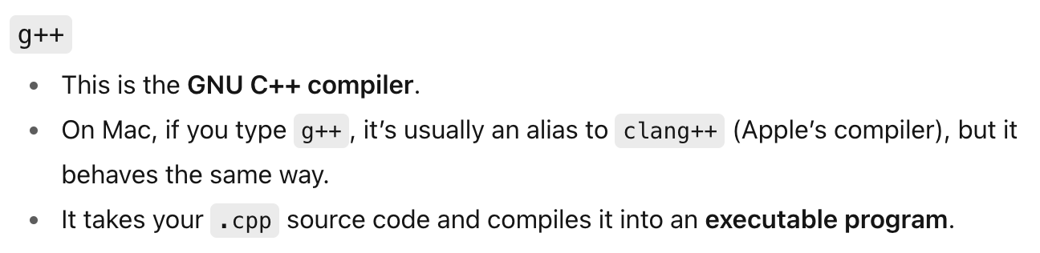
How to Declare a Function as a Friend
a class named Customer that contains three functions, of which two are members of the same class. The third function is named displayAsAFriend(); it is not a member of the Customer class but a friend. The displayAsAFriend() function is a non-member function that has access to private data members custNum and balanceDue: It cannot use the class name Customer and the scope resolution operator in the function header. It does not need to be declared in the public section of the class definition. It must use the C++ keyword friend in the declaration.
Demo: Listing3-1 The Customer class and a friend function

Slide 7
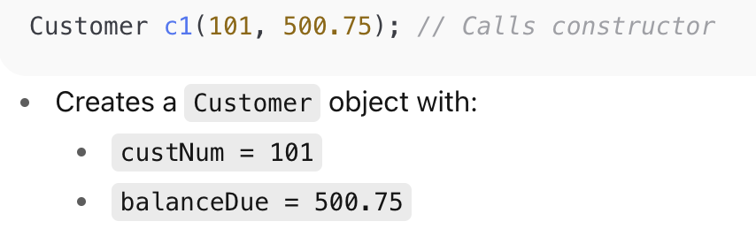
How to Declare a Function as a Friend
Constructor: A special function in a class that runs automatically when an object is created. Its main role is to initialize data members.
Name matches the class: Customer::Customer → the function name is the same as the class name (Customer), so C++ recognizes it as a constructor, not a normal function.
Parameters: (int num, double balance) → this constructor takes two arguments:
num (an integer, e.g., customer ID).
balance (a double, e.g., outstanding balance).
Scope resolution operator ::: Used because the constructor is defined outside the class body, so we write Customer::Customer to say “this constructor belongs to the Customer class.”

Slide 8
Understanding the Benefits of Overloading and Polymorphism
We overload ordinary C++ functions when we give two functions the same name but different parameter lists. We overload C++ constructors by creating two or more constructors for the same class. Having more than one function with the same name is beneficial.
We can use one easy-to-understand function name without regarding the data types involved. Polymorphism allows such operation to be carried out differently, depending on the object.
When we overload a function, the function name is polymorphic. C++ operators are the symbols we use to perform operations on objects. These include arithmetic operators, logical operators, and insertion and extraction operators.
Separate actions can result from same operators when applied to different data types. To be able to use arithmetic symbols with our own objects, we must overload the symbols.

Slide 9
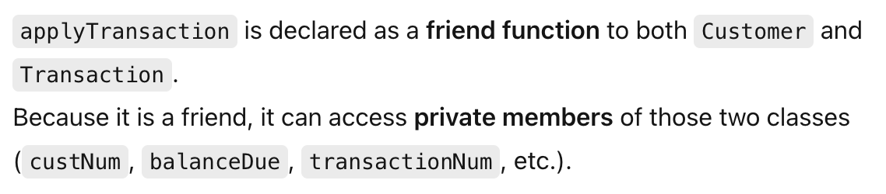
Using a friend Function to Access Data from Two Classes
Demo 3-2
function named applyTransaction() that we can use it as a friend function. It needs two parameters, a Customer and a Transaction. The friend function will also display data from the Customer object, applies the payment amount of the Transaction object to the balanceDue of the Customer object, and display Transaction data.
The declaration of the applyTransaction() function refers to both the Customer and the Transaction class as parameters.
No matter which class we define first, we have to make reference to the other class before it is defined. The solution is to use a forward declaration, which is a statement that lets the compiler knows that the class exist, and the details will come later.

Slide 10
Overloading Operators – The General Rule
Operator overloading is the process by which apply operators to our own abstract data types. The +, -, * and / symbols make it easy to work with built-in data types such as int and double. Classes contain a variety of data members. If we want the compiler to perform arithmetic with two objects, we must tell the compiler what we need.
We must overload an operator by making it a function; subsequently, we can use it just like any other function. There is no need to overload every available operator for each defined class. We choose the operator that we need, and which make sense for our class.
C++ operators are classified as unary or binary, depending on whether they take one or two parameters, respectively. If an operator is usually defined as a unary, we cannot overload it to become binary, and vice versa. Associativity refers to the order in which actions within an expression are carried out. We cannot change associativity when we overload operators. We cannot change the normal precedence of any operator.

Slide 11
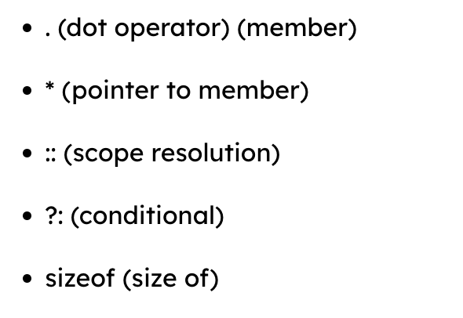
Overloading Operators – The General Rule
Associativity refers to the order in which actions within an expression are carried out. We cannot change associativity when we overload operators. We cannot change the normal precedence of any operator. We cannot overload an operator we invent, e.g. $. The five operators that cannot be overloaded are:

Slide 12
Overloading an Arithmetic Operator
Demo-3-3 shows an Employee class containing an operator+() function and an operator-() function. We have specified the rules for applying the + and the – operators on two Employee instances.
Both operator functions return a double; the + operator returns the sum of their salary, and the – operator returns the difference of their salary. We may overload other arithmetic operators and specify other reasonable rules.
When we use the operator-() function, we must use the two Employee objects we want to subtract in the correct order. When we use a subtraction expression such as diff = driver – clerk in a C++ program, the driver object is the object that calls the operator-() function.
The second operand in the expression driver – clerk is the clerk.
It is the clerk who becomes the passed parameter emp in the function header.

Slide 13
Overloading an Operator to Work with an Object and a Primitive Type
When we add two objects using the + operator (or any binary operator), the objects do not have to be the same type on both sides of the operator.
We can add an object and a primitive data type, but we must overload the + operator appropriately. Each of the two overloaded operator+() functions in demo 3-4 works with two operands: an Employee object and a double.
The member function, Employee operator+(double);, is where the first operand is an Employee object and the second operand is double.
The friend function, friend double operator+(double, Employee);, is where the first operand is a double, and the second operand is an Employee object.
Demo 3-4

Slide 14
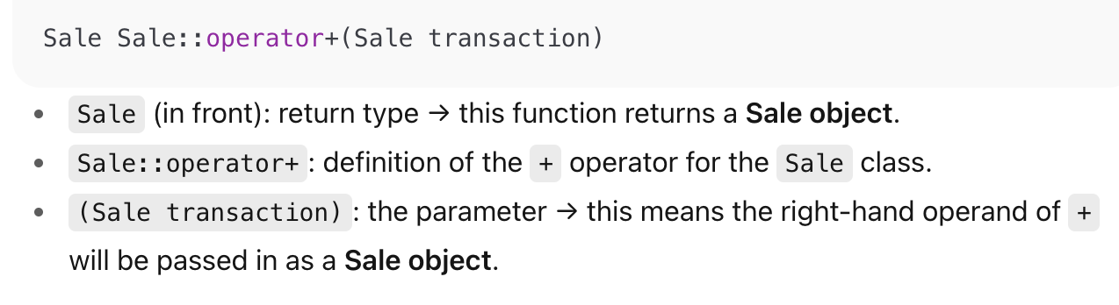
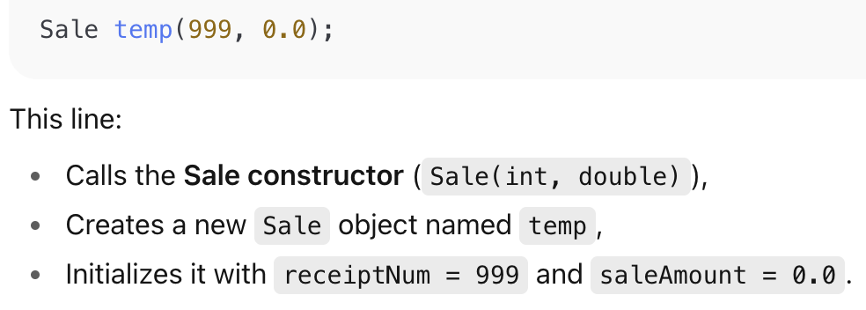
Using Multiple Operations in an Expression
Most modern programming languages allow us to chain operations. They allow several operators to be used within a same expression, e.g. total = a + b + c; We should consider creating operators for our own classes to support chain operations.
Demo 3-5 shows a Sale class that includes an overloaded operator+() function. The overloaded operator+() function is written to allow the addition of multiple Sale objects in sequence.

Slide 15
Overloading Output
The << operator acts as an output operator only when cout (or another output stream object) appears on the left side. Here, cout becomes the driving object in the overloading operator<<() function.
To overload the << operator to work with the Sale object, we must add the overloaded operator<<() function prototype to the Sale class:
The operator<<() function is a friend to the Sale class. It receives a reference to an ostream object and a reference to a Sale. The Sale reference can be defined as const because the output should not alter the Sale data.
The content of a function body can display a Sale with any desired text and in any format we want. The data being displayed is the data that belongs to the Sale object, which is the argument that appears on the right of << in a cout statement.

Slide 16
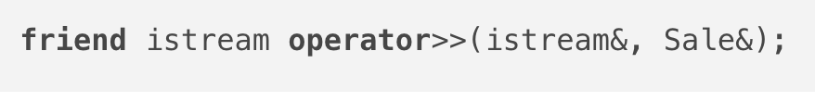

Overloading Input
The extraction operator (>>) can be overloaded for input using the operator>>() function. The advantage of overloading operators such as >> is that the resulting programs look cleaner and are easier to read.
Consider a Sale class that contains a receiptNum and a saleAmount. We can create an extraction operator, or operator>>() function, by using a prototype as follows:
The parameters of the operator>>() function are istream objects and Sale objects. Unlike the Sale object in the operator<<() function, the Sale object that receives data values cannot be passed to this function as a constant.
This is because this function needs to change the Sale’s data values through data entry. When we write a program that uses a Sale class member such as aShirt, we only need the following code:

Slide 17
Overloading the Prefix ++ and -- Operator
With C++, we use ++ to increment variables, and -- to decrement variables. It is important to take note of the difference in how expressions are evaluated when the ++ or the -- is placed before a variable, rather than after the variable.
When a prefix operator such as ++ is used in an expression, the mathematical operations takes place before the expression is evaluated.
When the postfix operator is used, the expression is evaluated before the mathematical operation takes place. We can overload the prefix ++ or -- operators to use with our own class object; the function names are operator++() and operator--().
When you use ++ or -- for objects, the same prefix and postfix rules apply as they do with simple built-in types. Consider the Inventory class definition with data members for a stock number and a quantity sold.
We can create an operator++() function for incrementing the quantity sold each time a sale occurs i.e. Inventory& operator++()

Slide 18
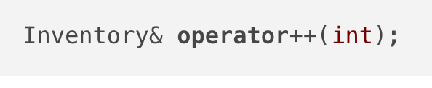
Using Postfix Increment and Decrement Operators
For the postfix ++ operator, we use an integer parameter to distinguish it from the prefix ++ operator. The Inventory class postfix operator++() function prototype is:
The int parameter to the Inventory class operator++() function is a dummy parameter. The parameter is not used within the function but exists only to provide a different function prototype.
If we call the prefix ++ operator function with a statement such as ++item;, the function without the dummy parameter executes. If we call the postfix ++ operator function with a statement such as item++;, the function with the dummy parameter executes.

Slide 19
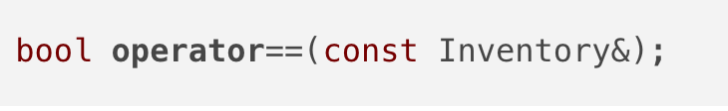
Overloading The == Operator
When writing an operator==() function, we need to decide what will constitute to equality in class members. When we create our own class, we can decide whether equivalency means every data field must be equivalent, or only specific data members.
The operator==() function usually returns with either an integer value representing “0” or “1” or a boolean variable representing “true” or “false”.
For the operator==() that returns with a boolean value, the prototype would be

Slide 20
Overloading The = Operator
If we want the = operator to do something other than assigning each member, then we must create a custom operator=() function. If a class contains a pointer and we create two objects from the class and assign one object to the other, then the two objects will contain pointers to the same memory.
This overlap may not pose a problem unless one of the object is deleted or goes out of scope. When the destructor is called for the first object, the memory to which that object points is released.
The second object contains a pointer to deallocated memory, a memory that is no longer assigned to anything in the application. When you declare any data field, you allocate memory for that field – that is, you allocate storage for it and assign a name to the location.
When you dynamically allocate memory, you use a pointer variable so as to assign the starting address of the new block of memory to it. In C++ we use the new operator to dynamically allocate memory and the delete operator to free the previously allocated memory.

Slide 21
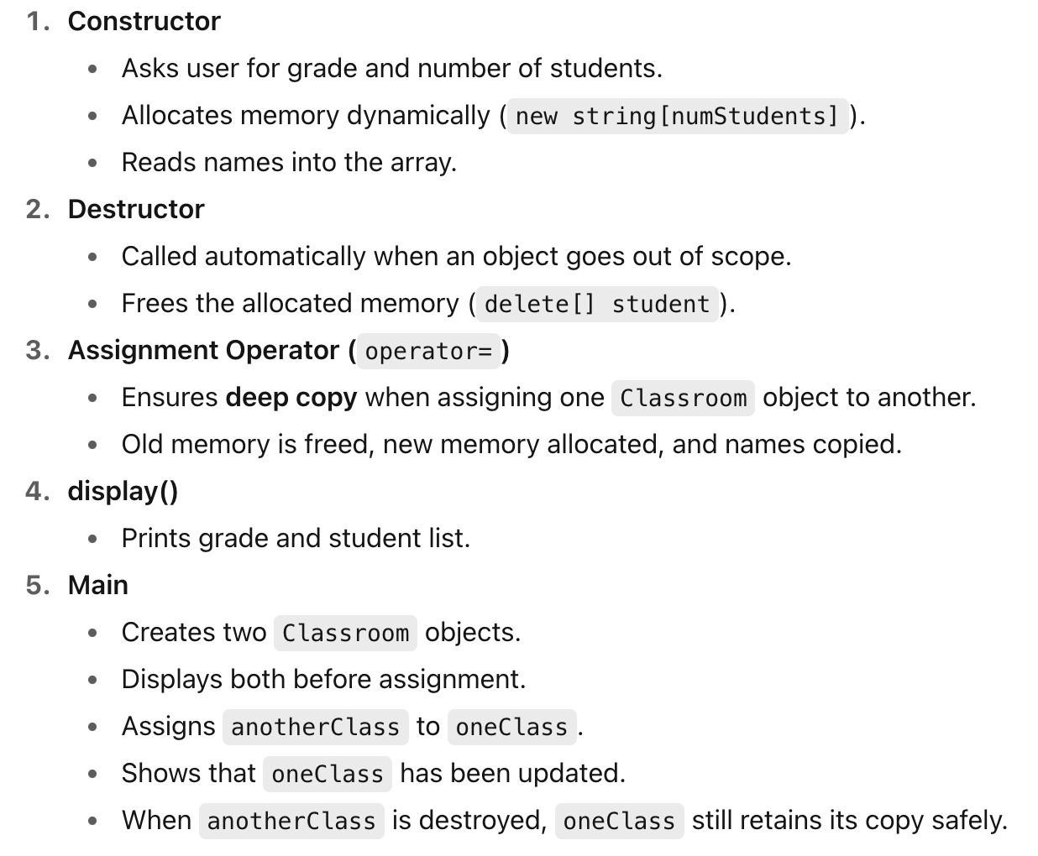
Overloading The = Operator: Demo 3-6

Slide 22
Overloading [ ] and ( )
The subscript operator, operator[], is declared like any other function, but called in a manner similar to accessing an array element. We can include any instruction we want within an operator[] function. We may use the operator[] function to access an element of a class.
We may also use it to perform a task that both requires an argument and codes that not quite fit to another operator’s usual meaning.
We can use the parenthesis operator, operator(), as an alternative way to make assignment to an object. Usually, we would use this function only when we want it for a logical purpose which is already used by another operator.
Suppose we have created an Inventory class with a constructor that initialises the fields to default values; if we want an additional set function to set field values and apply a discount to the price.
Demo-3-7 shows how we can overload the operator() to meet this objective

Slide 23
Overloading [ ] and ( )
The subscript operator, operator[], is declared like any other function, but called in a manner similar to accessing an array element. We can include any instruction we want within an operator[] function. We may use the operator[] function to access an element of a class.
We may also use it to perform a task that both requires an argument and codes that not quite fit to another operator’s usual meaning.
We can use the parenthesis operator, operator(), as an alternative way to make assignment to an object. Usually, we would use this function only when we want it for a logical purpose which is already used by another operator.
Suppose we have created an Inventory class with a constructor that initialises the fields to default values; if we want an additional set function to set field values and apply a discount to the price.
Demo-3-7 shows how we can overload the operator() to meet this objective

Slide 24
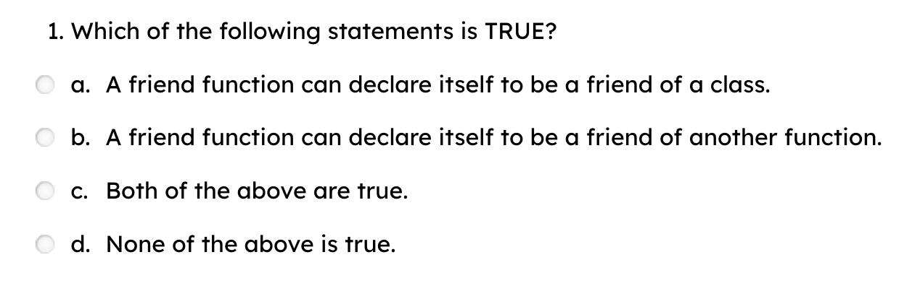
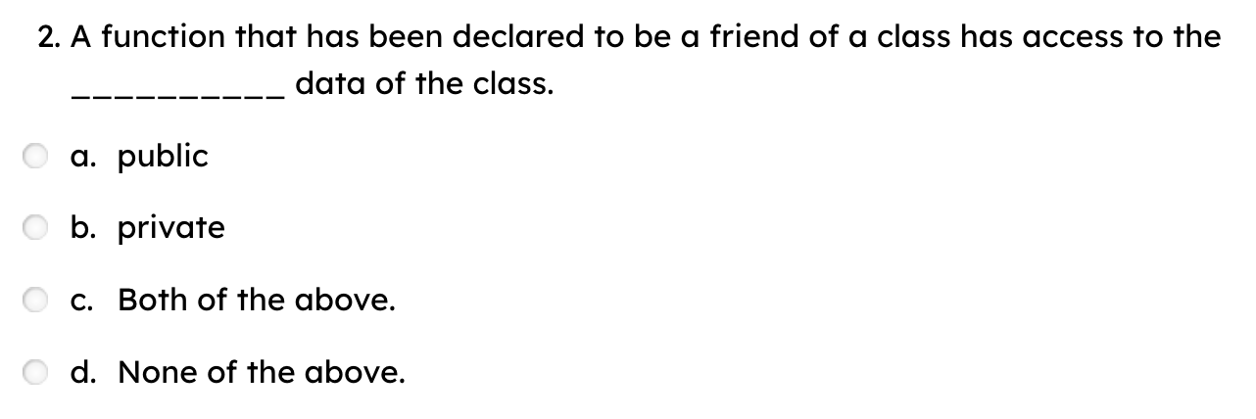
Quiz:

Slide 25
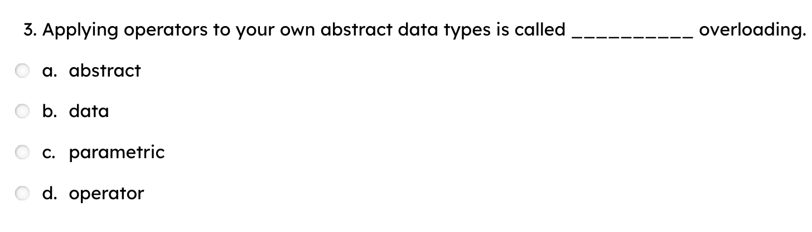
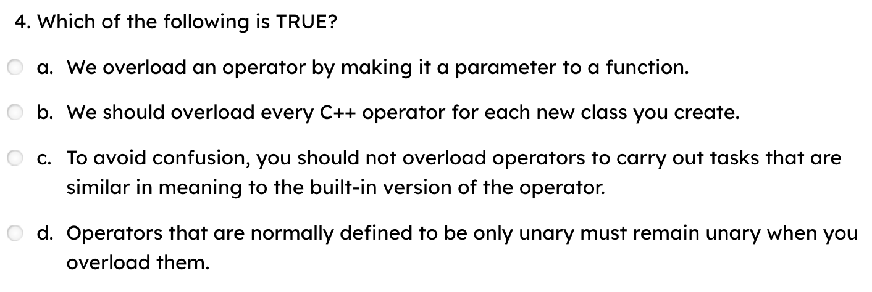
Quiz:

Slide 26
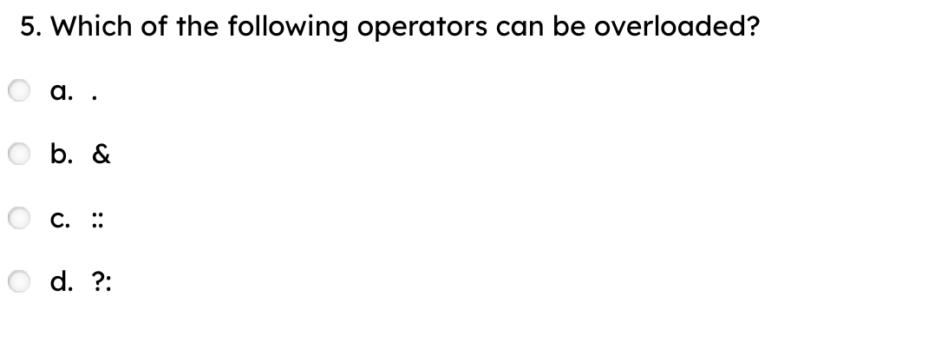
Quiz:

