Slide 1
Study Unit 4 Simple Directmedia Layer – Part 1
29-Sep-25

Slide 2

Learning Outcomes
By the end of this Study Unit, you should be able to:
assemble and set up an SDL Library and create our first window
implement an SDL program that blits an image onto a window
illustrate the use of SDL programs to handle user input by allowing users to X out a window
illustrate the use of SDL programs to handle keyboard input
demonstrate the use an SDL_image extension library to load png images
appraise the hardware accelerated based on 2D rendering feature to load an image and to render it
appraise the hardware accelerated primitive rendering feature to render common shapes

Slide 3
Overview
This unit provides an outline of the contents of lessons 1 to 8 of the online SDL tutorial at http://lazyfoo.net/tutorials/SDL/index.php
We will be introduced the Simple DirectMedia Layer (SDL). We will assemble SDL components (header files, library files and binary files) so that we can implement C++ program that is able to access the SDL functions.
We will blit images to the screen and also implement SDL programs that can handle mouse and keyboard events. We will load image files (bmp and png), stretching them to fit the screen.
We will also implement 2D and primitive rendering using SDL2 hardware’s accelerated based features.

Slide 4
Overview
SDL startup → window creation → surfaces → blit → event loop → cleanup.
Image loading: BMP vs. PNG (via SDL_image), format conversion, stretching.
Event-driven programming: QUIT, KEYDOWN, simple keyboard handling.
Transition to renderer/texture & geometry drawing.
C++ OOP fundamentals used in SDL simulations: classes, static members, constructors, destructors, operator overloading.
Common pitfalls / debugging tips: missing free calls, missing SDL_RenderPresent, uninitialized variables, no delay in loops

Slide 5
Introduction
A popular choice among game developers, both beginners and experts alike, is the Simple DirectMedia Layer (SDL). It is a cross-platform library that functions as a thin layer between your game and the underlying operating system.
This makes it possible for a game written using SDL to run on various versions of Windows as well as other platforms such as Linux and MacOS. For the purpose of this course (MTD215), we will focus our discussion on using SDL with Microsoft Visual C++.

Slide 6
Setting up SDL
SDL is a dynamically linked library.
It has three parts:
The header files (.h)
The library files (.lib)
The binary files (.dll)
The C++ compiler needs to be able to find the header files when compiling, so it knows what SDL_Init() and the other SDL functions and structures are. After the C++ compiler compiles all the source files, it has to string them together.
In order for the program to string properly, it needs to know the addresses of all our functions including the ones for SDL. In order to run a dynamically strung application, we need to be able to import the library binaries at runtime. Our operating system needs to be able to find the library binary when we run our program.

Slide 7
Setting up SDL
Go to http://lazyfoo.net/tutorials/SDL/01_hello_SDL/windows/msvsnet2010u/index.php.
Follow the instructions from steps 1 to 14 to setup an SDL for Visual C++. We will be ready to write our first SDL application.

Slide 8
Hello SDL: Your First Graphics Window
This topic and the sample source code are based on the materials from the website http://lazyfoo.net/tutorials/SDL/01_hello_SDL/index2.php.
Listing5-1 shows a simple SDL program displaying a graphics window for two seconds. We #include the header file (SDL.h) since we are going to need the SDL functions and datatypes to run any SDL code.
It's important that we have the arguments of the main() function as an integer followed by a char* array. The return type will be an integer. An SDL surface (SDL_Surface) is just a 2D image. A 2D image can be loaded from a file or it can be the image inside of a window.

Slide 9
Hello SDL: Your First Graphics Window
The SDL_Init() function is used to initialise the SDL subsystems. Since all we care about is using SDL's video subsystem, we will only be passing it the SDL_INIT_VIDEO flag.
We create a window using the SDL_CreateWindow function. The first argument sets the window's caption or this part of the window. The next two arguments define the positions of “x” and “y” in the window they are created in.
Since we don't care where it has been created, we just put SDL_WINDOWPOS_UNDEFINED for the x and y positions. The next two arguments define the window's width and height. The last argument are the creation of flags. An SDL_WINDOW_SHOWN makes sure the window is shown when it is created.
A call to SDL_UpdateWindowSurface will update the window, showing everything we drew. SDL_Delay will wait for a given amount of milliseconds so as to keep the window from disappearing. Finally, we will destroy (using SDL_DestroyWindow) the window to free its memory and quit SDL (using SDL_Quit).

Slide 10
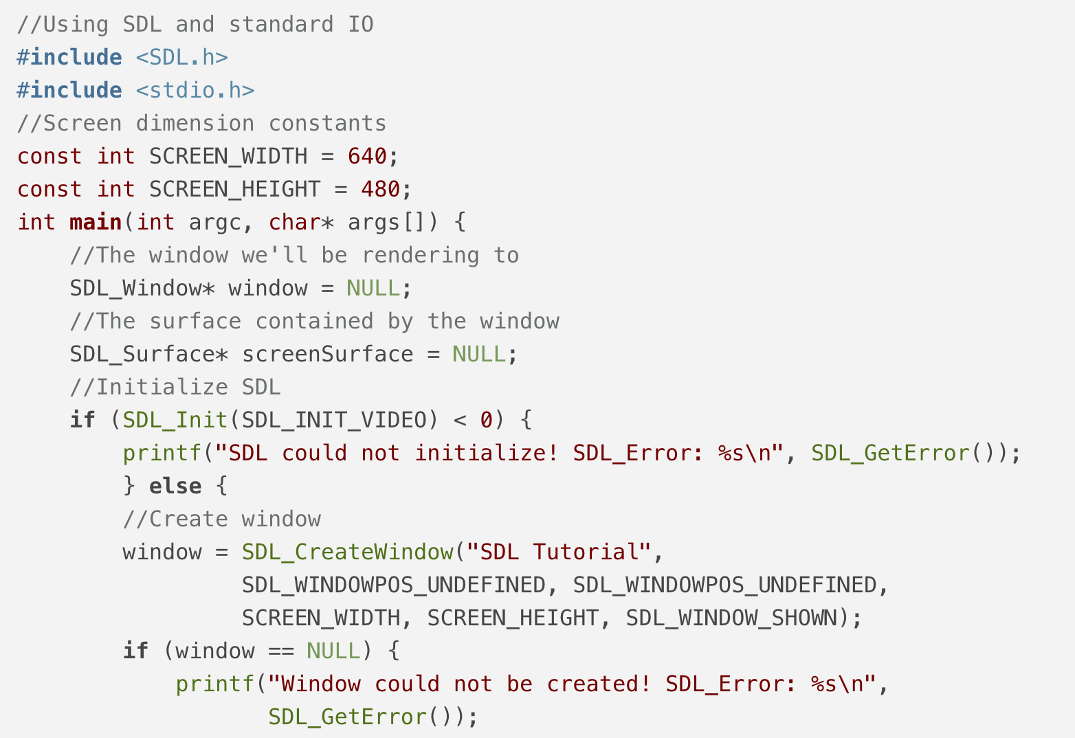
Hello SDL: Your First Graphics Window: Listing 5.1 A simple SDL program

Slide 11
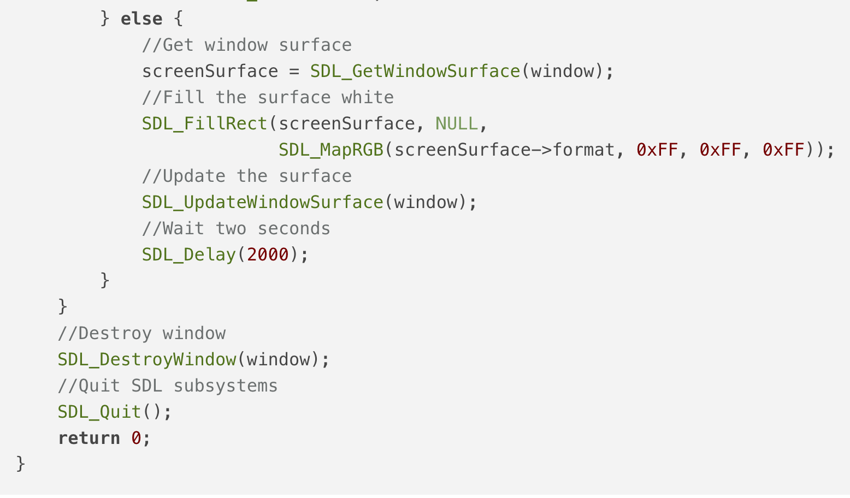
Hello SDL: Your First Graphics Window: Listing 5.1 A simple SDL program

Slide 12
Getting an Image on the Screen
This topic and the sample source code are based on the materials from the website: http://lazyfoo.net/tutorials/SDL/02_getting_an_image_on_the_screen/index.php.
In this lesson, we shall implement a SDL program that loads an image file and displays the image on screen.
The two global variables we have to declare are two SDL Surface objects (see Listing5-2a). An SDL surface is just an image data type that contains the pixels of an image along with all the other data needed to render it.
SDL surfaces use software rendering which means it uses the CPU to render. The images we are going to be dealing with here are the screen image and the image we will be uploading from a file.
These are pointers to SDL surfaces and we will be dynamically allocating memory to load images. We want to show images inside of the window. In order to do that we need to get the image inside the window.

Slide 13
Getting an Image on the Screen
In the init() function, we call SDL_GetWindowSurface to grab the surface contained by the window (see Listing5-2b). In the loadMedia() function, the SDL_LoadBMP function will take in the path of a bmp file and return the loaded surface (see Listing5-2c).
In the close() function, we use SDL_FreeSurface to free the surface we loaded (see Listing5-2d). SDL_DestroyWindow will take care of freeing the screen surface. In the main() function, we initialise SDL and load the image. We then blit the loaded surface onto the screen surface using SDL_BlitSurface (see Listing5-2e).
What blitting does is that it takes a source surface and stamps a copy of it onto the destination surface. The first argument of SDL_BlitSurface is the source image. The third argument is the destination.

Slide 14
Getting an Image on the Screen
After drawing everything on the screen that we want to show for this frame we have to update the screen using SDL_UpdateWindowSurface. When you make draw calls like SDL_BlitSurface, you have to render to the back buffer.
What we have to do now is to draw everything to the back buffer first. Once we're done with that, we shall swap the back and front buffers. The user can now see the finished frame. This is known as “double buffering”.

Slide 15
Event Driven Programming
This topic and the sample source code are based on the materials from the website: http://lazyfoo.net/tutorials/SDL/03_event_driven_programming/index.php.
In this lesson, we will implement an SDL program that handles the SDL_QUIT event.
Listing5-3a to Listing5-3d are very similar to those in the previous program. In the main() function, we handle input from the user with SDL using the event-handling system (see Listing5-3e).
An SDL event (SDL_Event) is an object that represents a key press, mouse motion, joy button press, etc. With this application, we are going to look for quit events to end the application. When we press a key, move the mouse, or touch a touch screen, we are putting events into the event queue.

Slide 16
Event Driven Programming
The event queue will then store them in the order of the events occurred, waiting for us to process them. When we want to find out what events occurred are, we have to poll the event queue to get the most recent event by calling SDL_PollEvent.
SDL_PollEvent will keep taking events off the queue until it is empty. When the queue is empty, SDL_PollEvent will return to “0”. If an event from the event queue is an SDL_QUIT event (which is the event when the user X out the window), we set the quit flag to “true” to exit the application.

Slide 17
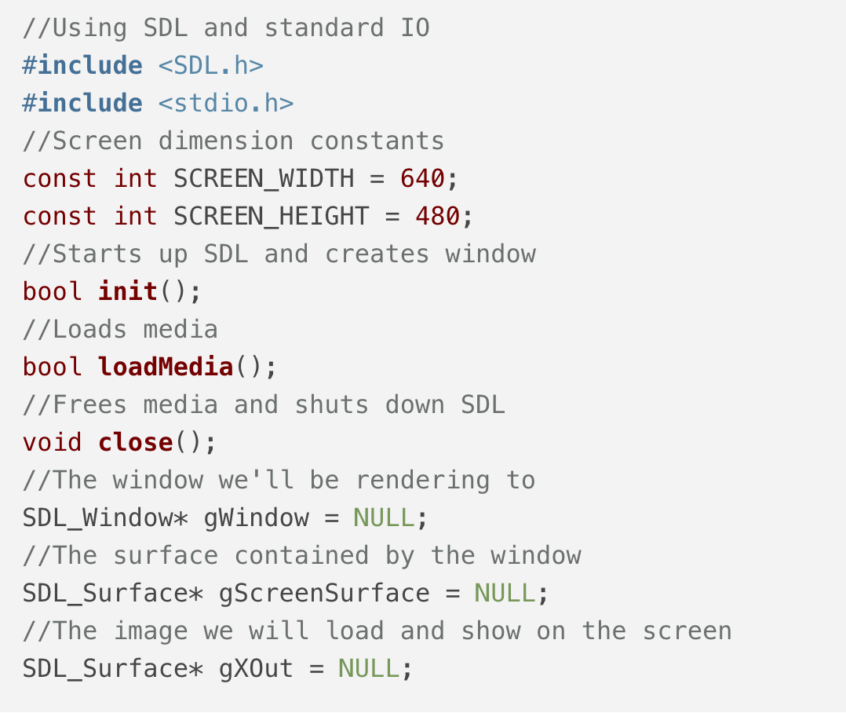
Listing5-3a Headers, global variables and function prototypes

Slide 18
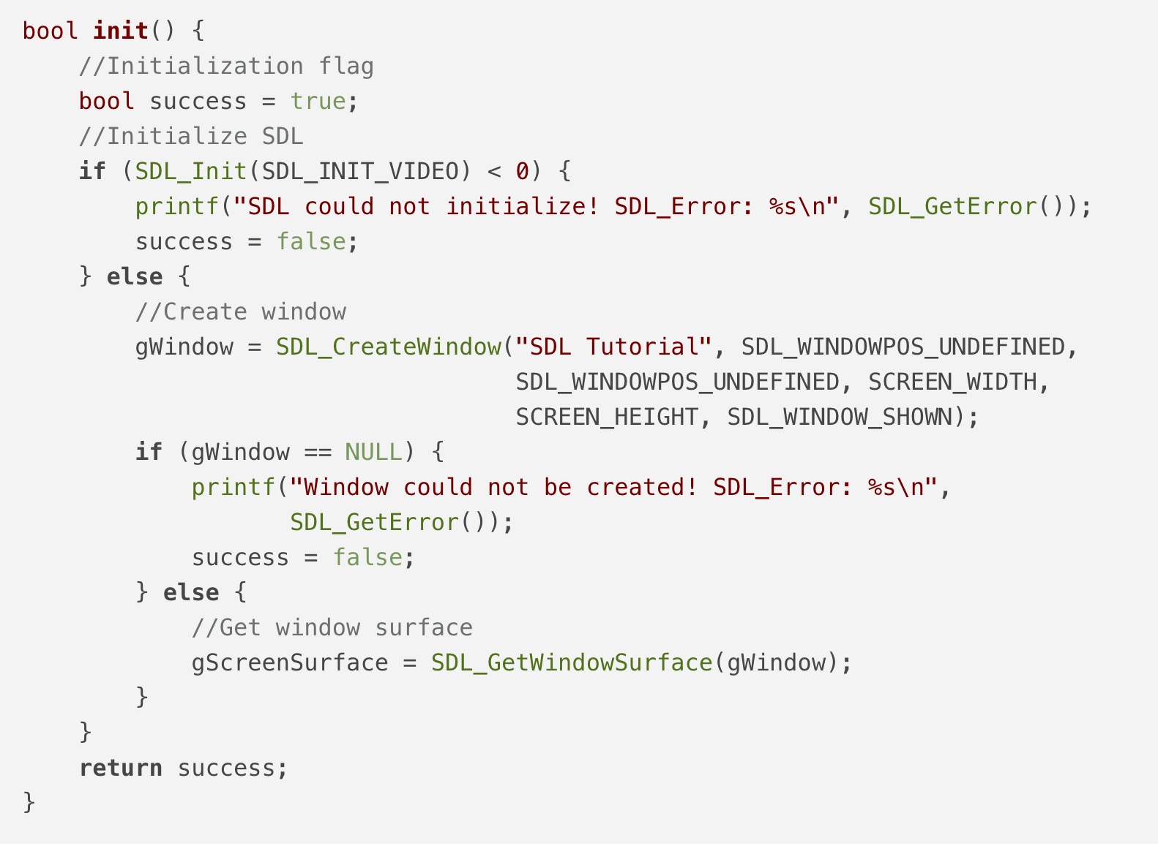
Listing5-3b The init() function

Slide 19
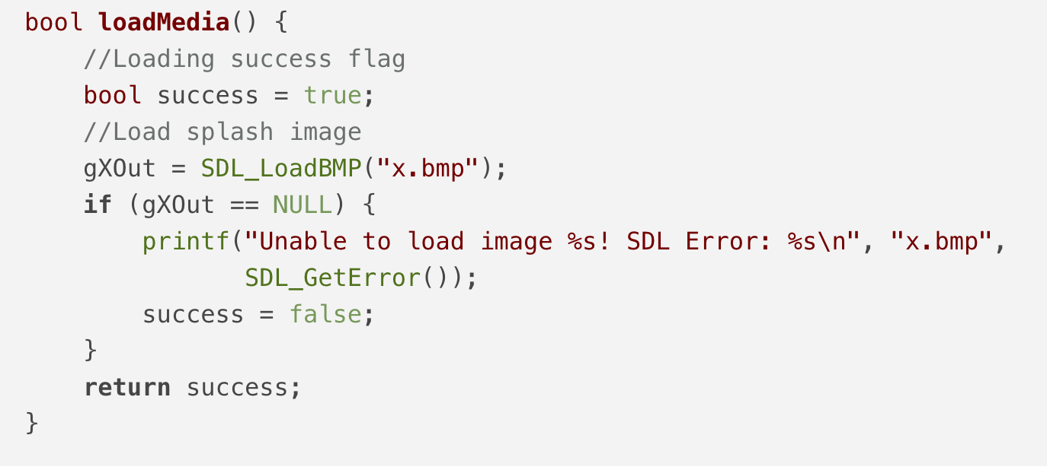
Listing5.3c The loadMedia() function

Slide 20
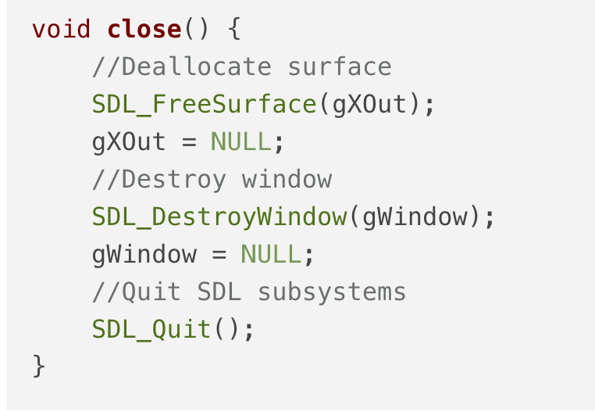
Listing5.3d The close() function

Slide 21
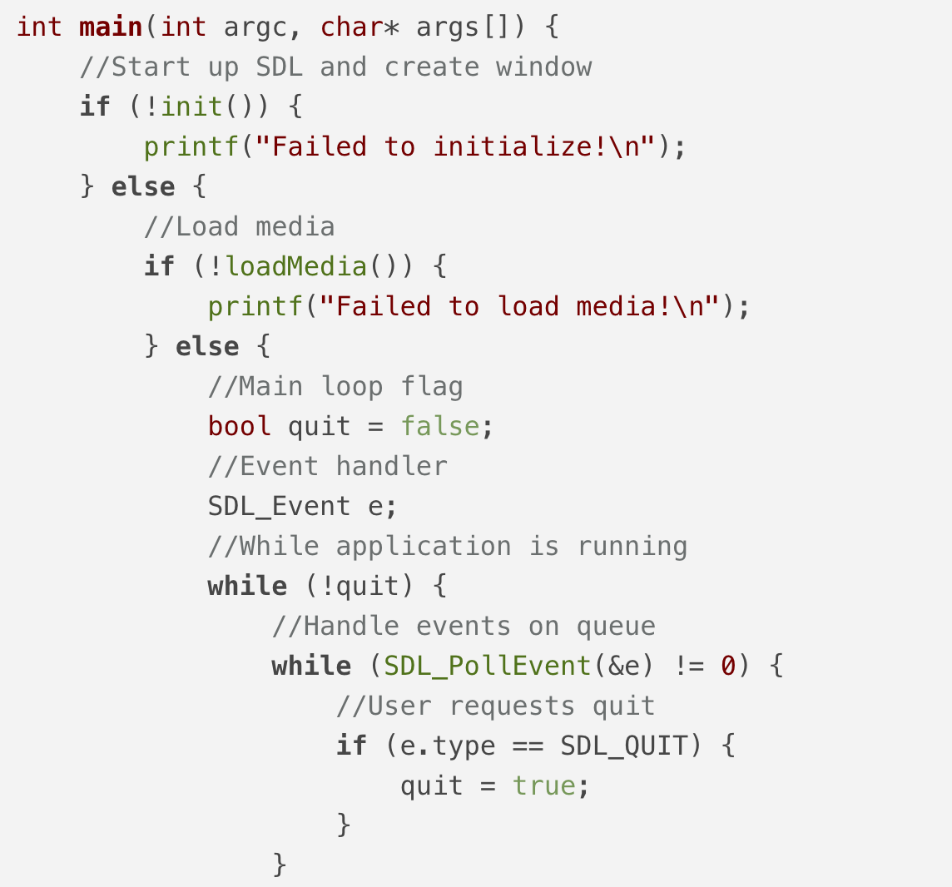
Listing5-3e The main() funciton

Slide 22
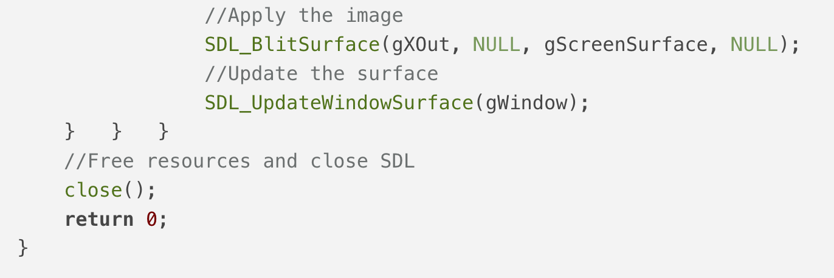
Listing5-3e The main() funciton

Slide 23
Key Presses
This topic and the sample source code are based on the materials from the website: http://lazyfoo.net/tutorials/SDL/04_key_presses/index.php. In this lesson, we will implement an SDL program in the event when one of the arrow keys is pressed.
We have an array of pointers to SDL surfaces called gKeyPressSurfaces to contain all the images we will be using (see Listing5-4a). Depending on which key the user presses, we will set gCurrentSurface (which is the image that will be blitted to the screen) to one of these surfaces.
Our event loop is situated in the main() function (see Listing5-4f). In the event loop, we handle the SDL_QUIT (Closing the window) event and the SDL_KEYDOWN event.

Slide 24
Key Presses
Our event loop is situated in the main() function (see Listing5-4f). In the event loop, we handle the SDL_QUIT (Closing the window) event and the SDL_KEYDOWN event.
Inside of the SDL Event is an SDL Keyboard event which contains information for the key event. Inside of that is a SDL keysym which contains the information about the key that was pressed.
That keysym contains the SDL key code which identifies the key that was pressed. The code sets the surfaces based on which key that was pressed. After the keys have been handled and the surface has been set, we will blit the selected surface to the screen.

Slide 25
Key Presses
Our event loop is situated in the main() function (see Listing5-4f). In the event loop, we handle the SDL_QUIT (Closing the window) event and the SDL_KEYDOWN event.
Inside of the SDL Event is an SDL Keyboard event which contains information for the key event. Inside of that is a SDL keysym which contains the information about the key that was pressed.
That keysym contains the SDL key code which identifies the key that was pressed. The code sets the surfaces based on which key that was pressed. After the keys have been handled and the surface has been set, we will blit the selected surface to the screen.

Slide 26
Optimised Surface Loading and Soft Stretching
This topic and the sample source code are based on the materials from the website: http://lazyfoo.net/tutorials/SDL/05_optimized_surface_loading_and_soft_stretching/index.php.
In this lesson, we will implement an SDL program that uses the technique of faster blitting and image stretching.
When we are developing a game, we need to convert images into their optimised formats to speed up the blitting process. SDL 2 has also a new feature for SDL surfaces, called “soft stretching”. It allows you to blit an image and scale it to a different size.
When we load a bitmap, it is typically loaded in a 24bit format since most bitmaps are 24bit. Most, if not all, modern displays are not 24bit by default. If we blit an image that's 24bit onto a 32bit image, the SDL will convert it every single time the image is blitted.

Slide 27
Optimised Surface Loading and Soft Stretching
When an image is loaded, we should convert it into the same format as the screen so no conversion is needed to be done on blit. This can be done with SDL_ConvertSurface
We have to pass the surface we want to convert with the format of the screen. Note that SDL_ConvertSurface returns a copy of the original format in a new format. The original loaded image is still in the memory after this call.
We have to free the original loaded surface or we will have two copies of the same image in memory. The SDL 2 has a new dedicated function to blit images to a different size: SDL_BlitScaled
SDL_BlitScaled takes in a source surface to blit onto the destination surface. It also takes in a destination, SDL_Rect, which defines the position and size of the image we are blitting.

Slide 28
Extension Libraries and Loading Other Image Formats
This topic and the sample source code are based on materials from the website: http://lazyfoo.net/tutorials/SDL/06_extension_libraries_and_loading_other_image_formats/index.php.
In this lesson, we will implement an SDL program that loads a png image file and display it on the screen.
We need to download SDL_image headers and binaries from the SDL_image website http://www.libsdl.org/projects/SDL_image/. We also need to go to the configuration properties to tell Visual C++ where to search for header files (include Directories) and library files (Library Directories).
We need to go to <linker><input><Additional Dependencies> and add the text SDL_image.lib. Next, copy all “dll” files and put them either in our project's working directory (where the vcxproj file is at), or inside of the system directory.

Slide 29
Extension Libraries and Loading Other Image Formats
In the program, we want to initialise SDL_image with PNG loading, so we pass the PNG loading flags into IMG_Init. The IMG_Init will return the flags that that have been successfully loaded. If the flags returned do not contain the flags we requested, that means there is an error.
We use IMG_Load as opposed to SDL_LoadBMP to upload our image file. The IMG_Load can upload many different types of format which we can find out about in the SDL_image documentation.

Slide 30
Texture Loading and Rendering
This topic and the sample source code are based on the materials from the website: http://lazyfoo.net/tutorials/SDL/07_texture_loading_and_rendering/index.php.
In this lesson we will implement an SDL program that loads an image and render it using textures.
Textures in SDL have their own data type which is intuitively called an SDL_Texture. When we deal with SDL textures we need an SDL_Renderer to render it to the screen.
We have to declare a global renderer named "gRenderer". We also have to create a renderer (by calling SDL_CreateRenderer) for our window so we can render textures on it (see Listing5-7b).

Slide 31
Texture Loading and Rendering
This topic and the sample source code are based on the materials from the website: http://lazyfoo.net/tutorials/SDL/07_texture_loading_and_rendering/index.php.
In this lesson we will implement an SDL program that loads an image and render it using textures.
Textures in SDL have their own data type which is intuitively called an SDL_Texture. When we deal with SDL textures we need an SDL_Renderer to render it to the screen.
We have to declare a global renderer named "gRenderer". We also have to create a renderer (by calling SDL_CreateRenderer) for our window so we can render textures on it.

Slide 32
Texture Loading and Rendering
Next, we shall initialise the rendering of colours using SDL_SetRenderDrawColor. This controls what colour is used for the various rendering operations. We shall then create a texture from the loaded surface using SDL_CreateTextureFromSurface.
This function creates a new texture from an existing surface. That means we have to free the loaded surface and then return the loaded texture. When we are done with the texture, we have to remember to de-allocate the textures using SDL_DestroyTexture.
In the main loop, after the event loop, we call SDL_RenderClear to fill the screen with the colour that was last set with SDL_SetRenderDrawColor. We shall also call SDL_RenderCopy to copy a portion of the texture to the current rendering target, which is the screen. We have to use SDL_RenderPresent to update the screen.

Slide 33
Geometry Rendering
This topic and the sample source code are based on the materials from the website: http://lazyfoo.net/tutorials/SDL/08_geometry_rendering/index.php.
In this lesson, we will implement an SDL program that renders a rectangle.
If we need some basic shapes rendered and we do not want to create additional graphics, the SDL can save us the effort. In our media loading function, we do not need to load any media.
The SDL's primitive rendering allows us to render shapes without the need to load special graphics. The main() function handles the quit event and clear the screen. We are setting the clearing of colours to white with SDL_SetRenderDrawColor. Every frame as opposed to setting it once in the initialisation function.

Slide 34
Geometry Rendering
The first primitive we're going to draw is a filled rectangle, using the SDL_RenderFillRect() function, which is a solid rectangle. First, we have to define a rectangle to define the area we want to fill with colours.
The member variables that make up an SDL_Rect are x, y, w, and h for the x position, y position, width, and height respectively. You can initialise a struct by giving it an array of variables in the order they are in the struct.
After defining the area of the rectangle, we are set to render the colours with SDL_SetRenderDrawColor. This function takes the renderer in for the window we are using, and the RGBA values for the colour we want to render

Slide 35
Geometry Rendering
After defining the area of the rectangle, we are set to render the colours with SDL_SetRenderDrawColor. This function takes the renderer in for the window we are using, and the RGBA values for the colour we want to render.
We can also draw the outline of the rectangle with an empty centre using SDL_RenderDrawRect. It works the same way as a solid filled rectangle as this piece of code is almost the same as the one for filling a rectangle.
We can draw a pixel thin line using SDL_RenderDrawLine. First, we have to set the colour for the line, then to give the rendering call the starting x/y position and ending x/y position. The last bit of geometry we render (a sequence of dots) using SDL_RenderDrawPoint. After we have finished drawing all our geometries, we shall update the screen.

Slide 36
Highlights: SDL Basics & Event Handling
Writing a minimal SDL program to open a graphics window, call SDL_Init(), SDL_CreateWindow(), SDL_UpdateWindowSurface(), SDL_DestroyWindow(), SDL_Quit()
Loading a BMP image with SDL_LoadBMP() and blitting to the window surface.
Explaining double buffering (SDL_BlitSurface → back buffer → SDL_UpdateWindowSurface).
Implementing a basic event loop that handles:
SDL_QUIT (closing the window)
keyboard events (SDL_KEYDOWN) for arrow keys → switching images
Writing a pseudo-code for SDL event loop handling keyboard & mouse

Slide 37
Highlights: SDL Extensions & Image Handling
Need for optimized surface loading (SDL_ConvertSurface) to speed up blitting and avoid per-frame format conversion.
Using SDL_BlitScaled to stretch an image to fit a window
Steps to extend SDL to support PNG:
Add SDL_image headers & link library
Initialize PNG support with IMG_Init(IMG_INIT_PNG)
Load image with IMG_Load() instead of SDL_LoadBMP()
Check for errors and convert to screen format if needed
Free surface and quit SDL_image on exit

Slide 38
Highlights: C++ OOP Concepts Relevant to SDL Apps
SDL startup → window creation → surfaces → blit → event loop → cleanup.
Image loading: BMP vs. PNG (via SDL_image), format conversion, stretching.
Event-driven programming: QUIT, KEYDOWN, simple keyboard handling.
Transition to renderer/texture & geometry drawing.
C++ OOP fundamentals used in SDL simulations: classes, static members, constructors, destructors, operator overloading.
Common pitfalls / debugging tips: missing free calls, missing SDL_RenderPresent, uninitialized variables, no delay in loops.

