Slide 1
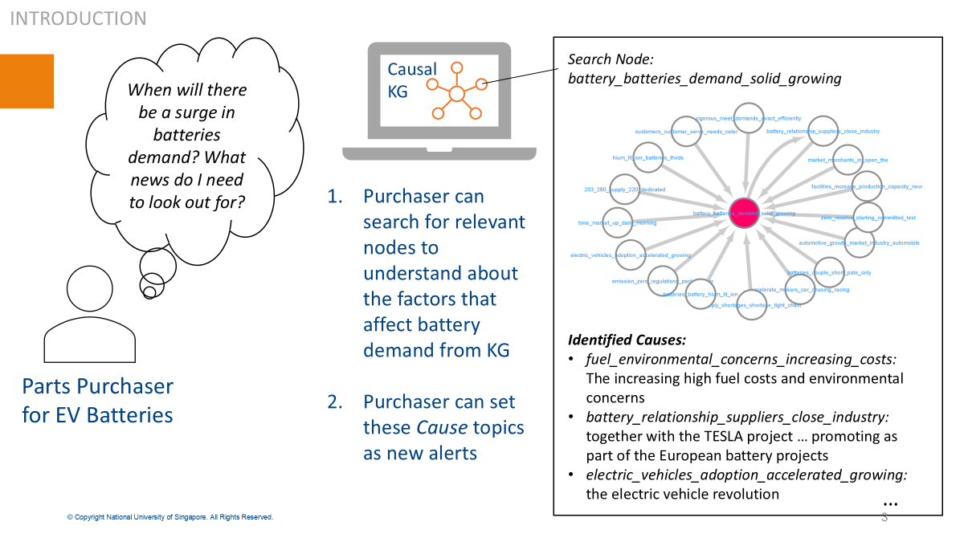
Causal Relationship Analysis: Goal
Many jobs rely on news to learn about causal events in the past and present to make informed decisions and predictions about the future.
It requires to have a general understanding of how one thing leads to another.
This activity helps users understand and interpret causal events
” Constructing and Interpreting Causal Knowledge Graph from News”, Panasonic/NUS

Slide 2
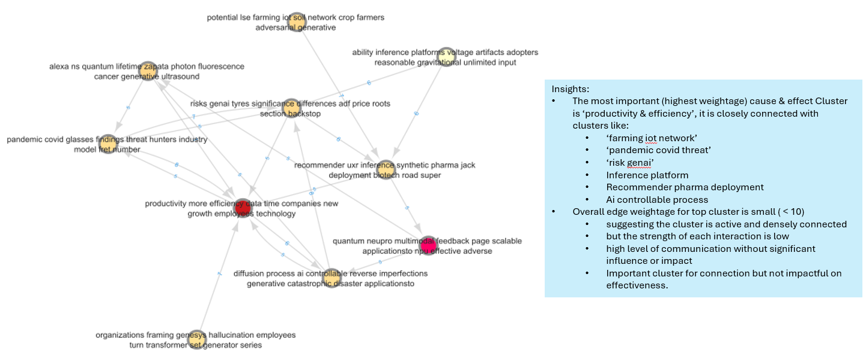
Causal Relationship Analysis: Current Status
Specific KGs (AI server cloud, electronic products) are generated by news articles
Using the KG, engineers find events by themselves [manual] (e.g. “productivity & efficiency”)
Engineers also analyze the causal chain and find insights [manual] (e.g. “pandemic covid threat”, “risk of GenAI”)
Improve the efficiency of engineers’ process (manual to auto, accuracy)

Slide 3
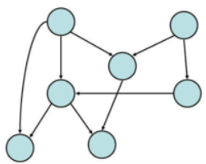
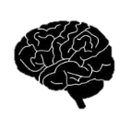

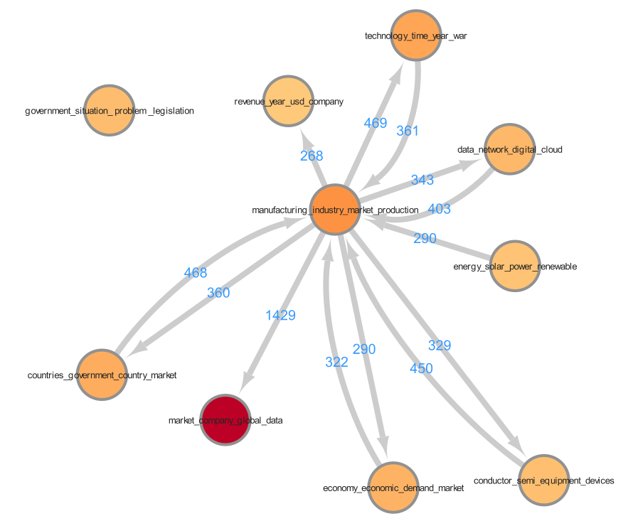

Causal Relationship Analysis: Roadmap Idea
Technical Level
Use Case
Technology
Step3
Causality extraction | Cluster labeling | Causal chain analysis
Temporal sentiment
CKG Summarization
AI
AI
AI
Productivity
Covid
A->B positive
A->C negative
Step2
Causality extraction | Cluster labeling | Causal chain analysis
 |  | Google search
**Topic model
AI
AI
Productivity
Covid
Step1
Causality extraction | Cluster labeling | Causal chain analysis
 | manual | Google search
NOW
cause-effect extraction
AI

Slide 4
Causal Relationship Analysis: Roadmap Idea
Step | Capability |  | How
 | Before | After
1 |  | Explainability: graph, visual representation and summarization of corpus | Embedding: Bert Clustering: HDBSCAN, K-Means TM: TfIdf, BerTopic
2.1 | No support for temporal features | TF 2.1: Support- Build pipeline with simple transformation | Scoring, normalization
2.2 |  | TF 2.2: Improve numerical stability, volatility, robustness, canonicalization | Advanced transformation for standardization- statistics, hypothesis test
2.3 |  | TF 2.3: Improve accuracy, correlation | Ensemble, optimization
3. CL | Uncontrolled, overlapping, subjective | Automated, customized, controlled, | Based on input seed words: Guided, semi supervised TM
4 | Non-automated causal chain | Higher degree causal chain- challenging, lot of noise, cycle, | Advanced graph computation methods + refined LLM

Slide 5
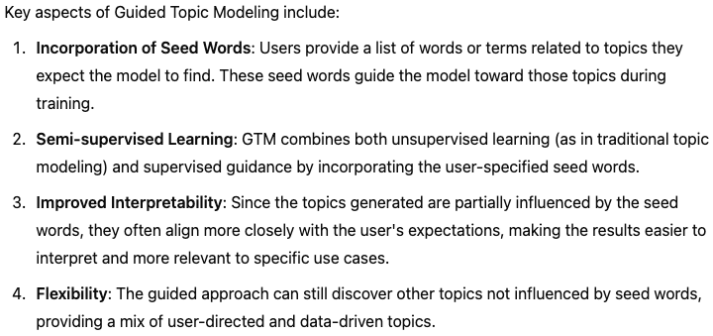
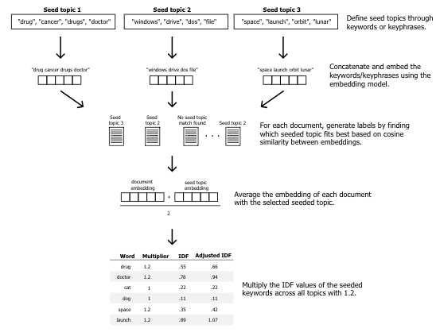
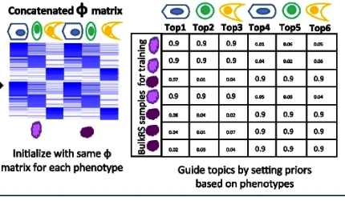
Backup

Slide 6
Backup
Prompt engineering
Text summarization
AI
Temporal sentiment
CKG Summarization
A->B positive
A->C negative
Temporal- dynamicity
Sentiment
Summarization
Powerful topic model
*Guided topic model
Cluster labeling
AI
Productivity
Covid
Informative, interpretable, distinct
Intra-cluster topic model
No support
**Raw TSF
Manual, overlapping
Causal relation
extraction
24-Q3
2024
~2025

Slide 7
Backup
Temporal sentiment
CKG Summarization
Improved Coherence: Transformer-based models provide deep contextual embeddings, which capture semantic relationships between words more effectively than traditional word frequency-based models like LDA.
Handling Short Text: Models like BERTopic and BTM, which use transformer embeddings, are much better suited to handling short texts (e.g., social media posts) than traditional methods.
Dynamic Topic Discovery: Transformer-based models allow for more flexible topic modeling approaches, such as zero-shot and prompt-based methods, that don't require pre-defining the number of topics.
Adaptability: Using LLMs, you can adjust models to focus on different types of documents or domains without significant retraining.
Development
Step3
Investigation
Step2
Prompt engineering
Text summarization
Transformer-based VAE Topic Models
Zero-shot Topic Models (ZSTM)
Prompt-based Topic Modeling
Cluster representation
Temporal
Sentiment
Intra-cluster topic model
Step-1
24-Q3
2024
~2025

Slide 8
Causal Relationship : Outcome
Outcome
Technical Outcome (Evaluation) items
Academia
Entropy
Skewness
Variance
Uncertainty
…
Paper
Book
…
Causal Graph
Panasonic-specific Outcome (Evaluation) items
Business Division
Impact (positive/negative) to Panasonic market
Impact (positive/negative) to Panasonic devices
Impact from new market to Panasonic
…
Report
Analysis
…

Slide 9
Causal Relationship : Panasonic-specific Evaluation
Evaluation Idea
Impact from new market (AI Server) to Panasonic
Positive factors
news
market
relation
Causal Graph (specific)
Causal Graph
evaluation (discussion)
extract
Business Division
AI Server
Panasonic
Capacitor
Inductor
…
Negative factors
news
market
relation

Slide 10
Reference Info : AI Server Supply Chain
Demand
Equipment Vendor
Device Vendor
Component Vendor
Manufacturing Equipment
GPU/CPU
Mother Board
Server Vendor
Applied Materials
NVIDIA, AMD
Supermicro, ASUS
Server
Memory (HBM)
Storage
Device
Dell, Lenovo, Foxconn
Cloud Platformer
TSMC
Data Center
Micron, Seagate
Capacitor (Low ESR)
Power Unit
Software Vendor
GAFA
Panasonic, Murata
OS etc.
Inductor (12mm)
Eaton, Schneider
Comm Unit
Linux, VMWare
Cyntec
Board (CCL)
CISCO, Intel
Panasonic, EMC
Supply

Slide 11
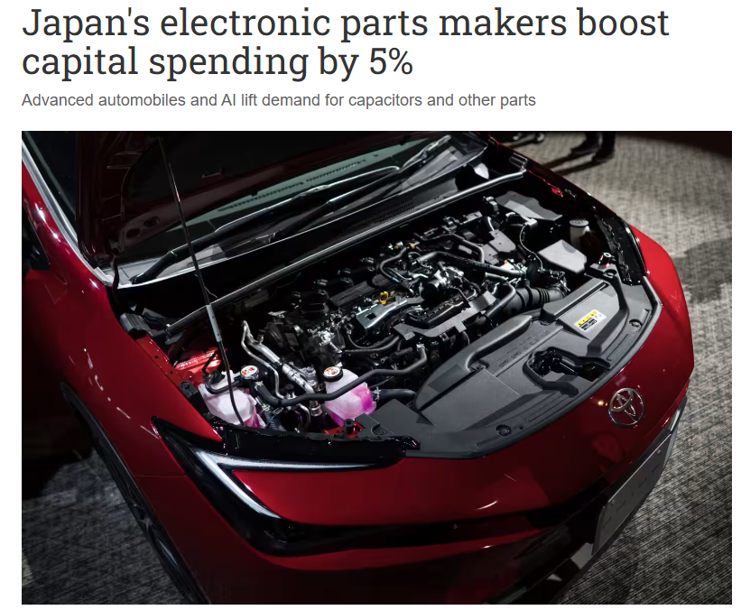
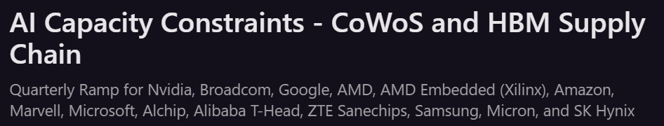
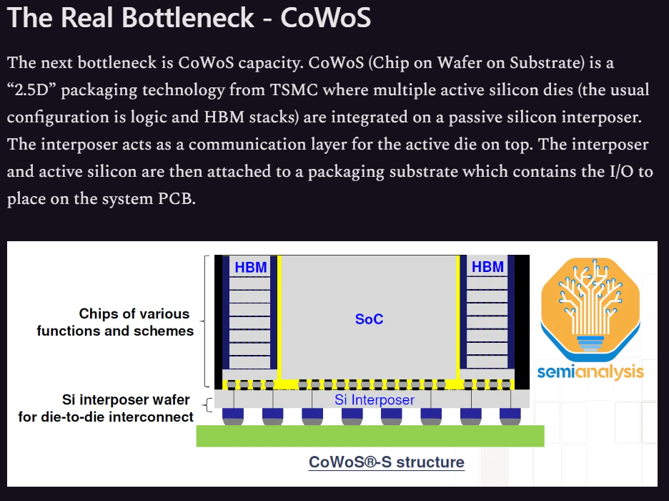
Reference Info : News examples
Positive News
Negative News
https://asia.nikkei.com/Business/Business-trends/ Japan-s-electronic-parts-makers-boost-capital-spending-by-5
https://www.semianalysis.com/p/ai-capacity-constraints-cowos-and

Slide 12
Causal Relationship : Evaluation
Evaluation Idea
Evaluation data will be created from the crawled news articles by manual
Extracted causal graph is compared with the evaluation data
Crawled data
Development
Causal Graph
preprocessing
causality
extraction
Compare
Evaluation
Check
Create evaluation data (causal graph)

Slide 13
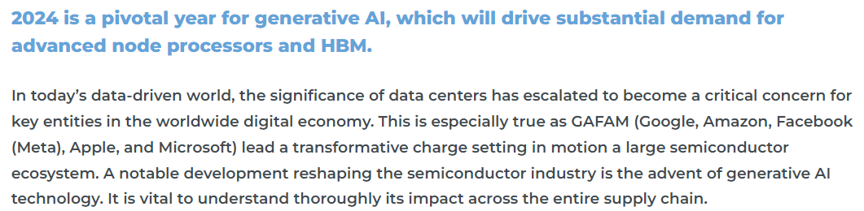
Causal Relationship : Evaluation
Example of evaluation data #1
Yole Group Viewpoint: Transforming Data Centers with Generative AI: Spotlight on Memory and Processing Power
https://www.yolegroup.com/yole-group-actuality/transforming-data-centers-with-generative-ai-spotlight-on-memory-and-processing-power/
GAFAM
generative AI
memory (HBM)
data centers
semiconductor
node processors

Slide 14

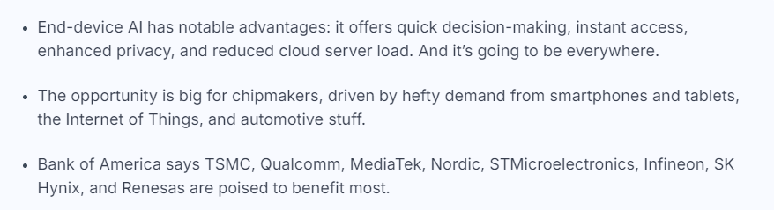
Causal Relationship : Evaluation
Example of evaluation data #2
This Is AI’s Most Underrated Opportunity, And The Eight Stocks At The Center Of It
https://finimize.com/content/this-is-ais-most-underrated-opportunity-and-the-eight-stocks-at-the-center-of-it
Generative AI
Cloud
TSMC
Smartphone
Chip makers
Tablet

