Slide 1

Prediction of psychiatric disorders for pedriatic samples
Paul-Louis Delacour
Mathieu Chevalley
Tristan Meynier
17. Dec 2020

Slide 2
Agenda
A First approach to understand the relation between age and psychiatric disorder
Analysing brain age residuals using Statistics
Analysing brain EEG features using Beta VAE
4. Deep Learning approach to predict severity of disease

Slide 3
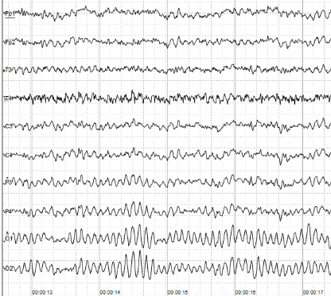
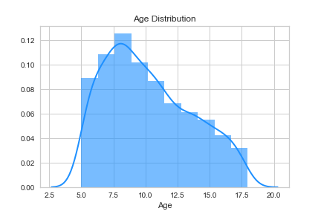
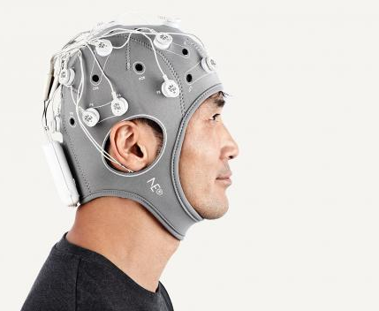


Data
Young Patients
Diagnosis
 | Autism
 | Attention disorder
 | …
 | Anxiety Disorder
Age and Sex
https://neurolite.ch/fr/produits/eeg/eeg-sans-fil-enobio
https://www.dr-dechaumont-palacin-neurologue-toulouse.fr/neurologie/electroenc%C3%A9phalographie-eeg/

Slide 4










Goal : Understand how much information EEG data contains about the psychiatric disease
$$p\left(Age \right| Brain ,Healthy)$$
Train
$$p\left(Age \right| Brain ,Diagnosis)$$
$$p\left(Age \right| Brain ,Unhealthy)$$
Test
$$p\left(Age \right| Brain ,Diagnosis)= \frac{p\left(Brain \right|Age ,Diagnosis)⋅p\left(Age \right| Diagnosis)}{Z}$$
$$Age$$
$$Brain$$
$$Diagnosis$$
$$Age$$
$$Brain$$
$$Age$$
Causality Assumption
$$Diagnosis$$
$$Diagnosis$$

Slide 5
Goal : Verify what can be extracted in EEG
Remove influence of Age and Sex confounders :
Balance the data set for Sex
Test of Age distribution shift among different population
(Anova, …)

Slide 6

Statistical testing on Brain Age residuals:
$$age_{res}=age_{true}−age_{pred}$$
$$H0: the age residuals do not contain enough information to allow$$
$$significant differentiation between patient status or scores.$$

Slide 7
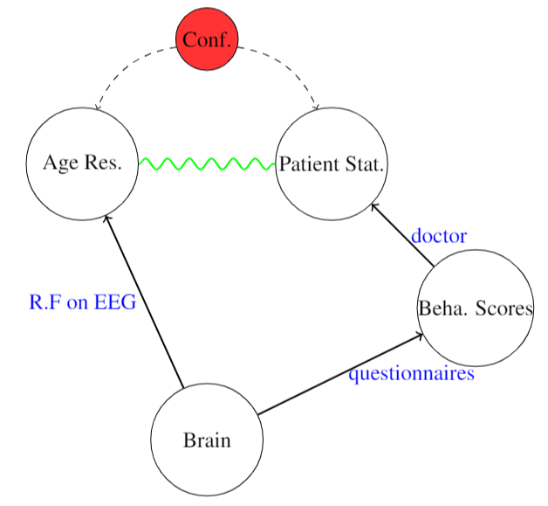

Statistical testing on Brain Age residuals:
$$patient status:$$
Age and Gender
Not
significant
Healthy/ADHD/Autism
SWAN/SRS
Keep only patients < 18 years old
Keep only patients with one disease

Slide 8
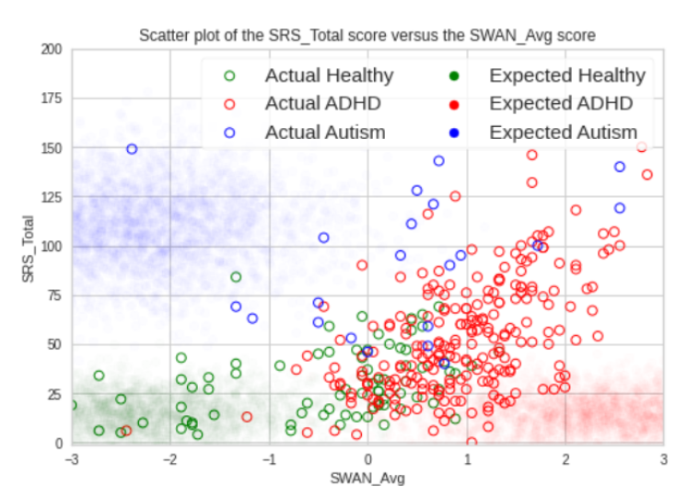
Statistical testing on Brain Age residuals:

Slide 9


Statistical testing on Brain Age residuals:
$$scores:$$
Age and Gender
SWAN/SRS
Significant!
Keep only patients < 18 years old

Slide 10
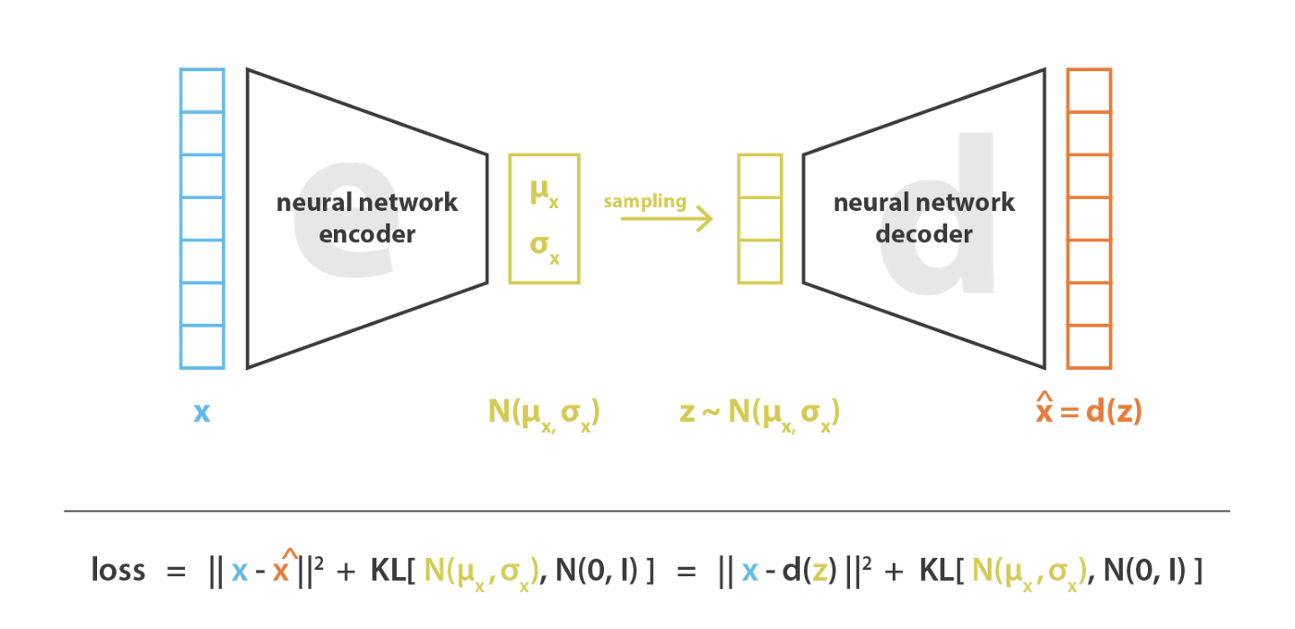

Disentangled Latent Representation of EEG features with bate-VAE
Goals:
Interpretability
Confirm and discover factors of variations
Facilitate downstream tasks
$$β$$

Slide 11
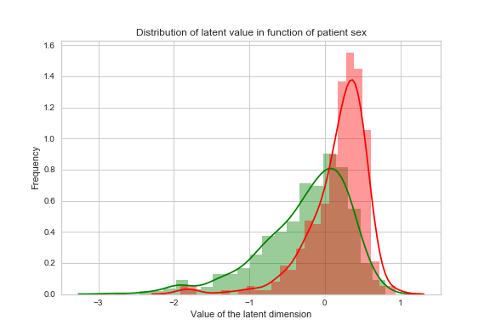
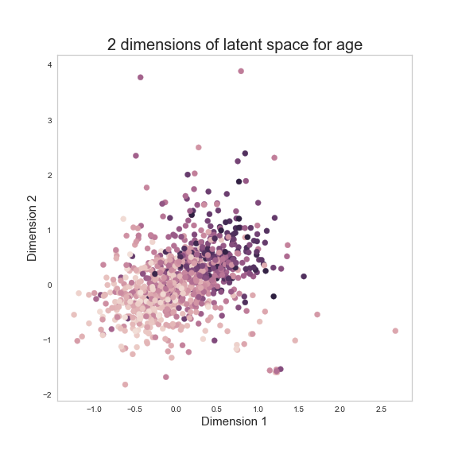
Latent factors
Gives interpretability => if predictions (e.g LASSO) based on those latent dimensions, may be only spurrious correlations from data generation process

Slide 12
Downstream tasks
Latent representation keeps signal:
Can predict Age, Sex accurately
Makes predicting SRS scores possible
Confirm SRS signal in EEG data
SWAN score prediction based on Age and Sex latent factors => non interesting correlation
In general: easy to fit models, simple models yield good results

Slide 13
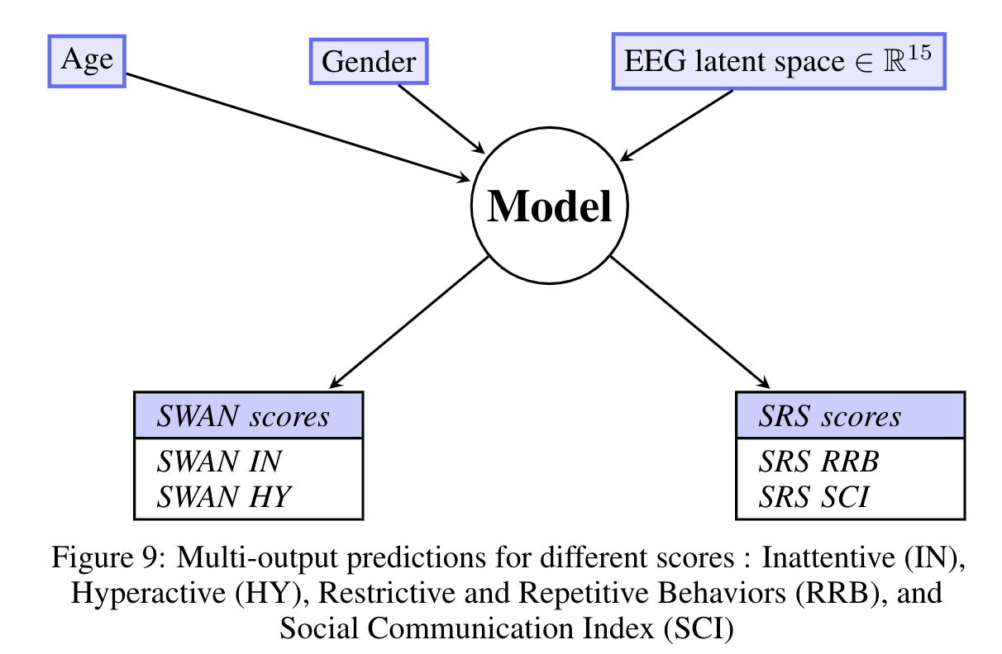
Deep learning Approach to predict psychiatric scores
 | Mean baseline | MSE without res
SWAN IN | 1.112 | 1.111
SWAN HY | 1.022 | 1.032
SRS RRB | 0.875 | 0.868
SRS SCI | 0.776 | 0.775
Comparison of MSE for the
prediction of different scores

Slide 14
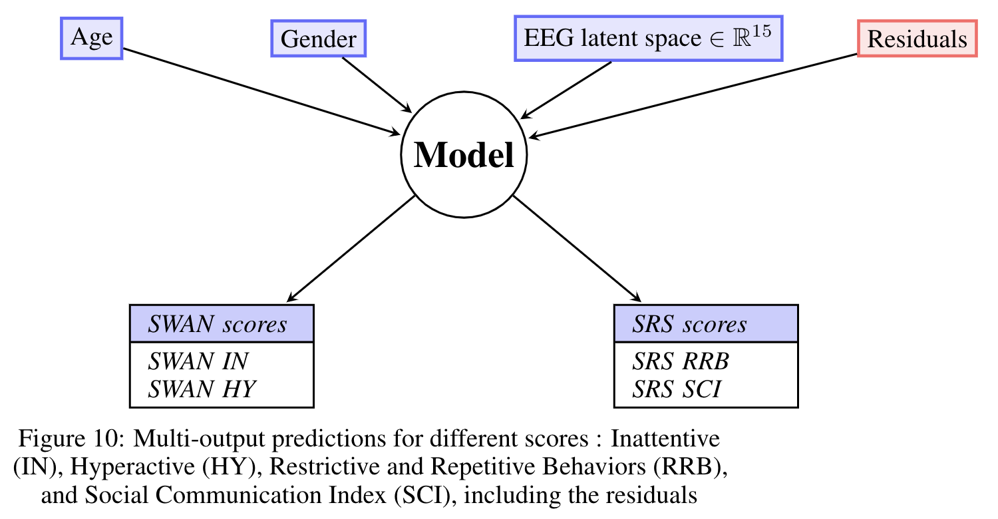
Deep learning Approach to predict psychiatric scores
Can residuals impact the prediction ?
 | Without residuals | Including residuals
SWAN IN | 1.111 | 1.090
SWAN HY | 1.032 | 1.033
SRS RRB | 0.868 | 0.861
SRS SCI | 0.775 | 0.770
Comparison of MSE in models
with and without residuals

Slide 15
Conclusion and future work
Not enough signal in EEG features for diagnosis
Age and Sex stxrong factors of variations => need to be careful in analysis
Some signal about SRS (autism) in the brain
Should try using raw EEG recodings and fit deep learning models on themx
13.12.20
15

Slide 16
Paul-Louis Delacour
Dept. of Computer Science, ETH Zürich
pdelacour@student.ethz.ch
Tristan Meynier Georges
Dept. of Computer Science, ETH Zürich
temynier@student.ethz.ch
Mathieu Chevalley
Dept. of Computer Science, ETH Zürich
mchevalley@student.ethz.ch

