Slide 1

Prediction of psychiatric disorders for pedriatic samples
Paul-Louis Delacour
Mathieu Chevalley
Tristan Meynier
17. Dec 2020

Slide 2
Agenda
Can we predict the "Age" of the brain from EEG features ?
Does the brain age change between psychiatric disorders or psychiatric scores?
Can we predict psychiatric scores from EEG ?

Slide 3
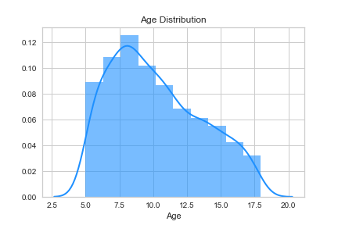
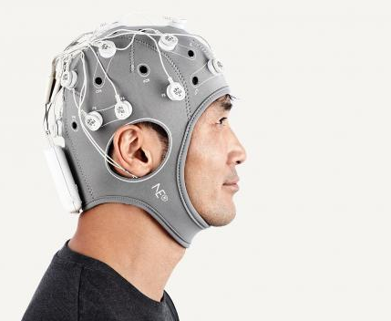
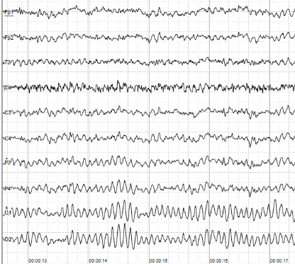


Task description :
Young Patients
Diagnosis
Data
Features extracted from EEG
(Electroencephalography)
 | Autism
 | Attention disorder
 | …
 | Anxiety Disorder
Age and Sex
https://neurolite.ch/fr/produits/eeg/eeg-sans-fil-enobio
https://www.dr-dechaumont-palacin-neurologue-toulouse.fr/neurologie/electroenc%C3%A9phalographie-eeg/

Slide 4

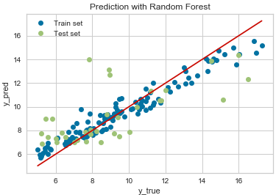
Concept of Brain Age
Age can be well predicted from EEG data
Brain Age = Predicted Age
For some diseases, Brain Age can differ significantly from the true age
Brain Age seems to be of good help when analyzing psychiatric diseases
Best model : r2 = 0.46

Slide 5
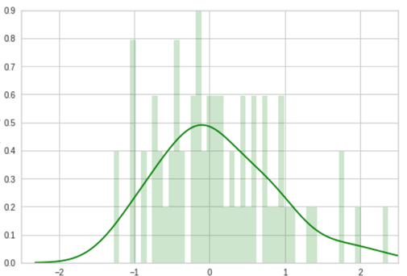







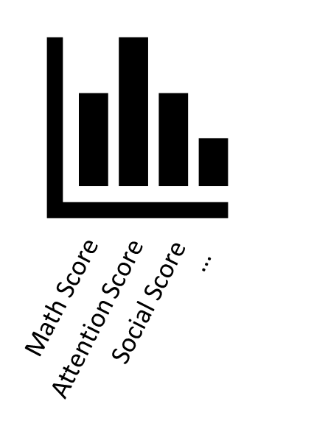


Does the brain age change between psychiatric disorders or psychiatric scores?
Age Residual
Healthy
-
=
Predict
Frequency
EEG Features
Brain Age
Chronological Age
Predict
psychiatric disorders
?
0
-
=
Age Residual
Predict
Brain Age
Chronological Age
psychiatric scores
f( )?
-
=
Brain Age
Chronological Age

Slide 6
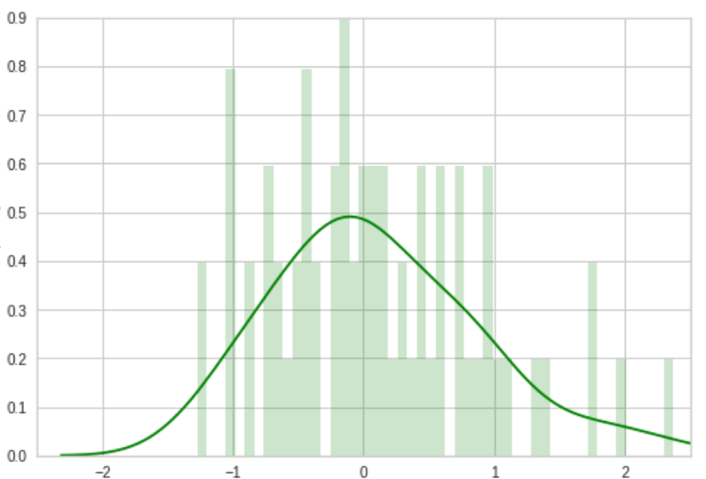
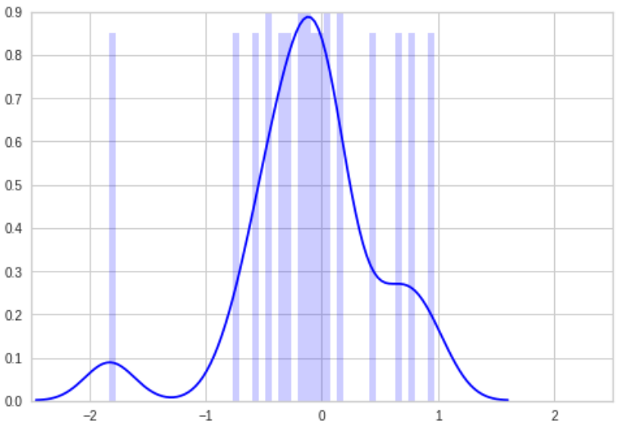


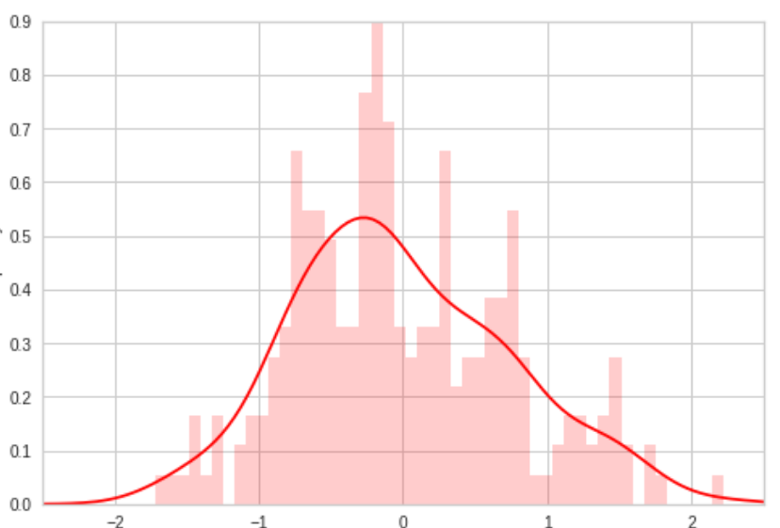


Does the brain age change between psychiatric disorders?
Healthy
-
-
=
Brain Age
Chronological Age
Wilcoxon Test
p = 0.457
Autism
-
=
Confounding factors
Brain Age
Chronological Age
Wilcoxon Test
p = 0.308
Confounding factors
ADHD
-
=
Brain Age
Chronological Age

Slide 7
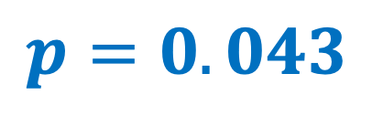
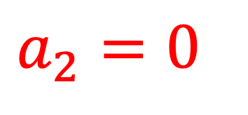
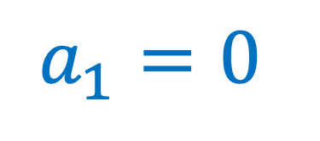
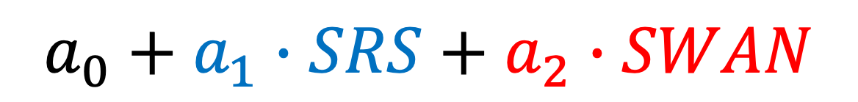
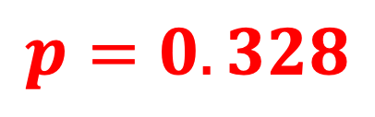
Does the brain age change between psychiatric scores?
Confounding factors
ADHD
Autism
-
=
f( )
$$a_{0}+a_{1}∙SRS+a_{2}∙SWAN$$
Brain Age
Chronological Age
?
?
$$a_{1}=0$$
$$a_{2}=0$$
Student’s
t-Test
$$p=0.043$$
$$p=0.328$$

Slide 8
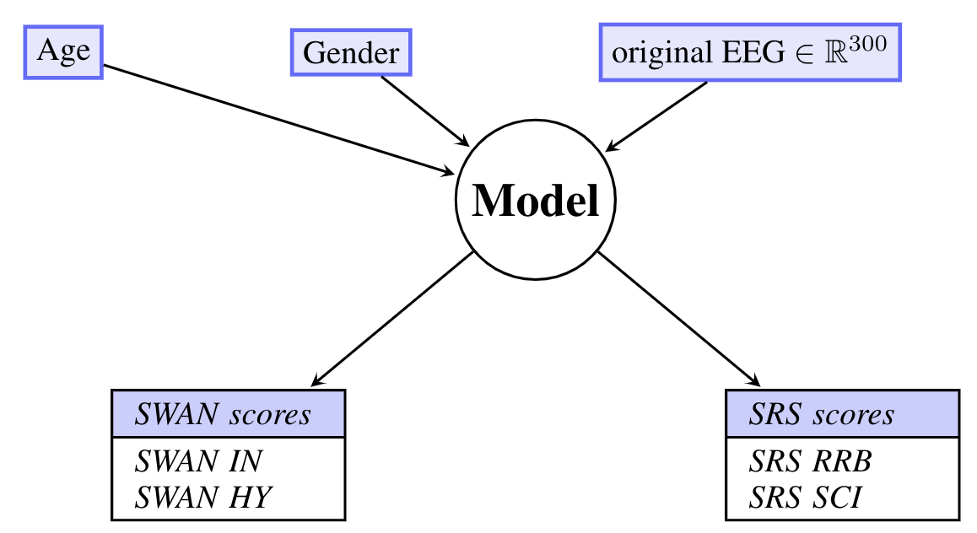
Can we predict psychiatric scores efficiently ?
Psychiatric scores are correlated
Gain of information by predicting all of them at the same time

Slide 9
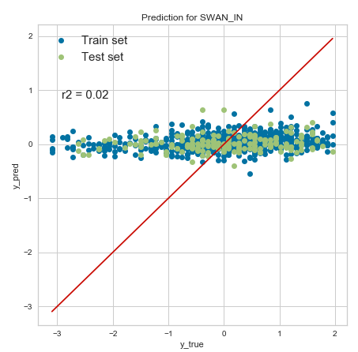
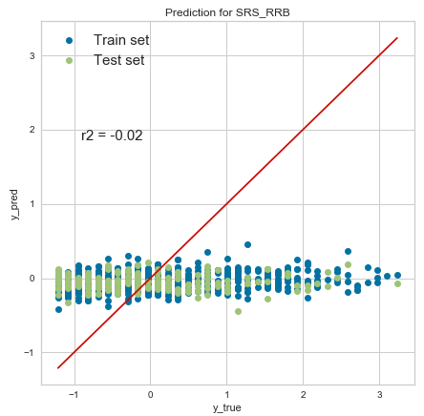
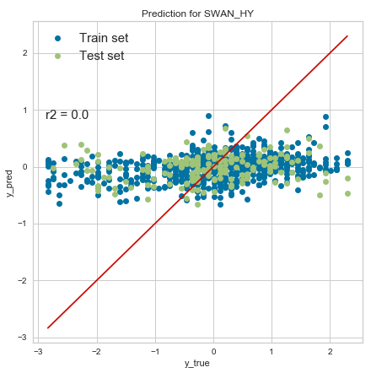
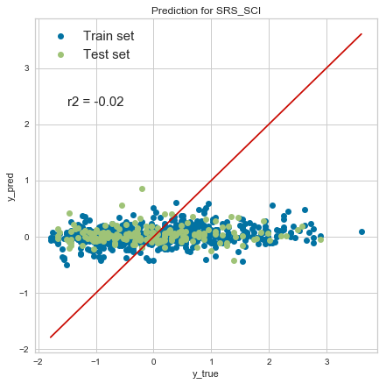
R2 = 0.02
R2 = -0.02
HARD task
Models don’t caption relevant information to predict psychiatric scores
R2 = 0.00
R2 = -0.02

Slide 10
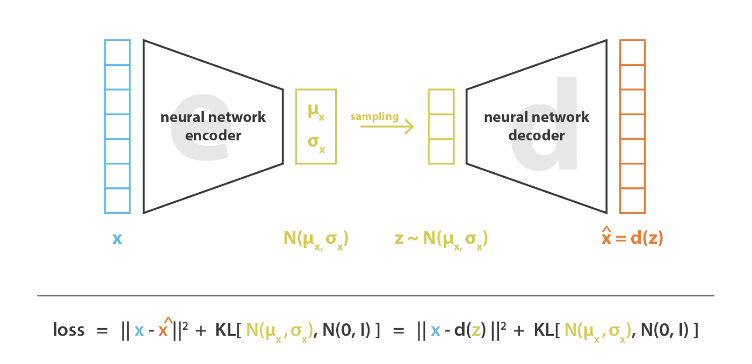

Disentangled Latent Representation of EEG features with beta-VAE
Goals:
Better model: less overfitting as latent only keeps signal and removes noise
Interpretability
Confirm and discover factors of variations
$$β$$

Slide 11
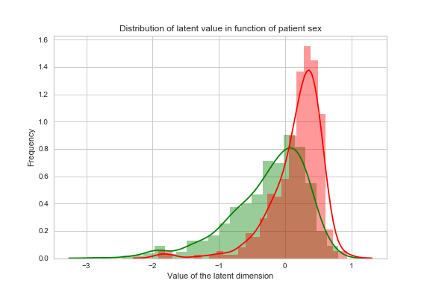
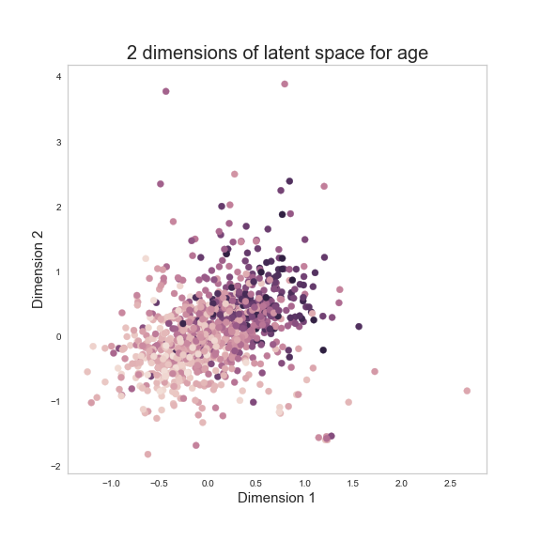
Latent factors
Gives interpretability => if predictions (e.g LASSO) based on those latent dimensions, may be only spurrious correlations from data generation process

Slide 12
Downstream tasks
Latent representation keeps signal:
- Can predict Age, Sex accurately
Makes predicting SRS scores possible
- Confirm SRS signal in EEG data
SWAN score prediction based on Age and Sex latent factors
=> EEG not useful for SWAN
In general: easy to fit models, simple models yield good results

Slide 13
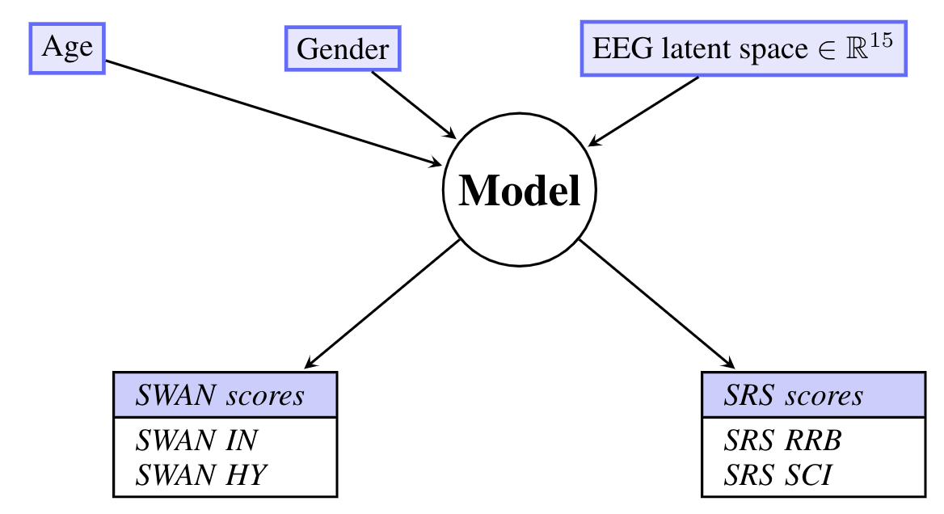

Improve predictions by using a Disentangled Latent Representation
$$ℝ^{300} →ℝ^{15}$$
Simplify the model might help to have better predictions

Slide 14
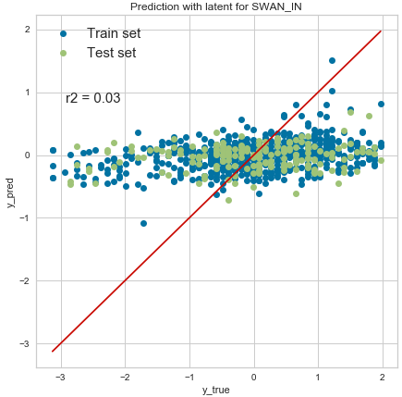
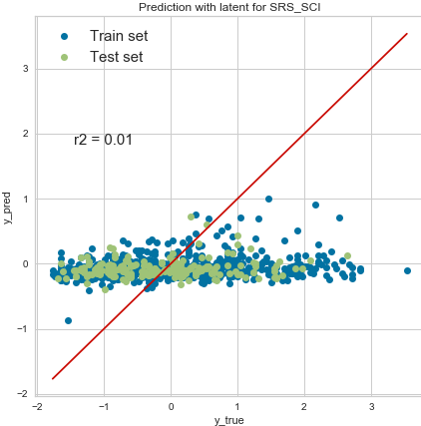
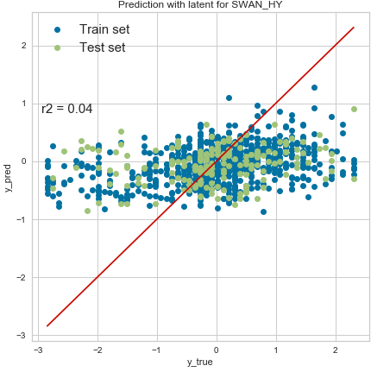
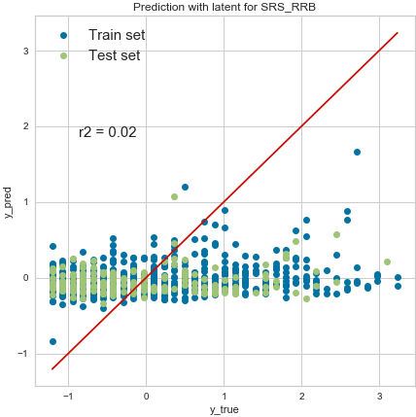
R2 = 0.03
R2 = 0.01
Benefit of Latent space :
Better predictions (but is still not enough)
Easier interpretation to know which features are useful
-SWAN : Age and Sex
-SRS : Other features
R2 = 0.04
R2 = 0.02

Slide 15
Conclusion and future work
Not enough signal in EEG features for diagnosis
Age and Sex strong factors of variations => need to be careful in analysis
Some signal about SRS (autism) in the brain
Should try using raw EEG recodings and fit deep learning models on them

Slide 16
Paul-Louis Delacour
Dept. of Computer Science, ETH Zürich
pdelacour@student.ethz.ch
Tristan Meynier Georges
Dept. of Computer Science, ETH Zürich
temynier@student.ethz.ch
Mathieu Chevalley
Dept. of Computer Science, ETH Zürich
mchevalley@student.ethz.ch

