Slide 1

Model Error
Zybooks 8-1

Slide 2

A Model is a Function
y=β₀​+β₁​x
y=β₀​+β₁​x₁​+β₂​x₂​+⋯+β_{p}​x_{p}​
y=β₀​+β₁​x+β₂​x²
y=β₀​+β₁​x+β₂​x²+β₃​x³+⋯+β_{k}​x^{k}
$p\left(x\right)=\frac{e^{β_{0}+β_{1}x}}{1+e^{β_{0}+β_{1}x}}$
So far …

Slide 3
Which Model is Best?
Underfit: Model is too simple. Misses complexity
Overfit:
Model is too complex, fits the data too closely
Misses general trends

Slide 4
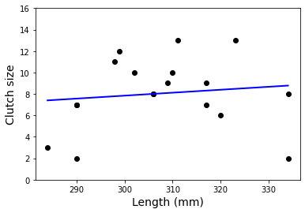
Too Simple: Underfit

Slide 5
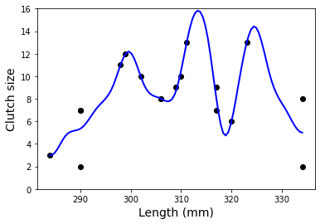
Too Complex: Overfit

Slide 6
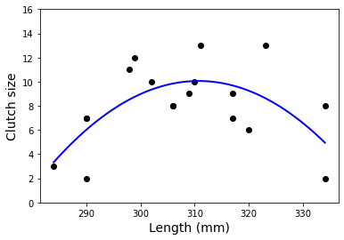
Just Right: An Optimal Model

Slide 7
Describing Error
Total error is how much observed values differ from predicted values
Total error comes in three flavors
Bias: How much of the difference between prediction and observed is due to ssumptions built into the model?
Variance: How spread out from the model are the predictions?
Irreduciable Error: How much error is built into the situation being modeled

Slide 8
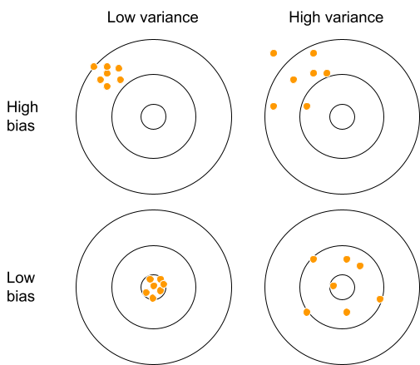
Bias and Variance are Bull’s Eyes

Slide 9

Bias vs. Variance
Decrease
Decrease the bias by choosing a more complex model
Model’s predictions are closer to observed values—but more spread out
Decrease
Decrease the variance by choosing a less complex model
Model’s predictions are less spread out—but farther from observed values

