Slide 1

Model Error
Zybooks 8-1

Slide 2

A Model is a Function
y=β₀​+β₁​x
y=β₀​+β₁​x₁​+β₂​x₂​+⋯+β_{p}​x_{p}​
y=β₀​+β₁​x+β₂​x²
y=β₀​+β₁​x+β₂​x²+β₃​x³+⋯+β_{k}​x^{k}
$p\left(x\right)=\frac{e^{β_{0}+β_{1}x}}{1+e^{β_{0}+β_{1}x}}$
So far …

Slide 3
Which Model is Best?
Underfit: Model is too simple. Misses complexity
Overfit:
Model is too complex, fits the data too closely
Misses general trends

Slide 4
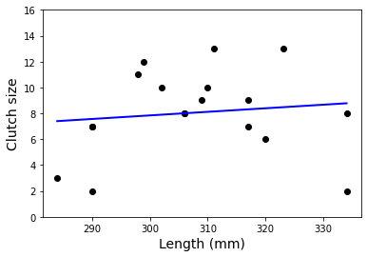
Too Simple: Underfit

Slide 5
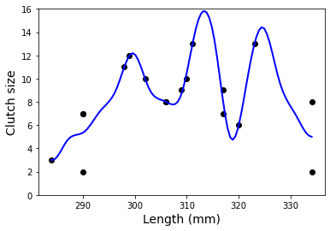
Too Complex: Overfit

Slide 6
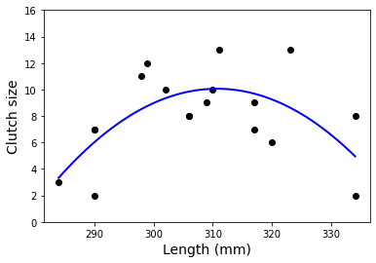
Just Right: An Optimal Model

Slide 7
Describing Error
Total error is how much observed values differ from predicted values
Total error comes in three flavors
Bias: How much of the difference between prediction and observed is due to ssumptions built into the model?
Variance: How spread out from the model are the predictions?
Irreduciable Error: How much error is built into the situation being modeled

Slide 8
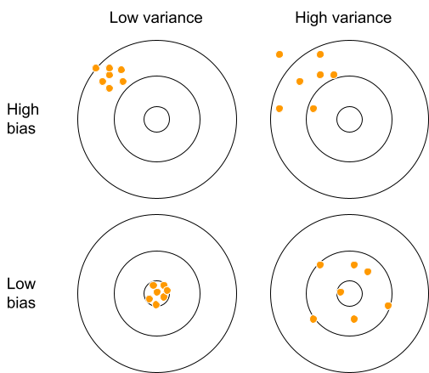
Bias and Variance are Bull’s Eyes

Slide 9

Bias vs. Variance
Decrease
Decrease the bias by choosing a more complex model
Model’s predictions are closer to observed values—but more spread out
Decrease
Decrease the variance by choosing a less complex model
Model’s predictions are less spread out—but farther from observed values

Slide 10
Machine Learning
Algorithms that use data to build models in order to make predictions
Pieces
Algorithm itself
Training data: used to the build the ML object
Validation data: used to fine-tune the ML object
Test data: used to test the accuracy of the ML object. Must be isolated from both the training data and the validation data
Prediction: output of the ML object

