Slide 1


R-Santé Trimester
December 2020 - February 2021
Machine-Learning approaches for the identification of therapeutic targets and drugs against "triple negative" breast cancers

Slide 2
Breast Cancer – Context and figures
Breast cancer is the most common form of women’s cancer
5-year survival rate of 85%
In France, 1 out of 9 women affected during her life

Slide 3
Not one but several breast cancers
No such thing as “breast cancer”, but “breast cancers”
They share global characteristics, but have different biological characteristics, aggressiveness, and most importantly therapeutic arsenals
Proteins expressed on the surfaces of tumor cells serve to assign its class to each cancer
Type of breast cancer | Biomarker
ER+ | Estrogen receptor
PR+ | Progesterone receptor
HER2+ | EGF growth factor receptor
Triple negative | None of the three above

Slide 4
Triple Negative Breast Cancer (TNBC)
TNBC represents 15% of breast cancers
Unlike other types, TNBC does not benefit from specific therapies and has worse survival prognosis
Because the TNBC class is affected by default, we need to find specific markers to characterize it, and thus specific therapeutic targets

Slide 5
Research subject
Reverse problem
Predicting potential targets for promising TNBC-drugs in order to identify mechanisms of action and biological pathways at stake
Hits repartition
Fabien Reyal’s team at the Institut Curie has identified 80 molecules as hits, for which some targets are known

Slide 6

1. Prediction of new interactions
a. Principle of the approach
CBIO has developed chemogenomic approaches based on Machine-Learning algorithms capable of predicting Drug-Protein interactions
After a training on a set of known interactions, the algorithm predicts the probability of interaction between drugs and proteins
Train set of interactions
Proteins (genetic sequences) | 2 670
FDA-approved molecules (SMILES) | 5 070
Interactions | 17 000
~
data from

Slide 7
1. Prediction of new interactions
b. Results
For one given hit, the algorithm predicts the probabilities of interaction with all the 2670 proteins of the dataset
False if the interaction does exist
UniProt ID | Gene Name | Name | prediction_moy | prediction_max | prediction_min | New DTI
Q96LZ3 | PPP3R2 | Calcineurin subunit B type 2 | 0.9903547535047348 | 0.9909232284260809 | 0.9896406651722641 | FAUX
P49069 | CAMLG | Calcium signal-modulating cyclophilin ligand | 0.9903531051218503 | 0.9909204106853566 | 0.9896251972165548 | FAUX
P62937 | PPIA | Peptidyl-prolyl cis-trans isomerase A | 0.9903511465405067 | 0.9909188770018675 | 0.9896379652956574 | FAUX
P30405 | PPIF | Peptidyl-prolyl cis-trans isomerase F, mitochondrial | 0.9903455449587122 | 0.9909246331749878 | 0.989614291645793 | FAUX
P63098 | PPP3R1 | Calcineurin subunit B type 1 | 0.9898435029684848 | 0.9904505374473251 | 0.9891058876185786 | VRAI
O43447 | PPIH | Peptidyl-prolyl cis-trans isomerase H | 0.9025886511247805 | 0.9152241481224603 | 0.874872554506795 | VRAI
An example : top predictions for Cyclosporine – DB00091

Slide 8
2. Pathway enrichment
a. Principle
Prediction of protein interactions for every hit
However, the number and the diversity of the proteins predicted with high scores do not allow straightforward biological interpretation
We propose to interpret the results with a method of pathway enrichment analysis
The enriched pathways are those whose proteins are statistically more represented in the list of predicted targets

Slide 9


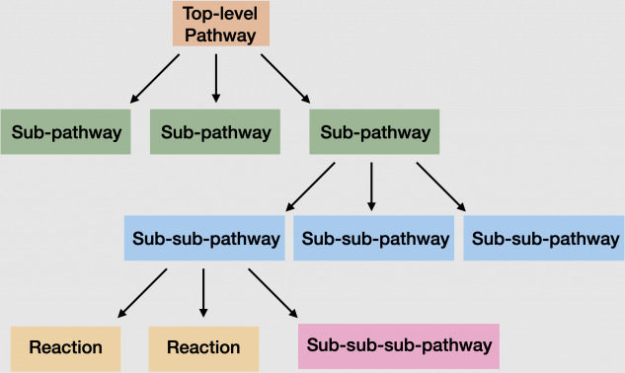
2. Pathway enrichment
b. Tools and Database
I used the web server g:Profiler which is a tool for pathway enrichment
It uses databases such as Reactome
Reactome is a pathway database organized in levels

Slide 10
2. Pathway enrichment
c. Results
The results of the statistical test can be represented as following :
Proteins
Pathways
(ordered by decreasing enrichment)
Pathway enrichment for every protein with a probability of interaction better than 0,9

Slide 11
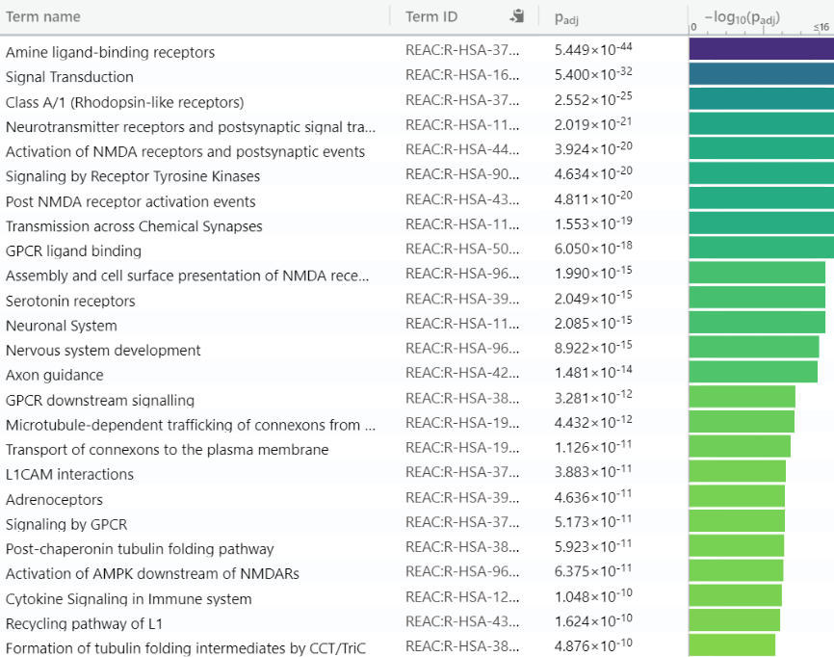
2. Pathway enrichment
c. Results
The most enriched pathways identified with the data predicted

Slide 12
Observations & Analysis
2 top pathways of first hierarchical level expected for proteins involved in cancer :
- signal transduction
- developmental biology
That is reassuring, it means that some of the hits have known or predicted targets involved in pathways relevant to cancer in general

Slide 13
2. Pathway enrichment
c. Results
Pathway :
« Signal Transduction »

Slide 14
2. Pathway enrichment
c. Results
Pathway :
« Signal Transduction »
Pathway :
« Developmental Biology »

Slide 15
Observations & Analysis
We observe pathways attached to the “Neuronal System” pathway, which is less expected
It means that some TNBC drugs’ known targets or predicted targets could be related to pathways normally active in the neuronal system
Proteins from this system could be expressed in TNBC, and could play a role in the deregulation of the cells
So proteins in these neuronal pathways could be therapeutic targets to treat TNBC

Slide 16
2. Pathway enrichment
c. Results
Pathway :
« Neuronal system »

Slide 17
Perspectives
Unexpected pathways are research tracks
Check whether proteins in the neuronal pathway are expressed in TNBC, and not in the corresponding healthy cells
Search for other key proteins in the pathway that may be targeted by other active molecules
Could lead to drug repositioning (reduction of time and costs to reach the market)
For example, in my case, TNBC patients receiving paroxetine or sertraline (hits given as antidepressants, not-targeting cancer), tend to have longer survival

Slide 18
Thank you
Matthieu Najm
Dr. Chloé-Agathe Azencott
Pr. Véronique Stoven

