Slide 1


Why you should test your software and how you can do it
FMRIB Analysis Group
Tuesday 31st March 2020
Paul McCarthy <paul.mccarthy@ndcn.ox.ac.uk>
Notes:
software that you are writing for your own research
python bias

Slide 2
Overview
Why testing is necessary
Reducing the number of errors that you make when writing software
Testing a Python application
Automated testing using Github+CI
Notes:
bias towards python
assume github / gitlab
not automatic

Slide 3
Science in 2020
Research results == software outputs?
Notes:
claim
own code
faith
uneasy

Slide 4
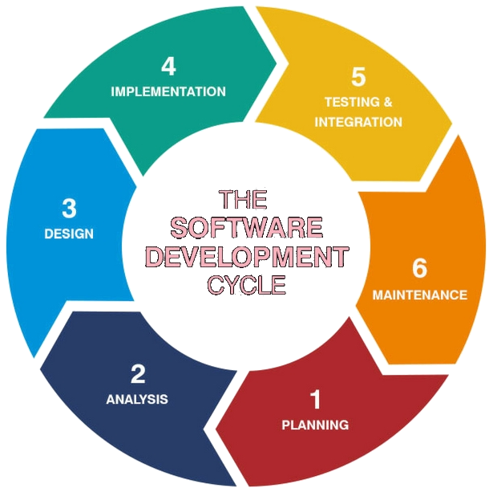
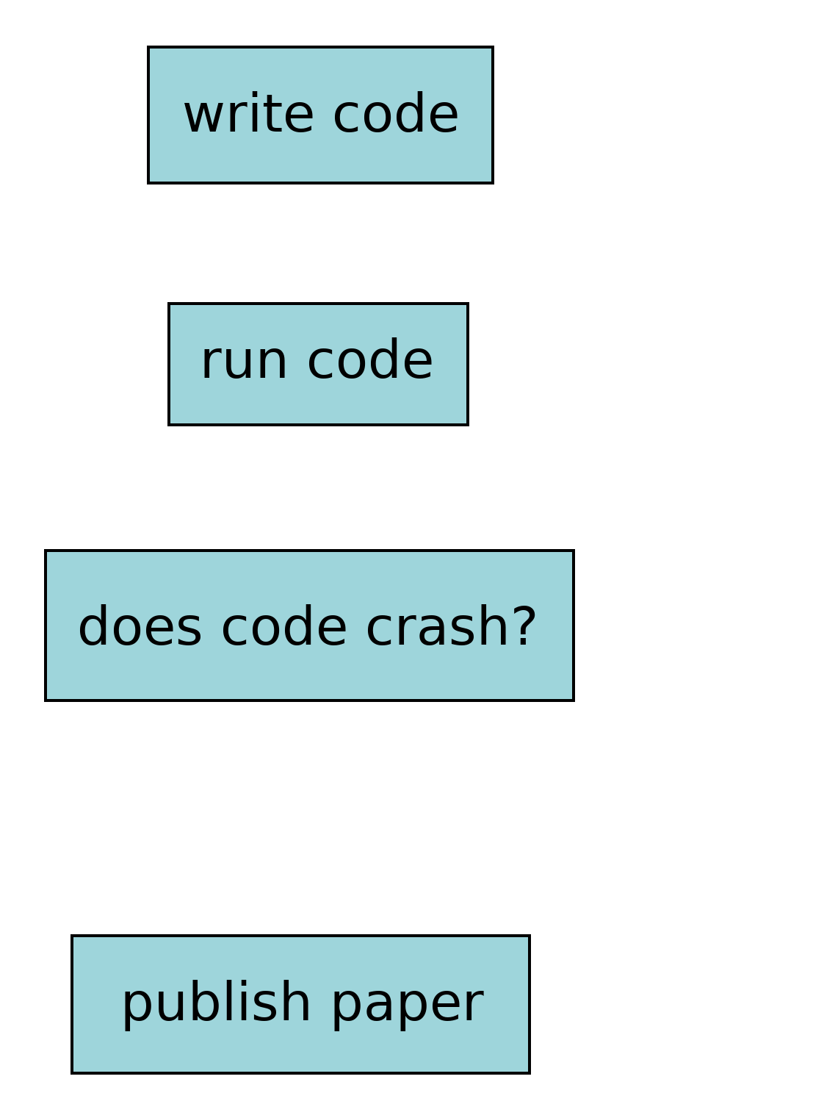
Software development practices
In industry
In research
https://www.synotive.com/blog/software-development-client-questionnaire
Notes:
tongue in cheek
CS degree
NASA
research
bugs exist

Slide 5
Compiled vs interpreted languages
Compiled/strongly-typed
(e.g. C/C++/Java)
Interpreted/dynamically typed
(e.g. MATLAB/Python)

Slide 6
Compiled vs interpreted languages
Compiled/strongly-typed
(e.g. C/C++/Java)
Write code
Compile code
Run code
Interpreted/dynamically typed
(e.g. MATLAB/Python)

Slide 7
Compiled vs interpreted languages
Compiled/strongly-typed
(e.g. C/C++/Java)
Write code
Compile code
Run code
Interpreted/dynamically typed
(e.g. MATLAB/Python)
Write code 1.
Run code 2.
Notes:
compilation step
types

Slide 8
Compiled vs interpreted languages
Compiled/strongly-typed
(e.g. C/C++/Java)
Write code
Compile code
Run code
Interpreted/dynamically typed
(e.g. MATLAB/Python)
Write code 1.
Run code 2.
The compiler analyses every single line of code, and catches lots of errors for you.
Notes:
compilation step
types

Slide 9
Compiled vs interpreted languages
Compiled/strongly-typed
(e.g. C/C++/Java)
Write code
Compile code
Run code
Interpreted/dynamically typed
(e.g. MATLAB/Python)
Write code 1.
Run code 2.
The compiler analyses every single line of code, and catches lots of errors for you.
The interpreter only analyses the code that gets run, so errors may still be present in infrequently used branches/sections of code.
Notes:
compilation step
types

Slide 10
Compiled vs interpreted languages
Compiled/strongly-typed
(e.g. C/C++/Java)
Write code
Compile code
Run code
Interpreted/dynamically typed
(e.g. MATLAB/Python)
Write code 1.
Run code 2.
We can depend on the compiler to catch many errors for us.
(but it won’t catch everything!)
The compiler analyses every single line of code, and catches lots of errors for you.
The interpreter only analyses the code that gets run, so errors may still be present in infrequently used branches/sections of code.
Notes:
compiler - extra layer of security

Slide 11
Compiled vs interpreted languages
Compiled/strongly-typed
(e.g. C/C++/Java)
Write code
Compile code
Run code
Interpreted/dynamically typed
(e.g. MATLAB/Python)
Write code 1.
Run code 2.
We can depend on the compiler to catch many errors for us.
(but it won’t catch everything!)
We have no compiler, so need to be much more careful during development, and rely on other tools and techniques to catch errors.
The compiler analyses every single line of code, and catches lots of errors for you.
The interpreter only analyses the code that gets run, so errors may still be present in infrequently used branches/sections of code.
Notes:
most researchers

Slide 12
Compiled vs interpreted languages
It doesn’t matter how smart you are – you will make mistakes
Compiled/strongly-typed
(e.g. C/C++/Java)
Interpreted/dynamically typed
(e.g. MATLAB/Python)
*
1. Use a good editor/IDE
2. Organise your code sensibly
3. Write code to test your code
4. Use CI to run your tests for you
We can depend on the compiler to catch many errors for us.
(but it won’t catch everything!)
We have no compiler, so need to be much more careful during development, and rely on other tools and techniques to catch errors.
†
*
*IDE: Integrated Development Environment
†CI: Continuous Integration
Notes:
points 1 and 2: reducing errors
points 3 and 4: finding errors

Slide 13
1. Use a good editor/IDE
If you’re using MATLAB, feel free to zone out for the next couple of minutes
If you’re using Notepad, TextEdit, Gedit, vanilla Emacs, etc, then you’re doing it wrong
You should be using an editor which provides (at least):
  Syntax highlighting
  Intelligent error detection
Optional (but recommended) extras which will make life easier
  Automatic code completion
  Refactoring (e.g. rename a function in every place it is called)
  (important for larger projects) Code navigation/file management
Notes:
error detection - interpreted, no compiler, need linting

Slide 14
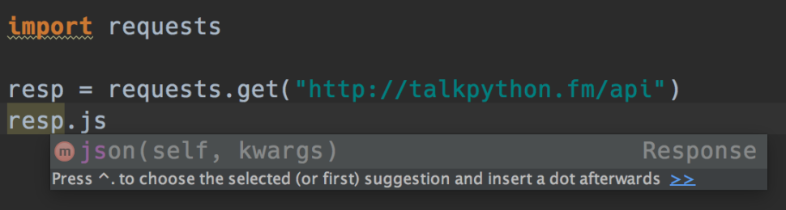
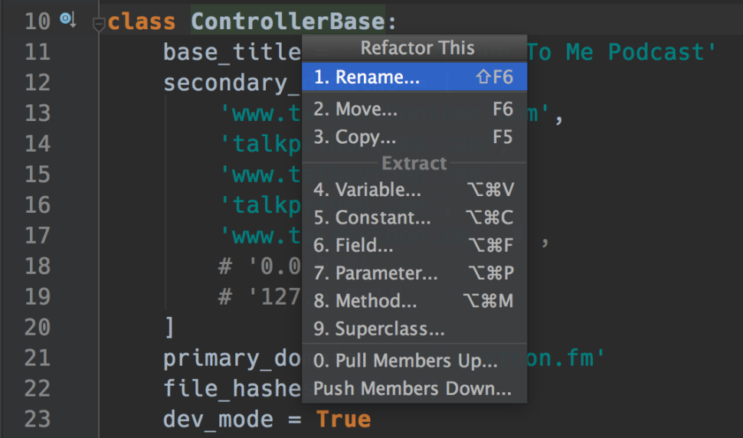
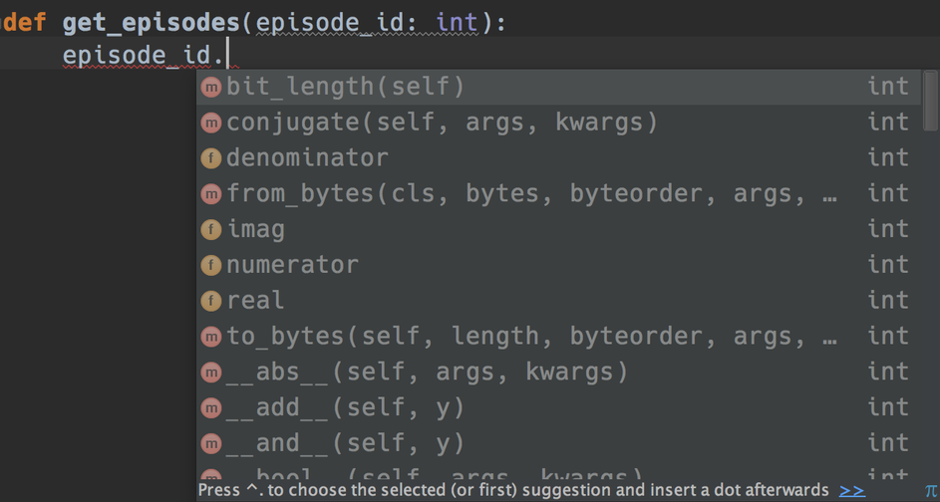
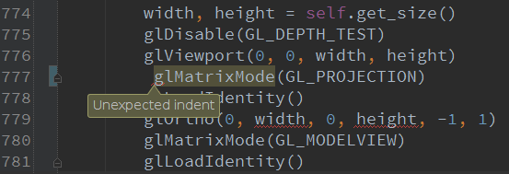
1. Use a good editor/IDE
If you’re using MATLAB, feel free to zone out for the next couple of minutes
If you’re using Notepad, TextEdit, Gedit, vanilla Emacs, etc, then you’re doing it wrong
You should be using an editor which provides (at least):
  Syntax highlighting
  Intelligent error detection
Optional extras which will make life easier
  Automatic code completion
  (important for larger projects) Code navigation/file management
You should make sure that your editor is correctly integrated with your Python environment
https://blog.michaelckennedy.net/2015/11/19/9-reasons-you-should-be-using-pycharm/

Slide 15
1. Use a good editor/IDE
PyCharm (everything included)
Spyder (MATLAB-like)
VS Code (needs some setup)
Atom (needs some setup)
Sublime Text (non-free, popular amongst hipsters)
Emacs (only for the masochistic)

Slide 16
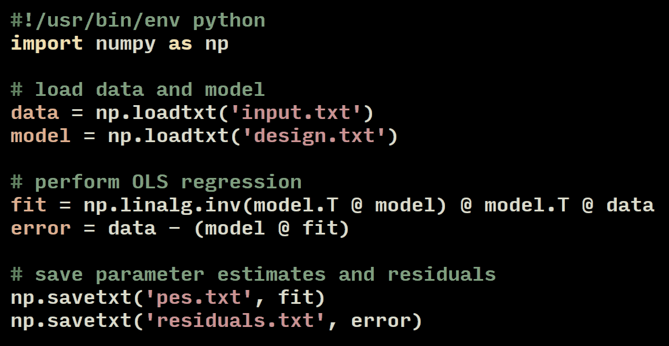
2. Organise your code sensibly

Slide 17
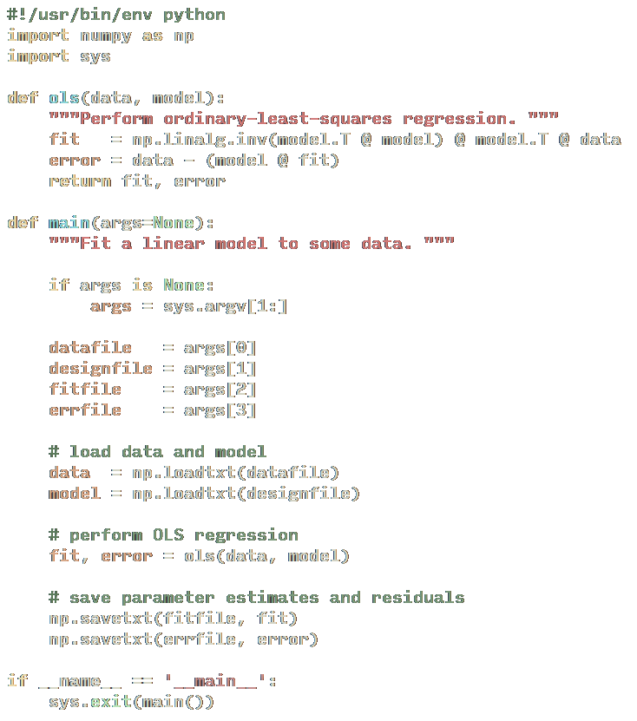
2. Organise your code sensibly

Slide 18
2. Organise your code sensibly
Harder to test
Easier to test

Slide 19
2. Organise your code sensibly
General advice
Wherever possible, strive to write functions which are:
Small
Simple
Without side-effects
They will be easier to understand, easier to re-use, and easier to test.

Slide 20
2. Organise your code sensibly
General advice
Try to separate procedural operations (e.g. loading/saving data) from purely functional/numeric operations.
Doing so will make the critical parts of your code easier to test.

Slide 21
2. Organise your code sensibly
General advice
Use functions, modules, and packages to arrange your project in a sensible manner.

Slide 22
2. Organise your code sensibly
General advice
There is no correct answer to the question of how you should organise your code.
If it is easy to understand and navigate (and it does its job), then it is a good design.

Slide 23
2. Organise your code sensibly
General advice
Don’t be afraid to refactor and rearrange your code as it evolves.
If you already have a test suite, then you can use it to ensure that you are not breaking things when you rearrange them.
*
*Integration tests, introduced later, are handy here.

Slide 24
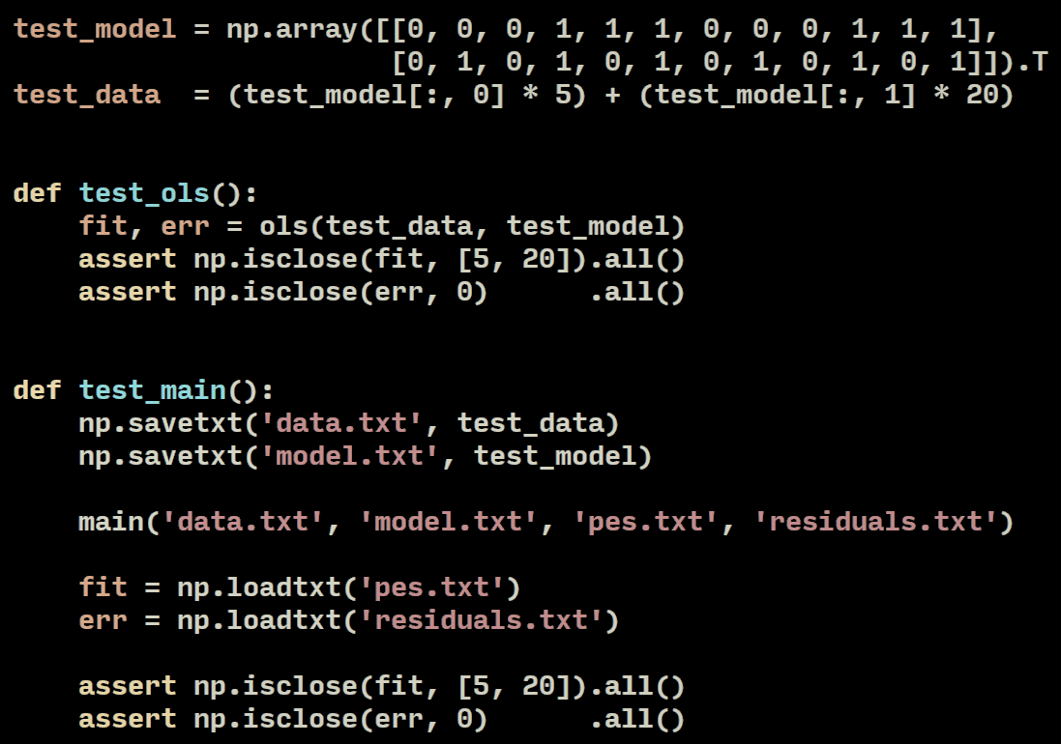
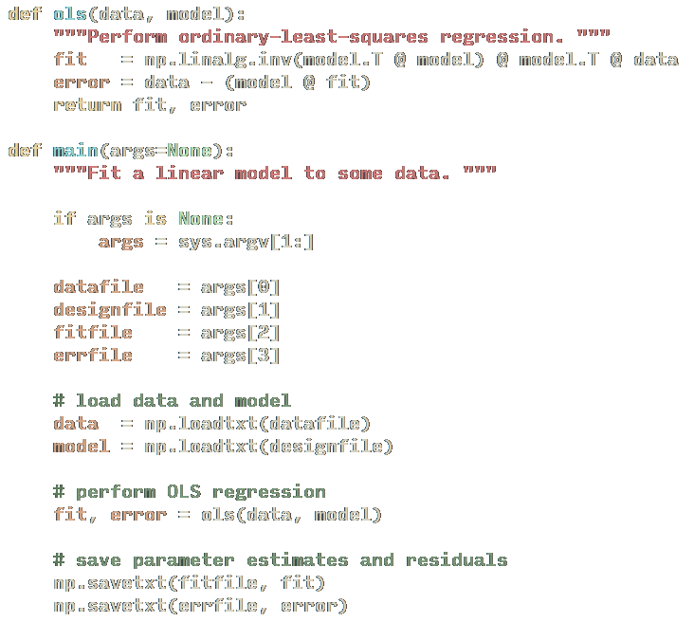
3. Write code to test your code
Notes:
could also use pregen benchmark data

Slide 25
3. Write code to test your code

Slide 26
3. Write code to test your code

Slide 27
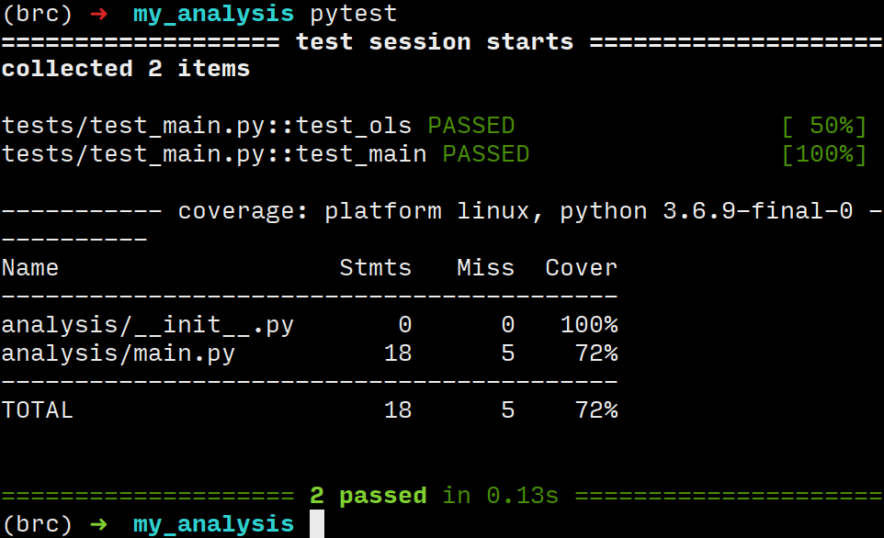
3. Write code to test your code
and run that code
pytest https://docs.pytest.org/en/latest/
searches through your code for functions beginning with test_ and runs them for you.
coverage https://github.com/nedbat/coveragepy
tells you which lines of code were executed during testing
Notes:
show setup.cfg briefly

Slide 28
3. Write code to test your code
General advice
Write and run tests at the same time as you are writing the code.
Doing so will help you to better understand and trust your code.

Slide 29
3. Write code to test your code
General advice
Write tests for individual functions - these are known as unit tests.
Write tests for the entire program - these are known as integration tests.

Slide 30
3. Write code to test your code
General advice
Whenever you fix a bug in your code, write a test for it, so you’ll know if it ever pops up again.
This is known as a regression test.

Slide 31
4. Use CI to run your tests for you
Continuous Integration (CI): Run code on somebody elses’ servers using magic
Push some changes to your remote repository (e.g. Github)
Github notifies the CI provider about the changes
The CI provider starts up a Docker container or a VM running somewhere in the cloud
A script, running in the container/VM, checks out your project, and runs your tests for you
Notes:
not just testing - you can run anything (deploy, doc building, etc)

Slide 32
4. Use CI to run your tests for you
Several CI providers work seamlessly with Github:
  CircleCI (https://circleci.com/)
  Travis (https://travis-ci.org/)
  Azure (https://azure.microsoft.com/en-us/services/devops/pipelines/)
  Appveyor (https://www.appveyor.com/)
Free for open source projects
If using Gitlab, you can install your own CI provider (running on your own hardware)

Slide 33
4. Use CI to run your tests for you
Example project:
https://github.com/pauldmccarthy/win-brc-automated-testing

Slide 34
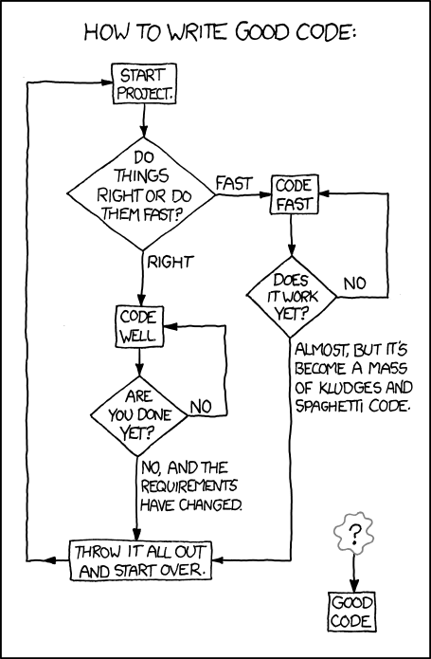
Thanks for listening!
https://xkcd.com/844/

Slide 35
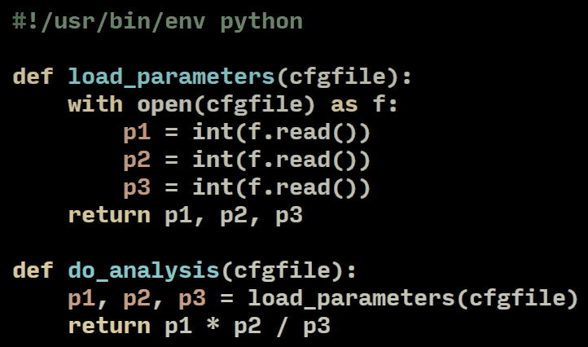
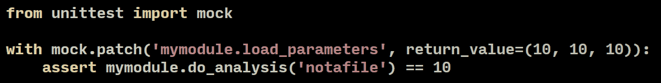
Bonus: mock for dependency injection
https://docs.python.org/3/library/unittest.mock.html

