Slide 1
Augmented Reality Flatpack Furniture Assembly
Paul Doherty
2566465D

Slide 2

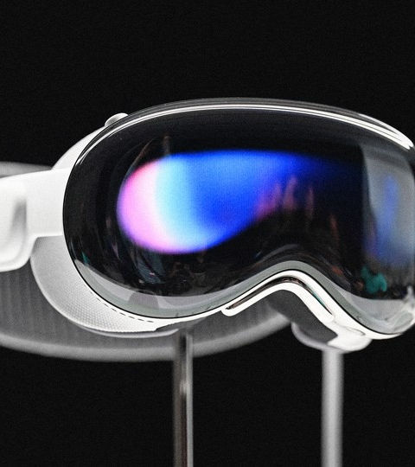

The Problem
AR is ‘one of the leading technologies of the 21st century’ (Arena et al. 2022)
Head mounted displays becoming consumer products
What potential uses could they have for consumers?

Slide 3

Flatpack Assembly
AR could be used to guide consumers on flatpack furniture assembly
Assembling furniture is known to cause issues for many people.
67% of adults admitted to having difficulty with assembling flatpack furniture. (Richardson 2011)

Slide 4
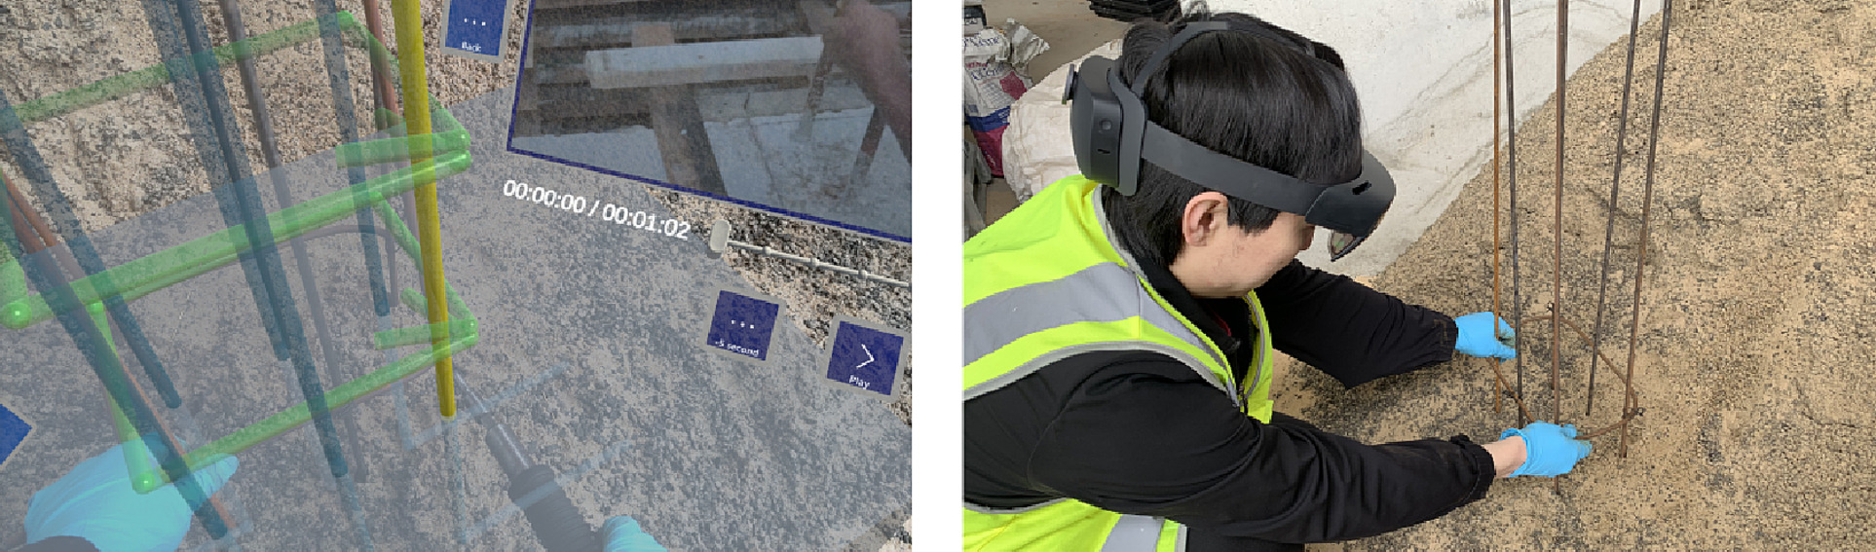
The Aim
AR has previously been studied in industrial contexts
Can reduce error by 82% (Tang et al. 2004)
If it has this effect on industrial assembly, why can’t it do the same for consumer assembly?
(Wu et al. 2023)
Can AR instructions be more effective at guiding consumers in flatpack furniture assembly than paper instructions?

Slide 5
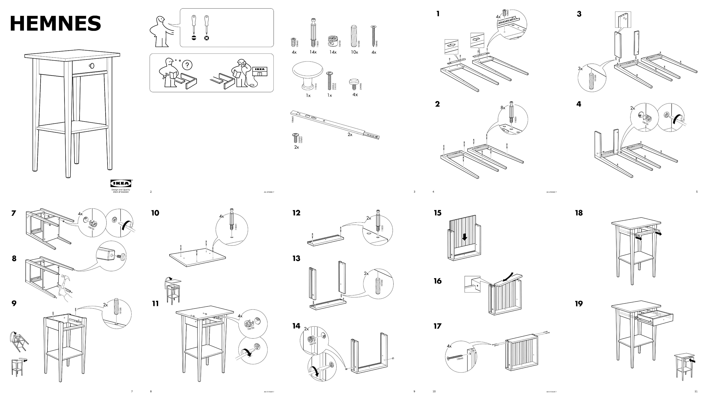
Design
Main requirements source was IKEA instructions
Requirements include:
Showing which part to add
Showing where a part should be added
Showing the orientation of a part
Displaying if a part should be screwed in
Giving close up views of smaller parts

Slide 6
Communicating Instructions
Object tracking was chosen as a good option for showing users how to correctly assemble a piece of furniture.
Users can be shown in real time what to do, and if what they are doing is correct
Animations to show the path of how a part should be added

Slide 7
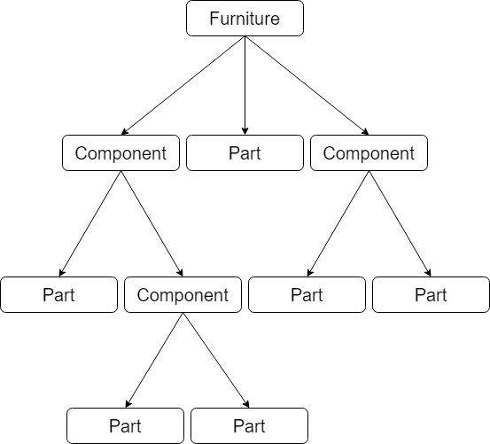
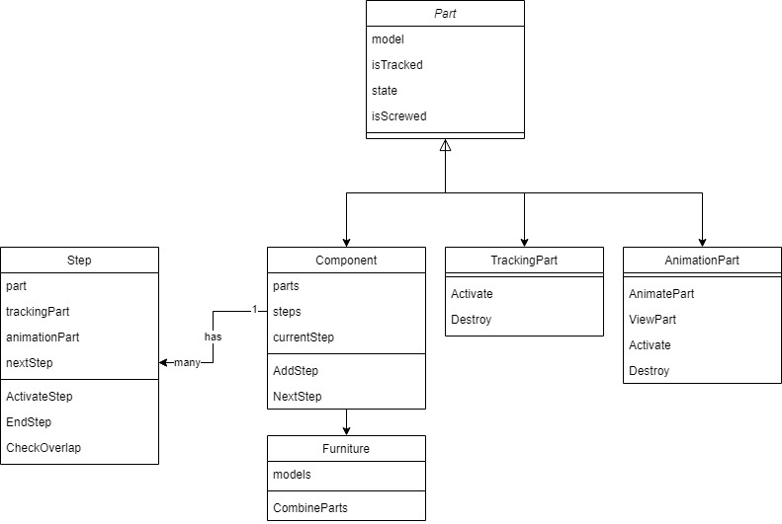
The System
Framework based on the composite design pattern
Furniture has a list of steps
Steps have a part and a next step
Steps can be components
Components break down into more parts
Tracking parts and animation parts are used to demonstrate the instructions

Slide 8

Platform
Development platform chosen was Unity
Comes with many built in AR packages
VisionLib object tracking package has Unity integration

Slide 9
DEMO

Slide 10
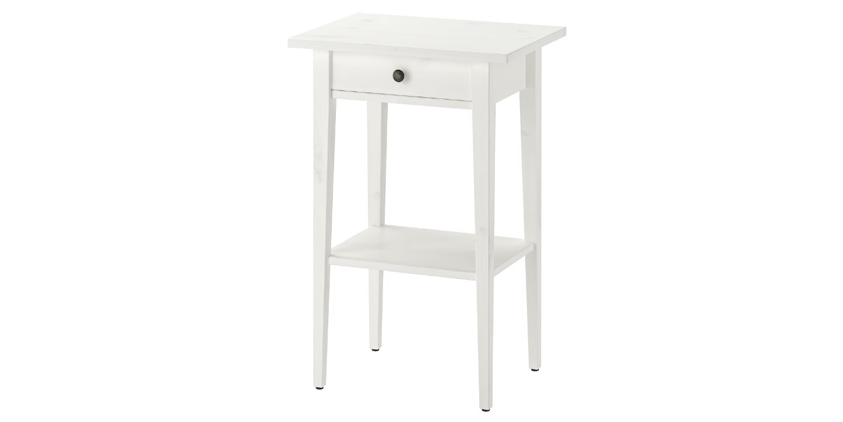
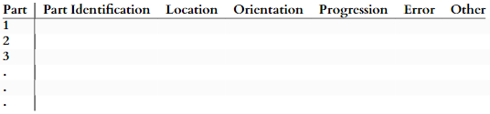
Evaluation
Evaluated using a think aloud experiment
Participants of three groups assembled IKEA HEMNES bedside table:
Paper instructions group
Animation instructions group
Tracking instructions group
Any issues the participants had were recorded
Errors in assembly were recorded
Issues and errors were categorised:
Part identification
Location
Orientation
Progression

Slide 11
Issue Scores
Issue scored 1:
Issue was very insignificant and did not hinder overall progress
Issue scored 2:
Issue caused some delay but was handled by participant
Issue scored 3:
Issue caused significant delay and stopped progress, these issues required assistance to deal with

Slide 12
Tracking Issues
“Tracking had to be forced into position rather than being a guide on position”
Tracking proved to be very difficult to work with
Two participants gave up trying to use tracking feature
One tried all the way through but only successfully used it three times
Tracking instructions without tracking are very similar to animation instructions

Slide 13
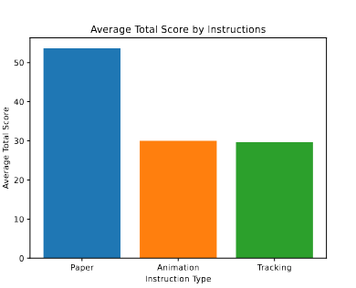
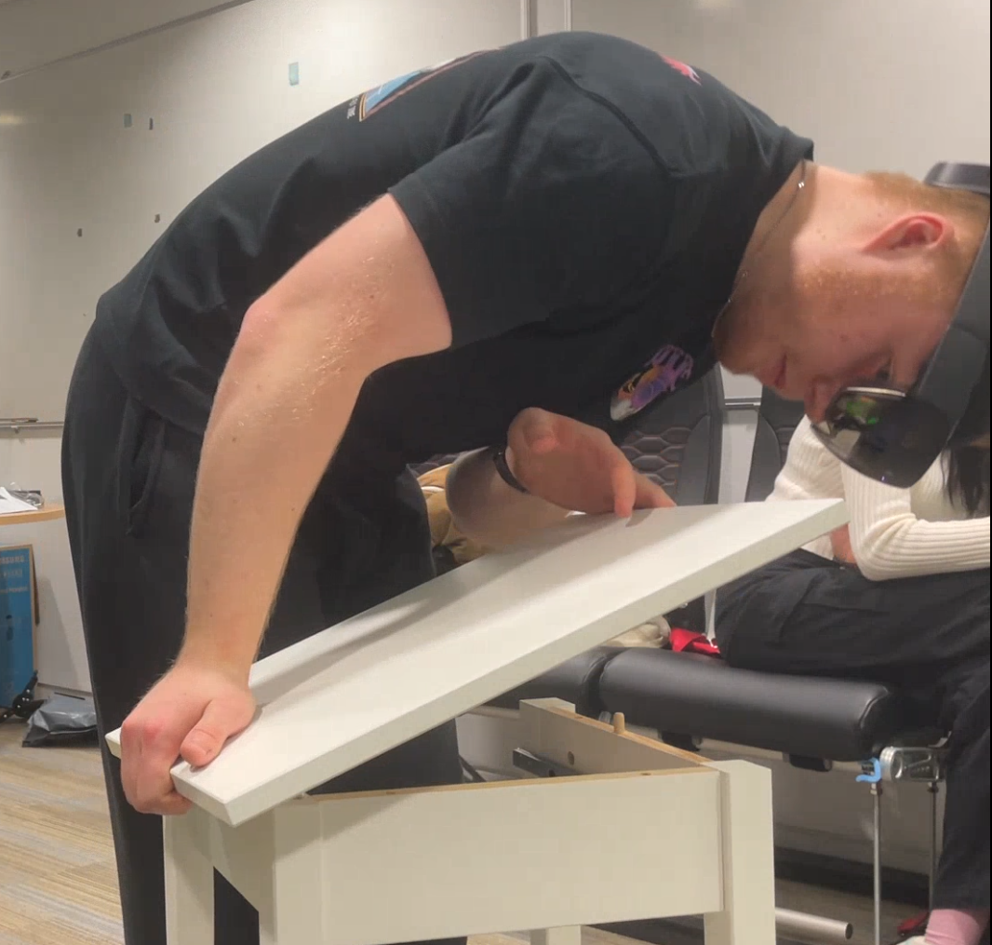
Results
Paper instructions caused more errors than AR
A trend appeared with AR instruction having a lot of issues at the start and then dropping quickly
Paper instructions had consistent level of issues
AR errors were regularly happening at new features/step types
Paper issues were similar throughout

Slide 14
Conclusion
Most development time and effort went to object tracking instructions
Animation was more effective and enjoyable for participants
Biggest issue with AR was the learning curve
New technology to participants
User guide and improved user interface required
Tracking is not ready in current state
Inaccurate
Demanding on the Hololens
Future research could use image tracking as a temporary solution

Slide 15
Bibliography
F. Arena, M. Collotta, G. Pau, and F. Termine. An Overview of Augmented Reality. Computers, 11(2):28, Feb. 2022. ISSN 2073-431X. doi: 10.3390/computers11020028. URL https:// www.mdpi.com/2073-431X/11/2/28. Number: 2 Publisher: Multidisciplinary Digital Publishing Institute
M. Richardson. Assembly complexity and the design of self-assembly products. In M. M. Soares, W. Karwowski, and N. A. Stanton, editors, Human factors and ergonomics in consumer product design, pages 187–200. CRC Press, 2011
A. Tang, C. Owen, F. Biocca, and W. Mou. Performance Evaluation of Augmented Reality for Directed Assembly, pages 311–331. Springer London, London, 2004. ISBN 978-1-4471- 3873-0. doi: 10.1007/978-1-4471-3873-0_16. URL https://doi.org/10.1007/ 978-1-4471-3873-0_16.
S. Wu, L. Hou, H. Chen, G. K. Zhang, Y. Zou, and Q. Tushar. Cognitive ergonomics-based Augmented Reality application for construction performance. Automation in Construction, 149: 104802, May 2023. ISSN 0926-5805. doi: 10.1016/j.autcon.2023.104802. URL https: //www.sciencedirect.com/science/article/pii/S0926580523000626

