Slide 1
Session 4
Evaluating Clinical Prediction Models
Advanced Data Science · NYU Paris · 2026
Paul Dubois

Slide 2
Main question
We have a trained model.
How can we interpret the output as probabilities?
Notes:
Start from what they actually have: a fitted model with a predict_proba method that returns numbers between 0 and 1. The question of the day is whether those numbers mean anything, and the first half of the answer is uncomfortable — in general they do not, and each model family is wrong in its own characteristic way.
Set the plan: four standard classifiers on one dataset, four different failures, each with a mechanism you can name. Then, once we know why it happens, what to do about it.

Slide 3
Why a model’s output is not a probability

Slide 4
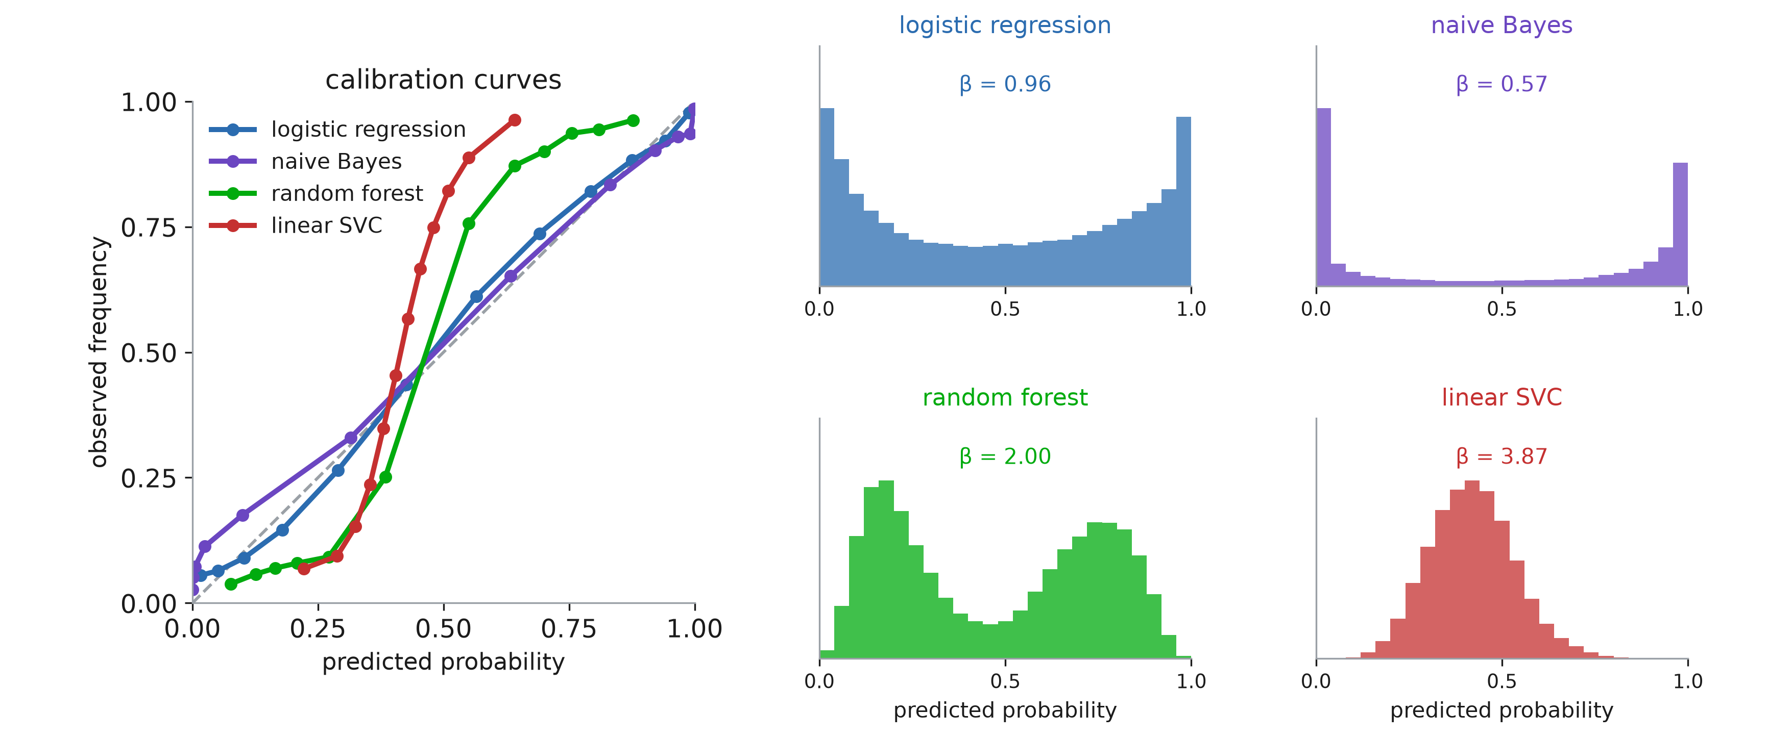
Models tend to have bias
Notes:
One dataset — twenty features, two of them informative, two of them redundant copies — and a deliberately small training set of 100 rows so the effects are visible. Four classifiers you would all reach for. This is the scikit-learn calibration comparison, and it is worth reproducing because the four failures are so different from each other.
Read the histograms first, not the curves, because the histograms are the shape of the problem.
Logistic regression: spread across the range, curve on the diagonal, β = 0.96. Naive Bayes: 58% of all predictions are below 0.05 or above 0.95 — it is almost always certain. Random forest: the exact opposite, 1% of predictions are that confident, and the mass sits in two humps around 0.15 and 0.8. Linear SVC: nothing below 0.2 or above 0.7 at all.
Now the curves. Logistic on the diagonal; naive Bayes flatter than the diagonal (β = 0.57, too extreme); forest and SVC steeper (β = 2.00 and 3.87, too timid), with the characteristic sigmoid shape.
One number to flag before they over-read the Brier column later: naive Bayes has a BETTER Brier score than logistic regression here, 0.101 against 0.128, because it discriminates better — AUC 0.929 against 0.896. Promise them the decomposition that explains it; it opens the second half. Being badly calibrated and being useless are different things, and a single scalar will not separate them.
The rest of the section takes the four in turn and names the mechanism.

Slide 5
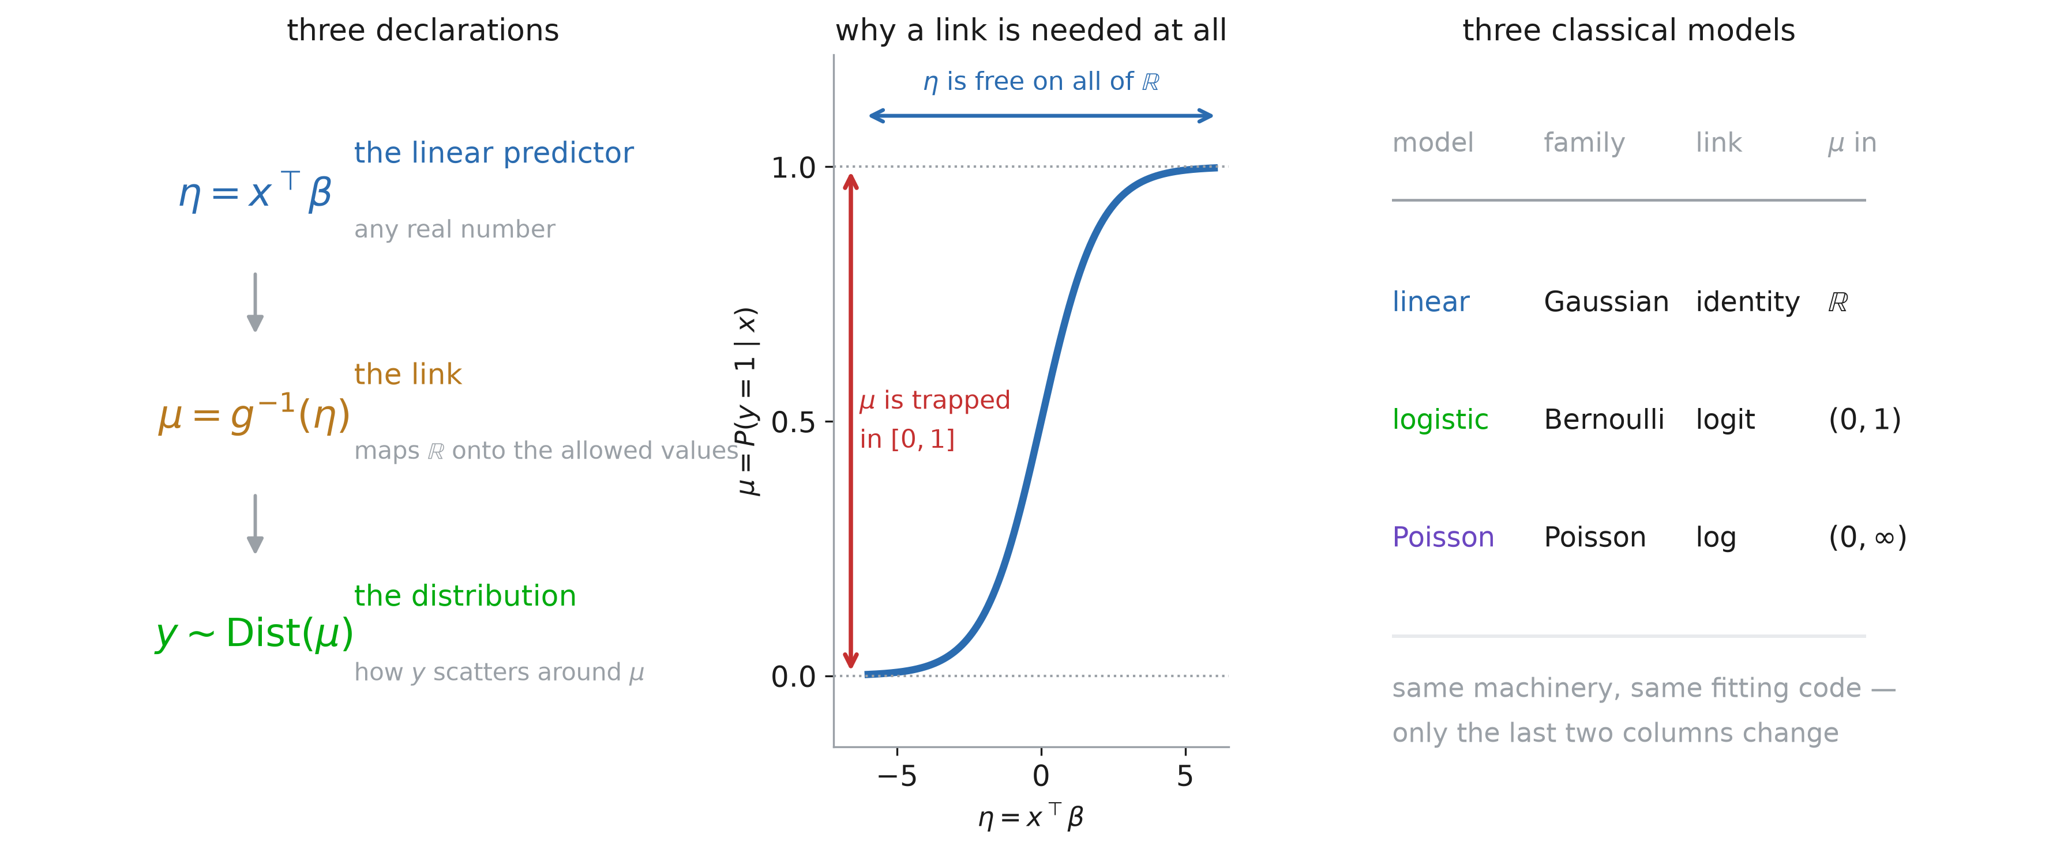
A generalized linear model
Notes:
Before the argument about logistic regression, the vocabulary it needs. Most of them have fitted GLMs without being told the name.
A GLM is three declarations and nothing else.
One: the LINEAR PREDICTOR, η = xᵀβ. Say the letter — eta. This is the only place the model is linear, and it is free: xᵀβ will happily come back −7.3 or +12.
Two: the LINK. The mean μ = E[y | x] is usually not free. A probability has to sit in [0, 1]; a count rate has to be positive. So we do not model μ directly, we model η and map it back: μ = g⁻¹(η). The middle panel is that mapping for logistic regression — the whole real line squeezed into the unit interval by the sigmoid. The link g is the trip in the other direction, from μ to η.
Three: the DISTRIBUTION of y around μ. Gaussian, Bernoulli, Poisson.
Right panel is the one that makes it land. Linear regression is a GLM: Gaussian with the identity link, where μ really is free so the link does nothing. Logistic regression is a GLM: Bernoulli with the logit. Poisson regression is a GLM. Same machinery, same fitting code, and only the last two columns change.
One sentence to make η concrete, because it will recur all session: for logistic regression η = logit(p), so η IS the log-odds. It is the same quantity as the x-axis of the calibration-slope plot, and the same quantity Platt scaling takes as its input. Three names, one object.

Slide 6
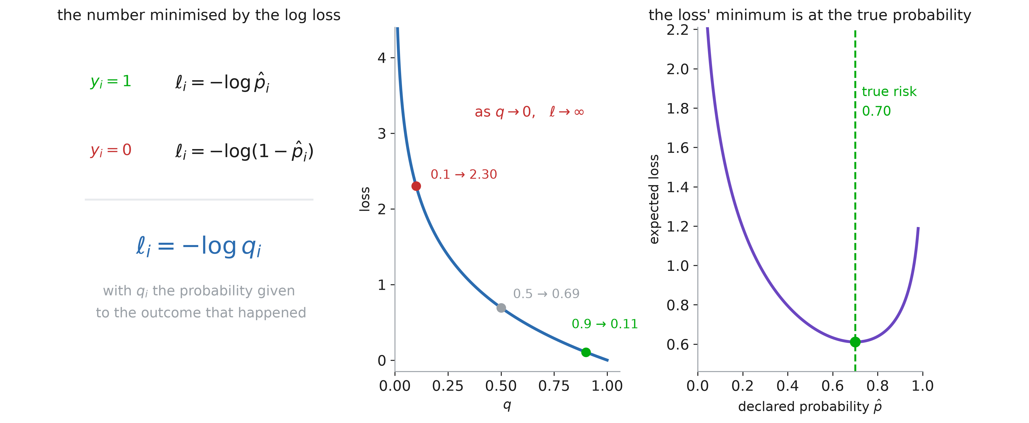
What the log loss is doing
Notes:
The GLM slide said “Bernoulli” in declaration three and moved straight on. Take that seriously for the next few slides and the rest of the session falls out of it.
Start with a question to the room, and wait for the silence: who CHOSE log loss? Everyone has typed LogisticRegression(); nobody chose anything. So what is that loss doing, and why that one?
Left: the definition, and it is smaller than people remember. For a row with y = 1 it is −log p̂; for y = 0 it is −log(1 − p̂). One line covers both: it is −log q, where q is the probability you gave THE OUTCOME THAT HAPPENED. Say that phrase twice. The loss never looks at the outcome that did not happen — there is no credit for the 0.3 you had left over.
Middle: the shape. Give the right answer 0.9 and you pay 0.11. Say 0.5 and you pay 0.69. Give 0.1 and you pay 2.30, and the curve has no ceiling — as q → 0 the loss goes to infinity. Being confidently wrong is unboundedly expensive, and that is deliberate. Contrast accuracy, which only asks which side of 0.5 you were on and cannot tell 0.51 from 0.99. A loss that cannot tell those apart cannot possibly train a model to produce meaningful probabilities.
Right is the slide, and it is the one to spend time on. Fix a patient whose TRUE risk is 0.70 and ask what number you should declare. Plot the expected loss against your declared p̂. The minimum sits at 0.70. Not near it — at it.
That is what the log loss is doing: it makes honesty optimal. You cannot do better by shading your answer towards 0 or 1 to look decisive, and you cannot do better by hedging towards 0.5 to look cautious. The technical name is a PROPER scoring rule, and proper means exactly this: the expected loss is minimised by reporting the true probability. It is the entire reason we can hope for calibrated output at the end of training.
One detail that pays off later: the minimum value is 0.61, not zero. Even a perfect forecaster pays something, because the outcome is genuinely random — that floor is the entropy of the true risk. When we decompose the Brier score later, the irreducible term is this same idea. A loss that does not reach zero is not a failure; a model whose loss reaches zero on held-out data is a leak.

Slide 7
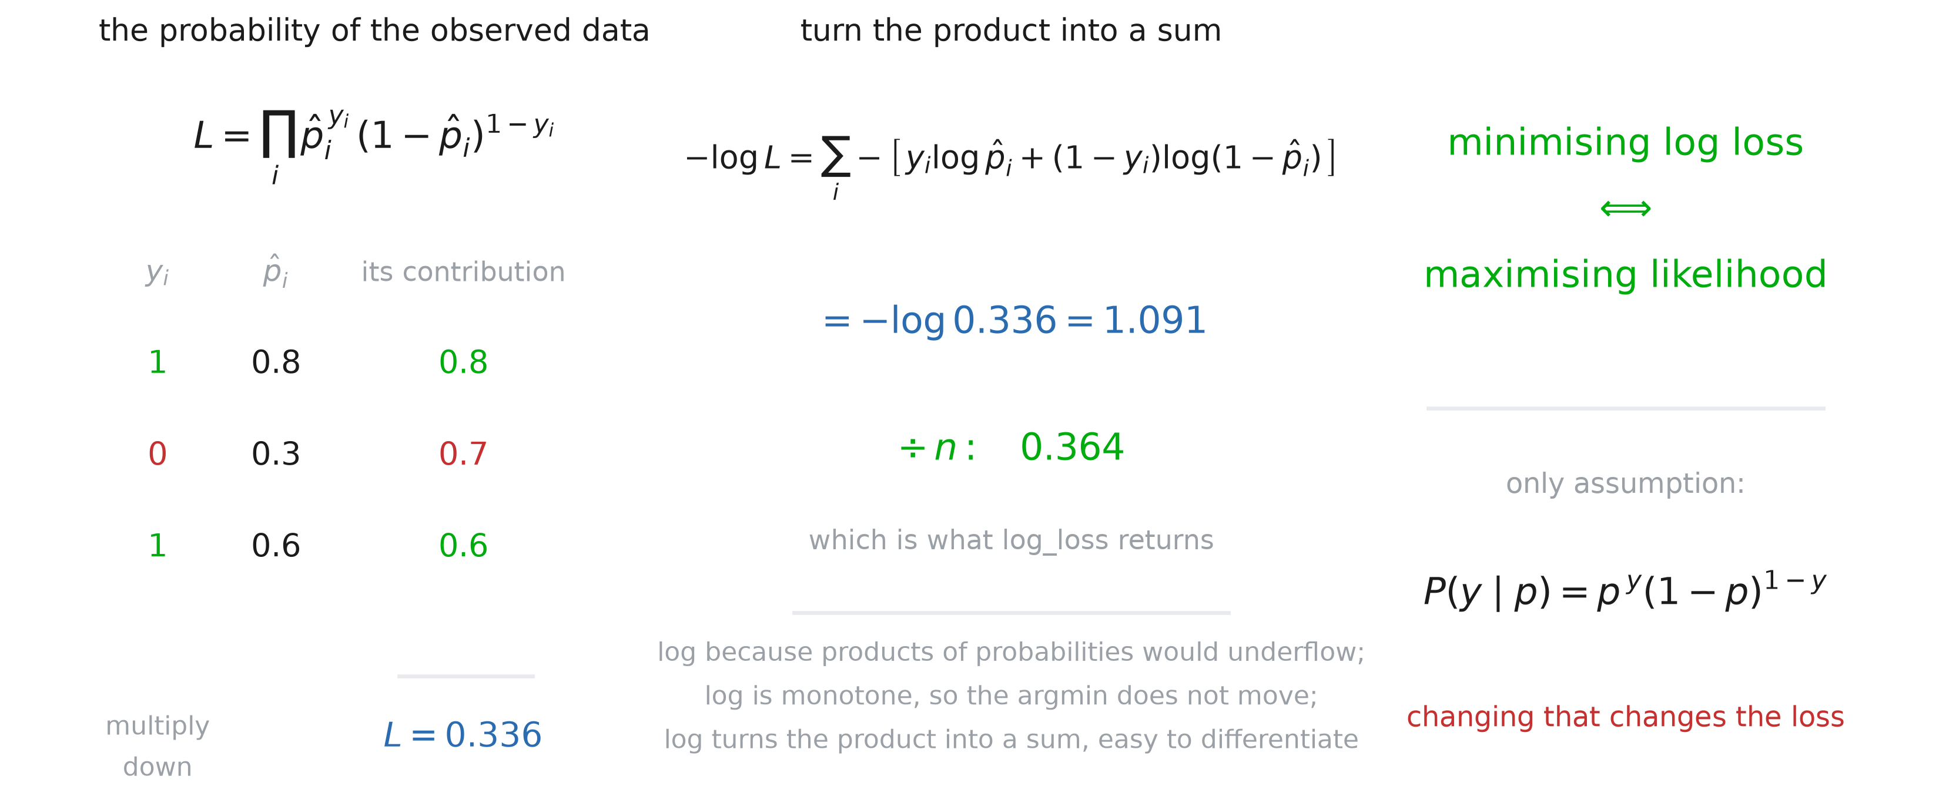
Log loss is a likelihood
Notes:
Now where it comes from, because “someone designed a proper scoring rule” is still a story about a clever choice, and the truth is better than that.
Left: three patients, outcomes 1, 0, 1, and a model saying 0.8, 0.3, 0.6. Ask the room for the probability the model assigned to what actually happened — to that exact dataset. Row one contributes 0.8. Row two contributes 0.7, the other side, because the event did not happen. Row three contributes 0.6. Multiply: 0.336. That is the LIKELIHOOD, and every student has met the word without meeting the object.
Middle: nobody wants a product of six thousand numbers below one — it underflows to zero in float64 within a few hundred rows, and it does not differentiate pleasantly. So take the log, which turns the product into a sum, and flip the sign, so that big-is-bad like every other loss. −log 0.336 = 1.091; divide by n and you get 0.364, which is the number log_loss hands back. Say the structural point: log is monotone, so the sign-flipped log has its minimum exactly where the likelihood has its maximum. Taking the log changes the number, never the argmin.
Right: so what was LogisticRegression().fit() doing all along? Maximum likelihood. Not “penalising errors” — finding the β that makes the data you actually observed as probable as it can be made.
And now point at the single input, because this is the hinge of the whole section. The ONLY thing we assumed was one line: P(y | p) = p^y (1−p)^(1−y). The Bernoulli. Everything else was bookkeeping — a product, a log, a sign. So if you change that one line, you get a different loss, automatically, with no new ideas required. Change it to a Gaussian and you should get squared error. That is a claim, and the next few slides make good on it.

Slide 8
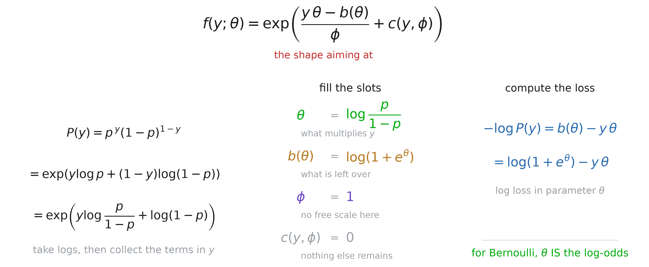
Now write it in exponential form
Notes:
Start at the top of the slide, not the left, because the whole slide is an exercise in matching and you cannot match against nothing.
Put that shape up and be honest about it: I am handing you a form with four empty slots — something multiplying y, something subtracted, something dividing, and a leftover term. Where does it come from? Take it on trust for ninety seconds. The only claim right now is that the Bernoulli fits into it, and the NEXT slide is where we say why this shape and not another, and who else fits.
Then what we are doing is plain: rewrite the line we assumed two slides ago — nothing new, the same Bernoulli — until it looks like the thing at the top. Do it on the board; it is three lines.
Left. Start with P(y) = p^y (1−p)^(1−y). Take logs and exponentiate, which changes nothing: exp(y log p + (1−y) log(1−p)). Now collect the terms in y: y log p − y log(1−p) + log(1−p), so the coefficient of y is log(p/(1−p)).
Middle: now read the bottom line against the template, slot by slot. What multiplies y? log(p/(1−p)). That goes in the θ slot. What is left over, not multiplied by y? log(1−p), and the template wants it SUBTRACTED, so b(θ) = −log(1−p), which rearranged in terms of θ is log(1+e^θ). What divides? Nothing — so φ = 1. And what is left with neither a y nor a θ in it? Nothing at all, so c(y, φ) = 0.
Make the φ point explicitly, because it is the clearest evidence that the template is doing work. You cannot say “φ = 1” by staring at a Bernoulli. You can only say it once something has told you there is a φ slot to fill. Same for c. The template is not decoration; it is the question sheet.
Emphasise, because it is the sentence they should leave with: nobody CHOSE the log-odds. We wrote down the Bernoulli, rearranged it, and the log-odds fell out as the coefficient of y. That is the precise sense in which it is the distribution’s own natural coordinate — and it is the first hint that the logit is not a convenience.
Right: and the loss comes along for free. The loss is −log of the density, and in this form that is b(θ) − yθ, which is log(1+e^θ) − yθ. Check it against what they already have: substitute θ = log(p/(1−p)) back in and you are staring at −[y log p + (1−y) log(1−p)], the log loss we started from. Same function, new coordinate.
Worth ten seconds: the middle form, log(1+e^θ) − yθ, is what a library actually computes. That is BCEWithLogitsLoss in torch — it takes the linear predictor, never forms the probability, and is numerically stable because of it. They have all used it; now they know what the “WithLogits” is.
So the whole Bernoulli story is: yθ − b(θ). Two symbols. The obvious question is whether that shape was a Bernoulli accident — and it is not, which is the next slide.

Slide 9
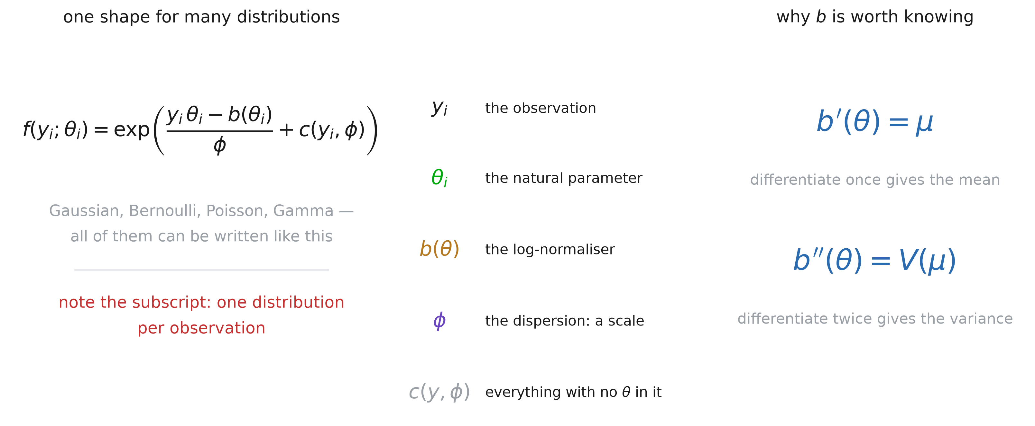
The exponential family
Notes:
Pay the debt from the previous slide. I put that shape up and asked them to take it on trust; here is the justification, and it is simply that the Bernoulli was not special.
Left: the same template, now with subscripts and a name. Do not let them read it as a new distribution — it is a TEMPLATE, and the Bernoulli is the instance we just built by hand. Gaussian, Poisson and Gamma go in too, each with its own θ and its own b. Two contrasts with our case are worth naming: the φ that was stuck at 1 for us is a free scale for the Gaussian, where it is the variance; and the c that was 0 for us is where the Gaussian parks its y²/2σ² and its log√(2πσ²).
If someone asks whether EVERY distribution fits: no. The uniform on [0, θ] does not, because its support depends on the parameter, and mixtures generally do not either. The family is large enough to cover what we model and small enough to have theorems.
Point at the subscripts before anything else, because this is where the confusion of the section lives. There is one distribution PER OBSERVATION. Patient i has their own y_i and their own θ_i. The dispersion φ has no subscript: it is one number for the whole dataset.
Middle: the glossary, and take all five — they have met four of them already, which is the point. y_i is the observation. θ_i is the natural parameter, whatever multiplies y_i; for us that was the log-odds. b(θ) is the log-normaliser, whatever has to be subtracted to make the thing sum to one; for us that was log(1+e^θ). φ is a dispersion, a scale factor, 1 for the Bernoulli and not for the Gaussian. c(y, φ) is the leftovers — everything with no θ in it, which means it contributes nothing to the fit and you can ignore it.
Right: the two facts that make the template worth having. Differentiate b once and you get the mean. Differentiate it twice and you get the variance function. These are not obvious, and they are the return on all this rewriting: one function, b, and its first two derivatives hand you everything the model needs. We check them on the Bernoulli on the next slide.
If someone asks the fair question — why bother, we already had the log loss — the answer is two slides away. The template is what lets us derive the LINK and the LOSS from the distribution alone, for any member, once. That is what “canonical” is going to mean.

Slide 10
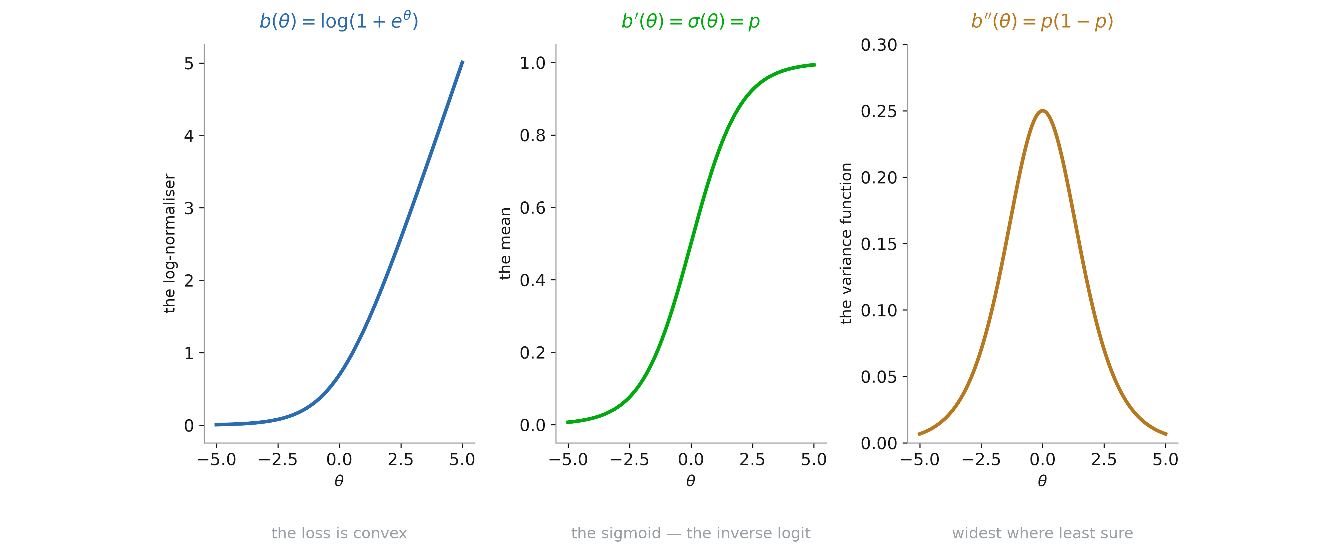
The two derivatives
Notes:
Cash the promise on the case we built by hand. Bernoulli, so b(θ) = log(1+e^θ), and the claim is that differentiating it once gives the mean and twice gives the variance.
Left: b itself, the softplus. Flat on the left, linear on the right. It is convex, and say why that matters now rather than later: the loss is b(θ) − yθ, so the loss is a convex function plus a linear one, which is convex. Logistic regression has one optimum and no local minima, and this is the reason. Nothing about the fit is luck.
Middle: b′. Differentiate log(1+e^θ) and you get e^{θ/(1+e}θ) — the sigmoid. Which is p. Which is the mean of a Bernoulli. The claim b′ = μ is true here, and it is not a coincidence of notation: the sigmoid the room has been drawing since session two is the derivative of the Bernoulli’s log-normaliser. Let that be slightly surprising.
Right: b″ = p(1−p), the Bernoulli variance. Peaked at 0.25 where θ = 0, i.e. where p = 0.5, and collapsing at both ends. Read it as a statement about the world: the outcome is most variable where the model is least sure, and nearly deterministic where it is confident.
Two things to put a pin in, both of which return before the section is out. The curve on the right is also the SLOPE of the curve in the middle — one function describes both how fast the probability moves and how much the outcome scatters. And that coincidence is what makes the gradient of logistic regression collapse to something as simple as Xᵀ(y − p̂).

Slide 11
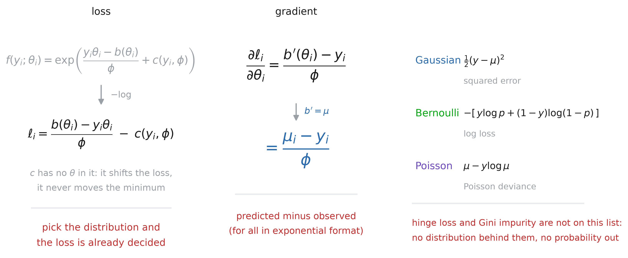
Loss is chosen for distribution
Notes:
Now make good on the claim from the likelihood slide: change the distribution and the loss changes with it, automatically. We did the Bernoulli by hand three slides ago; here is the same operation done once for the whole template.
Left: one operation, and it is the one they now recognise. The likelihood of row i is the density; the loss is minus its log, summed over rows. Take minus the log of the template and the exponential disappears: ℓ_i = (b(θ_i) − y_i θ_i)/φ − c(y_i, φ). Put the Bernoulli’s b and φ = 1 into that and you are back at log(1+e^θ) − yθ, which is where we were three slides ago.
Point at c and then dismiss it. It contains no θ, so it is a constant as far as the fit is concerned: it moves the value of the loss up or down and leaves the argmin exactly where it was. That is why you never see it in a loss function in a library.
So the red line: you do not pick a distribution AND a loss. You pick a distribution and the loss is already determined. The three declarations of a GLM were the whole specification.
Middle: differentiate once with respect to θ. You get (b′(θ) − y)/φ, and we know b′ = μ — we drew it on the previous slide — so it is (μ − y)/φ — predicted minus observed, divided by a constant. Say the generality out loud: this is not a fact about classification. EVERY member of the family has a loss whose derivative in the natural parameter is the residual. Squared error having gradient (μ − y) is this same statement, which is why that one feels obvious and this one should too.
Right: the three instances, so nobody thinks this is exotic. Gaussian gives squared error — expand −log of a Gaussian density and everything that is not (y − μ)²/2 is in c. Bernoulli gives log loss. Poisson gives μ − y log μ, which is what sklearn calls the Poisson deviance and what you would use for counts of readmissions. Three losses they already use, one derivation.
The red line at the bottom is the one to hold on to for the rest of the session. Hinge loss is not minus the log of anything. Gini impurity is not minus the log of anything. The SVC and the random forest are not fitting a distribution at all, so there is nothing in their objective that makes the output a probability — and the last three slides of this section are exactly that bill coming due.

Slide 12
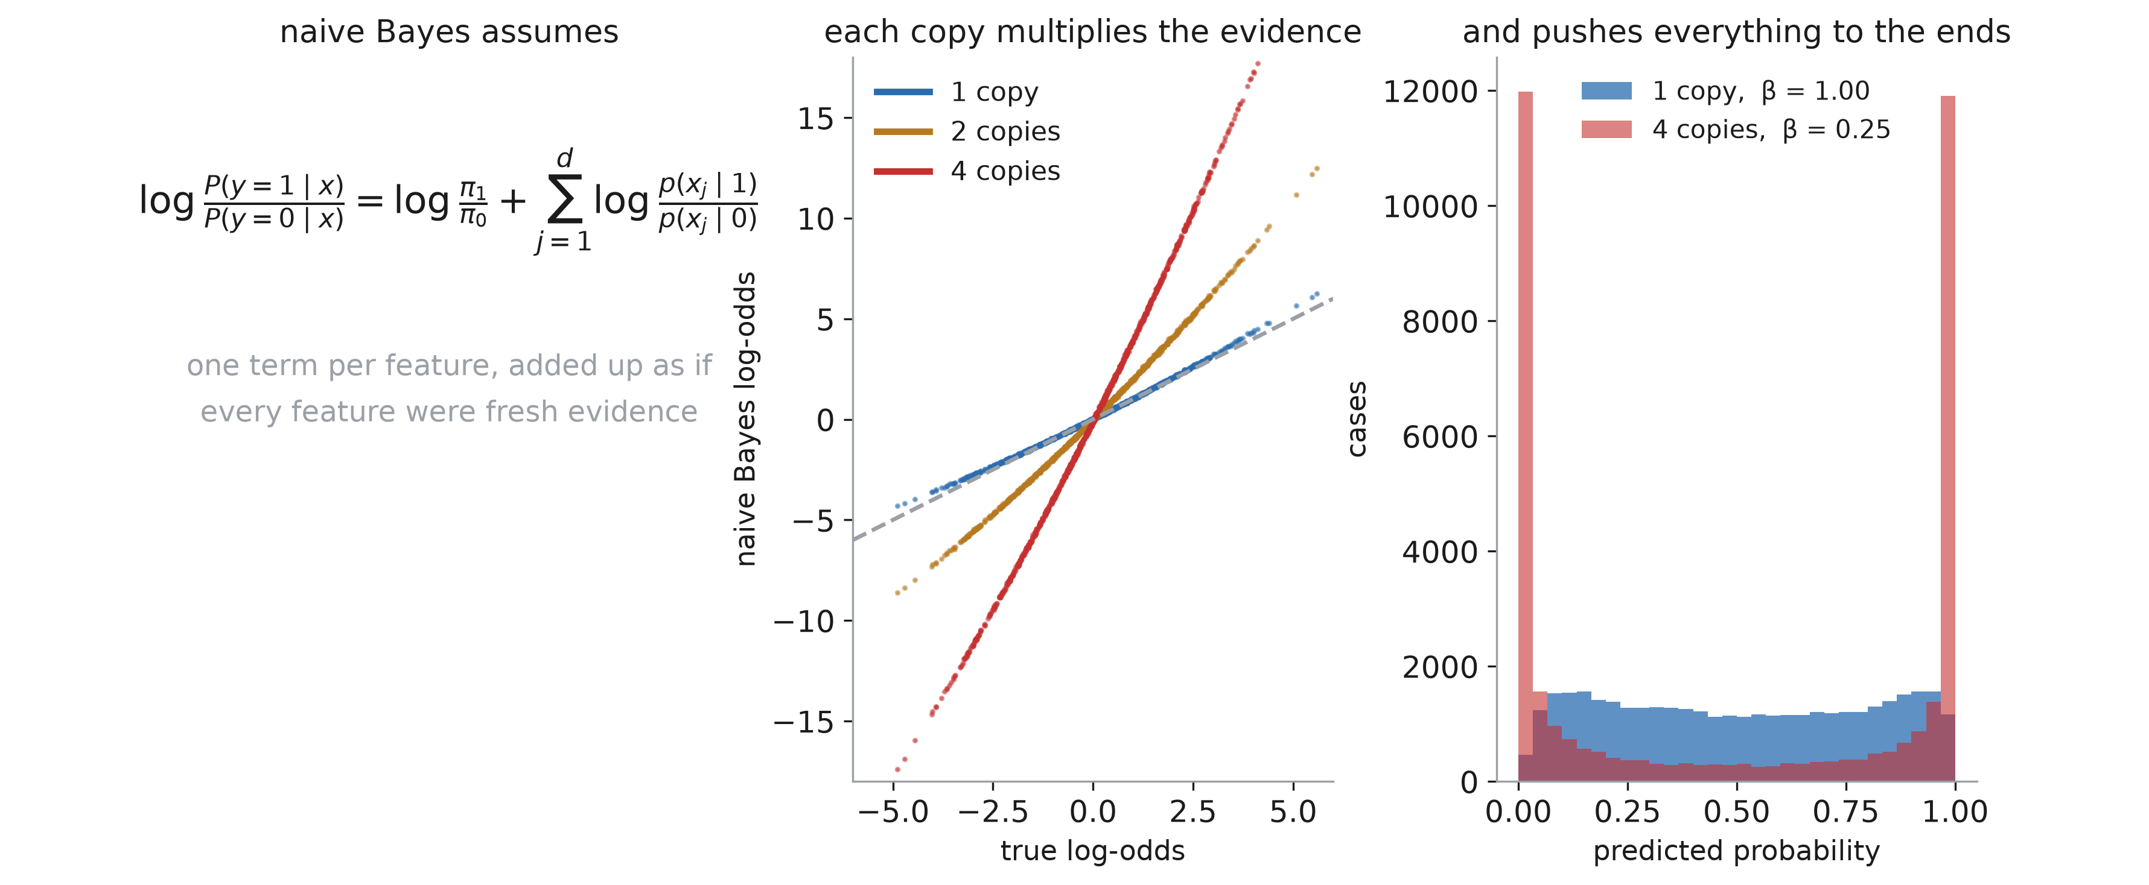
Naive Bayes counts the same evidence twice
Notes:
Naive Bayes is the “too extreme” failure, and its mechanism is the cleanest of the four because you can do it in your head.
Left: the model. The posterior log-odds are the prior log-odds plus one term per feature — and that addition is only valid if the features are conditionally independent given the class. Every feature is treated as fresh evidence.
Middle is the experiment, and it is almost too neat. Take ONE informative feature and hand the model k near-identical copies of it. The fitted log-odds are k times the truth: the measured slopes are 0.99, 1.99 and 3.97 for one, two and four copies. The model is not learning anything new from the copies; it is counting the same evidence again, and confidence compounds.
Right: what that does to the probabilities. With four copies, β collapses to 0.25 — exactly 1/k, as it must — and the predictions pile up against 0 and 1.
Now connect it back: the dataset in this section has n_redundant=2, two features that are linear combinations of the informative ones. That is a mild version of what I just did deliberately, and it is enough to produce the 58% figure from the first slide.
The general lesson, which is bigger than naive Bayes: correlated features are the norm in clinical data — repeated labs, a score and its components, height and weight and BMI. Any model that assumes independence will be overconfident in exactly this way.

Slide 13
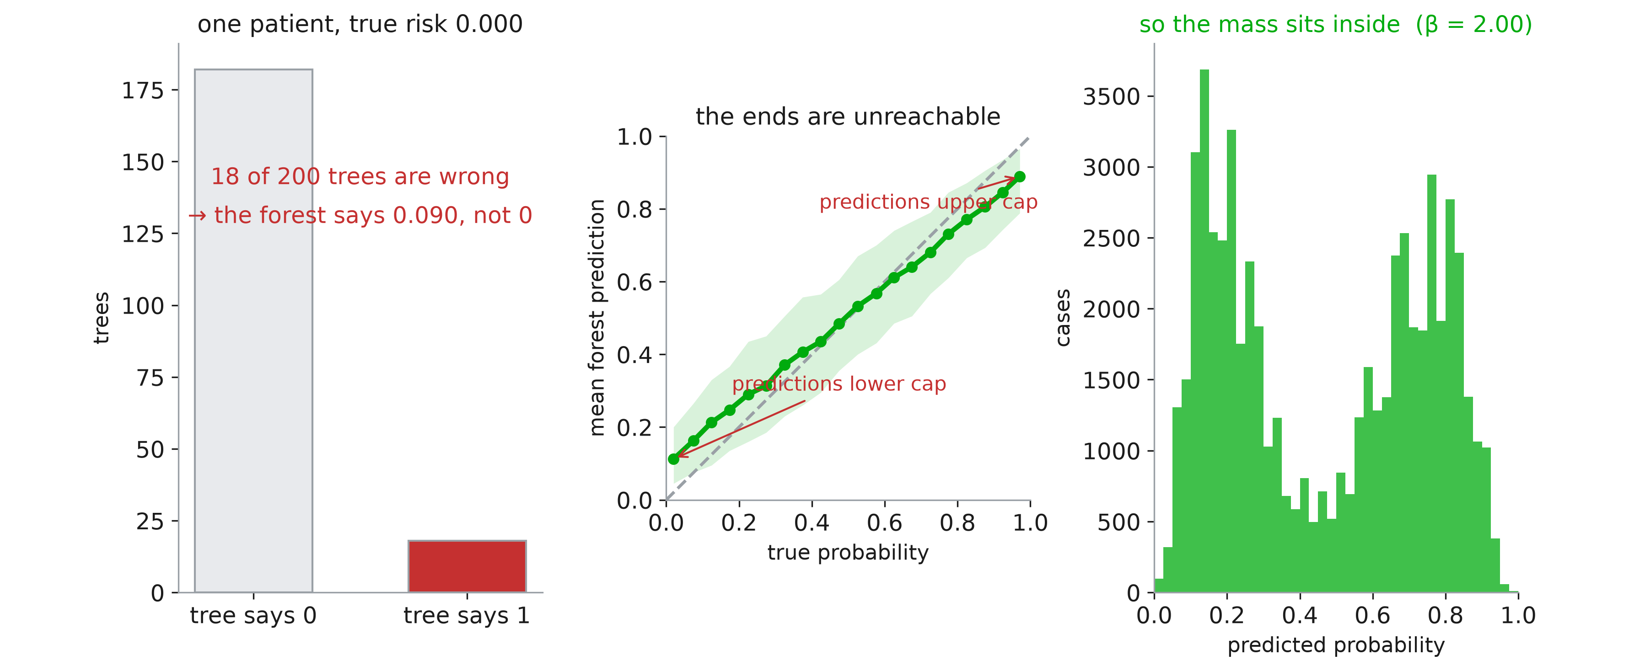
Random forests cannot reach the ends
Notes:
The opposite failure, and the argument is Niculescu-Mizil and Caruana’s.
Left: take the lowest-risk patient in the test set — true risk essentially zero. For the forest to output 0, every single tree must output 0. But the trees are high-variance, because each sees a bootstrap sample and a random subset of features at each split. Here 18 of the 200 trees say 1, so the forest says 0.09. Not because it is uncertain in any meaningful sense — because averaging cannot cancel errors that all point the same way.
And they do all point the same way, which is the middle panel. Predictions live in [0, 1]. Near zero, an erring tree can only err UPWARD; near one, only downward. The error is one-sided at both ends, so the average is pulled inward at both ends, and the mean prediction curve bends away from the diagonal in a sigmoid.
Right: the consequence on the shared example. Two humps, nothing at the ends, β = 2.00.
Say the counter-intuitive part out loud, because it is the memorable bit: this model should trust itself MORE. The repair stretches its predictions outward, which is the opposite of what people expect a correction to do.
And note it is specific to averaging: a single tree has the reverse problem, it outputs only 0 and 1. Bagging fixed the variance and bought a bias in the probabilities.

Slide 14
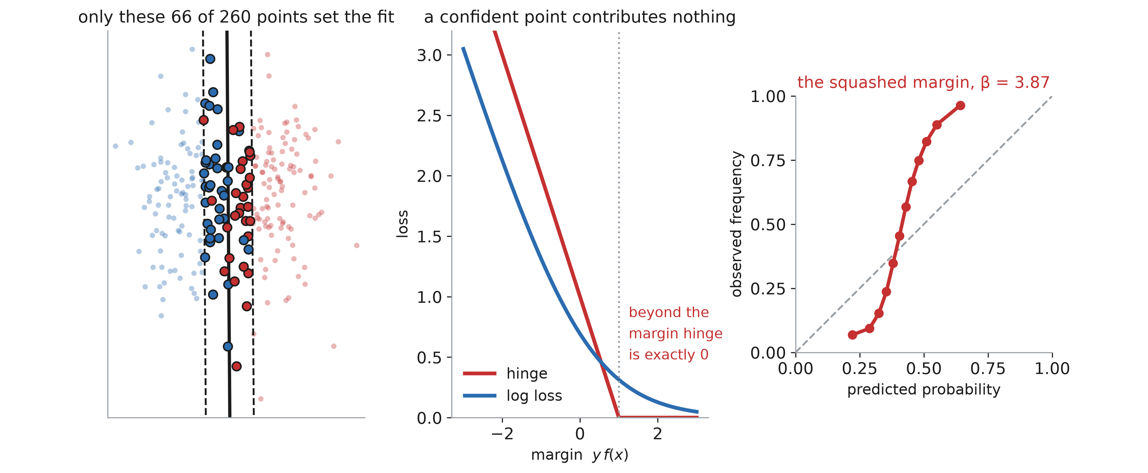
Margins only look at the boundary
Notes:
The SVC is the worst of the four, and for a reason that is structural rather than incidental.
Left: the fitted boundary and its margin. Of 260 points, 66 lie inside the margin or on the wrong side. Those are the only points that matter — move any of the other 194 and the solution does not change.
Middle: why. Hinge loss is exactly zero once y·f(x) exceeds 1. A point that is comfortably, correctly classified contributes NOTHING to the objective. This is the pin from the second slide of the section: log loss falling towards zero but never reaching it, against hinge going flat at exactly zero past margin 1.
And the deeper version of the same point: hinge loss is not minus the log of any density. There is no distribution here whose negative log-likelihood we are minimising, so no b, no θ, no canonical pairing, and nothing that forces the residuals to sum to anything. Logistic regression ends up with the balance property because its loss came from a distribution; this one cannot, because its loss did not.
So the fit is determined entirely by the hard cases near the boundary, and the scale of f(x) is set by the margin, not by any probabilistic consideration. There is no reason for f to be a log-odds, and it is not.
Right: what happens when you squash it anyway. Min-max the decision function into [0, 1] — which is what a naive pipeline does — and you get the strongest sigmoid of the four, β = 3.87, with no prediction below 0.2 or above 0.7.
Historical note worth ten seconds: this is exactly the problem Platt was solving in 1999. The method we will use to repair all four of these models was invented for this one.

Slide 15
Until proven otherwise, models predict a score
Notes:
Pull the four together. Logistic regression was calibrated because the loss, the link and the data-generating mechanism agreed — the first two by construction, since both came out of the Bernoulli, and the third by luck of the simulation — and even then only in-sample, and only at a sensible C. Every other model was biased, and each in a different direction: naive Bayes too extreme, forest and SVC too timid.
So the working assumption should be reversed from the one students arrive with. A model’s output is a SCORE until you have looked at a reliability diagram. The ranking may be excellent — the forest had the best AUC here — while the numbers are unusable.
Transition to the fix: all four failures are monotone distortions of the truth. That is a strong hint about the repair, and it is what the next section is about — fit a function that maps the model’s output to a probability, on data the model has not seen.

Slide 16
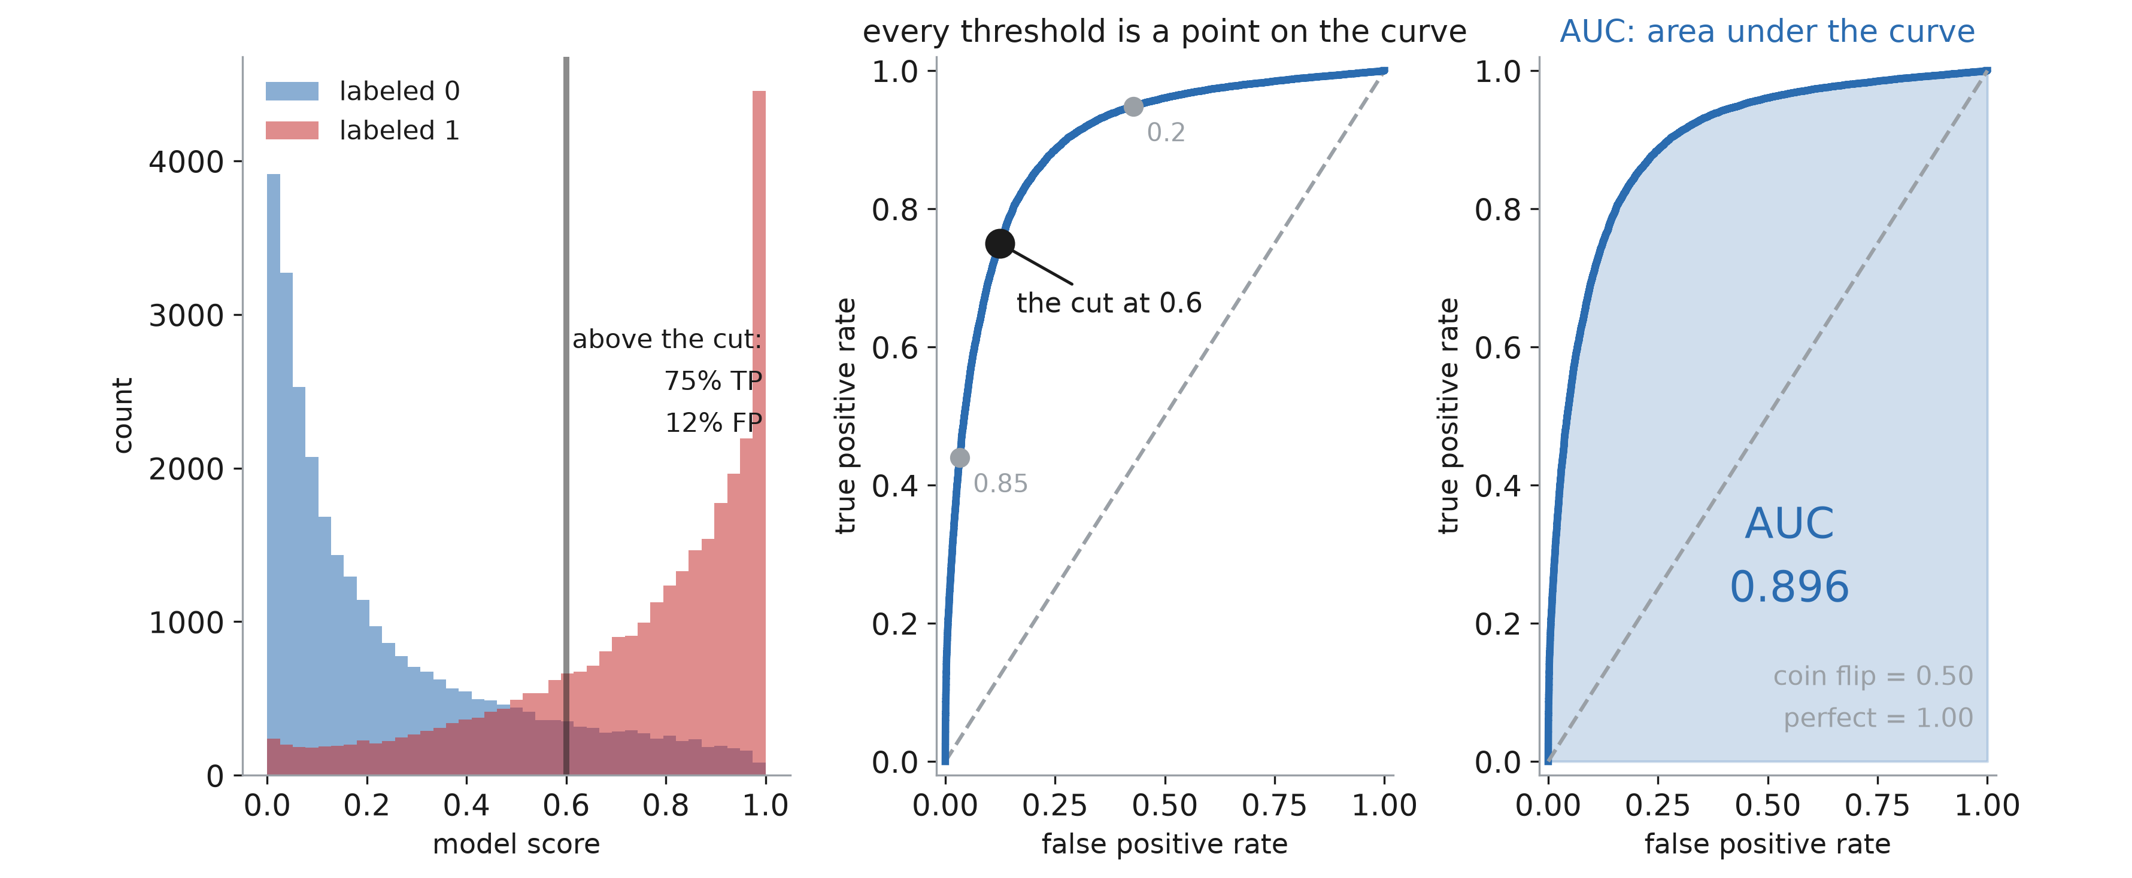
What is AUC?
Notes:
I have been quoting AUCs all session — 0.896, 0.929, 0.934 — without defining the thing. It is the other half of model evaluation, and the half that is blind to everything we are about to repair, so it needs saying properly.
Panel 1. A classifier does not really give you a decision, it gives you a score, and a decision only appears when you pick a threshold. Here are the logistic regression’s scores, drawn separately for the patients who had the complication and those who did not. The two distributions OVERLAP — that is the entire problem of classification in one picture. Put the cut at 0.6 and you catch 75% of the complications while also flagging 12% of the people who were fine. Move the cut left and you catch more of both; move it right and you catch fewer of both. There is no setting that wins on both counts, and nothing in the data tells you where to put it.
Panel 2. So stop picking one. Slide the threshold from 1 down to 0, and at every position record the pair (false positive rate, true positive rate). Each threshold is a point; the whole sweep is a curve. That is the ROC curve. The marked black point is the cut from panel 1; the two grey points are the cuts at 0.85, which is cautious, and 0.2, which is aggressive. The curve is the model’s complete menu of trade-offs, with the choice of threshold taken out.
Panel 3. Summarise the menu by the area underneath it. A model that ranks perfectly hugs the top-left corner and scores 1.0; a model that ranks at random follows the diagonal and scores 0.5. This one gets 0.896.
Two things to say explicitly, because both come back later. First, AUC is threshold-free by construction — it is a summary over ALL thresholds — so it can never tell you which threshold to use, and a model with a great AUC can still be useless at the only cut-off your hospital would accept. Second, and this is the one that matters for the rest of the session: notice that nowhere in that construction did we compare a predicted probability with an observed rate. We only ever asked which patient scored higher. Hold on to that.

Slide 17
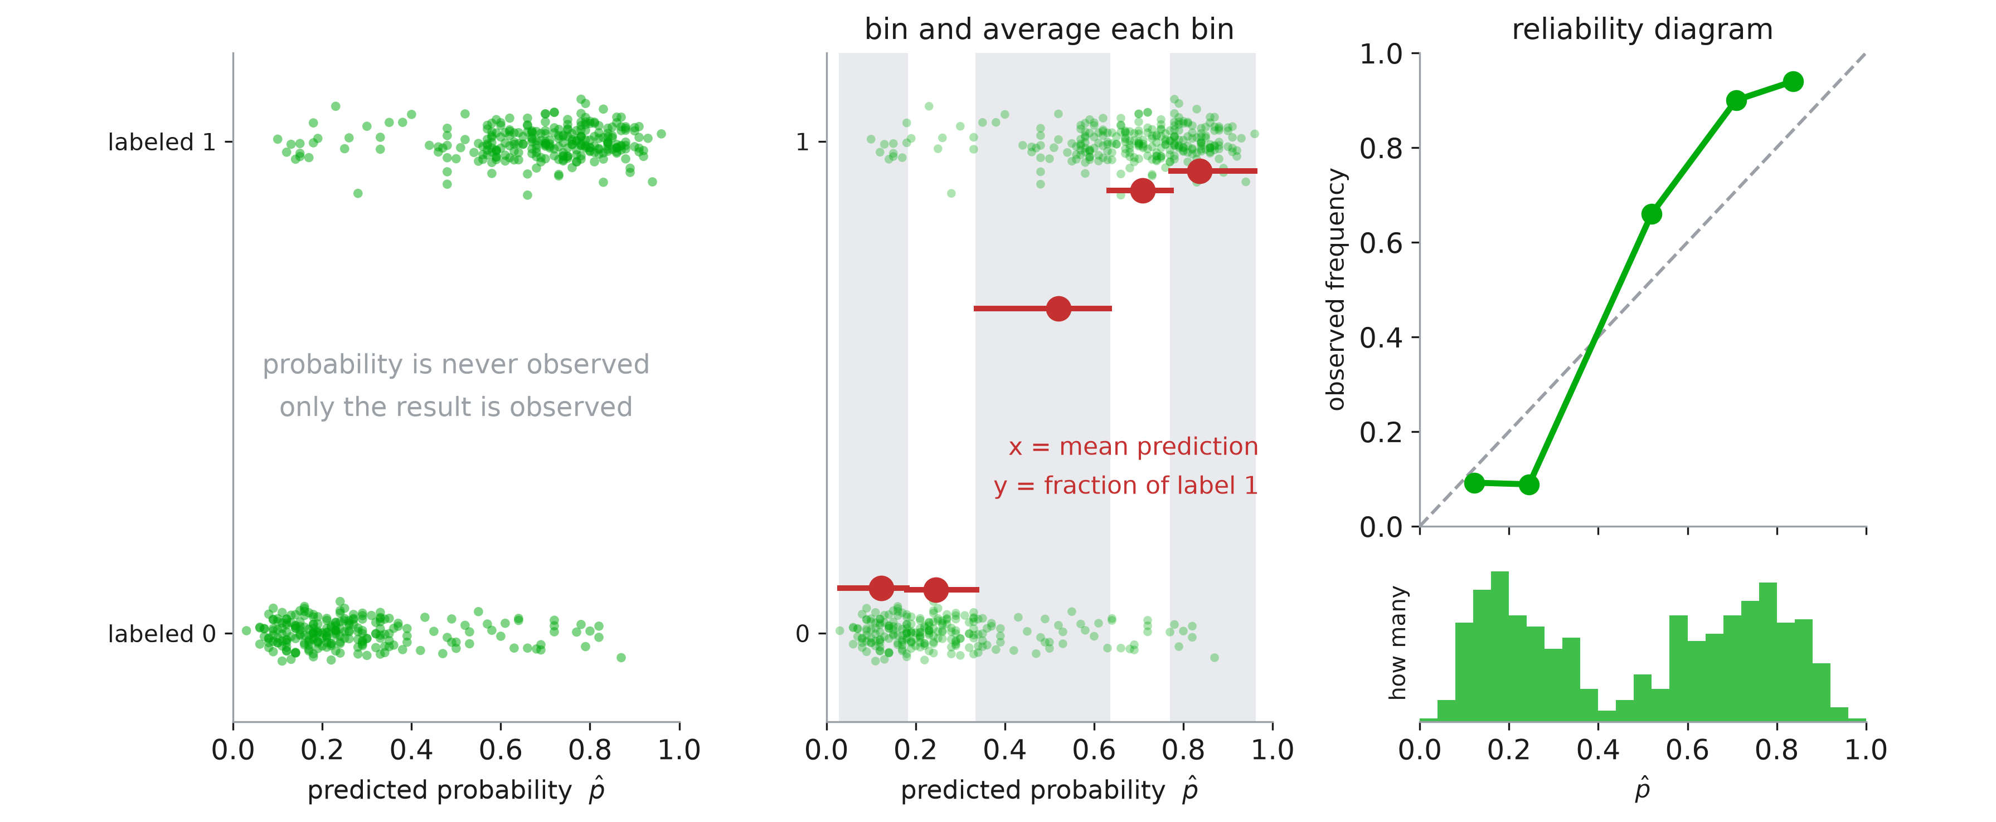
Reliability diagrams
Notes:
We have been reading these since the first slide of the session without once saying how they are made. Fix that now, because every metric that follows is a summary of this picture, and the construction has choices in it.
Start with the problem, panel 1. Five hundred patients from the random forest. Each one has a prediction between 0 and 1 — and an outcome that is 0 or 1. There is no such thing as an observed probability for a single patient: the complication either happened or it did not. So we cannot plot predicted against observed directly. That is the whole difficulty, and it is worth letting them sit with the cloud for a moment. You can see the model is doing something — the dots at the top lean right, the dots at the bottom lean left — but you cannot see whether 0.7 MEANS 0.7.
Panel 2, the trick, and it is the only idea on the slide. You cannot get a probability out of one patient, but you can get one out of a GROUP. Sort the patients by prediction, cut them into bins — five here, shaded alternately — and inside each bin ask two questions. What did the model say on average? That is the x-coordinate. What fraction actually had the complication? That is the y-coordinate. One red dot per bin. The red bar shows the bin’s span; the dot sits at the bin’s mean prediction.
Panel 3, throw away the cloud and keep the dots. Add the 45-degree line, which is where a truthful model lands: predicted 0.3, observed 0.3. Now the picture reads in one glance — this forest sits ABOVE the diagonal in the middle and at the top, so the true rates are higher than it claims, and we know from the α-β slide that this is the β = 2.00 too-timid shape.
And the histogram underneath, which is not decoration. It says where the patients actually are. Two humps, almost nothing between 0.4 and 0.5 — so the part of the curve that crosses the diagonal is supported by very few patients, and you should not read it hard. Any reliability diagram without this histogram is hiding something: a point at 0.9 computed from eight patients looks exactly like a point at 0.9 computed from eight hundred.
Terminology for the exam: this is a reliability diagram, a calibration curve or a calibration plot — three names, one object. And note sklearn gives it to you as calibration_curve, with n_bins and strategy arguments, which are precisely the two choices the next slide is about.

Slide 18
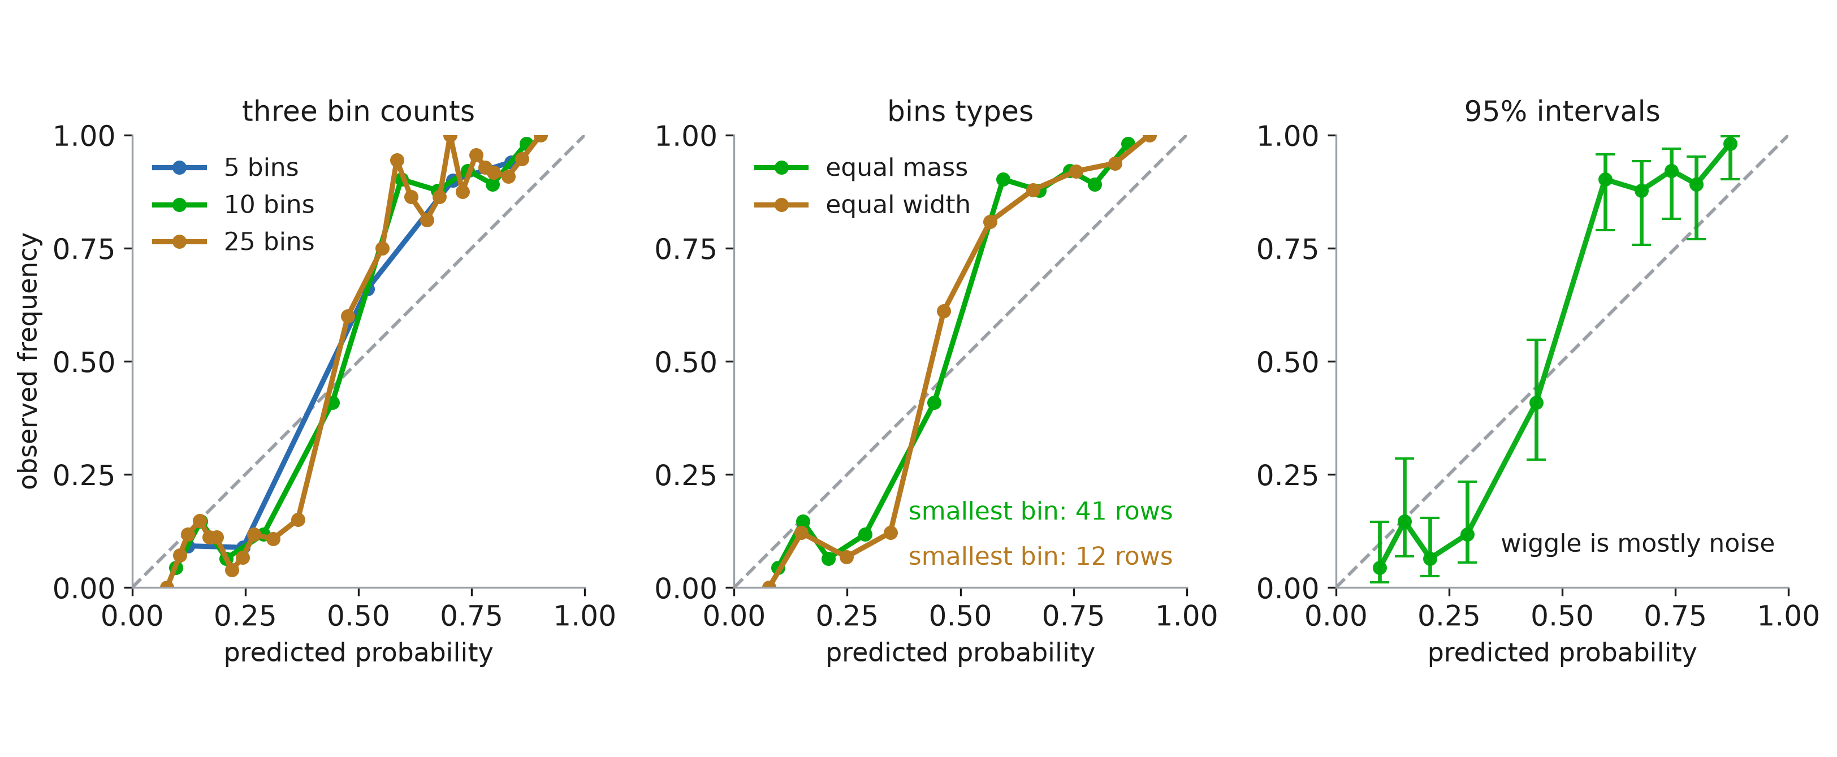
Choices hidden in a calibration curve
Notes:
Three decisions go into that picture, none of them printed on it. Someone hands you a calibration curve; these are the questions to ask.
Panel 1: how many bins? The same 500 patients, three times. Five bins gives a smooth, confident-looking curve. Twenty-five gives a jagged one that touches 1.00 and drops to 0.04. Both are the same model on the same data. Every wiggle you are tempted to interpret — “it over-predicts in the 0.6 to 0.7 range” — may be nothing but the bin count. Few bins hide real structure; many bins invent structure that is not there. This is exactly the bias-variance trade-off from session 1, applied to a plot.
Panel 2: how are the bins drawn? Equal WIDTH cuts the [0, 1] axis into ten equal pieces; equal MASS puts the same number of patients in each. They are different curves from the same data. The numbers in the corner are the point: with equal mass the smallest bin still holds 41 patients, with equal width it holds 12. Those sparse equal-width bins are where the wild swings at the ends come from. Equal mass — strategy="quantile" — is the better default for exactly this reason, and it is what the curves elsewhere in this deck use.
Panel 3: how sure are we of each point? Each dot is a proportion estimated from about fifty patients, so it carries a binomial confidence interval — Wilson intervals here, because the normal approximation misbehaves near 0 and 1. Look at the widths. They span 0.2 or more. Now look back at panel 1 and ask how much of that jaggedness survives once every point is allowed to move a fifth of the way up or down. Almost none of it. The overall tilt is real; the wiggle is not.
The habit to build, and it is the point of the slide: a reliability diagram is a plot with error bars that are usually not drawn. Before concluding that a model is miscalibrated in some specific region, check n in that region. Before comparing two curves, check that they were binned the same way. And prefer the summary numbers — β, and the Brier score — when you need to actually decide something, because they use every patient instead of throwing them into ten buckets.

Slide 19
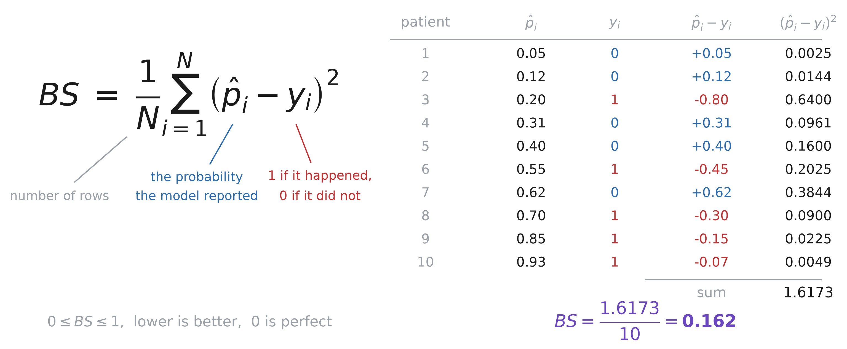
Brier score
Notes:
Before we compare repairs we need something to compare them with, and every scoreboard in the rest of the session leans on one number. It is the simplest formula in the deck, so let us just compute it once, by hand, and never be vague about it again.
Left, the definition. For each patient take the probability the model reported, subtract the outcome — 1 if the complication happened, 0 if it did not — square it, and average over the cohort. That is the entire Brier score. Say what is NOT in that formula, because it is the reason it is trustworthy: no threshold, so you are not committing to a decision rule; no binning, so there is no arbitrary choice of how many bins as there is in a reliability diagram; and no fitted parameters, so there is nothing to overfit. Every patient contributes exactly one term.
Right, the same ten patients worked through. Walk two rows out loud. Patient 1: told 0.05, no complication, error +0.05, squared 0.0025 — essentially free. Patient 3: told 0.20, and the complication happened, error −0.80, squared 0.6400. That single patient contributes 40% of the total. Sum the column, 1.6173, divide by ten, and the Brier score is 0.162.
Three reference points to anchor the scale, and it is worth putting them on the board because a bare 0.162 means nothing on its own. Predict 0.5 for everybody and you score 0.25. Predict the base rate ȳ for everybody — the no-model model — and you score ȳ(1 − ȳ), which for a 30% complication rate is 0.21. A perfect oracle scores 0. So the number only has meaning relative to the base rate of YOUR cohort: on a rare outcome, a Brier score of 0.02 can be worthless.
Two footnotes. First, this is mean squared error with 0/1 targets; nothing more. sklearn.metrics.brier_score_loss, and if you compute it with mean_squared_error you get the same number. Second, and this catches people reading older papers: Brier’s 1950 original summed over BOTH classes, so it ranges to 2 and is exactly twice this. Everyone now means the version on this slide.
The one property that makes it usable at all: it is a PROPER scoring rule. Your expected penalty is smallest when you report your honest belief — hedging towards 0.5 to look safe, or exaggerating towards 0 and 1 to look decisive, both cost you. That is what we are about to exploit: a repair that improves the Brier score is a repair that made the probabilities more honest, not one that gamed the metric.

Slide 20
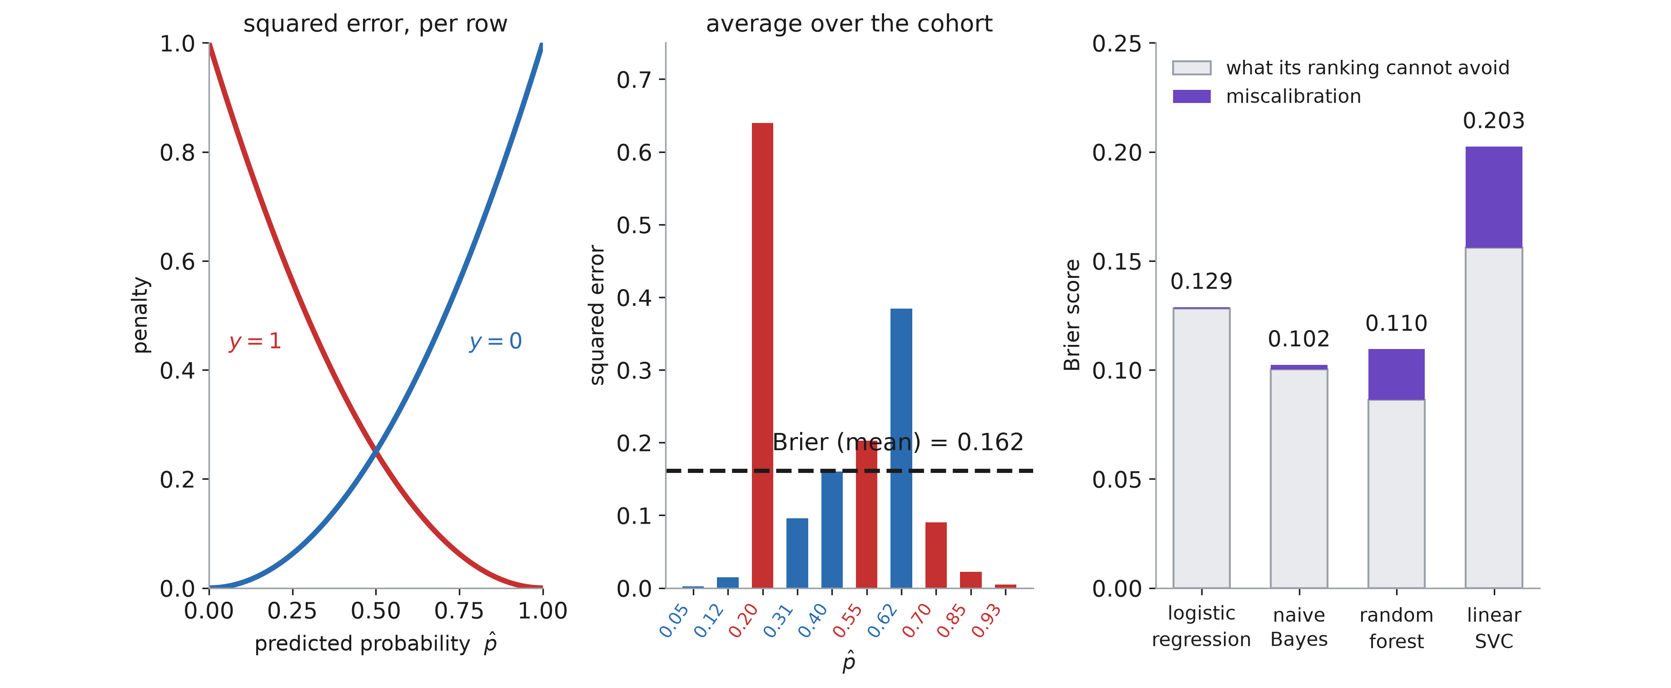
Brier score and calibration
Notes:
Now that the arithmetic is settled, three things about the number that the formula does not show.
Left: one patient. The model said p̂, the outcome was y, and the penalty is (p̂ − y)². That is the whole definition. A patient who was told 0.7 and did have the complication costs (0.7 − 1)² = 0.09. Two things to notice about the shape. It is zero only when you were exactly right, and it is a PARABOLA, so being wrong by 0.6 hurts nine times as much as being wrong by 0.2 — confident mistakes are punished disproportionately. Compare with log loss from the first half: same instinct, but log loss goes to infinity at a confident mistake, while Brier tops out at 1. Brier is the gentler of the two, and it is bounded.
Middle: the cohort. Average the per-patient penalties. Ten patients here, and the Brier score is 0.162 — that is all “Brier score” means, a mean squared error where the target happens to be 0 or 1. Note which bars dominate: the patient given 0.20 who had the complication, and the one given 0.62 who did not. Two confident mistakes, 63% of the total. The seven it got roughly right contribute almost nothing. A Brier score is essentially a report on your worst calls.
Right: the catch, and this is the panel that matters. The four models from the first slide, scored. Naive Bayes 0.102, better than logistic regression’s 0.129 — which is the number I flagged at the start of the session and promised to explain. Here is the explanation. Murphy’s decomposition splits the score in two: BS = miscalibration + (irreducible − resolution). Grey is what the model’s ranking cannot avoid; purple is what recalibration could remove.
Read the four bars. Logistic regression: almost no purple, so it is honest — its score is simply limited by how well it separates patients. Naive Bayes: a sliver of purple and a much shorter grey bar, because it RANKS better; it wins on discrimination while being badly calibrated. Random forest: a real purple band, about a fifth of its score, sitting on the best grey bar of the four. Linear SVC: worst on both counts.
So the lesson to write down: a Brier score is a good summary and a terrible diagnosis. A bad one does not tell you whether the model ranks badly or lies about its confidence, and only the second of those is fixable by what we are about to do. Never report it without a reliability diagram beside it.

Slide 21
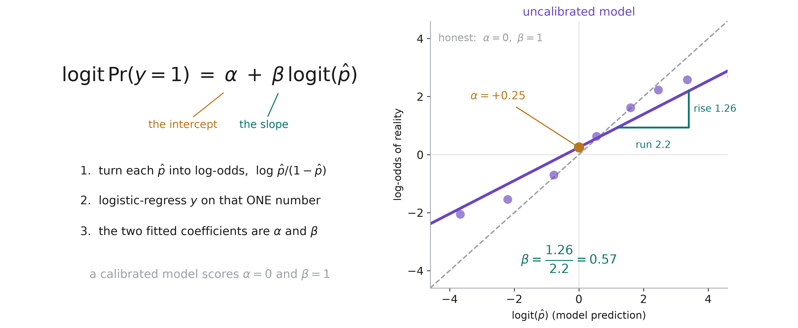
Intercept α and slope β
Notes:
The Brier score said HOW badly; these two numbers say in WHICH DIRECTION. They are the pair I have been quoting since the first slide — β = 0.57 for naive Bayes, β = 2.00 for the forest — so let us compute them properly.
Left, the recipe, and it is deliberately the same shape as Platt scaling two slides from now: take the model’s prediction, put it on the log-odds scale, and logistic-regress the outcome on that one number. The fitted intercept is α, the fitted slope is β. This is Cox’s 1958 recalibration, and it is the standard way clinical papers report calibration — if you read a TRIPOD-compliant paper, these two numbers are in the results table.
Why the log-odds scale and not the probability scale? Because on the probability scale a “straight line” is meaningless — the truth is squashed into [0, 1] and every relationship curves. Taking logits unbends it, so the question “is the model telling the truth” becomes “does this scatter lie on the 45-degree line”, and a straight line has exactly two parameters to check.
Right, the fit for naive Bayes, the second model from the opening slide. Each purple dot is a bin of patients — x is what the model claimed in log-odds, y is the log-odds of what actually happened, and the dot size is how many patients are in the bin. The dashed 45-degree line is the honest model.
Read α off geometrically: it is the height of the fitted line where the model says logit = 0, that is, where it predicts 50%. Here +0.25, so at the point where the model says “coin flip” the truth is very slightly above a coin flip.
Read β as rise over run: go 2.2 to the right along the model’s axis and the truth only rises 1.26, so β = 0.57. That is the whole diagnosis of naive Bayes in one number. The model moves its opinion nearly twice as far as reality moves. Point at the dots at the ends — bottom-left the model says −3.7 and the truth is −2.0; top-right it says +3.4 and the truth is +2.6. It is shouting where it should be speaking.
One warning to leave them with: α and β are fitted numbers, so they have standard errors, and on a few hundred patients those are wide. A β of 0.9 is not distinguishable from 1. Do not over-read the second decimal.

Slide 22
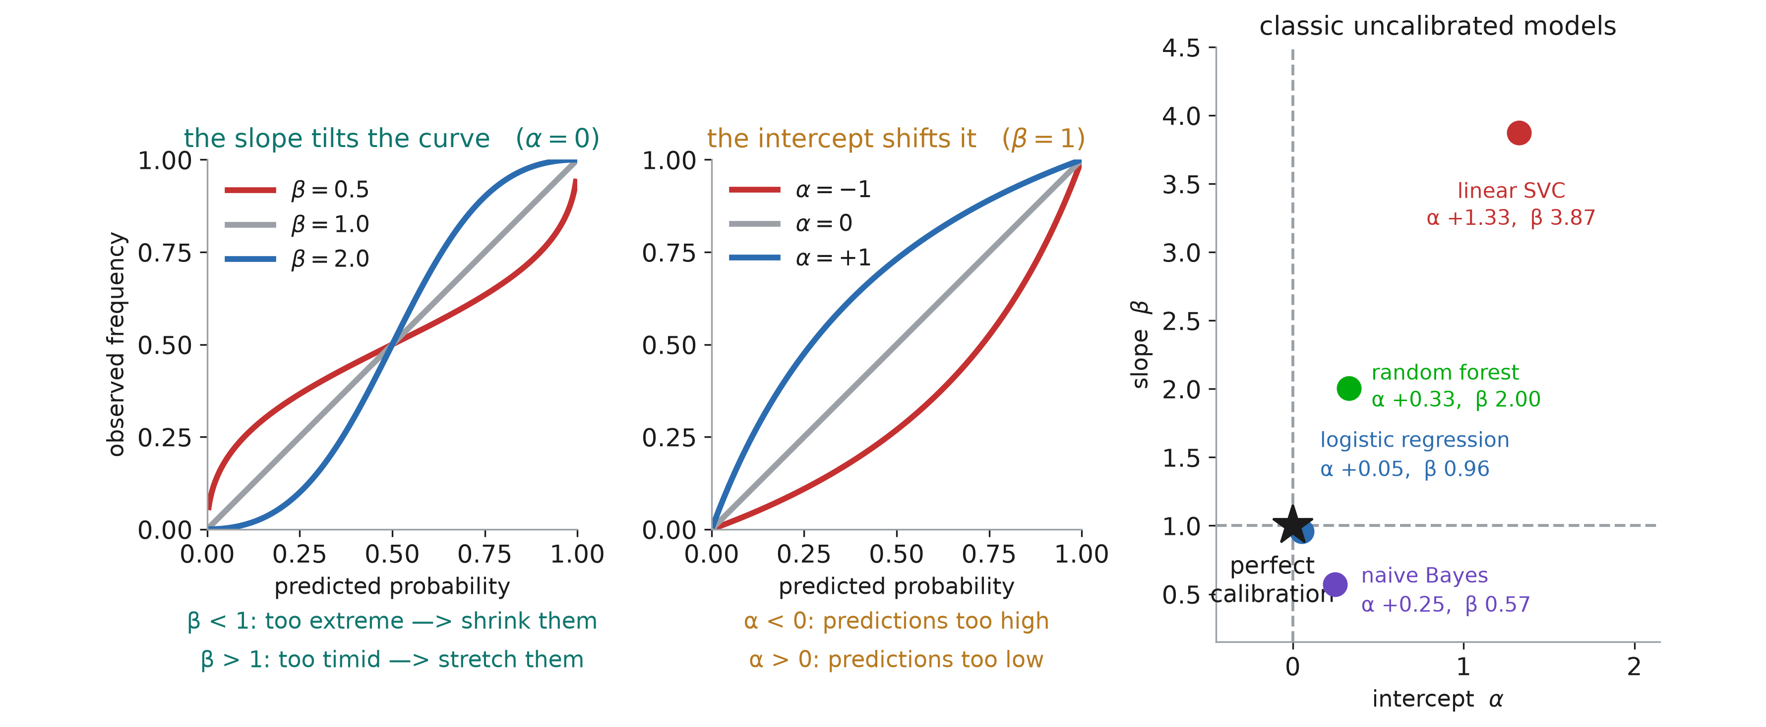
Reading α and β
Notes:
Now the interpretation, and the two numbers do genuinely different jobs.
Left panel, the slope alone, with α held at 0. β = 1 is the diagonal. β = 0.5 in red is FLATTER than the diagonal: the model’s predictions are spread wider than the truth, so a prediction of 0.9 corresponds to an observed 0.75. Too extreme, and the repair shrinks the predictions towards the middle. β = 2 in blue is STEEPER: the model’s predictions are bunched in the middle while the truth spreads out, so 0.6 corresponds to 0.69. Too timid, and the repair stretches them outward.
Make them say which is which, because the intuition is backwards for most people. A curve that is FLAT means the model is OVERCONFIDENT. Flat looks cautious and means the opposite.
Middle panel, the intercept alone, with β held at 1. Now the shape is preserved and the whole curve lifts or drops. α = −1 in red means the truth is below what was claimed everywhere — the model quotes risks that are systematically too high. α = +1 is the reverse. This is the one that moves when you deploy a model in a hospital with a different base rate, and it is the easy one to fix: a single additive shift on the log-odds scale, no refitting.
The clinical framing worth saying out loud: α is a bias on the whole population — everyone is quoted 20% when the truth is 12% — while β is a bias that depends on the patient, hurting the high-risk and low-risk ends hardest and leaving the middle roughly right. For a triage tool, β is the dangerous one, because the patients at the ends are the ones the tool exists to find.
Right panel, the four models from the opening slide placed on the (α, β) plane. The star is honesty. Logistic regression sits essentially on it, α +0.05, β 0.96. Naive Bayes is BELOW the line, β 0.57 — the only one of the four that is overconfident. The forest at β 2.00 and the SVC at β 3.87 are above it, both too timid, the SVC absurdly so and with a large α on top.
And now the transition. Notice that everything on this slide is a monotone distortion, and notice that the fix we just described — α + β·logit(p̂) — is itself a two-parameter map from score to probability. That is not a coincidence: measuring calibration this way and repairing it by Platt scaling are the same regression, run for two different purposes. Which is the next slide.

Slide 23
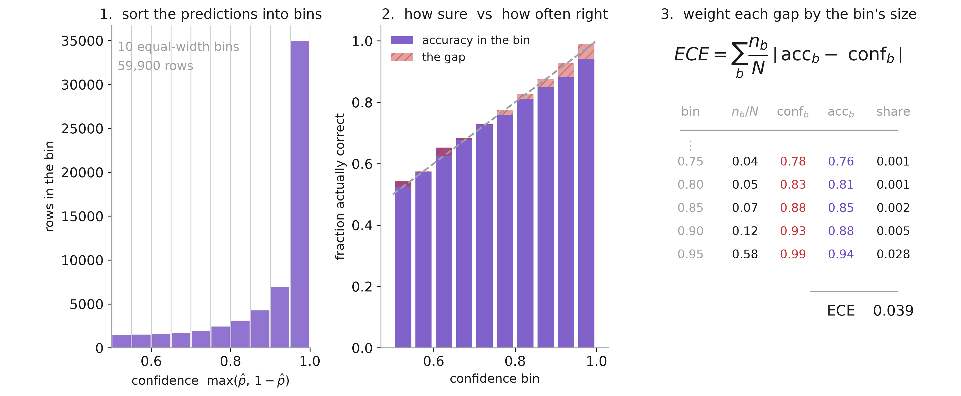
Expected calibration error
Notes:
The third metric, and the one they will meet in every deep-learning paper on calibration. Brier gave one number for accuracy-and-honesty together; α and β gave the direction of the bias; ECE tries to answer a narrower question — on average, how far is the model’s stated confidence from how often it is actually right?
First, a definition change to flag explicitly, because it trips people up. Everything so far has used p̂, the probability of the complication. ECE comes from the multiclass literature and uses CONFIDENCE — max(p̂, 1 − p̂), how sure the model is whichever way it came down — paired with ACCURACY, the fraction it got right. So a prediction of 0.02 and a prediction of 0.98 are both “98% confident”. That is a real loss of information, and it is the first thing to hold against the metric.
Panel 1: sort the predictions into M bins of confidence — ten equal-width bins here, from 0.5 to 1.0. Look at the shape: naive Bayes puts 35 000 of its 60 000 patients in the top bin. It is almost always sure. This is the histogram from the opening slide of the session, redrawn on the confidence axis.
Panel 2 is the heart of it, and this is the picture people mean when they say “reliability diagram” in a deep-learning paper. For each bin, the purple bar is how often the model was RIGHT, and the dashed diagonal is how sure it SAID it was. The red hatched sliver on top of each bar is the gap between them. Every sliver points the same way — accuracy below confidence — which is the signature of overconfidence. If the bars reached the diagonal exactly, the model would be perfectly calibrated in this sense.
Panel 3: turn the picture into a number. Take each bin’s gap, weight it by the share of patients in that bin, and add up. The weighting is what makes it an EXPECTED error — the top bin holds 58% of the patients, so its gap of 0.05 contributes 0.028, which is most of the total on its own; the sparse low-confidence bins barely matter however wrong they are. The answer is 0.039.
And say what that number means in words, because it is the one genuinely nice thing about ECE: it is on the probability scale. 0.039 means that, averaged over patients, this model is about 4 percentage points more sure of itself than it has any right to be. Neither Brier nor β gives you a sentence that plain.
Next slide: why you should nevertheless not report it on its own.

Slide 24
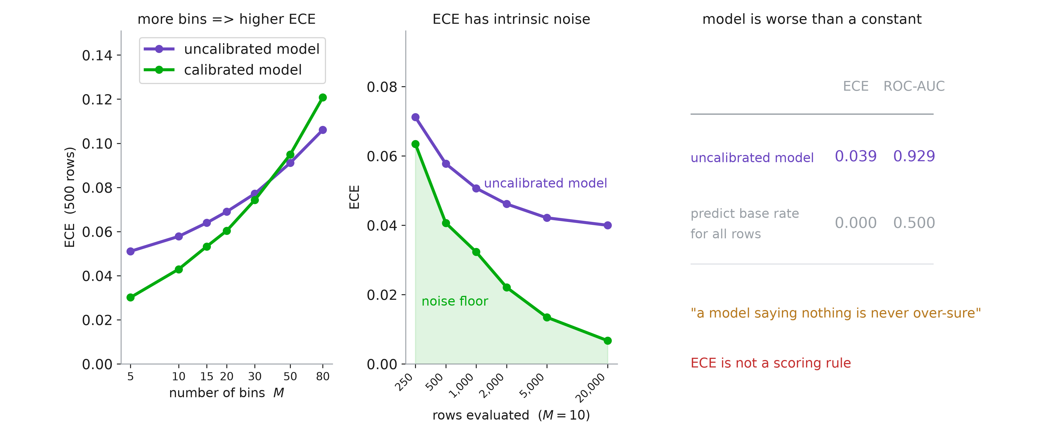
ECE flaws
Notes:
Three problems, in increasing order of seriousness.
Panel 1. The number depends on M, and nothing in the definition tells you what M should be. Ten is conventional, and that is the entire justification. Worse, the dependence has a direction: more bins means fewer patients per bin, means the observed accuracy in each bin is noisier, means |accuracy − confidence| is larger on average even when the model is perfect. ECE is biased UPWARD, and the bias grows with M.
The green line is the part to dwell on. That is a model whose predictions ARE the true risks — perfectly calibrated by construction, nothing there to find. On 500 patients it scores 0.03 at M = 5 and 0.12 at M = 80. Pure measurement noise, read as miscalibration. And follow the two lines to the right: past about 35 bins the PERFECTLY calibrated model scores WORSE than naive Bayes. The bin count alone reverses the ranking. If someone reports ECE without stating M, they have not reported anything.
Panel 2. The same problem seen from the other side. The green band is the noise floor — what a perfect model scores at M = 10 — as a function of how many patients you evaluate on. At 20 000 patients the floor is 0.007 and naive Bayes sits at 0.040, so the gap is real and readable. At 250 patients the floor is 0.063 and naive Bayes is 0.071. Indistinguishable. For a single-centre clinical study, which is the setting this whole session is about, ECE at M = 10 is mostly measuring your sample size. The honest fix if you must use it: compute the floor by simulation for YOUR n and M, and report ECE against that floor rather than against zero.
Panel 3 is the deepest problem and the reason I would not let it stand alone. Compare naive Bayes, ECE 0.039 and AUC 0.929, with a model that predicts the base rate for every single patient. That constant model has ECE 0.000 — a perfect score — and AUC 0.500. It is useless, and ECE calls it flawless.
The technical statement is that ECE is not a proper scoring rule: it is not minimised in expectation by telling the truth, so you can improve it by saying less. The Brier score cannot be gamed that way — that was the property we established two slides ago — which is exactly why Brier is the one to report and ECE is the one to add for interpretability.
So, the working rule for the three metrics together. Brier for the headline number, because it is proper and cannot be gamed. α and β for the direction, because they tell you what to fix. ECE only alongside the diagram that produced it, always with M and n stated. And a reliability curve in all cases, because every one of these scalars throws away the shape.

Slide 25
Calibration methods

Slide 26
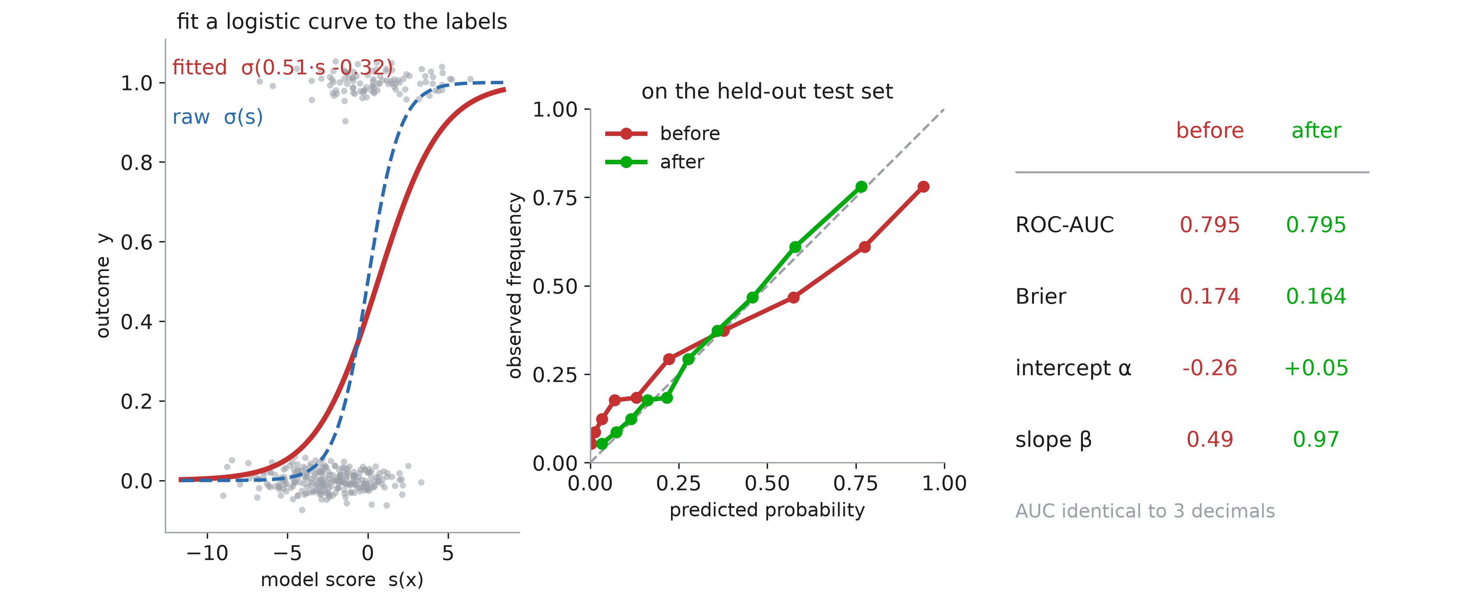
Platt scaling: fits a sigmoid
Notes:
The first and oldest of the three, and the one to teach properly because the other two are variations on it.
Left panel is the whole method. Throw away every feature. Keep one number per patient — the model’s score s(x) — and the label y. That is a dataset with one predictor and a binary outcome, so fit the thing we spent the first half of the session on: a one-variable logistic regression, p̂ = σ(a·s + b). Two parameters. The grey dots are the labels, jittered so you can see the density; the red curve is the fit; the blue dashed curve is what the model was implicitly claiming by squashing its own score. Here the fit is σ(0.51·s − 0.32) — the slope is a HALF, which is the method saying, in one number, “this model is twice as confident as it has earned”.
Middle panel, on patients neither the model nor the calibrator has seen: the red before-curve sags below the diagonal, the green after-curve sits on it.
Right panel is the scoreboard, and there are two lines worth pausing on. Brier 0.174 to 0.164, slope β from 0.49 to 0.97 — that is the repair. And ROC-AUC 0.795 to 0.795, identical to three decimals, because σ(a·s + b) with a > 0 is strictly increasing and therefore cannot reorder two patients. Say it plainly: calibration is free. You are not trading away discrimination, you are relabelling the axis.
Two properties follow from “only two parameters”, and they are the reason Platt survives in small clinical studies. It needs very little data — a few hundred rows is genuinely enough to pin down two numbers. And it cannot overfit much, because there is almost nothing there to overfit. The price is the assumption: it can only produce sigmoid-shaped corrections. If the true distortion is not of that shape, Platt will not find it, however much data you give it.
Historical footnote: Platt, 1999, and the model he was fixing was the SVM — the worst-behaved of our four.

Slide 27
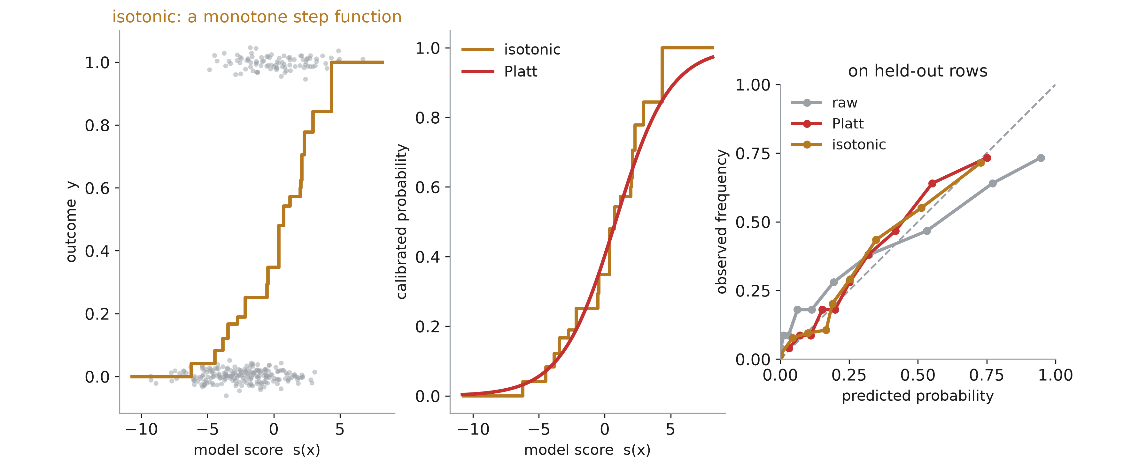
Isotonic regression: fits any monotone shape
Notes:
The second technique drops Platt’s assumption and keeps only the part we actually believe.
What do we really know about the map from score to probability? Not that it is a sigmoid. Only that it is INCREASING — a higher score should not mean a lower risk. Isotonic regression fits the best non-decreasing function of the score, with no other constraint. Left panel: the result is a staircase. The algorithm is pool-adjacent-violators — sort by score, sweep left to right, and wherever the running average goes DOWN, merge the two blocks into one and take their pooled average. Repeat until the whole sequence is non-decreasing. Twenty steps here. That is it; it is one pass, and it is exact, not iterative optimisation.
Middle panel puts the two maps side by side on the same axis. The staircase tracks the sigmoid closely in this example, because I generated this example with a sigmoid distortion — Platt’s assumption happens to be true. Under those conditions the extra flexibility buys nothing and costs something: on held-out patients Platt gets Brier 0.160 and isotonic 0.164, and isotonic’s slope is 0.77 against Platt’s 1.03. Flexibility you do not need is variance you did not have to pay for.
Two failure modes to flag, both visible in the left panel. The steps at the ends are wide and are estimated from few patients, so the extreme probabilities are the least reliable ones — and note the top step is exactly 1.000, which is a probability no honest model should ever issue. And the function is piecewise constant, so patients whose scores differ get the identical probability; the map is monotone but not strictly so, which means isotonic CAN destroy a little discrimination where Platt cannot.
Where isotonic earns its keep is the case this figure does not show: a distortion that is not sigmoid at all. Then Platt is structurally unable to fix it and isotonic is. That trade is the next slide.

Slide 28
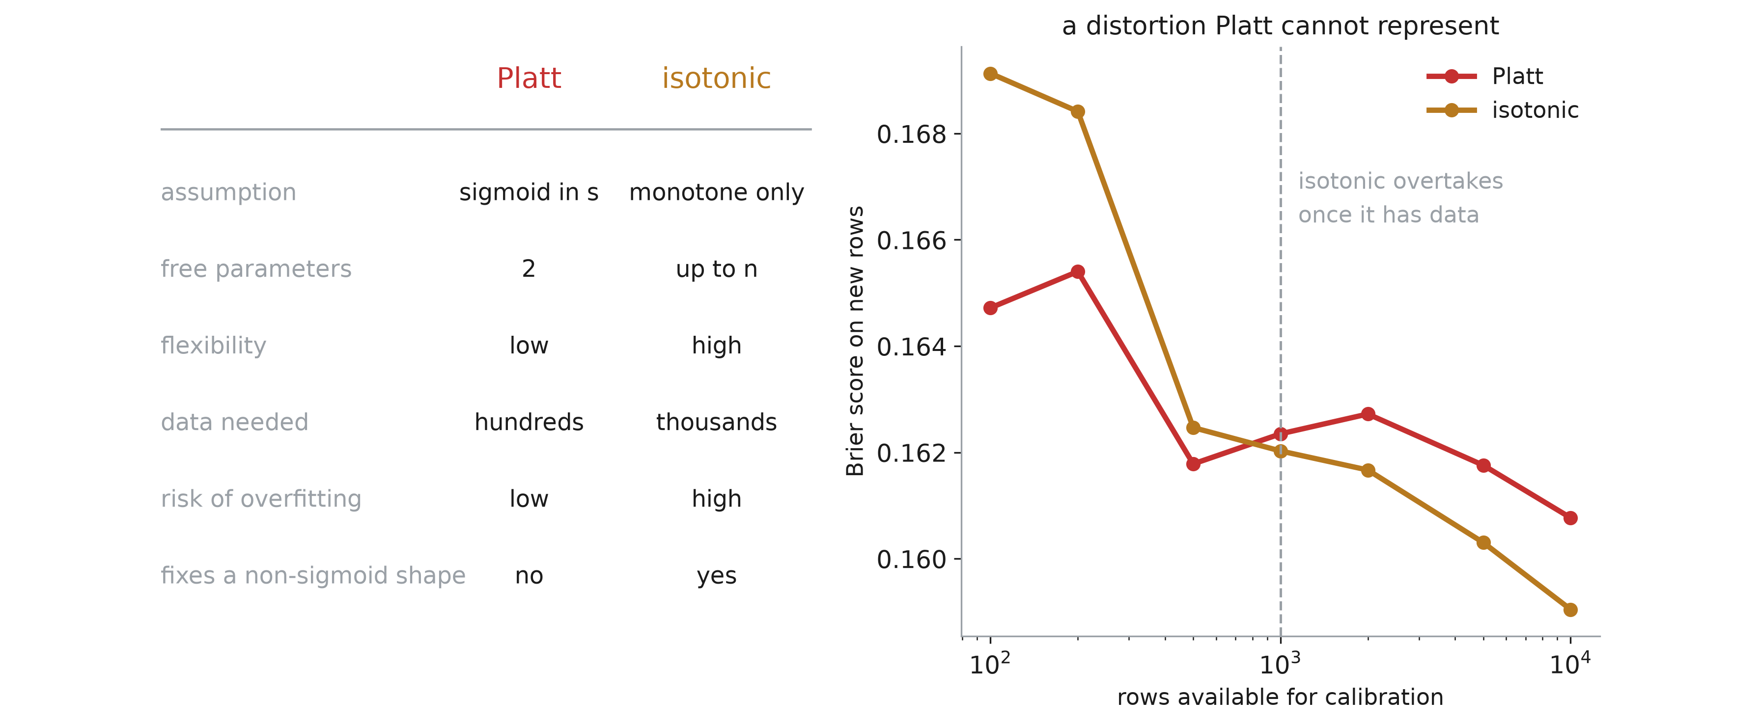
Flexibility against data
Notes:
Left, the comparison as a table; right, the same comparison run as an experiment.
Read the table down the middle column first. Platt assumes a sigmoid in s and has two free parameters; isotonic assumes only monotonicity and has up to n — one per distinct score, in the limit. Everything else in the table follows from that one row. More parameters means more flexibility, means more data needed, means more risk of overfitting, and means it can represent shapes Platt cannot.
Right panel is the experiment that makes it concrete, and the set-up matters: here the true distortion is deliberately NOT sigmoid, so Platt is mis-specified — this is isotonic’s best case, not a neutral one. x-axis is the number of patients available to fit the calibrator, log scale; y-axis is Brier on new patients.
Below about a thousand, Platt wins despite being wrong about the shape, because isotonic’s staircase is chasing noise. Above it they cross and isotonic keeps improving while Platt flattens out — Platt has hit its own ceiling, the bias of an assumption that does not hold, and no amount of extra data will move it.
So the rule of thumb, and it is only a rule of thumb: hundreds of rows, Platt. Thousands, and a reliability curve that does not look sigmoid, isotonic. For a typical single-centre clinical study — a few hundred events — the answer is Platt, and this is why sklearn’s default is method="sigmoid".
Both of them, note, need patients the model has not seen. Which is the problem the next slide is about.

Slide 29
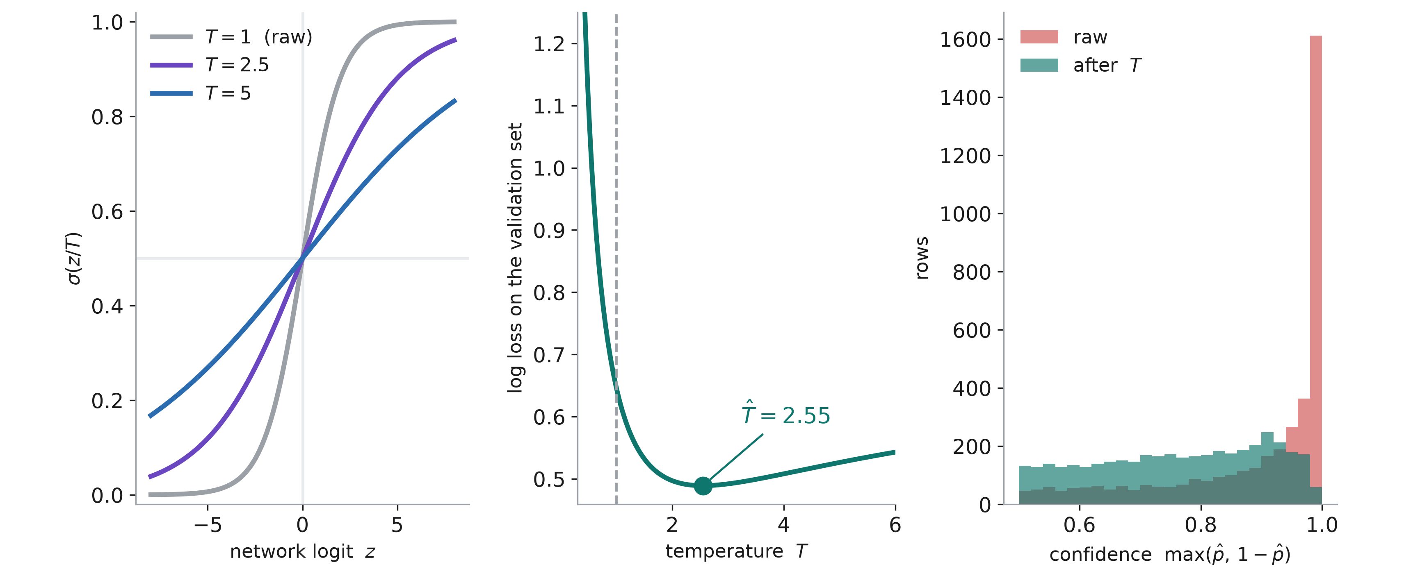
Temperature scaling
Notes:
The third method, and the one they will actually meet if they go anywhere near deep learning. Guo et al., 2017, “On calibration of modern neural networks” — the paper that made this a default step in the vision and NLP pipelines.
The setting first, because it explains the design. A network does not hand you a probability, it hands you a LOGIT, and the probability comes from a sigmoid or a softmax at the very end. Train that network to near-zero training loss and the logits keep growing — the loss can always be reduced a little further by pushing the correct logit higher — so the network ends up enormously overconfident. This is the naive Bayes failure from the first half, but industrial-strength: a modern image classifier routinely reports 99% on inputs it gets wrong a third of the time.
The fix is one number. Divide every logit by T before the sigmoid: p̂ = σ(z / T).
Left panel, what T does. T = 1 is the raw model. Larger T flattens the curve, so the same logit produces a probability closer to a half. Two things to point at. The curves all cross at z = 0 — the sign of the logit never changes, so nothing that was classified one way is now classified the other. And the ordering along the curve is preserved, so the ranking, and therefore the AUC, is untouched. T < 1 would sharpen instead; it is allowed, just rarely what you need.
Middle panel, how T is found. Fix the network, take the validation set, and plot the log loss as a function of T. It is a one-dimensional, convex-looking curve with a clear minimum — here T̂ = 2.55. You can literally find it by scanning a grid, which is what makes this the cheapest calibration method in the deck: one forward pass over the validation set, no refitting, no gradients through the network. Note the asymmetry: being too sharp on the left is punished much harder than being too soft on the right. Log loss hates a confident mistake.
Right panel, the effect on the predictions. Before, in red, a spike of 1600 patients pinned against confidence 1.0 — the model is certain about a fifth of the cohort. After, in teal, that spike is gone and the confidence spreads out across the range. The model has not learned anything new; it has stopped shouting.
Say the multiclass version out loud, since that is where they will use it: softmax(z / T) instead of σ(z / T), same single T shared across all classes and all inputs. Because it is shared, it cannot reorder the classes, so the argmax is unchanged and the top-1 accuracy is EXACTLY the same after calibration as before. That is the property that got it adopted — you can add it to a trained model and nobody’s benchmark number moves.

Slide 30
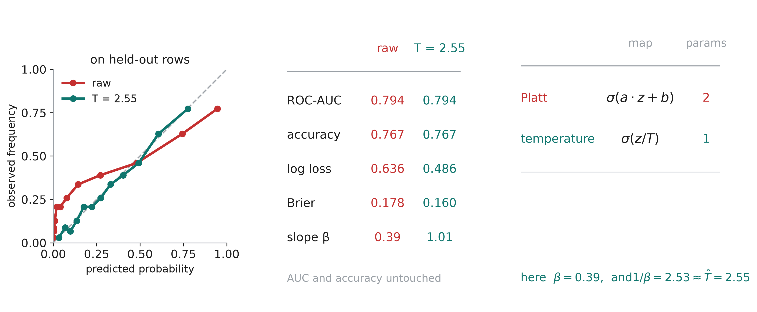
Temperature link with Platt
Notes:
What it buys, and what it cannot do.
Left, the reliability diagram on held-out patients. The raw curve is the flat, overconfident shape we now recognise on sight — and read it the way we agreed two slides ago: flat means overconfident. After temperature scaling it sits on the diagonal.
Middle, the scoreboard, and the top two rows are the headline. ROC-AUC 0.794 before and after. Accuracy 0.767 before and after. Identical, not approximately identical — dividing every logit by a positive constant cannot reorder anything and cannot move anything across the 0.5 boundary. Meanwhile log loss falls from 0.636 to 0.486 and Brier from 0.178 to 0.160. You have bought honest probabilities for free, in the strict sense that nothing else changed.
Bottom row ties it to the previous section: slope β goes from 0.39 to 1.01. And now the connection worth spending thirty seconds on, right panel. Platt fits σ(a·z + b), two parameters. Temperature fits σ(z / T), one — it is Platt with the intercept forced to zero and a reparameterised as 1/T. So everything follows: it can repair a slope but it CANNOT repair an intercept. If the model is systematically too high or too low across the board, no temperature will fix it, because every candidate map passes through 0.5 at z = 0.
And the numbers confirm the algebra. The raw model had β = 0.39; one over that is 2.53; the fitted temperature was 2.55. Temperature scaling is, quite literally, estimating 1/β and dividing by it.
So the ladder, and this is the summary for the whole section: one parameter for a network whose logits are merely too big, two for a general monotone-sigmoid distortion, and up to n for isotonic when you have the data and the distortion is not sigmoid at all. Pick the fewest parameters your problem needs — every one of them has to be paid for with patients the model has never seen, which is the next section.

Slide 31
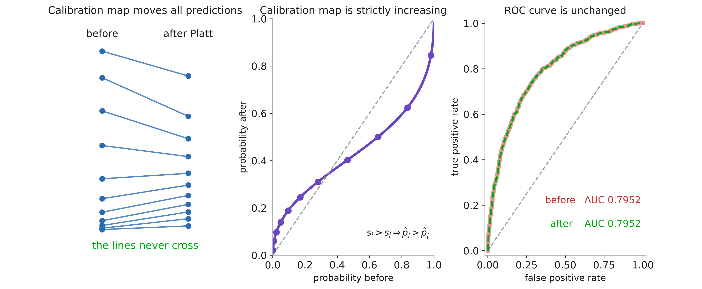
Platt calibration does not change AUC
Notes:
Everything in the section we are about to start is a MONOTONE map applied to the score. Platt, isotonic, temperature — all three take the model’s output and push it through an increasing function. This slide is the consequence, and it is the reason recalibration is worth doing at all: it costs you nothing.
Panel 1. Eleven patients, spread across the range, red if they had the complication. On the left their probability before Platt scaling, on the right after. Every one of them moves — that is the whole point of calibrating — and some move a long way; the top red patient falls from 0.88 to 0.62. But look at the lines. They never cross. No patient overtakes another. The order going in is the order coming out.
Panel 2. Why. Here is the map itself: probability after against probability before. It is strictly increasing, which is exactly the statement that if patient i scored above patient j before, they score above them after. Platt’s map is σ(a·s + b) with a > 0, and a sigmoid of an increasing linear function is increasing — there is no arrangement of a and b that can make it fold back on itself.
Panel 3. And therefore, since AUC depends on nothing but order, the ROC curve is not merely similar, it is the SAME curve. I have drawn the before curve thick and the after curve dashed on top of it so you can see there is only one line there. AUC 0.7952 before, 0.7952 after. Every one of the millions of case–control pairs kept the answer it had.
This is the free-lunch slide, so say it plainly. Recalibration improves the Brier score, fixes β, cleans up the reliability diagram, and takes NOTHING from discrimination. If a colleague worries that calibrating might hurt the model’s ability to find sick patients, this is the answer: it mathematically cannot.
And the reverse is worth stating too, because it is the trap: a great AUC is no evidence of calibration, since you can destroy calibration completely — square all the probabilities, say — without moving the AUC at all.

Slide 32
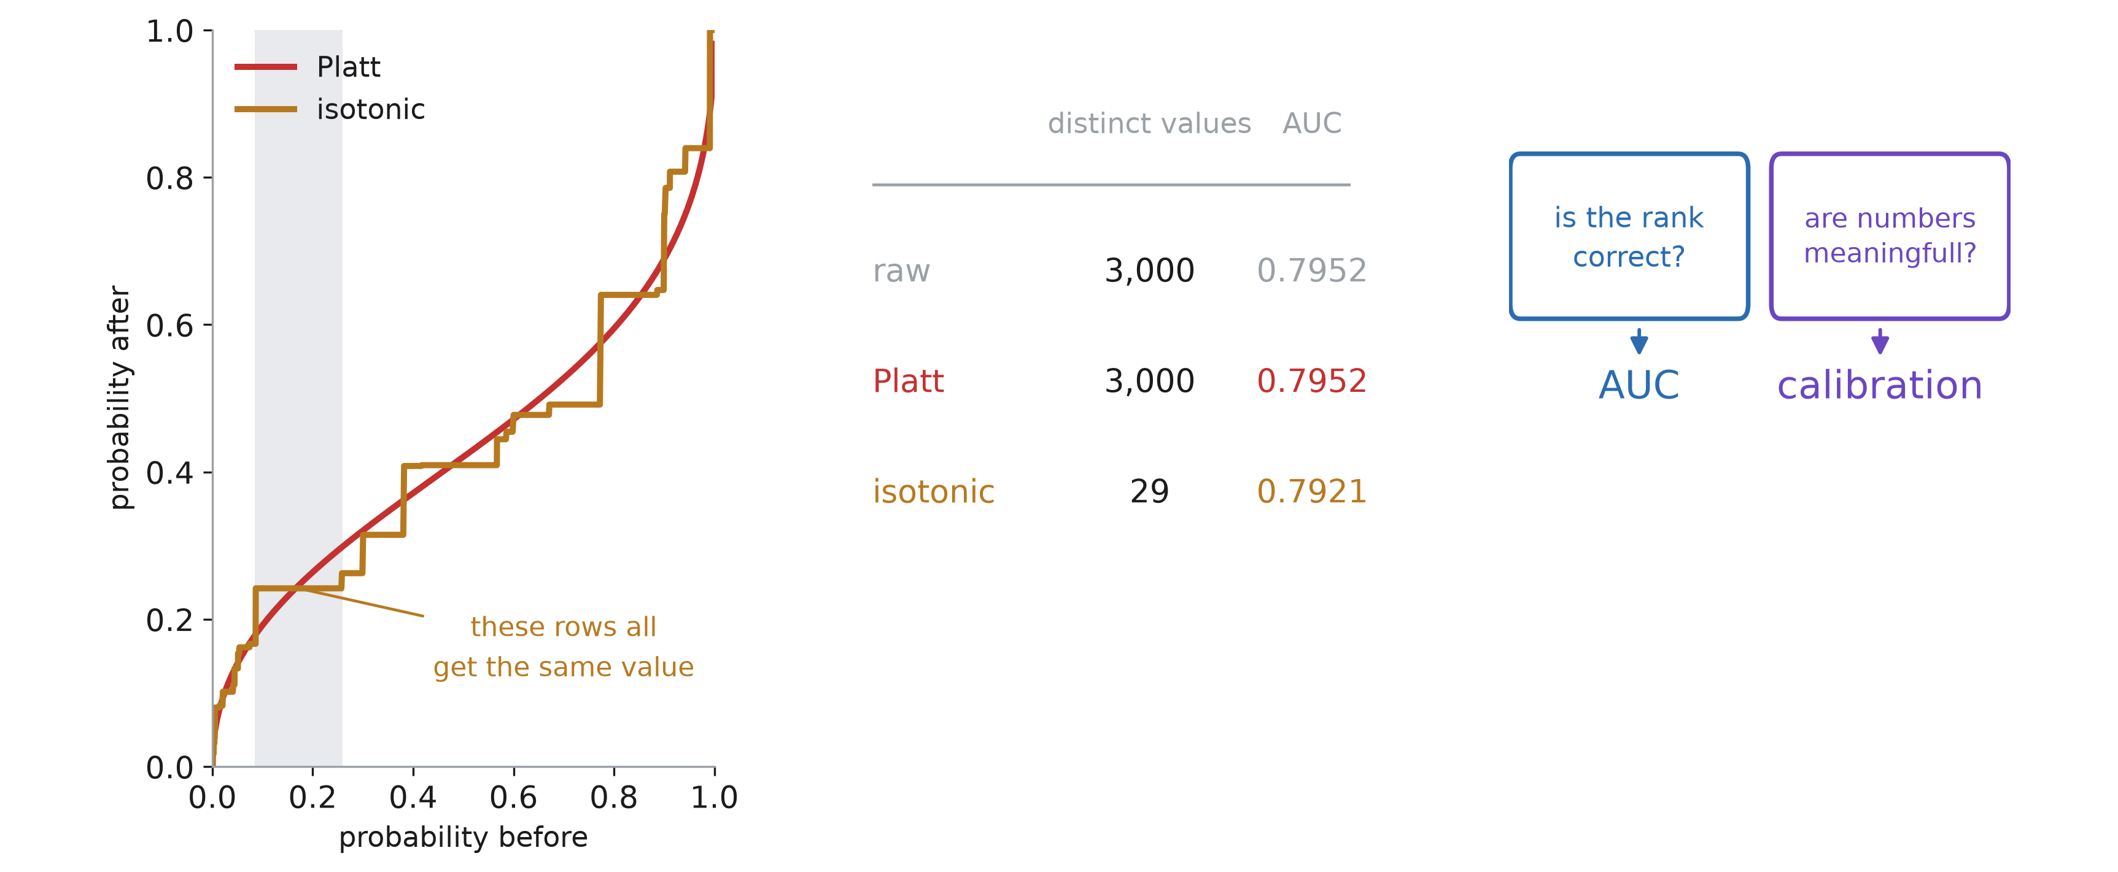
Isotonic calibration and AUC
Notes:
Strictly increasing was the condition. Isotonic regression is increasing but not STRICTLY, and that is the whole exception, so let us be precise about it.
Panel 1. The two maps on the same axes. Platt in red is a smooth curve — every distinct input gives a distinct output. Isotonic in amber is a staircase, and a staircase has flat treads. The shaded band is the widest of them: 592 patients walked in with 592 different scores and walked out with the identical probability, 0.24.
Those patients used to be ordered. Now they are tied. And a tie, as we said two slides ago, counts half a pair instead of a whole one — so every pair inside that tread that the model used to get right is now scored 0.5 instead of 1.
Panel 2 puts a number on it. The raw model and the Platt-calibrated model have 3 000 distinct values and identical AUC to four decimals. Isotonic collapses them to 29 and gives back 0.003 of AUC. So the exception is real, and it is also tiny — 0.003 on 0.795. Worth knowing, not worth worrying about; and it is one more small entry on the isotonic side of the ledger we drew two slides ago, alongside needing more data.
Panel 3 is the summary for the whole metrics half of the session. There are two questions you can ask about a model, and they are independent. Does it put the right patients first — that is discrimination, and AUC measures it. Are the numbers it prints honest — that is calibration, and the reliability diagram, β and the Brier score measure it. Recalibration moves the second and leaves the first untouched. Nothing you have seen today moves the first at all; to improve AUC you need a better model, not a better calibrator.
So report both, always. A paper that gives you only an AUC has told you the model can rank patients and has said nothing whatever about whether its 30% means 30%.

Slide 33
Recalibration needs data of its own

Slide 34
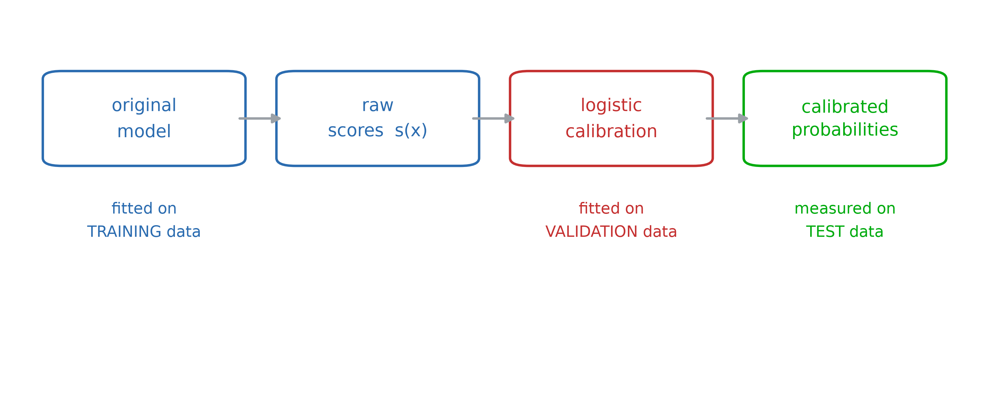
Main steps
Notes:
The fix itself is almost insultingly small. Take the model’s output, treat it as a single feature, and fit a one-variable logistic regression of the outcome on it: p̂ = σ(a·s + b) — Platt, from two sections ago. Two parameters, and it repairs every monotone distortion we catalogued at the start — the naive Bayes stretch, the forest squash, the SVC squash — because all of them are monotone, and a sigmoid of a linear function of s is the most natural monotone family to reach for.
Say the free lunch out loud: the map is strictly increasing, so it never reorders two patients. The AUC after recalibration is the AUC before it, to the last decimal. You are not trading discrimination for calibration; you are only relabelling the axis.
Now the part of the slide that actually matters, and the reason this section exists: the three colours are three DIFFERENT sets of rows. The model is fitted on training data. The calibrator is fitted on validation data. The result is measured on test data. It is tempting to read that as ceremony — one more fold because that is what one does. It is not. The next two slides show that folding the middle box into the first one does not merely weaken the estimate, it produces a calibrator that is confidently, systematically wrong, and wrong in a direction you can predict in advance.

Slide 35
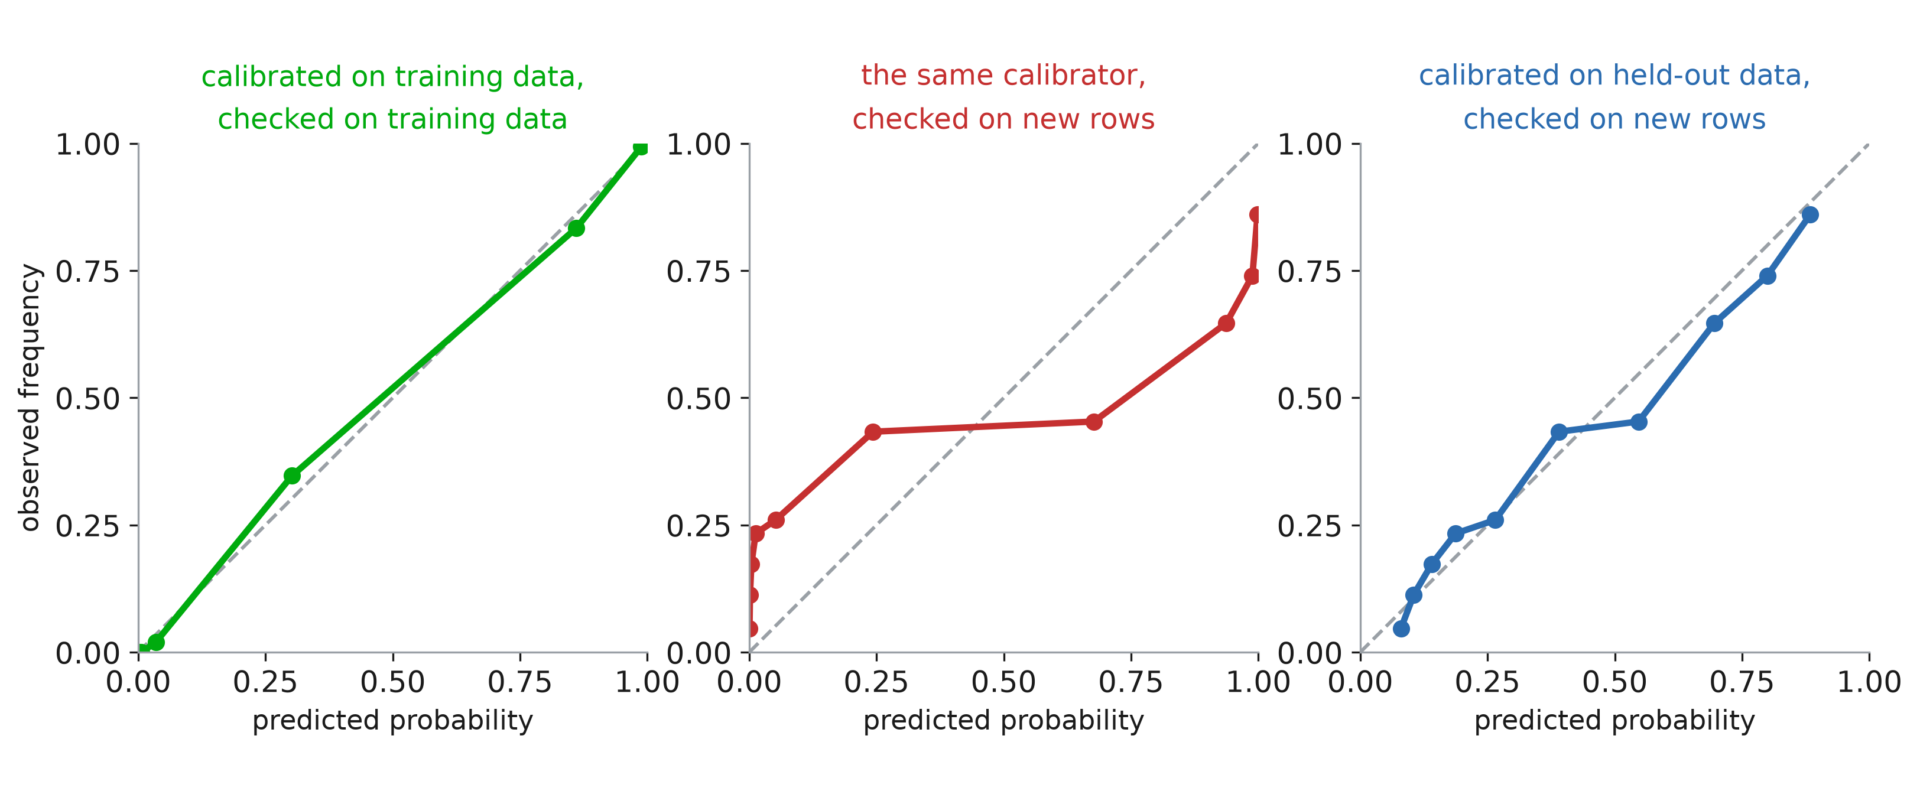
Calibration leak
Notes:
Same experiment, now told the way it would actually reach you — as three reliability diagrams, which is what someone hands you in a slide deck.
Left: calibrated on training data, and checked on training data. Perfect. Sits on the diagonal from end to end. If this is the plot in the paper, the model is declared calibrated and everyone moves on.
Middle: the same calibrator, the same fitted numbers, checked on patients it has not seen. Look at the shape rather than the distance from the diagonal — the two vertical walls at 0 and at 1. A whole column of patients was given a probability below 0.01, and about a quarter of them had the complication. Another column was told 0.99, and a quarter of them did not. Those are the 69% from the previous slide, and this is what “closer to 0 and 1 than it should be” costs at the bedside: the flat middle means the model has stopped distinguishing a 30% patient from a 60% one.
Right: the honest version, held-out calibration set, checked on new patients. Not as pretty as the left panel — and that is the lesson. The left panel is prettier than the right one, and it is the useless one.
So a calibration curve computed in-sample is not weak evidence, it is no evidence at all. When someone shows you a reliability diagram, the first question is not “how close to the diagonal” — it is “which rows is this computed on”.

Slide 36
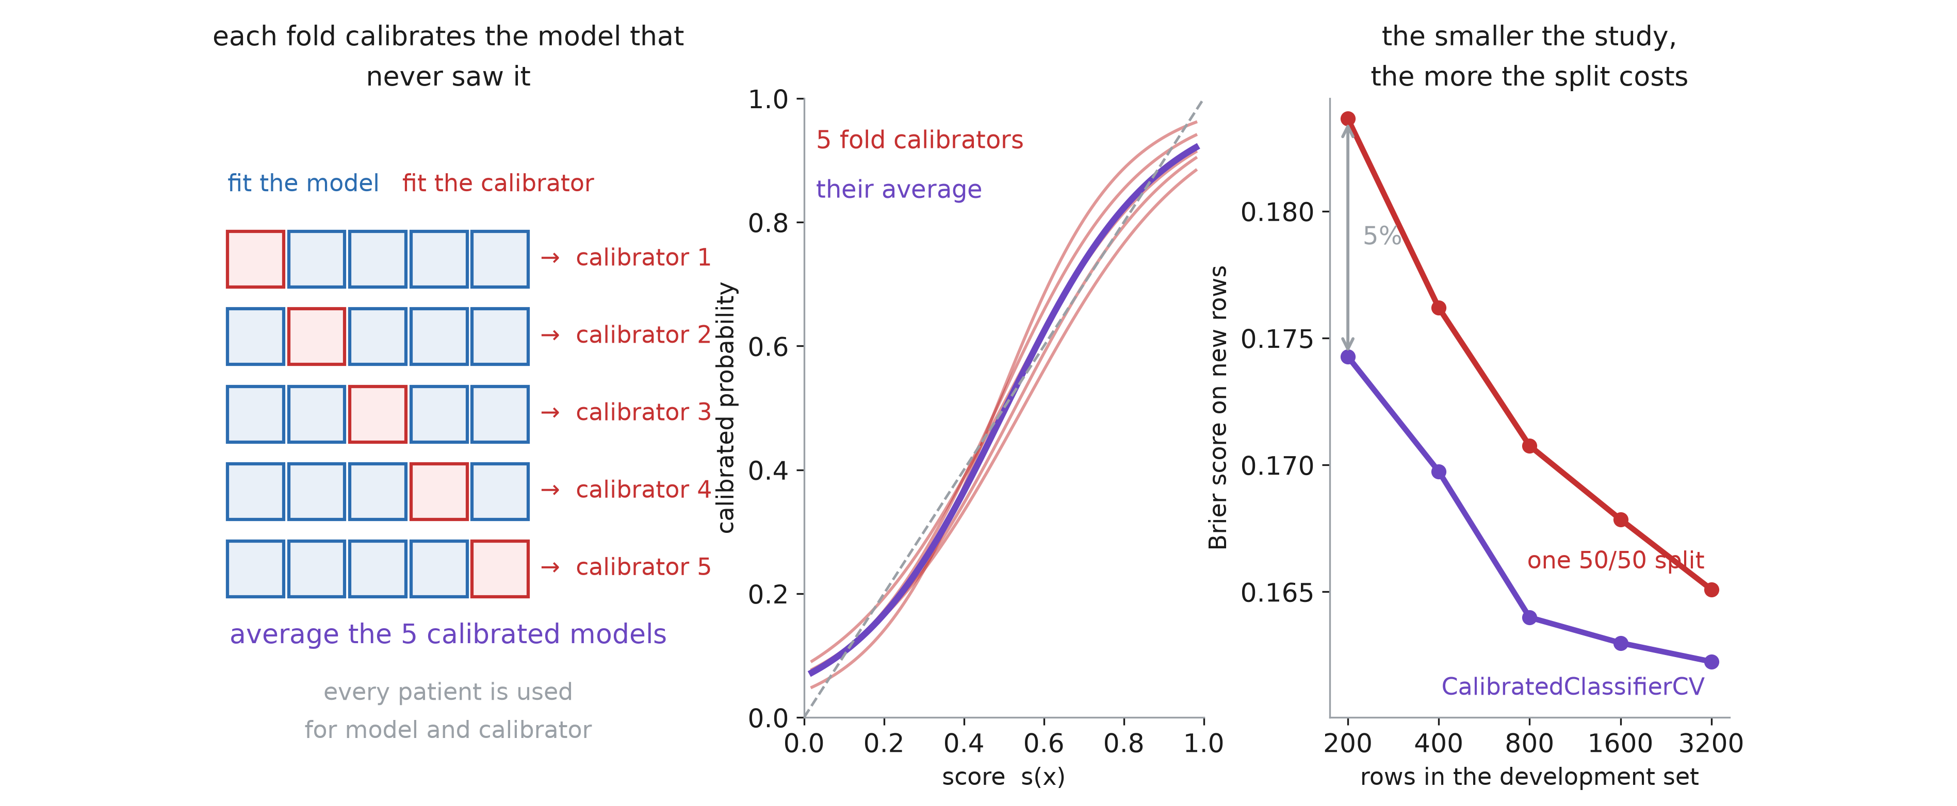
Cross validation for calibration
Notes:
Third technique, and it is not a third calibration curve — it is a way of paying for one of the first two without sacrificing data. Platt and isotonic both need rows the model was not fitted on, and in a 400-patient study handing half of them to the calibrator is a real loss: the model is fitted on 200 rows instead of 400, and you feel it.
Left panel, the trick. Split the development set into five folds. For fold 1, fit the model on the other four and fit a calibrator on fold 1 — which that model has never seen, so the mapping it learns is honest. Repeat five times. You now have five (model, calibrator) pairs, and the final prediction is their average. Every patient has been used to fit a model AND to fit a calibrator, and no patient has ever calibrated a model that saw it. That is CalibratedClassifierCV with the default ensemble=True: the split is conceptual, not physical.
Middle panel is the part people miss. Each fold’s calibrator is fitted on only a fifth of the data, so the five faint red curves disagree noticeably. They are individually noisy. Their average, in purple, is much steadier — the same variance-reduction argument as bagging, one level up: averaging five noisy calibrators beats one calibrator fitted on a fifth of the rows, and it also beats one fitted on half.
Right panel is what it is worth. Brier on new patients against the size of the development set. At 200 patients, the single 50/50 split gives 0.184 and the cross-validated version 0.174 — about five percent better. At 3200 the gap has narrowed to 0.165 against 0.162. The smaller the study, the more the split costs you, which is exactly backwards from what you can afford — and exactly why this estimator exists.
The catch, since there is always one: you are now deploying an ensemble of five models, not one, so prediction costs five times as much, and “the model” is harder to write down in a paper. With cv="prefit" you get the single-split version instead, for when you already have a fitted model you cannot refit.
And one thing it does NOT do: it does not give you a test set. The three-fold rule — fit, calibrate, evaluate — still needs a third, untouched set of patients to report on. Which brings us to why that rule exists at all.

Slide 37
From probabilities to decisions

Slide 38
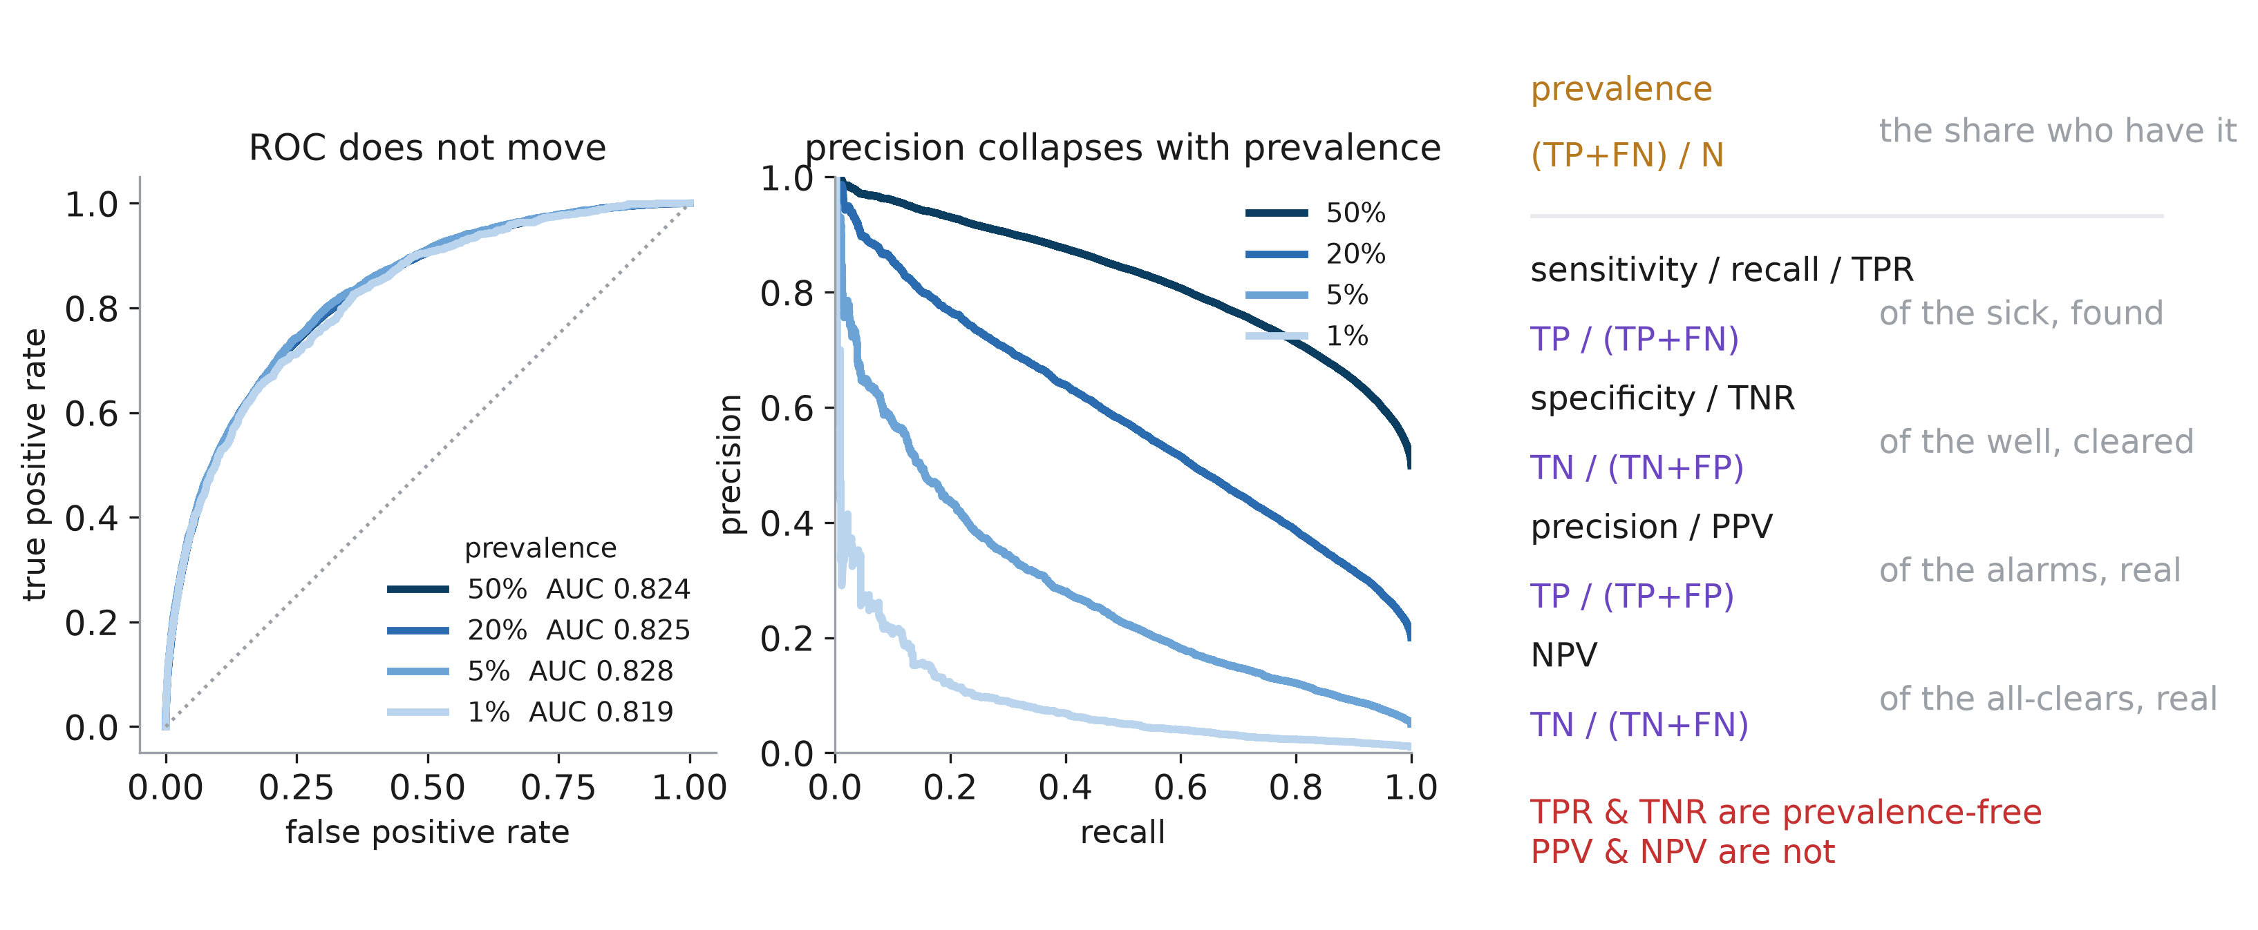
TPR, TNR, PPV, NPV
Notes:
AUC answered “can it rank”. It did not answer “if this model raises an alarm, should I believe it”, and for a rare outcome those are wildly different questions.
Start with the first line on the right, because the whole slide turns on it. PREVALENCE is simply how common the outcome is in the group you are looking at — the number of patients who had the event, divided by the number of patients. (TP+FN)/N. If 195 of 1 000 surgical patients had a complication, the prevalence is 19.5%. They have met it already under another name: it is the base rate ȳ from the Brier decomposition, the number a no-model model would predict for everybody.
Three things to say about it, because all three come back. It is a property of the COHORT, not of the model — swapping models does not change it. It varies enormously by setting: the same condition might be 0.1% in the general population and 20% among people already referred to a specialist. And it is the reason a model validated in one place can behave differently in another, even when nothing about the model has changed.
Then the rest of the vocabulary, once and properly, because half the confusion in this area is four names for two ideas. Recall, sensitivity and true positive rate are the same number: of the patients who had the event, what fraction did we catch. Specificity is its mirror on the other class. Precision and PPV are the same number too, and it is a different KIND of question: of the alarms we raised, what fraction were real.
The line in red is the one to write down. Sensitivity and specificity condition on the truth — they are properties of the test. Precision and NPV condition on the prediction, so they depend on how common the disease is in the room you are standing in.
Now the two curves, and the experiment is set up carefully: one cohort, one model, and I thin out the positives to change the prevalence without touching the score distribution inside either class. So any difference you see is class balance alone.
Left, the ROC curve. Four prevalences from 50% down to 1%, and the curves lie on top of each other; AUC 0.824, 0.825, 0.828, 0.819 — that is sampling noise, not signal. ROC is built from TPR and FPR, both of which condition on the truth, so prevalence cancels out.
Right, the precision–recall curve for the same four. It collapses. At 50% prevalence you hold precision near 0.9 out to recall 0.5; at 1% prevalence precision is under 0.2 almost immediately. Same model, same ranking, same AUC — and a completely different experience for the clinician receiving the alerts.
So the rule: when the outcome is rare and the cost of a false alarm is real, the PR curve is the honest picture and ROC flatters. Note also the baselines differ. A random model has AUC 0.5 always, but its PR curve sits at precision = prevalence, so “PR-AUC 0.3” means something excellent at 1% prevalence and something terrible at 50%. Always report the prevalence next to a PR-AUC.

Slide 39
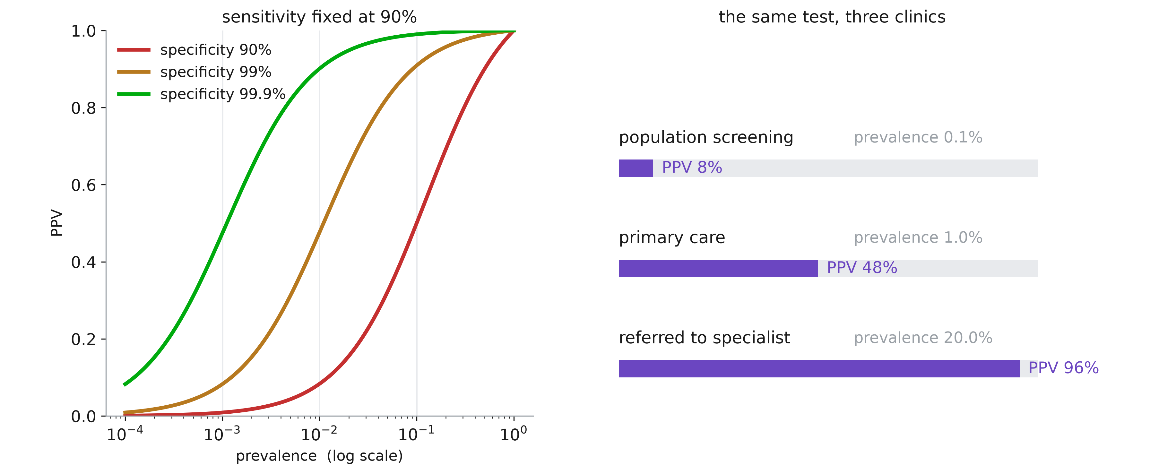
Precision depends prevalence
Notes:
One more slide on this, because it is the single most common misreading of a validation paper, and it is Bayes’ rule wearing a clinical hat.
Left panel. Fix sensitivity at 90% and plot PPV against prevalence, log scale, for three specificities. Every curve collapses towards zero on the left. Follow the red one, specificity 90%, which most people would call a decent test: at 1% prevalence its PPV is about 8%. Nine out of ten alarms are false. The test did nothing wrong; there are simply a hundred times more well people than sick ones, so even a small false positive rate on that huge group swamps the true positives.
And notice what fixes it: moving UP the curves, that is, specificity. Going from 90% to 99% buys far more PPV than any plausible gain in sensitivity would. When the outcome is rare, specificity is the scarce resource.
Right panel, the same test — identical sensitivity 90%, identical specificity 99% — deployed in three places. Population screening at 0.1% prevalence: PPV 8%. Primary care at 1%: PPV 48%. A specialist clinic where 20% of referrals have the disease: PPV 96%. The bar is the same test each time.
Two consequences to state. First, a model validated in a specialist clinic and deployed in primary care will disappoint, and no amount of retraining fixes it — the population changed, not the model. Second, this is why the calibration half of the session matters: the intercept α is exactly what moves when prevalence shifts, and it is the one thing you can correct without refitting.

Slide 40
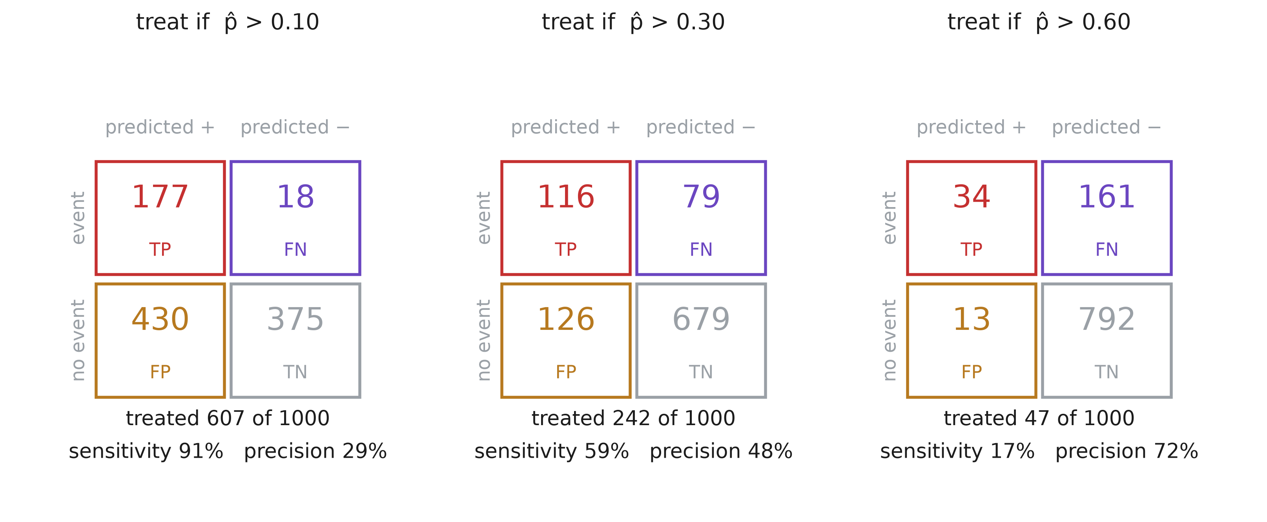
Thresholds impact
Notes:
Before we can talk about whether a decision is a good one, we need to be able to describe a decision at all. That is the confusion matrix, and this slide is the bridge from “the model outputs 0.34” to “the patient gets treated”.
The layout: rows are the TRUTH — did the complication happen — and columns are the DECISION the threshold produced. Four cells. True positives, top left, are the events we caught and acted on. False negatives, top right, are the events we missed. False positives, bottom left, are the people we treated who were going to be fine. True negatives, bottom right, are the people we correctly left alone. Every metric in this half of the session is a ratio of these four numbers.
Now the point of the slide: it is ONE model, unchanged, on ONE cohort of a thousand patients. The only thing that differs between the three panels is where the threshold sits. And look how completely the picture changes.
At 0.10 you treat 607 of the 1 000. You catch 177 of the 195 events — sensitivity 91% — but 430 of the people you treat did not need it, so the PPV is 29%. Of every ten alarms, seven are false. This is what an over-cautious threshold buys: almost nothing gets missed, and most of the medicine is wasted.
At 0.60 you treat 47 people. The PPV is 72%, so now most alarms are real — but sensitivity has collapsed to 17%, and 161 complications happen to patients the model told you not to worry about.
At 0.30, in between, 242 treated, sensitivity 59%, PPV 48%.
Which of these three is right? Nothing on this slide can tell you, and that is exactly the gap the next slide fills. Notice that none of the three is “the model being better or worse” — the model is identical. What changed is a value judgement about which error you would rather make.
And one number that does NOT move across the three panels: the prevalence. 195 events in 1 000 patients, 19.5%, in all three. It is a fact about the cohort, so the threshold cannot touch it — which is why sensitivity and specificity are stable across settings and PPV is not.

Slide 41
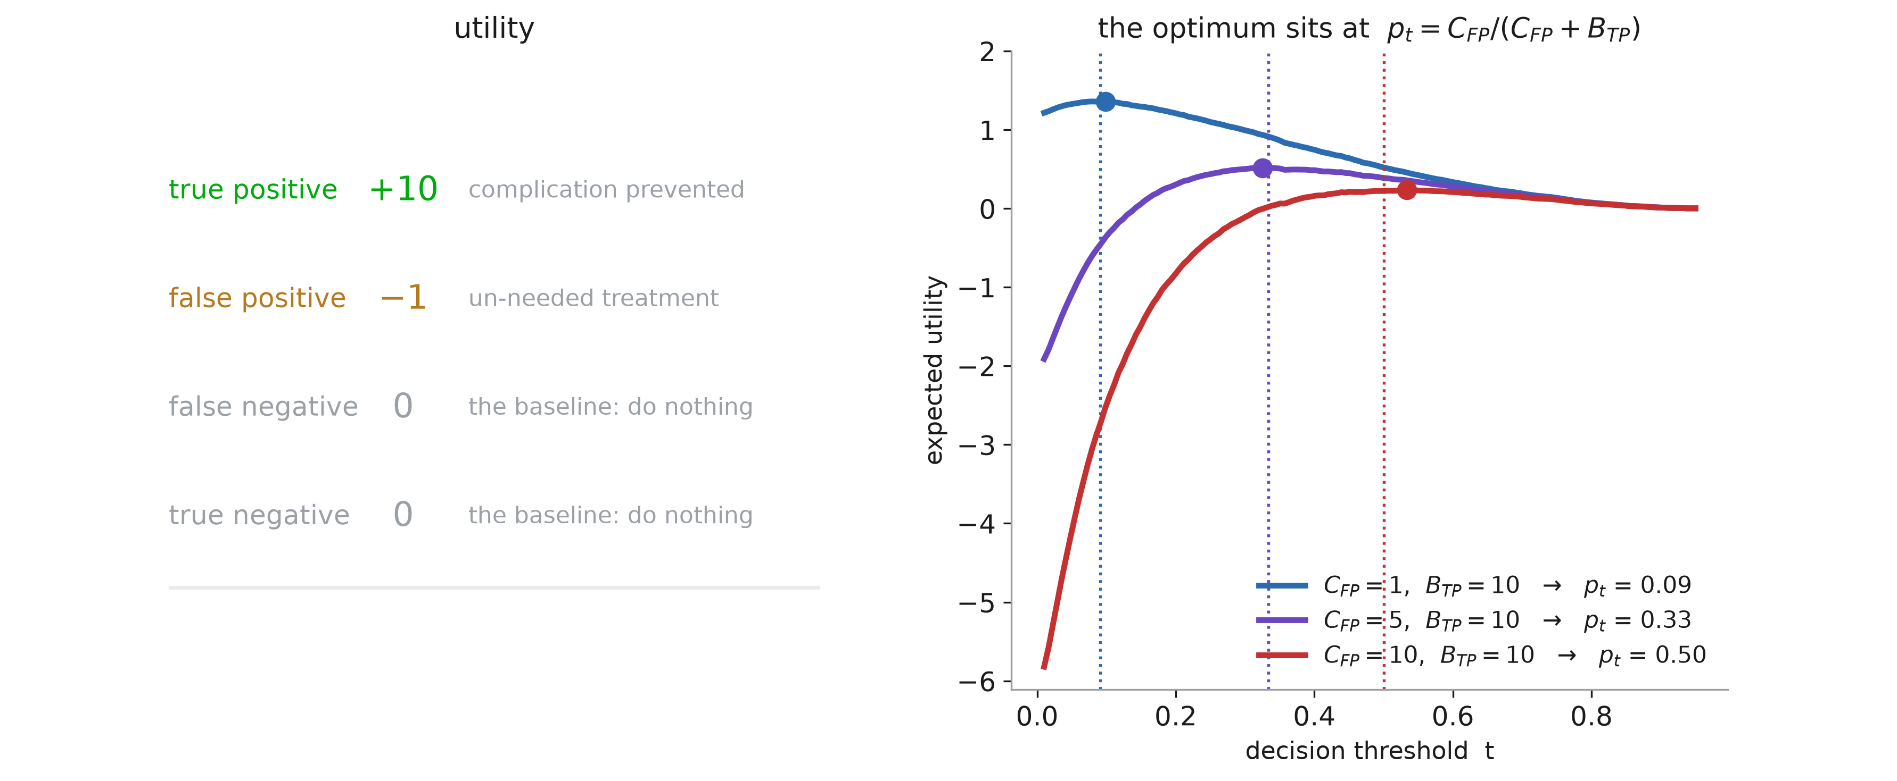
Threshold and context
Notes:
Everything so far evaluates the model. Now evaluate the DECISION, which needs something the data cannot supply.
Left panel. To act on a prediction you must say what the four outcomes are worth. A true positive — a complication caught and prevented — call it +10. A false positive — someone treated who did not need it, with the side effects and cost that entails — call it −1. The two negatives are the do-nothing baseline, zero by construction, because utilities only ever matter up to a common shift.
The red line is the honest part: those numbers do not come from your dataset. They come from clinicians, from patients, from health economics. No amount of data will tell you how bad an unnecessary course of antibiotics is relative to a missed sepsis. This is a values question wearing a numerical costume.
Right panel. Once you have the numbers, expected utility per patient is a function of the threshold, and it has a maximum. Three cost ratios, three curves, three optima — and the optima are not mysterious. The vertical dotted lines are at p_t = C_FP / (C_FP + B_TP), and the fitted maxima sit on them. With a false positive costing 1 against a benefit of 10 you should treat anyone above 9% risk. Make the false positive as bad as the true positive is good, and the threshold goes to 50%.
That formula is the whole slide, so make them stare at it. The threshold is not a tuning parameter to be optimised on validation data, and it is certainly not 0.5 because that is predict()’s default. It is a statement about the relative harm of the two errors, and once a clinician tells you that ratio, the threshold is determined.
Which gives us a way to evaluate models that includes the clinical stakes — the next two slides.

Slide 42
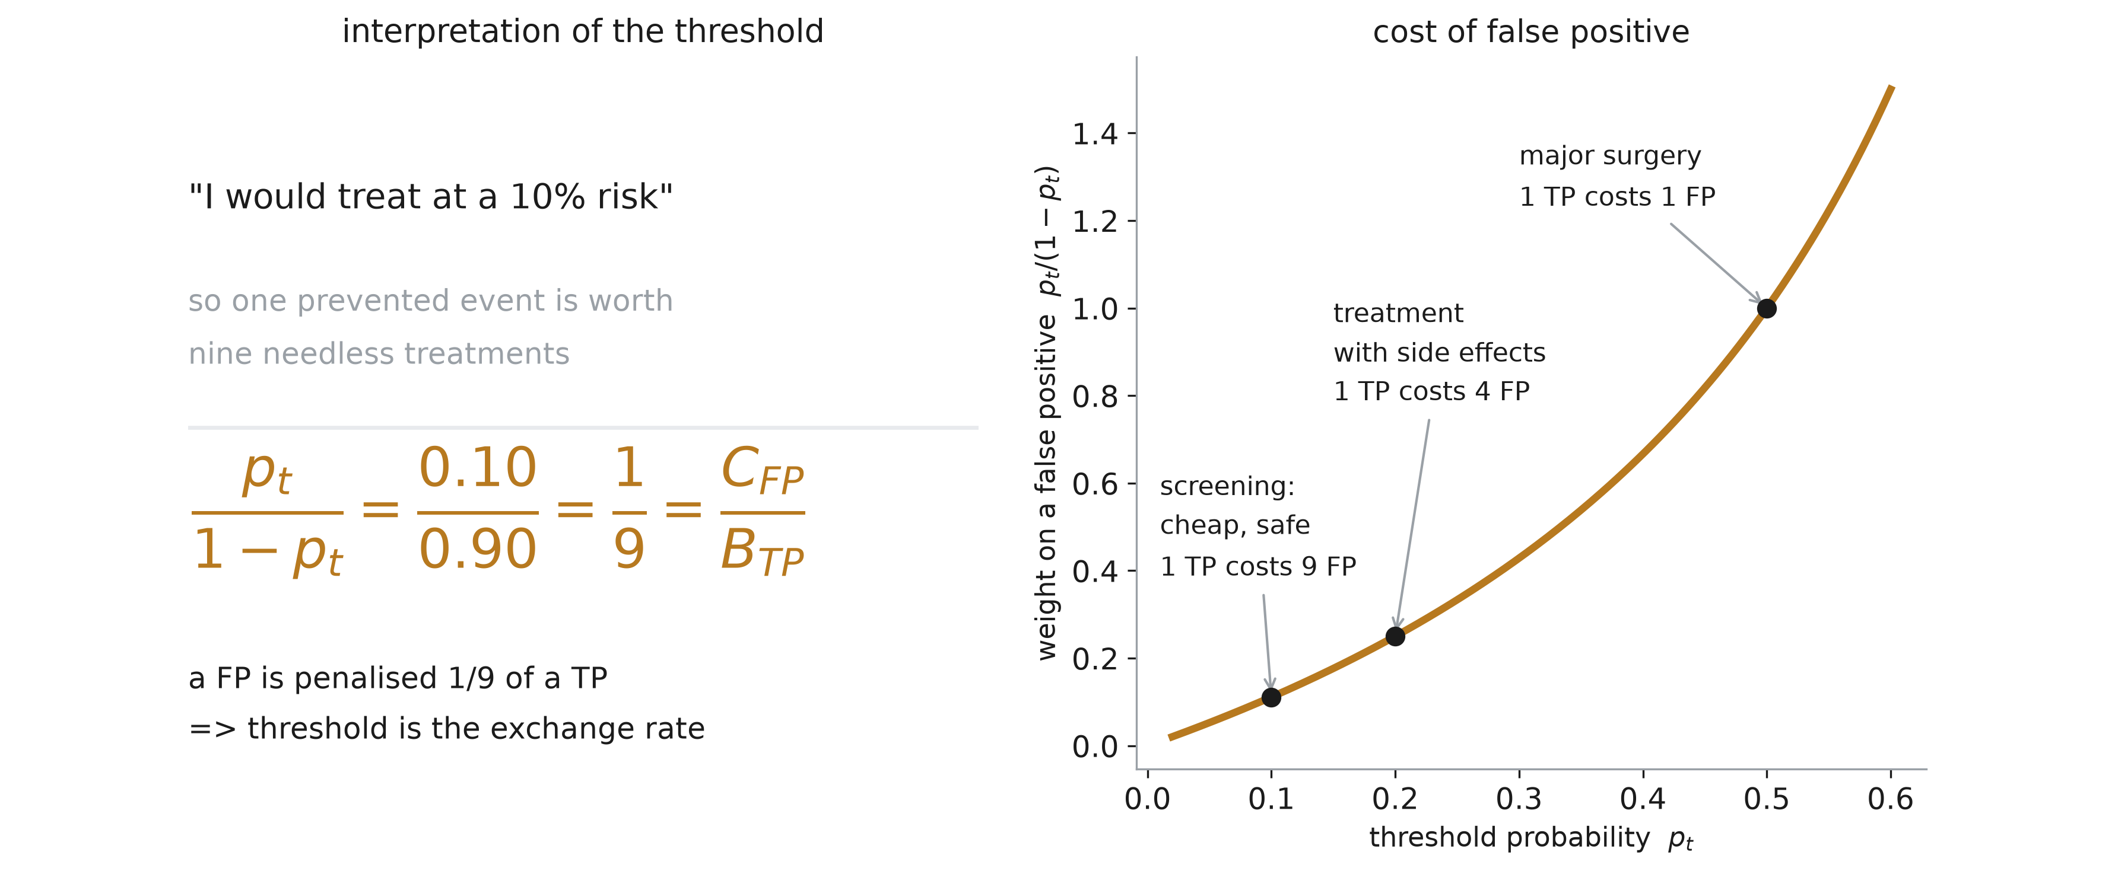
Net benefit
Notes:
The trouble with expected utility is that nobody will give you +10 and −1. Ask a surgeon to put a number on a prevented complication and you will not get an answer. Net benefit is the trick that gets around this, and it is genuinely clever.
Left panel. You will not get utilities out of a clinician, but you will get a threshold. “I would treat at a 10% risk” — that, people say readily. And by the formula from the previous slide, saying it commits them to the exchange rate whether they realise it or not: p_t/(1−p_t) = 0.10/0.90 = 1/9 = C_FP/B_TP. One prevented event is worth nine unnecessary treatments. The threshold and the cost ratio are the same information in different clothes.
So take the threshold as the input and derive the weights from it, instead of asking for the weights.
Right panel makes the exchange rate concrete across the range clinicians actually use. At p_t = 0.05, which is a cheap safe screening test, one true positive is worth nineteen false positives — you will accept a lot of over-referral. At p_t = 0.20, a real treatment with real side effects, one is worth four. At p_t = 0.50, major surgery, one is worth one, and you will only operate on someone you think is more likely than not to need it. The curve p_t/(1−p_t) is steep at the right end, which is the formal version of “you become very reluctant to intervene when the intervention is dangerous”.
Next slide turns this into a number you can compute.

Slide 43
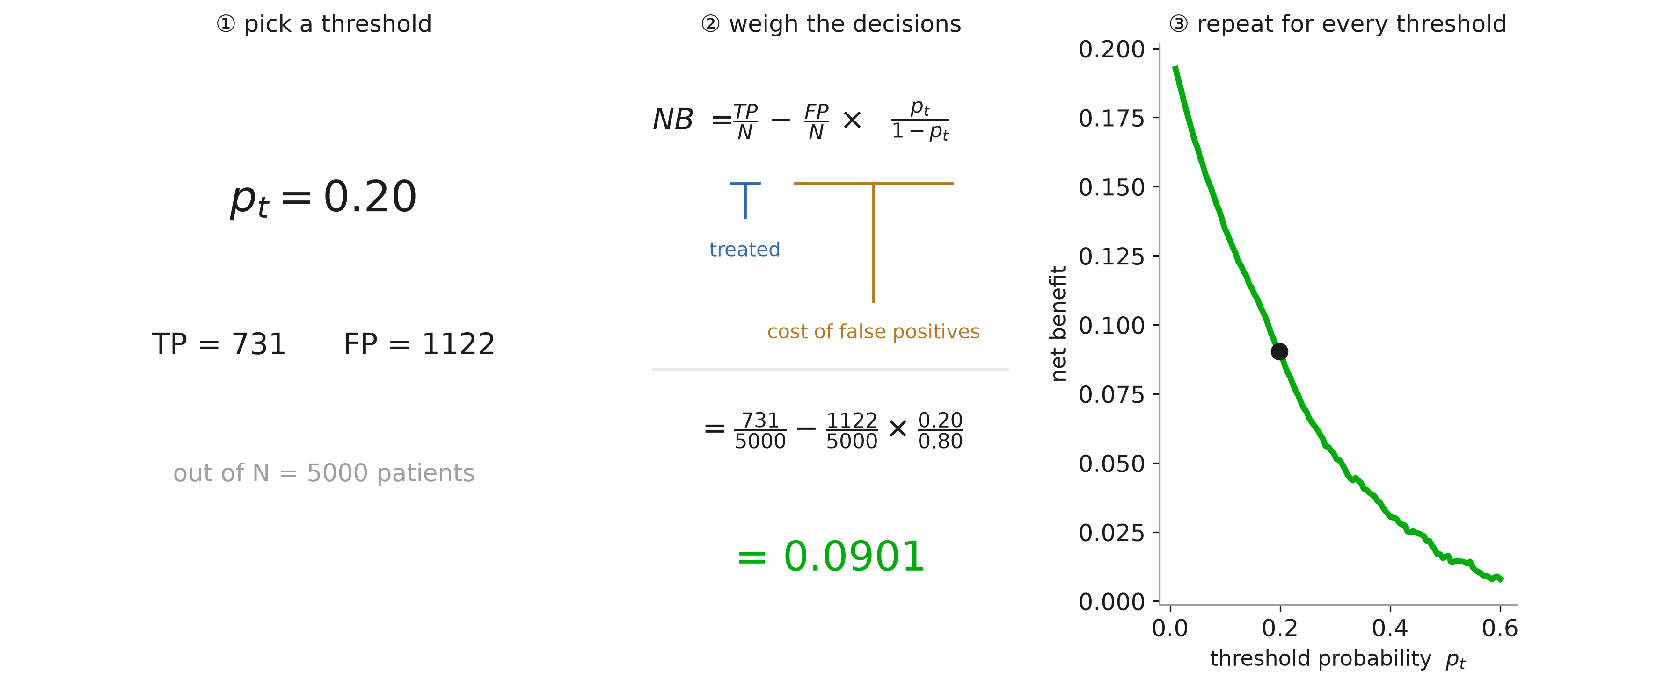
Computing net benefit
Notes:
Three steps, and it is all arithmetic you can do on a whiteboard.
Step one. Pick a threshold — 0.20 here — and actually make the decisions. Treat everyone the model scores above 0.20. In this cohort of 5 000 that catches 731 true positives and produces 1 122 false positives.
Step two. Count the true positives per patient, then subtract the false positives per patient weighted by the exchange rate that the threshold implies. 731/5000 minus 1122/5000 times 0.20/0.80. That is 0.0901.
The units are the reason to bother with this. Net benefit is measured in TRUE POSITIVES PER PATIENT, net of the harm done by the false alarms. Multiply by 1 000 and you get “this model, used at a 20% threshold, is worth 90 net complications caught per thousand patients”. That is a sentence you can say in a meeting with people who do not know what a Brier score is, which is exactly the point of the metric.
Step three. There is nothing special about 0.20, so repeat for every threshold and plot. The curve slopes down, and it must: as the threshold rises you treat fewer people and catch fewer events, and the weight you place on each false positive rises at the same time.
One warning while the formula is on screen. Net benefit is computed from the model’s own probabilities against a threshold on the same scale, so it assumes the probabilities MEAN something. A miscalibrated model will be judged at the wrong operating point. Everything in the first half of this session is a prerequisite for this half.

Slide 44
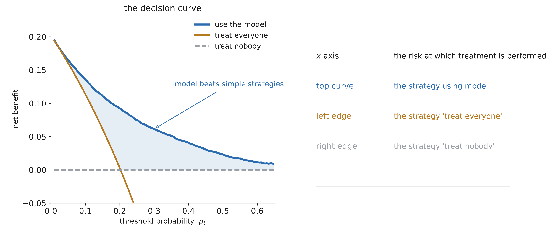
Decision curve analysis
Notes:
A net benefit on its own is a number with no scale — is 0.09 good? Decision curve analysis answers that by plotting the model against the two strategies that need no model at all.
Left panel. The blue curve is the model. The amber line is “treat everyone”, which catches every event, so its net benefit starts at the prevalence and falls steeply as the weight on false positives grows. The dashed line at zero is “treat nobody”, which by construction has a net benefit of exactly zero — no true positives and no false ones.
Those two are the bar to clear. A model is worth deploying at a given threshold only if its curve is ABOVE both of them there, and the shaded region is where this one is.
Right panel, how to read it, and I want them to be able to do this from a paper. The x axis is not a tuning knob, it is the clinician’s own threshold — you find where you sit on it and read straight up. The highest curve at that point is the strategy to use. The vertical gap between the model and the next best strategy is the gain, and it is in interpretable units: a gap of 0.02 means twenty extra true positives per thousand patients WITHOUT any increase in false positives, because the weighting has already paid for them.
Two things to note about the ends. On the far left everyone gets treated anyway, so no model can help. On the far right nobody is treated, and the bar is zero.
And the last line, in red, is the one that separates DCA from a beauty contest: only the range of thresholds a clinician would actually use matters. If your model wins between 0.4 and 0.6 but nobody would ever set the threshold there, it has won nothing.

Slide 45
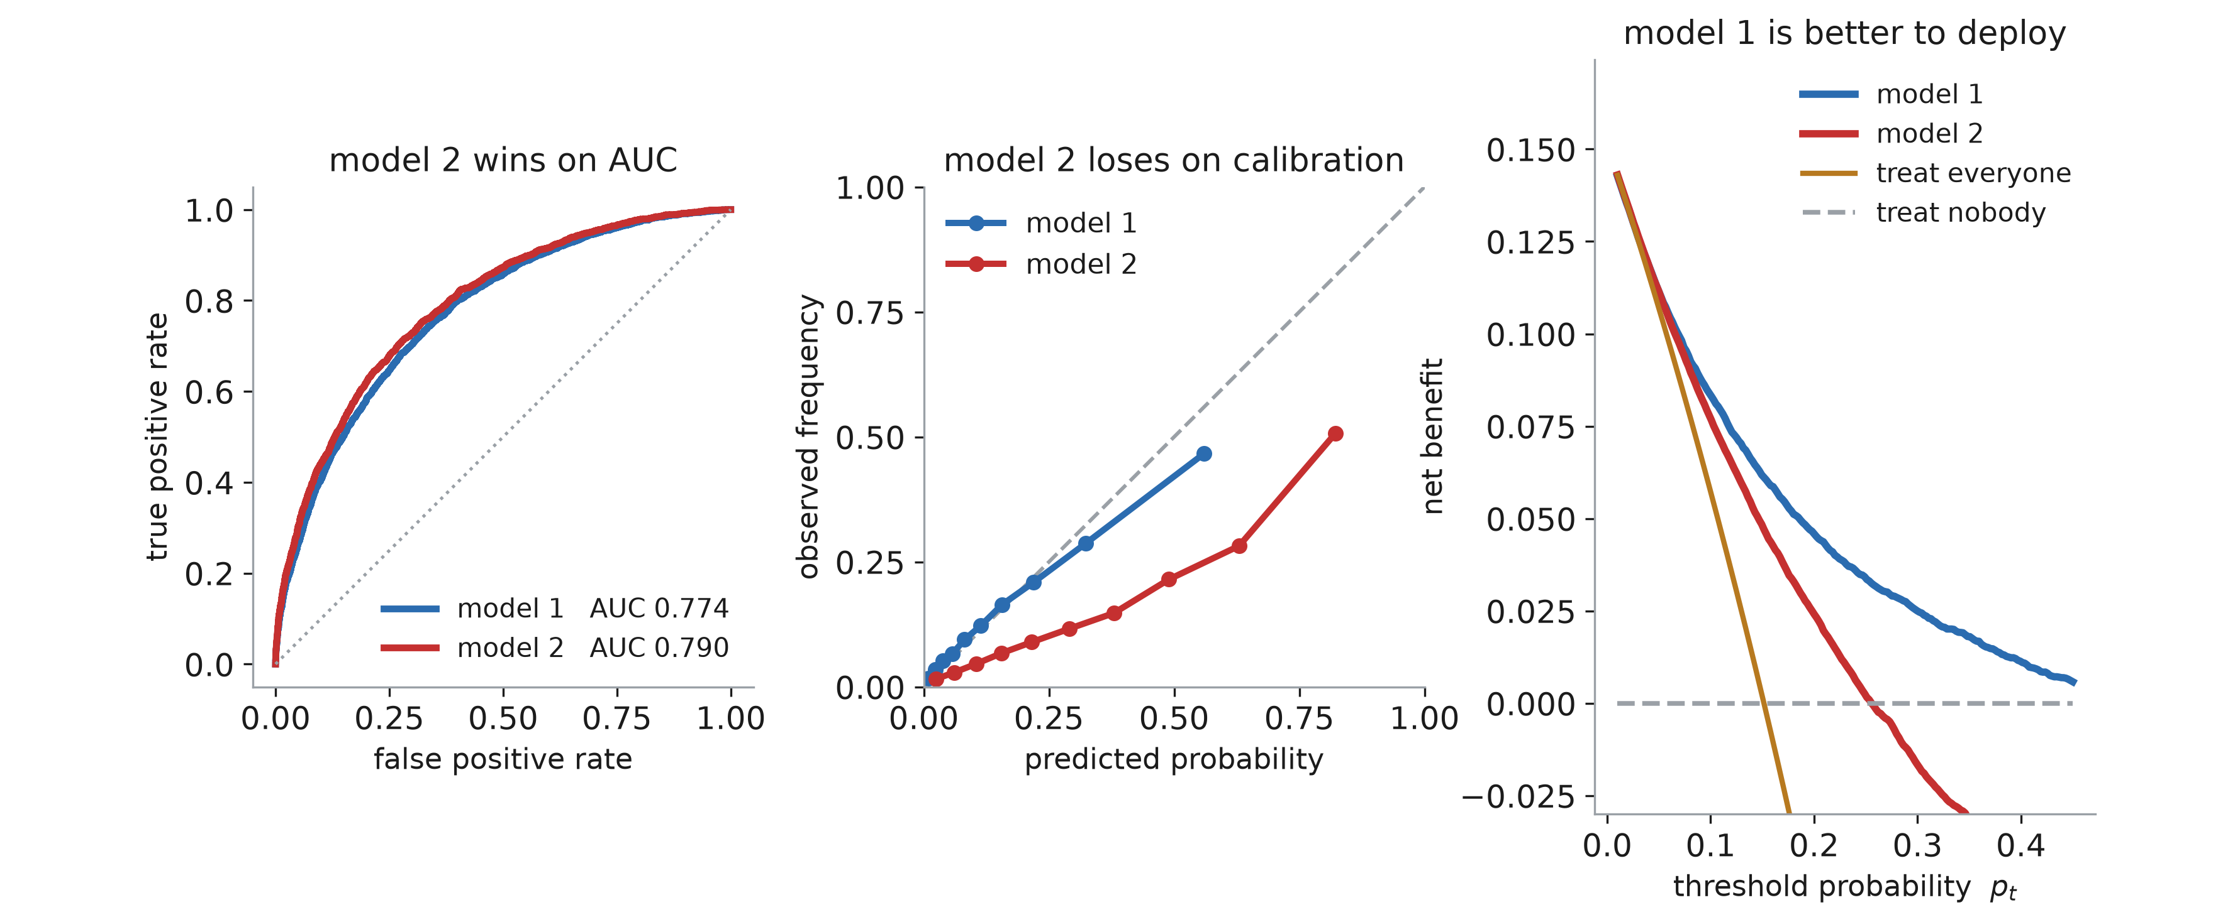
AUC vs decisions
Notes:
The payoff slide for the whole session, and it ties the two halves together.
Two models on the same cohort. Left: model 2 has the better ROC curve, AUC 0.790 against 0.774. On the strength of that alone it is the one you would publish.
Middle: model 2 is badly miscalibrated. Its reliability curve sits well below the diagonal — it systematically overstates risk. Model 1’s sits on the diagonal. We now have the vocabulary for this: model 2 has an intercept problem.
Right: net benefit. Across the whole clinically plausible range of thresholds, model 1 is above model 2, and by a wide margin. Model 2 crosses zero around 0.26, meaning that past that threshold you would be better off treating nobody than using it. Model 1 is still positive at 0.45.
Why: because model 2 overstates risk, a threshold of 0.20 on its output is not really a 20% threshold. It sweeps in far too many patients, so at the operating point the clinician actually chose, it generates false positives that its slightly better ranking cannot pay for. AUC never saw this, because — as we proved two sections ago — AUC only looks at order, and calibration is invisible to it.
So the summary for the session. Ranking is necessary and not sufficient. Calibration makes the numbers mean something. Net benefit asks whether ACTING on them helps, and it is the only one of the three that involves the clinical stakes at all. A model is not ready because its AUC is high; it is ready when it ranks well, its probabilities are honest on data it has never seen, and its decision curve beats treat-all and treat-none across the thresholds your clinicians would actually use.

