Slide 1
PyTorch

Slide 2

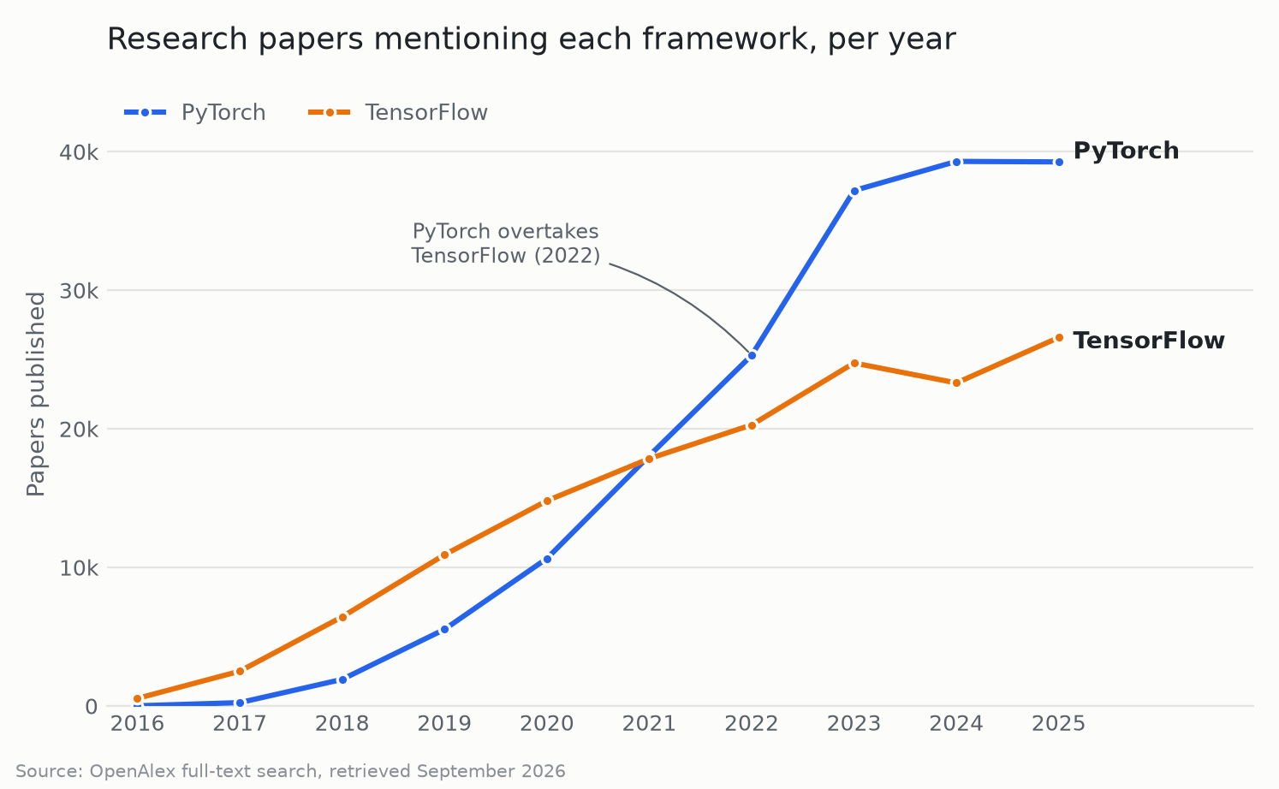
PyTorch in a few words…
Developed by Facebook’s AI research group
Getting very popular
Easy to use
Good performance in production
Flexible across a wide range of tasks
Provides tools for parallelizing & distributing computations

Slide 3
Key Concepts of PyTorch
Tensor: multi-dimensional array of numbers
Autograd: automatic differentiation engine (to avoid manual computation of gradients, cf. last TD correction)
Neural network module: base class to inherit from for all our neural network classes
Optimizer: an algorithm that is used to update the parameters based on the computed gradients and a given loss function
Dataset/Dataloader: a base class for our data
Notes:
Inheritance allows us to define a class that inherits all the methods and properties from another class.

Slide 4


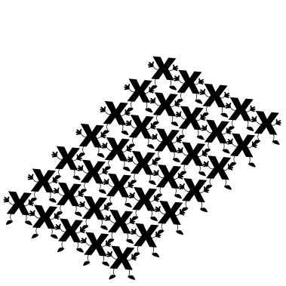
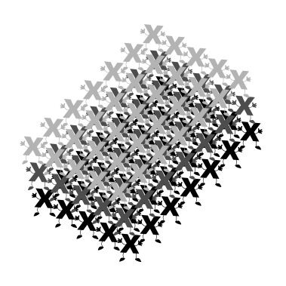
Tensor
Scalar
Vector
Matrix
Tensor

Slide 5
Autograd
Symbolic derivative of a function is precise; however, as the function of interest become more complex, the symbolic derivative becomes increasingly difficult to determine.
Finite difference approach uses the definition of a derivative to estimate the derivative of a function; however, it suffers from low accuracy and instability.
Automatic differentiation is using the chain rule to break the computation of the derivative. It achieves machine precision accuracy.

Slide 6
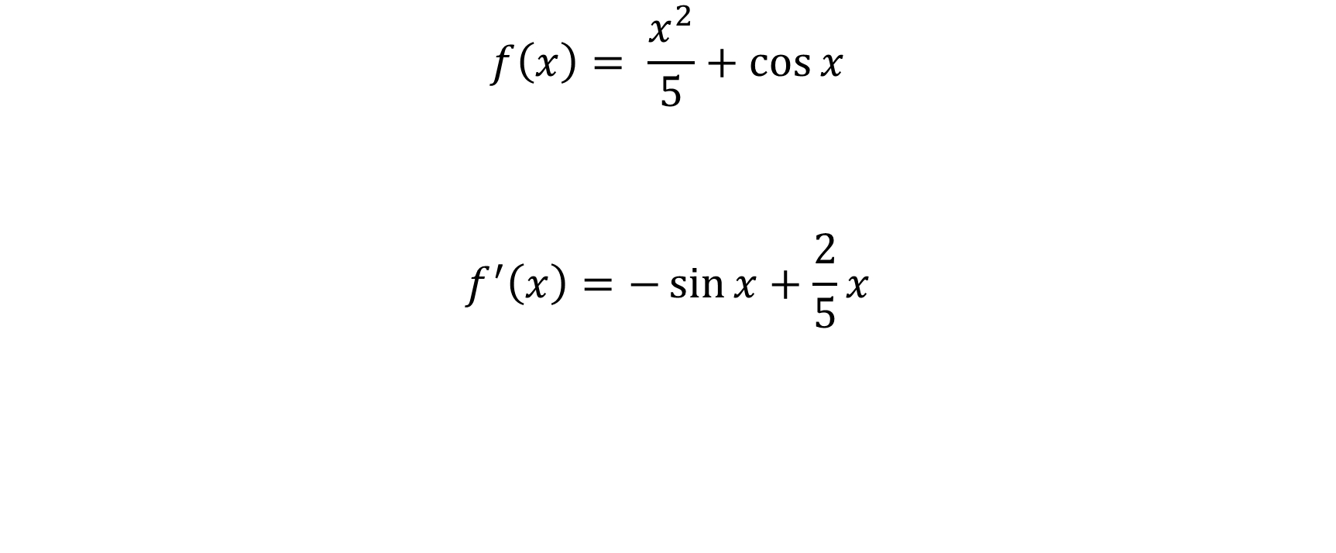
Symbolic derivative

Slide 7
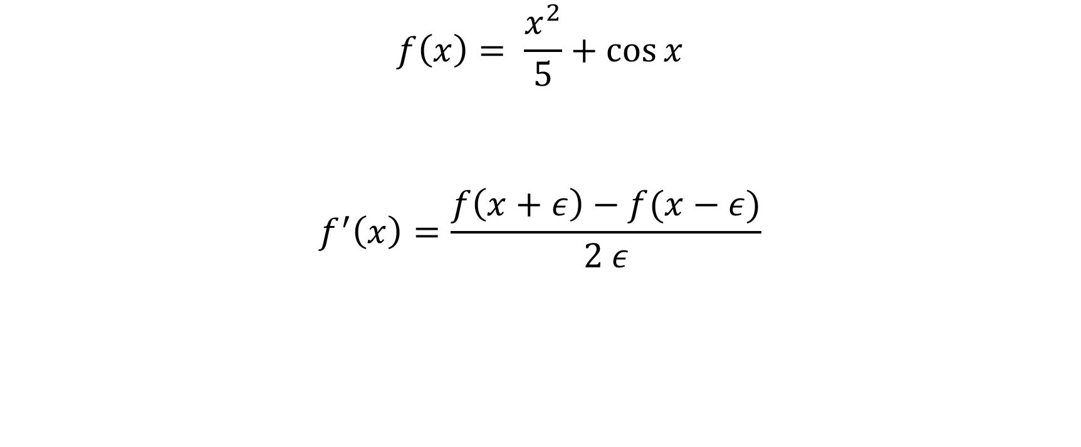
Finite differences

Slide 8
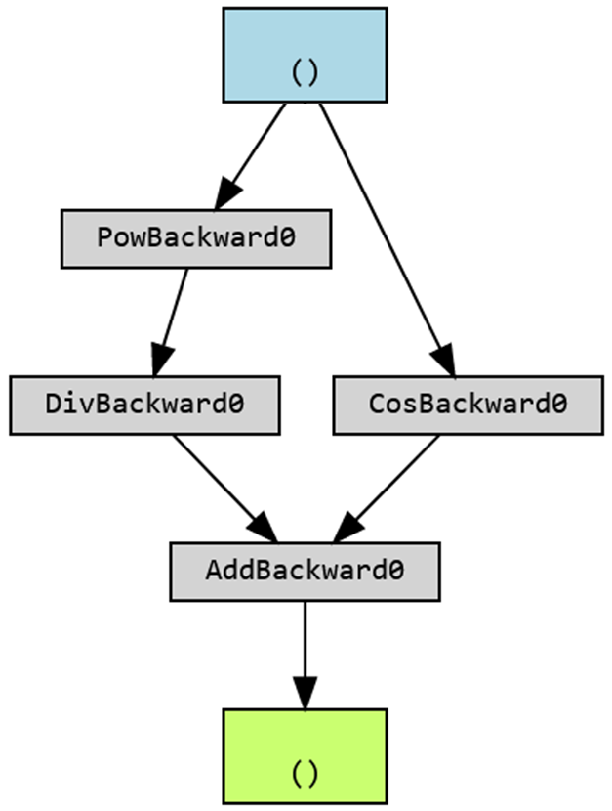
Autograd (automatic differentiation)
x = torch.tensor(1.0, requires_grad=True)
z = ((x**2)/5) + torch.cos(x)

Slide 9
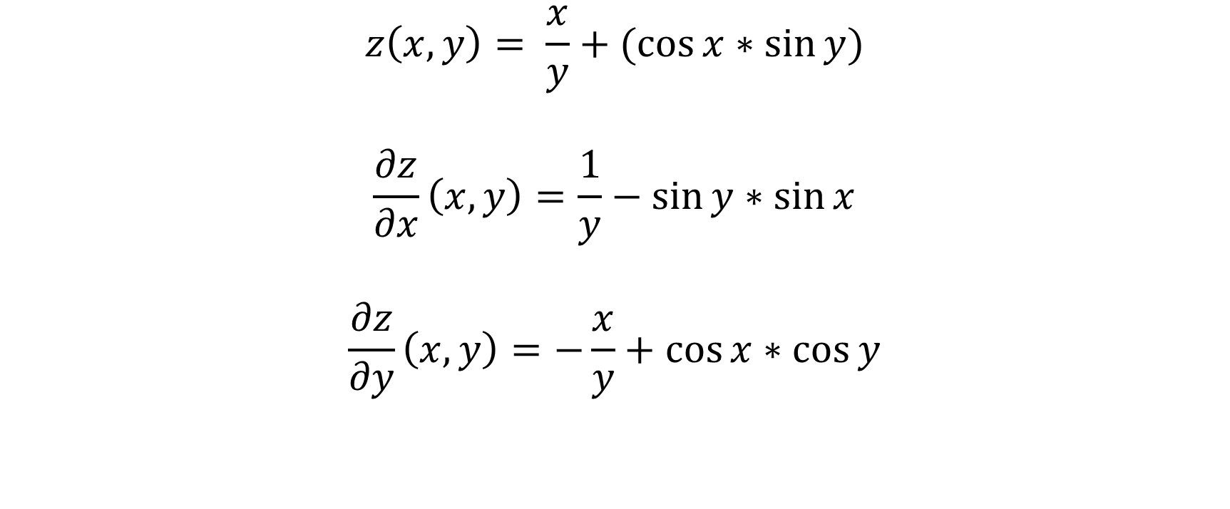
Symbolic derivative

Slide 10
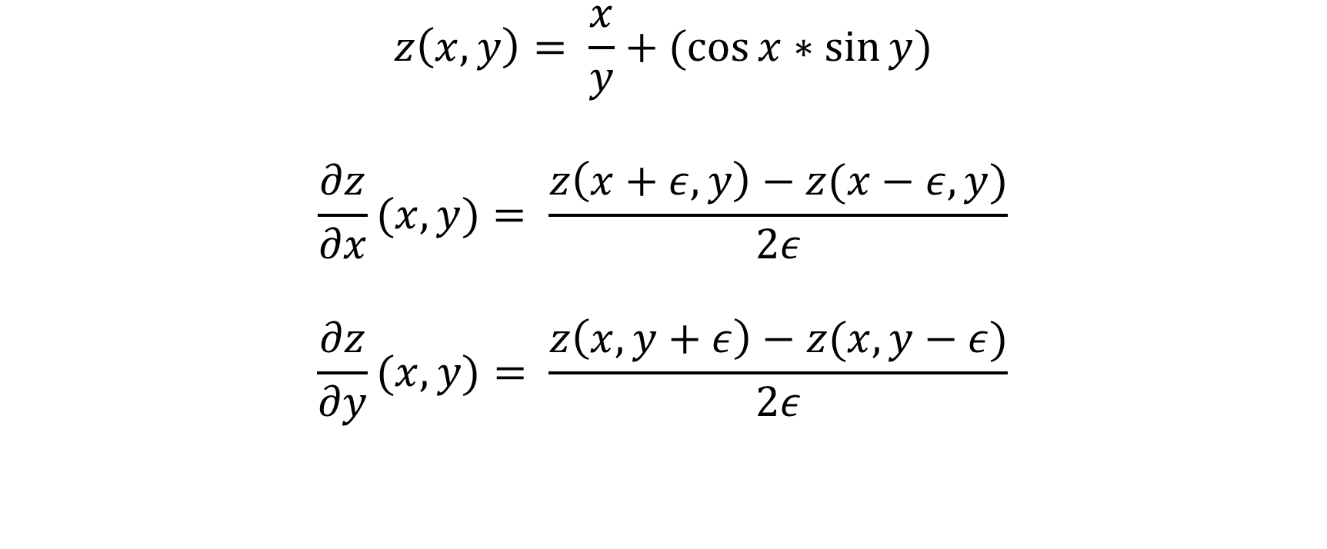
Finite differences

Slide 11
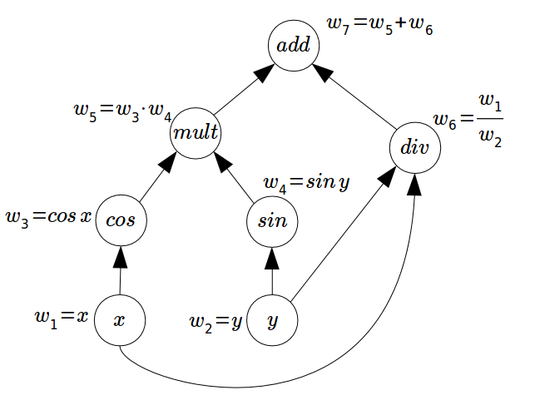
Autograd
x = torch.tensor(1.0, requires_grad=True)
y = torch.tensor(5.0, requires_grad=True)
z = (x/y) + torch.cos(x)*torch.sin(y)
(Internally)

Slide 12
Neural network module class
class Net(nn.Module):
def __init__(self):
super().__init__()
# initialize here your neural network
# (define its layers, etc…)
[…]
def forward(self, x):
# computes the outputs / predictions
[…]
return …
Notes:
No need for backward!

Slide 13
Neural network module class: an example
class Net(nn.Module):
def __init__(self):
super(Net, self).__init__()
self.fc1 = nn.Linear(1, 10)
self.fc2 = nn.Linear(10, 1)
def forward(self, x):
x = self.fc1(x)
x = nn.ReLU()(x)
x = self.fc2(x)
return x
Notes:
Pas d’activation function sur la dernière couche, on a le droit ! On pourrait aussi en mettre une.

Slide 14
Optimizer
All optimizers used in this course are variations of gradient descent:
  Stochastic Gradient Descent (SGD): simple gradient descent aggregated by batches
  Adaptive Moment Estimation (Adam): extension of SGD with momentum and moving average of the gradients to accelerate the training process and prevent oscillations.
  Root Mean Squared Propagation (RMSProp): extension of SGD that is designed to deal with the issue of vanishing gradients. It normalizes the gradients by the root mean square of their recent magnitudes.
It is easy to switch from one optimizer to another with PyTorch*.
* We will see more on optimizers later in this course.
Notes:
For now, let’s just understand the difference between stochastic gradient descent and standard gradient descent.
Stochastic Gradient Descent is a probabilistic approximation of Gradient Descent. It is an approximation because, at each step, the algorithm calculates the gradient for one observation picked at random, instead of calculating the gradient for the entire dataset.
This represents a significant performance improvement, when the dataset contains millions of observations.
Compared to Gradient Descent, Stochastic Gradient Descent is much faster, and more suitable to large-scale datasets.
But since the gradient it’s not computed for the entire dataset, and only for one random point on each iteration, the updates have a higher variance. This makes the cost function fluctuate more on each iteration, when compared to Gradient Descent, making it harder for the algorithm to converge.
New variations of Stochastic Gradient Descent have been developed to tackle these problems. For example, Mini-batch Stochastic Gradient Descent, addresses the variance problem by picking a sample of n observations from the dataset in each iteration instead of just one.
Suppose you have made an app and want to improve it by taking feedback from 100 customers. You can do it in two ways. First, you can give the app to the first customer and take his feedback then to the second one, then the third, and so on. After collecting feedback from all of them you can improve your app. But you can also improve the app as soon as you get feedback from the first customer. Then you give it to the second one and you improve again before giving it to the third one. Notice that in this way you are improving your app at a much faster rate and can reach an optimal point much earlier.
Hopefully, you can tell that the first process is the Vanilla Gradient Descent and the second one is SGD.

Slide 15
Dataset & Dataloader
To handle custom datasets, create a dataset class, and use a Dataloader to iterate through it.
class CustomDataset(Dataset):
def __init__(self):
# initialize your dataset
# (define the path, etc…)
def __getitem__(self, index):
# return one item of data
[…]
return …
def __len__(self):
# return the length of the dataset
return …
Notes:
Creating a PyTorch Dataset and managing it with Dataloader keeps your data manageable and helps to simplify your machine learning pipeline. A Dataset stores all your data, and Dataloader is can be used to iterate through the data, manage batches, transform the data, and much more.

Slide 16

Now it’s time to torch!

