Slide 1
Session 2
Main ML Models
Advanced Data Science · NYU Paris · 2026
Paul Dubois

Slide 2
Main question
You have a feature table.
What does each classical model actually do with it?
Notes:
Frame the deck: Session 2 built the feature table. Before we spend the rest of the semester on neural networks, we look under the hood of the models that still win on tabular data. Not a catalogue — a handful of mechanisms, each one drawn. The deck is deliberately light on text: the text is me.

Slide 3
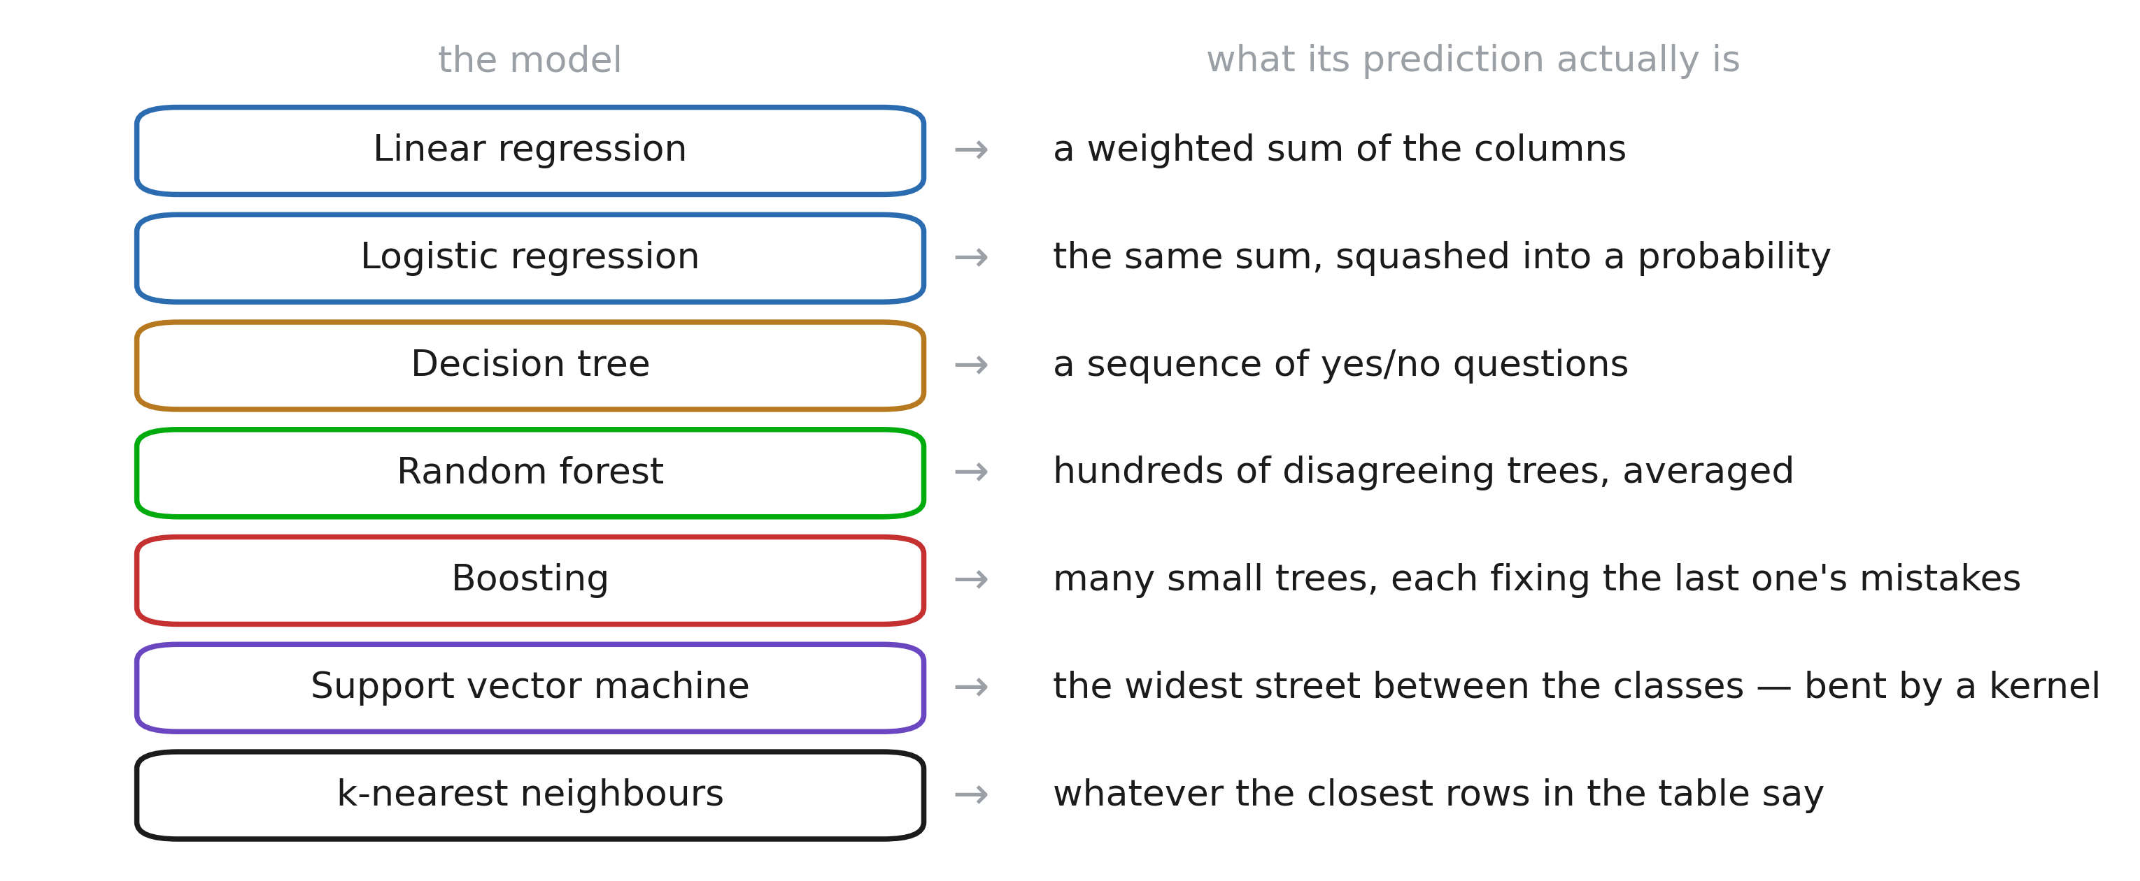
Classical models
Notes:
Read the right column aloud, not the left. Every row is a different answer to the same question — “what shape is f?” — and that is the only thing that changes between them. Seven models, and the colours group them into the three families we will actually work in: two linear (a weighted sum, with or without a squash), three built out of trees (one, many averaged, many added), and two that work by distance rather than by fitting a boundary at all. That is also the running order of the deck, so this slide is the table of contents. Promise them we come back to it at the end and put all seven boundaries on one picture.

Slide 4
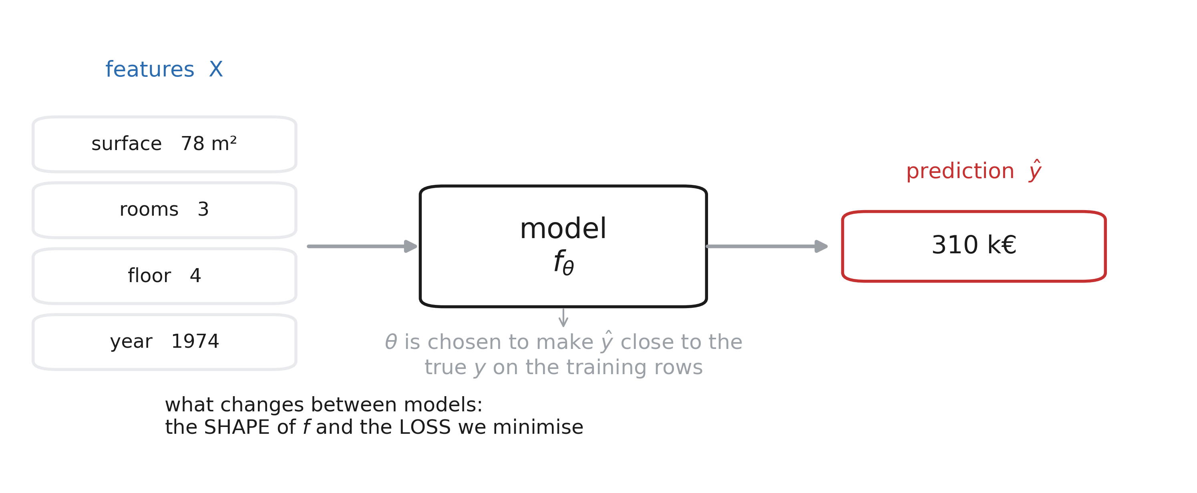
The model box
Notes:
Fix the vocabulary once: features X, target y, parameters θ, prediction ŷ, loss. Every model in this deck fills the box differently, but nothing outside the box moves. Stress the last line — the shape of f and the loss are the only two design choices; everything else is arithmetic.

Slide 5
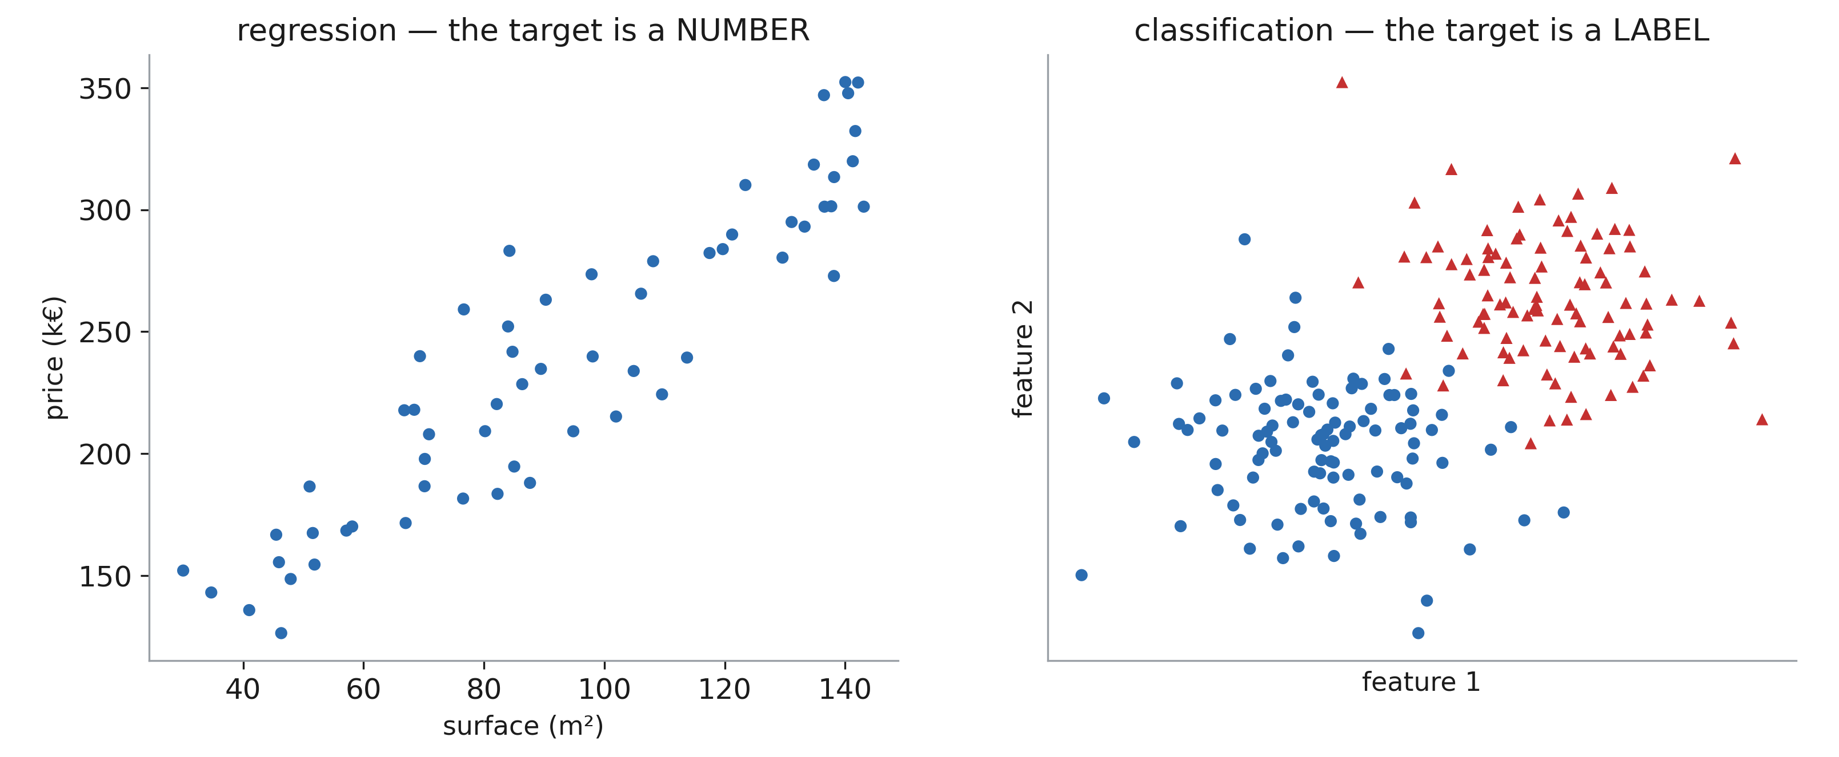
Two kinds of target
Notes:
Regression → a number, scored with squared error. Classification → a label, scored with accuracy / log-loss. Same models on both sides, with a different last step: linear regression ↔ logistic regression, regression tree ↔ classification tree. Say it now, so the parallel is expected rather than surprising later.

Slide 6
1. Linear regression

Slide 7
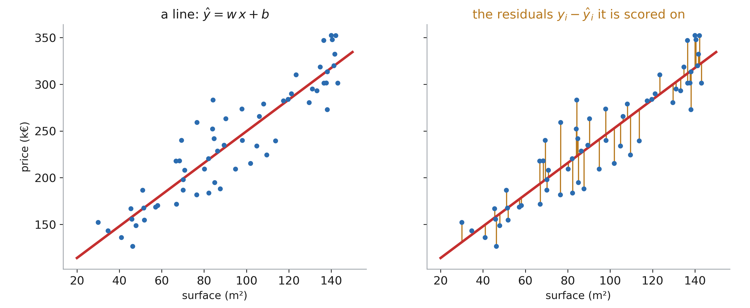
Fit a line, judge it on the residuals
Notes:
Left: the model is two numbers, a slope and an intercept. Right: what “good” means. Ask why we square the residuals rather than take absolute values — answers: it punishes big misses harder, it is differentiable everywhere, and it has a closed form. Squaring is also why one outlier can drag the whole line.

Slide 8
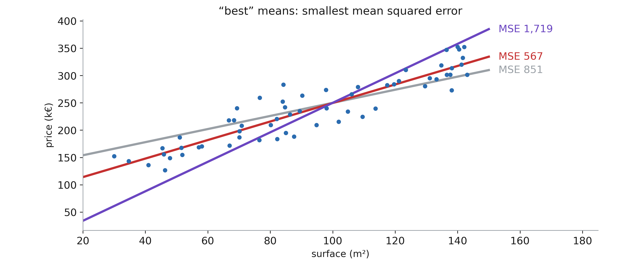
Quality is measured by MSE
Notes:
Three lines, three MSEs. The point: once you have written the loss down, choosing the model stops being taste and becomes arithmetic. Ask the room to rank the lines by eye first, then reveal the numbers — they usually get the order right and the margins wrong.

Slide 9
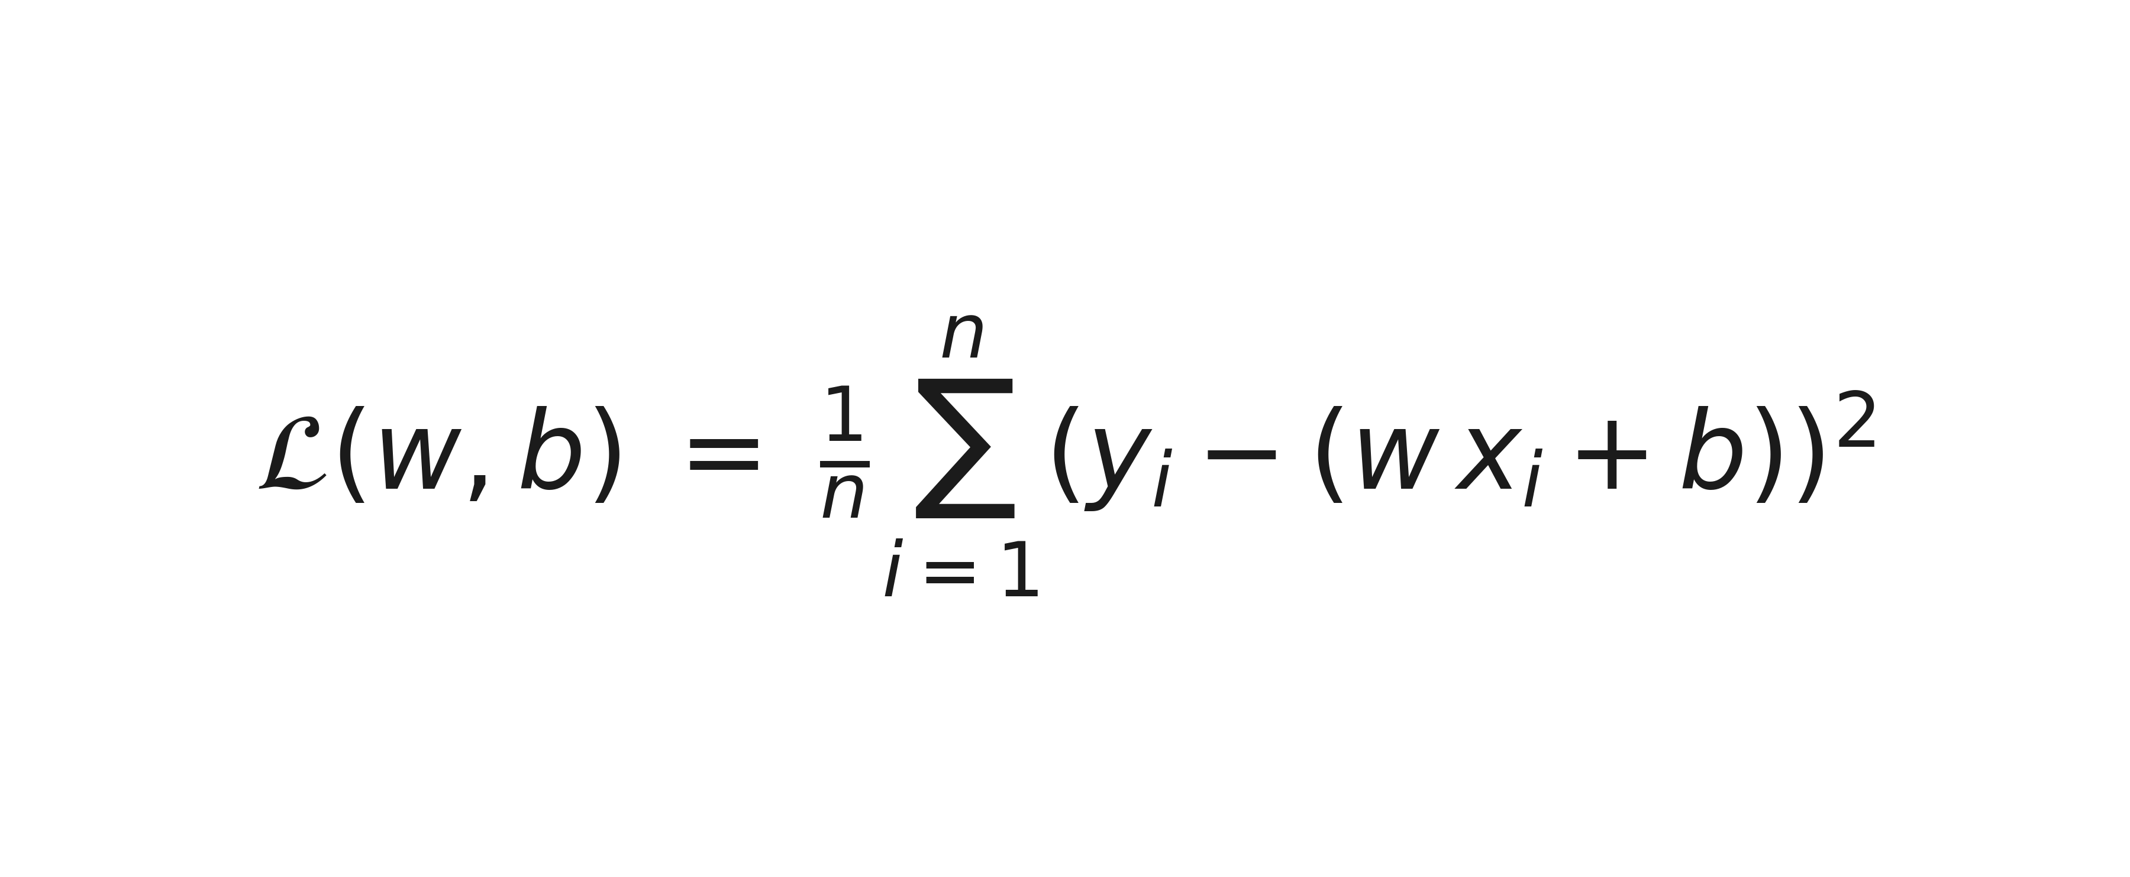
The loss, written out
Notes:
Two minutes maximum. Name every symbol: n rows, y_i truth, w and b the two things we are allowed to change. Note that x_i and y_i are FIXED — the function’s inputs are w and b, which is exactly the flip students find confusing.

Slide 10
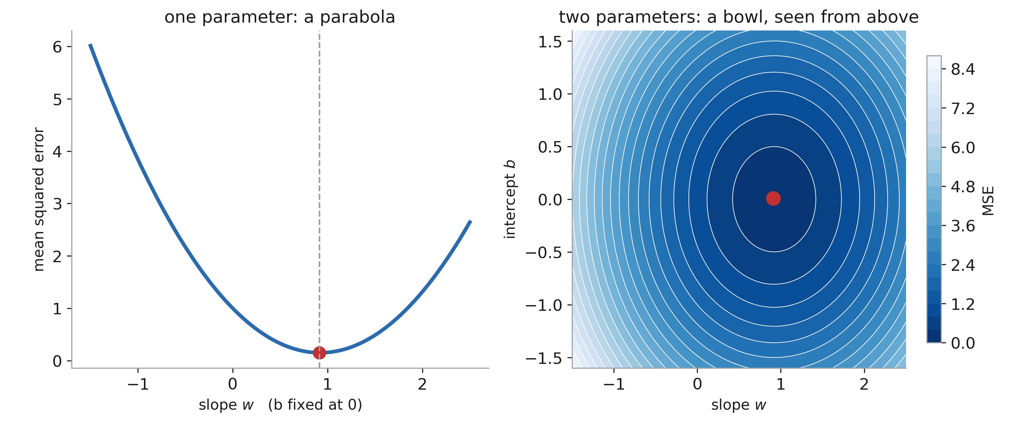
The loss is a bowl
Notes:
Left: freeze b, sweep w — a parabola. Right: sweep both — nested ellipses with one bottom. The key word is CONVEX: one minimum, no local traps, no random restarts, no seed. This is the property that neural networks will lose in three weeks. (Both panels use standardised columns so the bowl is round enough to read.)

Slide 11
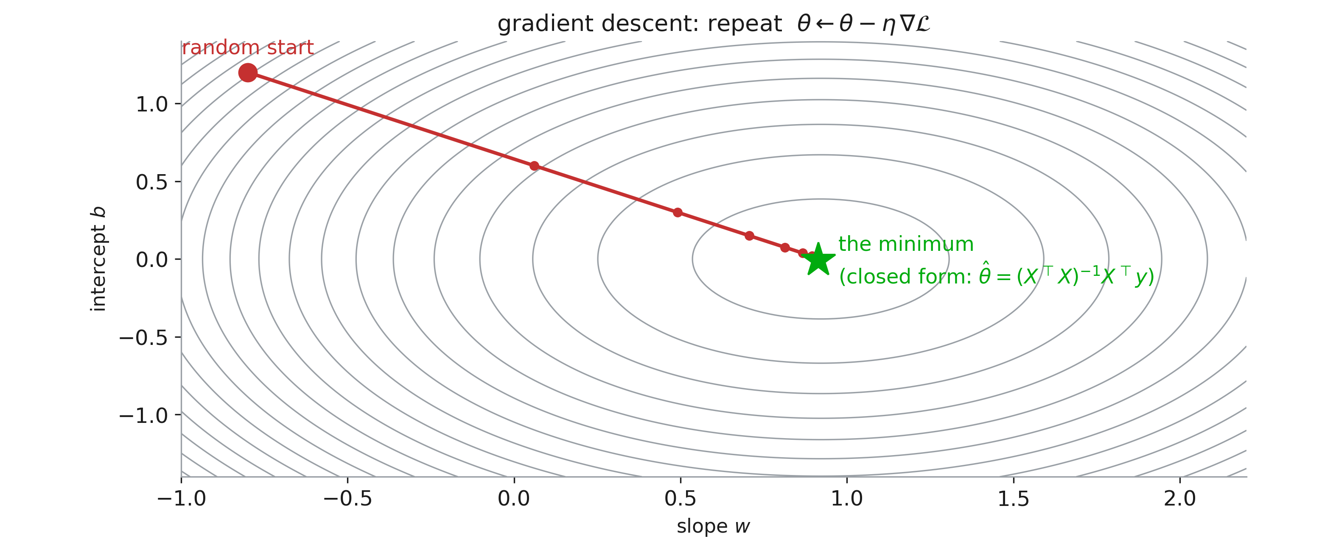
Two ways down the bowl
Notes:
Because the bowl is quadratic we can jump straight to the bottom: the normal equation. We nevertheless walk down it, because gradient descent is the ONLY option left once the model is a network — and the recitation notebook implements exactly this loop by hand. Point at the step size: too small crawls, too large diverges.

Slide 12
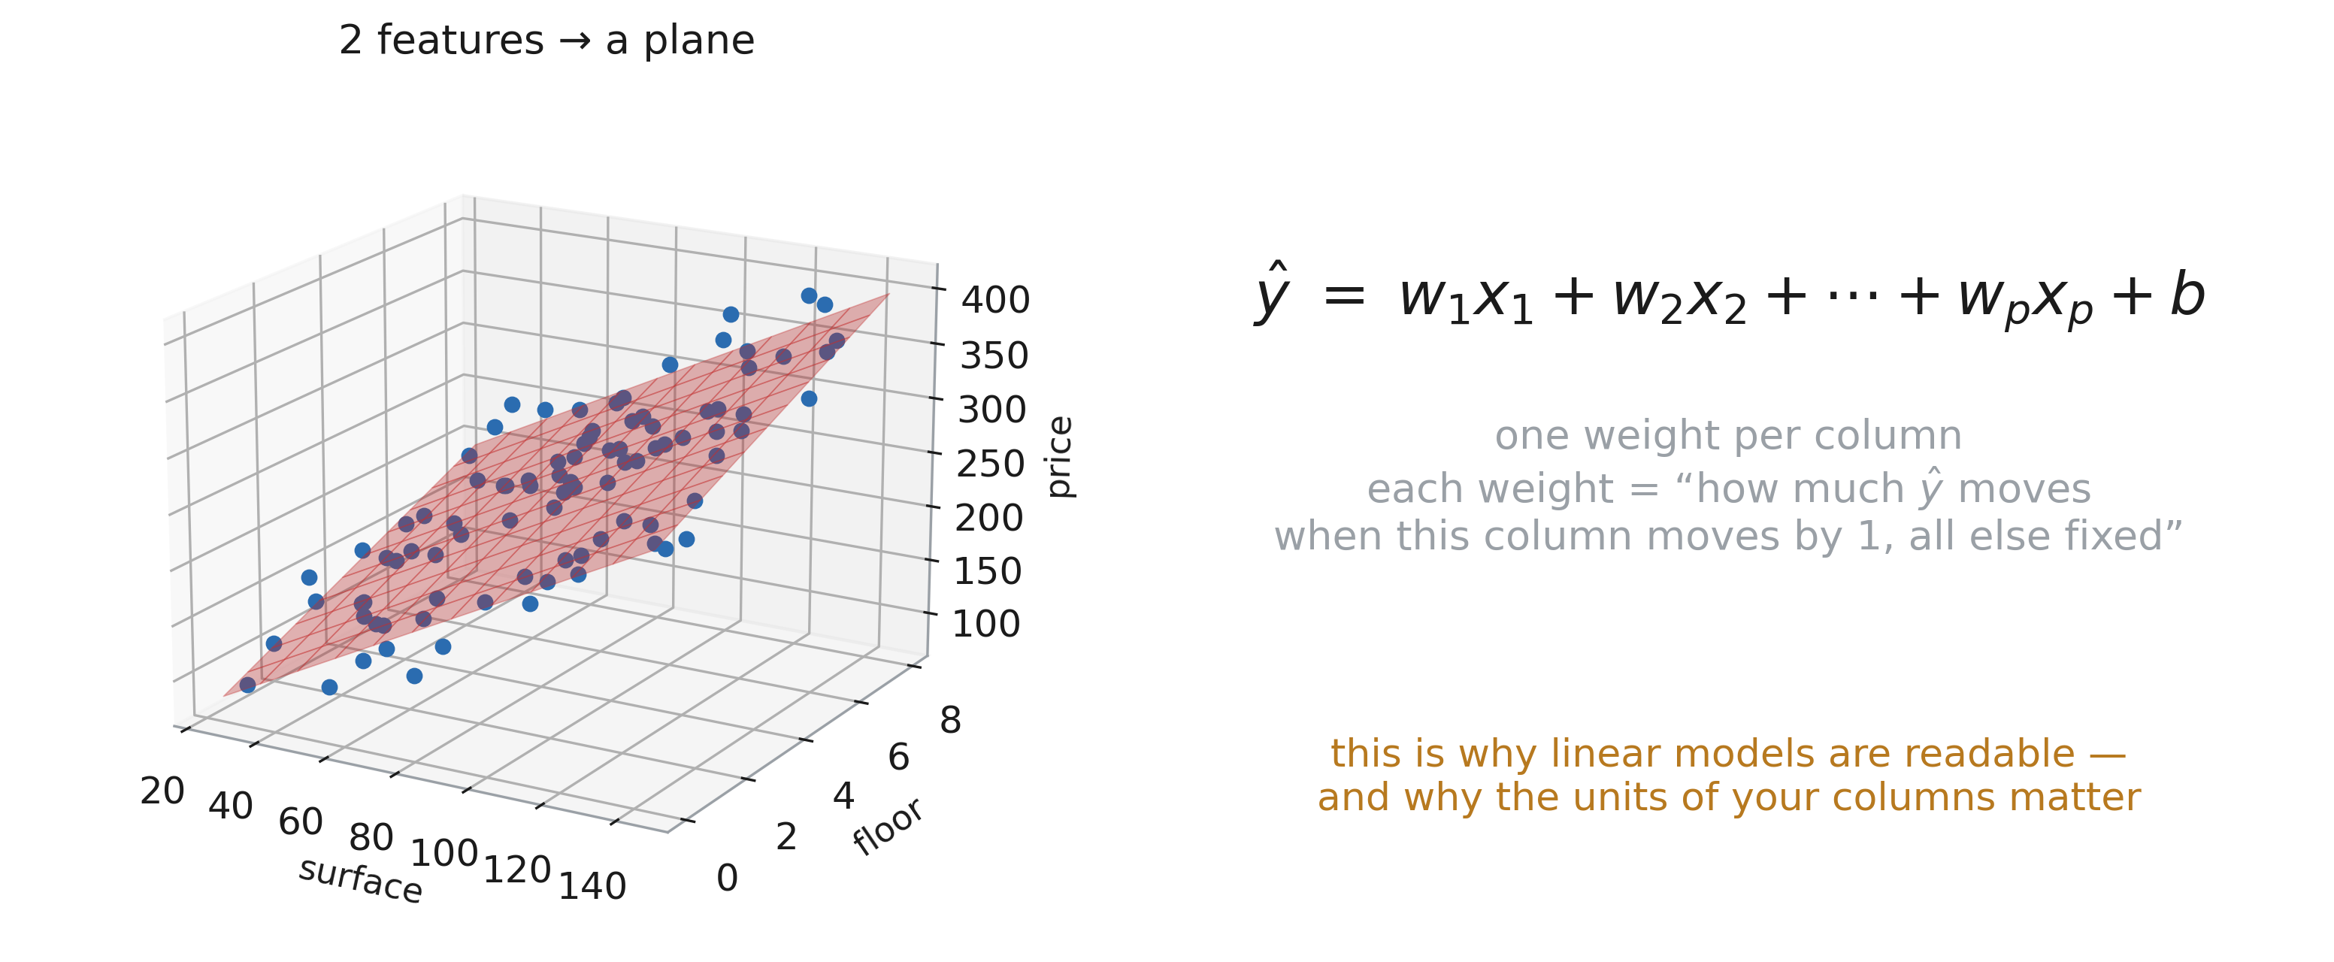
More columns: the line becomes a plane
Notes:
p features, p weights, one intercept. Each weight is a partial effect — “all else held fixed” — and that clause is where causal claims sneak in illegitimately; Session 13 comes back to it. Say the practical consequence: correlated columns split the credit between themselves, so a weight near zero is not evidence of no effect.

Slide 13
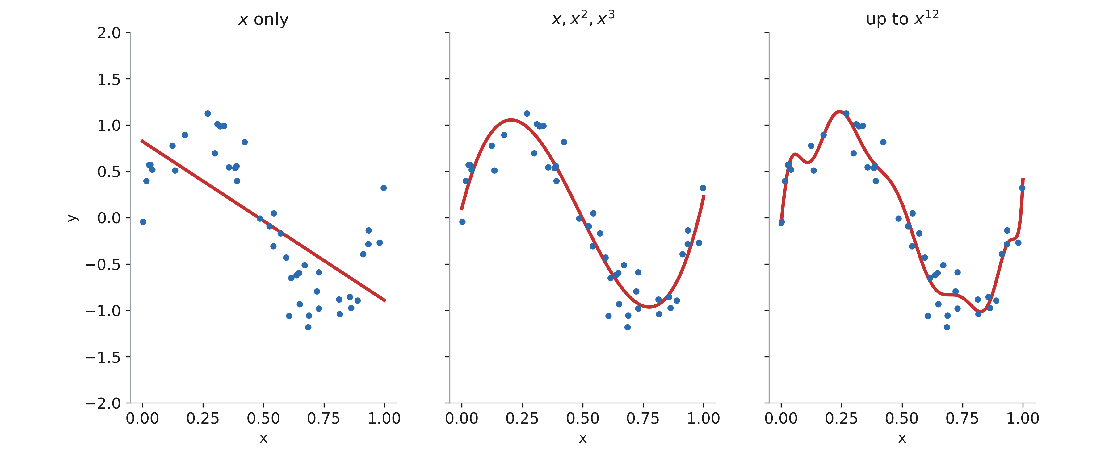
“Linear” means linear in the weights
Notes:
This surprises everyone. Adding x², x³, log x, or an interaction x₁·x₂ as extra COLUMNS keeps the model linear — same normal equation, same bowl. So a linear model is only as limited as your feature table. This is the direct payoff of last week’s feature engineering, and the reason “linear” is not an insult.

Slide 14
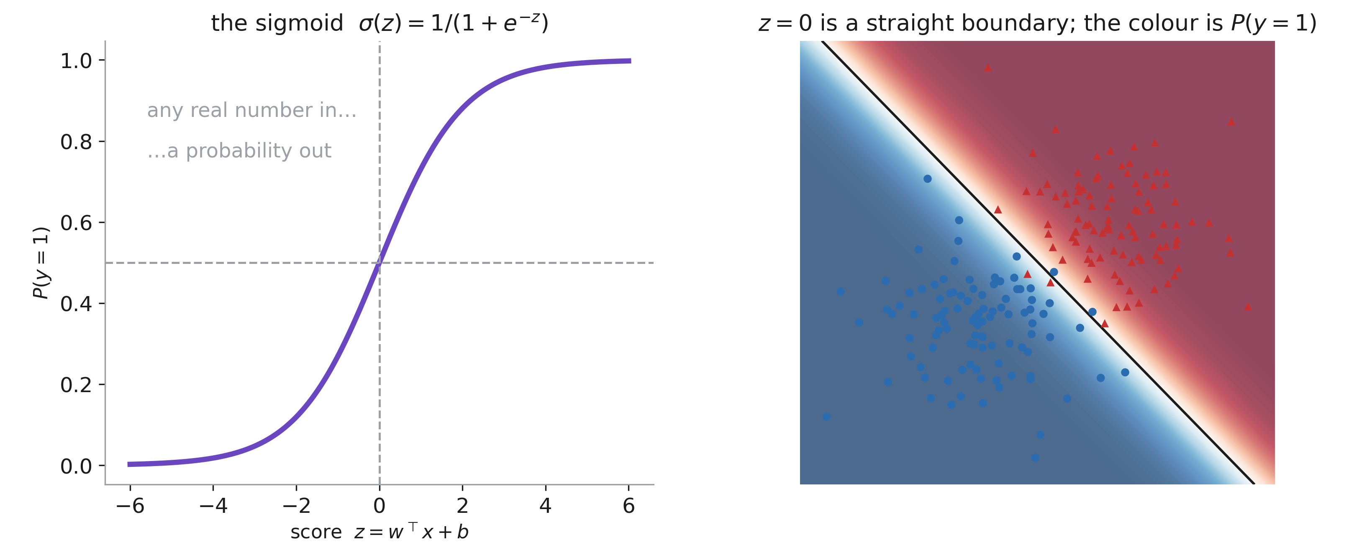
Classification: squash the same sum
Notes:
Left: the sigmoid — the score can be anything, the output has to be in [0,1]. Right: because the score is linear, the 0.5 contour is a straight line, always. Emphasise that logistic regression outputs a genuine probability, which is why it is still the default in clinical risk models — Session 4 is about whether that probability is calibrated.

Slide 15
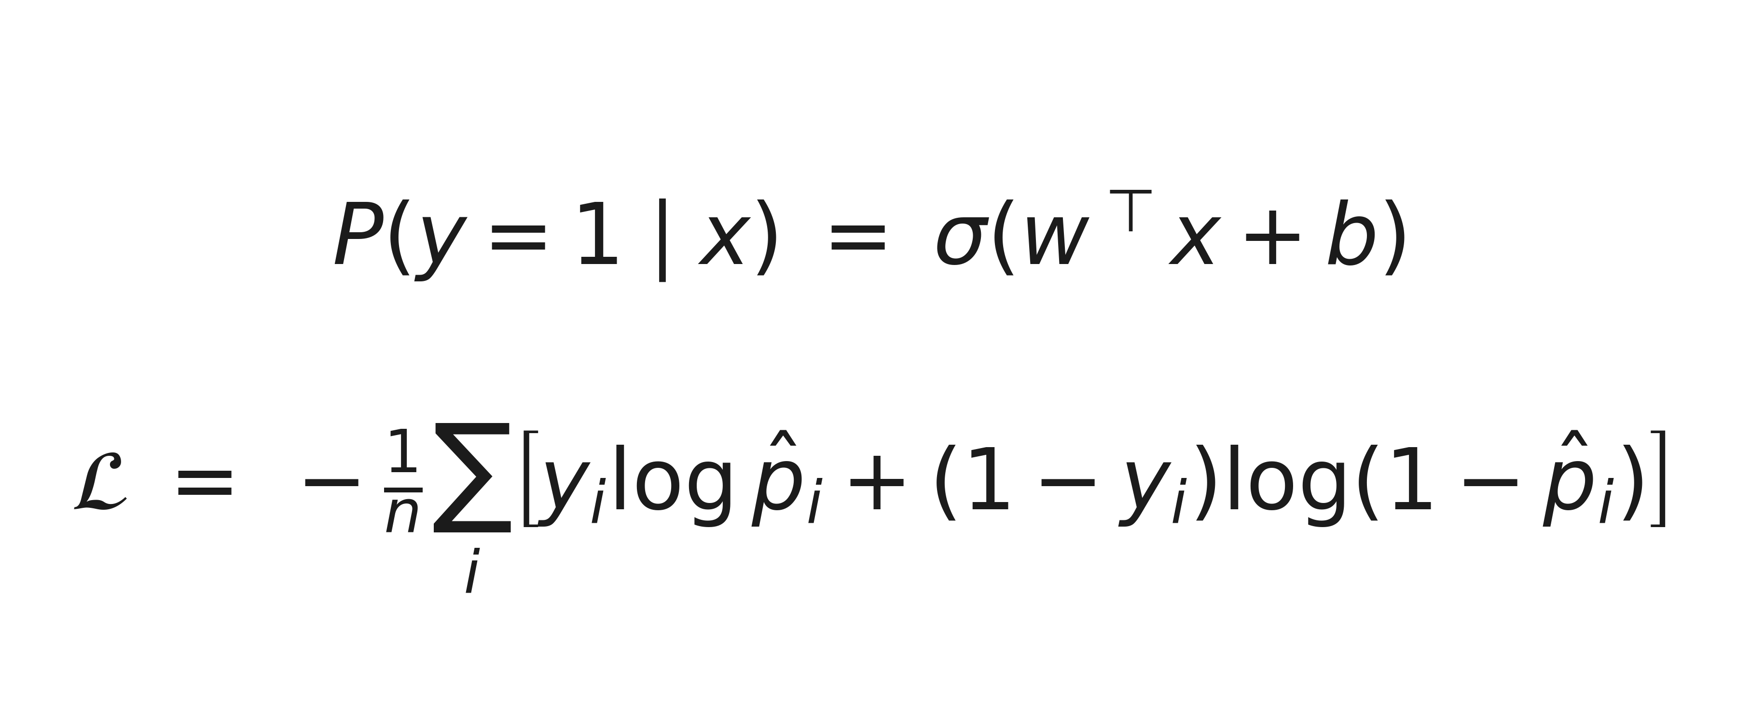
Fitted by maximum likelihood
Notes:
Squared error on a probability is a bad idea (it is not convex through the sigmoid, and it under-punishes confident mistakes). Cross-entropy is the right loss: it goes to infinity when you are confidently wrong. No closed form here — gradient descent is compulsory. Note that we will meet this exact loss again for every classifier network in the course.

Slide 16
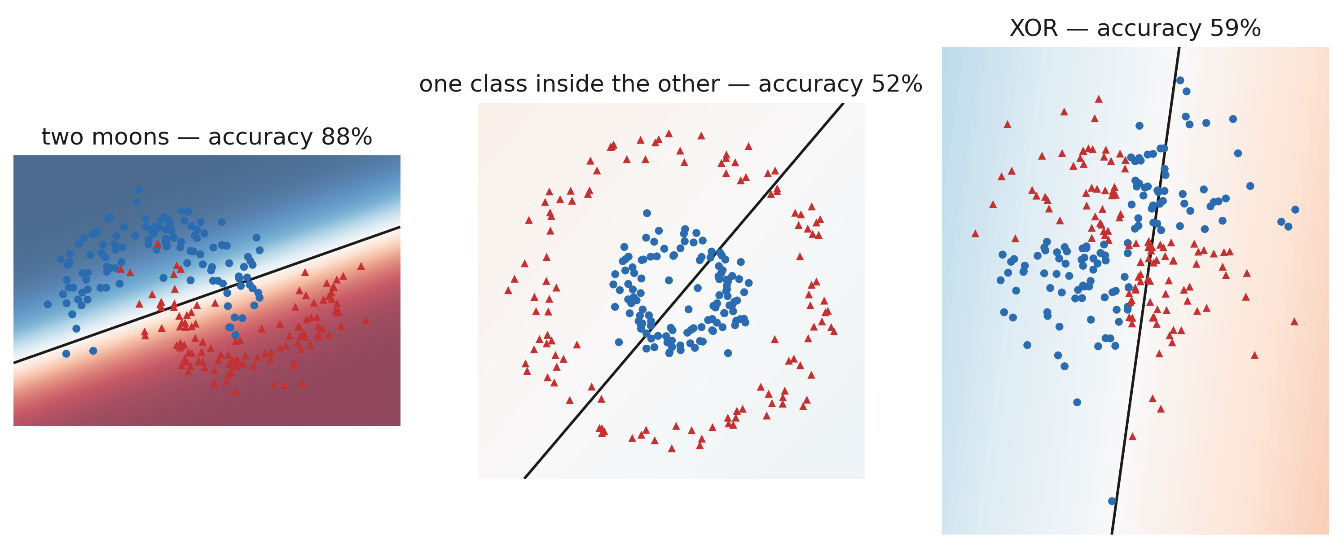
Where a straight boundary cannot go
Notes:
Three datasets a first-year student can draw, and logistic regression fails on all three — XOR at chance level. The fix is either better features (we just saw basis expansion) or a model that carves space itself. That is the cue for trees. Ask them what single extra column would rescue the XOR panel: x₁·x₂.

Slide 17
2. Decision trees

Slide 18
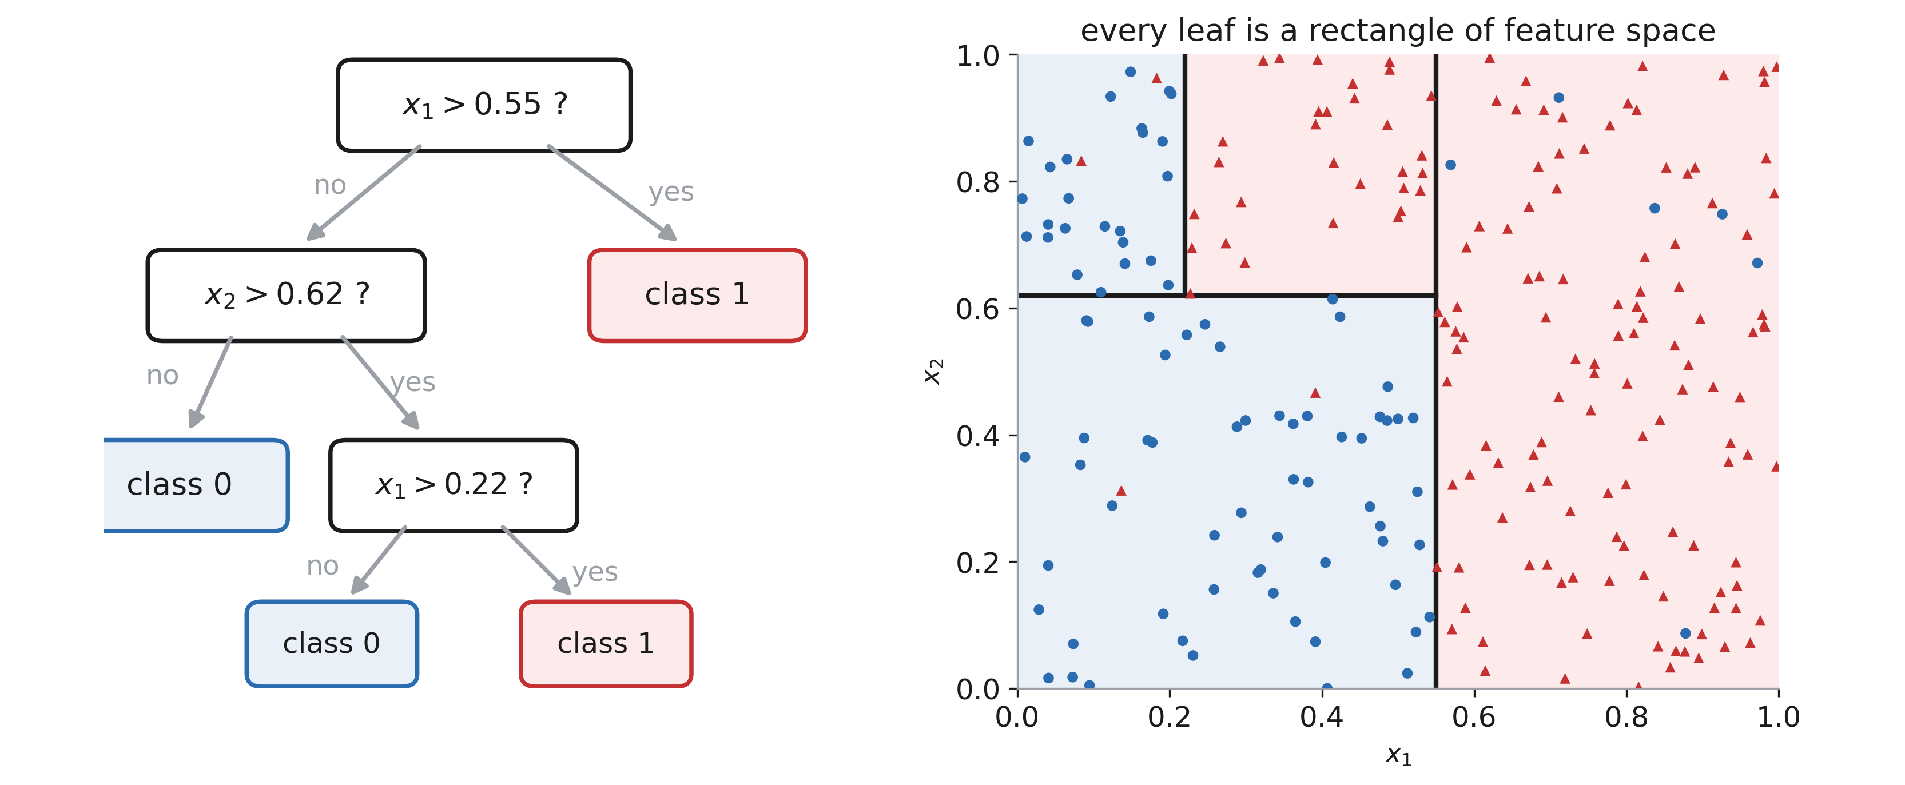
A tree is a sequence of questions
Notes:
The two panels are the SAME object: follow one path down the tree and you have named one rectangle on the right. Read one path out loud end to end. Say what this buys: no scaling, no dummy encoding, no distributional assumption, and a model a clinician can read off the page.

Slide 19
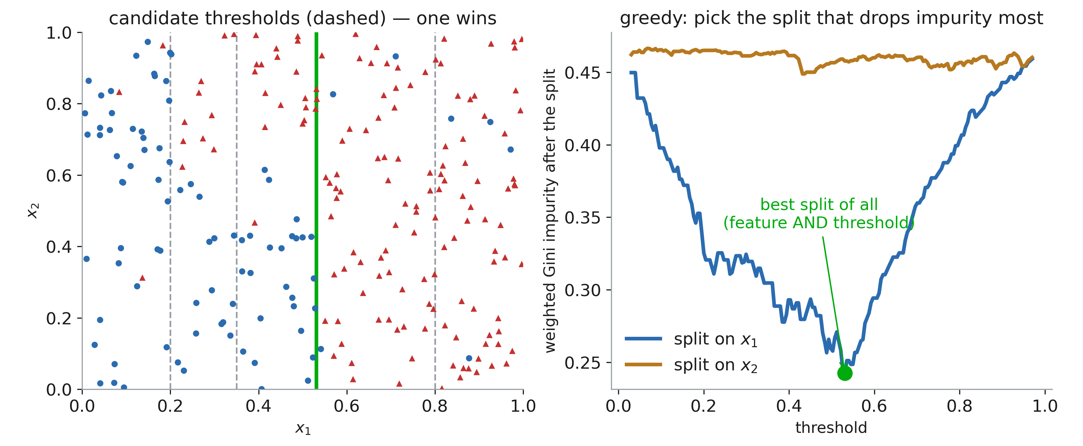
Best thresholds
Notes:
The algorithm is brutally simple: for every column, for every threshold, compute the impurity of the two children, keep the best pair. Then recurse. Note “greedy” — it never reconsiders an earlier split, so the tree it builds is not the best possible tree; finding that one is NP-hard. That greediness is a source of variance.

Slide 20
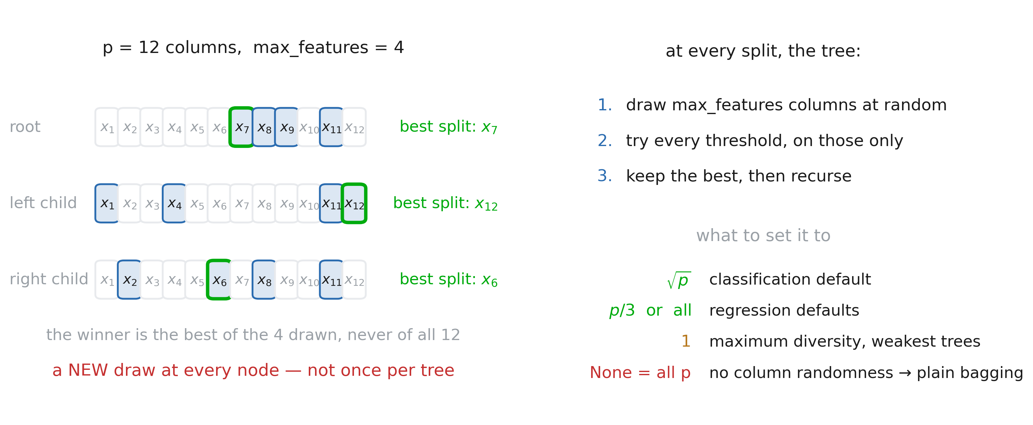
Feature selection
Notes:
Spend a minute on the mechanics, because the name suggests the wrong thing: it is NOT a feature-selection step, and it is not “use only these 4 columns for this tree”. Walk the three rows: at the root the tree draws 4 of the 12 columns and picks the best split among those 4 only — x7 here — even if the truly best split in the whole table was on x2. Then at the next node it draws 4 again, a fresh draw. So a single tree still gets to use every column somewhere; it just never gets to use the strongest one everywhere. On its own this only makes the tree worse — say that plainly, it is a deliberately handicapped split. The payoff comes in section 3: the dominant column is absent from roughly (1 − k/p) of the nodes, so the tree is forced to tell the second-best story in the data, and two such trees end up genuinely different rather than jittered copies of each other. Flag it as a promise to be cashed at “The knob: max_features”. Give the numbers on the right and flag the two names students trip on: None means all p columns, which is NOT “no columns” but “no randomness” — that is plain bagging; and "sqrt" is a string, not a number.

Slide 21
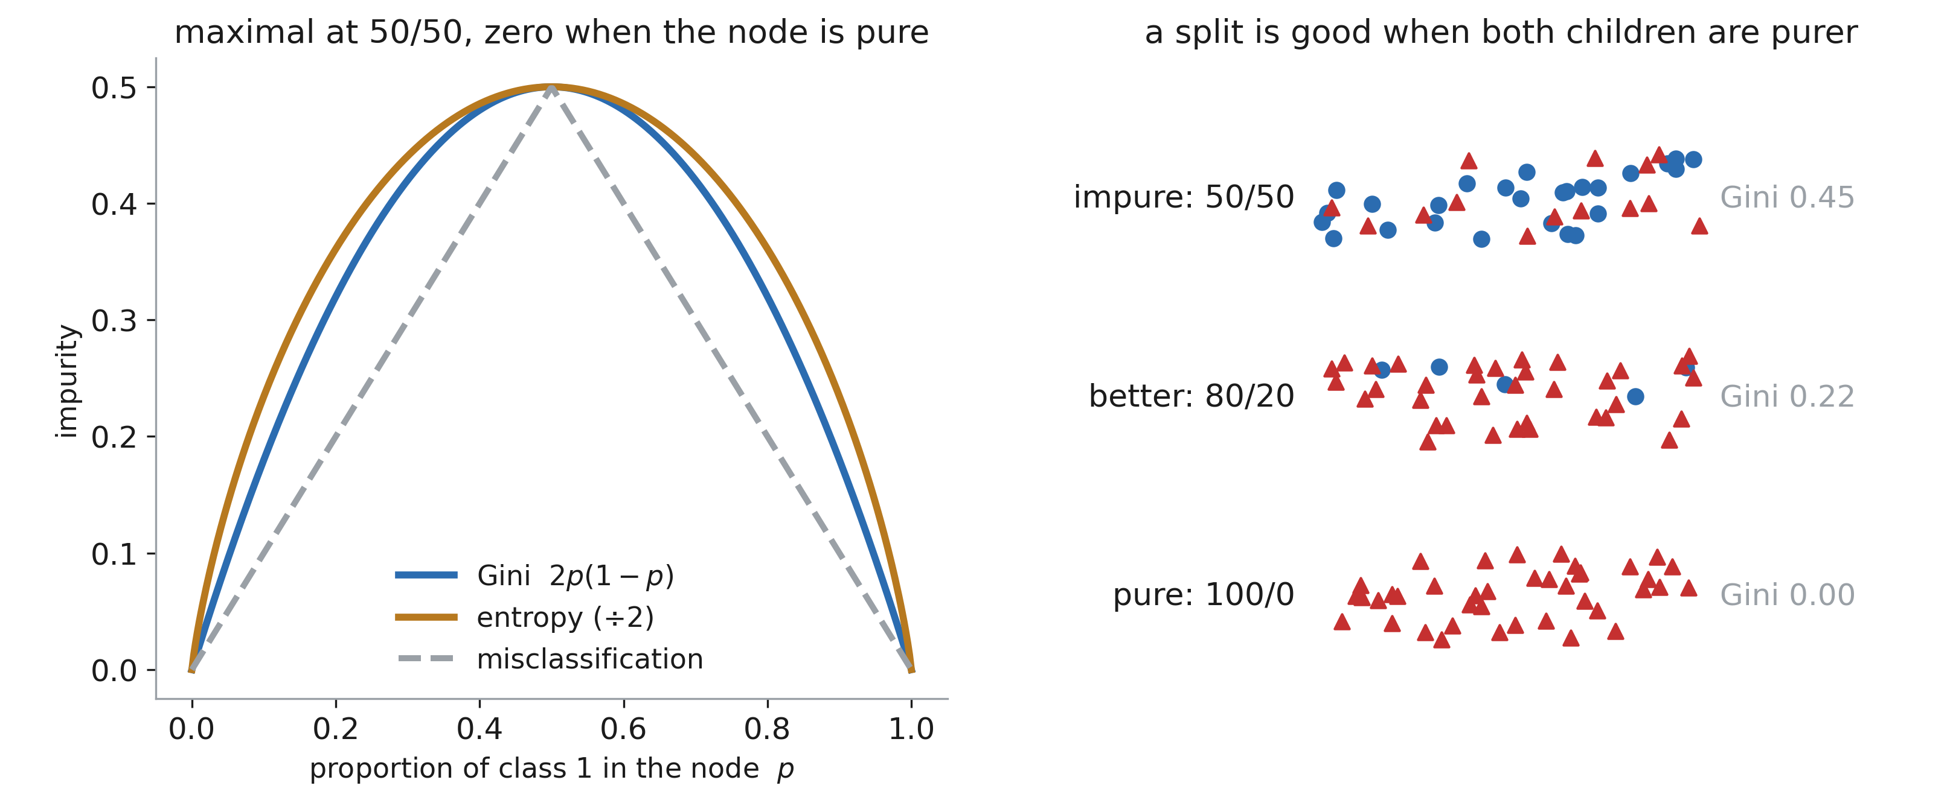
“pure” split
Notes:
Gini and entropy agree almost always; the choice between them is not worth a hyperparameter search. Misclassification rate is the one that does NOT work: it is piecewise linear, so it is flat for splits that clearly improve the node — you need a strictly concave measure to reward moving toward purity. For regression trees, replace impurity by variance and the story is identical.

Slide 22
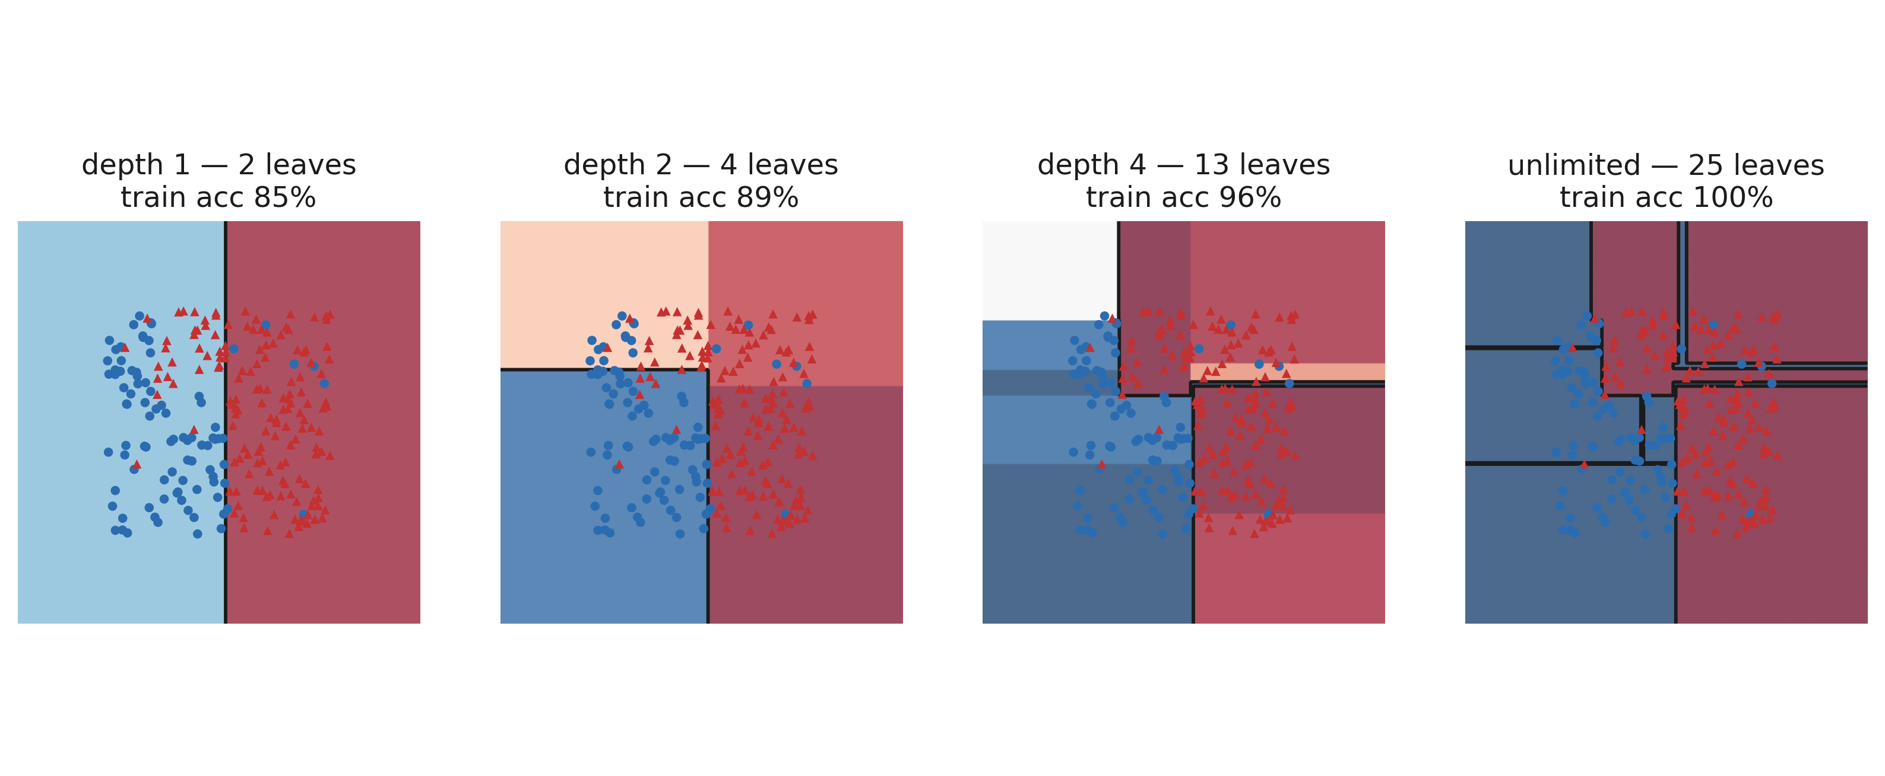
Depth is the capacity knob
Notes:
Walk left to right: one split, then four regions, then sixteen, then one leaf per noisy point. The last panel reaches 100% training accuracy and has clearly learned the noise — the same picture as the degree-15 polynomial from any regression course. Names to give them: max_depth, min_samples_leaf, ccp_alpha (cost-complexity pruning).

Slide 23
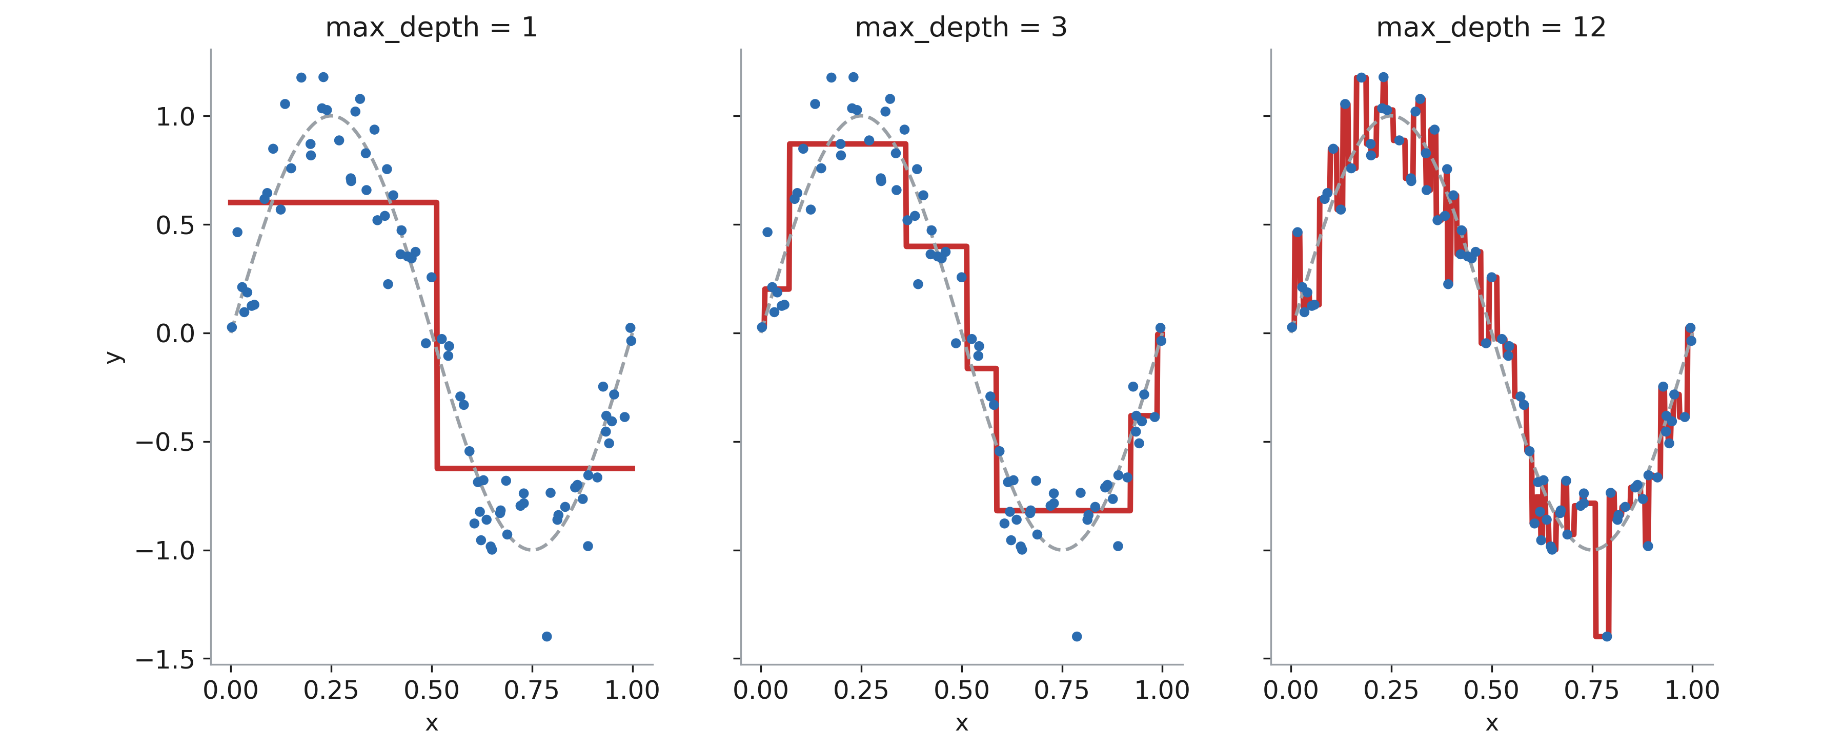
Regression trees predict staircases
Notes:
The prediction inside a leaf is the mean of its training rows — a constant. So the model is piecewise constant: never smooth, and flat outside the training range. That last point matters a lot in practice: a tree can NEVER extrapolate. Ask what a tree would predict for a 400 m² flat when the largest one it saw was 150 m².

Slide 24
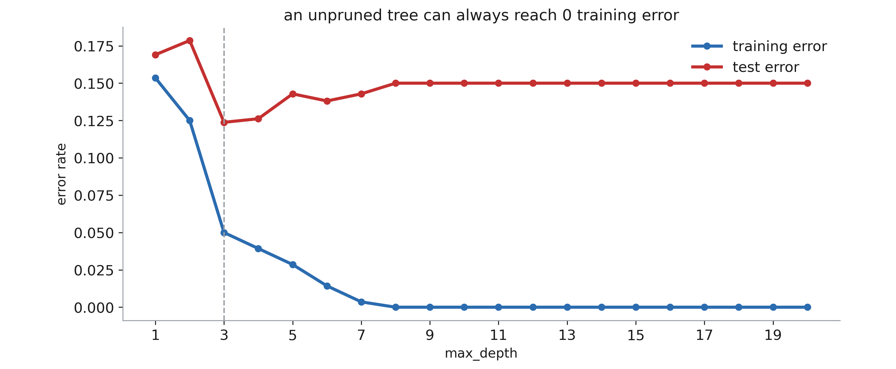
And over-fit
Notes:
Training error goes to zero, test error turns around. Same U as always. The honest summary of a single tree: shallow underfits, deep overfits, and the “right” depth is sample-size dependent. This slide is where students expect the answer “so tune the depth” — the next slide says why that is not enough.

Slide 25
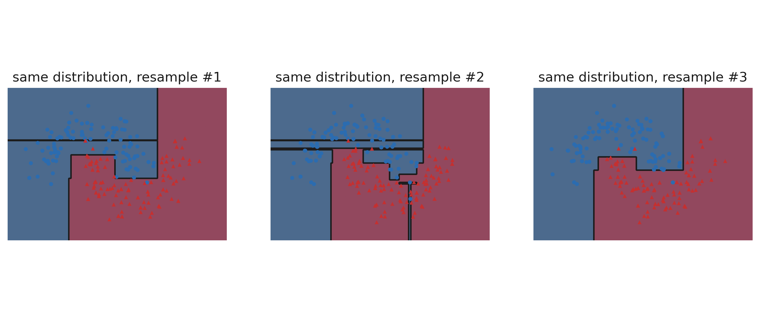
Decision trees problem: instability
Notes:
Three bootstrap resamples of the SAME distribution, three genuinely different boundaries. Because splits are chosen greedily, one row changing near the top of the tree rewrites everything below it. This is high variance in the exact technical sense, and it is not fixed by tuning depth — it is a property of the procedure. Hold this slide: the entire next section is the answer to it.

Slide 26
3. Random forests

Slide 27
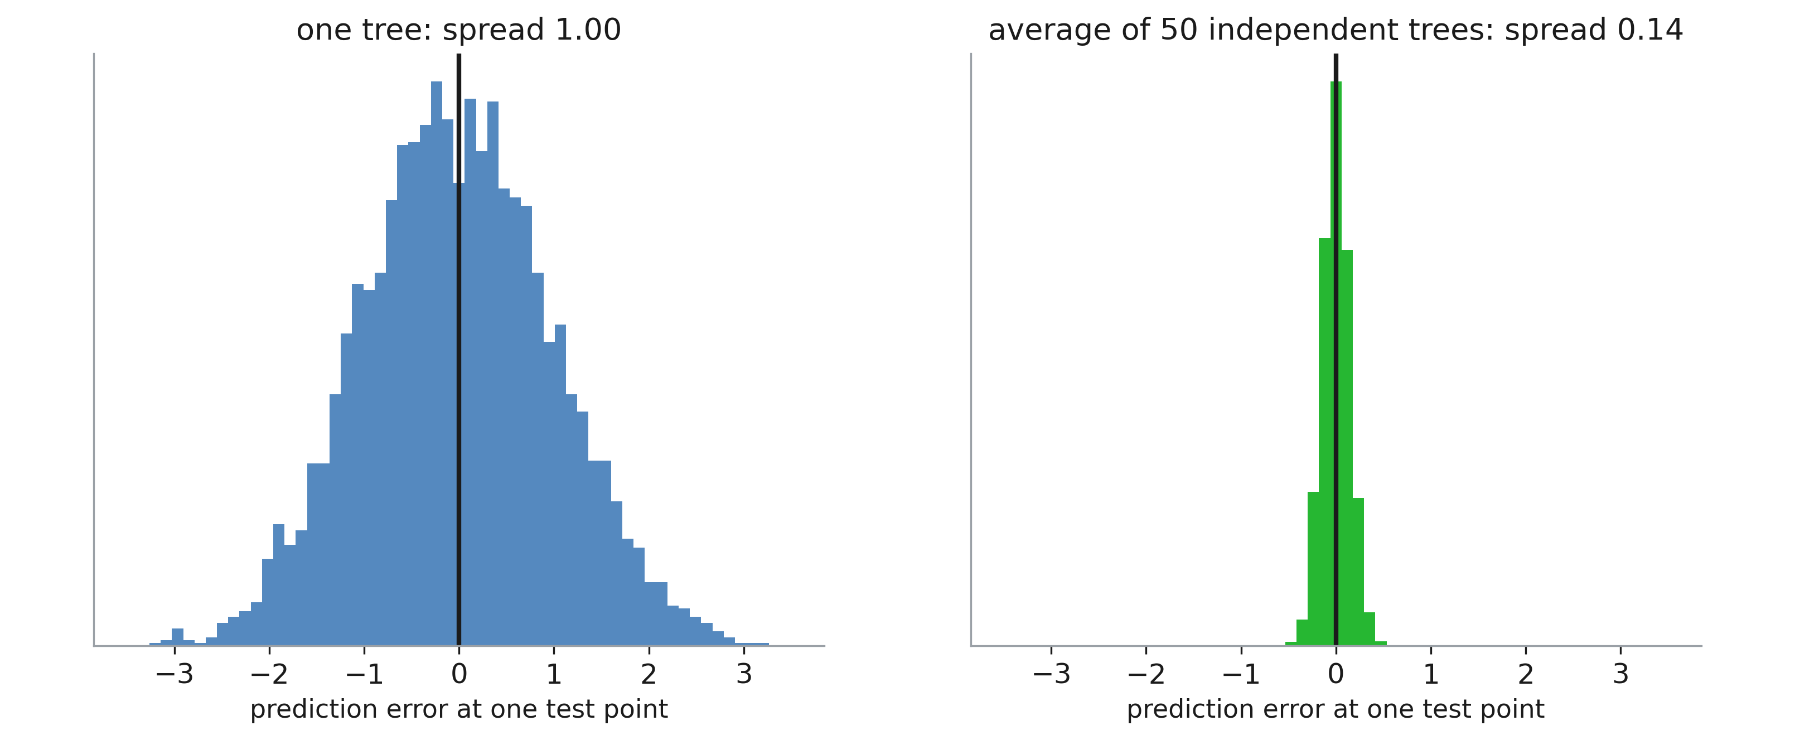
The idea
Notes:
Fifty noisy but unbiased guesses, averaged: the spread divides by √50, and the centre does not move. That is the whole trick. Bias is untouched — which is why we deliberately grow DEEP trees (low bias, high variance) and let the average clean up the variance. Averaging shallow trees would just give a confident bad model.

Slide 28
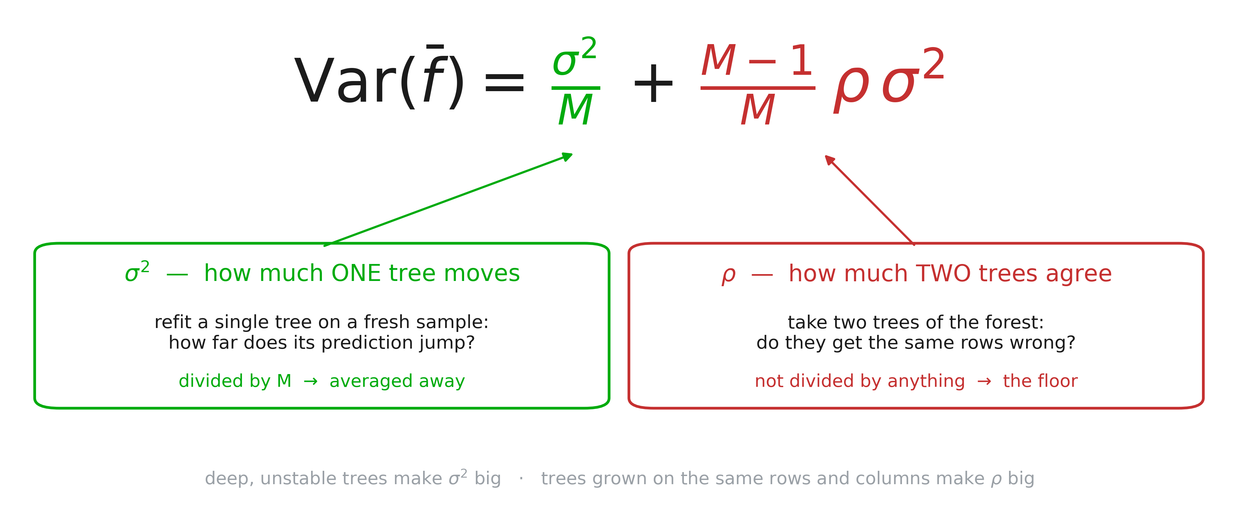
Trees must disagree
Notes:
Define the two symbols before the formula, because everything hangs on them. Fix ONE test row. σ² is the variance of a single tree’s prediction on that row across hypothetical refits — grow a tree on a fresh sample from the same population, ask it again, and see how far the answer moves. It is the tree-instability slide, turned into a number. ρ is the correlation between two trees of the SAME forest on that row — do they move together? do they get the same rows wrong? Note that both are properties of the PROCEDURE over hypothetical datasets, not of the forest you have in memory; students consistently read them as statistics of the fitted model. Now the derivation, three lines. M trees, each of variance σ², each pair correlated by ρ. The variance of a sum is the sum of all M² entries of the covariance matrix: M diagonal terms worth σ², and M(M−1) off-diagonal terms worth ρσ². Divide by M². Read the two terms out. GREEN: what each tree gets wrong on its own, divided by M — the term everybody knows. RED: what they all get wrong together, which averaging cannot see, because it is already inside every single tree. So the design problem is ρ, not σ². Making trees individually better is not the goal; making their MISTAKES independent is. Ask where ρ comes from before moving on: same rows, same columns, same greedy algorithm — of course they agree. Bagging and column subsampling exist to break exactly those.

Slide 29
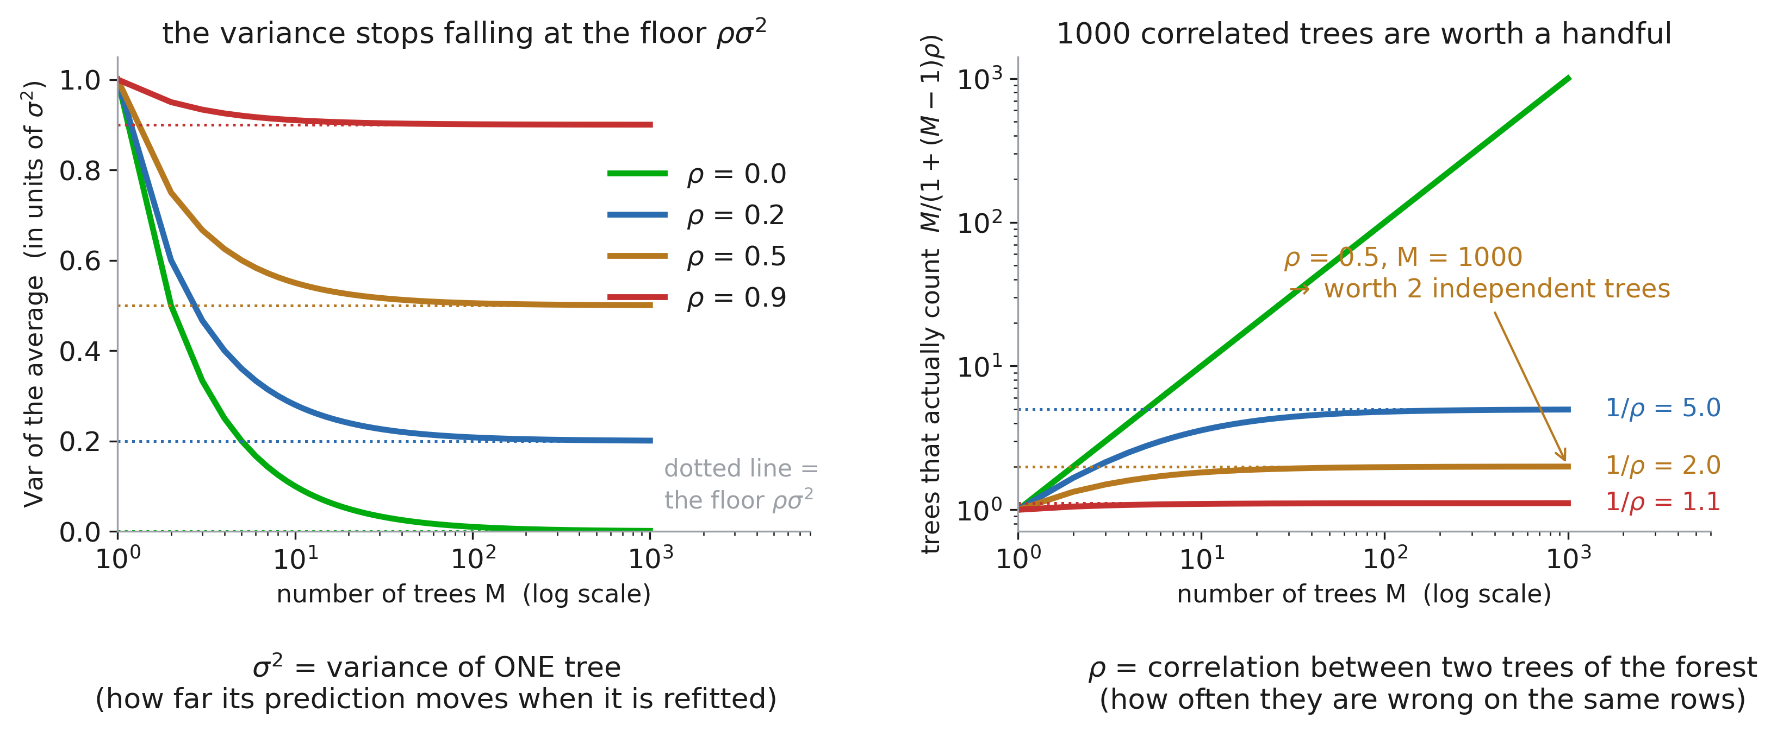
Averaging is not magic
Notes:
Restate the two symbols off the caption line before reading the curves — σ² is one tree’s wobble, ρ is how much two trees of the forest wobble together. Note the y-axis on the left is in UNITS of σ²: 1.0 is “as bad as a single tree”, so the picture is about the fraction of that wobble averaging can remove, whatever σ² happens to be. Left: the formula plotted. At ρ = 0 the variance really does go to zero — the textbook 1/M. At ρ = 0.9 you are done after about five trees and the curve is flat forever; the dotted line each curve settles onto is its own floor, ρσ². Right: the same fact as a count. M/(1 + (M−1)ρ) is how many INDEPENDENT trees your M correlated ones are actually worth, and it saturates at 1/ρ no matter how much compute you buy. At ρ = 0.5, a thousand trees are worth two. That number usually gets a reaction — let it. Three practical readings: (a) a forest that has stopped improving is telling you about ρ, not about M, so more trees is wasted money; (b) real forests land around ρ ≈ 0.1–0.3, so the ceiling is real but not fatal; (c) everything on the next two slides is an attempt to move ρ left — and the slide after those measures whether it worked.

Slide 30
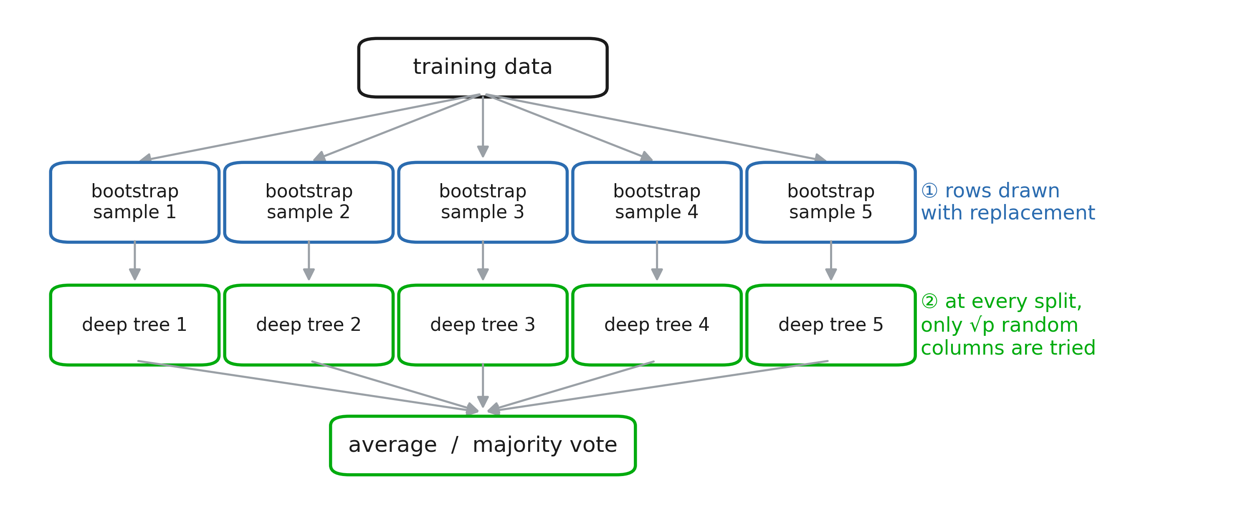
Two injections of randomness
Notes:
① Bootstrap the rows — that alone is “bagging”. ② At every split, only √p randomly chosen columns may be tried — that is what makes it a random FOREST rather than bagged trees. Each tree is individually worse than a tree fitted on everything; the average is better. Say that trade-off explicitly, it is the counter-intuitive part.

Slide 31
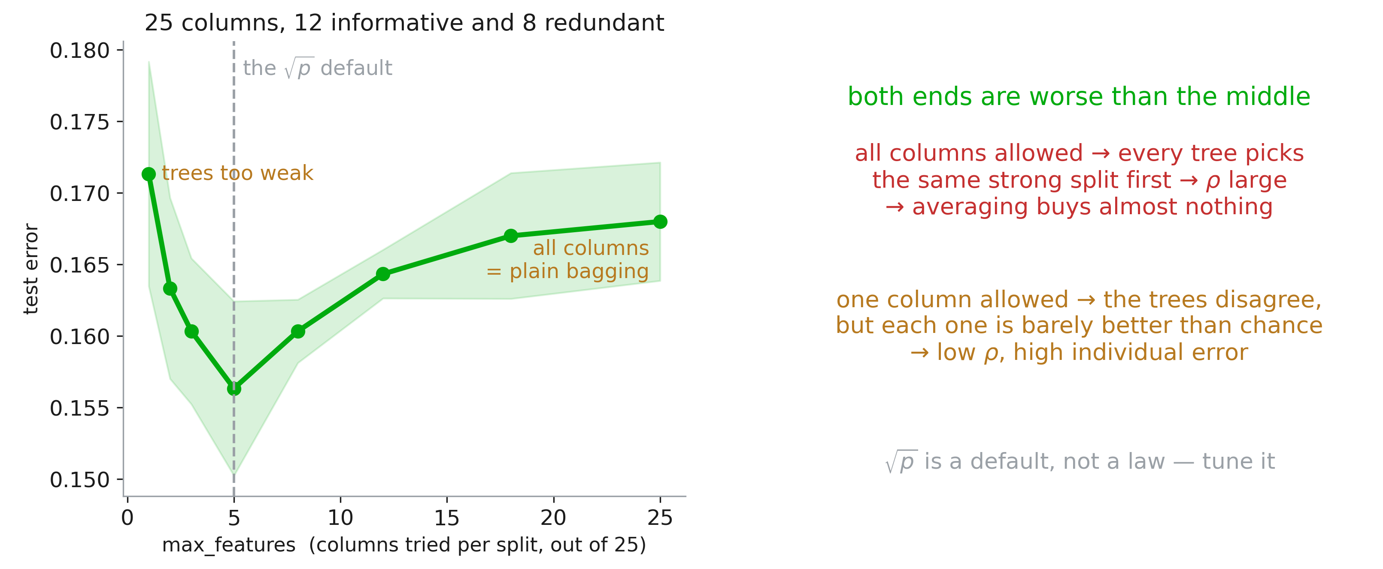
The knob: max_features
Notes:
Measured, not asserted: 25 columns, 12 informative and 8 redundant, and the U is real. Too many columns allowed → correlated trees → the ρ floor. Too few → each tree is close to random. √p for classification, p/3 for regression are the defaults; both are starting points for the search, which is Session 3’s topic.

Slide 32
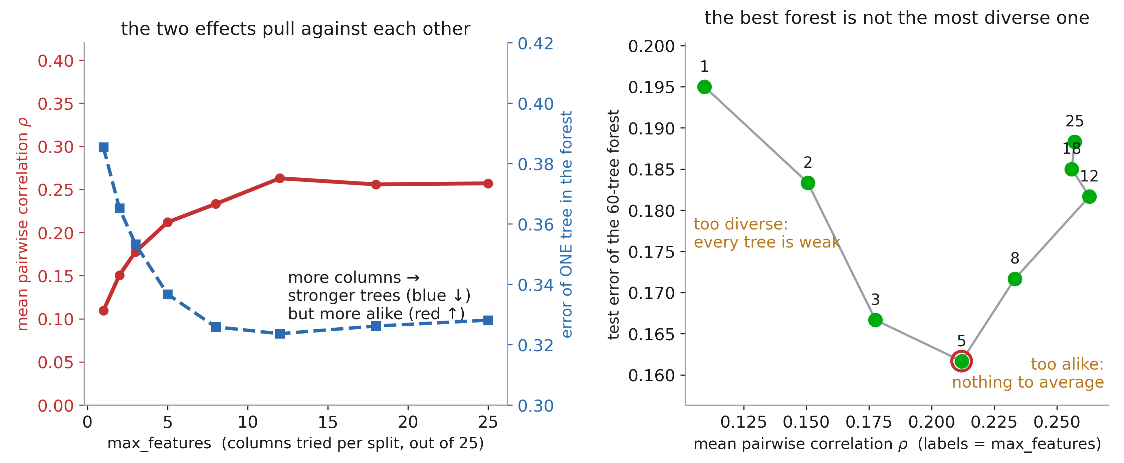
Strength against diversity
Notes:
Now ρ stops being a symbol. Left: fit 60 trees, ask each one separately for its predictions on the test rows, and correlate every pair — 1770 pairs. As max_features grows, the trees get individually better (blue, down from 38% to 32% error) and simultaneously more alike (red, up from 0.11 to 0.26). One knob, two effects, opposite signs. This is Breiman’s “strength versus correlation” in one picture. Right: the same runs plotted in ρ-space, each point labelled with its max_features. The forest is worst at BOTH ends, and the winner sits at ρ ≈ 0.21 — not at the lowest correlation available. Say why explicitly: the formula’s floor is ρσ², and σ² is the variance of a single tree, which grows as the trees get weaker. Pushing ρ down by crippling the trees raises σ² faster than it lowers ρ. This is also the honest answer to “why √p?” — it is where those two curves happen to cross for most tabular problems. Nothing deeper. Tune it.

Slide 33
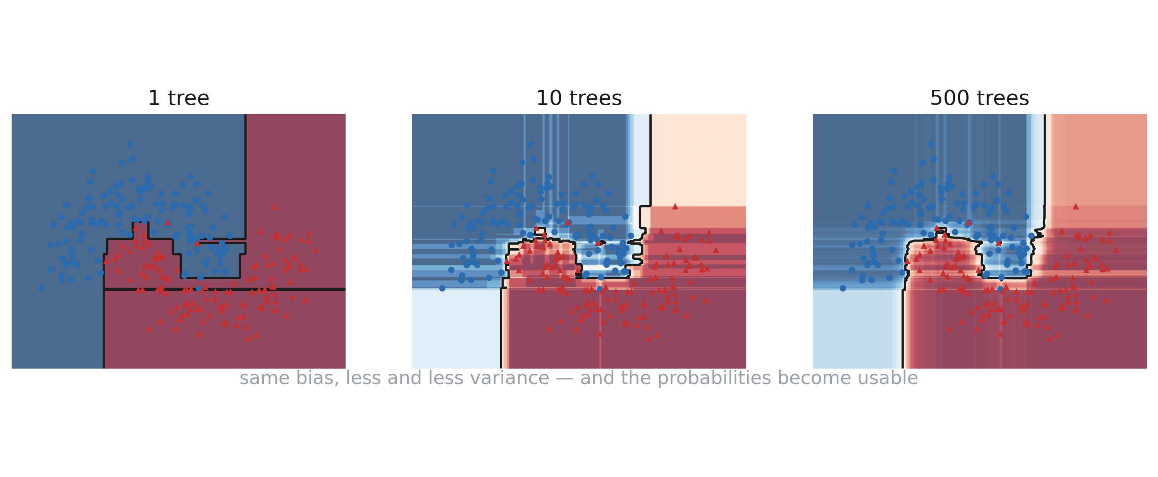
The boundary stops twitching
Notes:
Same data, 1 → 10 → 500 trees. The jagged single-tree boundary smooths out, and the colour field becomes a usable probability instead of a hard 0/1. Note that the forest boundary is still made of axis-aligned steps — averaging many staircases approximates a diagonal, it does not become one.

Slide 34
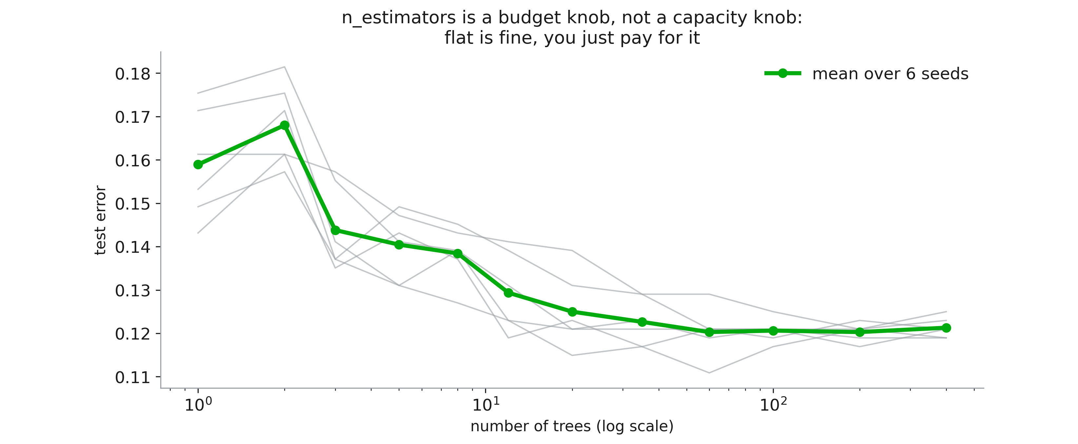
More trees never over-fits
Notes:
The single most common misconception about forests. n_estimators is a compute budget, not a capacity knob: the curve flattens and stays flat. You stop adding trees when the improvement stops paying for the inference time — typically a few hundred. Contrast this with boosting, two slides from now, where it is not true.

Slide 35
4. Boosting

Slide 36
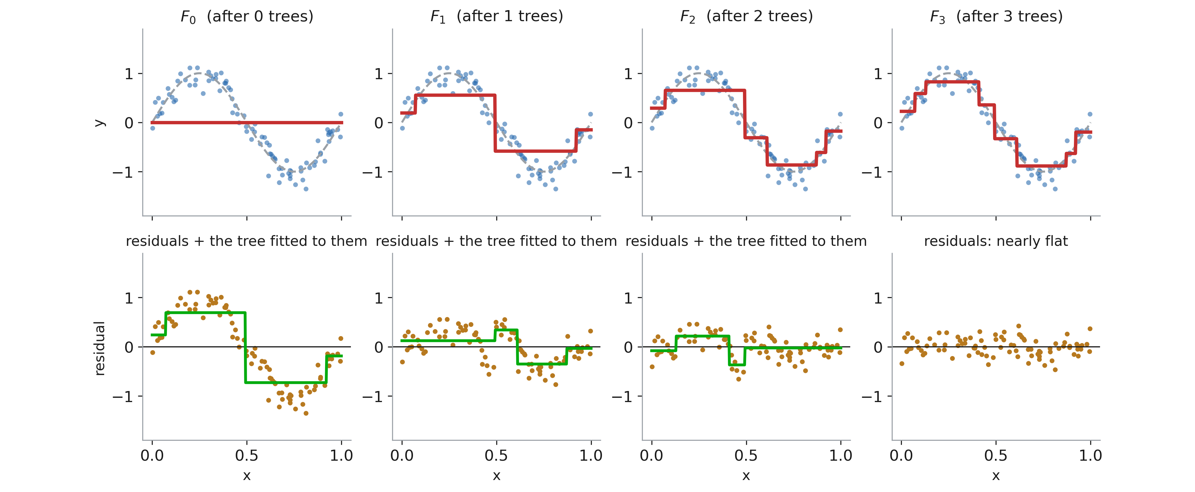
The other way to use many trees
Notes:
Top row: the running model. Bottom row: what is left to explain, and the small tree being fitted to it. Nothing here is bootstrapped and nothing is averaged — each tree is fitted to the CURRENT residuals and added with a small learning rate. Watch the residuals flatten. Three trees is already most of the signal.

Slide 37
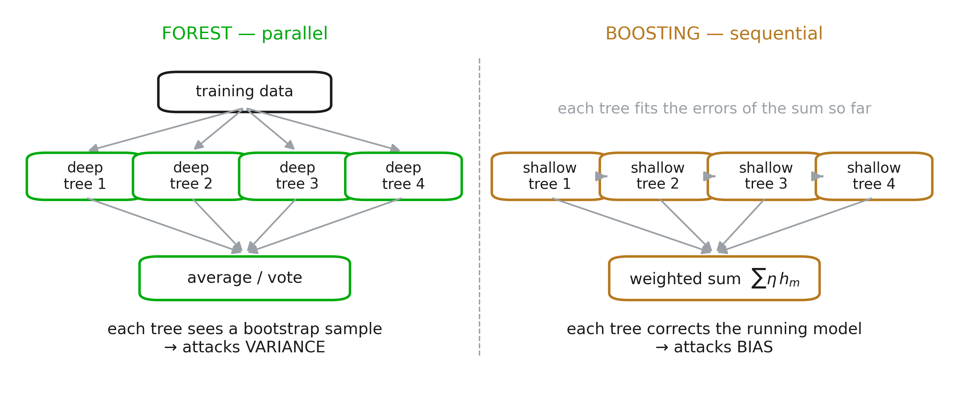
Forest and boosting attack different errors
Notes:
The one slide to remember from this section. Forest: deep trees, parallel, independent, attacks variance. Boosting: shallow trees, sequential, dependent, attacks bias. This is why boosting usually wins on tabular benchmarks and why it is far easier to break. XGBoost, LightGBM and CatBoost are engineering on top of this picture — Session 3 covers them properly.

Slide 38
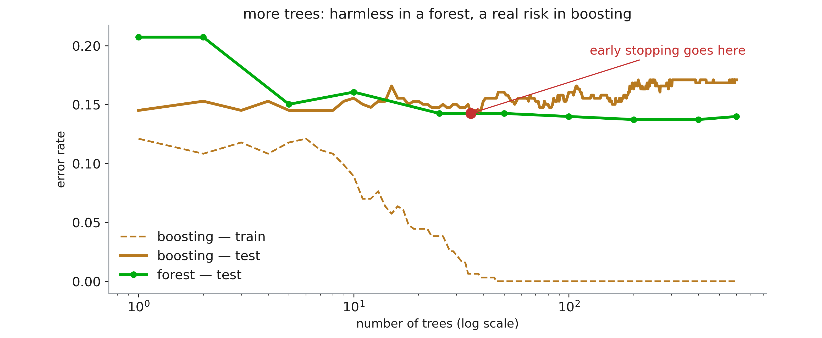
Boosting can overfit
Notes:
The practical difference. The forest curve is flat forever; the boosting curve turns around, because every extra tree adds capacity aimed straight at the residuals. Hence early stopping and a small learning rate — the two knobs you always set. Practical rule: forest for a strong baseline in one line, boosting when you have the time to tune it and a validation set you trust.

Slide 39
5. Support Vector Machines

Slide 40
Which line?
Notes:
Start from the honest embarrassment of the linear model: when the classes are separable there is not one solution, there are infinitely many, and every one of them has zero training error. Logistic regression breaks the tie almost by accident (it keeps pushing the weights up until the likelihood stops improving), and nothing in the loss says a word about where the boundary should sit inside the gap. Ask the room to vote for one of the four before revealing the next slide. Nearly everyone picks the middle one, which is the whole point: they already have the intuition, the SVM just writes it down.

Slide 41
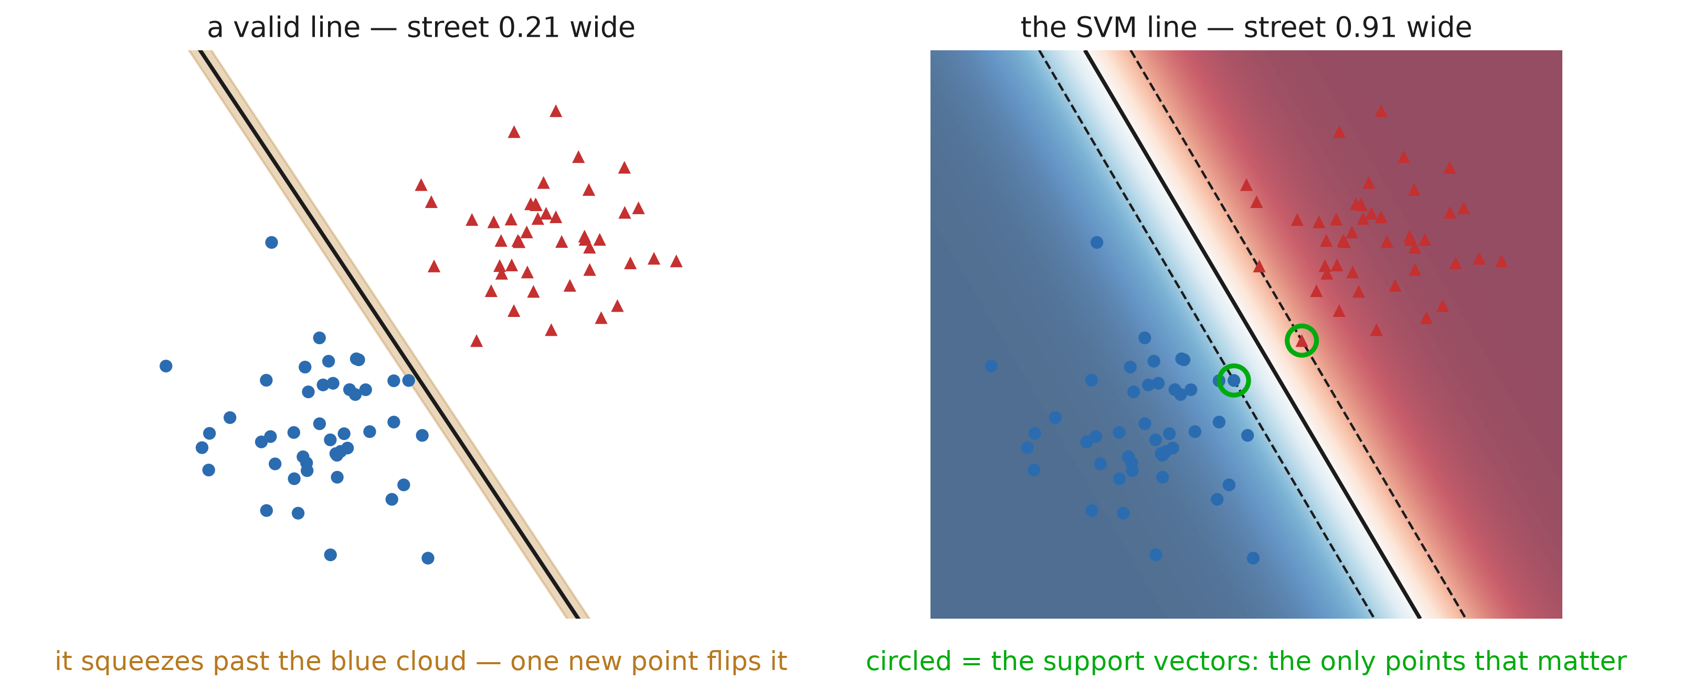
The widest street
Notes:
The SVM’s answer: among all the lines that separate the data, take the one with the widest empty band around it — the margin, the “street”. Left is a genuine separator whose street is 0.21 wide; right is the widest available, 0.91. Both are perfect on the training set, but the left one is one new patient away from being wrong. Then the punchline of the whole method: the fitted line depends ONLY on the circled points, the support vectors — the ones touching the edge of the street. Delete every other row of the training set and refit: you get exactly the same line. Compare that with logistic regression, where every point pulls a little, and with a tree, where one distant row can change a split near the root.

Slide 42
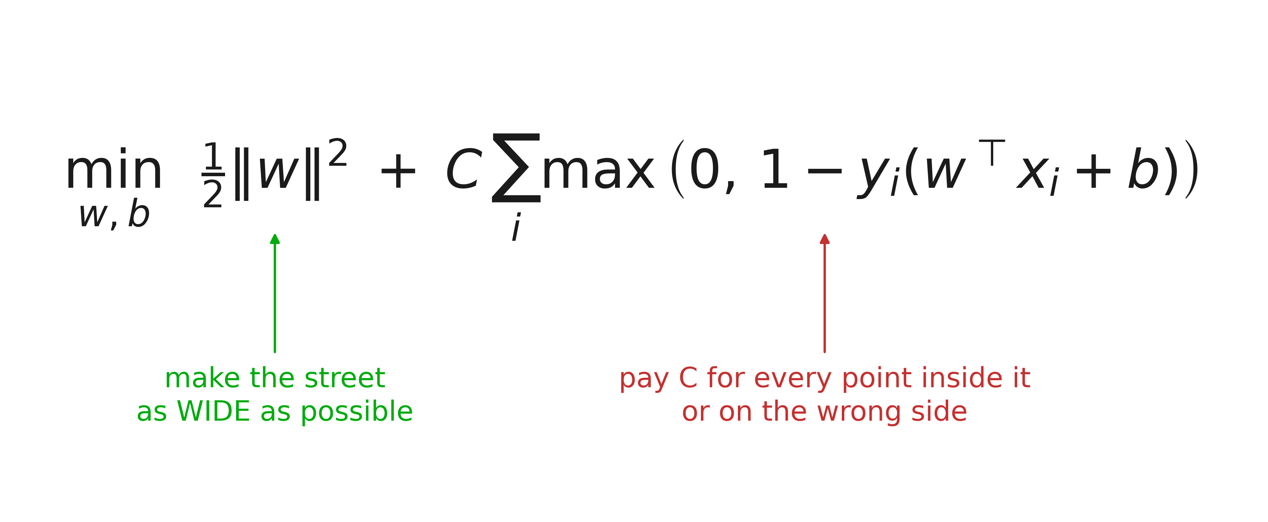
What it minimises
Notes:
Two terms, and they are exactly the trade of Session 3: ‖w‖² is a regularizer — the street width is 2/‖w‖, so shrinking w widens the street — and the hinge sum is the data-fit term. The hinge, max(0, 1 − y·f(x)), is zero as soon as a point is on the correct side AND outside the street; that flat zero region is why most points end up irrelevant and only the support vectors matter. Note what changed from logistic regression: the shape of the model is identical, a linear score wᵀx + b. Only the loss changed — log-loss became hinge loss. Every difference in behaviour comes from that one swap.

Slide 43
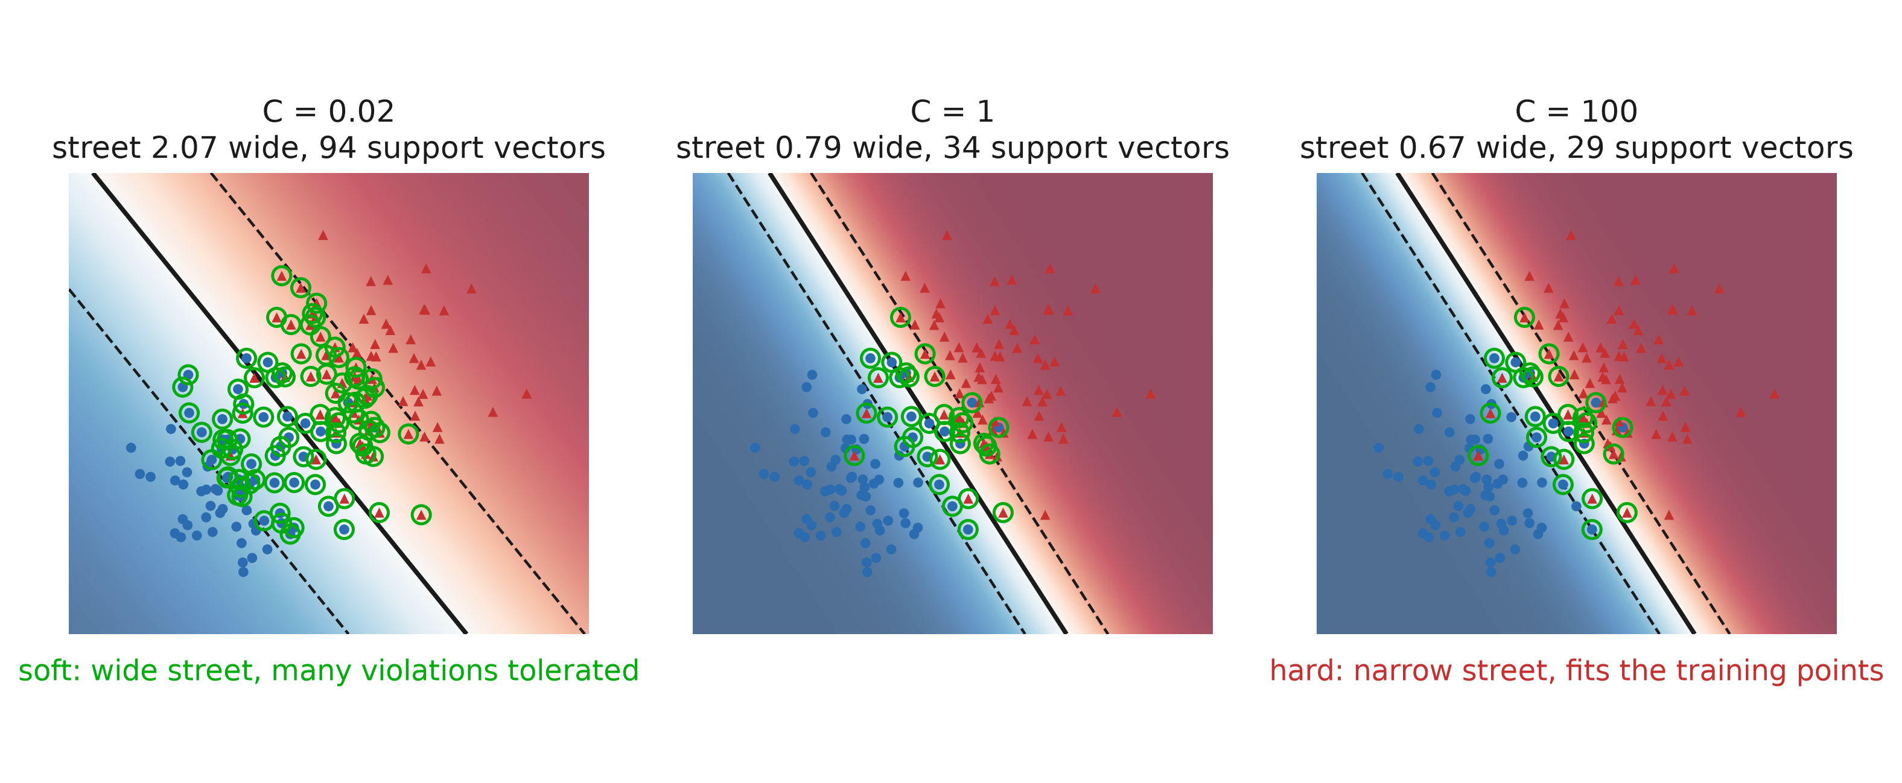
C: how much misbehaviour do you allow?
Notes:
Real data overlaps, so “the widest street with nothing inside it” usually has no solution. The soft margin lets points sit inside the street, or on the wrong side, at a cost of C each. Small C: violations are cheap, the street grows fat, most points end up supporting it — a smooth, heavily regularized boundary. Large C: violations are expensive, the street shrinks around the awkward points and the model starts to chase them. So C is 1/λ, the same knob under a different name, and it is the single hyperparameter people get wrong on this model. Say the practical rules: ALWAYS scale your columns first — this is a distance-based method, an unscaled column silently dominates the norm — and tune C on a log grid.

Slide 44
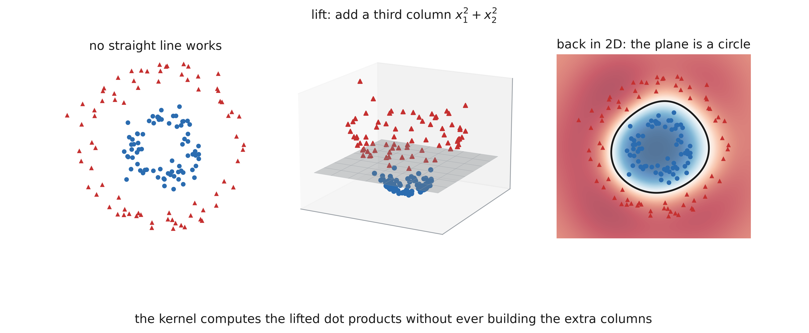
The kernel trick
Notes:
Left: no straight line can do this. The old fix from section 1 was to add columns by hand — and if we add x₁² + x₂², the two classes separate by a flat plane in 3D, which is a circle when we drop back to 2D. Nothing mysterious yet, it is basis expansion. The trick is what makes it cheap. The SVM’s solution only ever needs DOT PRODUCTS between pairs of points, never the points themselves. A kernel is a function that returns the dot product in the lifted space directly, so we can work in a space with a thousand — or infinitely many — extra columns and never build a single one. That is the sentence to remember: the model is linear in a space we never visit.

Slide 45
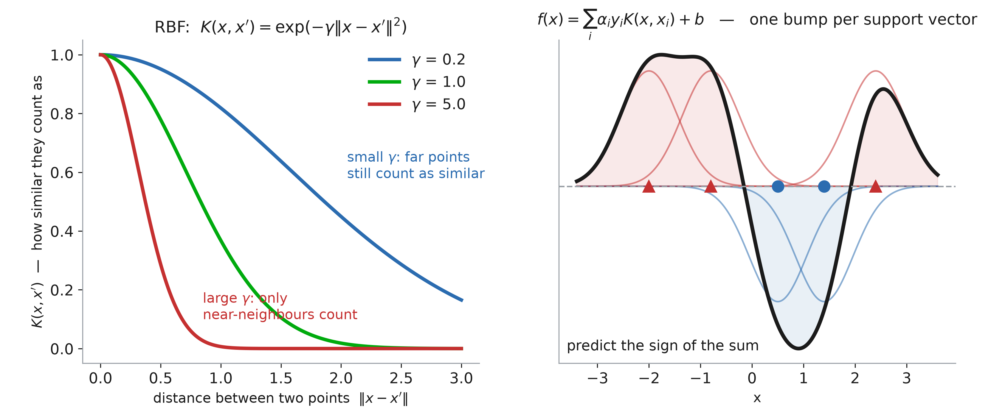
Radial Basis Function (RBF) kernel
Notes:
Before listing kernels, say what one IS, because “kernel” sounds like machinery and it is really just a similarity score: K(x, x’) is one number saying how alike two rows count as. Left: the RBF, the one everybody uses. It only looks at the distance between the two points, and gamma sets how fast similarity dies with distance — small gamma, everything is a bit similar to everything; large gamma, only immediate neighbours count. Right: why that matters. The fitted SVM is literally a weighted vote of similarities to the support vectors — one bump per support vector, positive for one class, negative for the other, and the prediction is the sign of the sum. Read the picture left to right: two red support vectors build a red region, two blue ones dig a blue valley, and the boundary is where the sum crosses zero. Two consequences worth saying out loud: this is why gamma is a bias-variance dial (narrow bumps → each point defends its own island → the memorised panel from the previous slide), and why an SVM is closer to k-NN than to a linear model once you kernelise it — the difference being that only the support vectors get to vote.

Slide 46
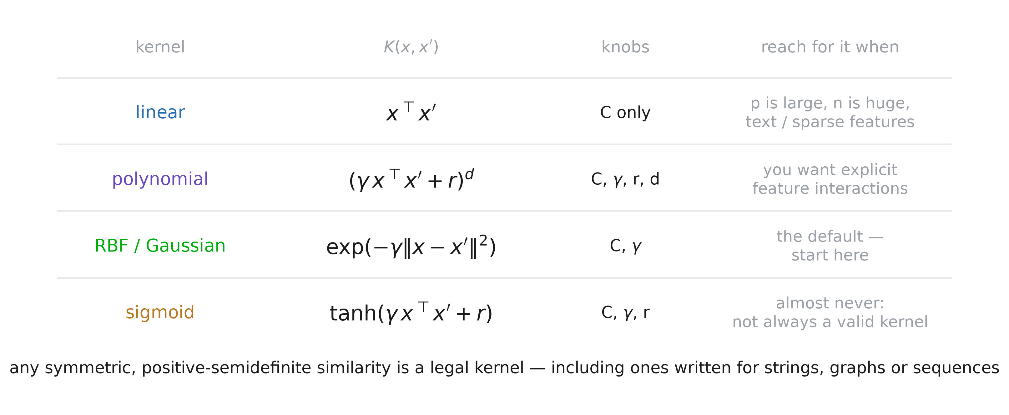
Typical kernels
Notes:
Four rows, and honestly only two matter. LINEAR: no lift at all, and the right choice when p is already large — text, genomics, anything sparse and high-dimensional, where the data is usually separable without any lift and LinearSVC scales to far more rows. POLYNOMIAL: an explicit lift to all products of degree up to d; it gives you interactions by hand, but it has three knobs and it is numerically touchy — degree 5 on unscaled columns overflows happily. RBF: the default, infinite-dimensional lift, two knobs, and what you should start with. SIGMOID: mostly a historical curiosity, and for some gamma/r it is not even positive semi-definite, so the solver is optimising something with no guarantee behind it. That last point is the rule underneath the table: a function is a legal kernel if it is symmetric and positive semi-definite — Mercer’s condition — which is exactly the condition for “there exists a space in which this is a dot product”. You never check it by hand; you either use one of these or you build new ones from them, since sums, products and positive multiples of kernels are kernels. Then the part students find surprising: x does not have to be a vector. There are kernels for strings, for graphs, for sequences of clinical measurements — anything where you can define a sensible similarity, you can run an SVM on, without ever turning the object into a feature table. That was a big deal in bioinformatics for protein and DNA sequences.

Slide 47
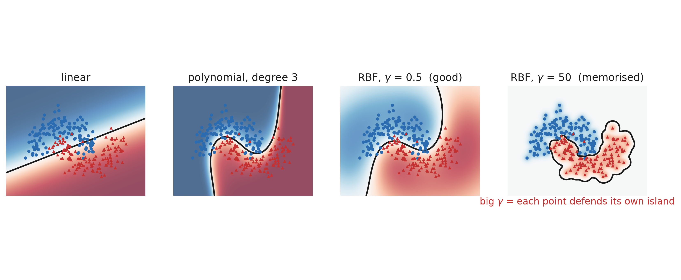
Kernels in practice
Notes:
Four fits, one dataset. Linear is the plain max-margin line. Polynomial bends it. The RBF kernel is the default and the one worth knowing: it scores a point by its distance to each support vector, so gamma sets how far a support vector’s influence reaches. Small gamma → wide, smooth influence. Large gamma → each point defends a small island around itself, and the fourth panel is what memorisation looks like. C and gamma interact and must be tuned together, always on scaled data — that pair is the standard worked example in the next session’s hyperparameter search. Say where SVMs sit today: excellent on small, clean, well-scaled datasets, wonderful theory, and rarely first choice on a big tabular table because fitting is roughly quadratic in the number of rows and boosting simply beats it there.

Slide 48
5. K - Nearest Neighbors

Slide 49
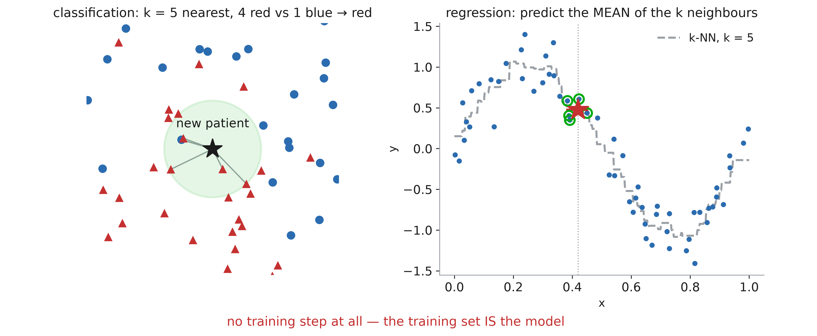
How a prediction is made
Notes:
The entire algorithm, and it fits in one sentence: to predict for a new row, find the k closest rows in the training set and let them decide — majority vote for a class, mean for a number. Walk the left panel: five nearest, four red, one blue, answer red. There is nothing else; no weights, no loss, no optimiser. So “training” is just storing the table. The cost has simply moved: fitting is free, and every single prediction pays for a scan of the training set. That is the opposite trade from every other model in this deck, and it is why k-NN is awkward in production — the model file is the dataset, which is also a privacy problem when the rows are patients. Two choices are yours to make, and they are the whole model: k, and the distance. Euclidean is the default; Manhattan is better with many columns; and for categorical or mixed rows you need something else entirely (Hamming, Gower). Mention weights="distance" too — nearer neighbours voting louder is usually a free improvement over a flat vote.

Slide 50
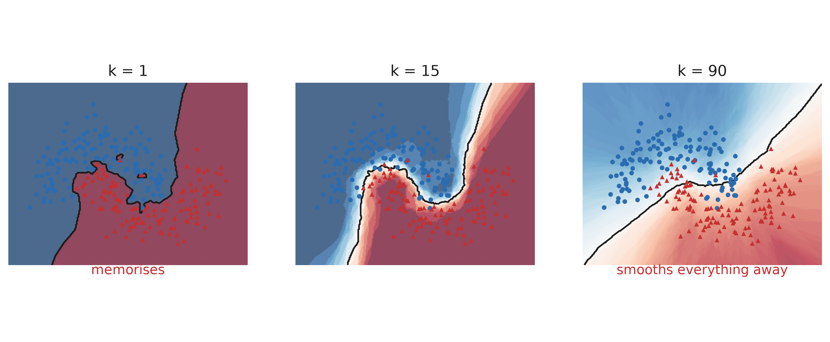
No training needed
Notes:
k-NN is the useful contrast: zero training, all the work at prediction time, and k is a pure bias–variance dial. k = 1 memorises, k = 90 flattens everything. It also fails loudly in high dimensions, which is the cleanest way to introduce the curse of dimensionality — and why we scale features before ever computing a distance.

Slide 51
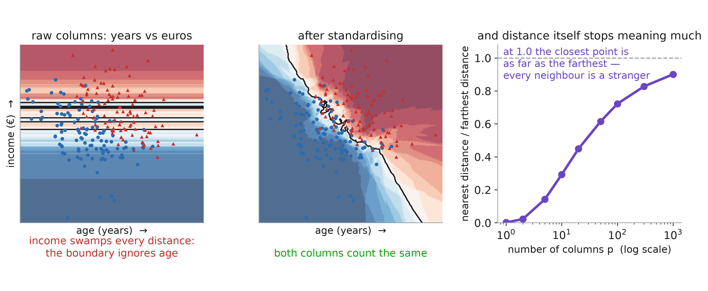
Where k-NN breaks
Notes:
Two failure modes, and both are about the distance rather than the idea. Scale: the left panel is the same data fitted on raw columns. Income has a spread of 15 000 and age a spread of 9, so every distance is essentially the income gap and the boundary is a set of horizontal lines — age has been silently deleted from the model. Standardise, and the boundary becomes the diagonal the data actually shows. Say the rule: for anything distance-based — k-NN, SVM, k-means, PCA — scaling is not optional, and the scaler must be fitted inside the cross-validation fold, which is next session’s topic. Dimension: the right panel is the curse of dimensionality made concrete. Draw random points, look at the closest and the farthest one from a query: in 2 columns the nearest is ~50 times closer, by 1000 columns the ratio is 0.9 — the nearest point is essentially as far away as the farthest. “Nearest” stops carrying information, so k-NN degrades to guessing. This is also why the answer to “should I add 300 more features?” is different for a tree, which ignores the useless ones, than for k-NN, which averages them straight into the distance.

Slide 52
5. Choosing

Slide 53
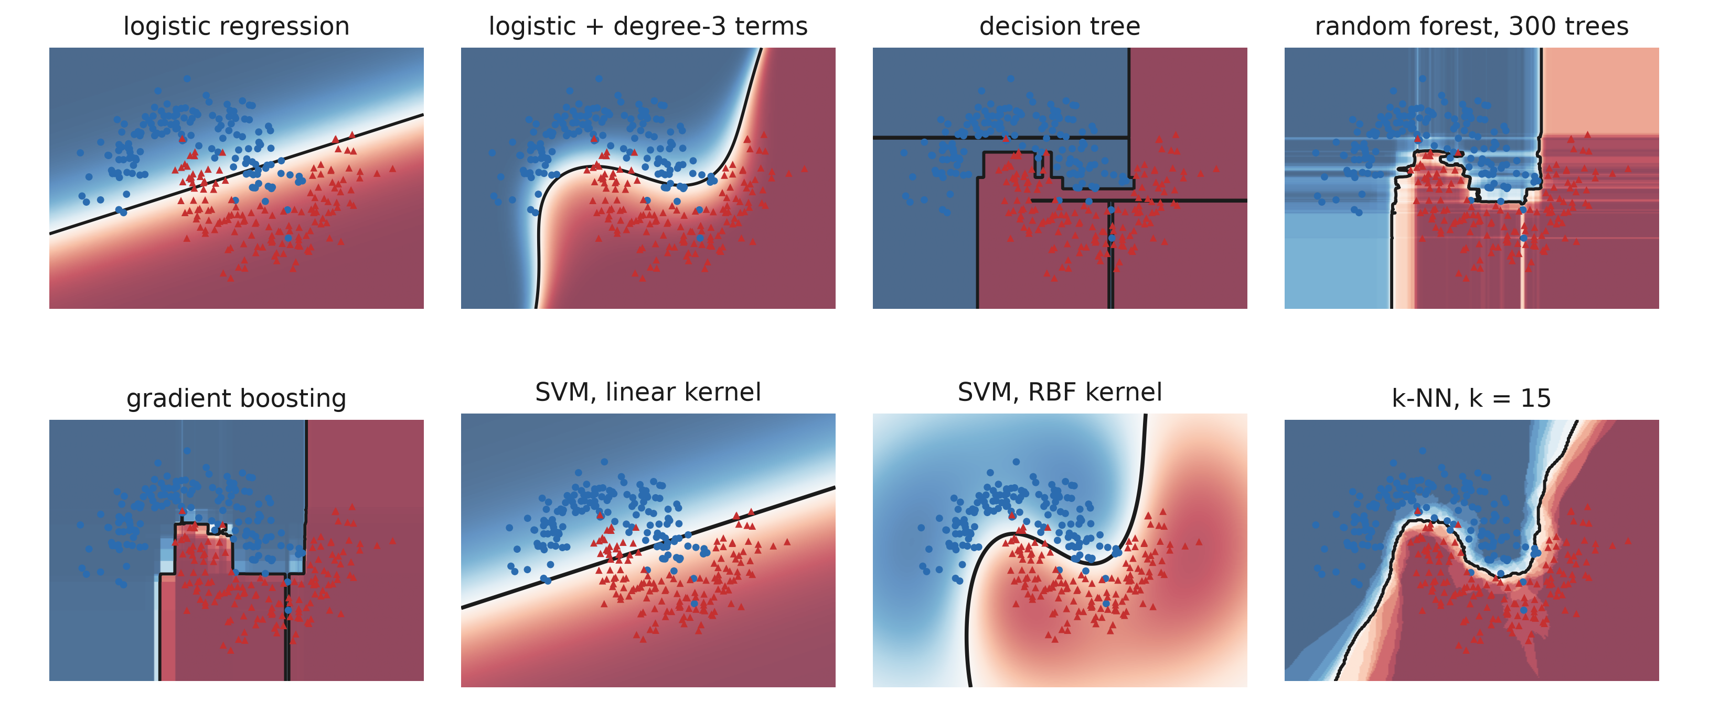
One dataset, eight boundaries
Notes:
The summary slide of the deck: the same 300 points, every model we built, in the order we met them. Read the shapes, not the accuracies — they are all within a few points of each other here, which is itself the lesson. Top row: a straight line; the same line curved by adding columns; raw rectangles; those rectangles averaged into something smooth. Bottom row: rectangles sharpened by boosting; a straight line again, but the widest one; that line bent by an RBF kernel; and a boundary that simply traces wherever the neighbours are. Two questions for the room. First, which one would you ship — and watch them hesitate, because on this data it does not matter, so the answer has to come from somewhere else: the size of the table, the number of junk columns, the inference budget, whether a human has to sign off on it. Second, which of these could you explain to a regulator? That thins the field fast. Close on where the course goes: none of these carve the space for you. They all take the columns you hand them and draw a shape. From next week the model builds its own features, and that changes everything.

