Slide 1
Session 6
Optimizers and Training Neural Networks
Advanced Data Science · NYU Paris · 2026
Paul Dubois

Slide 2
Main question
Autograd gives us the gradient.
How do we turn it into a network that trains well?
Notes:
Last session ended on loss.backward(): autograd fills .grad for every parameter. Today is everything around that line — the optimizer that turns the gradient into a step, the learning rate and how it should move during training, three tricks that make training stable (clipping, batch norm, dropout), and the loss we put at the top.

Slide 3
Optimizers

Slide 4
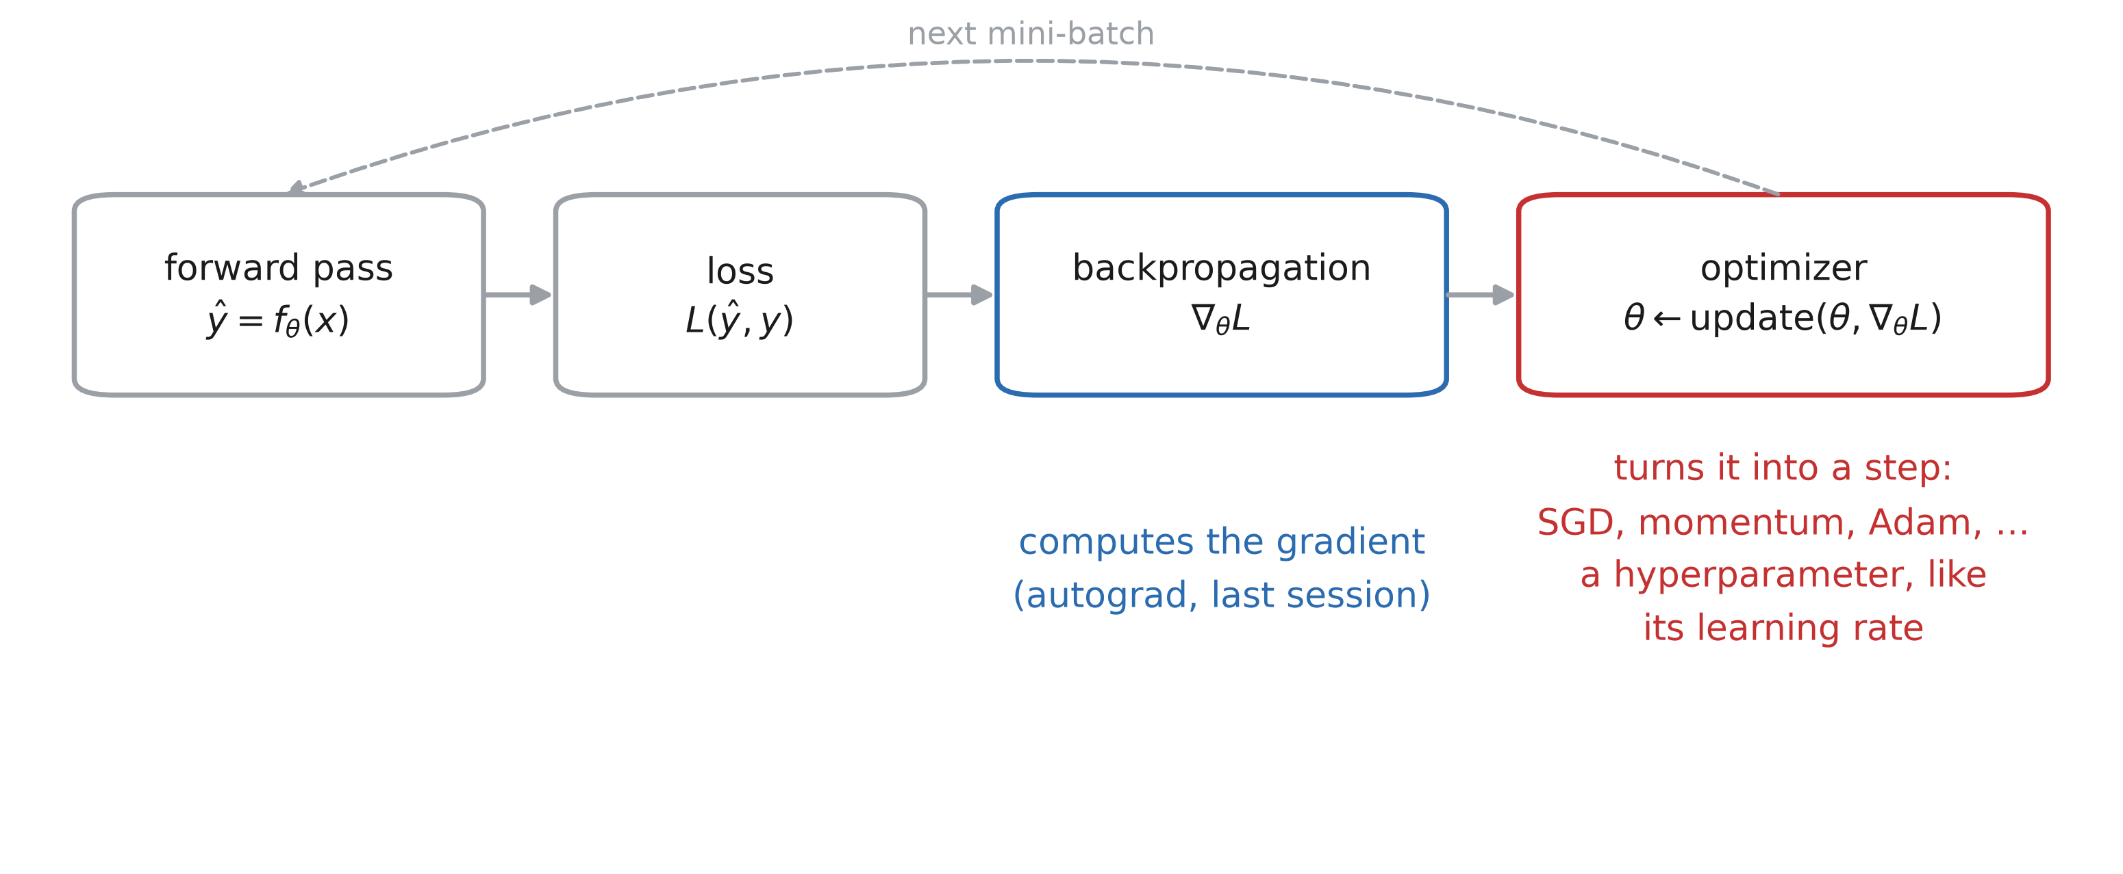
What an optimizer does
Notes:
Two reminders. Backpropagation is the algorithm that computes the gradient of the loss with respect to every parameter of the network. A gradient descent optimization algorithm takes that gradient and decides how to update each parameter to reduce the loss.
Choosing the optimizer is among the most important design decisions in deep learning. Treat it as a hyperparameter — and its own settings (learning rate, momentum, …) are hyperparameters too. The difficulty: the literature now lists hundreds of optimization methods.

Slide 5
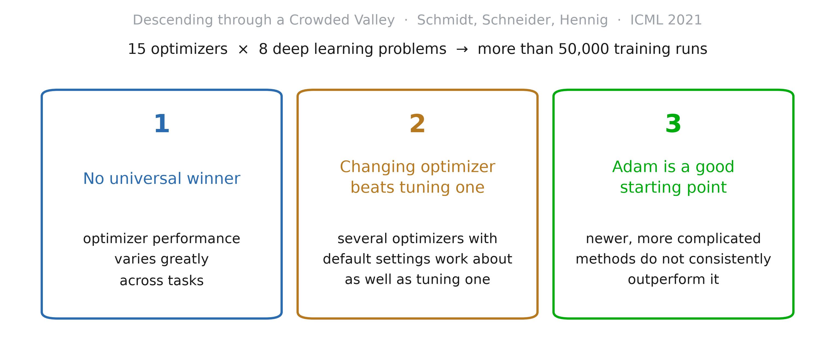
Benchmarking optimizers
Notes:
Schmidt, Schneider, Hennig, “Descending through a Crowded Valley — Benchmarking Deep Learning Optimizers” (ICML 2021, https://arxiv.org/abs/2007.01547). More than 50,000 individual runs. Three conclusions, quoting them:
optimizer performance varies greatly across tasks; (ii) evaluating multiple optimizers with default parameters works approximately as well as tuning the hyperparameters of a single, fixed optimizer; (iii) no method clearly dominates, but Adam remains a strong contender, with newer — more complicated, less documented — methods failing to significantly and consistently outperform it.
Practical reading: start with Adam; if you have budget, try a few optimizers at their defaults before spending it on tuning one.

Slide 6
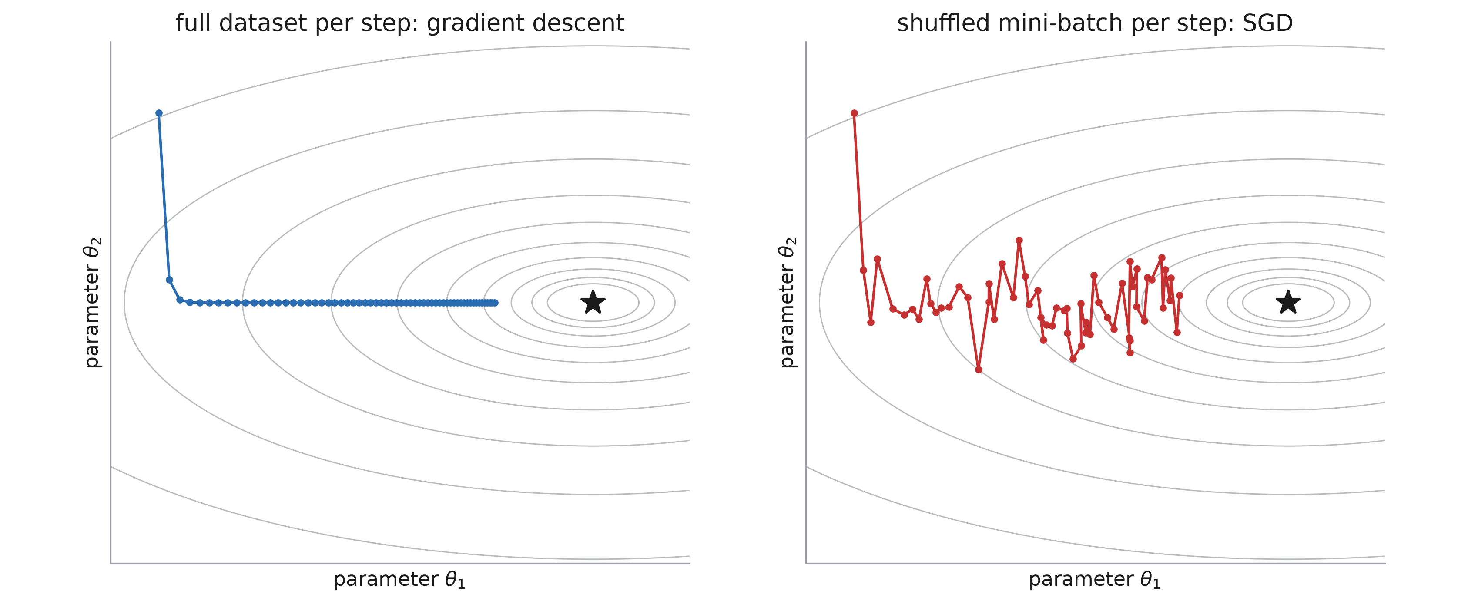
SGD in PyTorch is gradient descent
Notes:
The naming in PyTorch is a bit confusing. torch.optim.SGD implements plain gradient descent: θ ← θ − lr · gradient. The stochasticity comes purely from the data loading: each optimizer step uses a shuffled mini-batch. Feed it the whole dataset at every step and you get gradient descent, not SGD.
Left: the full-data gradient, a smooth path. Right: the same update on mini-batch gradients — noisy, but each step is much cheaper, and it still heads to the minimum.

Slide 7
Batch size
train_loader = DataLoader(
train_data, batch_size=32, shuffle=True)
for epoch in range(n_epochs):
for inputs, targets in train_loader:
optimizer.zero_grad()
output = model(inputs)
loss = loss_fn(output, targets)
loss.backward()
optimizer.step()
Notes:
Only the first line changes. In practice a larger batch size usually allows a larger learning rate — next slide for why.

Slide 8
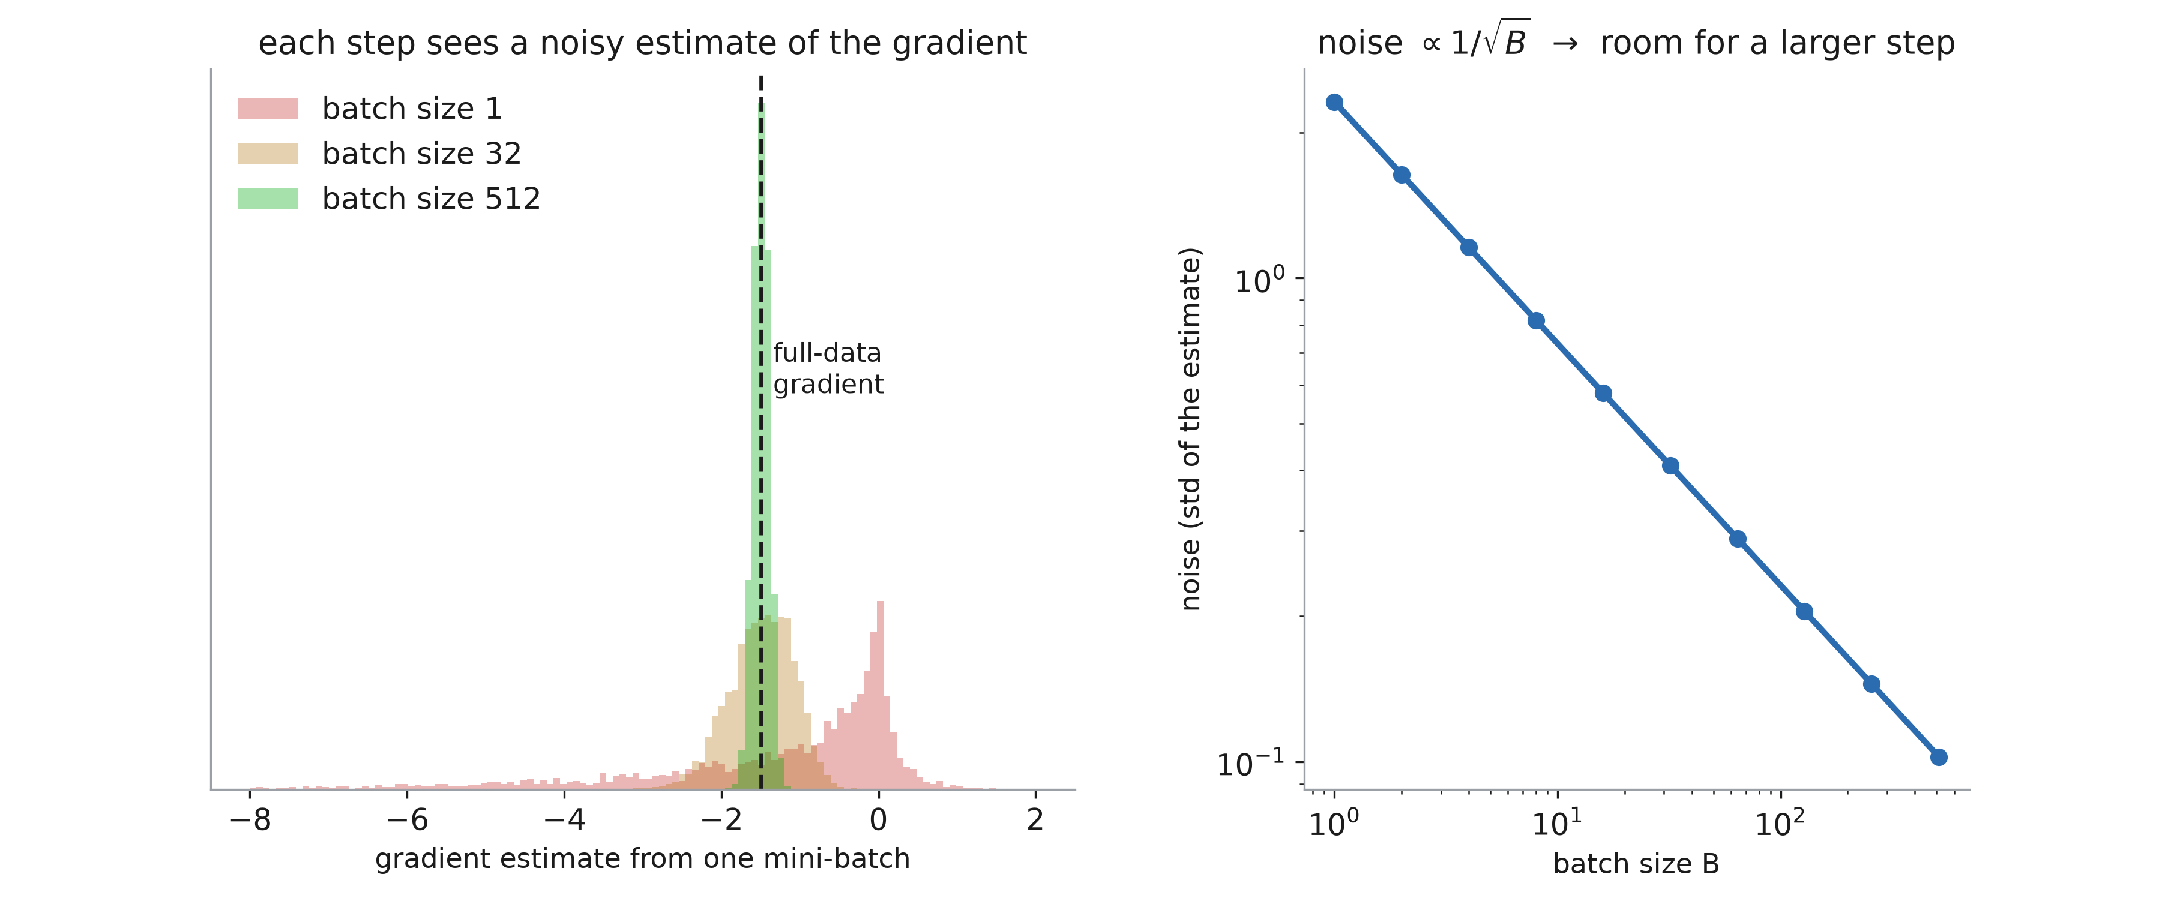
Bigger batches implies less noise
Notes:
IMPORTANT. A mini-batch gradient is an average of per-example gradients, so its noise shrinks like 1/√B. Left: the estimates from batches of 1, 32 and 512 around the full-data gradient. Larger batch → the gradient is more precise → less danger in taking a larger step, i.e. a larger learning rate.

Slide 9
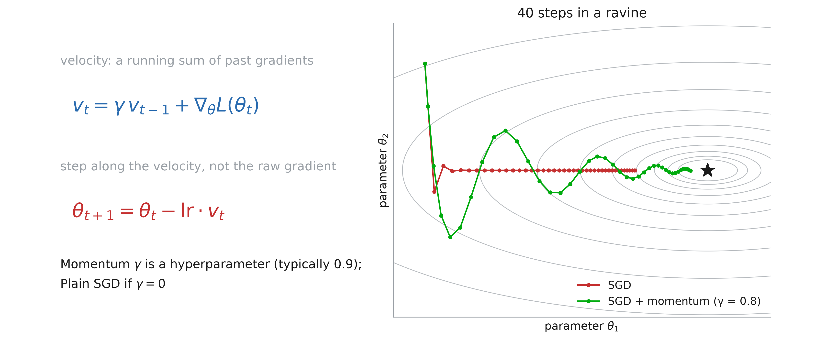
Momentum
Notes:
Picture a ball rolling down a hill: high gradient = steep parts, low gradient = flat parts. Often the minimum sits in a long, flat region; small gradients there mean small steps, and learning is slow. We want the ball to keep the momentum it gained on the steep slopes while it crosses the flat areas.
That is exactly what momentum does: the update uses a velocity v, the current gradient plus the previous velocity times γ. Along a consistent direction the velocity builds up; across a ravine the back-and-forth gradients cancel.
γ is a new hyperparameter (0.9 is the usual default). Further reading: Goh, “Why Momentum Really Works”, Distill 2017 — https://distill.pub/2017/momentum/

Slide 10
Learning rate

Slide 11
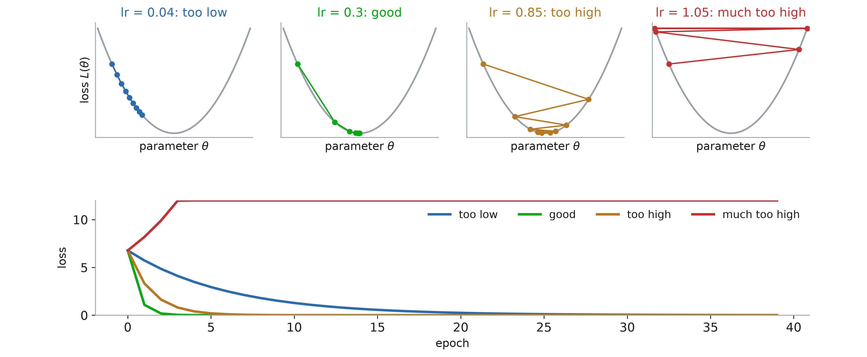
The learning rate
Notes:
Remind them what is on each axis: the parameter on x, the loss on y. Too low: it converges, slowly. Good: a few steps. Too high: it bounces from wall to wall but still gets there. Much too high: every step lands higher than the last — the loss diverges. The bottom panel is what they will actually see: the loss against epochs.

Slide 12
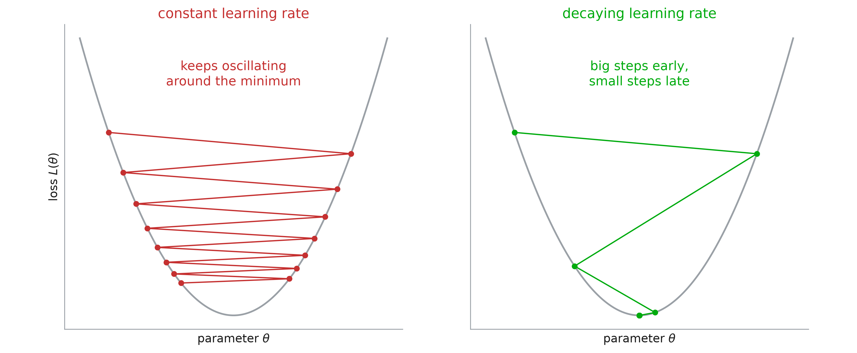
Decay the learning rate
Notes:
Same axes. We want to get close to the minimum quickly, so a large learning rate at the start; then we want to reduce it, otherwise we risk oscillating on either side of the minimum forever. Hence learning rate schedules.

Slide 13
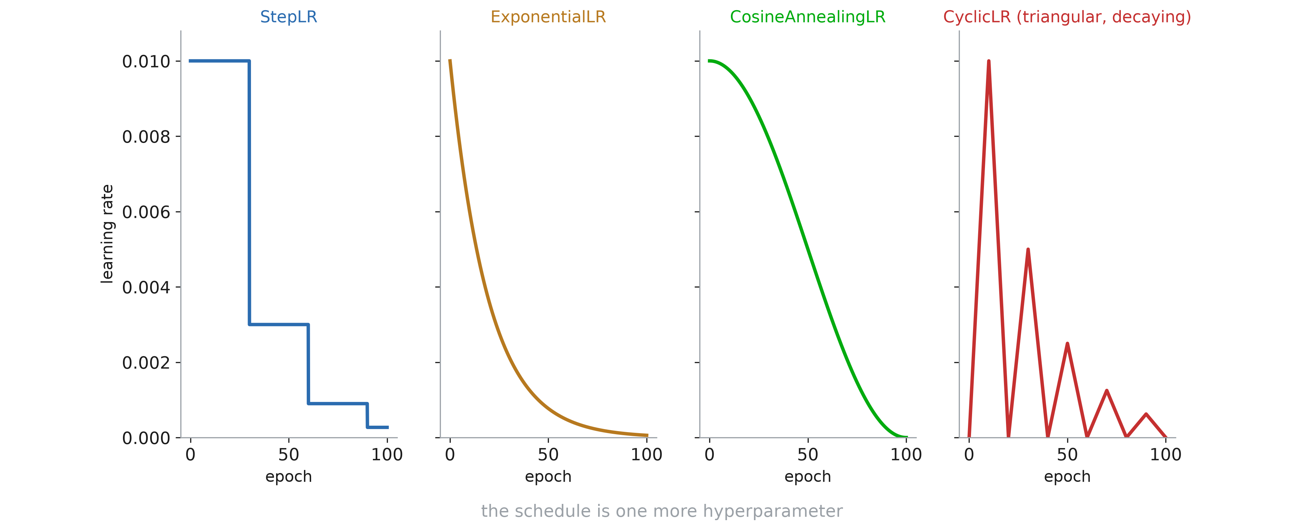
Learning rate schedulers
Notes:
All of these live in torch.optim.lr_scheduler, and there are many other — sometimes rather exotic — ways to schedule the learning rate. Which schedule to use is itself a hyperparameter. Call scheduler.step() once per epoch, after optimizer.step().

Slide 14
In the recitation
Which optimizer, which schedule?
We will try several of them in the notebook.
Notes:
We will also code the last figure — the cyclic schedule — in the notebook.

Slide 15
Training stability and regularization

Slide 16
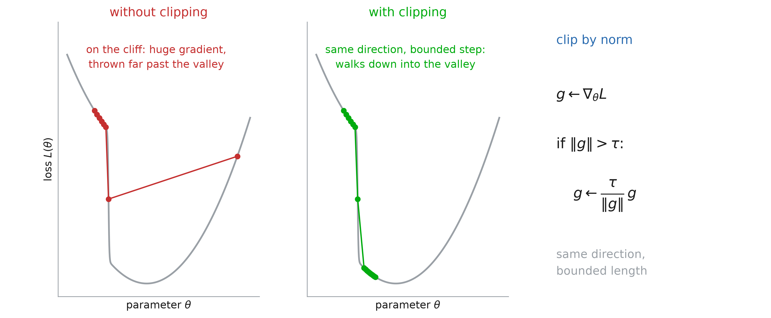
Gradient clipping
Notes:
Remind them of the axes again. Some loss surfaces have cliffs — common in recurrent networks. On the plateau the gradient is small; on the cliff it is enormous, and a single step throws the parameters far away, undoing the training so far.
Clipping by norm rescales the gradient when its norm exceeds a threshold τ: same direction, bounded length. In PyTorch: torch.nn.utils.clip_grad_norm_(model.parameters(), max_norm), between loss.backward() and optimizer.step(). The figure is the classic one from Goodfellow, Bengio, Courville, Deep Learning, ch. 10.11 (after Pascanu et al. 2013).

Slide 17
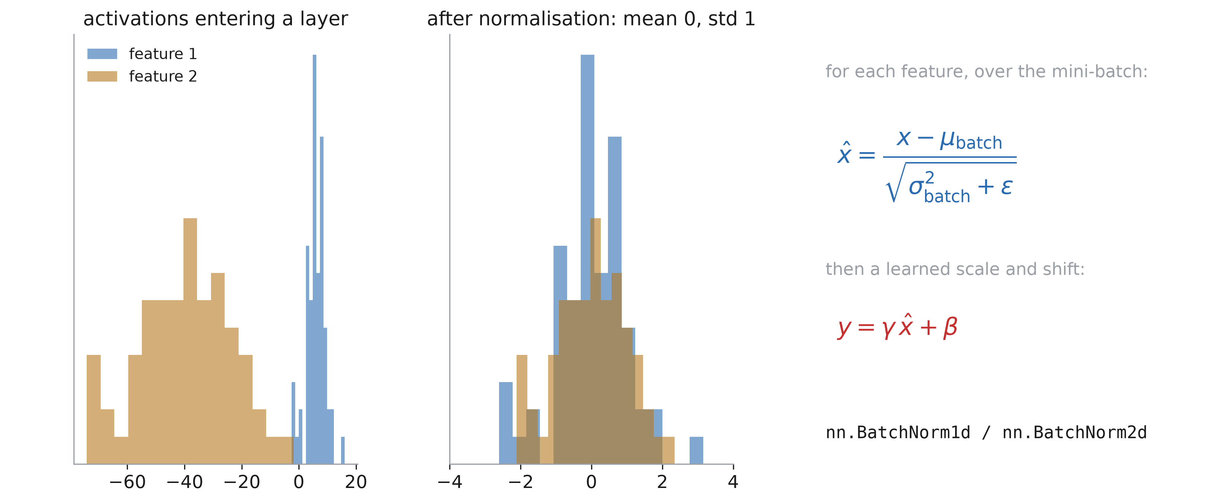
Batch normalization
Notes:
We already standardize the input data so each feature has mean zero and standard deviation one. Batch normalization does the same at the entrance of every layer, which also makes learning easier. Then a learned scale γ and shift β let the layer undo the normalization if that is what helps.
Proposed by Ioffe and Szegedy (2015), motivated by “internal covariate shift”. Why it works is still debated — Santurkar et al. (2018) argue it rather smooths the loss surface. Deep learning is recent and not fully understood, and new tricks are often oversold. The rule: try with and without, look at the validation loss, keep what is better.

Slide 18
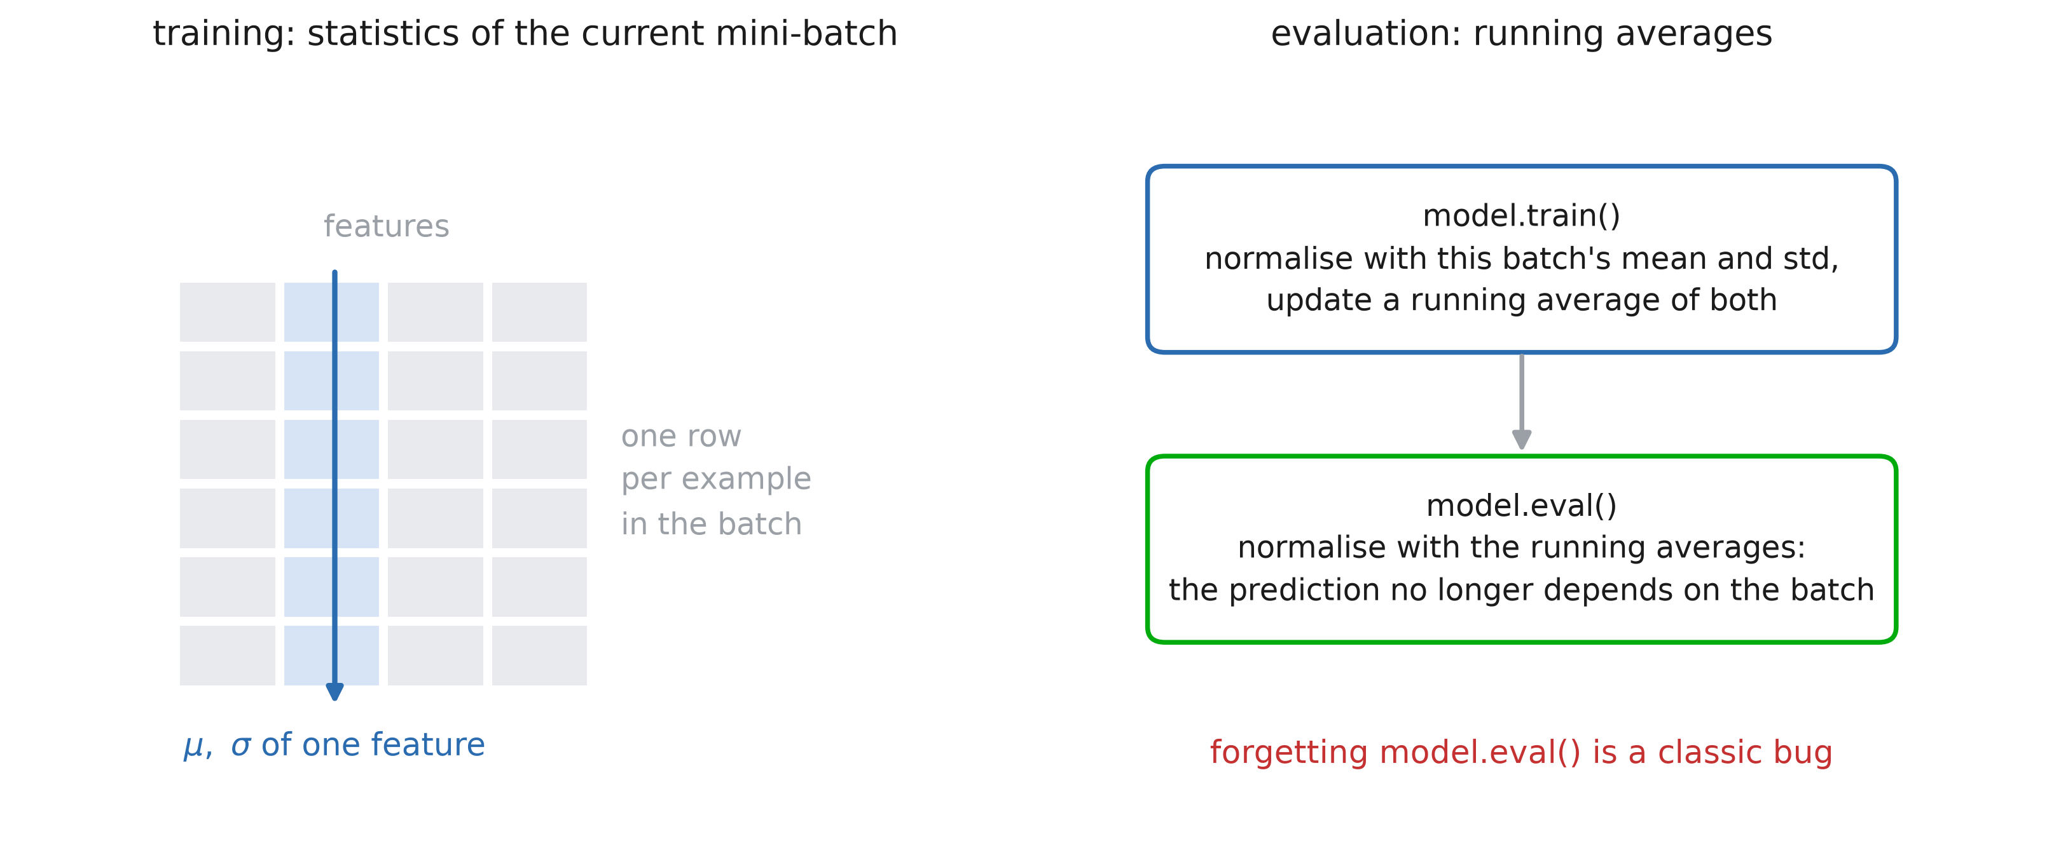
Why “batch” normalization
Notes:
The normalization is not computed on the whole dataset: the mean and standard deviation come from the current mini-batch. Hence the name — and hence very small batches make it noisy.
At evaluation time there may be one example, so the layer uses running averages collected during training. That is one of the things model.train() and model.eval() switch.

Slide 19
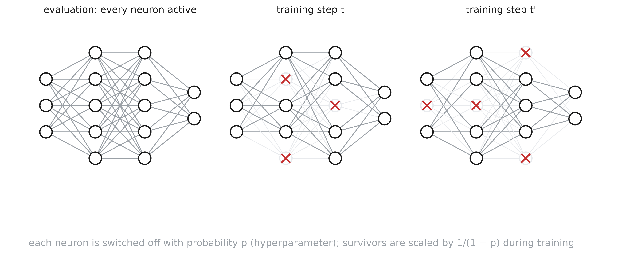
Dropout
Notes:
Srivastava et al. (2014), “Dropout: A Simple Way to Prevent Neural Networks from Overfitting”. Which neurons are switched off is random: each one is dropped with probability p — a new hyperparameter. With p = 0.1 each neuron has a 1 in 10 chance of being off. This is redrawn at every forward pass, so the network trains a slightly different thinned model at every step.
Caution: dropout is only active during training; at test time every neuron is on.
Caution 2: think of an output neuron. During training it receives inputs from only about (1 − p) of the hidden neurons. Remove dropout and it suddenly receives more — its activations become too large. To avoid this, PyTorch scales the surviving activations by 1/(1 − p) during training, so nothing changes at test time.

Slide 20
Losses

Slide 21
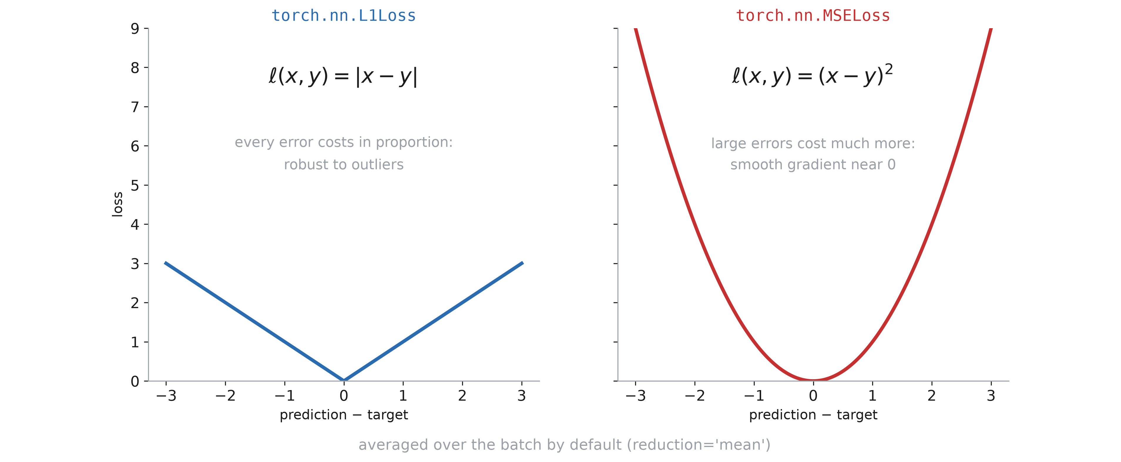
Regression losses
Notes:
The two regression losses they know. L1: every unit of error costs the same, so it is robust to outliers. MSE: large errors dominate; the gradient vanishes smoothly near zero.

Slide 22
Classification
In the case of a categorical output,
what should the loss be?

Slide 23
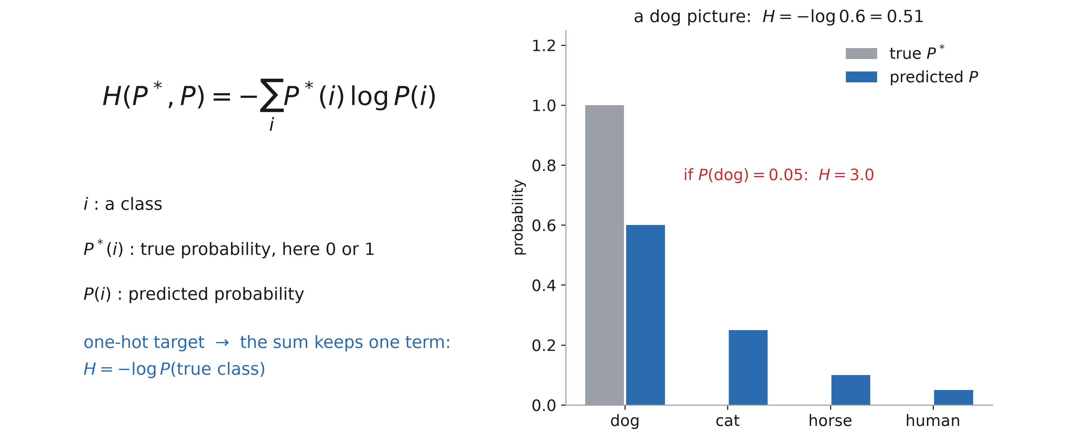
Cross entropy
Notes:
Work the example on the board: classes dog, cat, horse, human. A dog picture, so P* = (1, 0, 0, 0). Every term with P*(i) = 0 vanishes, and the loss is −log of the probability given to the true class: 0.51 for P(dog) = 0.6, 3.0 for P(dog) = 0.05.

Slide 24
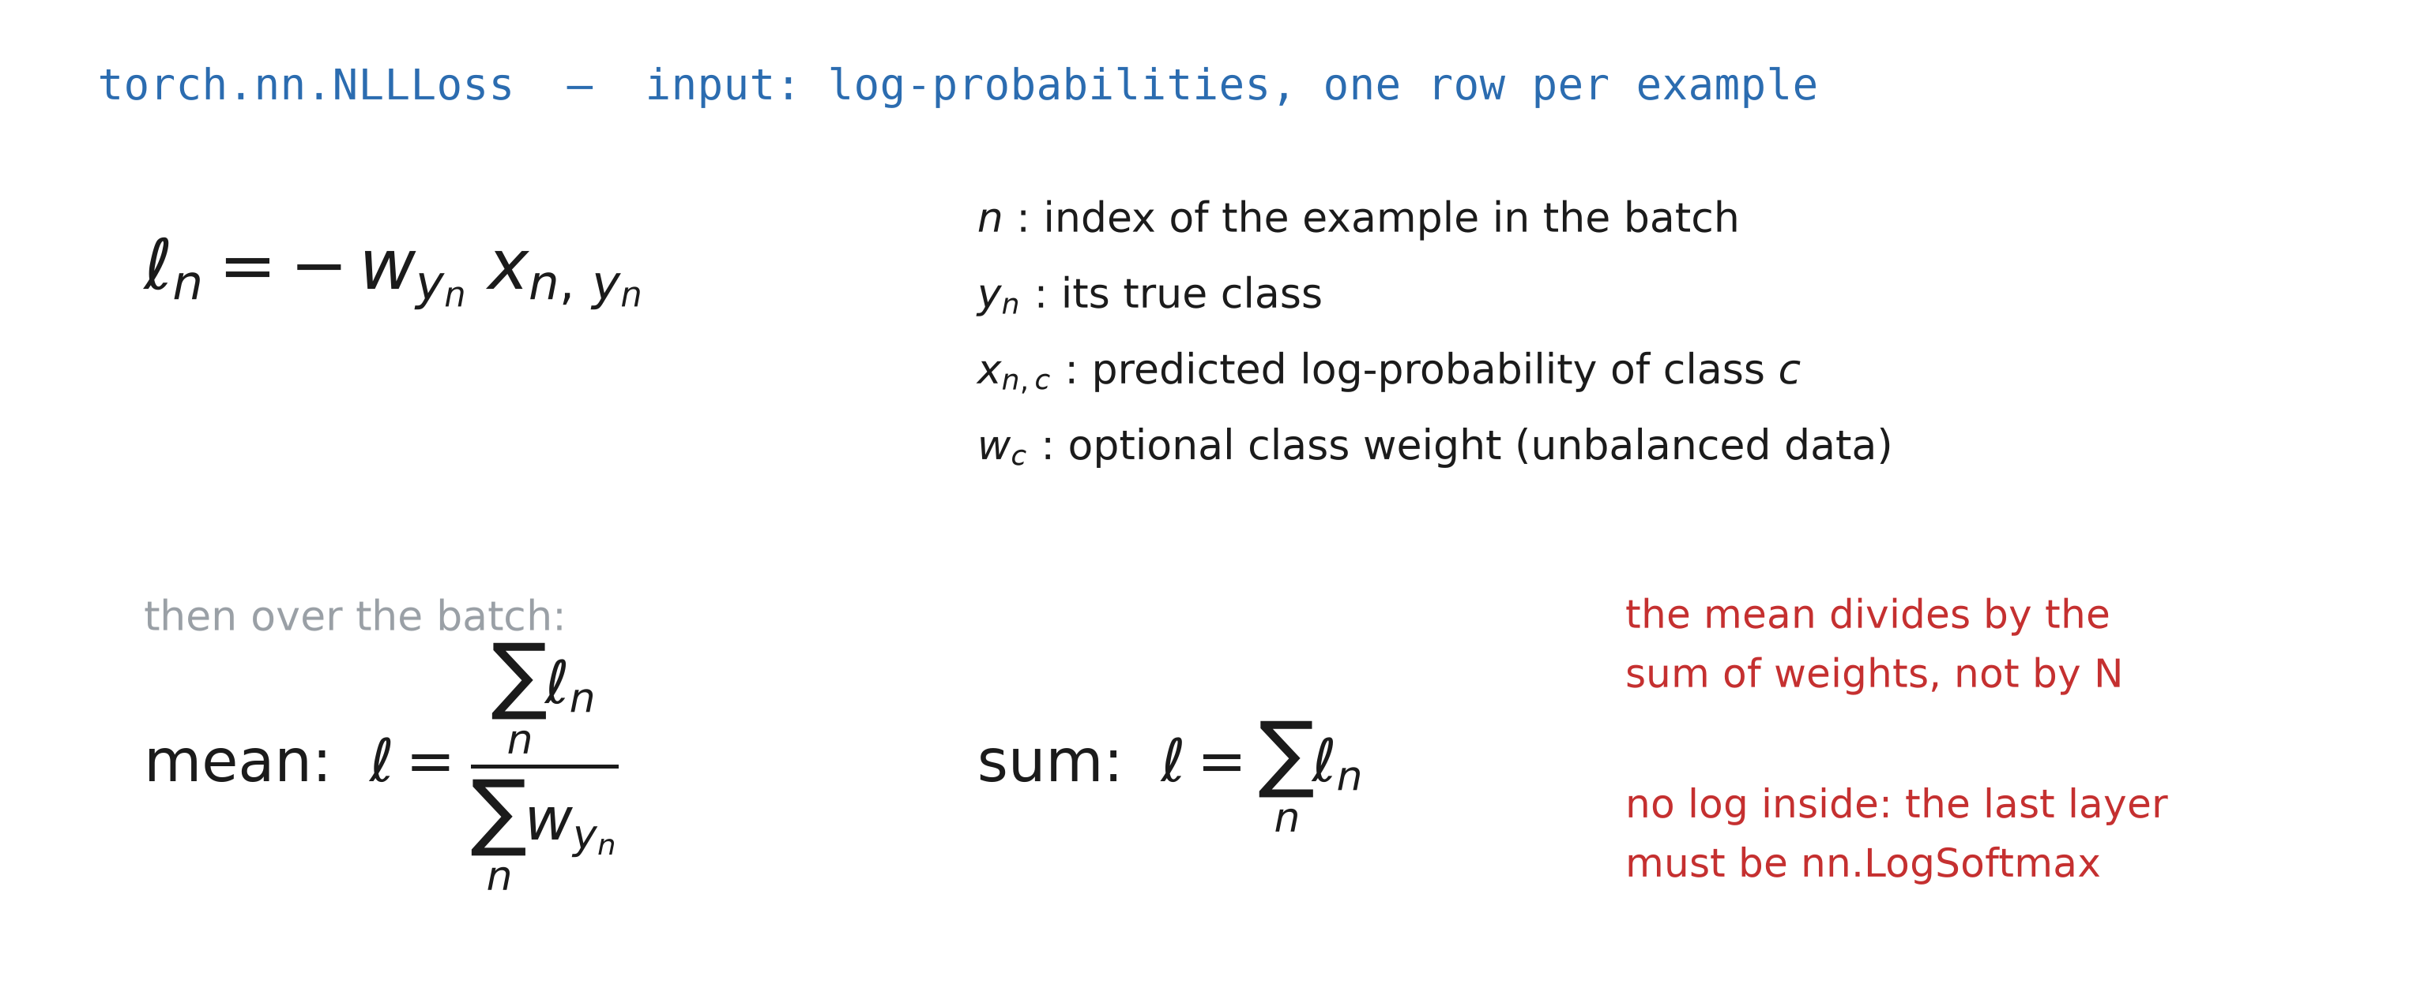
NLLLoss
Notes:
Why only x_{n, y_n}? Because for all the other classes P*(i) = 0. Careful: with reduction=‘mean’ PyTorch divides by the sum of the weights, not by N. In practice PyTorch handles it, but it is worth knowing how it works.
NLLLoss expects log-probabilities and takes no log itself: the last layer of the network has to be nn.LogSoftmax.

Slide 25
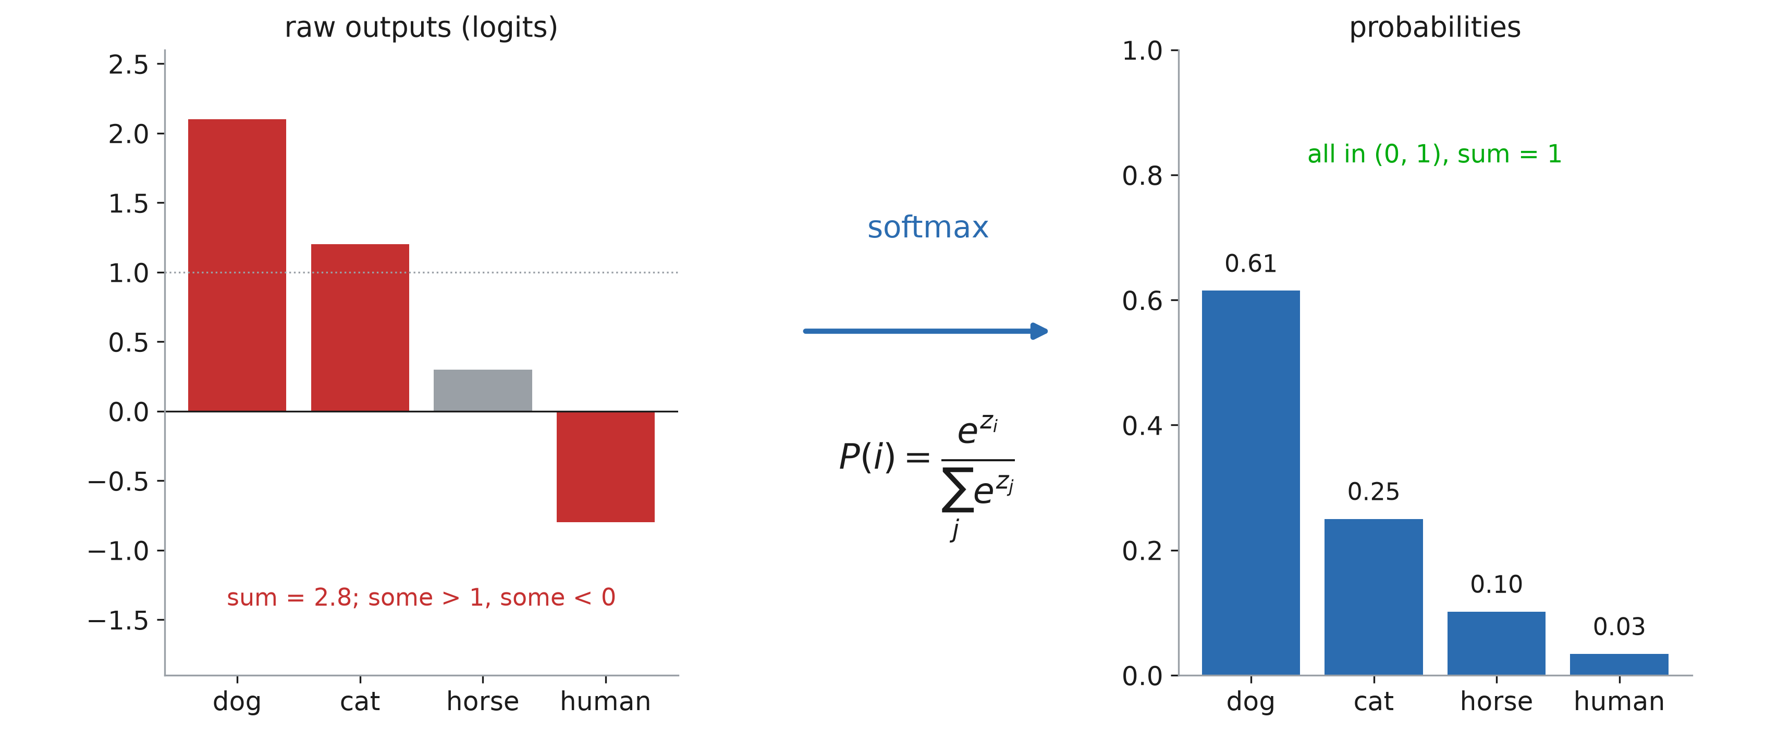
Why softmax?
Notes:
We want probabilities. Raw network outputs can be above 1 or negative, and they do not sum to 1 — and we cannot take the log of a negative number. Softmax exponentiates (everything becomes positive) and normalizes (everything sums to 1).
Idea of the figure after Adian Liusie, “Intuitively Understanding the Cross Entropy Loss” (2021) — https://www.youtube.com/watch?v=Pwgpl9mKars

Slide 26
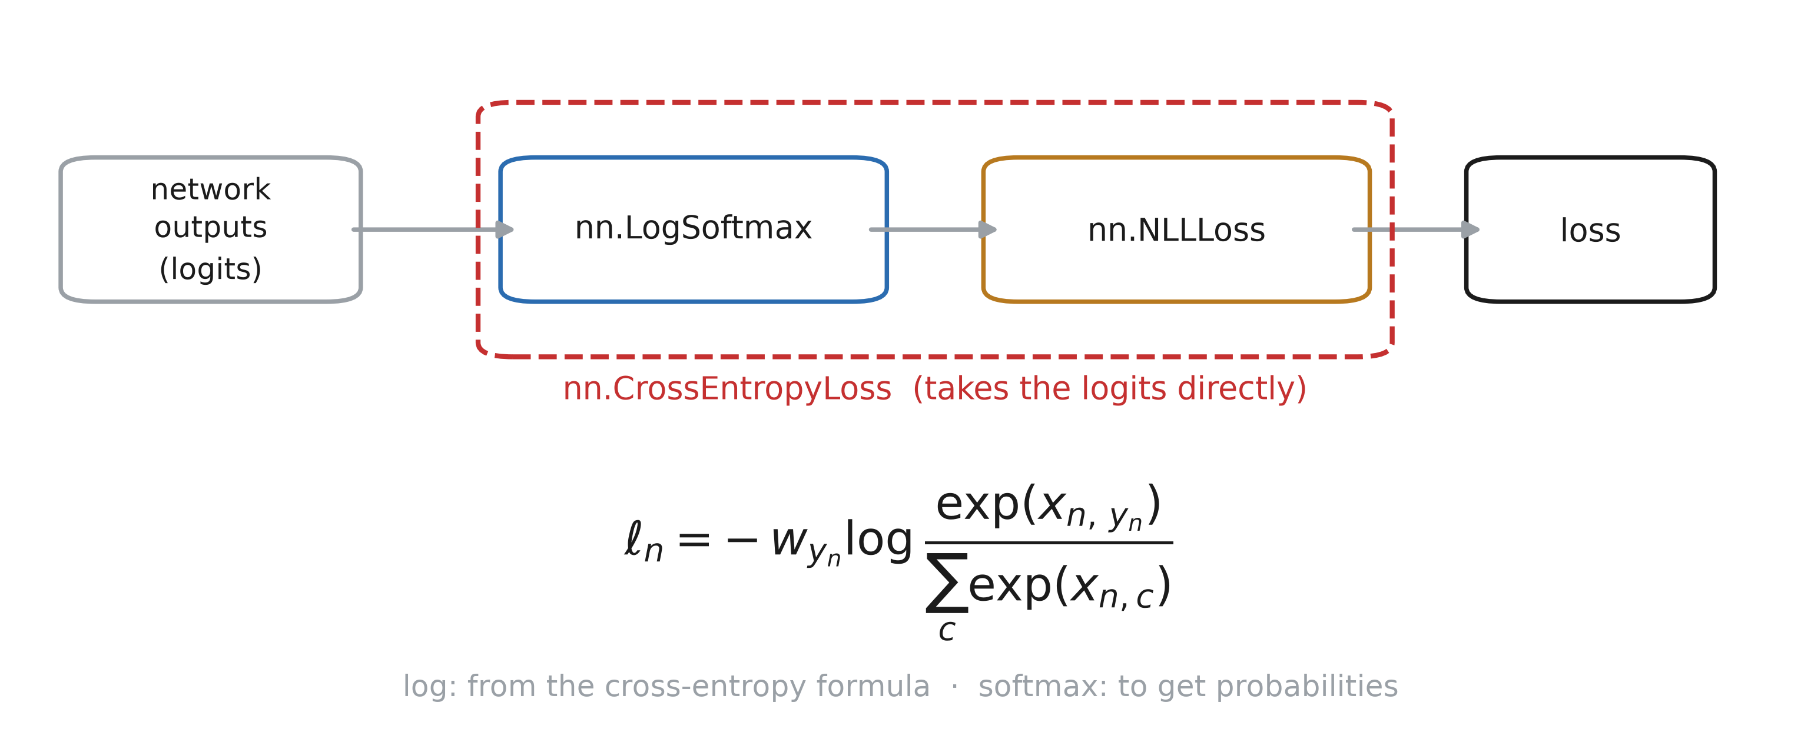
CrossEntropyLoss
Notes:
nn.CrossEntropyLoss is nn.LogSoftmax followed by nn.NLLLoss, in one numerically stable call. Why the log: the cross-entropy formula. Why the softmax: we want values between 0 and 1. So the network ends on a plain linear layer, and you never put a softmax before CrossEntropyLoss — that is a classic bug.

