Slide 1
Session 10
Recurrent Neural Networks
Advanced Data Science · NYU Paris · 2026
Paul Dubois

Slide 2
Main question
How do we feed a sequence to a network,
and predict the next state?
Notes:
Two new things today. First the architecture: recurrent networks, built for sequences. Then the representation: a word is not a number, so how do we give it to the network? Last session we trained CBOW and got word embeddings as a by-product; today we use them, and ask whether they are worth the trouble.

Slide 3
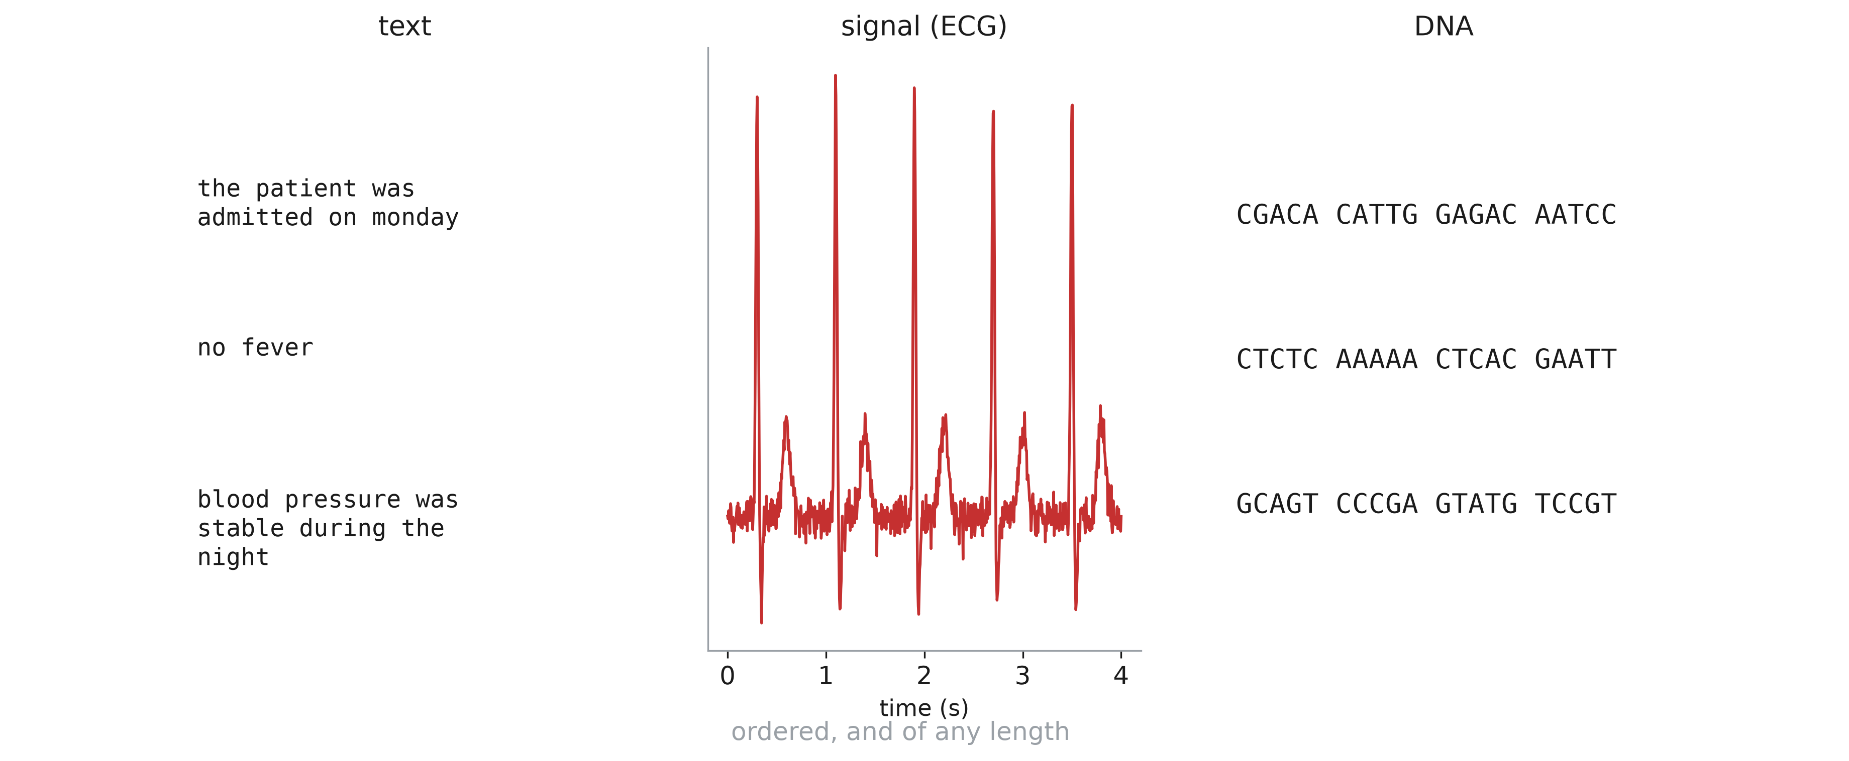
Sequences types
Notes:
Clinical notes, ECG, EEG, vital signs over a hospital stay, DNA. Two properties: the order matters (shuffle the words of a sentence, the meaning is gone), and the length varies from one example to the next.

Slide 4
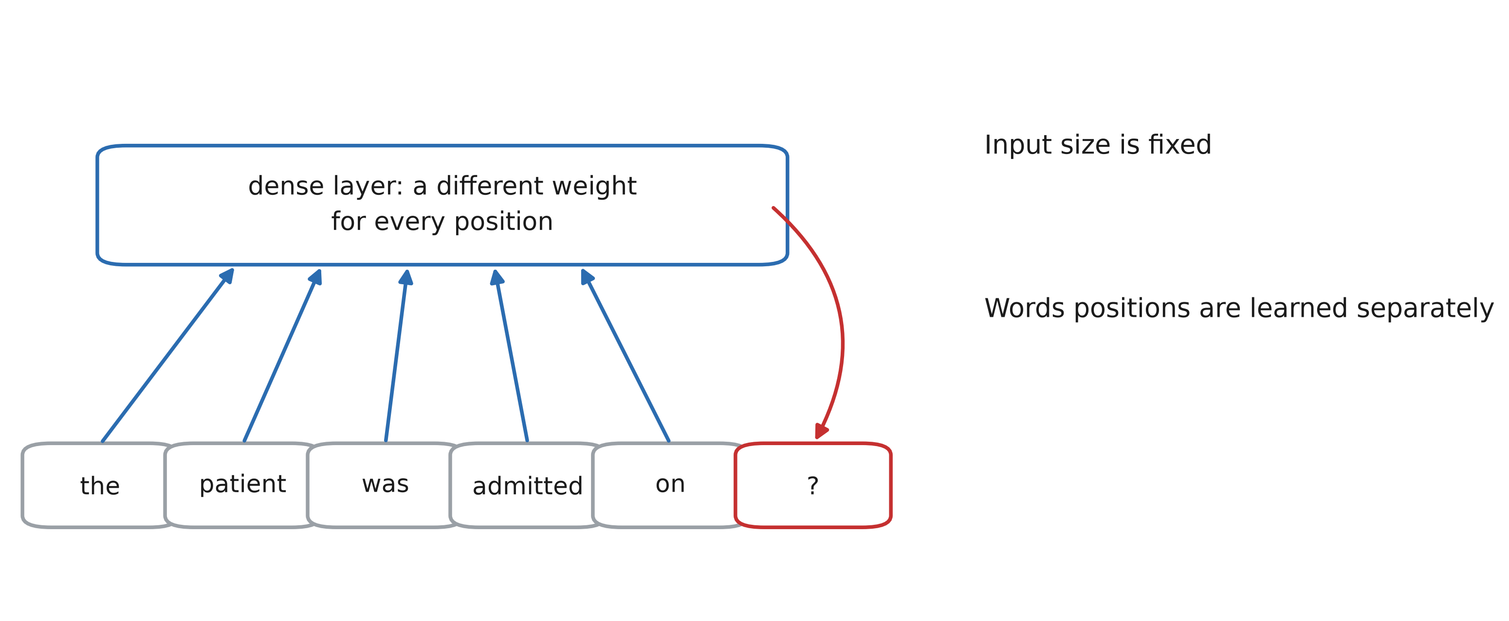
Dense networks are not for sequences
Notes:
We could take a fixed window of the last 5 words and feed it to a dense network. Three problems. The input size is fixed. Each position has its own weights, so what is learned about a word at position 4 does not transfer to position 2 — the same issue convolutions solve for images (share the weights across positions). And nothing outside the window can ever be used.

Slide 5
Recurrent neural networks

Slide 6
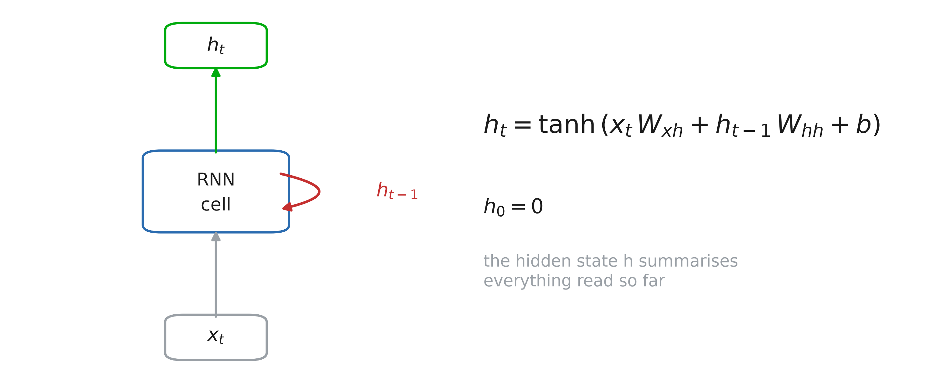
The recurrent cell
Notes:
Read the sequence one element at a time, and keep a memory: the hidden state h. At each step, the new state is computed from the current input and the previous state. The hidden state is a fixed-size summary of everything read so far — whatever the length of the sequence.

Slide 7
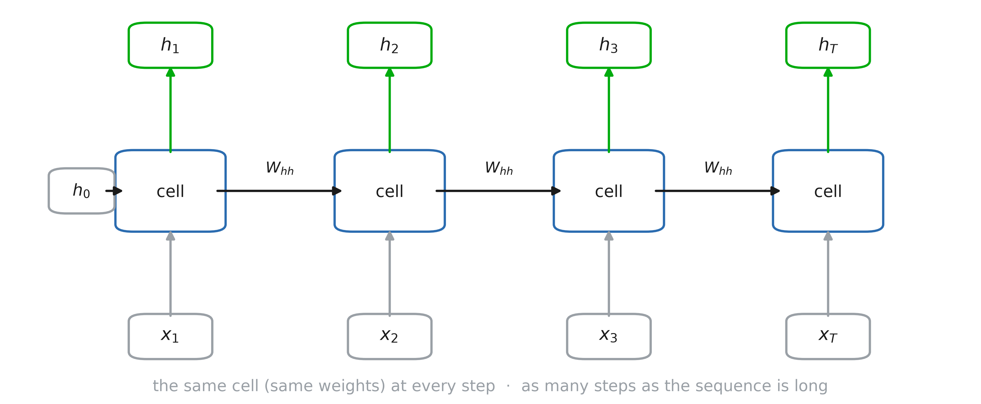
Unrolled in time
Notes:
Unrolled, an RNN is just a deep network with one layer per time step — but every layer shares the same weights W_xh, W_hh, b. So the number of parameters does not depend on the length of the sequence, and what is learned at step 3 is used at step 30. Same idea as a convolution, along time instead of space.

Slide 8
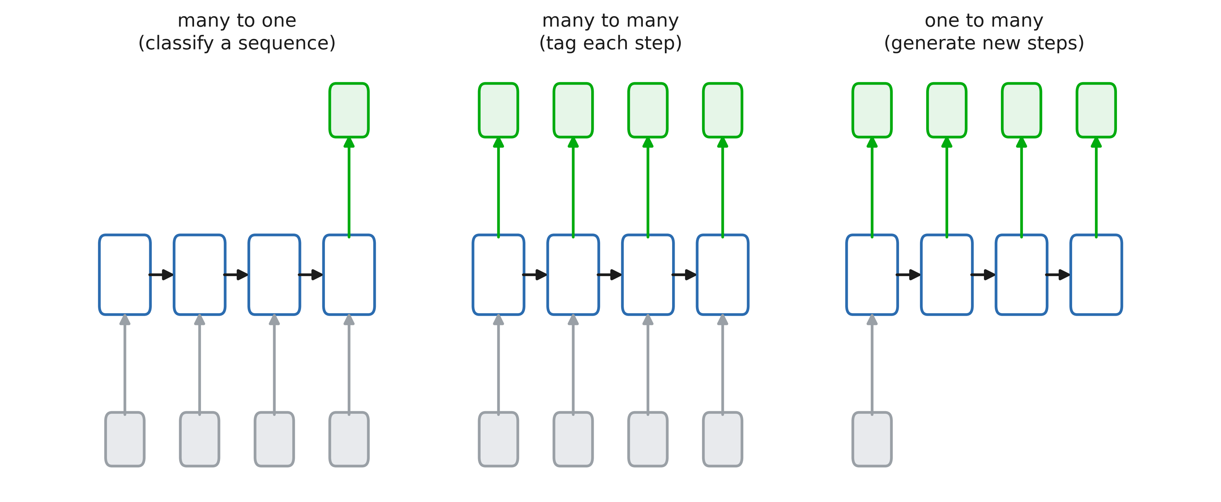
Tasks variations
Notes:
Many to one: read the whole sequence, use the last state (sentiment of a review, arrhythmia from an ECG). Many to many: an output at every step (next word, part of speech of each word). One to many: generation. Today: many to many, the next word at every position.

Slide 9
RNN from scratch: layers
class torch.nn.RNN(nn.Module):
def __init__(self, d_in, d_h,
act=torch.tanh):
super().__init__()
self.d_h, self.act = d_h, act
self.x2h = nn.Linear(d_in, d_h)
self.h2h = nn.Linear(d_h, d_h)
Notes:
Code along. Two linear layers: x2h computes x_t W_xh, h2h computes h_{t-1} W_hh. Each has its own bias; one would be enough (they are added together), but PyTorch’s nn.RNN also has two, which makes the comparison two slides from now exact. The activation is a parameter: tanh by default, we will try ReLU in a moment.

Slide 10
RNN from scratch: predictions
def forward(self, x): # [B, T, d_in]
B, T, _ = x.shape
h = torch.zeros(B, self.d_h)
outs = []
for t in range(T):
h = self.act(self.x2h(x[:, t])
+ self.h2h(h))
outs.append(h)
return torch.stack(outs, 1), h
rnn = RNN(5, 7)
# total parameters: 5×7 + 7 + 7×7 + 7 = 98
Notes:
h_0 = 0, then the same two layers at every step. The for loop is the point: step t needs h_{t-1}, so the steps cannot run in parallel. We return every hidden state (for many-to-many tasks) and the last one (for many-to-one).

Slide 11
PyTorch example
rnn = nn.RNN(input_size=100,
hidden_size=256,
batch_first=True)
x = torch.randn(64, 32, 100)
# 64 sequences, 32 steps, 100 features
outputs, h_last = rnn(x)
outputs.shape # [64, 32, 256]
h_last.shape # [1, 64, 256]
Notes:
batch_first=True puts the batch dimension first, like everywhere else in the course (the default is time first, for historical reasons). outputs holds the hidden state at every step, h_last the last one (with an extra dimension for the number of stacked layers). From now on we use the built-in layers: same numbers as our for loop, much faster.

Slide 12
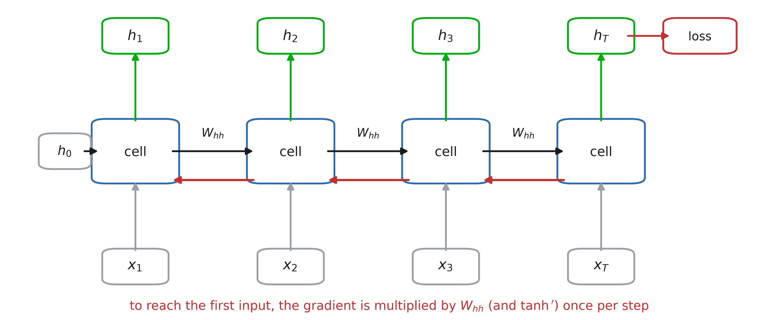
Back-propagation through time
Notes:
Training: compute the loss, backpropagate through the unrolled network. Nothing new — autograd does it — but the gradient that reaches the first steps went through T multiplications by W_hh and by tanh’. Also: the steps cannot run in parallel (step t needs step t − 1), so RNNs are slow on long sequences. That is one reason transformers replaced them.

Slide 13
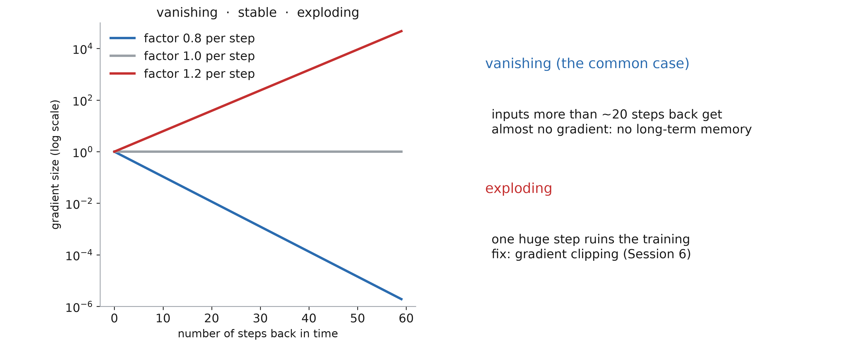
Vanishing and exploding gradients
Notes:
A product of T numbers: if they are below 1, it shrinks exponentially; above 1, it explodes. Exploding: one huge step ruins the training — gradient clipping, seen in Session 6, the figure was about RNNs. Vanishing is worse because it is silent: the network trains, but it never learns to use anything more than ~20 steps back. Bengio, Simard, Frasconi (1994); Pascanu, Mikolov, Bengio (2013).

Slide 14
How far back does the gradient reach?
for act in [torch.tanh, torch.relu]:
for scale in [1, 2, 4]:
torch.manual_seed(0)
x = torch.randn(1, 100, 8,
requires_grad=True)
rnn = MyRNN(8, 32, act)
with torch.no_grad():
rnn.h2h.weight *= scale
_, h = rnn(x)
h.sum().backward()
grad = x.grad[0].norm(dim=1)
plt.semilogy(grad) # one value per t
Notes:
grad[t] measures how much the input at time t influences the last state h_T: it is the signal training gets to learn a dependency from t to T. Default weights (the initialisation of nn.Linear, which is also nn.RNN’s), then h2h weights doubled and quadrupled; for tanh and for ReLU. Ask the room before the next slide: what shape do you expect, on a log scale? What changes with the scale? With ReLU?

Slide 15
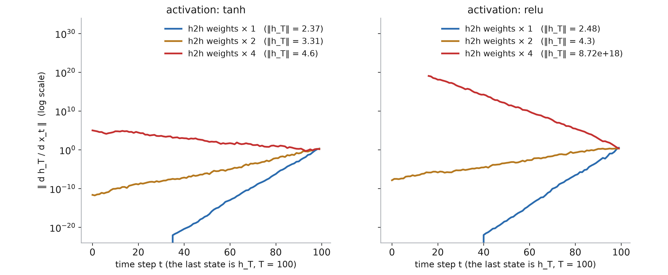
How far back does the gradient reach?
Notes:
Default weights (blue): a straight line on a log scale, so exponential decay; 60 steps back the gradient is 10^20 times smaller, then exactly zero in float32. ×2 (orange): slower decay, still 10^11 times smaller after 100 steps. ×4 (red): it explodes going back in time. ReLU (right) behaves the same for the gradient — but with ×4 the state itself explodes: ‖h_T‖ = 10^19, while tanh keeps every coordinate in (−1, 1), so ‖h_T‖ ≤ √32 ≈ 5.7. Next slide: why it is exponential.

Slide 16
Why tanh, not ReLU?
The same layer is applied T times
ReLU is unbounded: the state itself can explode
tanh keeps the state in (−1, 1) but gradients vanish
Notes:
In feed-forward networks ReLU won, but each layer has its own weights there. In an RNN the same map is applied again and again: if W_hh amplifies the state even slightly, a ReLU state grows exponentially (the ×4 curve: 10^19). tanh bounds it, and is centred on 0, while ReLU outputs are ≥ 0 and drift upwards. The cost: tanh’ ≤ 1, and close to 0 when saturated, which feeds the vanishing gradient. ReLU RNNs exist (nn.RNN(…, nonlinearity=“relu”)), with W_hh initialised close to the identity (Le, Jaitly, Hinton, 2015). GRU and LSTM keep bounded functions: tanh for the state, sigmoid for the gates.

Slide 17
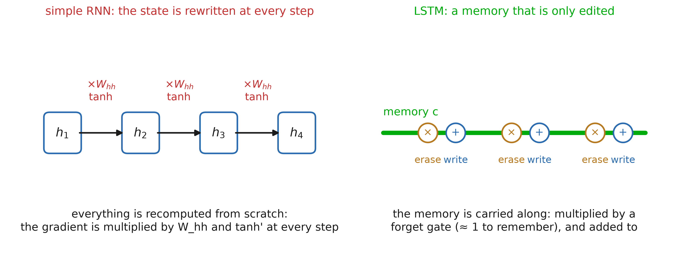
Long-term memory: the intuition
Notes:
A simple RNN rewrites its whole state at every step: like a whiteboard you must recopy entirely, through a distortion, each time you add something. After 50 copies nothing is left of the first line — and the gradient, which goes back through the same copies, vanishes. The LSTM idea (Hochreiter & Schmidhuber, 1997): keep a separate memory c, carried along a straight line, and only edit it — erase a little, write a little. If nothing is erased, the memory (and its gradient) goes through unchanged. Example: “The patients who were admitted on Monday after the accident … were”: the plural must survive many words.

Slide 18
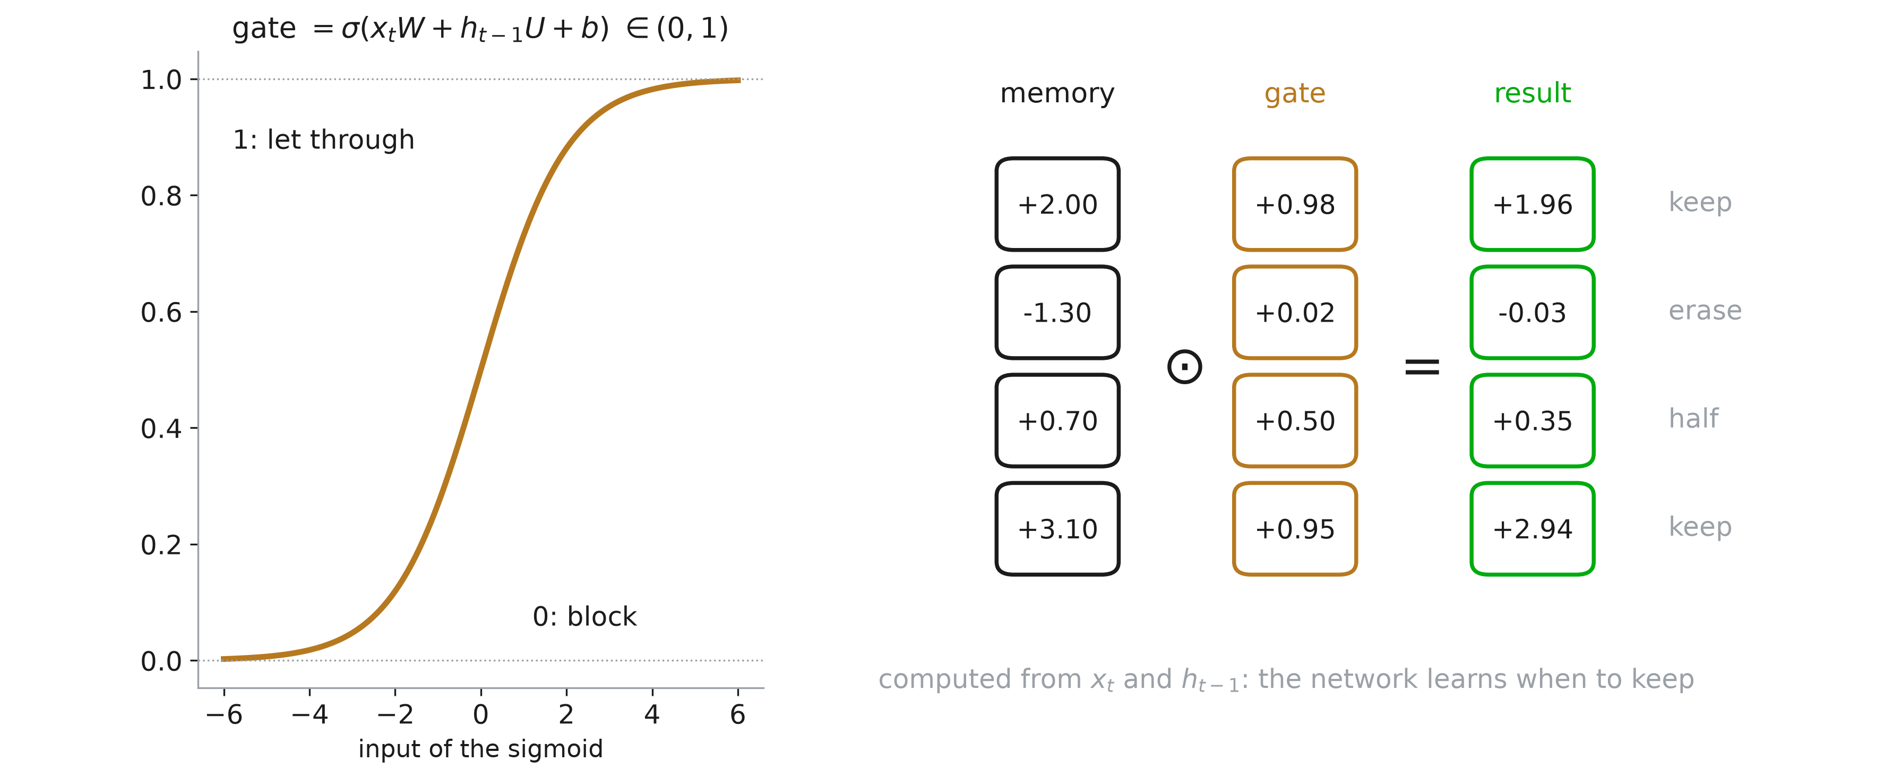
Gates: learned, soft switches
Notes:
How does the network decide what to erase or write? With gates: a vector of numbers between 0 and 1 (a sigmoid), computed from the current input and the previous state, multiplied element-wise with what it controls. 1 lets through, 0 blocks, and each coordinate is decided separately. A gate is differentiable, so when to keep and when to erase is learned by gradient descent like any other weight.

Slide 19
Three decisions at every step
Forget: what to erase from the memory?
Input: what new information to write?
Output: what to show from the memory?
Notes:
One gate per question. On “patients”: write “plural subject” (input gate open). During “who were admitted on Monday after the accident”: keep it (forget gate ≈ 1), but there is no need to show it. On the verb: show it (output gate open), the network predicts “were” and not “was”. After the verb: it can be erased (forget gate ≈ 0).

Slide 20
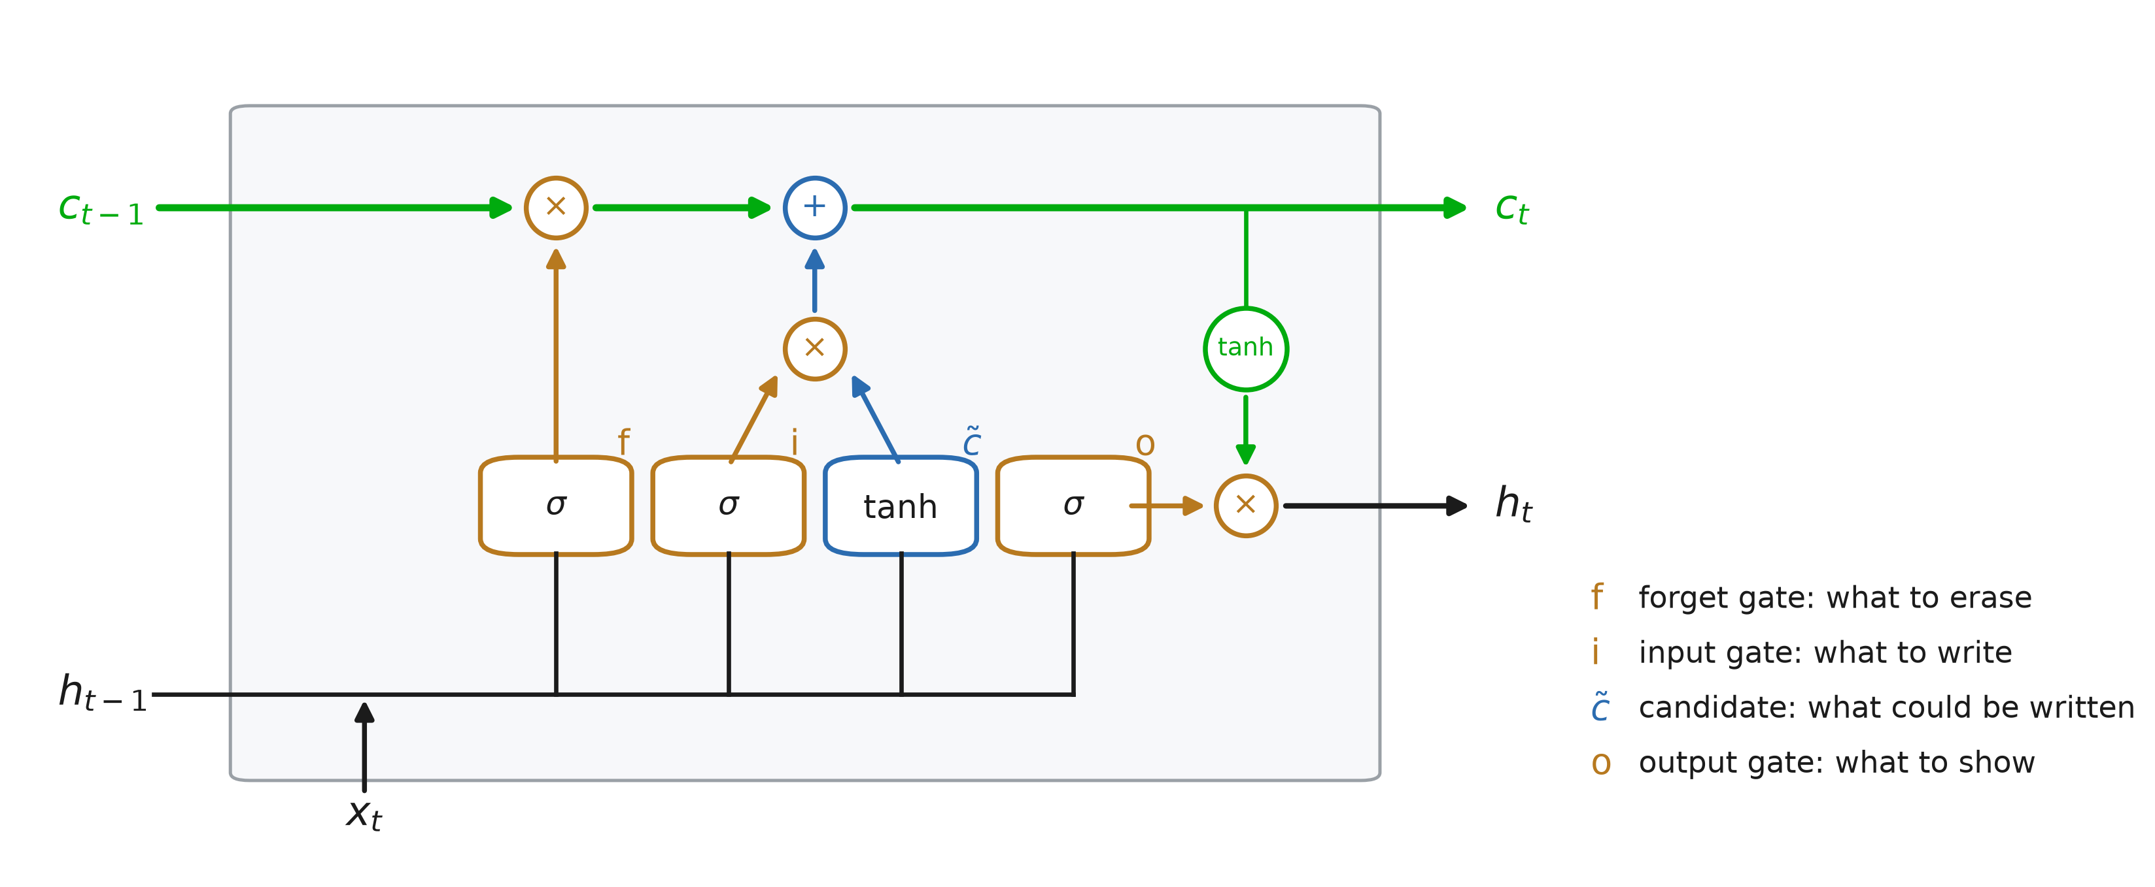
The LSTM cell
Notes:
Top: the memory line. It is multiplied by the forget gate f (erase), then the input gate i times the candidate c~ is added (write). Bottom: the four boxes all read the same inputs, h_{t-1} and x_t: three sigmoids (gates) and one tanh (candidate, the same formula as a simple RNN). Right: the new state h_t is a tanh of the memory, filtered by the output gate o. Two states go to the next step: c_t and h_t.

Slide 21
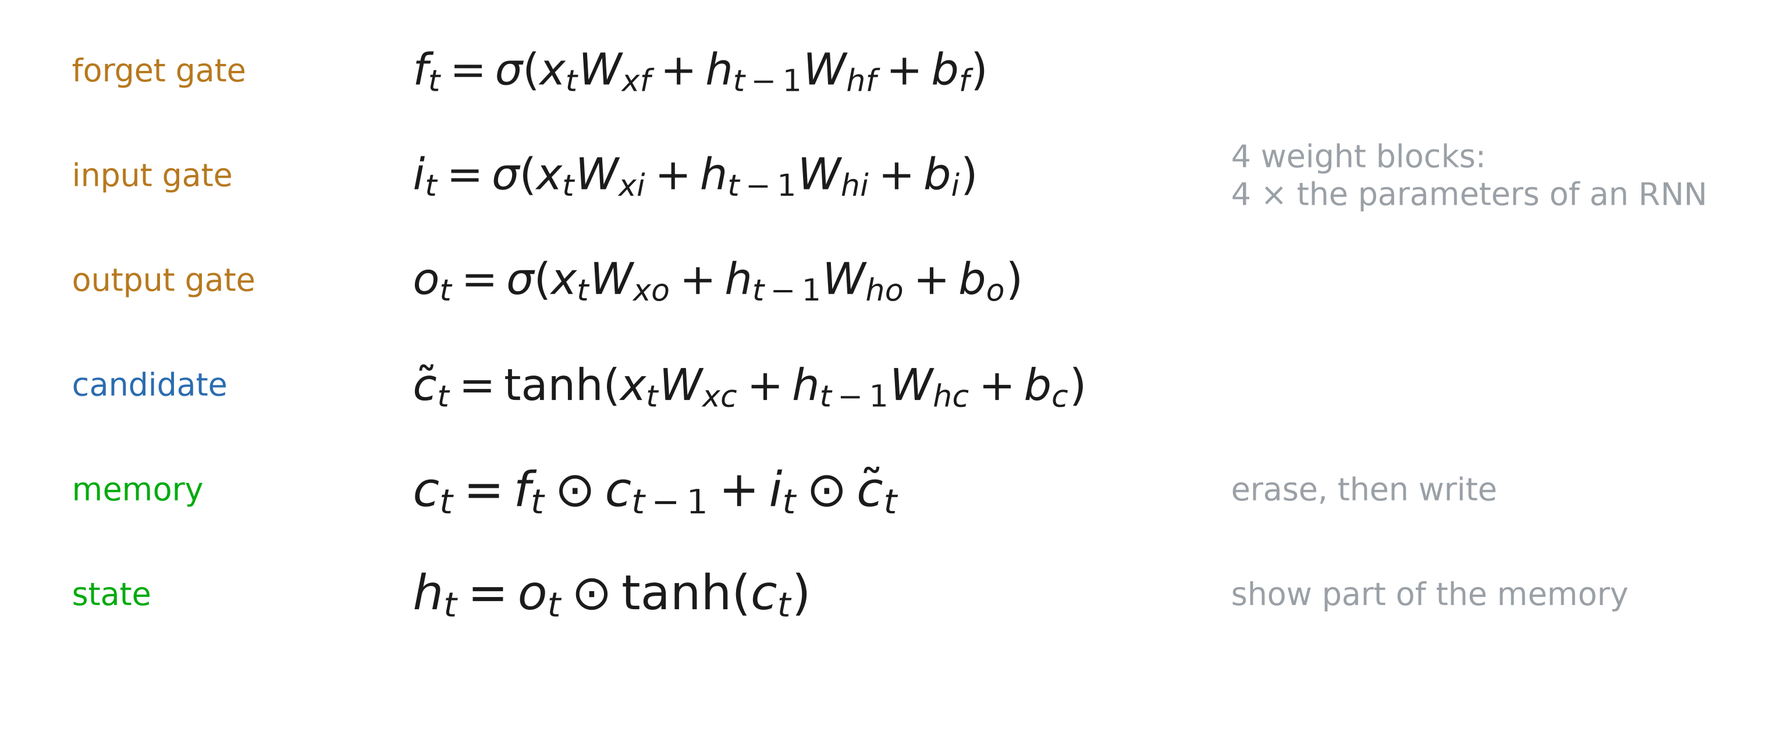
LSTM: the equations
Notes:
Each gate is a small layer of its own, with the same form as a simple RNN: four weight blocks instead of one, so four times the parameters for the same hidden size. The forget gate was not in the 1997 paper; it was added by Gers, Schmidhuber and Cummins (2000), and it is the one that makes LSTMs work in practice.

Slide 22
Why the gradient survives
c_t = f_t * c_(t-1) + i_t * c~_t
d c_t / d c_(t-1) = f_t
No W_hh, no tanh’ on the memory path
f ≈ 1: the gradient flows back unchanged
The network learns when to forget
Notes:
Compare with the simple RNN, where each step back multiplies the gradient by W_hh and by tanh’ (both usually small). Along the memory line, each step back only multiplies by f_t, and the network can learn f_t ≈ 1 for whatever must be kept: the gradient survives hundreds of steps (ignoring the indirect paths through the gates). It is the same trick as the skip connections of ResNets: an additive path. Exploding gradients are still possible: keep gradient clipping.

Slide 23
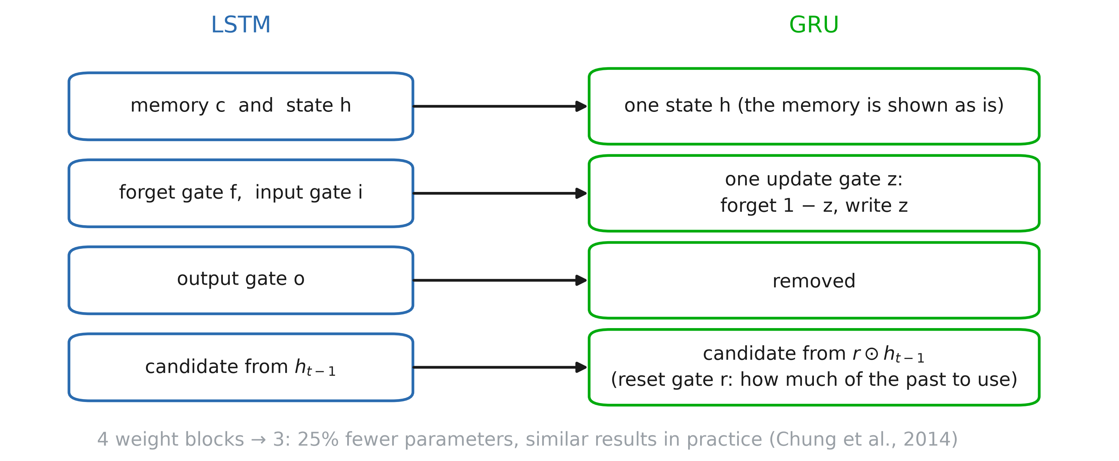
GRU: a simpler LSTM
Notes:
Cho et al. (2014) kept the idea — an additive, gated path through time — and made it simpler. One state instead of two. One update gate z for erasing and writing at once: what is written replaces exactly what is erased (keep 1 − z of the old state, write z of the new). No output gate. And a reset gate r, which lets the candidate ignore the past (r ≈ 0) when something new starts. Chung et al. (2014) found no clear winner between the two.

Slide 24
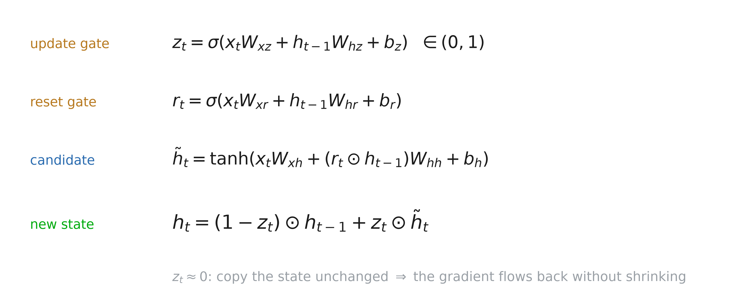
GRU: the equations
Notes:
The update gate z is between 0 and 1. When z ≈ 0 the state is copied unchanged, so the gradient flows back without being multiplied by anything small: the memory line of the LSTM, without a separate memory.

Slide 25
LSTM and GRU in PyTorch
x = torch.randn(64, 32, 100)
lstm = nn.LSTM(100, 256,
batch_first=True)
gru = nn.GRU(100, 256,
batch_first=True)
out, (h, c) = lstm(x)
out, h = gru(x)
lstm.weight_hh_l0.shape
gru.weight_hh_l0.shape
Notes:
Both are drop-in replacements for nn.RNN. Ask before the next slide: what are the shapes of h and c? Of weight_hh_l0?

Slide 26
Two states, or one
LSTM h, c: [1, 64, 256]
LSTM W_hh: [1024, 256] (4 blocks)
GRU h: [1, 64, 256]
GRU W_hh: [768, 256] (3 blocks)
Parameters: LSTM 367k, GRU 275k, RNN 92k
Similar results: we use nn.GRU today
Notes:
out is [64, 32, 256] for both: the state h at every step. The LSTM also returns its memory c. PyTorch stacks the weight blocks of the gates in one matrix: 4 × 256 rows for the LSTM (i, f, c~, o), 3 × 256 for the GRU (r, z, candidate). With 100 inputs and 256 hidden units: 366,592 parameters for the LSTM, 274,944 for the GRU, 91,648 for a simple RNN.

Slide 27
Predicting the next word

Slide 28
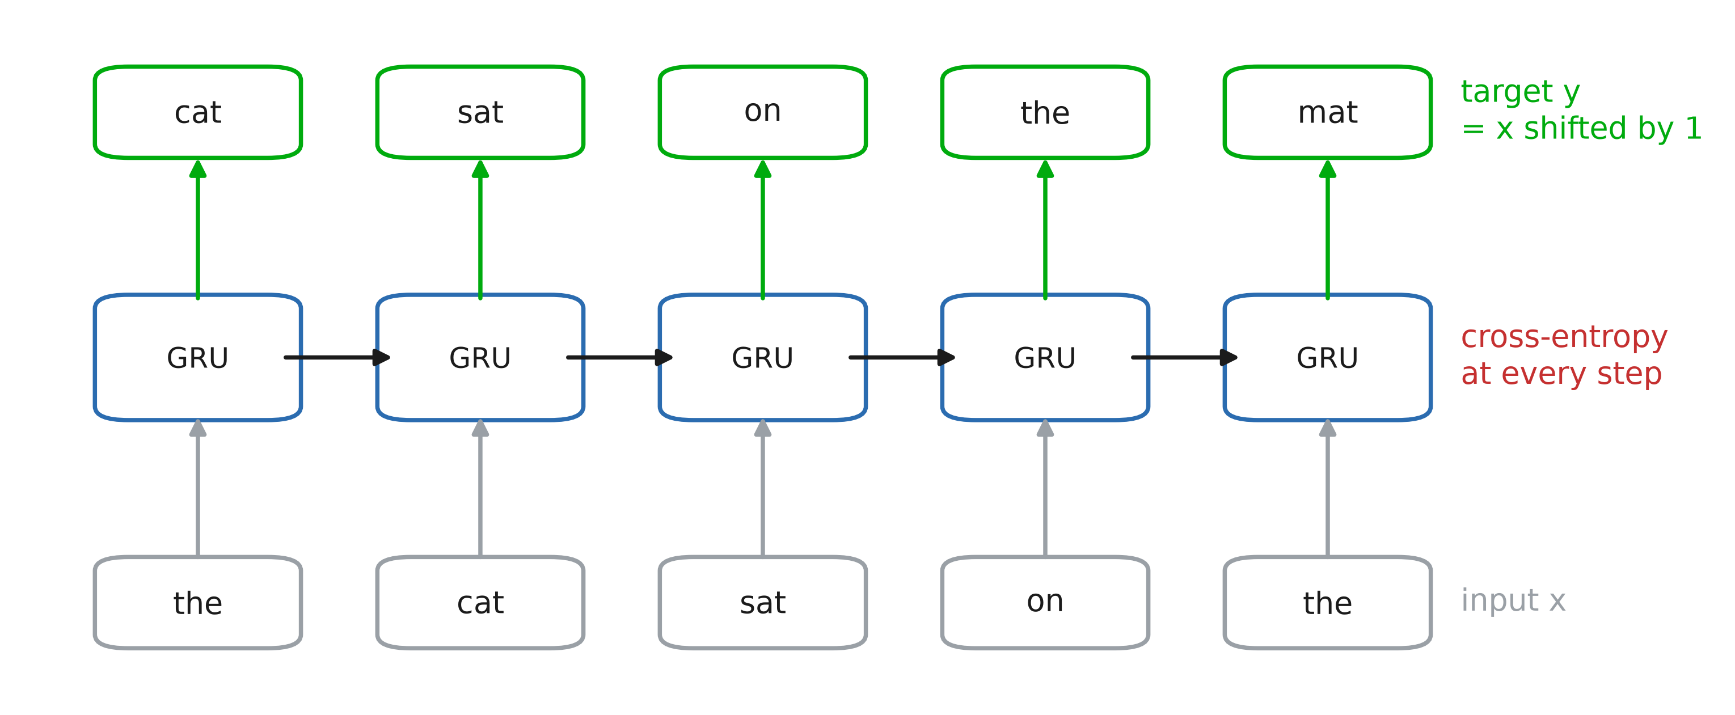
Language modelling
Notes:
The target is the input shifted by one word. At every position the network outputs a probability for every word of the vocabulary, and we take the cross-entropy with the word that actually comes next. One sequence of 32 words gives 32 training examples, and no labels are needed: the text is its own supervision.

Slide 29
Measuring it: perplexity
perplexity = exp(cross-entropy)
How many words the model hesitates between
Uniform guess over 10 001 words: 10 001
Perfect model: 1
Notes:
The cross-entropy is in nats, which is hard to read; its exponential is on an intuitive scale. A perplexity of 150: the model is as unsure as if it picked uniformly among 150 words. Accuracy (is the top word the right one?) is also reported, but it ignores how much probability the right word got. Caveat: a smaller vocabulary (more words mapped to UNK) makes the task easier, so perplexities are only comparable on the same vocabulary and the same test text.

Slide 30
RNN: one-hot encodings vs embeddings
def n_params(*modules):
return sum(p.numel() for m in modules
for p in m.parameters())
V = 10_001 # vocabulary size
one_hot = [nn.GRU(V, 256),
nn.Linear(256, V)]
embedded = [nn.Embedding(V, 100),
nn.GRU(100, 256),
nn.Linear(256, 100),
nn.Linear(100, V)]
n_params(*one_hot), n_params(*embedded)

Slide 31
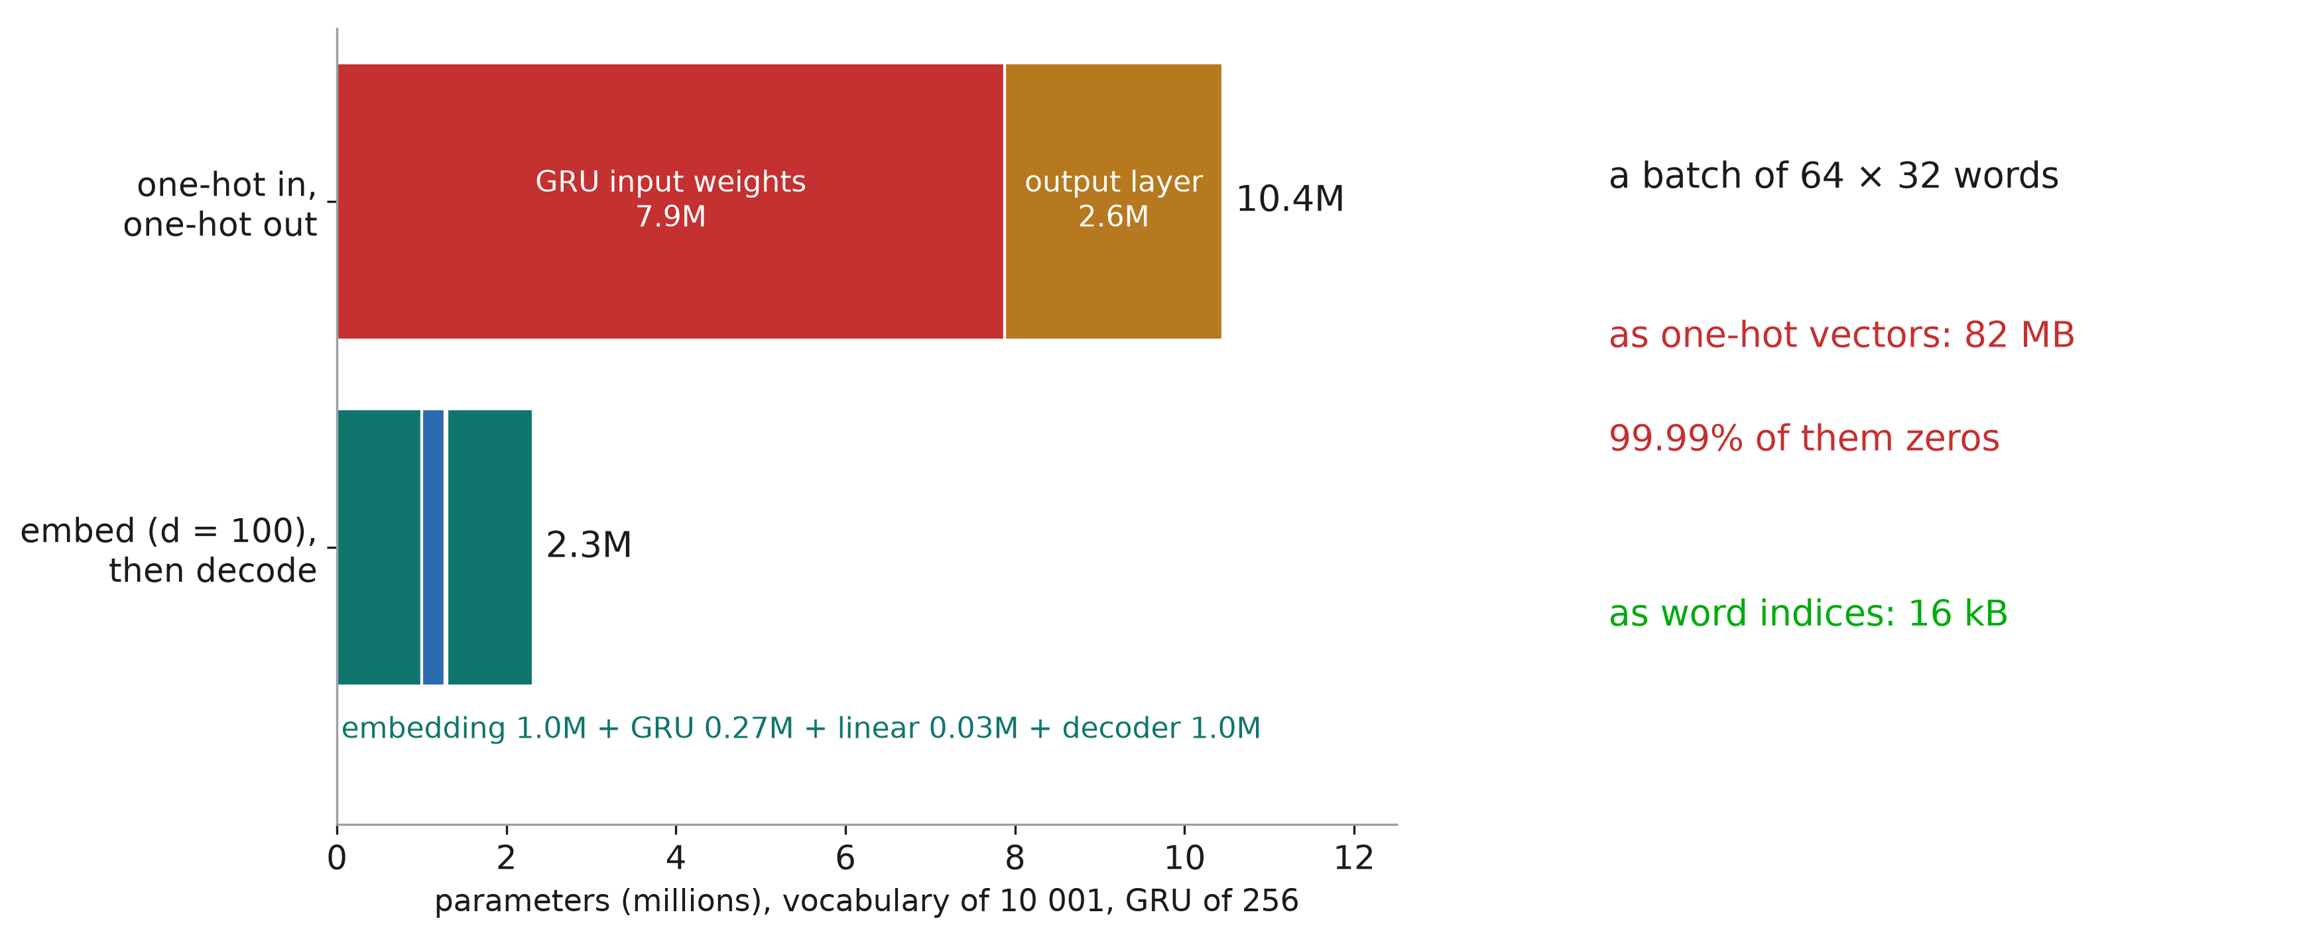
RNN: one-hot encodings vs embeddings
Notes:
10.4M parameters against 2.3M: the first and the last layers are huge. Going through a vector of size 100 on both sides divides the model by 4.5. And the input is 99.99% zeros — 82 MB for one batch, where the word indices take 16 kB.

Slide 32
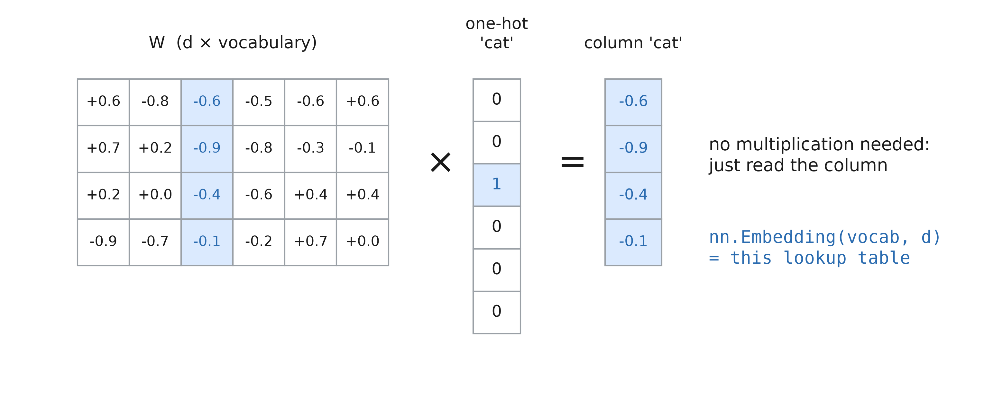
Embedding of one-hot selects a column
Notes:
Multiplying a one-hot vector by a matrix just reads one column. So a linear layer on one-hot inputs is a lookup table.

Slide 33
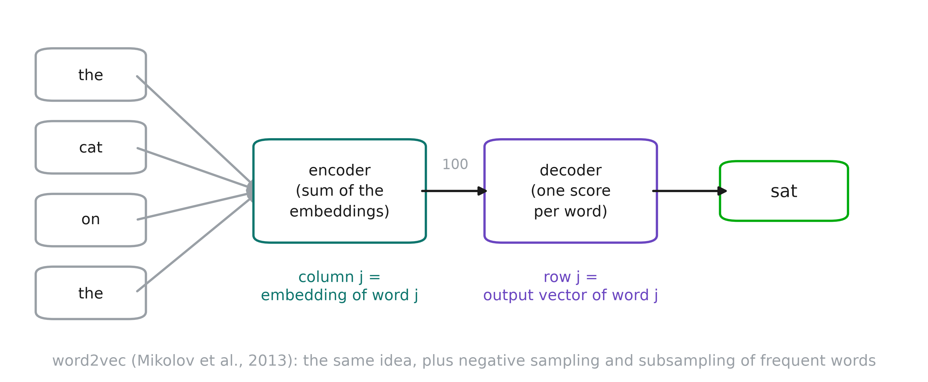
Reminder: Continuous Bag of Words
Notes:
Reminder. CBOW predicts a word from its context; the encoder’s column j is the embedding of word j. It also learns a decoder: from a vector of size 100 to a score per word — exactly the two pieces our language model needs. word2vec (Mikolov et al., 2013) is the official version of the same idea, with tricks that make it much better and much faster: negative sampling (push the right word up and 5 random words down, instead of a softmax over 10 001 words), and subsampling of very frequent words like “the”. We use gensim’s implementation.

Slide 34
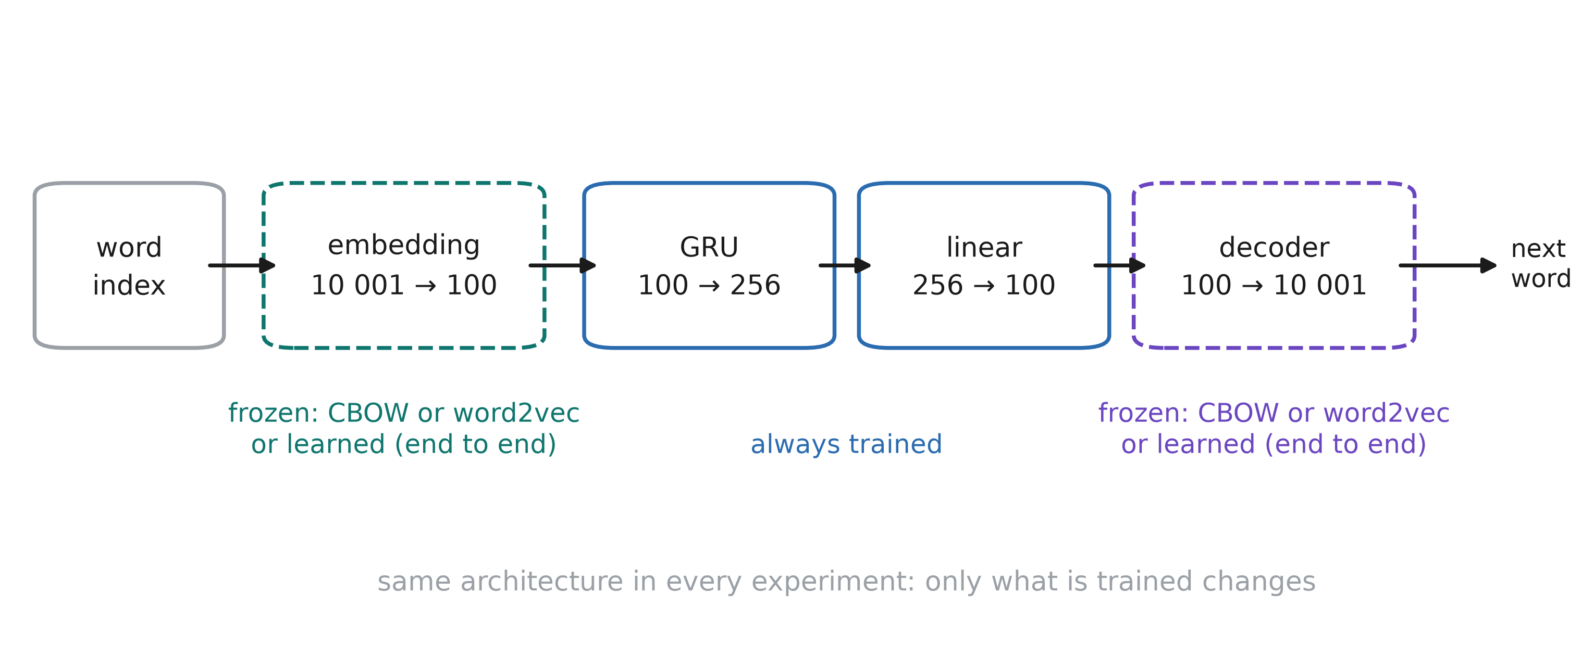
The model
Notes:
Three experiments, one architecture. Frozen: embedding and decoder come from CBOW or from word2vec and are not trained; only the GRU and the small linear layer are. End to end: same layers, random initialisation, everything trained on the next-word task.
One detail for word2vec: its decoder has no bias. With negative sampling, the score approximates log p(w | context) − log p(w), up to a constant, so we add the fixed bias log p(w), the frequency of each word. That turns the scores into log-probabilities without training anything.

Slide 35
Takeaways
RNNs share weights across time
GRU/LSTM better handle long sequences
Instead of one-hot vectors, use embeddings
word2vec: a cheap, clean, reusable one
Pre-training is usefull when more data is available

