Slide 1
Neural Networks
Introduction

Slide 2
What is Machine Learning?
Rule based
Machine Learning
If XXX
Model
If A
Then …
Input
Output
Machine learning can learn what a mathematical formula can not.
If B
Then …
Else if YYY
Training
New cases
If C
Then …
Data
Predictions
If D
Then …
Else
Then …
Learns from data
Notes:
Why do we actually need deep learning?
Deep learning is cheaper than a doctor => we can treat more patients
Models are not getting tired, unlike doctors who might miss details after long working hours
AI is usually good at grasping something that is hard to put in a formula. Historical computer aided systems were just a set of rules, and no matter how complex the rules were, they would always lack details that a human doctor would not miss.
Machine learning changes the paradigm: the computer learns from data, instead of predefined rules.
This means that our task is harder: instead of just implementing arbitrary rules, we need to actually think for each problem, about which type of model is best suited, train it, test it, compare with others, etc…

Slide 3
Vienne diagram of AI, ML, NN, DL
Artificial Intelligence (AI)
Machine Learning (ML)
Neural Networks (NN)
Deep Learning (DL)
Notes:
Why do we actually need deep learning?
Deep learning is cheaper than a doctor => we can treat more patients
Models are not getting tired, unlike doctors who might miss details after long working hours
AI is usually good at grasping something that is hard to put in a formula. Historical computer aided systems were just a set of rules, and no matter how complex the rules were, they would always lack details that a human doctor would not miss.
Machine learning changes the paradigm: the computer learns from data, instead of predefined rules.
This means that our task is harder: instead of just implementing arbitrary rules, we need to actually think for each problem, about which type of model is best suited, train it, test it, compare with others, etc…

Slide 4
Application of neural networks
Few examples of the application of deep learning:
  Image and video analysis: image and video classification, object detection, and segmentation.
  Healthcare: medical image analysis, drug discovery, and prediction of patient outcomes.
  Speech and language processing: speech recognition systems and Natural Language Processing tasks such as machine translation, language generation, and text classification.
  Finance: analyse financial data and make predictions about stock prices, credit risk, and fraud detection.
  Robotics: object recognition and manipulation in robots.
  Gaming: create artificial intelligence agents that can play games such as chess and Go at a high level.

Slide 5
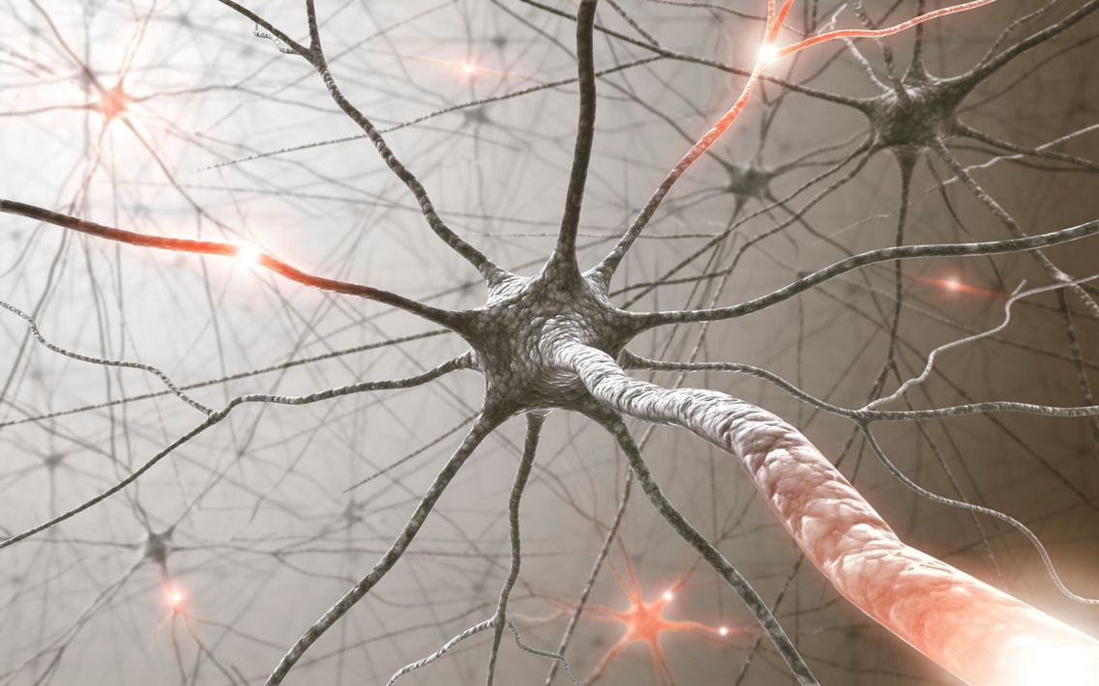
Biological Neuron
Notes:
Nous en avons des milliers dans le corps, beaucoup sont dans notre cerveau. Les neurones se transmettent des information grâce à des signaux électriques et chimiques. Il existe des tas de visualisation très jolies sur internet.

Slide 6
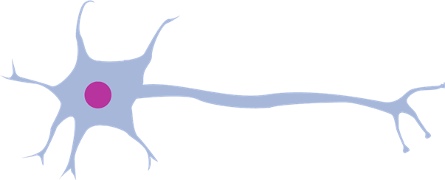
Biological Neuron
kernel
synapse
axon
cell
dendrite
Notes:
Les composants principaux d’un neurone biologique. Axon pour envoyer un signal, dendrite pour recevoir un signal, et synapse sontt des zones de communication

Slide 7
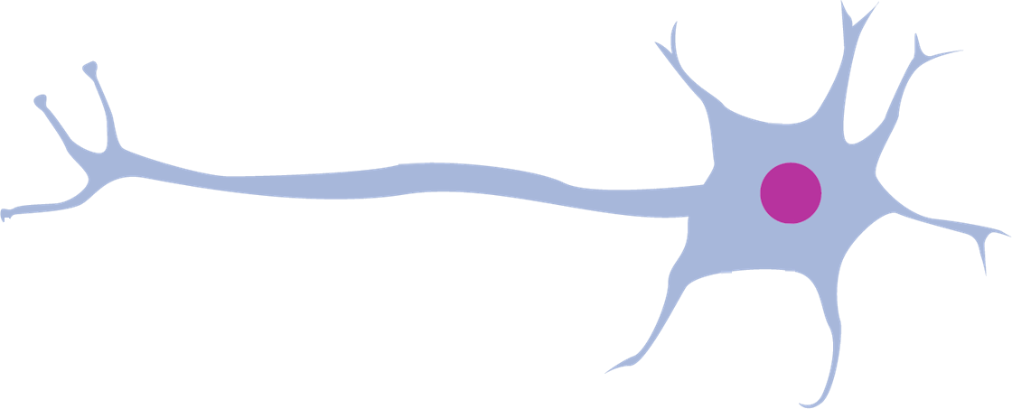




Synaptic integration
Notes:
L’intégration synaptique est le processus de transmission des informations d’un neurone à un autre (au niveau biologique).
Considérons le neurone de droite [montrer]: voyons sous quelles conditions il va transmettre l’information (un signal, une activation).
Tout d’abord, si un des neurones auquel il est connecté lui envoie un petit signal… [animation] Il ne transmet pas le signal.

Slide 8
Synaptic integration
Notes:
Ensuite, si un des neurones auquel il est connecté lui envoie un gros signal… [animation] Il transmet le signal.

Slide 9
Synaptic integration
Notes:
Mais si plusieurs des neurones auquel il est connecté lui envoient tous un petit signal… [animation] Il transmet le signal!
On dit que l’intégration synaptique se fait en puissance et en quantité.

Slide 10
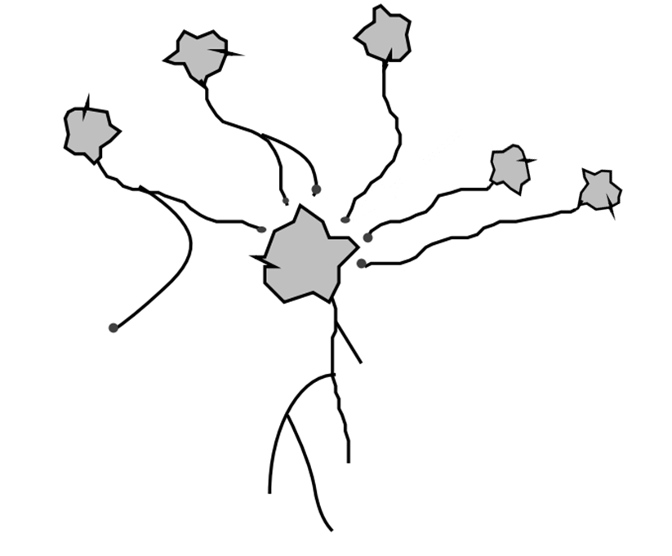
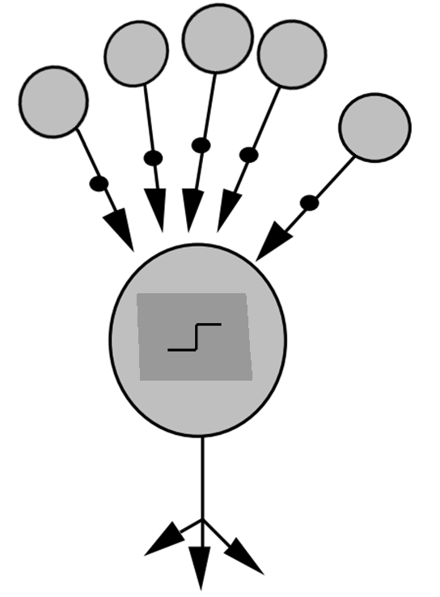
Simulation of a neuron
weights
cell
synapses
aggregation function
axon
outputs
Biological neuron
Computer neuron
Notes:
Passons maintenant à la simulation informatique de neurones.
(On considère le neurone central)
Les connexions entre neurones biologiques se font via des synapses; toutes ne sont pas de la même « qualité » : certaines transmettent très bien les signaux, d’autre beaucoup moins.
Nous simulons cela au niveau informatique via des poids.
Ensuite, le neurone biologique possède un corps cellulaire, qui décide si oui ou non, il transmet le signal. Ceci est fait au niveau informatique par une « fonction d’agrégat ».
Enfin, le neurone biologique a un axone, pour envoyer le signal a un ou plusieurs autres neurones. En informatique, le neurone possède une ou plusieurs sorties.

Slide 11


Using neurons

Slide 12


Adding complexity: width

Slide 13
Adding complexity: depth

Slide 14


Adding complexity: width & depth

Slide 15
Adding complexity: width & depth

Slide 16





Mathematically: layers
Notes:
Treat each layer as a vector

Slide 17




Mathematically
Notes:
Treat each layer as a vector

Slide 18













Mathematically: forward
Notes:
Some neurons may be consistently too large/small, so we add a bias

Slide 19







Mathematically: forward
Notes:
Need to add complexity: linear transform twice is itself a linear transform

Slide 20




Mathematically: forward
Notes:
With non-linear activation function sigma, the complexity of the system can not be simplified to a single layer.

Slide 21
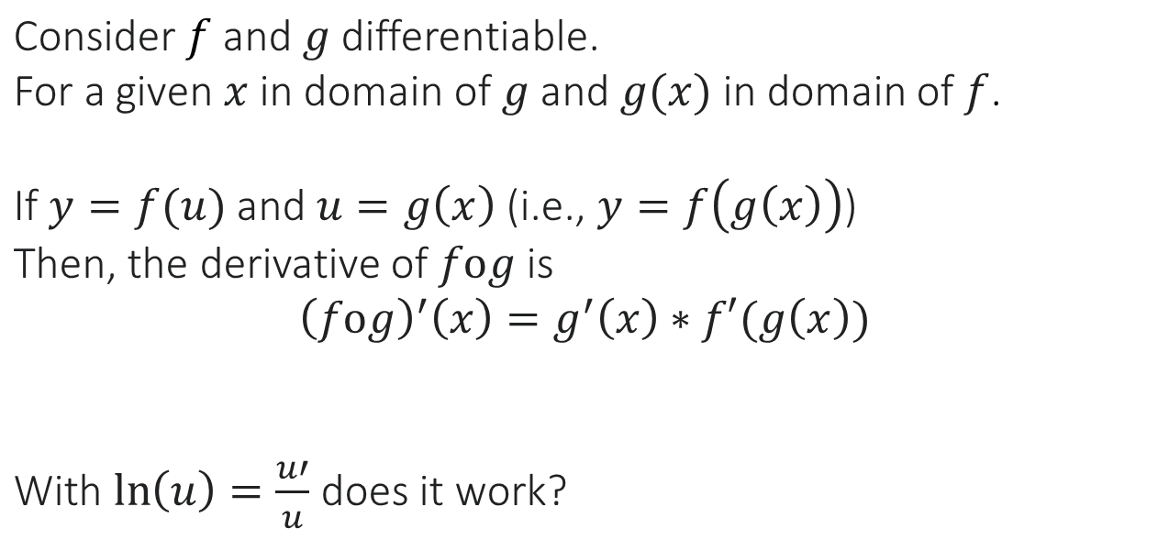
Mathematical Interlude
Notes:
With non-linear activation function sigma, the complexity of the system can not be simplified to a single layer.

Slide 22
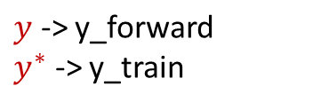
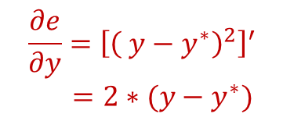
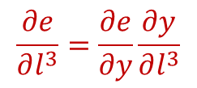
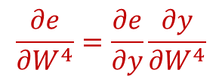

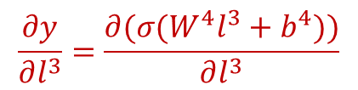
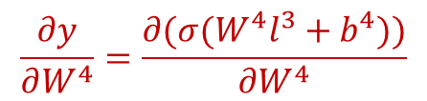
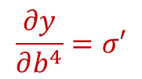
Mathematically: backward
What is written on the screen is not rigorous nor exhaustive (it does not say where these functions are evaluated) but we will see it in a more rigorous way during the TD 1
Notes:
Using chain rule, we step by step calculate the derivative of the error function in terms of all intermediate variables.
Then, we use gradient descent to update all parameters.

Slide 23
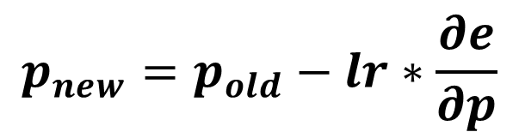
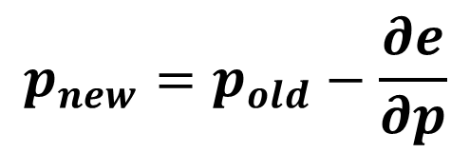
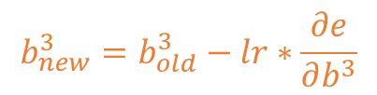
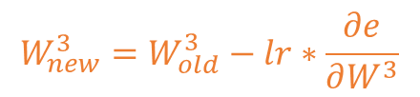

Mathematically: update
Notes:
We update the parameters by subtracting the gradient, times the learning rate.

Slide 24
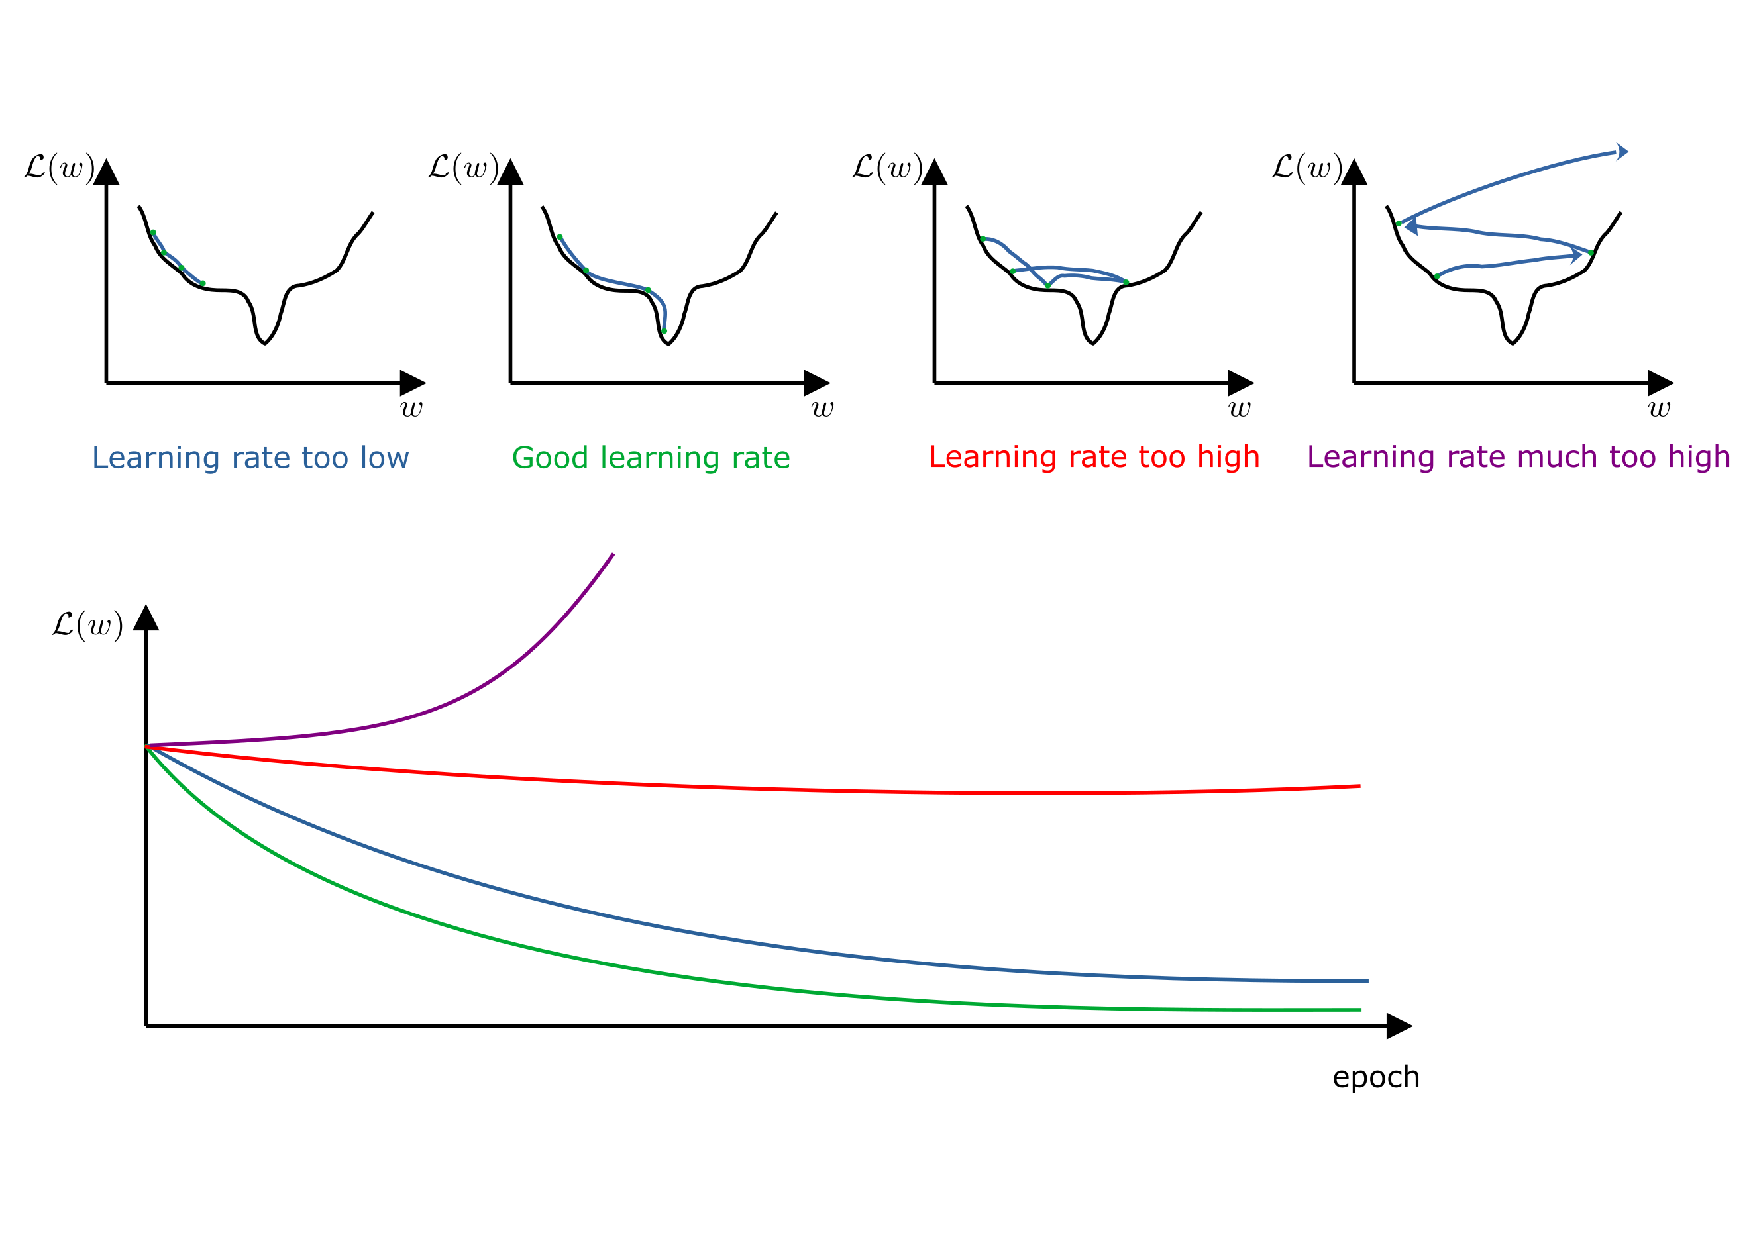
Interlude: Learning Rate

Slide 25
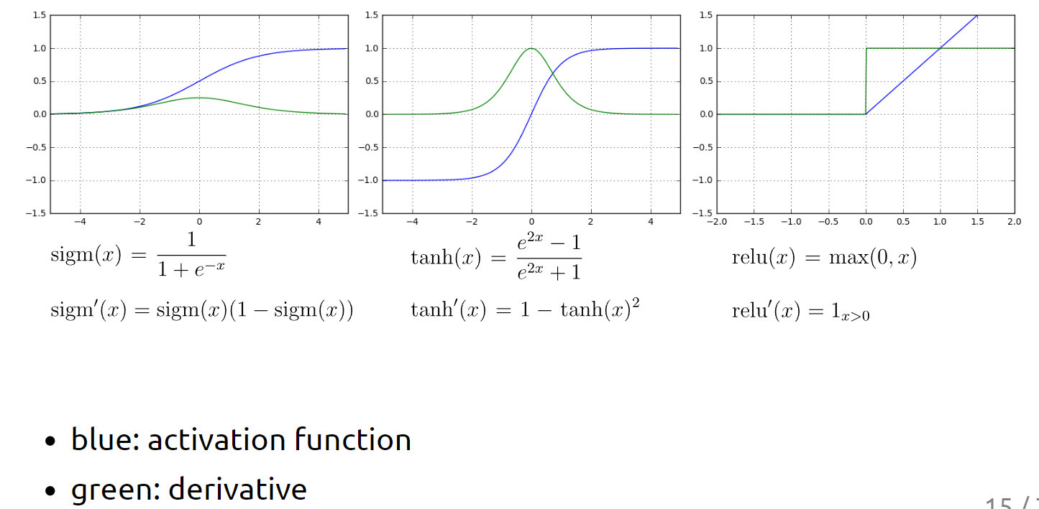
Interlude: Activation Function
Notes:
Quelle fonction d'activation devrait être utilisée ? Eh bien, si vous traitez une régression logistique binaire (est-ce un cancer ou pas), vous voulez des valeurs de sortie entre 0 et 1, donc la fonction d'activation de la dernière couche sera sigm. Si vous voulez prédire le prix d'une action, vous voudrez peut-être utiliser relu sur la dernière couche car vous voulez des valeurs de sortie dans R+. Pour les fonctions d’activation sur les couches cachées, il y a un certain nombre de règles qui existent mais le plus facile est de former le réseau avec certaines fonctions d'activation, de les changer et de voir si votre loss diminue. Si c’est le cas, garder les nouvelles fonctions d’activation, sinon garder les anciennes. En gros, le choix de la fonction d'activation à utiliser est un hyperparamètre (si vous ne savez pas ce qu’est un hyperparamètre j’explique dans quelques slides).

Slide 26
Training steps (training set)
Feed one piece of data (for which you know the desired output)
Calculate the error
Back-propagate the error to all intermediate variables
Update the parameters
Layers vectors cannot be updated but calculating their gradient speeds-up the calculations
Every time we feed the network, we get one point of the error function and its local gradient
While we could feed the same point until convergence, it is better to feed all our data before showing the same data again
Notes:
Note that in reality, x and y are also multi-dimensional vectors, but all the math remains the same.

Slide 27
Why splitting data?
Objective Evaluation
All data
Testing data
Testing data
Objective Model Selection
Training data
Validation data
Training data

Slide 28
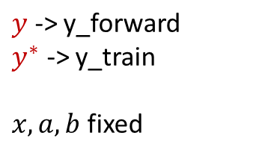





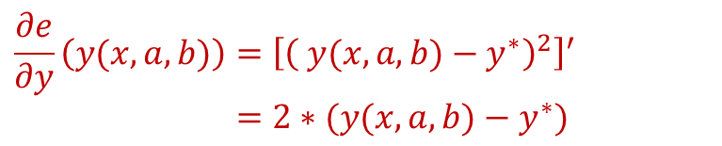

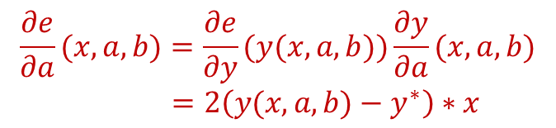
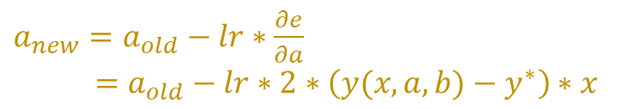
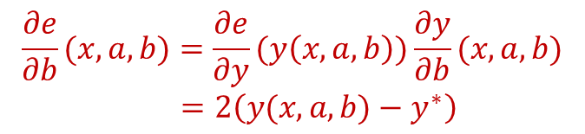
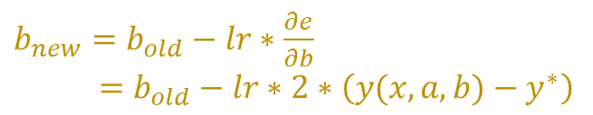
Simplest case by hand
Notes:
Les dérivées finales que l’on veut calculer ce sont par rapport à a et b, parce que ce sont a et b qu’on veut faire bouger.
We consider the simplest possible case: 1D x, 1D y, and no activation function.
Note that this is in fact just a linear model.

