Slide 1
Session 5 — Part 2
Time Series: Forecasting
Advanced Data Science · NYU Paris · 2026
Paul Dubois

Slide 2
Forecasting

Slide 3
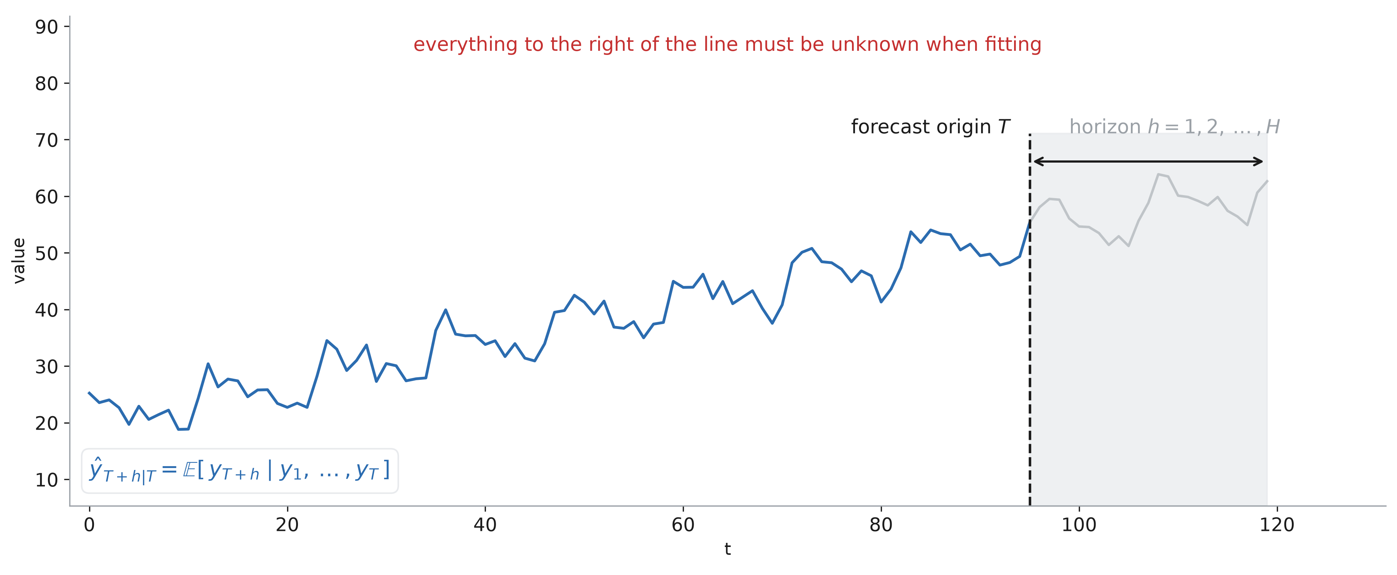
Task and rule

Slide 4
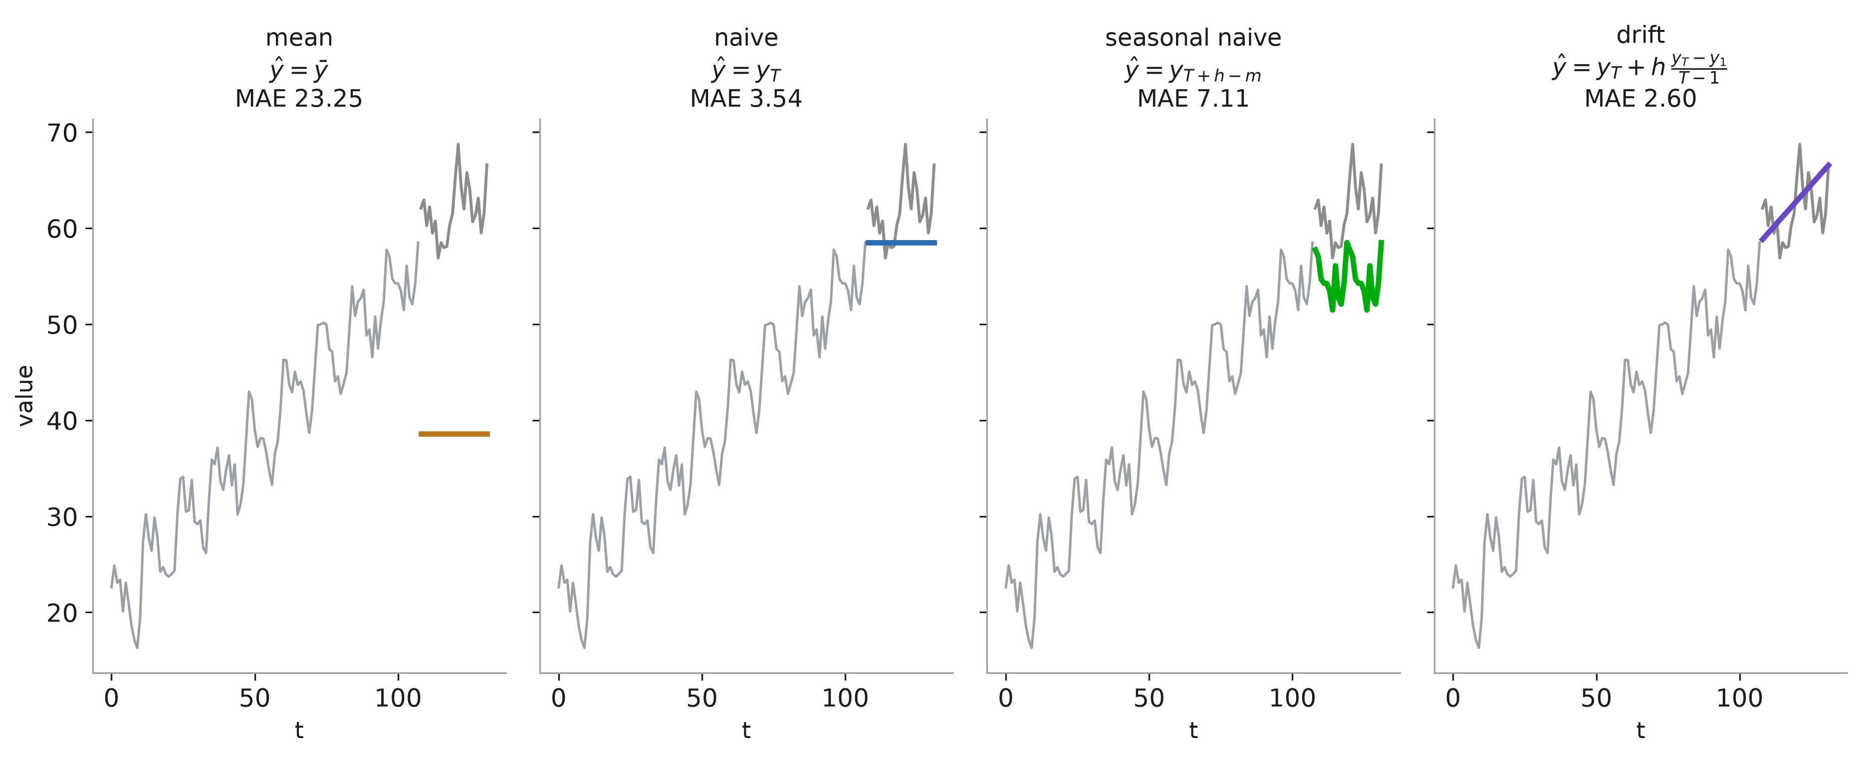
Four basic forecasts

Slide 5
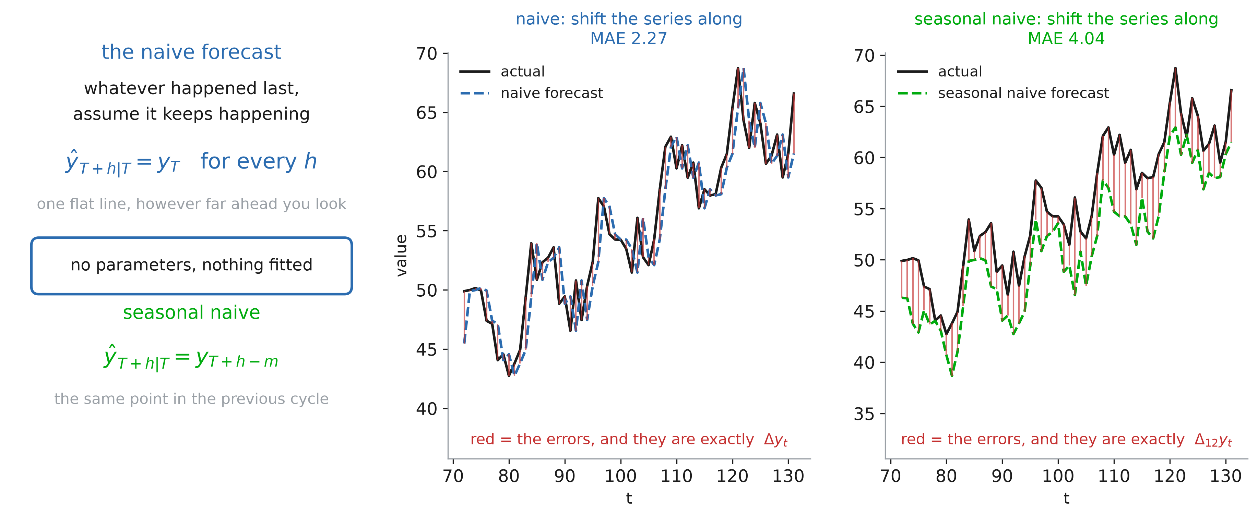
Naive forecast

Slide 6
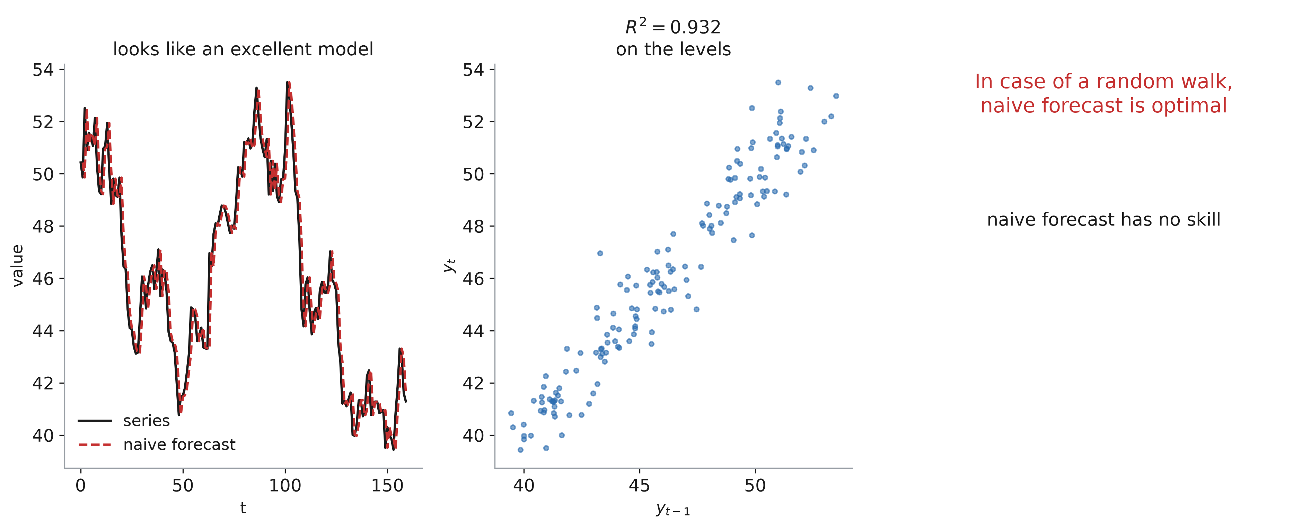
Naive for white noise

Slide 7
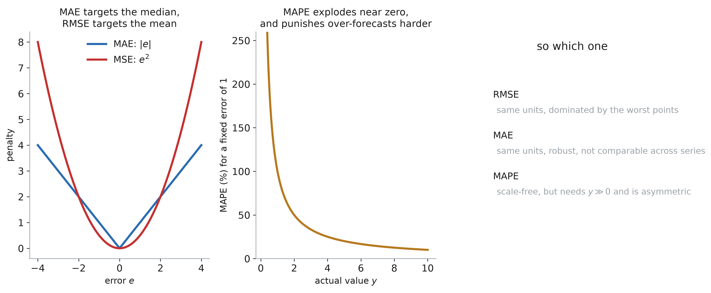
Choosing a metric

Slide 8
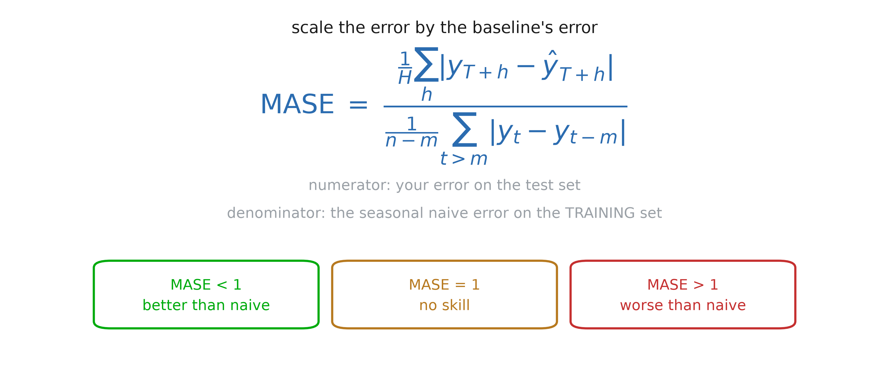
MASE

Slide 9
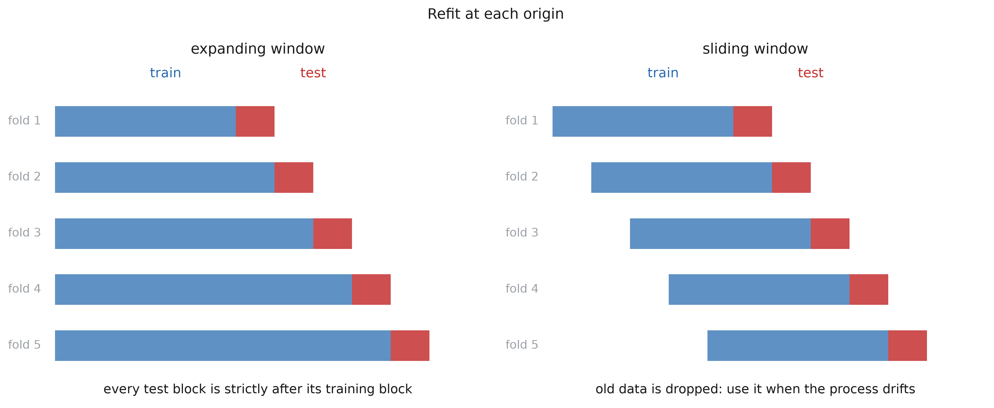
Backtesting

Slide 10
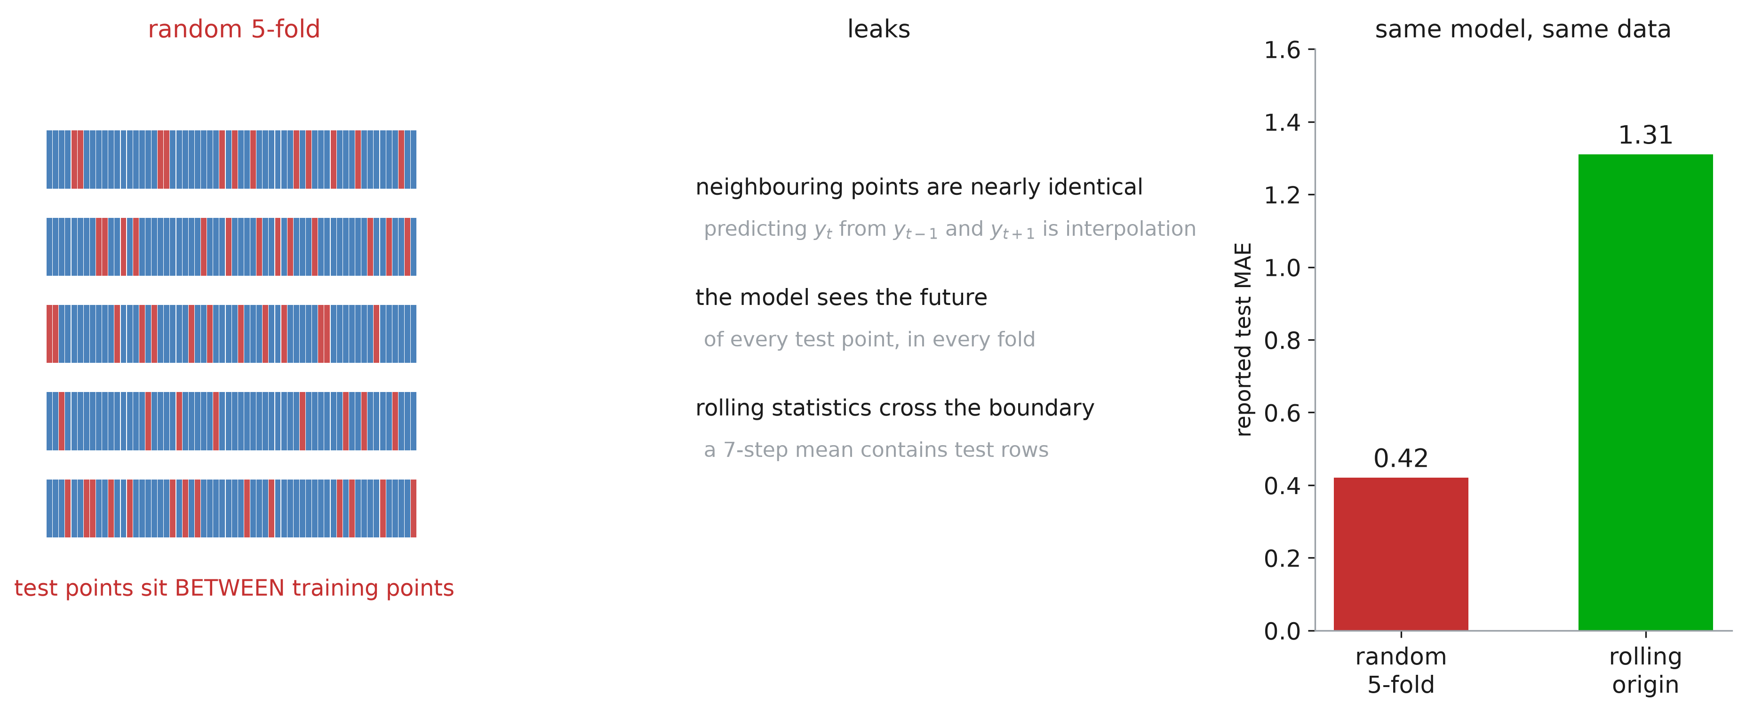
Random k-fold

Slide 11
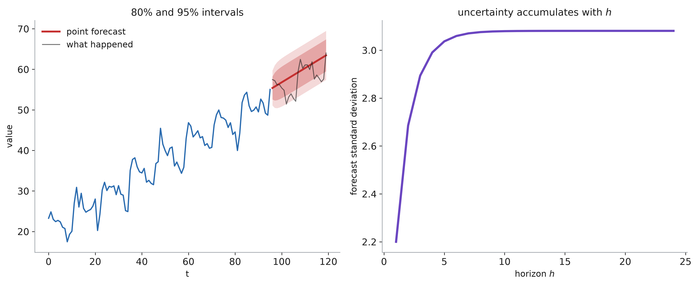
Forecasting an interval

Slide 12
ARIMA

Slide 13
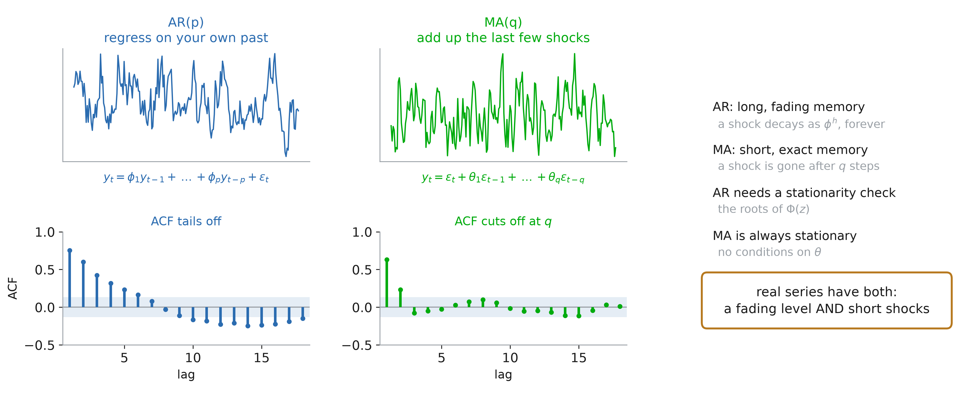
AR and MA, recap

Slide 14
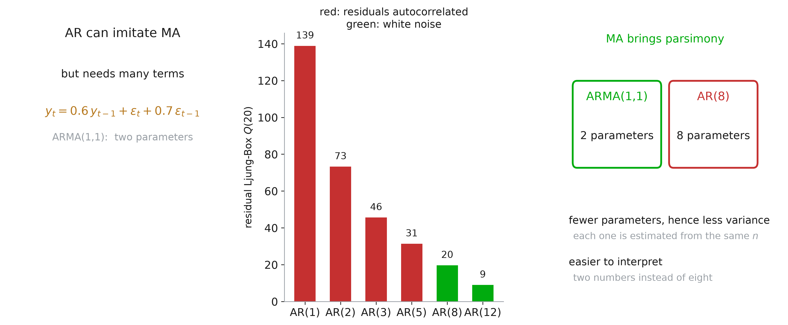
ARMA vs AR

Slide 15
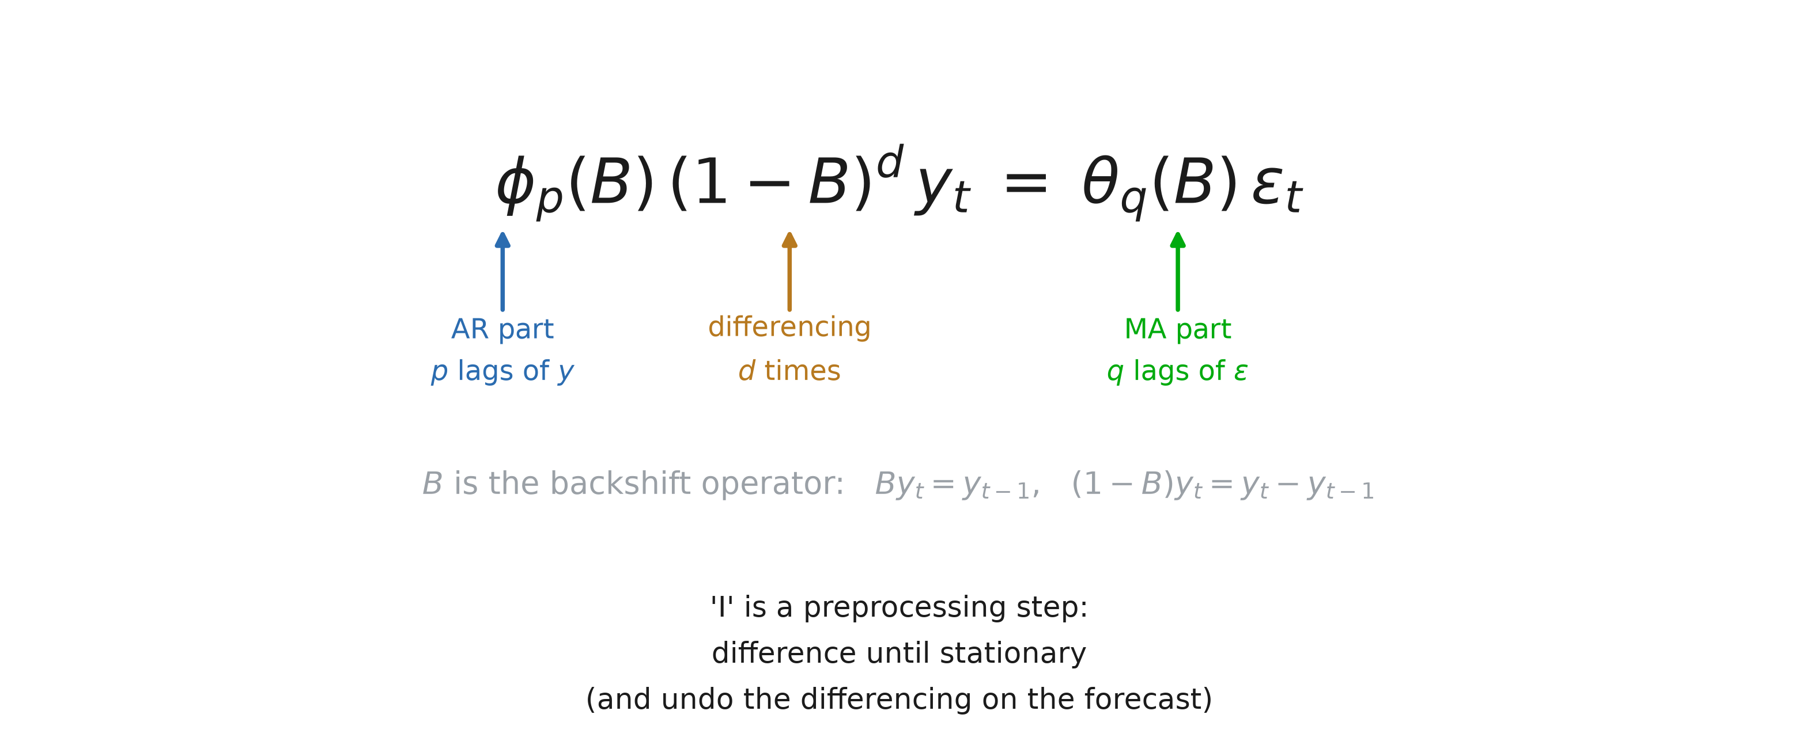
ARIMA(p, d, q) model

Slide 16
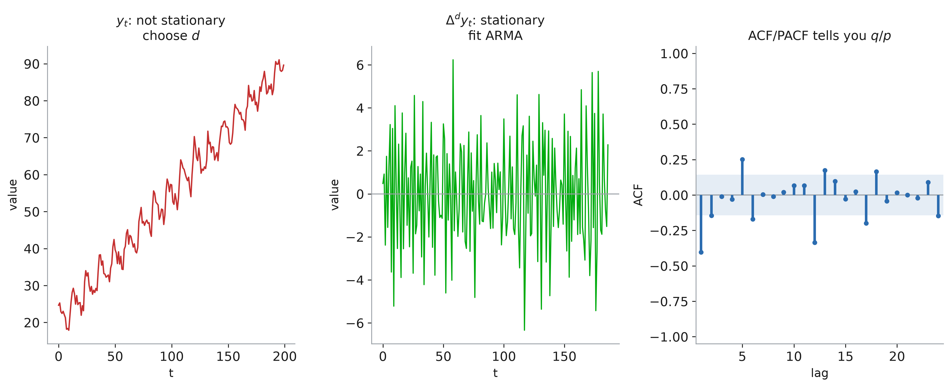
d first, then p and q

Slide 17
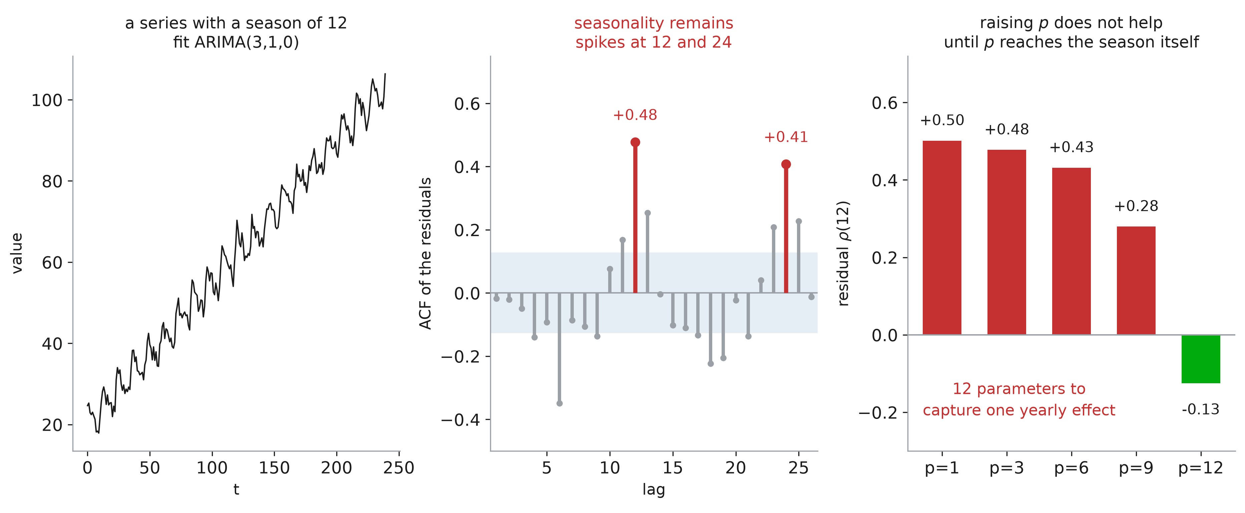
Seasonality problem

Slide 18
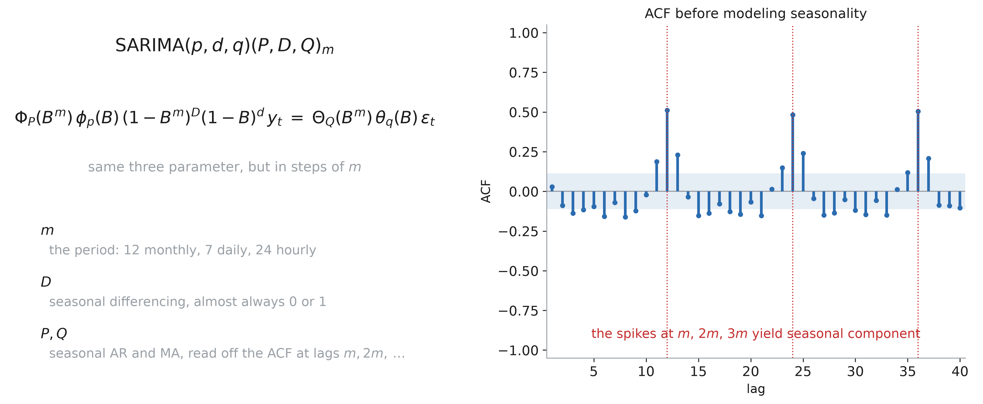
SARIMA

Slide 19
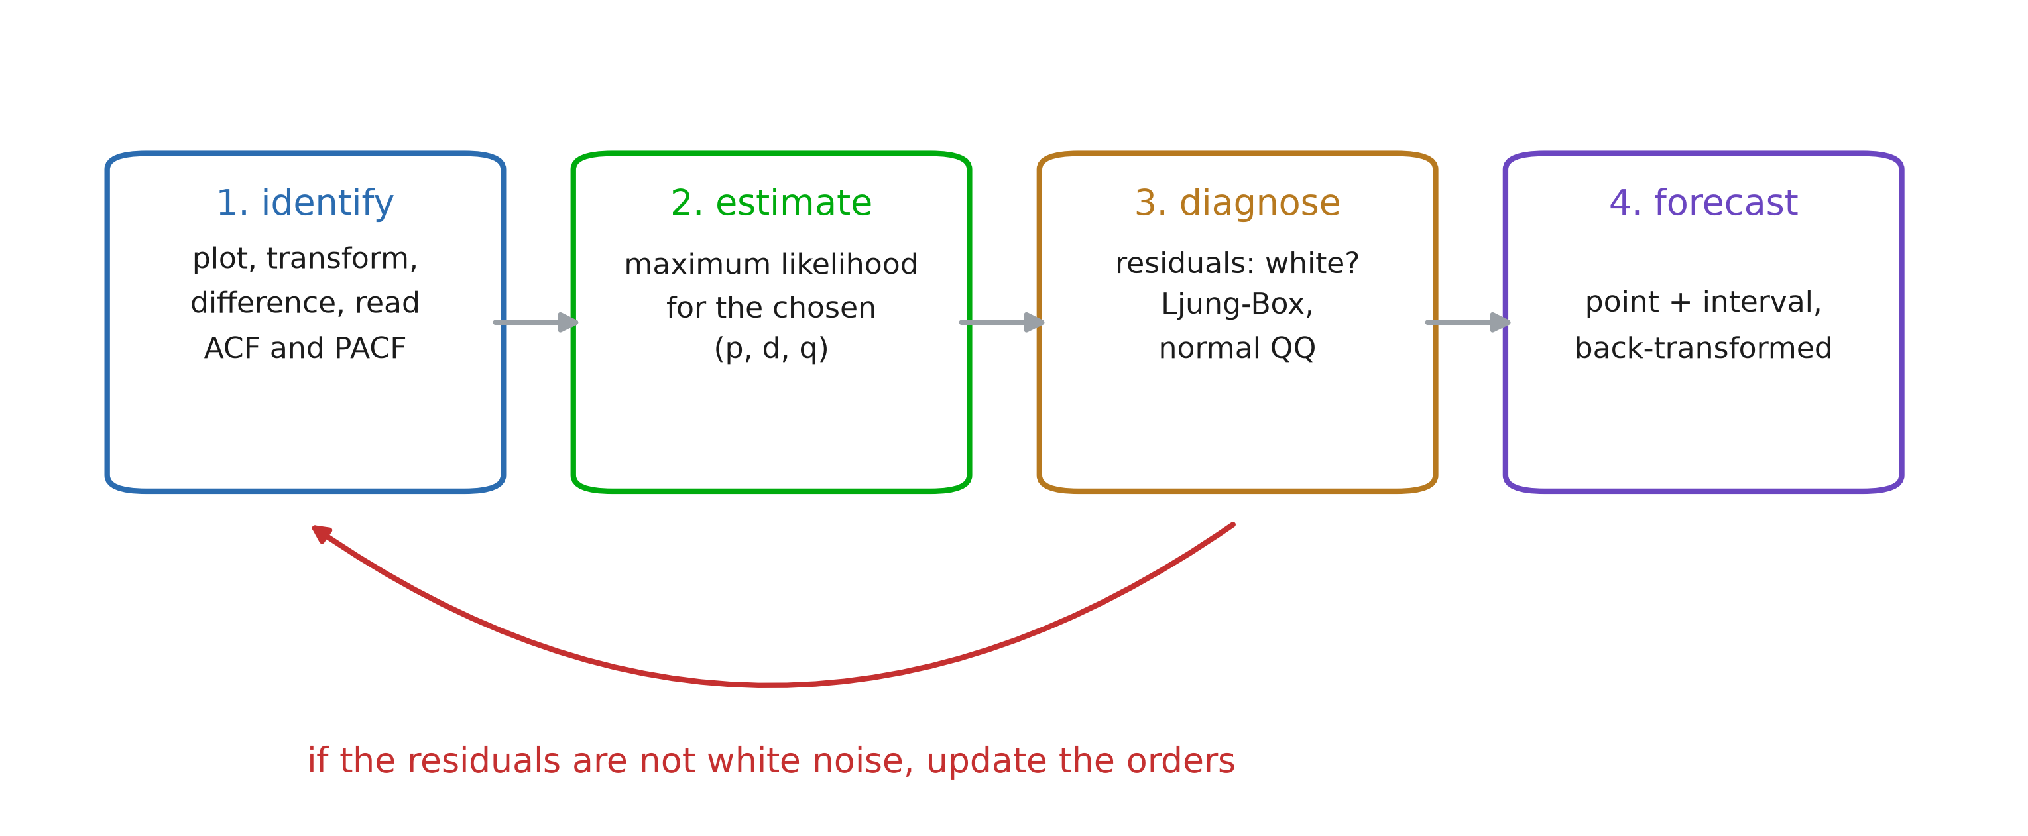
Box-Jenkins loop

Slide 20
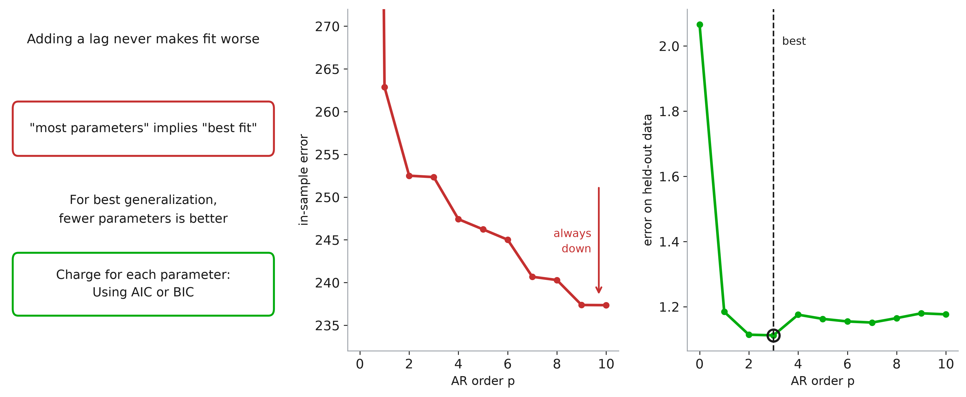
Penalty on parameters

Slide 21
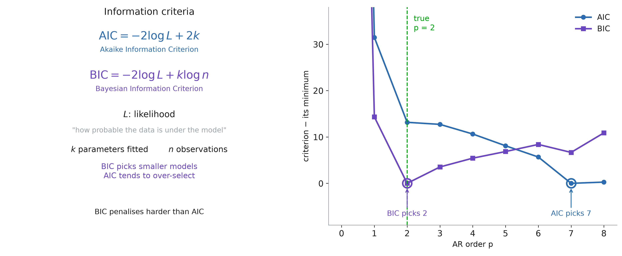
Choosing the orders

Slide 22
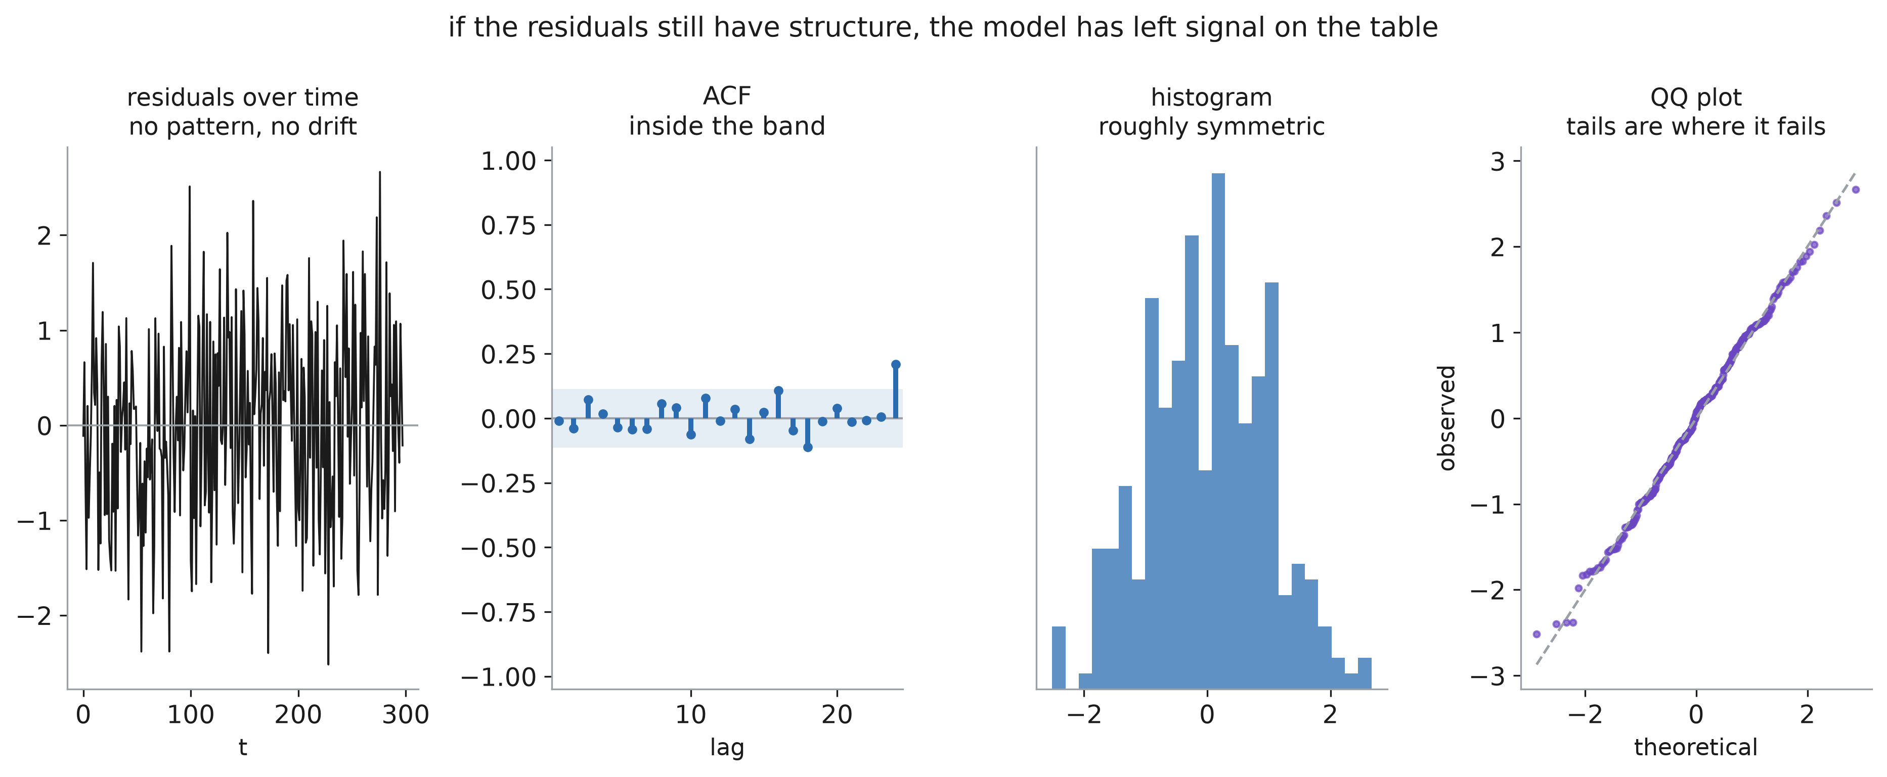
Residual diagnostics

Slide 23
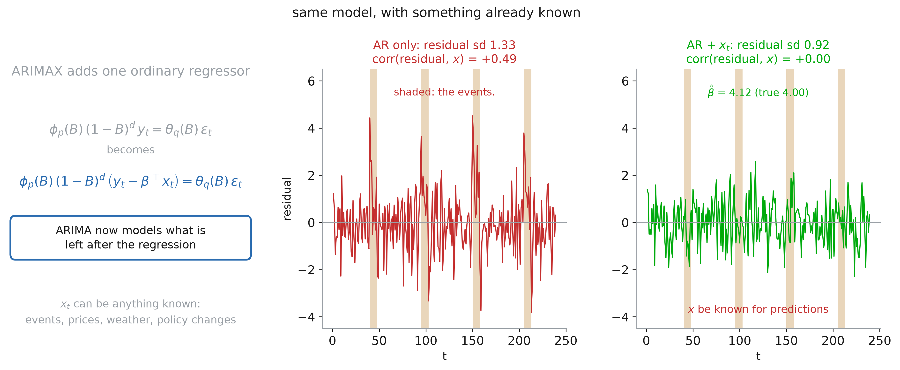
ARIMAX

Slide 24
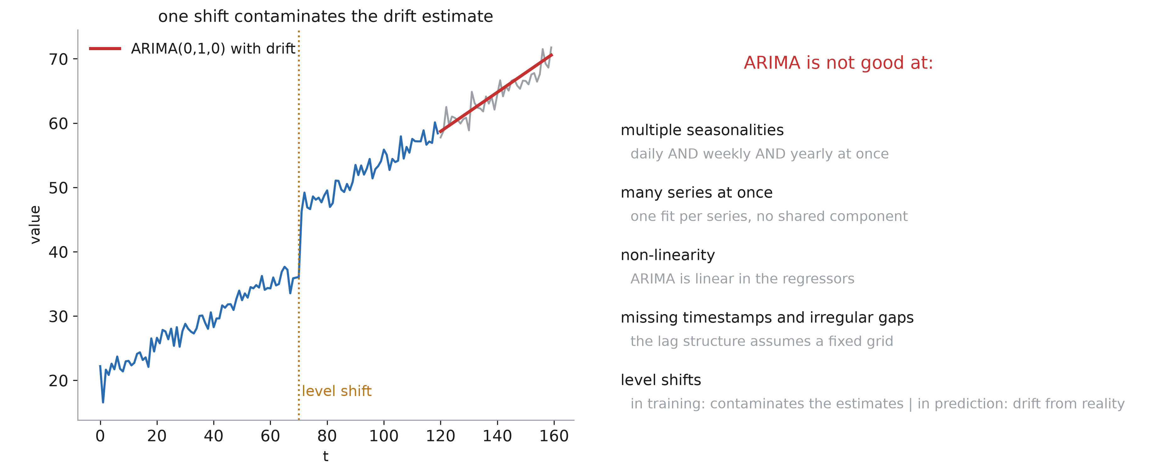
ARIMA’s weakness

Slide 25
Prophet

Slide 26
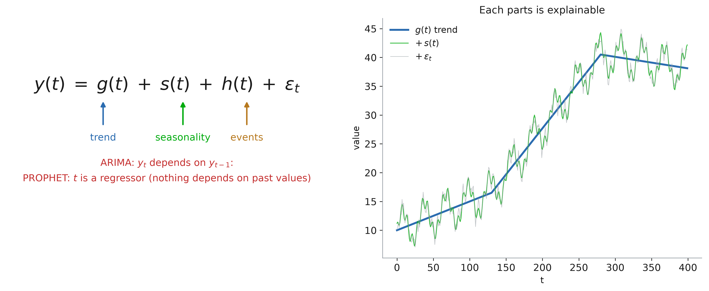
Fitting a curve to time

Slide 27
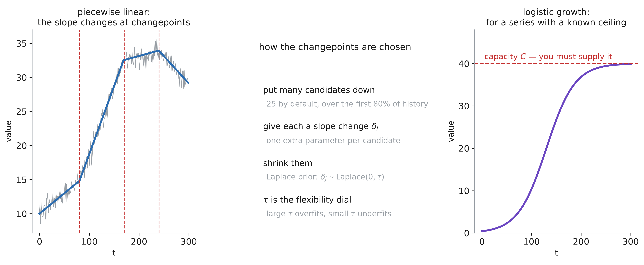
Trend and changepoints

Slide 28
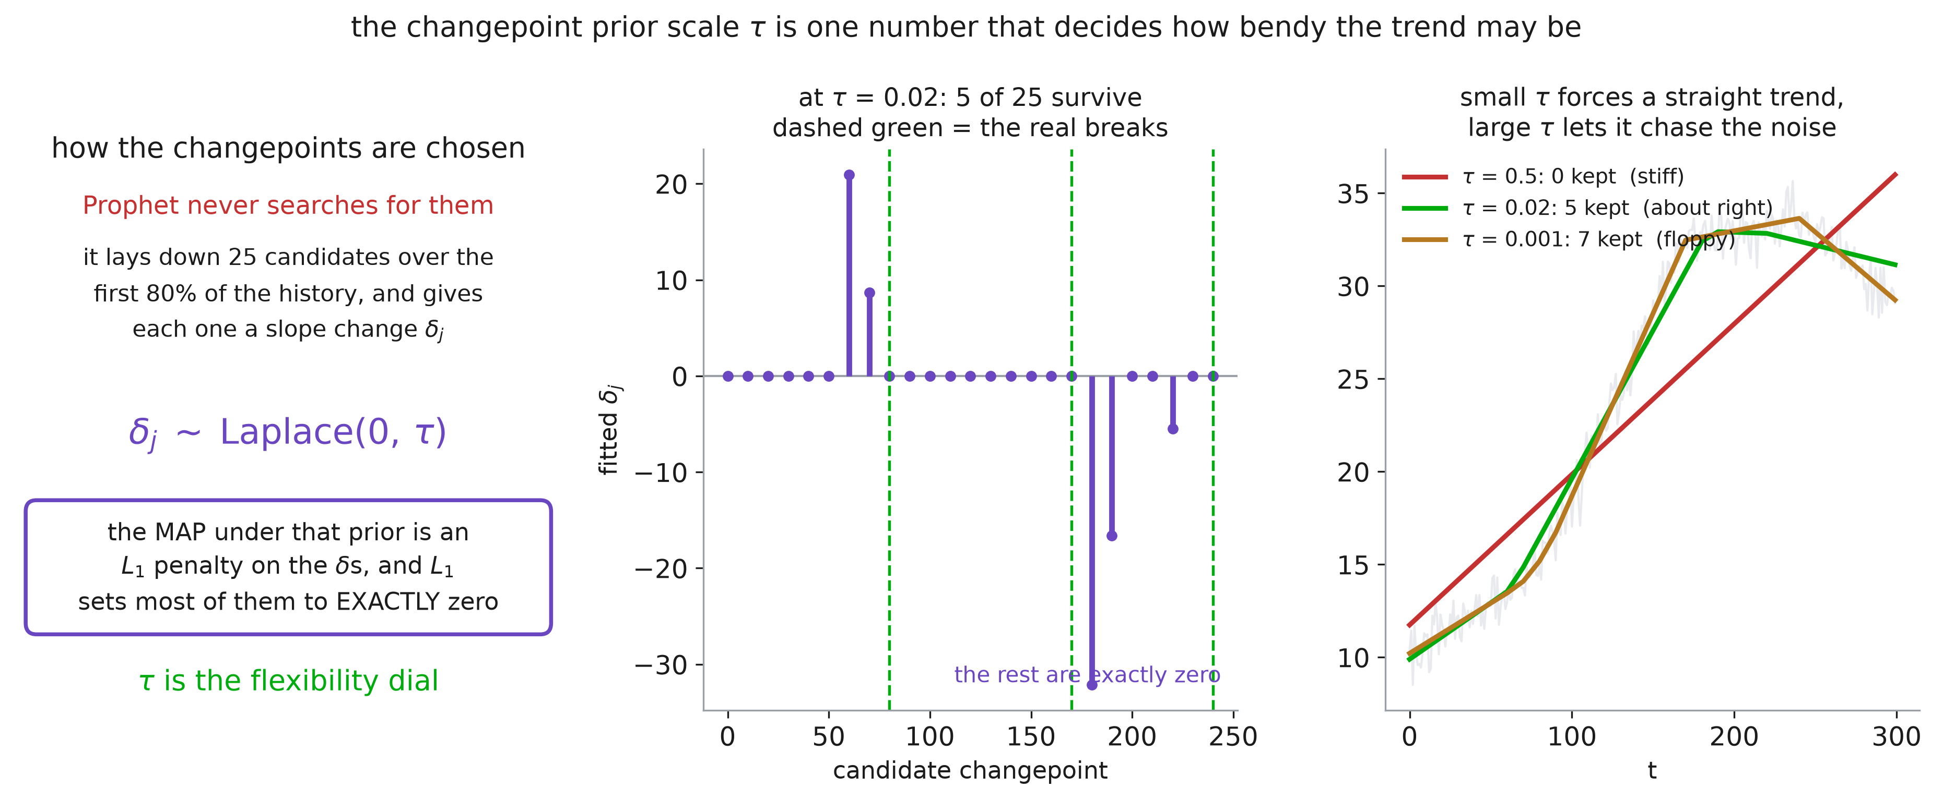
Shrinking the changepoints

Slide 29
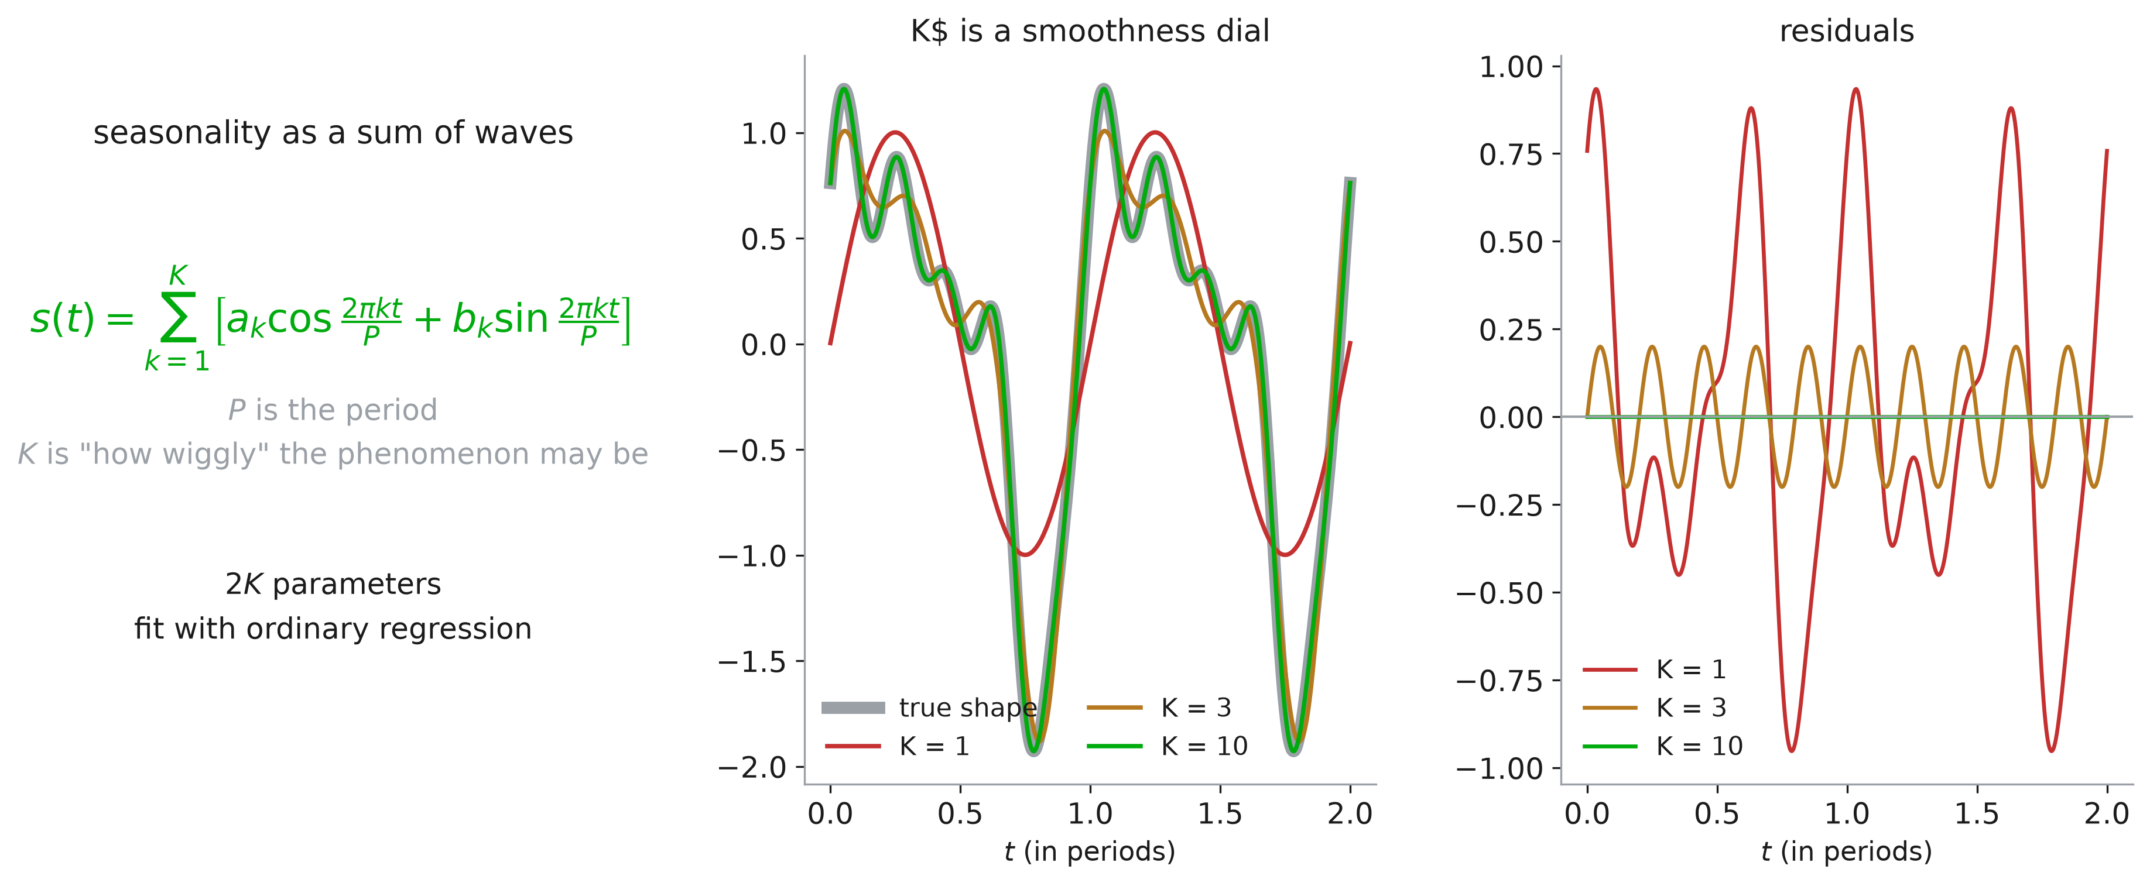
Seasonality as Fourier terms

Slide 30
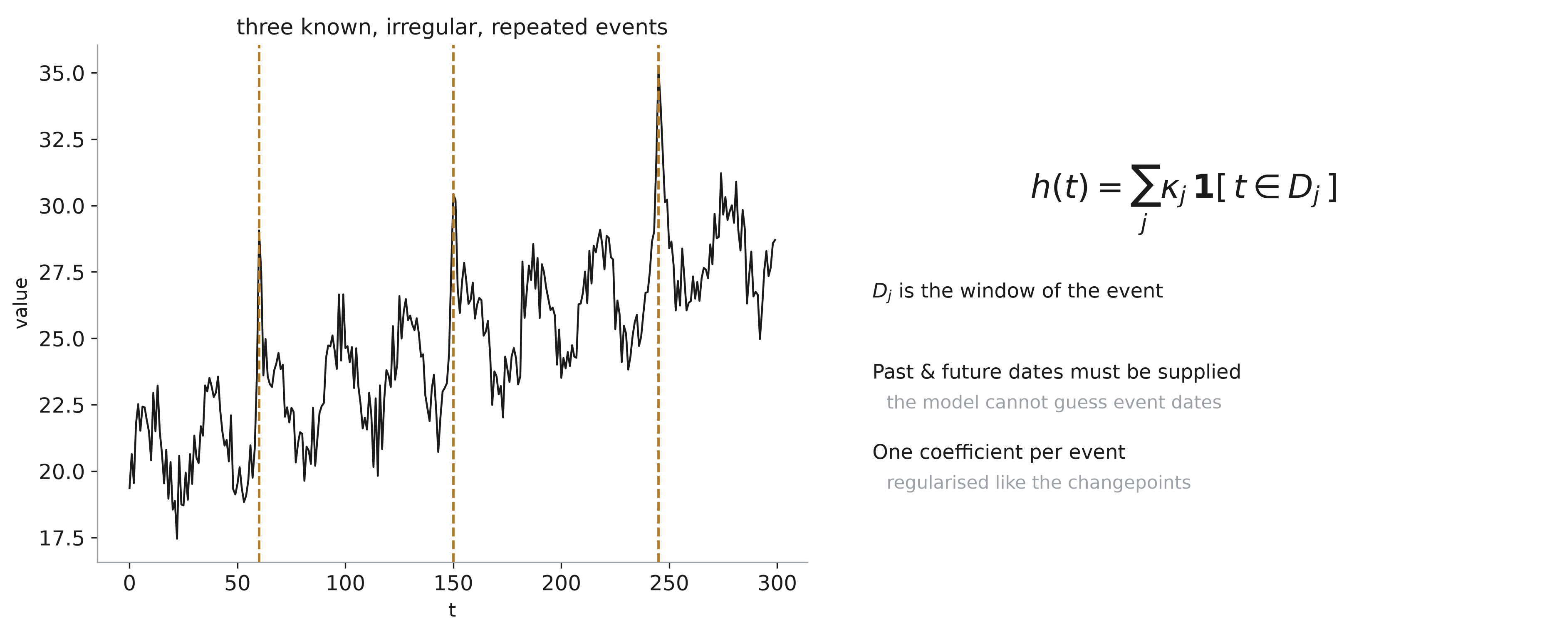
Events

Slide 31
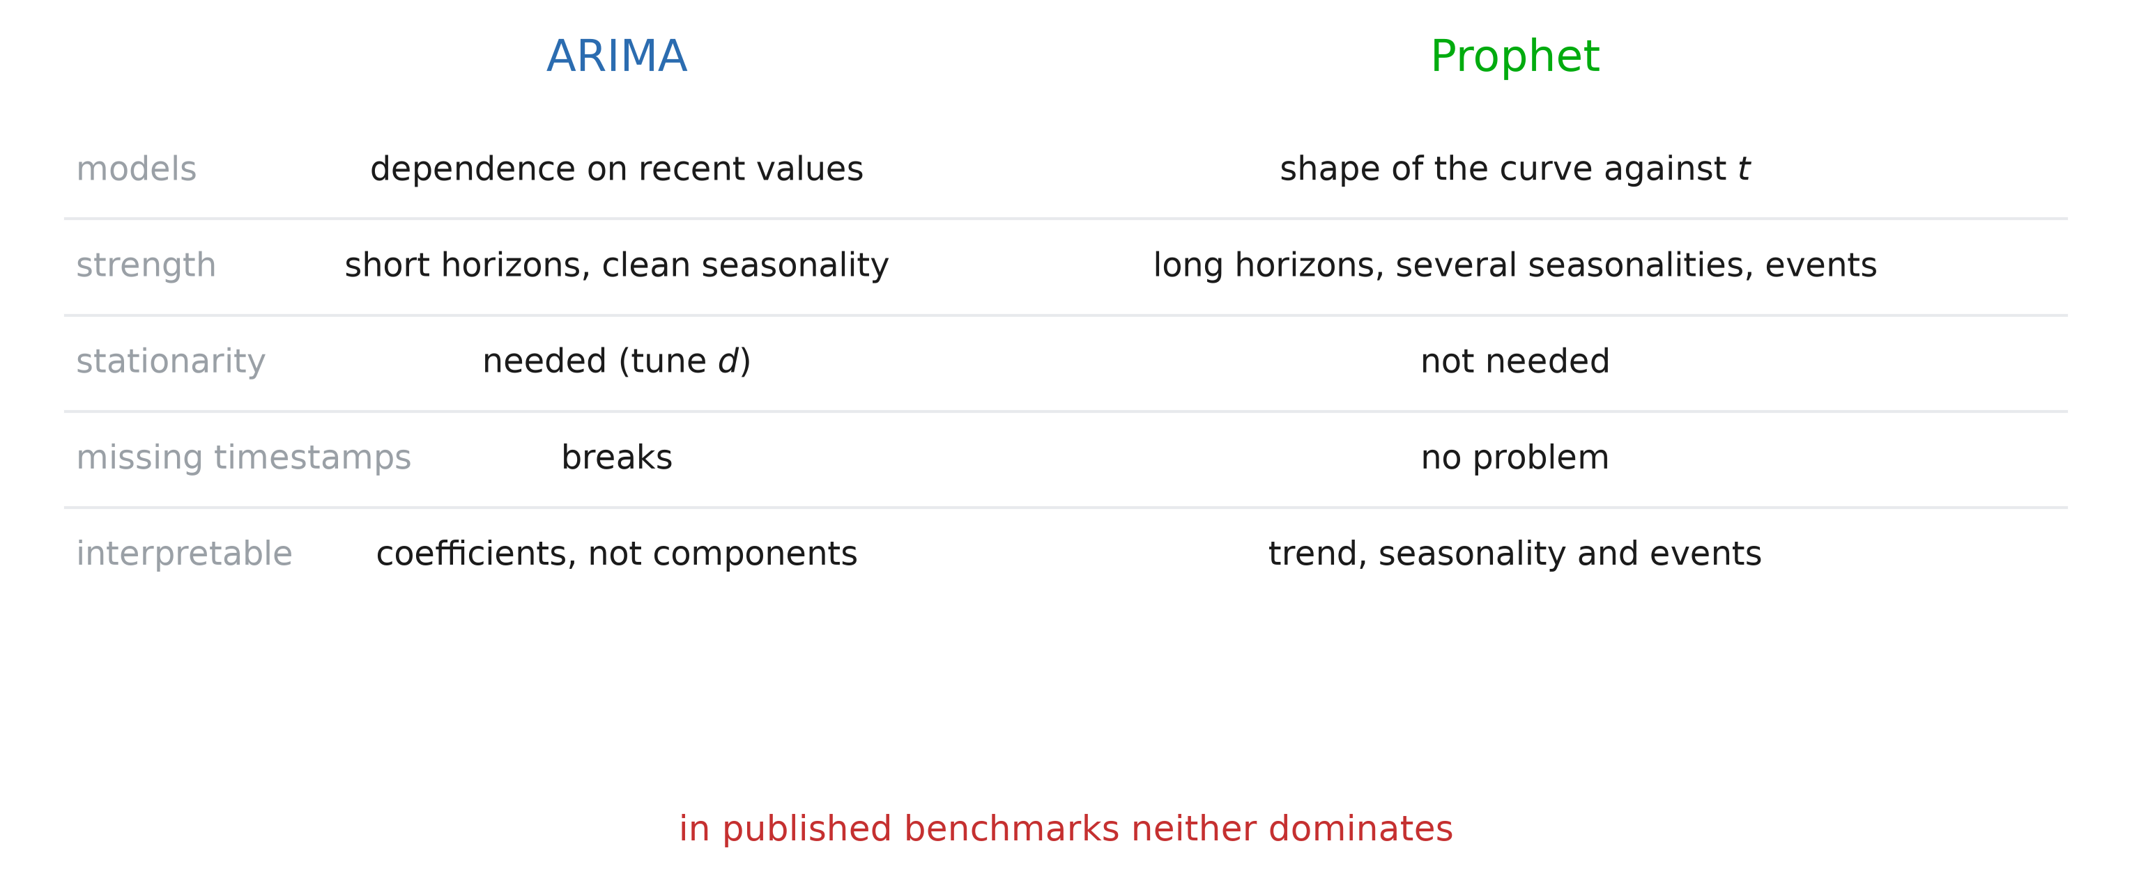
Prophet against ARIMA

